Slide 1
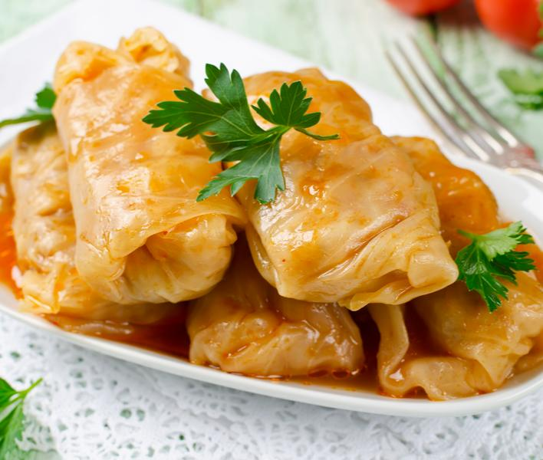
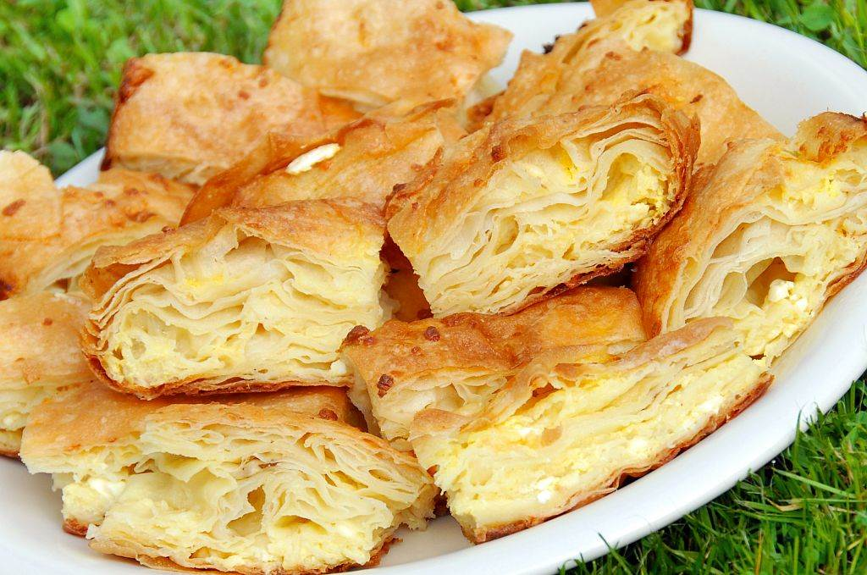
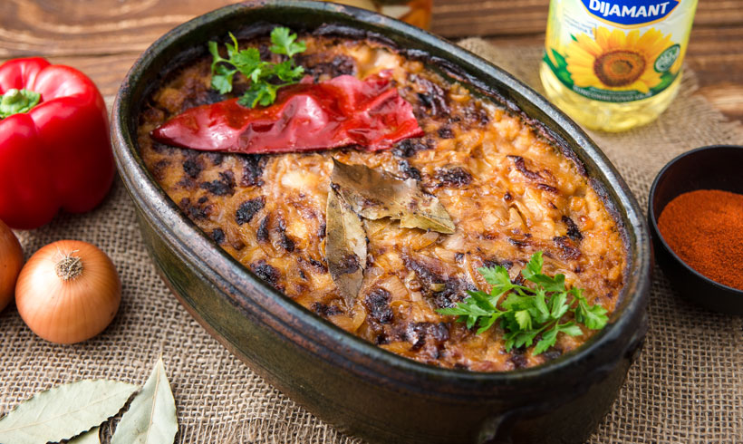
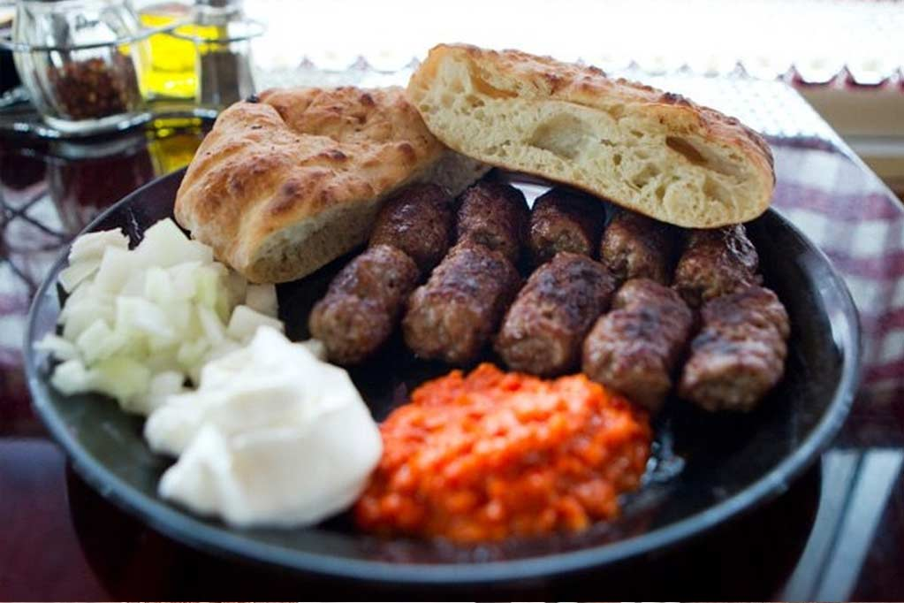
National cuisine
Presented by Milina Kosanovic

Slide 2
National food
National cuisine is the style of cooking in a particular country.
A national dish is a popular specialty typical of one country.
International cuisine is the national cuisine of one country prepared in another country. For example Italian cuisine in the USA is international cuisine, while it is national cuisine in Italy.

Slide 3
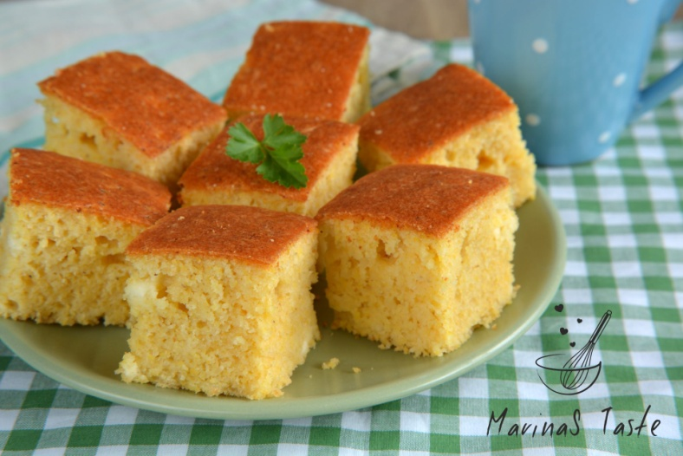
Serbian national cuisine
Gibanica – cheese pastry made with filo dough
Proja – a kind of corn bread made with eggs and cheese

Slide 4
Serbian national cuisine
Sarma – a dish made of fermented cabbage leaves wrapped around a filling of rice and minced pork or beef meat
Sauercrout- fermented cabbage (kiseli kupus)

Slide 5
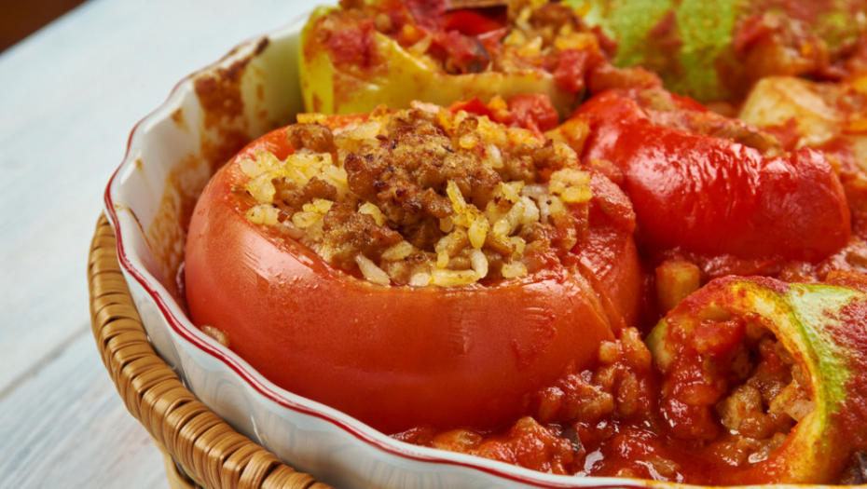
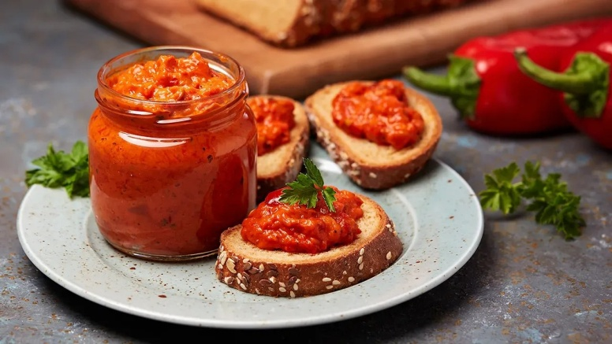
Serbian national cuisine
Punjene paprike- stuffed peppers
Ajvar- red pepper relish

Slide 6
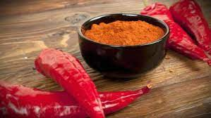
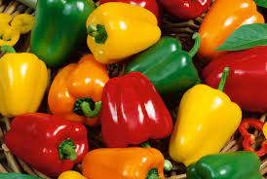
Serbian national cuisine
Pepper- paprika
Bell pepper- babura
Paprika- aleva paprika

Slide 7
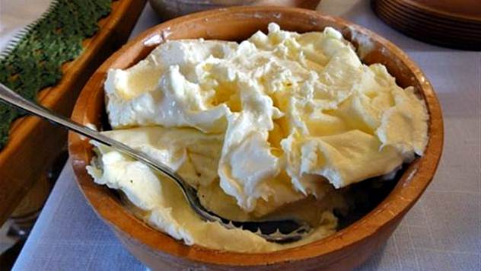
Serbian food
Ćevapi- grilled minced meat bars
Lepinja- a flat, round bun
Kajmak- a creamy dairy product made of mildly fermented cream

Slide 8
Serbian national cuisine
Prebranac- baked beans

Slide 9
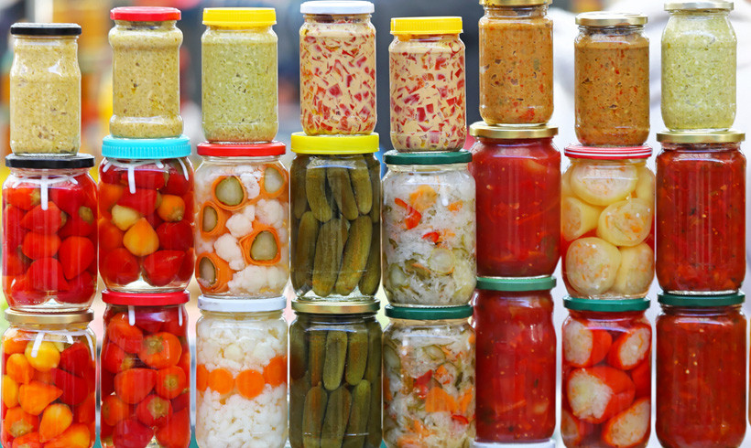
Serbian national cuisine
Turšija- mixed pickles

Slide 10
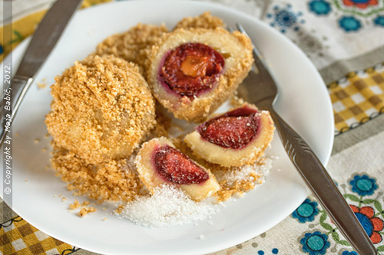
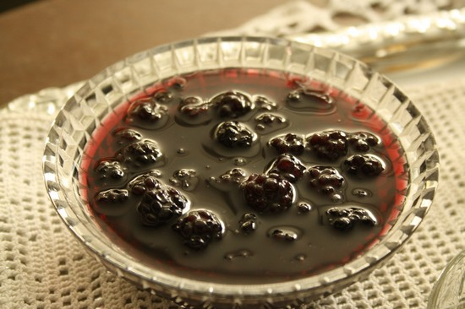
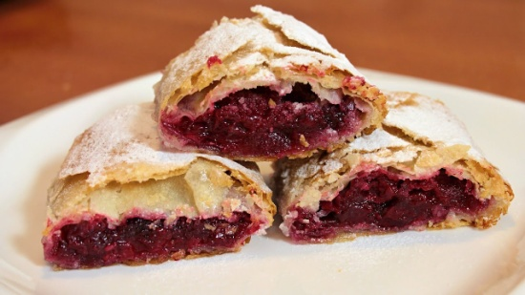
Serbian sweets
Slatko- fruit preserve
Knedle sa šljivama- plum dumplings
Štrudla sa orasima- strudel with walnuts
Pita sa višnjama- sour cherry pie
Rezanci sa makom- sweet noodles with poppy seeds

Slide 11
Serbian and international food
Barbecue- roštilj
Sausages – kobasice
Stew- paprikaš
Fish broth- riblja čorba
Moussaka- musaka
Chips- prženi krompirići (deblji)
French fries- pomfrit (tanji)
Mashed potatoes- pire

Slide 12
Task
Make a menu for an international conference held in Serbia. The conference will have a la carte dinner because buffet is not suitable in the times of the pandemic.
Include some national and some international dishes.
Think about 3 courses:
starter/appetizer
main dish
dessert

