Slide 1
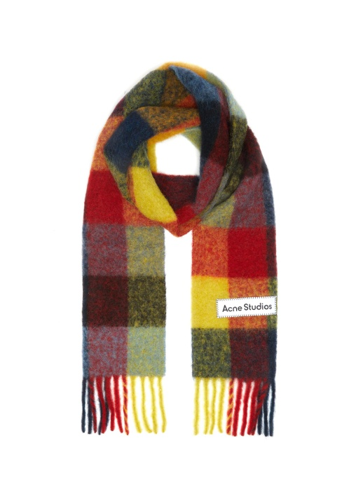
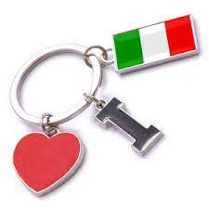
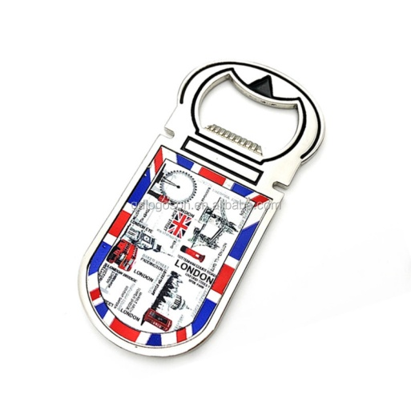
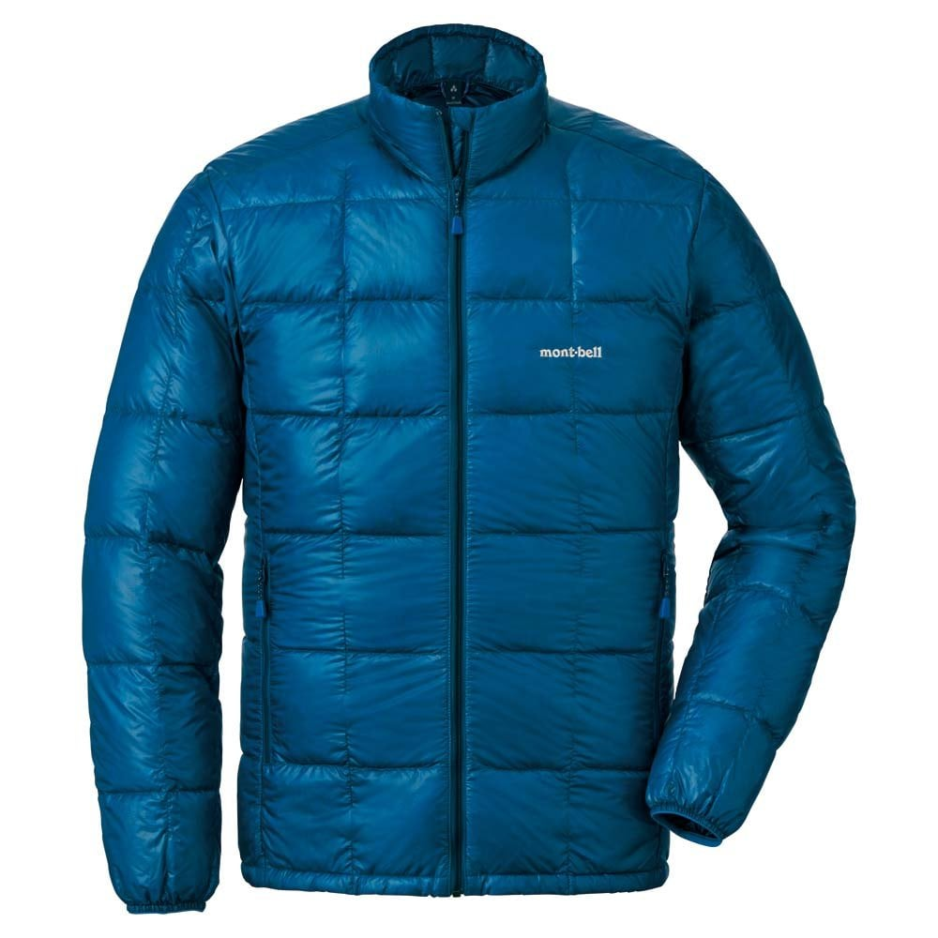
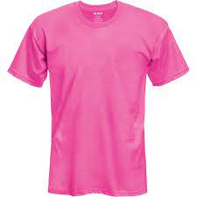
Shopping
Presented by Milina Kosanovic

Slide 2
What kind of shopper are you?
Do you like shopping for:
Clothes
Accessories
Souvenirs
Gifts
Electronic devices/gadgets

Slide 3
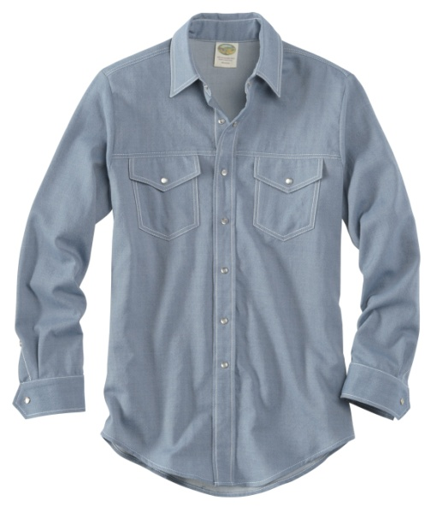
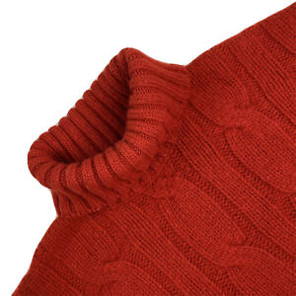
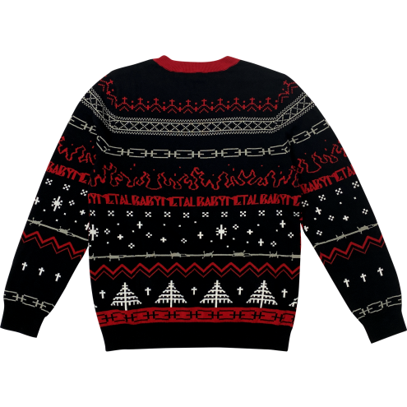
Shopping for clothes
T-SHIRT
SHIRT
SWEATER
TURTLE NECK SWEATER

Slide 4
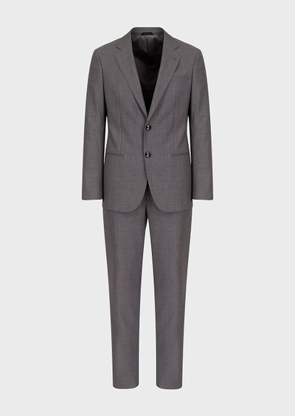
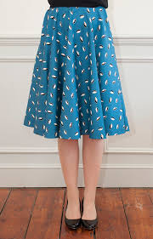
Shopping for clothes
SKIRT
SUIT
JACKET

Slide 5

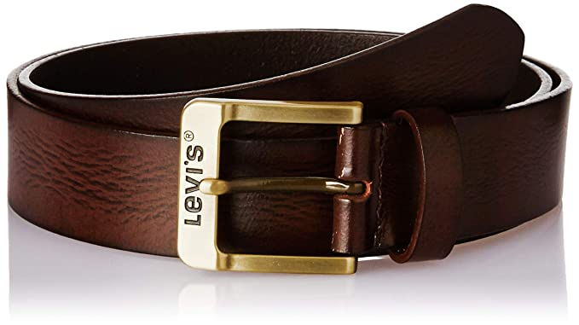
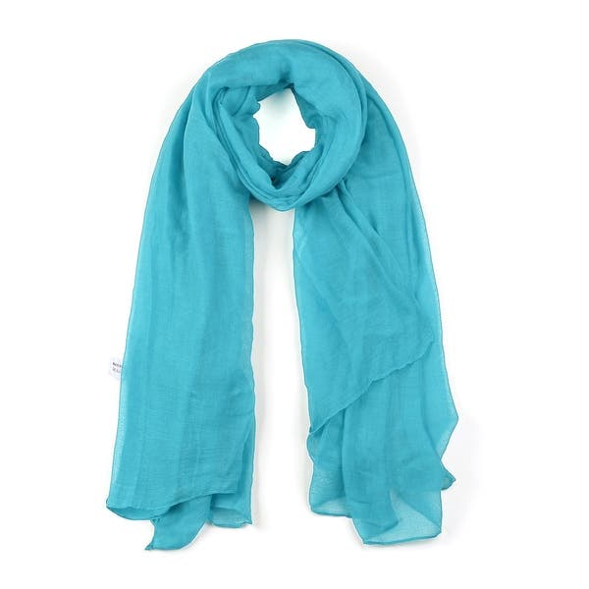
Shopping for accessories
BELT
SCARF
SHAWL

Slide 6
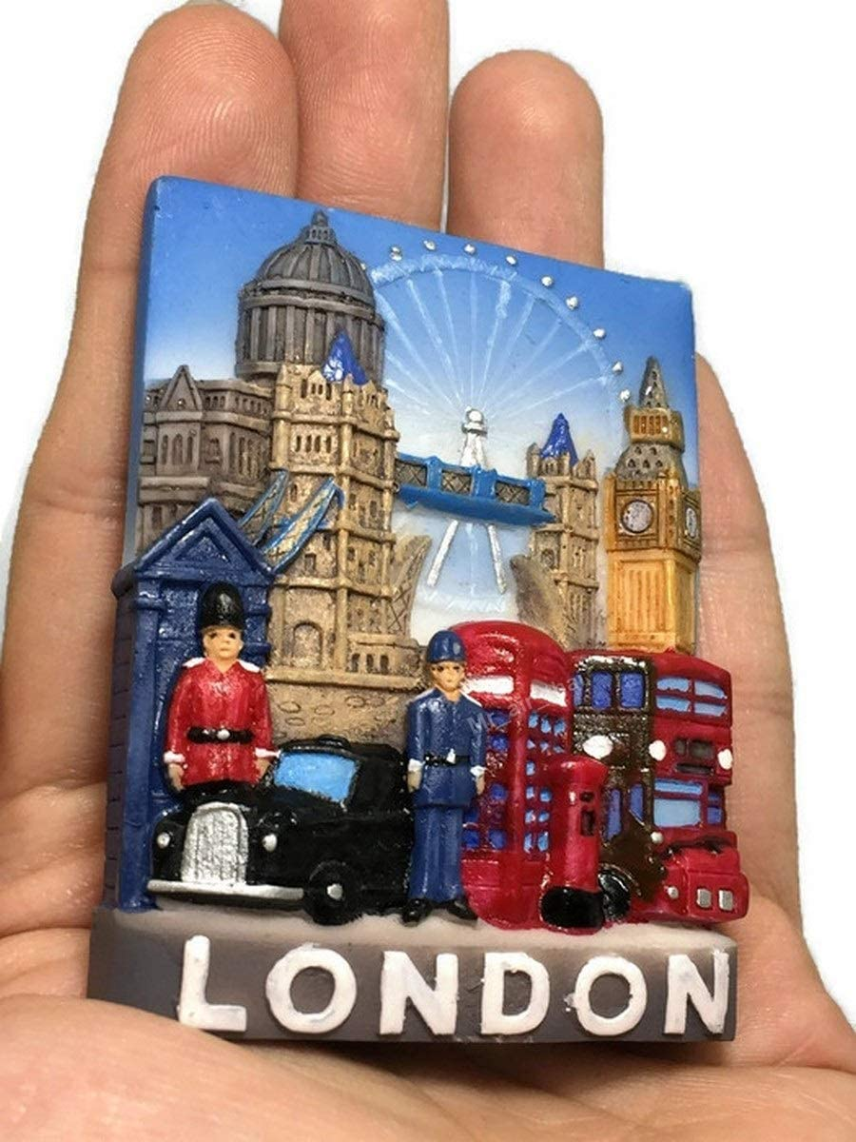

Souvenirs
KEYRING
FRIDGE MAGNET
BOTTLE OPENER

Slide 7
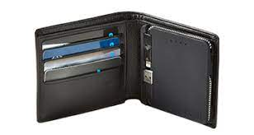
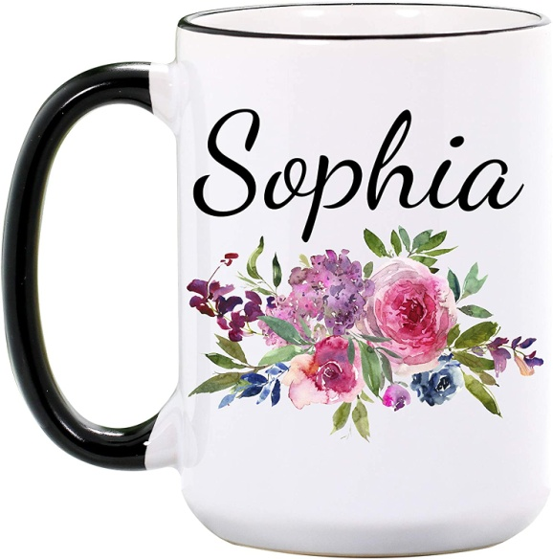
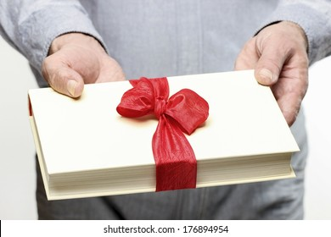
Gifts
WALLET
PERSONALIZED CUP
BOOK

Slide 8
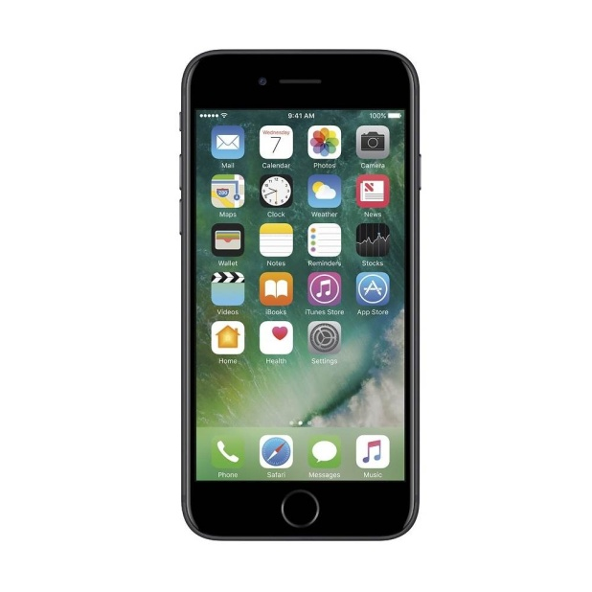
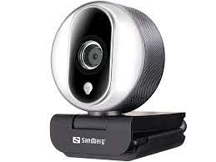
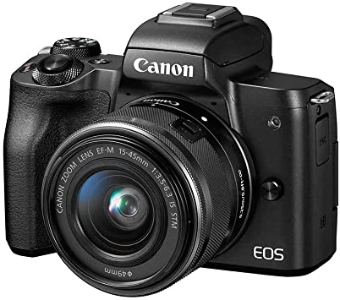
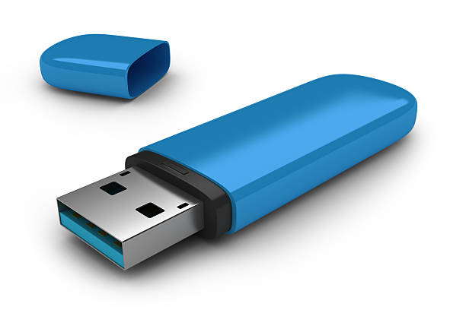
Electronic devices/gadgets
WEBCAMERA
CELL PHONE
FLASH STICK
CAMERA

Slide 9
Present Continuous
Gradi se od sadašnjeg vremena pomoćnog glagola TO BE (am, is, are) i sadašnjeg participa (infinitiv glagola+ing).
They are carrying 3 bags.
She is looking at her mobile phone.
Ukoliko se infinitiv završava na E ono se gubi pre dodavanja –ING.
Come-coming
Have-having

Slide 10
Present Continuous
Koristi se za radnju koja se događa u trenutku govora.
I am trying on new shoes.
You are looking for souvenirs.
He is carrying bags.
We are checking the prices.
You are spending too much.
They are paying at the cash register.

Slide 11
Present Continuous
Upitan oblik se gradi inverzijom, obrtanjem reda reči.
Am I looking in the wrong direction?
Are you looking for new shoes?
Is he driving now?
Are we going to the shop?
Are you speaking Spanish?
Are they waiting for Jake?

Slide 12
Present Continuous
Pitanja sa upitnom rečju sadrže inverziju.
Where am I going?
What are you looking for?
Where is he going?
Why are we waiting?
How many bags are you carrying?
How much money are they taking with them?

Slide 13
Present Continuous
Odričan oblik se dobija dodavanjem NOT na pomoćni glagol TO BE.
I am not trying on new shoes. (I`m not)
You are not looking for souvenirs. (You aren`t)
He is not carrying bags. (He isn`t)
We are not checking the prices. (We aren`t…)
You are not spending too much.
They are not paying at the cash register

Slide 14
Dialogue
Make a dialogue on the phone. Use the model:
A: Hello, what are you doing?
B: I am shopping for … (clothes)?
A: What are you looking for?
B: I am looking for …(a pair of jeans)?
A: Can you go out tonight?
B: Oh, wait a minute. I am… (trying on the jeans, paying at the cash register…)
A: OK, call me back later then/ get back to me later then.

