Slide 1
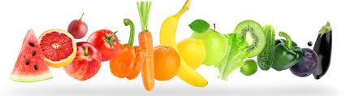
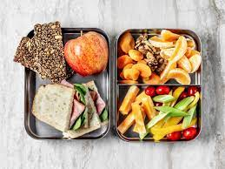
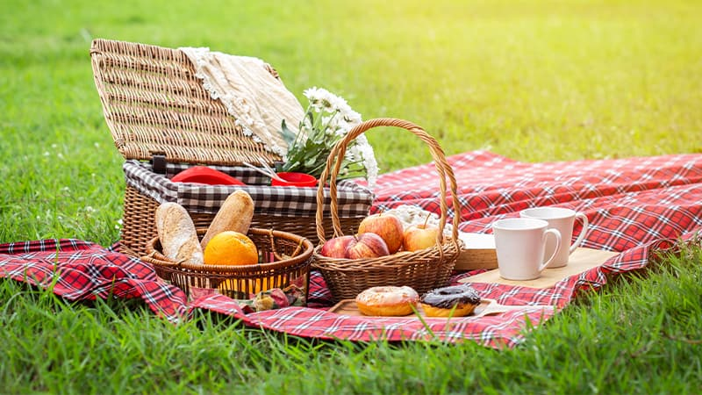
Kvantifikatori a lot of, much, many some, any
Presented by Milina Kosanovic

Slide 2
Advice for healthy diet
Which advice is correct?
Eat A LOT OF meat.
Eat A LOT OF vegetables.
Eat A LOT OF fruit.
Drink A LOT OF water.
Drink A LOT OF Coke.
Drink A LOT OF coffee.

Slide 3
Ask your friends about their diet
Do you eat a lot of fish?
Do you eat a lot of cakes?
Do you eat a lot of fruit?
Do you drink a lot of fizzy drinks?
Do you drink a lot of coffee?
Yes, I eat a lot of fruit.
No, I do not eat a lot of cakes.

Slide 4
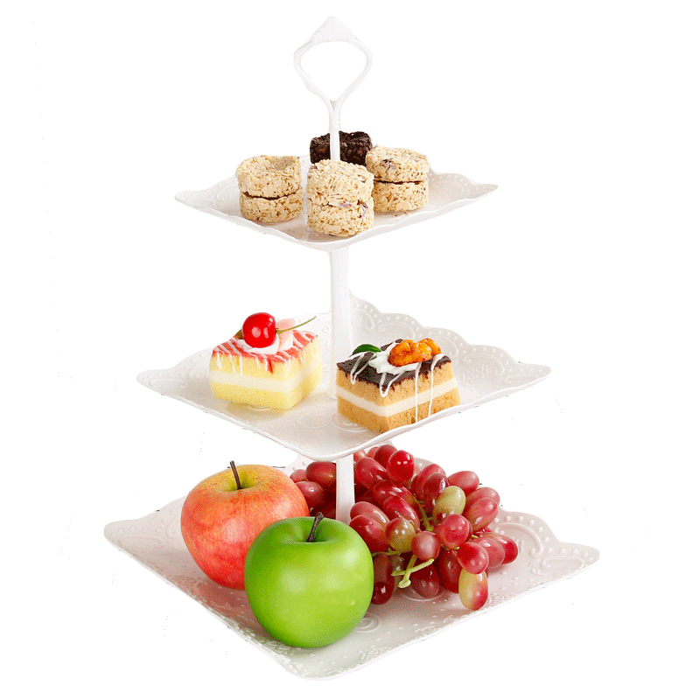
A lot of
A lot of se koristi i sa brojivim i sa nebrojivim imenicama, u svim tipovima rečenica, potvrdnim, upitnim i odričnim.
I eat a lot of cakes/fruit.
Do you eat a lot of cakes/fruit?
I do not eat a lot of cakes/fruit.

Slide 5
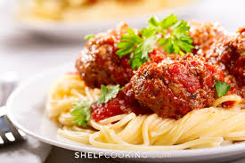
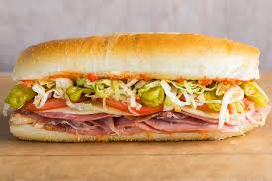
MUCH/MANY
Much se koristi uz nebrojive imenice, a many uz brojive i to uglavnom samo u upitnim i odričnim rečenicama. (Many može da se upotrebi u potvrdnim rečenicima ali zvuči formalno).
Do you eat much food for dinner?
I do not eat much food for dinner?
Do you eat many sandwiches at work?
No , I do not eat many sanwiches at work.

Slide 6
Ask your friends about what they pack for a picnic
Do you pack much/ many ...
Juices, chocolate, biscuits, Coke, water, bananas, cheese, oranges, apples, bread, eggs, cold meat, sandwiches, plastic cups, paper plates, napkins...
Well, I pack a lot of...
Well, I do not pack much/many

Slide 7
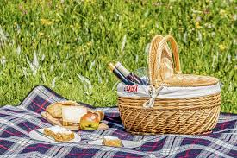
SOME/ANY
Some se koristi uz brojive i nebrojive imenice u potvrdnim rečenicama.
I always pack some bread/bananas.
Any se koristi uz brojive i nebrojive imenice u upitnim i negativnim rečenicama.
Do you pack any water/apples?
I do not pack any fruit/eggs.
I never pack any fruit/bananas.

Slide 8
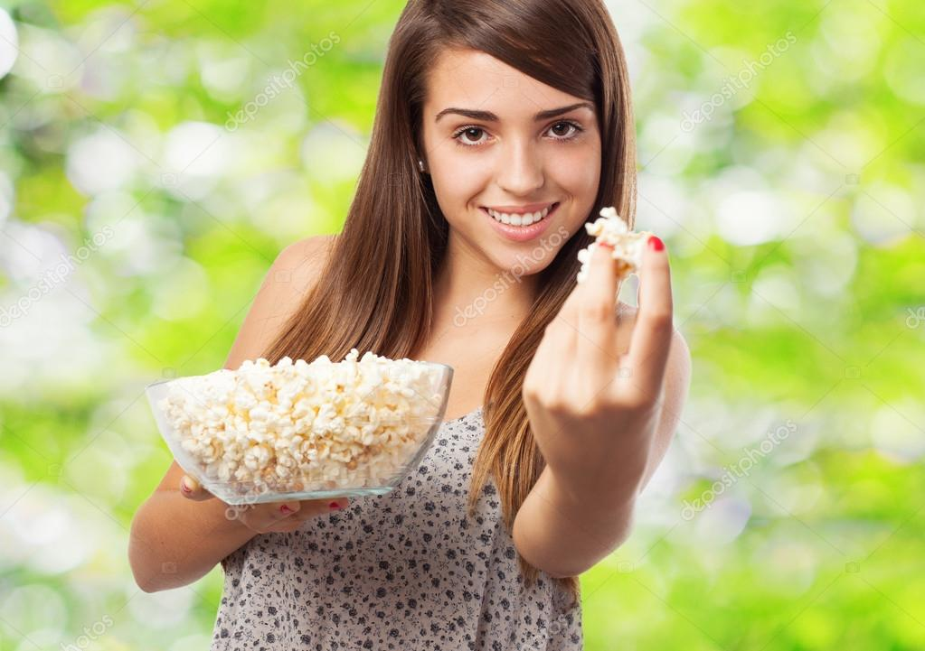
SOME
Some se koristi u pitanjima kada nudimo nekome nešto ili molimo da nam neko nešto da.
Can you bring some water?
Would you like some pop corn?

Slide 9
Make a plan for a picnic
Make a plan what to bring on a picnic:
We can take some...
We can pack a lot of...
We do not need any/much/many...

