Slide 1
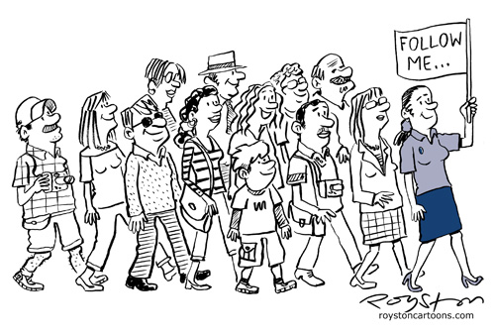
Tour Guiding
Working as a Tour Guide

Slide 2
Different Notions/Disambiguation
Escort (more general term, srb. pratilac grupe, turistička pratnja)
Tour Rep (agency representative at the resort)
Tour Guide (licenced) requires specific skills and qualifications

Slide 3
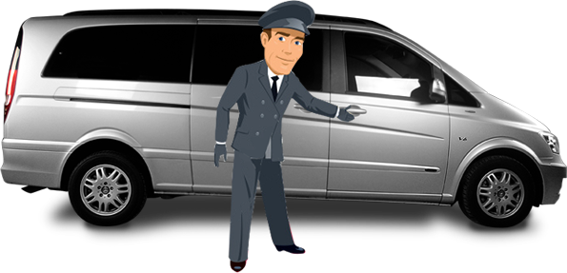
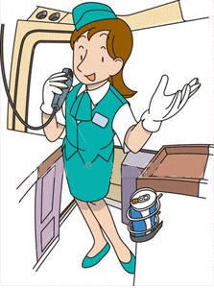
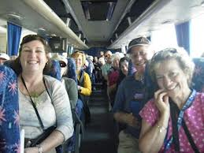

Transfer (can be done by a tour rep, escort, guide)
Taking a group of visitors from their place of arrival/departure to and from hotel/beach/airport by a shuttle, feeder service, courtesy bus etc.

Slide 4
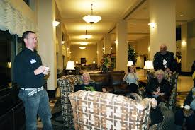
Checking In and Checking Out
Rooming List
Welcoming and seeing off the group from the airport etc.

Slide 5
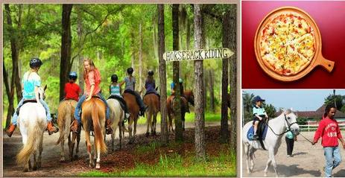
Optional Excursion (fakultativni izlet)

Slide 6

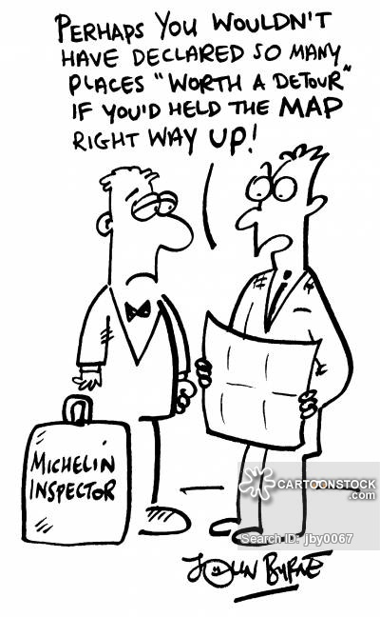
Self Guided
RAMBLING TOURS
Roam, wander, stroll on your own
Hiking , Trekking

Slide 7

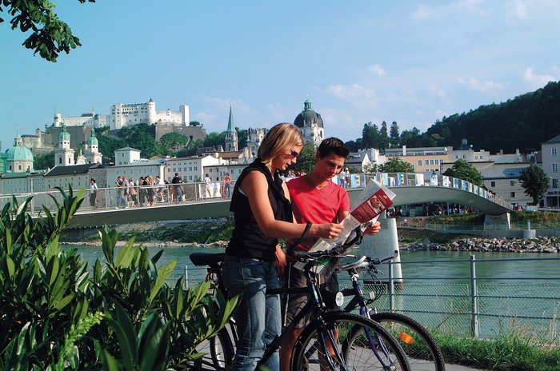
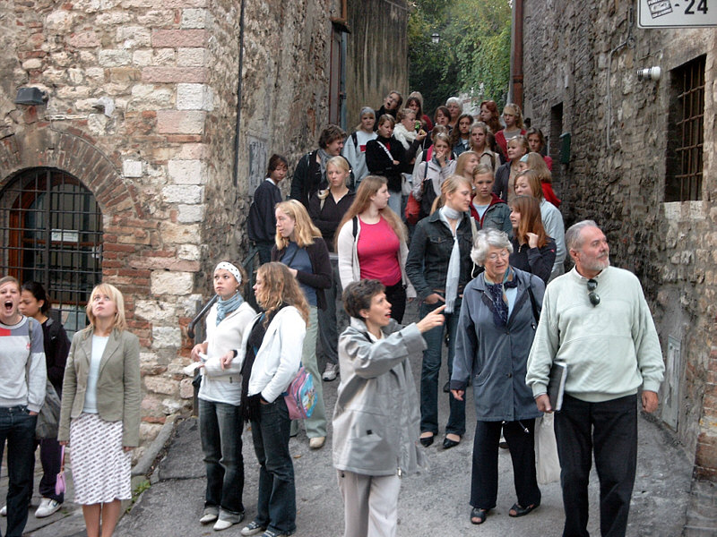
Sightseeing
On your own
with maps, brochures
Organized
Guided

Slide 8
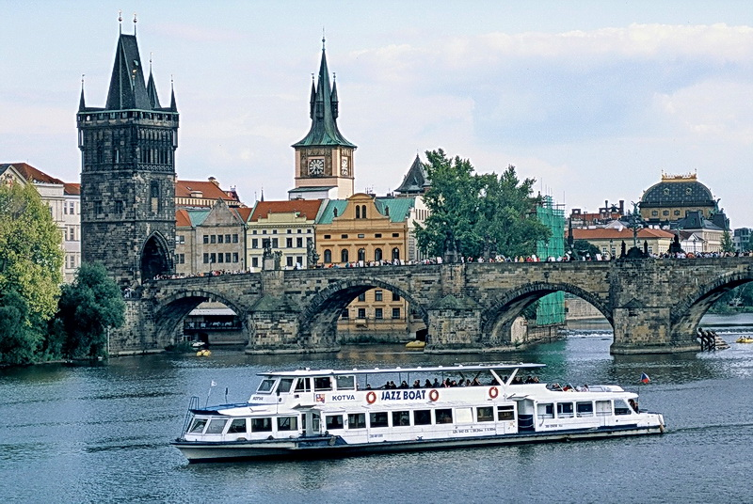
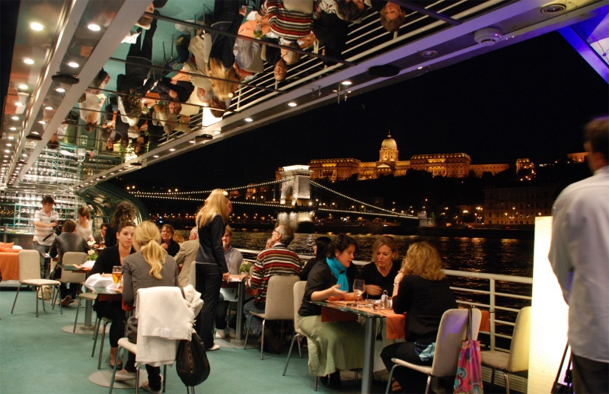
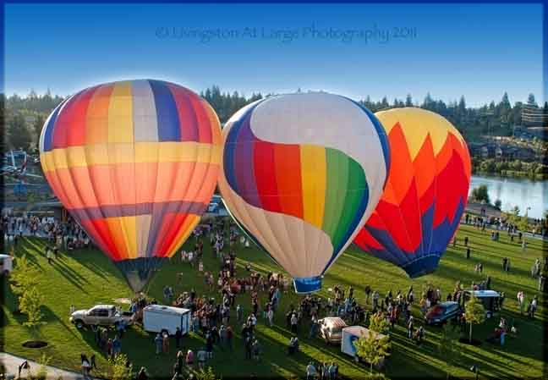
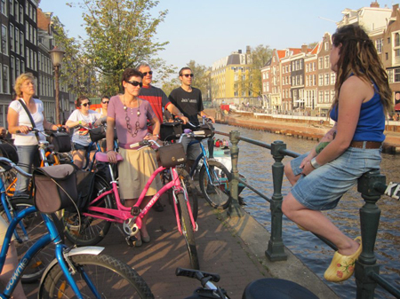

Slide 9

The Job of a Tour Guide
Usually free-lance (independent) or hired by a tour operator or agency.
Gets a fee and is paid per hour
The Institute of Tourist Guiding sets a standard, examines and accredits guides in England
BLUE BADGE
Normally recruited within the local community

Slide 10


Slide 11


In Serbia (ex-Yugoslavia)
Completed secondary school education
Take exams at the Ministry of Trade, Tourism and Telecommunications

Slide 12







Become a Greeter

Slide 13
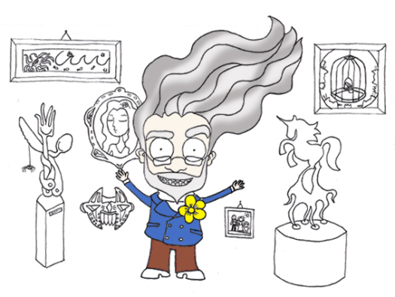


What is the Role of aTour Guide?

Slide 14

Personalization https://www.youtube.com/watch?v=1_xCW8NDhBE

Slide 15
The Role of Tour Guides (Complex)
interpretor of (heritage) sights
educator/teacher/information provider
entertainer
ambassador/mediator
providers of tourism experience
nurse
promoters/motivator of sustainability (assistance in accessibility), etiquette

Slide 16

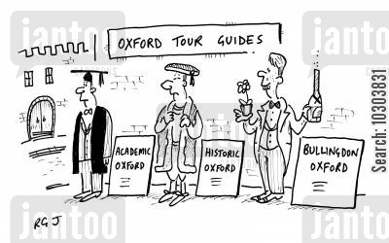

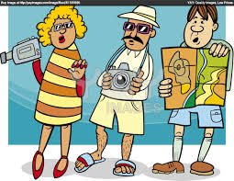

Slide 17
Interpretation varies according to:
location (setting, environment)
time (social political context), daily life of a destination
mood , anticipation (psychological factors), should be empathic
group (young-students, elderly, business people)
theme itself (Disneyland, theme parks are different from dark tourism sights)

Slide 18
Guide’s Commentary (not comment!)
The quality of commentary should be a combination of informative and entertainment contents, adapted to the clients’ interests and presented enthusiastically, encouraging
guide-tourist interaction, as well as the interaction within a tourist group.
- something additional, something that visitors cannot obtain via any other media!!!

Slide 19
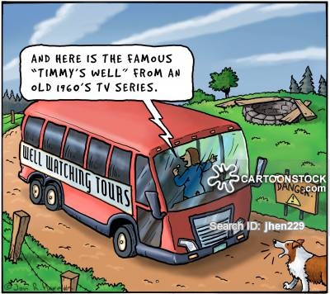
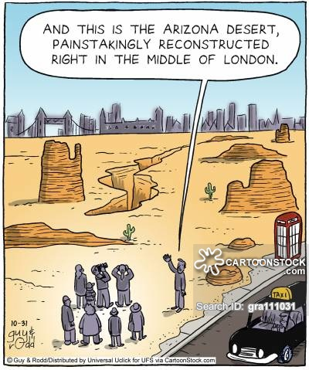
It should be interesting, lively, enthusiastic, not too ‘academic’ or heavy, but it should not be frivolous (superficial, banal) – balanced is o.k

Slide 20
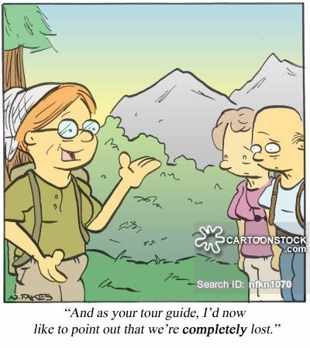
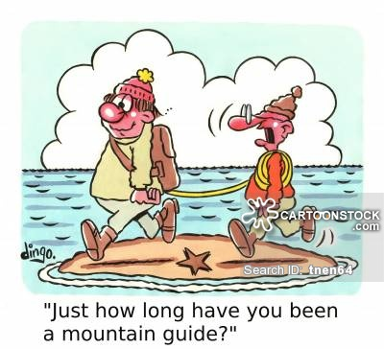
Are you really cut out for this job?

Slide 21
Features – personal traits
friendly, helpful, approachable, altruist (like people, they are VIPs), patient, energetic
should not patronize, preach and claim to know everything – you are not a superhuman!
educate tourists
skillful, efficient, elegant, helps if you’re fit
organized and responsible
to be really into many other (affiliating) fields

Slide 22
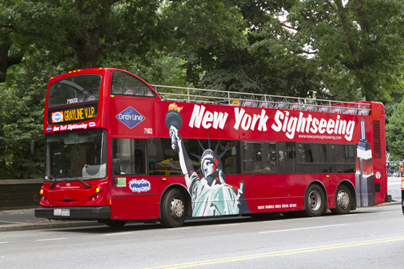
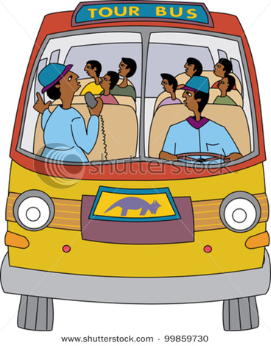
Panoramic Tour
HOP ON
HOP OFF BUS
Open-top bus

Slide 23
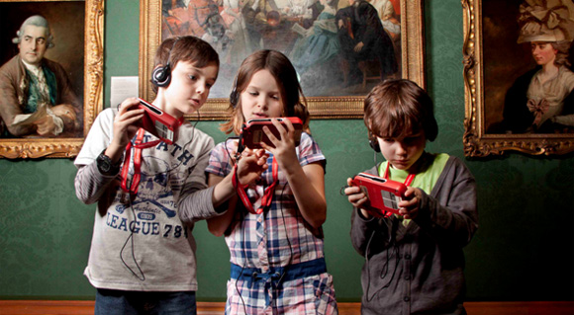
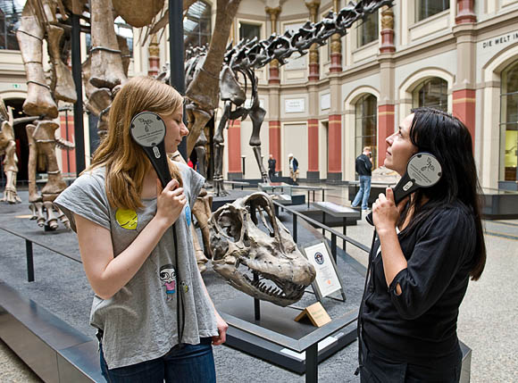
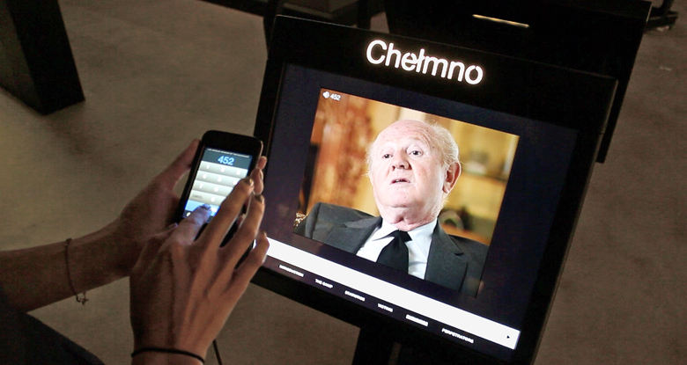
Audio Tour

Slide 24
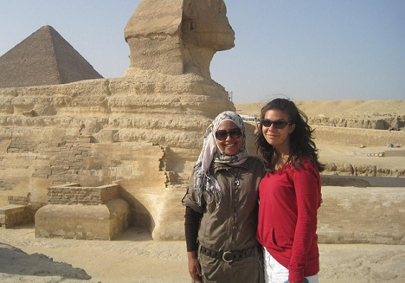

personal tour guide

Slide 25
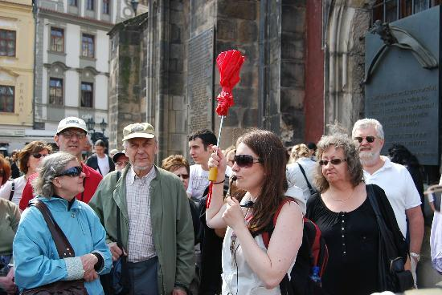
walking tour - group
Pick-up Point
Meeting Place

Slide 26
PAX (abbreviation for passengers)
FLOCKS of TOURISTS
Tourists are flocking to the places of interest

Slide 27
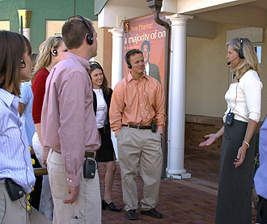
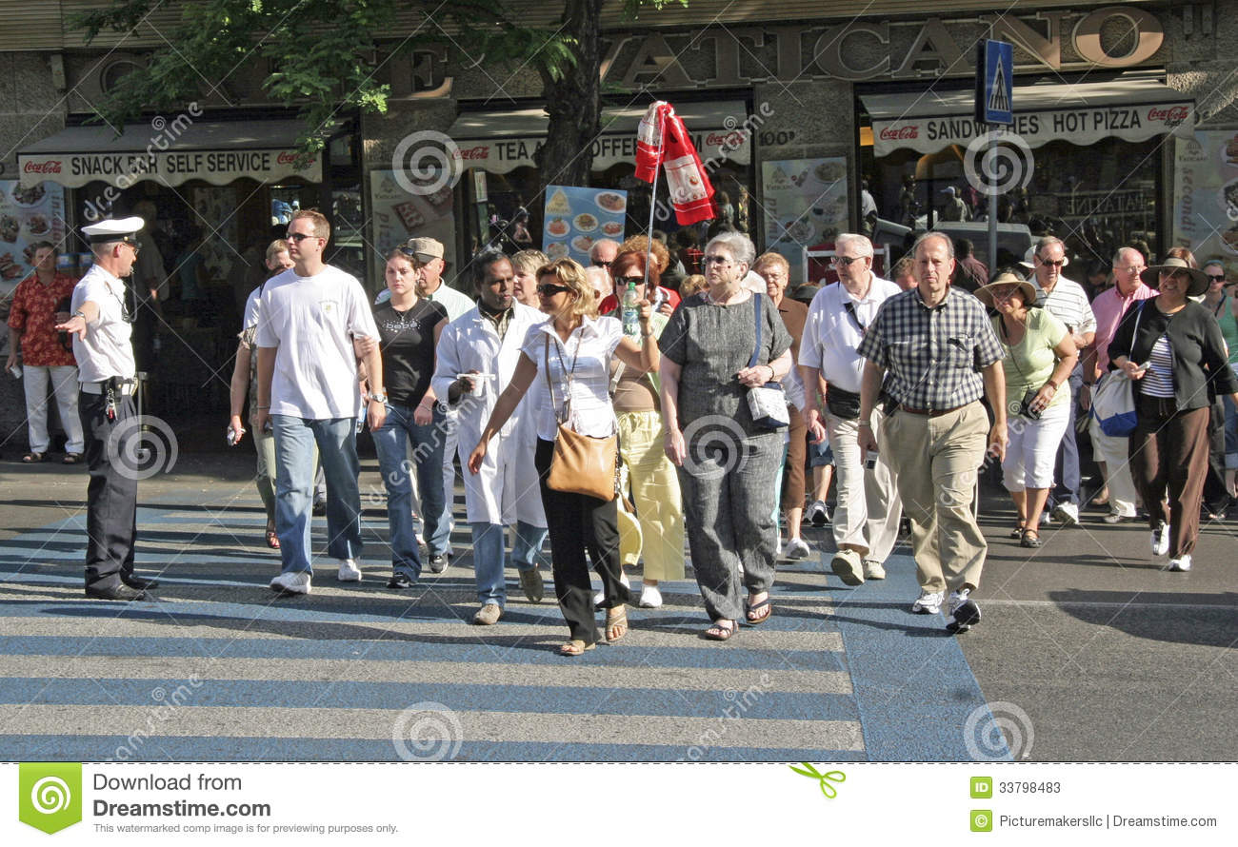
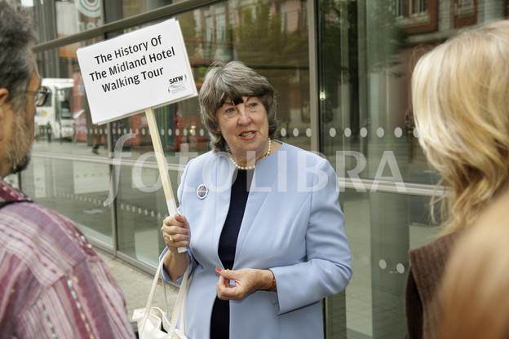
props – visual aids tech equipment

Slide 28
practical issues
able to sort out problems – first aid!
setting the time, itinerary should run smoothly, no lagging behind – time managing
giving tips (shops, toilets, local cafes&restaurants, prices, exchange offices)
checking in and out of hotels (rooming lists)
taking care of luggage, money, vouchers

Slide 29
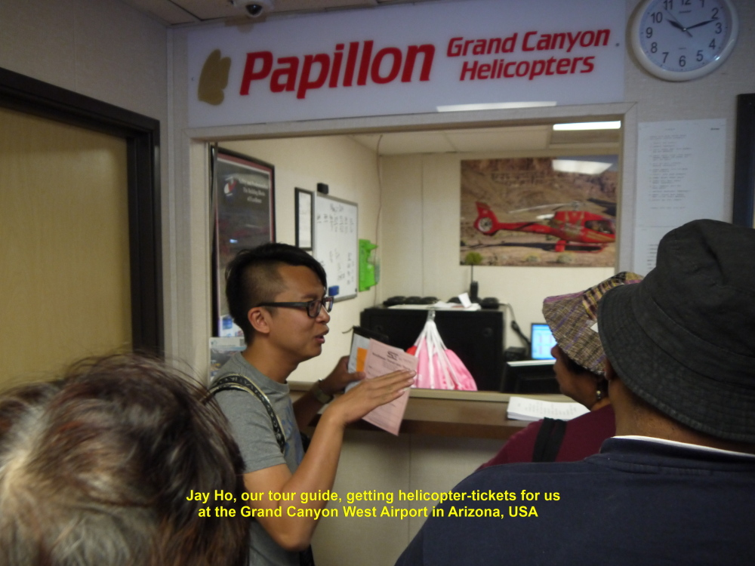
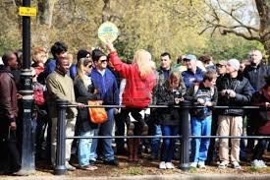
group managing

Slide 30
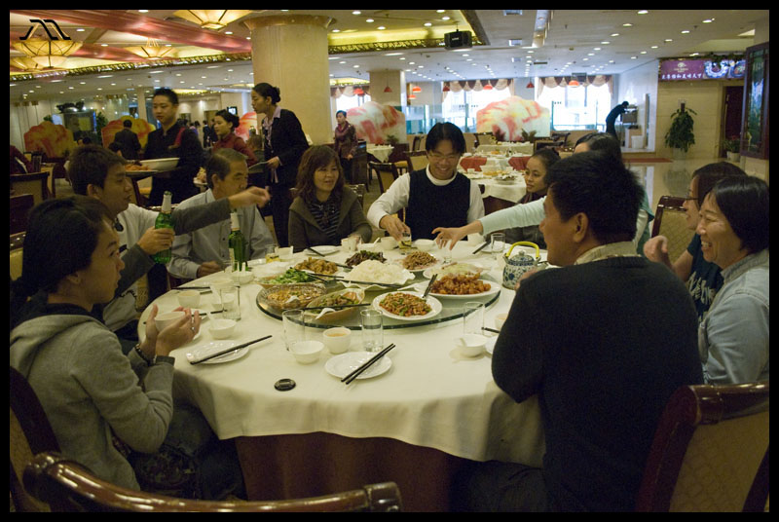
lunch

Slide 31
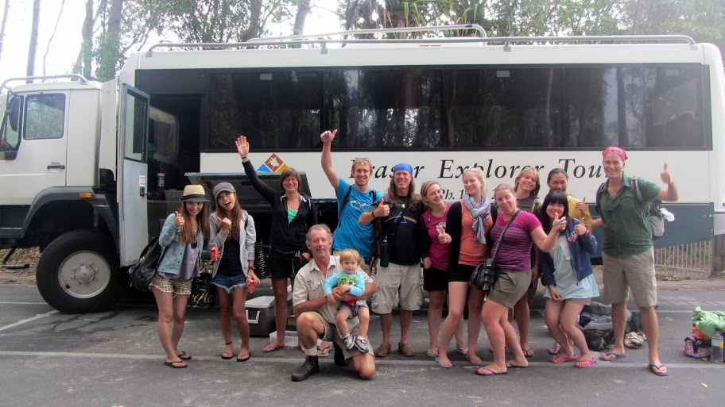
end of the tour
Drop off point
You say good bye to
The guide.
This is where the tour
ends.

Slide 32
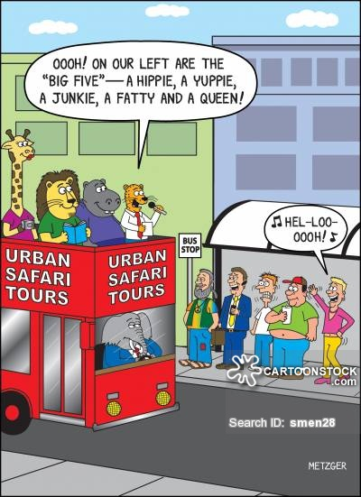
benefits
meet the world, great people and awful ones
witness to changes, lifestyles
networking
You can earn from tips and
fees
you get free or discounted
travel
Sometimes it does not feel
like the work at all

Slide 33
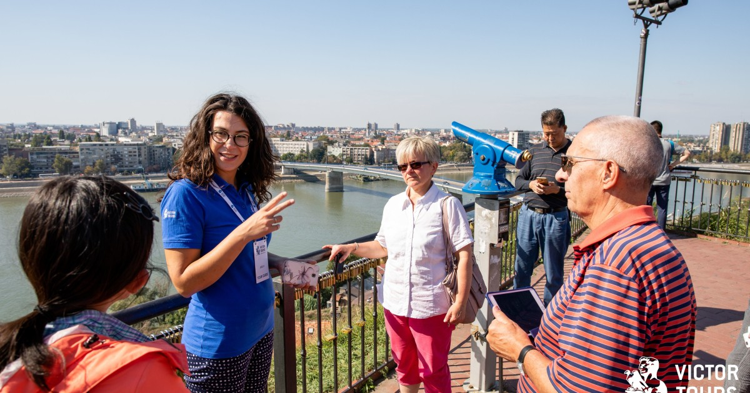
Watch about the job of a tour guide!
(pre Covid-19 )
https://www.youtube.com/watch?v=Uv_niyhdKLE

Slide 34
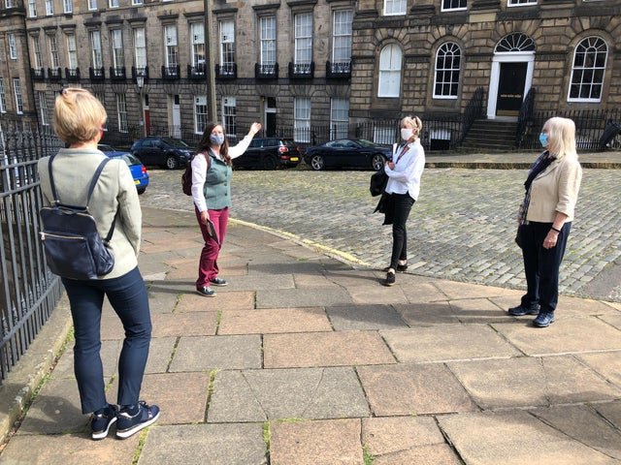
Tour Guides
Covid-19 challenges
https://www.youtube.com/watch?v=mHXdrWR_4sw
https://www.euronews.com/2020/09/25/rethinking-tourism-after-covid-19

Slide 35
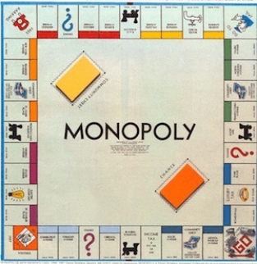
Thank you!

