Slide 1
Tourist Attractions: Passive Voice
Dimensions

Slide 2
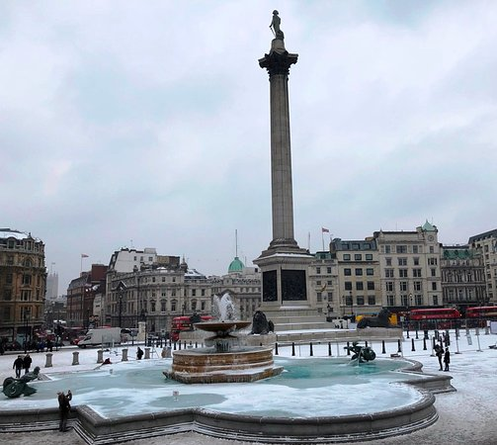
HW https://www.youtube.com/watch?v=AJ-0lQDY8_4
4a Write description using these notes
Nelson’s column, London
In Trafalgar Square – constructed 1829 – 1841 – commemorate Battle of Trafalgar 1805
Column = 56m; statue of Nelson 5.5 m. Granite
Base: 4 giant bronze lions (sculptor = Landseer) – represent strength of British Empire
A place to meet – celebrating New Year

Slide 3
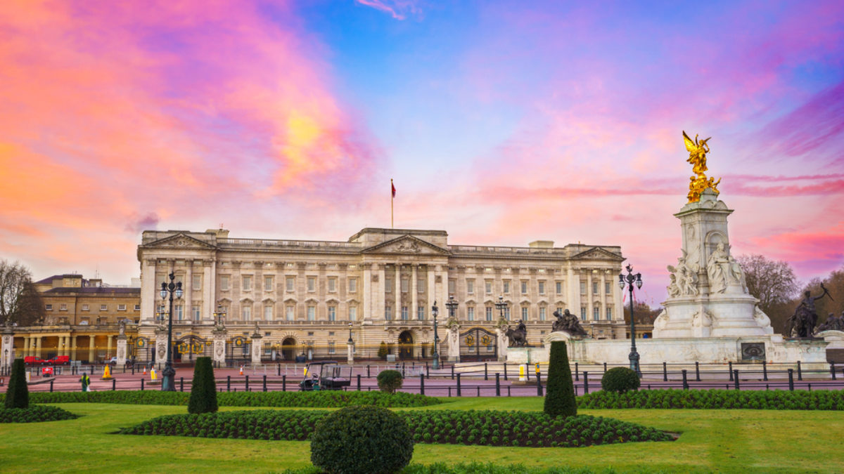
HW https://www.youtube.com/watch?v=jqI9IVe_uH8
4b Write description using these notes
Buckingham Palace, London
Originally a country house for Duke of Buckingham – converted to palace 1825 (architect = Nash)
Official royal residence 1837 – present
Façade redesigned 1913 – 429 rooms (78 bathrooms) – employs 335 staff
Buckingham Palace open to public August and September. Also art gallery

Slide 4
3 Which preposition (by, of, for) is used to describe
the person who did it?
2. the reason or function?
3. the material used?

Slide 5
3 Which preposition (by, of, for) is used to describe
1. the person who did it? BY
It was started by bishop Sully.
2. the reason or function? FOR
It is used for regular church services.
3. the material used? OF
It is made of marble.

Slide 6
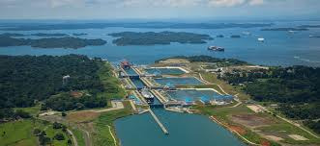
The Panama Canal (print or save Handout 3 from the website!) https://www.youtube.com/watch?v=q2T7CL9wqyM

Slide 7
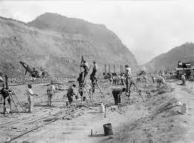
The Panama Canal is one of the most significant engineering achivements of the 20th century, but it was a project that took over 500 years to finally complete.

Slide 8
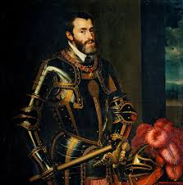
The first proposal to build a canal (1) was put forward in
1523. Charles V of Spain _________ a survey of the area,
but no action (3) _______________ (taken). More than three
centuries (4) ___________ (pass) before a new attempt (5)
_______________ (made). A French company, under the leadership of Ferdinand de Lesseps who (6) ____________ (build) the Suez Canal, (7) _________ (work) on the project for 20 years.

Slide 9
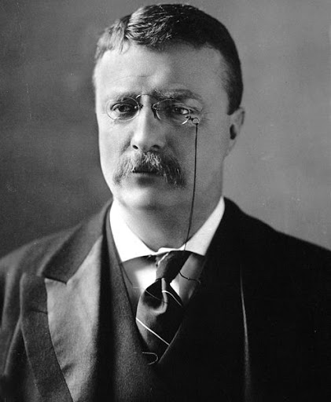
They (8) _____________ (begin) in 1880, but (9) ___________ (defeat) by disease and financial problems.
In 1906, President Roosevelt (10) _________ (order) the US Army Corps of Engineers to begin construction, and the project (11) _________ (control) by Colonel Goethals.

Slide 10
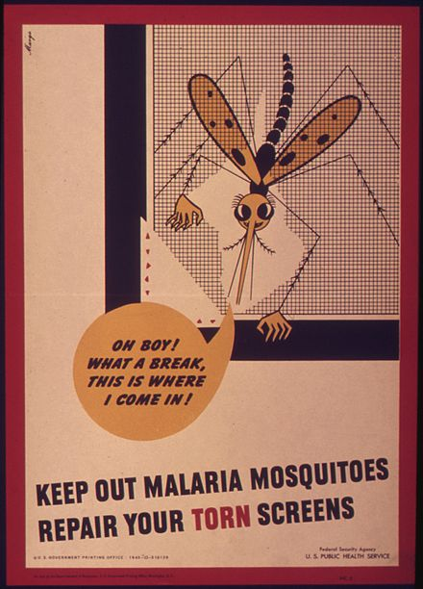
During the project, about 143 million cubic metres of earth (12) _____________ (remove), and the entire area, which (13) __________ (infest) with malaria-carrying mosquitoes, had to be sanitized. It _________ (estimate) that the project would take ten years, but in fact the work (15) _________ (complete) in the summer of 1914 at a cost of about $ 336 million

Slide 11
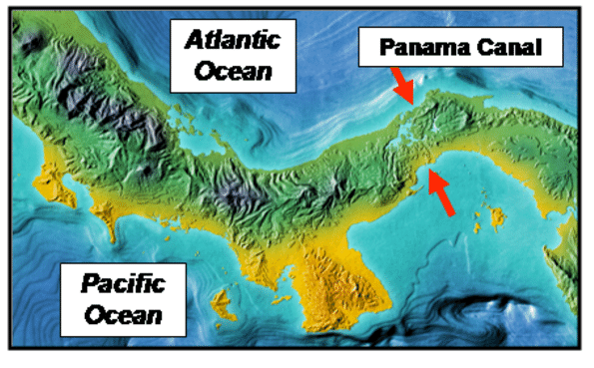
The canal which links the Pacific and Atlantic Oceans, is just over 64 kilometres long. The minimum depth is 12.5m and the minimum width is 91.5m.

Slide 12
A. The letters of the words below have been mixed up. Reorder them to make the names of four famous places and structure
GTAER RAMPDIY CHIENNA UTELNN GDENLO AGTE BGEDIR APAMAN ANLAC

Slide 13
Answers
GREAT PYRAMID CHANNEL TUNNEL GOLDEN GATE BRIDGE PANAMA CANAL

Slide 14
B. The text below describe the four famous places or structures from A.
Write in the name of the place or structure described.
Then put the words in the box into the correct place in the text. You will need to use some of the words more than once.
long length wide width high height deep depth

Slide 15
long length wide width high height deep depth
1 ________________________________________
Overall, it is 50.4 km long, and consists of three separate tunnels. The two main ones are 7.6m ____________, and the ___________ of the central service is 4.8m. The overall ________ of the undersea section is 39km.

Slide 16
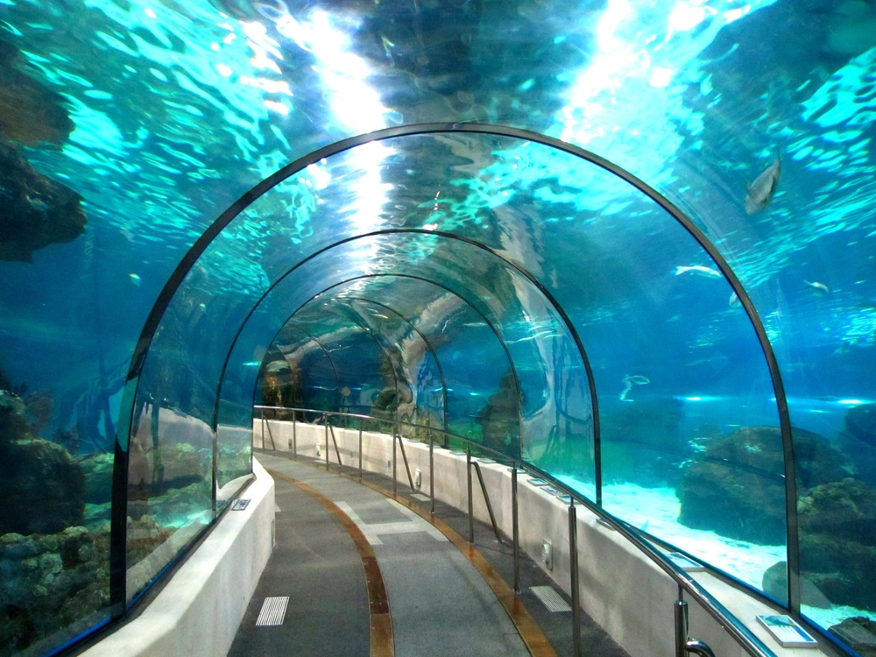
1. CHANNEL TUNNEL (EUROTUNNEL or CHUNNEL)
Overall, it is 50.4 km long, and consists of three separate tunnels. The two main ones are 7.6 m WIDE, and the LENGTH of the central service is 4.8 m. The overall DEPTH of the undersea section is 39km.
https://www.youtube.com/watch?v=kb78_cR4BHM

Slide 17
long length wide width high height deep depth
2. ___________________________________
It is suspended from two towers, each of which are 227.4m _____________ and the overall _______________ of the central span is 1280.2m

Slide 18
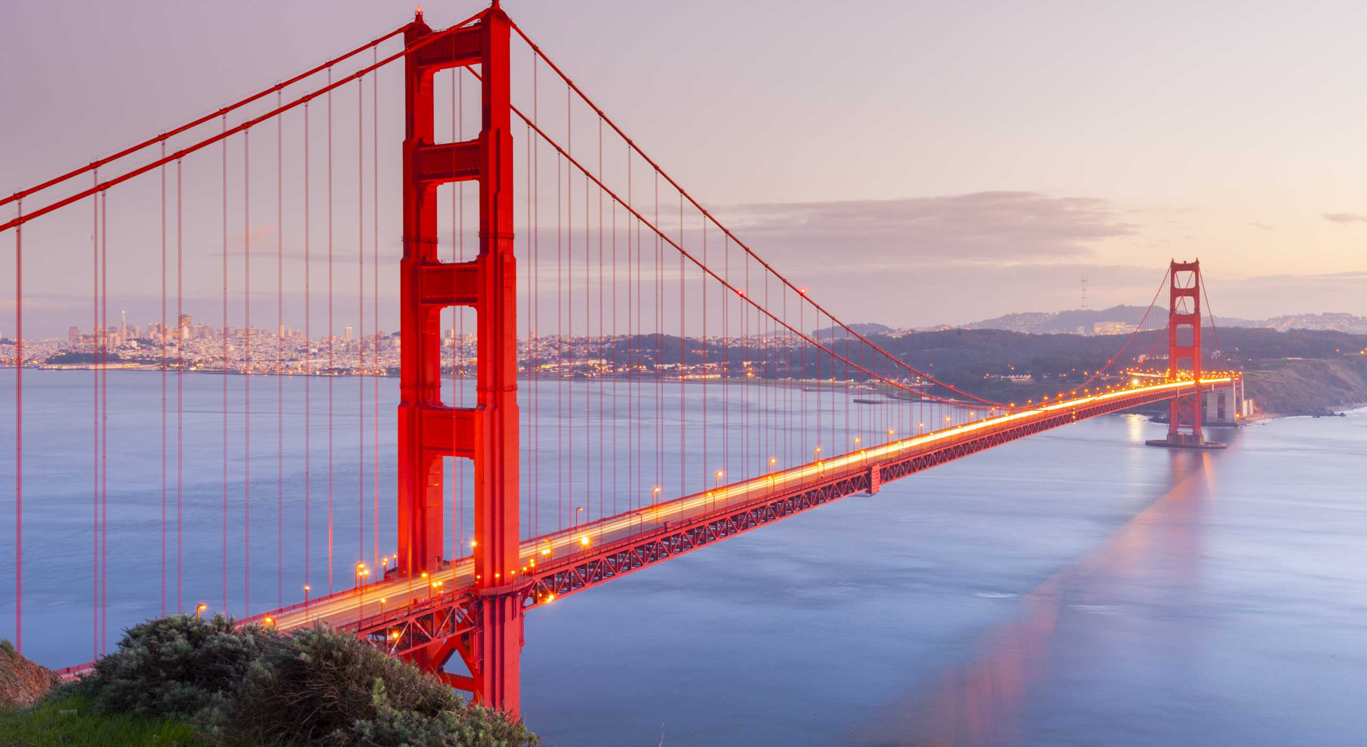
It is suspended from two towers, each of which are 227.4m HIGH and the overall LENGTH of the central span is 1280.2 m
https://www.youtube.com/watch?v=6HygbD44_j4

Slide 19
long length wide width high height deep depth
3. ___________________________________
The original ________________ of the structure was 147m, but it is now slightly lower as some of the top stones have been removed. At the base, each of the four sides is 230m _______________________ .

Slide 20
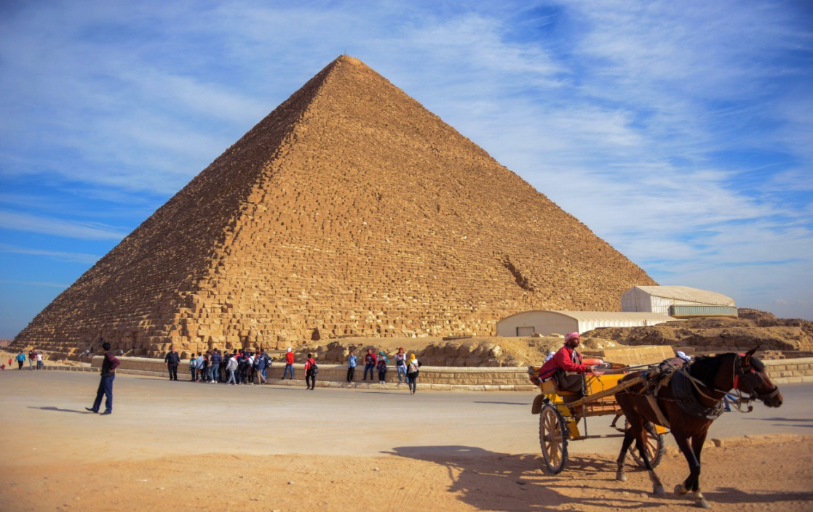
3. GREAT PYRAMID
The original HEIGHT of the structure was 147m, but it is now slightly lower as some of the top stones have been removed. At the base, each of the four sides is 230m LONG.
https://www.youtube.com/watch?v=zdEudTwbK8o

Slide 21
long length wide width high height deep depth
4. _______________________________
It is little more than 64km ___________, and with a minimum ______________ of 12.5m, it is _____________ enough to allow large vessels. It has a minimum _________ of 91.5, allowing vessels to pass each other at any stage.

Slide 22
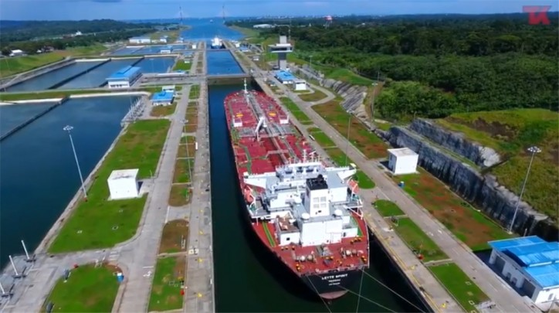
4. PANAMA CANAL
It is little more than 64km LONG, and with a minimum DEPTH of 12.5m, it is DEEP enough to allow large vessels. It has a minimum LENGTH of 91.5, allowing vessels to pass each other at any stage.

Slide 23
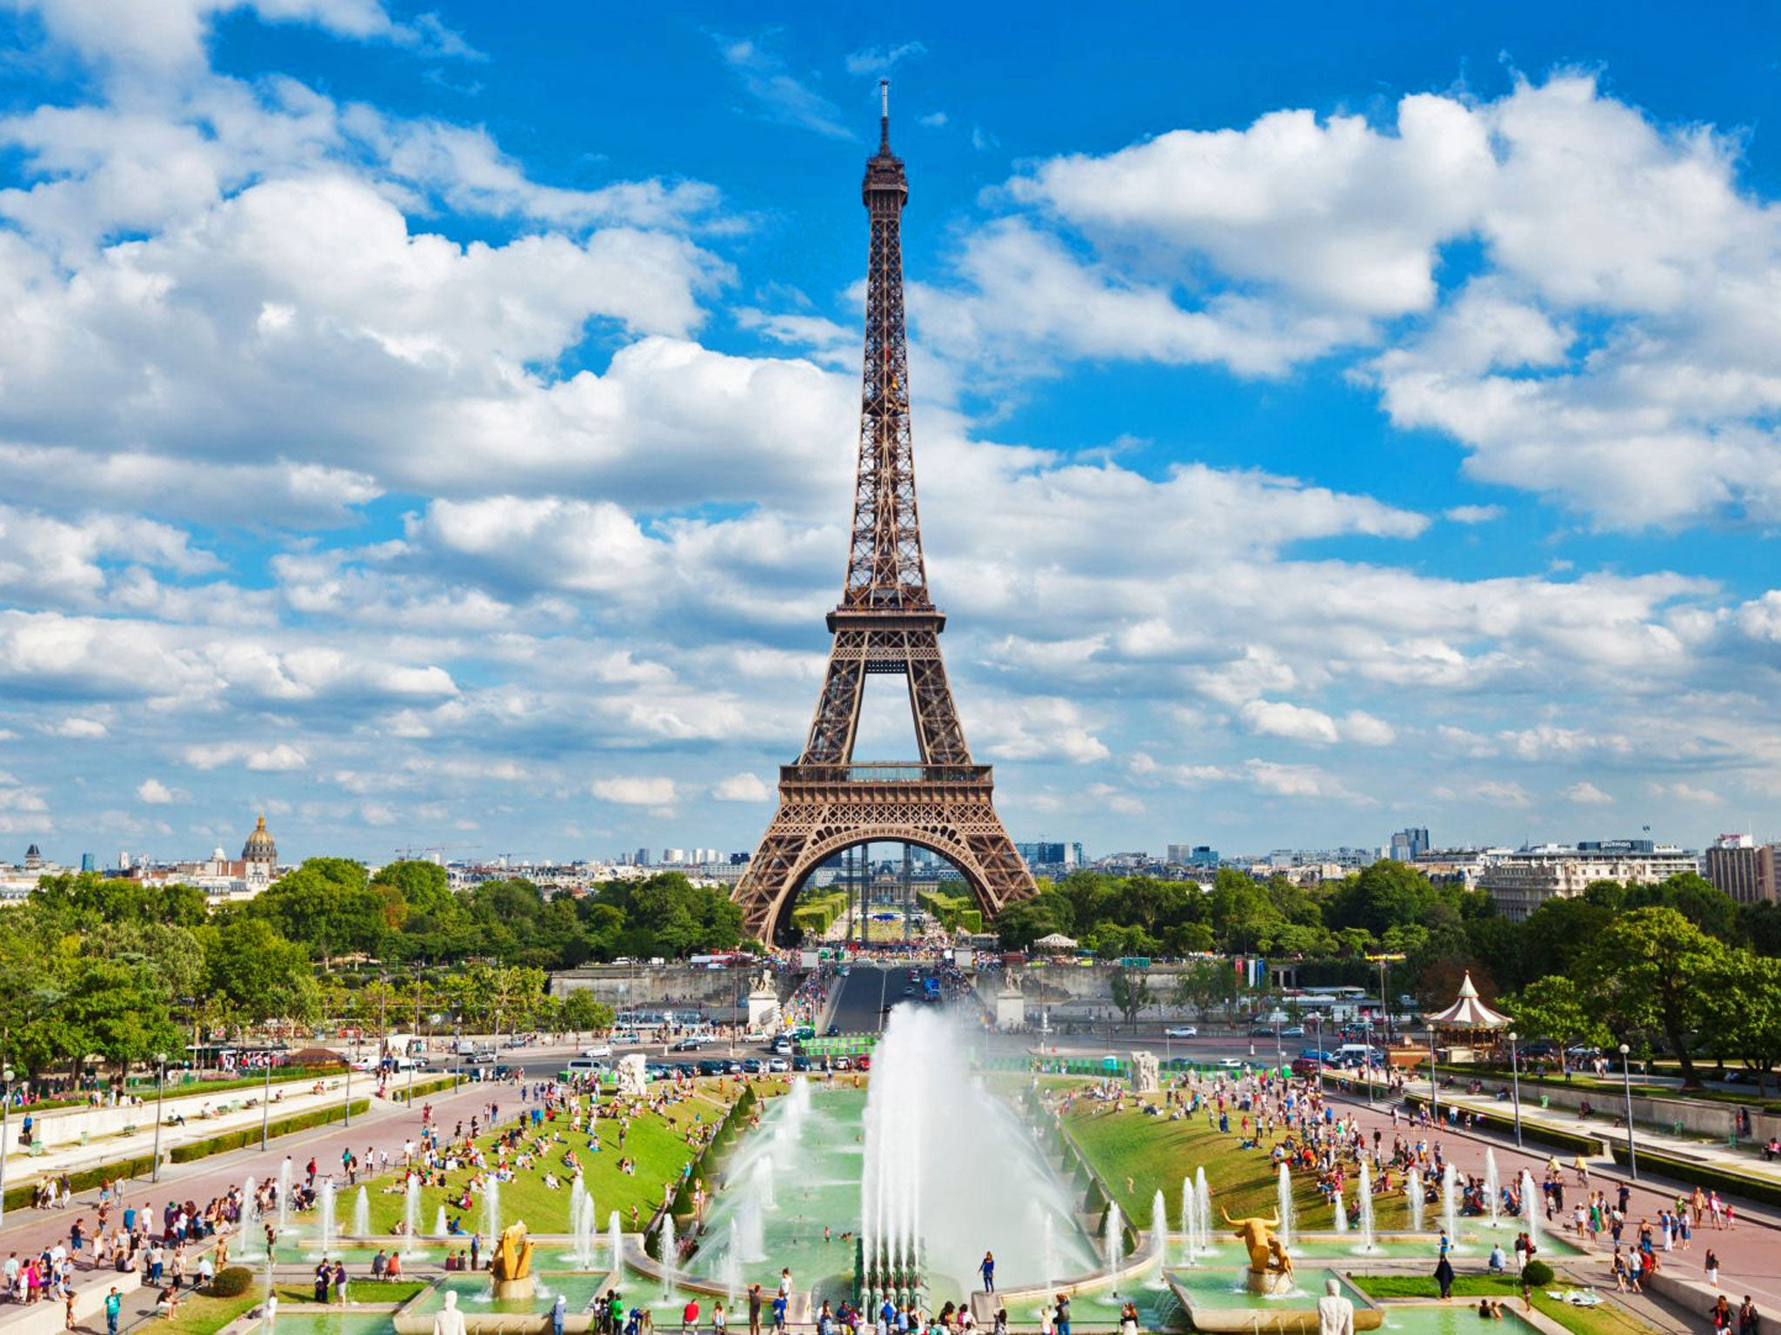
https://www.youtube.com/watch?v=CxOTAHryYkg

Slide 24

PRACTICE
1. THE EIFFEL TOWER
World’s tallest structure 100 years ago.
Completed_____________________________
1889
HEIGHT
300 metres
MATERIAL
iron

Slide 25
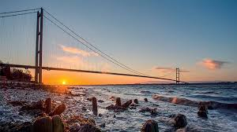
https://www.youtube.com/watch?v=h-WR9J07IqY

Slide 26
PRACTICE
2. THE HUMBER BRIDGE, ENGLAND
World’s longest bridge span.
Completed______________
1980 (took 8 years to build)
Cost_______________________
£96 million
LENGTH OF MAIN SPAN
1,410 metres
LENGTH INCLUDING SIDE SPANS
2,220 metres
HEIGHT OF TOWERS
162,5 metres

Slide 27
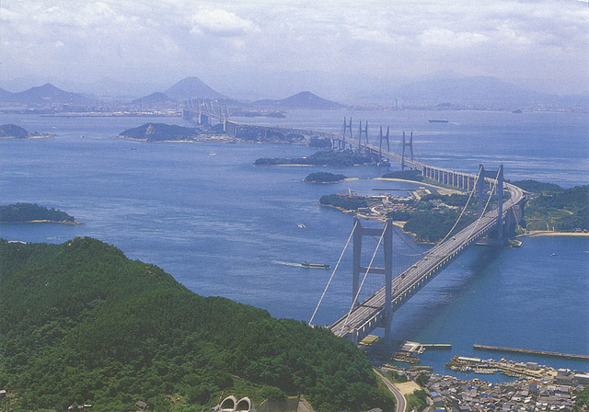

Slide 28
PRACTICE
3. SETO-OHASHI ROAD AND RAIL BRIDGE, JAPAN
Longest combined road and rail bridge in the world
Links Honshu and Shikoku
Opened____________________
1988
COST
£4.9 billion
LENGTH
12, 306 metres

Slide 29
References
Going International, Workbook, Unit 9.
1. Trafalgar Square
https://www.youtube.com/watch?v=AJ-0lQDY8_4
2. Buckingham Palace
https://www.youtube.com/watch?v=jqI9IVe_uH8
3. Panama Canal
https://www.youtube.com/watch?v=q2T7CL9wqyM
4. Channel Tunnel (Chunnel)
https://www.youtube.com/watch?v=kb78_cR4BHM
5. Golden Gate Bridge
https://www.youtube.com/watch?v=6HygbD44_j4
6. The Great Pyramid
https://www.youtube.com/watch?v=zdEudTwbK8o
7. The Eiffel Tower
https://www.youtube.com/watch?v=CxOTAHryYkg
8. Humber Bridge
https://www.youtube.com/watch?v=h-WR9J07IqY
https://learnenglish.britishcouncil.org/grammar/intermediate-to-upper-intermediate/passives

