Slide 1
Presenting a Tourist Attraction
PASSIVE VOICE

Slide 2
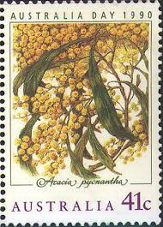
Interesting Facts https://www.australia.com/en
-The Land of Down Under (Australia&New Zealand)
Aussie&Kiwi
Aborigines&Maori (indigenous community)
-continent, country, island
-immigration, the largest Greek population
-golden wattle

Slide 3
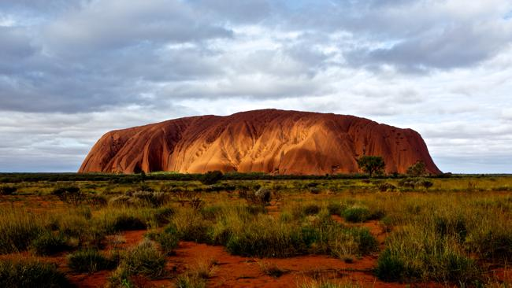
ULURU – Ayers Rocks, the largest sandstone formation
One of the most recognizable landmarks, sacred place of Aborigines

Slide 4
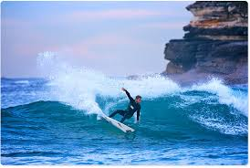
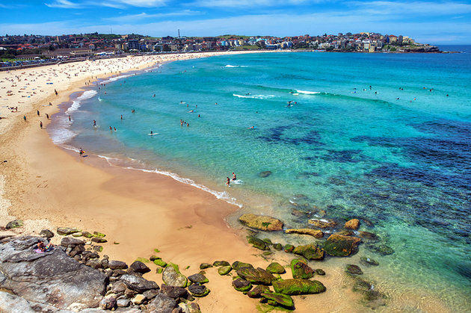
Bondi Beach
/bondai/

Slide 5
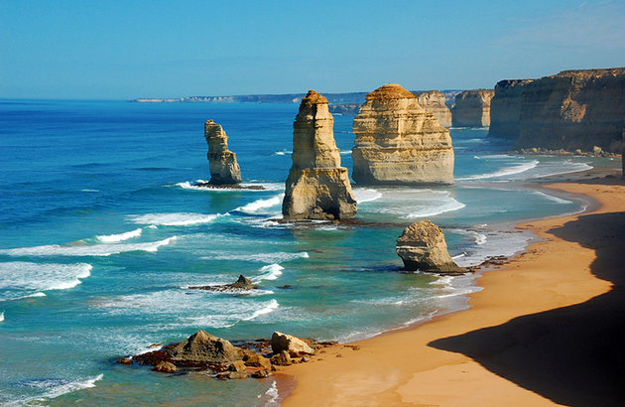
Great Ocean Road – built during Depression (Velika ekonomska kriza)
300km southeast

Slide 6
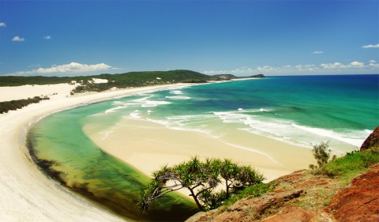
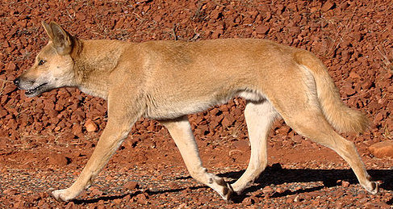
Fraser Island – largest sand island
DINGO

Slide 7
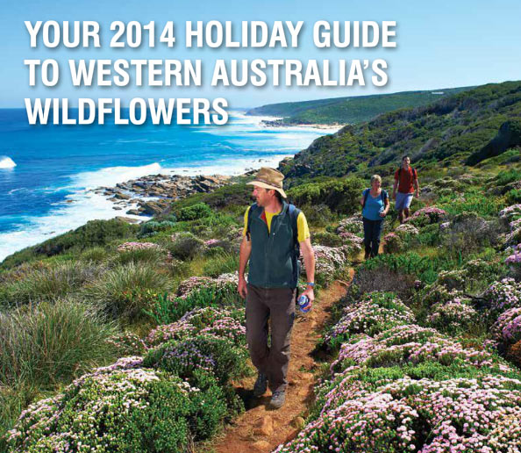
Western Australia – Wild Flowers

Slide 8
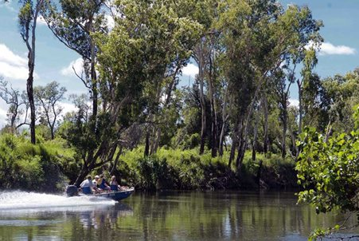
The National Park – The Wetlands of Kakadu

Slide 9
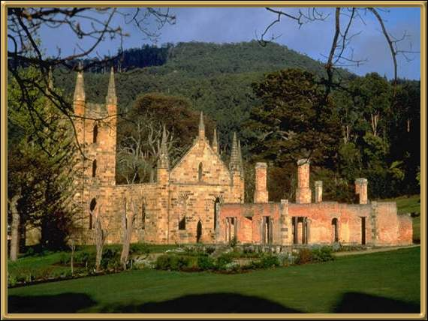
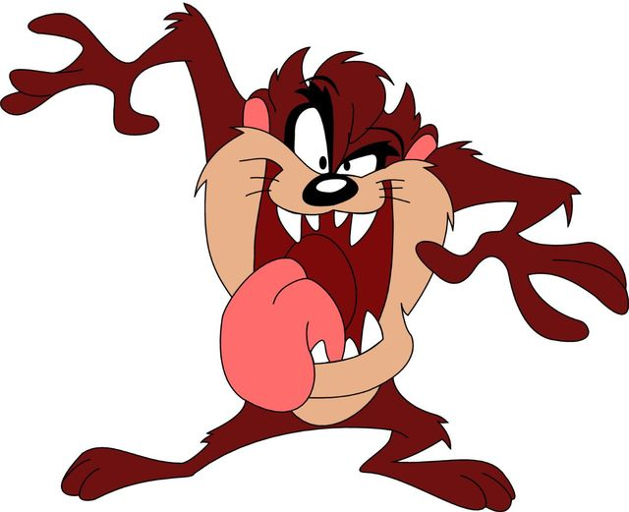
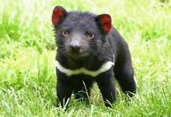
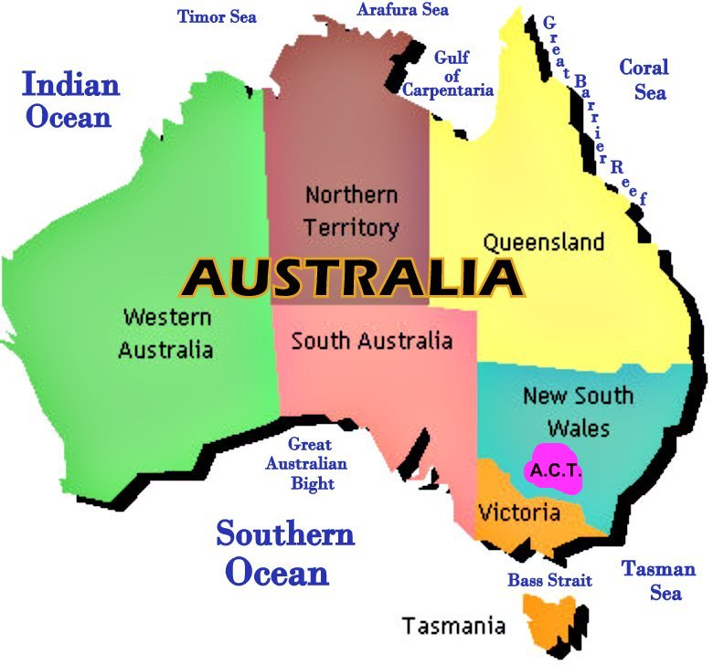
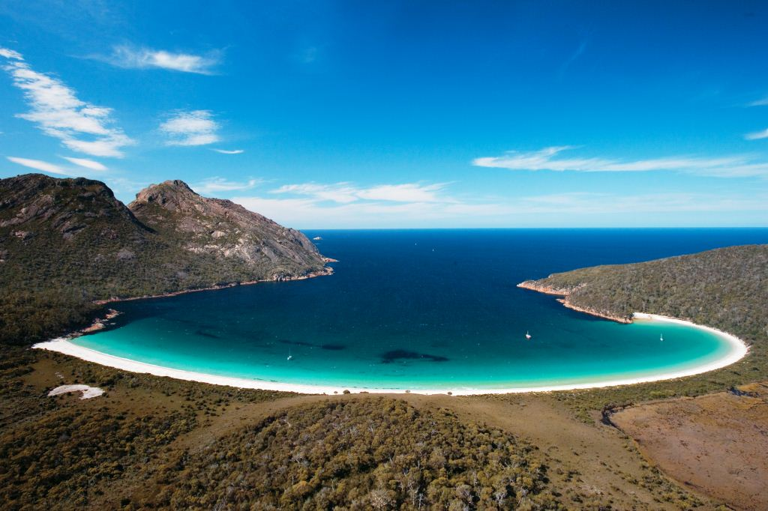

Slide 10
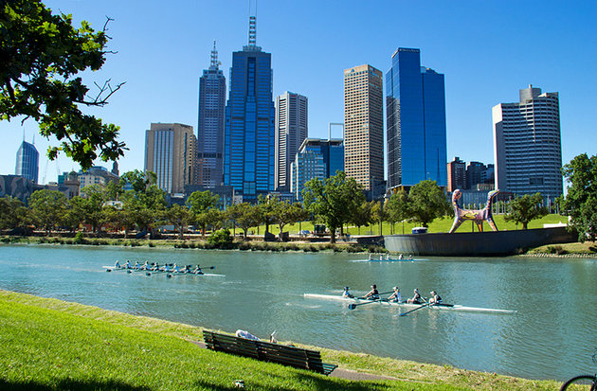

Melbourne

Slide 11

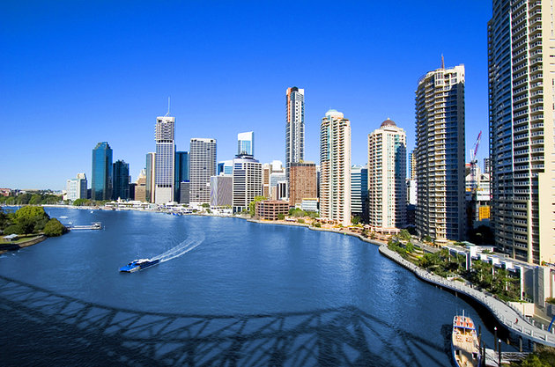
Lone Pine Koala Sanctuary- Brisbane

Slide 12
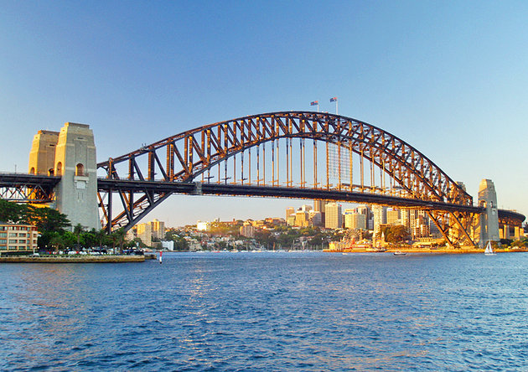
Sydney Harbour Bridge
https://www.youtube.com/watch?v=GTRQsa3jpXU

Slide 13
ATTRACTIONS
Natural | Built/Man-made
mountains lakes and rivers National parks heritage coast | Historic site (Shakespeare’s birthplace) archeological site monument |  | art gallery museum palace/stately home castle theme park
Events | Entertainment and leisure
music/arts festival religous festival carnival parade | theatre concert hall nightclub casino zoo | fiction-induced attraction industrial heritage hub green market -fair shopping zone sports centre/stadium

Slide 14
HW
Which types of visitor attractions in your city or region are there?
Which of the categories in the table do they belong to?
Can you think of another example for each of the types of attraction

Slide 15
PRESENTING TOURIST ATTRACTIONS
LANGUAGE FOCUS, Unit 9, page 128 andUnit 10, page 146
Know the elements
Indicating position
Measurements and dimensions
Comparatives (Superlatives)
Descriptive adjectives
Passives
Present Perfect, Past Simple
Relative Clauses
Expressions
Linkers

Slide 16
Elements natural attractions
snow-capped mountain top
gorge
wetland
reef
cliff
ecosystem
biodiversity
sea strait
species

Slide 17
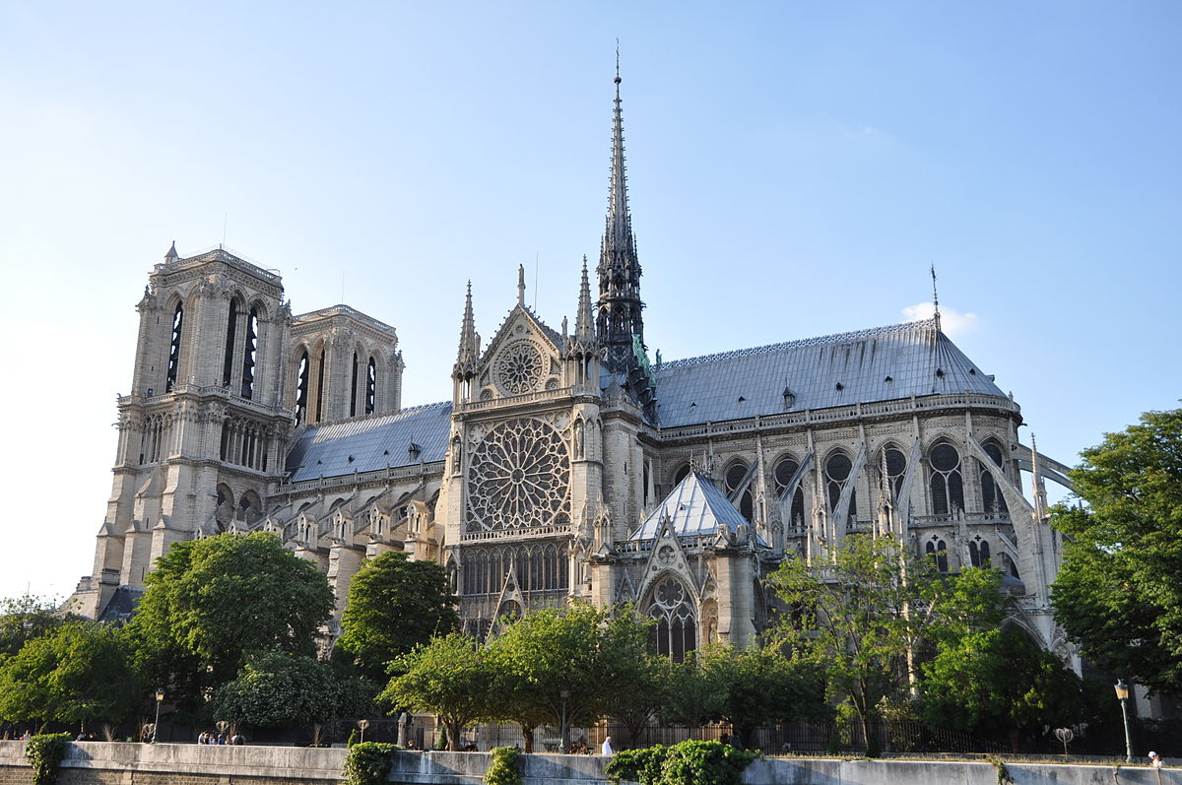

Slide 18


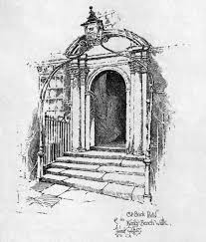
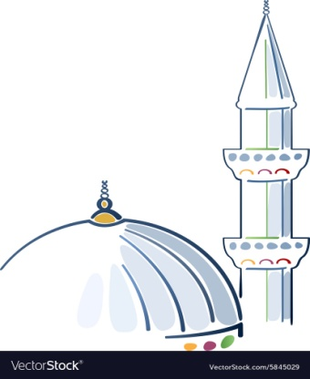
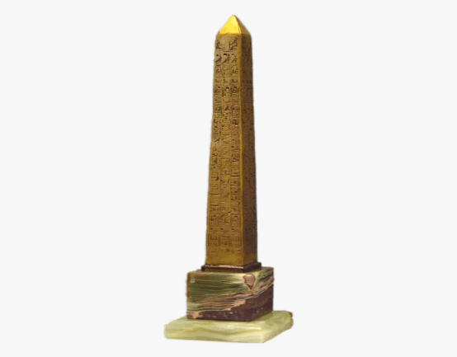
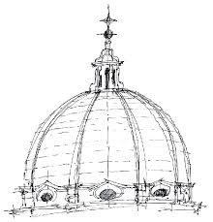
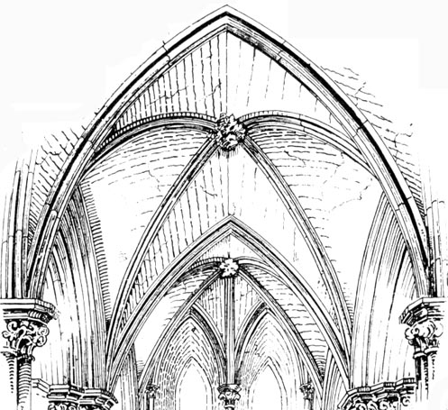
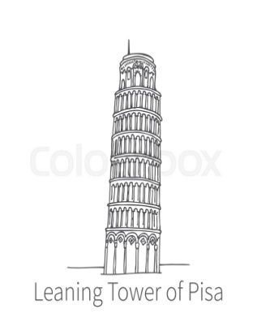

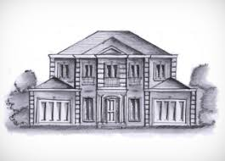
Elements man-made attractions
spire
dome
arch
façade
obelisk
tower
portal
minaret
column
vaulted ceiling
2. In which type of building would you find them (e.g. cathedral, mosque etc.)
3. Can you think of any famous building that has these

Slide 19
4. Add one of these words to the word groups listed below
construct granite statue
long show alongside
1 high, wide, thick,
2 underneath, in front of,
3 depict, represent
4 build, erect
5 marble, stone
6 carving, sculpture

Slide 20
4. Add one of these words to the word groups listed below
construct granite statue
long show alongside
1 high, wide, thick, long
2 underneath, in front of, alongside
3 depict, represent, show
4 build, erect, construct
5 marble, stone, granite
6 carving, sculpture, statue

Slide 21
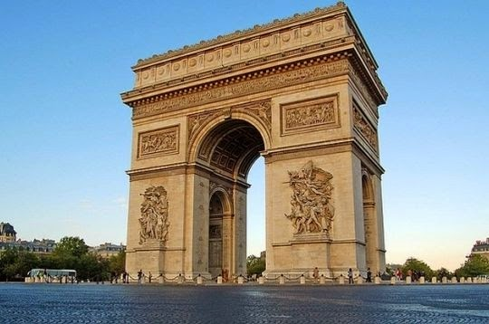
Arc de Triomphe

Slide 22
Arc de Triomphe https://www.youtube.com/watch?v=1QmvRCa3ji8
Which section
describes the use and function of the building?
describes when and why it was built?
gives some detailed description?
gives a general physical description?

Slide 23
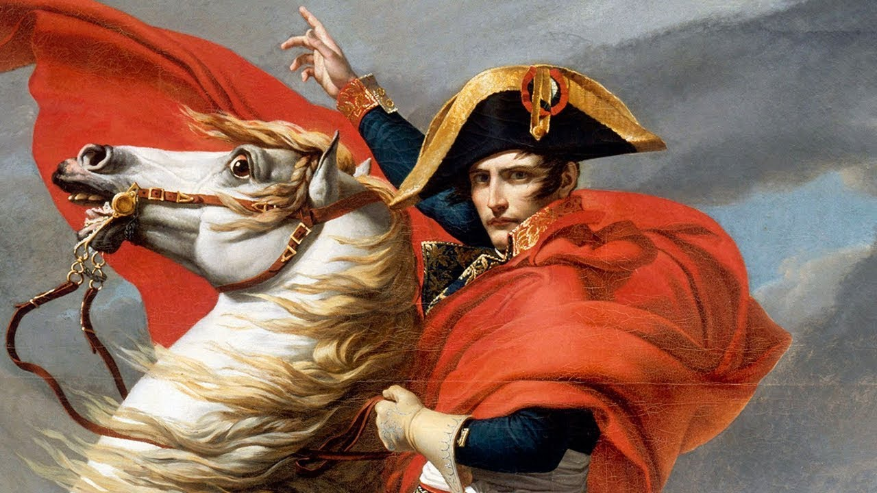
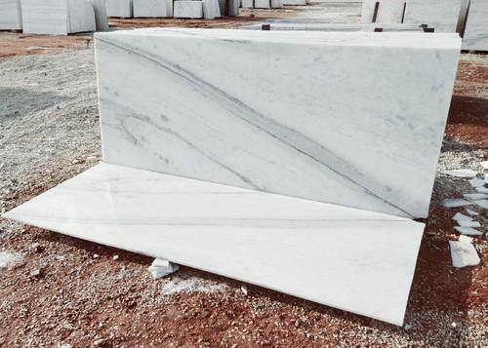
Arc de Triomphe
A) The Arc de Triomphe was erected in the early 19th as a tribute to the French army of Napoleon. It is built of marble.

Slide 24
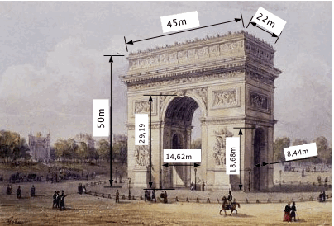
Arc de Triomphe
B) The arch is over 50 metres high, 45 metres wide and 22 metres thick

Slide 25
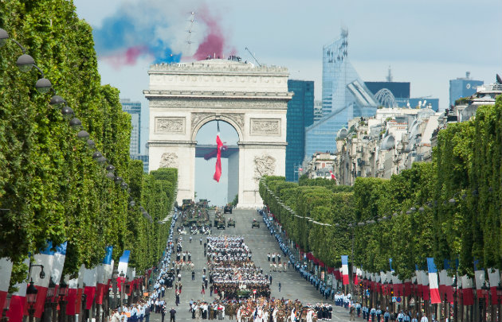
Arc de Triomphe
D) The arch is used for special processions. Underneath the arch is the Tomb of the Unknown Soldier. A flame is lit every evening at 6.30 p.m.

Slide 26
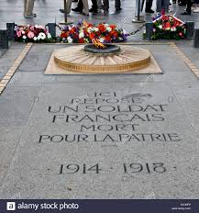
Arc de Triomphe
C) There are four sculptures carved on the façade. The most famous is La Marseillaise. It depicts the departure of the volunteers encouraged by a winged figure representing France.

Slide 27
Which section https://www.youtube.com/watch?v=v7WmOrtO5FE
describes the use and function of the building?
describes when and why it was built?
gives some detailed description?
gives a general physical description?

Slide 28
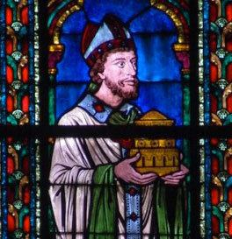
Notre-dame Cathedral
A) The cathedral of Notre-Dame was started by Bishop de Sully in 1163 and work continued for nearly 200 years. It was completed in 1345. The cathedral is dedicated to the Virgin Mary and stands in the centre of Paris on the Ile-de-la-Cite.

Slide 29
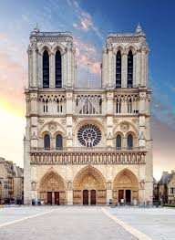
Notre-dame Cathedral
B) It is undoubtedly the finest example of French gothic architecture. The twin towers are a famous feature of the Paris skyline, and are 69 metres high. The spire, which was added in the 19th century, is 90 metres high

Slide 30
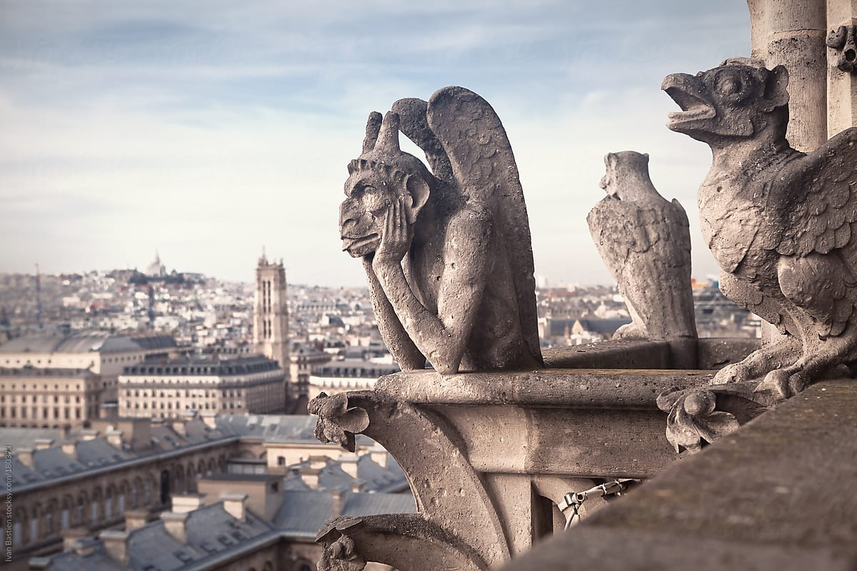
Notre-dame Cathedral
C) The façade is the most striking part of the building. The three portals are adorned with remarkable stone sculpture, including the Last Judgement. The rose window in the façade was built over 700 years ago and is magnificent.

Slide 31
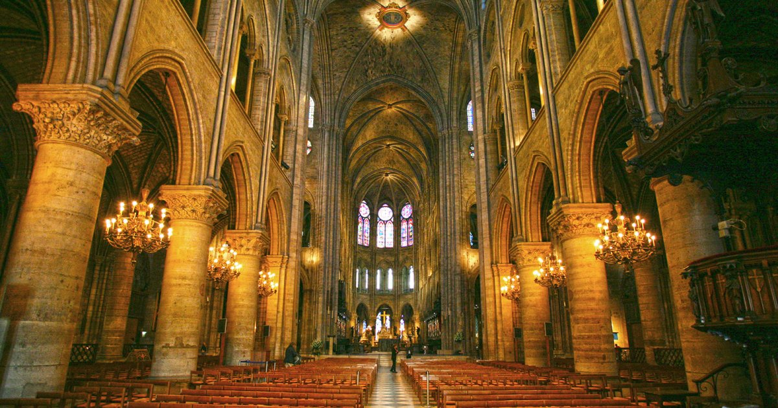
Notre-dame Cathedral
D) The cathedral is still used for regular church services as well as special occasions. The vast interior can accommodate 9000 people. The French road distances are established from the ‘0 km’ point located on the square in front of the cathedral entrance.

Slide 32
Language spot: Passive
1 Find a form of these verbs in the descriptions in Reading
1 erect 4 use 7 continue 10 establish
2 build 5 light 8 stand
3 depict 6 start 9 adorn
a. Which are Present tenses and which are Past tenses
b. Which are Passive and which are Active
c. Find other examples of Active and Passive

Slide 33
Language spot: Passive
1 Find a form of these verbs in the descriptions in Reading
1 erect 4 use 7 continue 10 establish
2 build 5 light 8 stand
3 depict 6 start 9 adorn
a. Which are Present tenses and which are Past tenses
b. Which are Passive and which are Active
c. Find other examples of Active and Passive

Slide 34
Key
It was erected – Past Passive
It was built – Past Passive
It is built – Present Passive
It is used – Present Passive
They are adorned – Present Passive
They are established – Present Passive
It was added – Past Passive
It is lit – Present Passive
They are carved – Present Passive

Slide 35
2 Is the Passive used more than the Active because
1. descriptions like this are more formal? √
2. we are thinking about what is done to the thing we are interested in, not about what it does? √
3. sometimes we do not know who or what does the action (i.e. who is the ‘agent’)? √
4 it makes the text more interesting?

Slide 36
3 Which preposition (by, of, for) is used to describe
1. the person who did it?
2. the reason or function?
3. the material used?

Slide 37
3 Which preposition (by, of, for) is used to describe
1. the person who did it? BY
It was started by bishop Sully.
2. the reason or function? FOR
It is used for regular church services.
3. the material used? OF
It is made of marble.

Slide 38
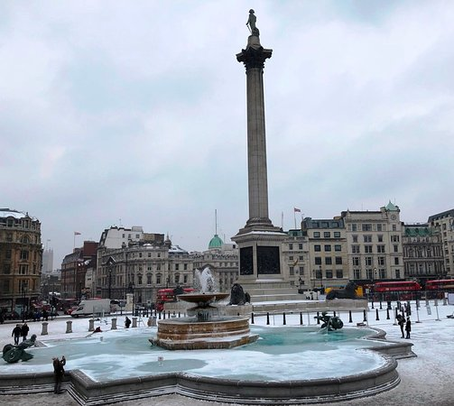
HW
4a Write description using these notes
Nelson’s column, London
In Trafalgar Square – constructed 1829 – 1841 – commemorate Battle of Trafalgar 1805
Column = 56m; statue of Nelson 5.5 m. Granite
Base: 4 giant bronze lions (sculptor = Landseer) – represent strength of British Empire
A place to meet – celebrating New Year

Slide 39
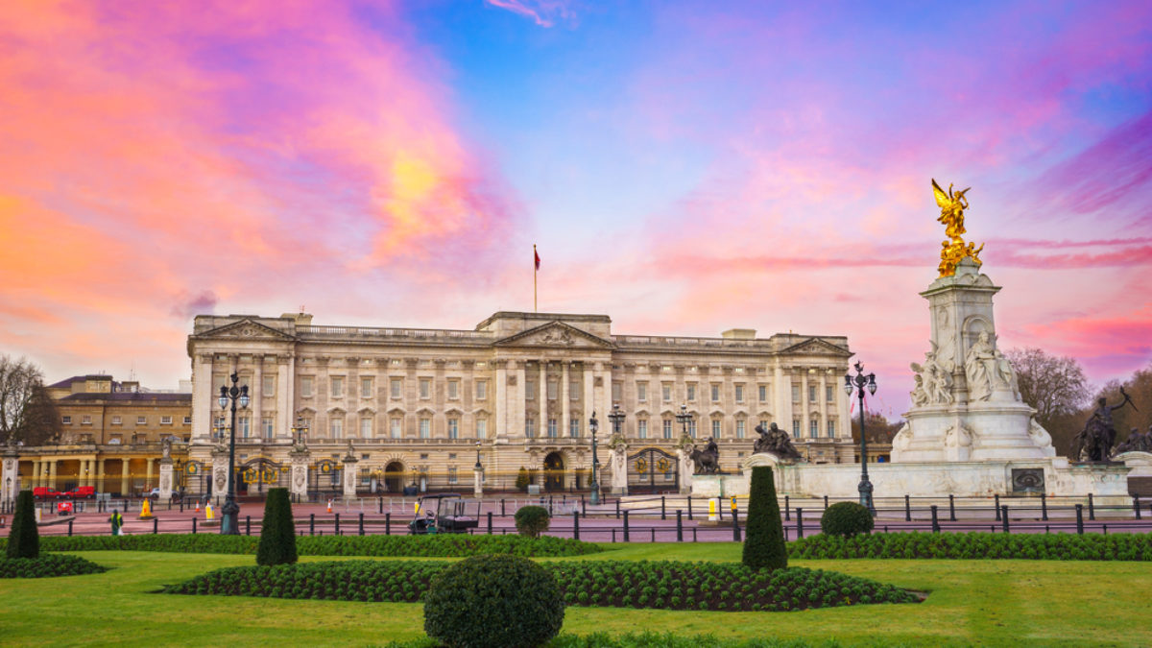
HW
4b Write description using these notes
Buckingham Palace, London
Originally a country house for Duke of Buckingham – converted to palace 1825 (architect = Nash)
Official royal residence 1837 – present
Façade redesigned 1913 – 429 rooms (78 bathrooms) – employs 335 staff
Buckingham Palace open to public August and September. Also art gallery

Slide 40
Task
Describe one of the places to another student using the language you have studied in this unit make your description sound interesting and exciting. When you have guessed each other’s place move on to another student and repeat the activity

Slide 41
References:
SYDNEY https://www.youtube.com/watch?v=OrIDTJH2ZZM
AUSTRALIA
https://www.youtube.com/watch?v=PdVLk_dPmtc&t=85s
https://www.youtube.com/watch?v=GTRQsa3jpXU
TOURIST ATTRACTION - DEFINITION
https://www.youtube.com/watch?v=umGU4KS8pI8

