Slide 1
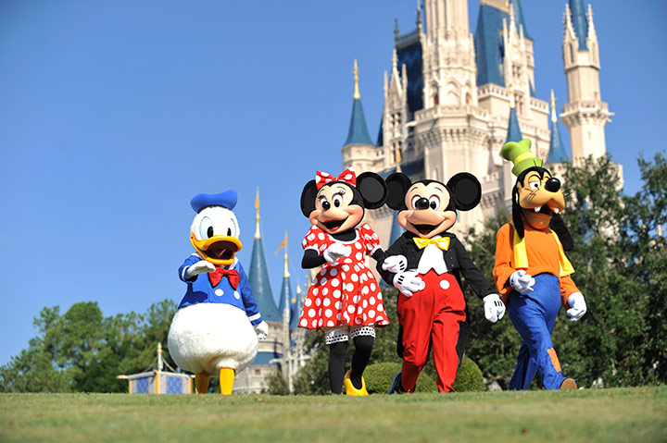
PRACTICE: Theme Park Holidays
Disneyland Paris, page 130

Slide 2
1. page 130, Discuss these questions
1. Have you ever been to theme park or amusement park?
2. What kind of attractions did you find there?
3. What was your favourite?
4. What are:
  a ghost train?
  a haunted house?
  a rollercoaster?
  a white knuckle ride?
  a big wheel?

Slide 3
2. page 130, Like most theme parks, Disneyland ® Paris is divided into several different ‘lands’. Which is based mainly on the American theme? What would you expect to find in each of these lands?
Main Street
Discoveryland
Adventureland
Fantasyland
Frontierland

Slide 4
3. page 130, Which of the ‘lands’contains attractions concerned with the following:
a. distant lands, a jungle, and a mysterious island?
b. fairy tales and magic castles?
c. shops and restaurants from America at the turn of the century?
d. space and technology?
e. cowboys and Indians?

Slide 5
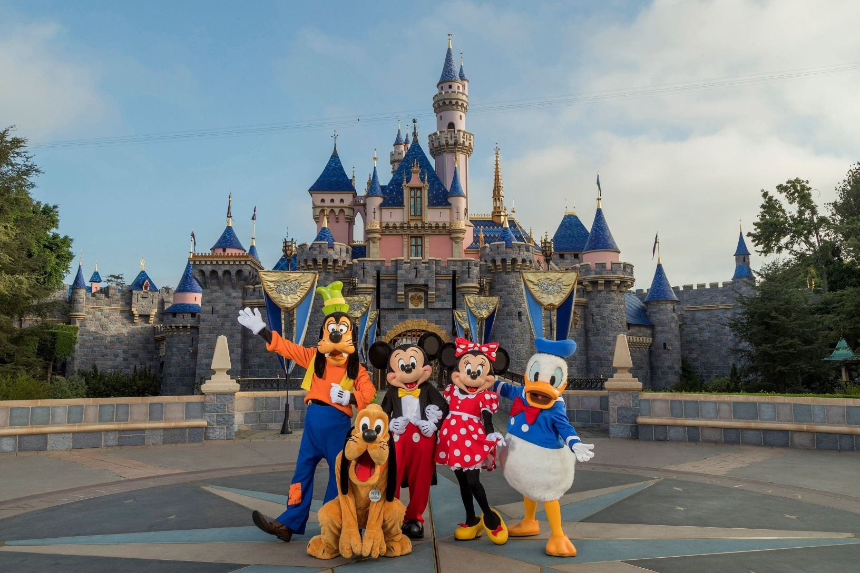
Watch top ten Disneyland rides https://www.youtube.com/watch?v=9we8JPMAH4M

Slide 6
4. page 130, What do you think happens in each of the following rides and attractions – and which land would you find them in?
1. Space Mountain
2. Pirates of the Carribean
3. Snow White
4. Big Thunder Mountain
5. Phantom Manor
6. Indiana Jones TM and the Temple of Peril
7. Star Tours
8. Sleeping Beauty’s Castle

Slide 7
6. page 130, Where in the theme park would you advise these visitors to go – not to go?
a. a family with two children aged three and five
b. someone interested in space and technology
c. a pregnant mother and her three-year-old child
d. two teenage friends
e. a person with a heart condition
f. the person sitting next to you/colleague
g. a member of your own family
h. your teacher

Slide 8
‘suggestion’ phrases reminder
Why don’t you PICK
How about/What about SEEING.....
If I WERE you, I WOULD GO...
I suggest TRYING OUT
Have you considered USING
I ADVISE YOU NOT TO TAKE

Slide 9
Planning a Theme Park, page 133
OUTPUT TASK

Slide 10
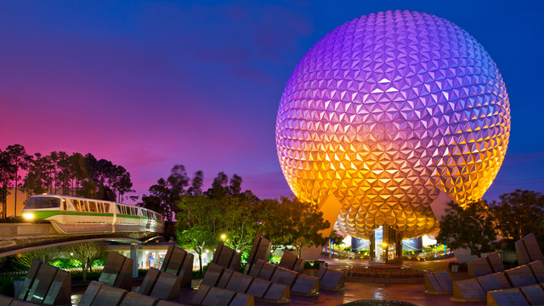
http://www.wikihow.com/Build-a-Tourist-Attraction-in-Lesotho https://disneyworld.disney.go.com/destinations/epcot
Walt Dysney World® in Florida

Slide 11
Planning a Theme Park
Epcot at Walt Dysney World® in Florida is a theme park which consists of two parts: Future World, which explores the role of communications, transport, agriculture, and energy and also looks at the world of imagination, and World Showcase, which examines the world around us, recreating the sights and the smells of such far apart places as Britain/London and China/Beijing.

Slide 12
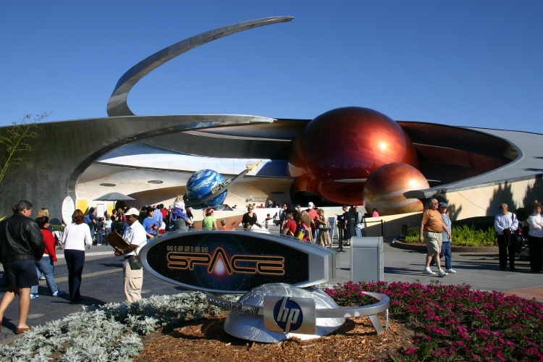
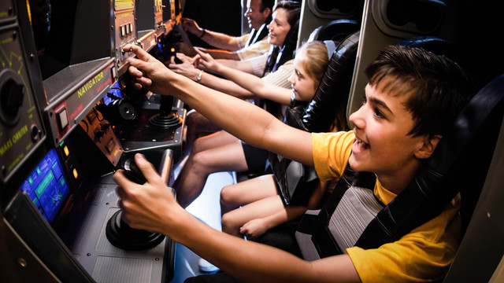
Future World

Slide 13
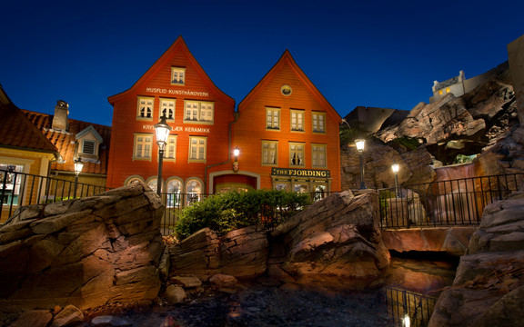
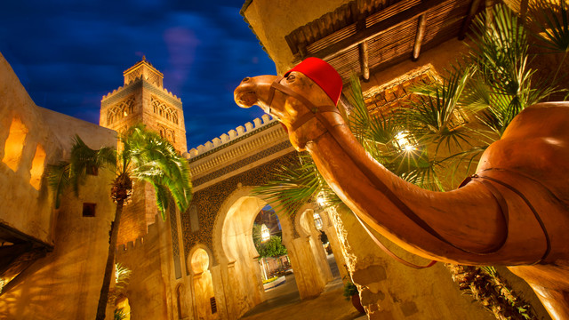
1. page 133, In the World Showcase there are exhibitions on the following countries:

Slide 14
1. page 133, If you were designing your own World Showcase Theme Park, what exhibits would you build for each of the countries. Would you add some other countries?
UK exhibits
half-timbered houses (Stratford-upon-Avon)
warm beer in a traditional pub
red telephone boxes (booths)
a tea shop in a country cottage (Stamford)

Slide 15
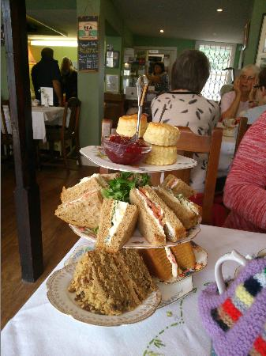
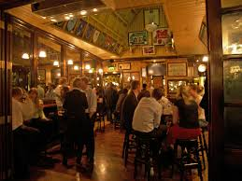
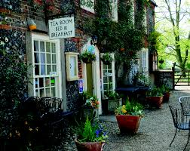
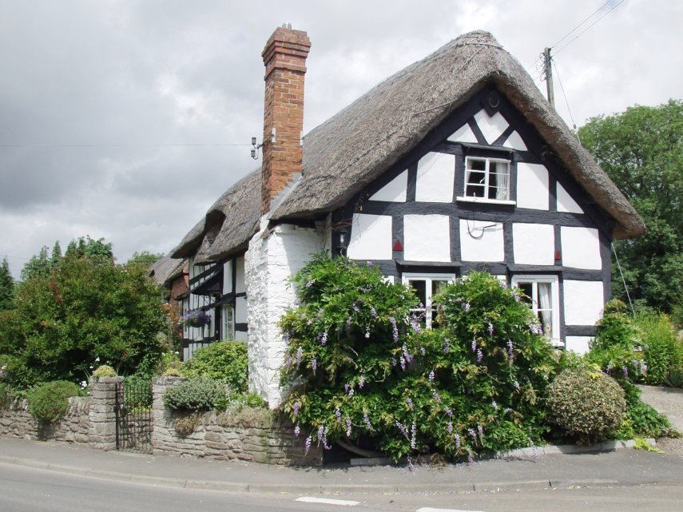
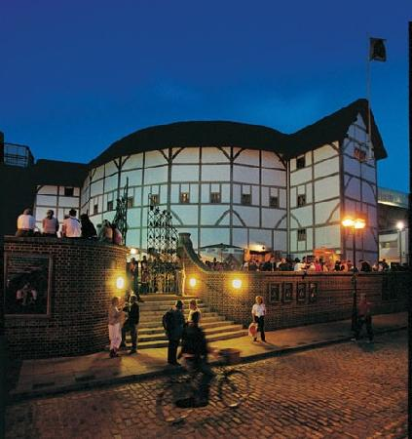
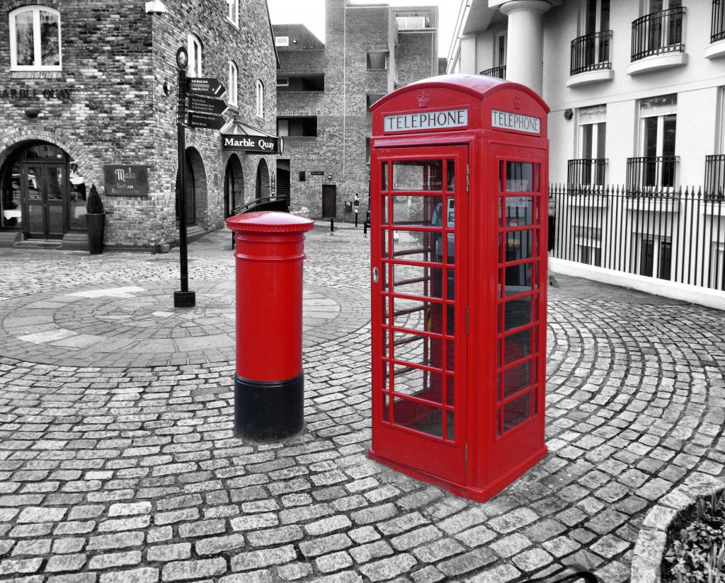
UK

Slide 16
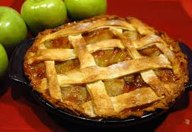
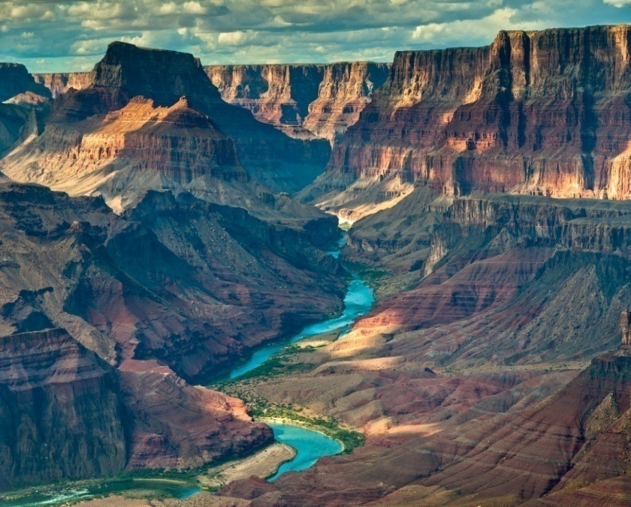
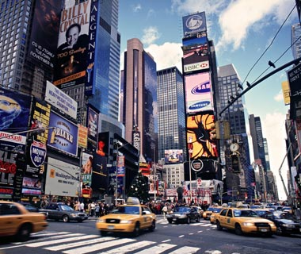
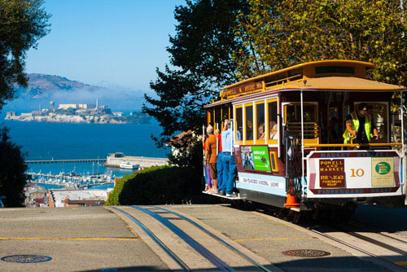
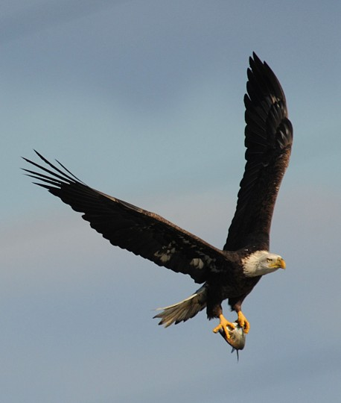
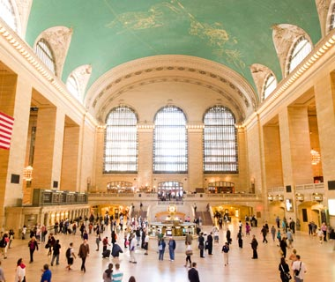
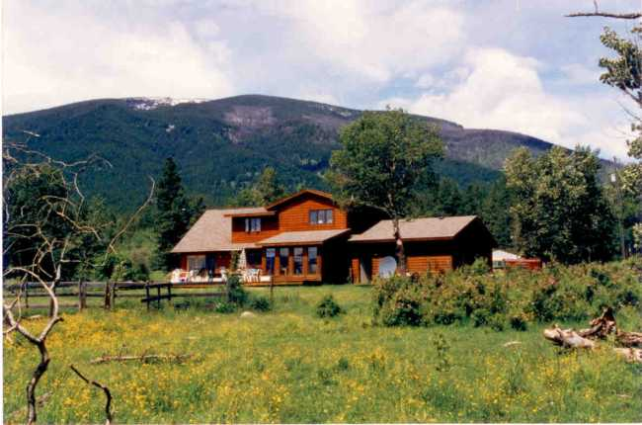
US

Slide 17
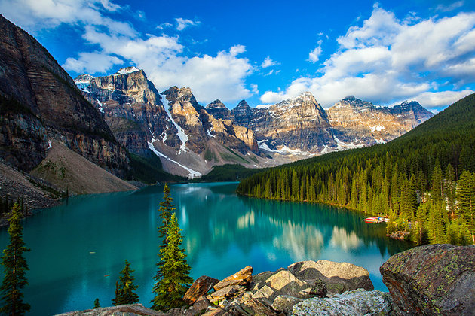
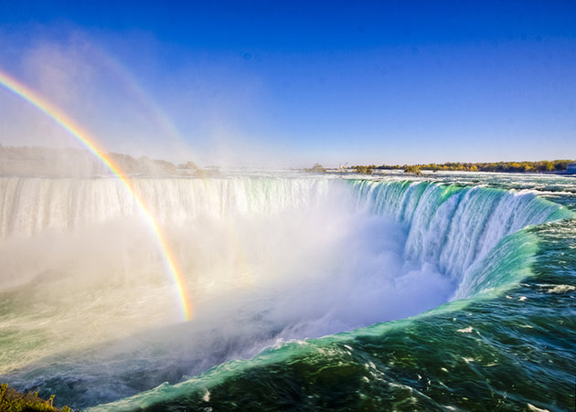
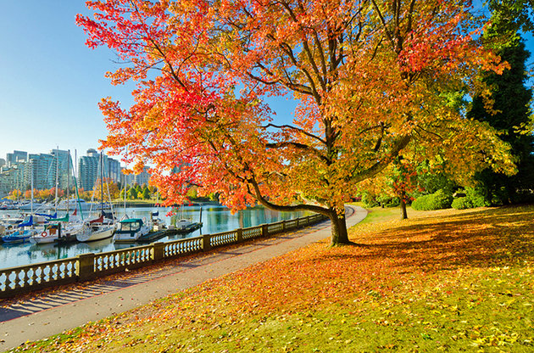
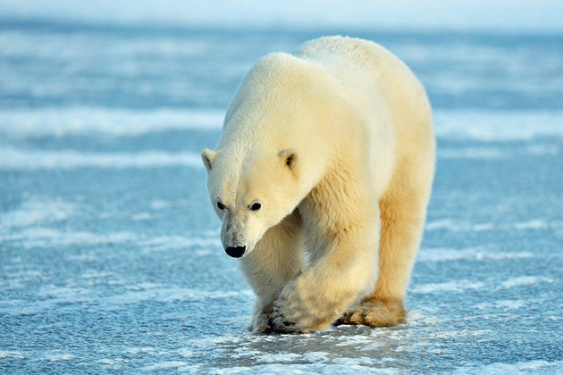
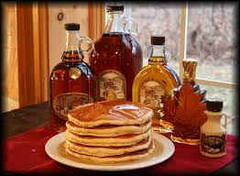
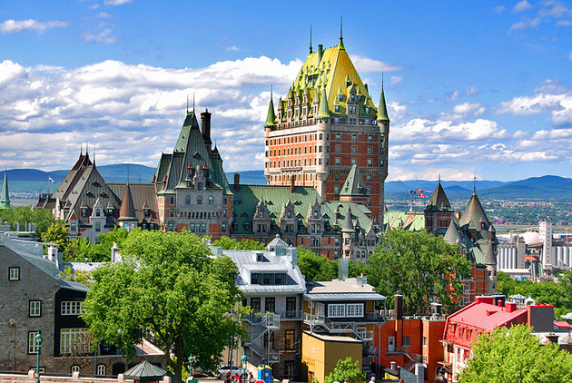
Canada

Slide 18
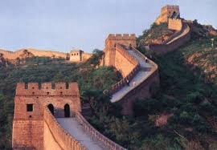
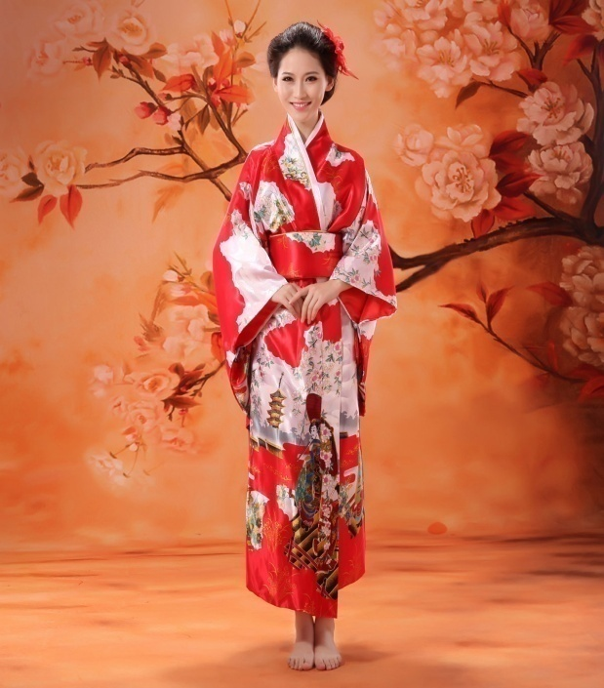
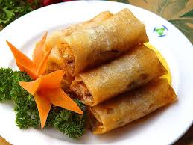
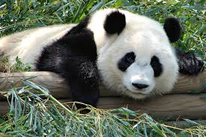
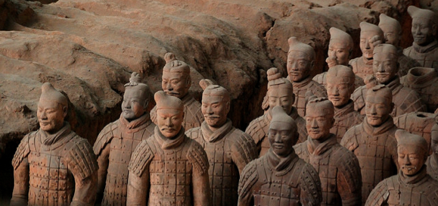
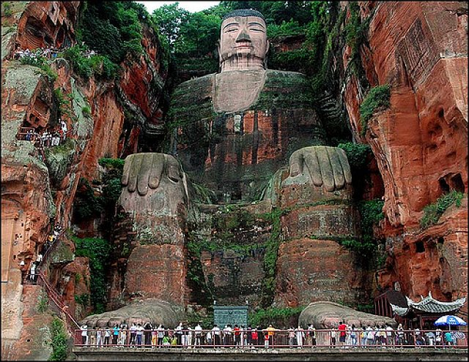
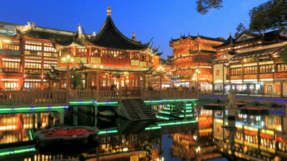
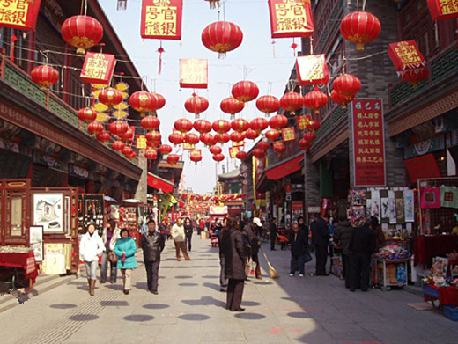
China

Slide 19

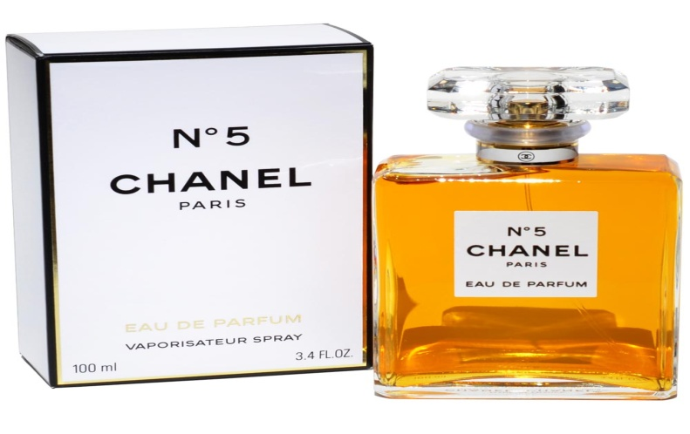
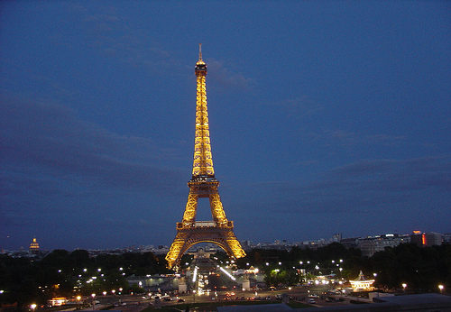
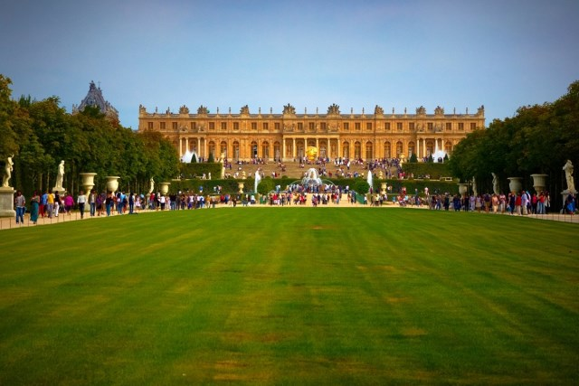
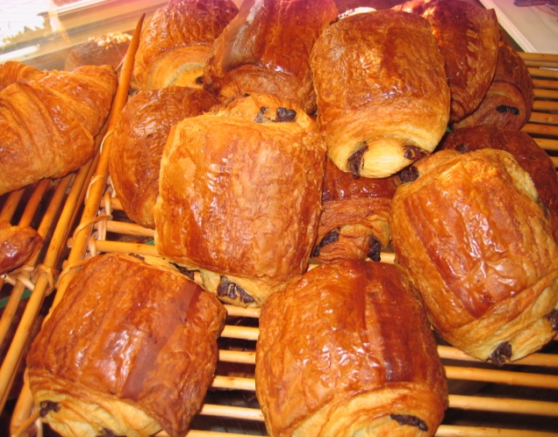
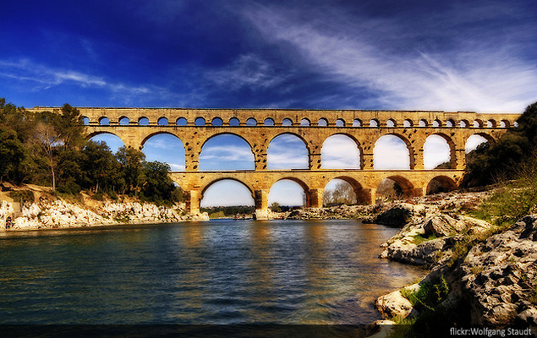
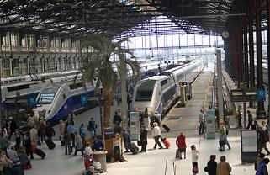
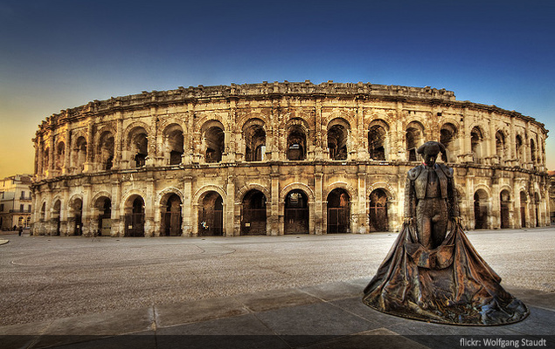
France

Slide 20
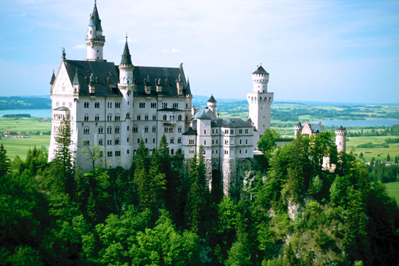
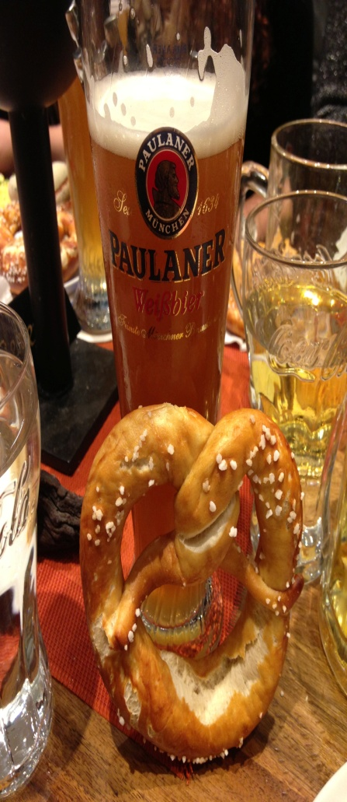
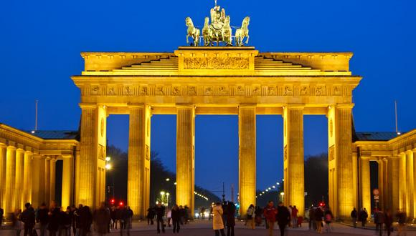
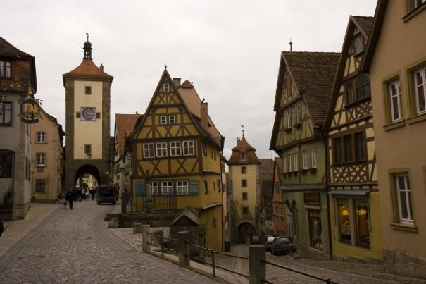
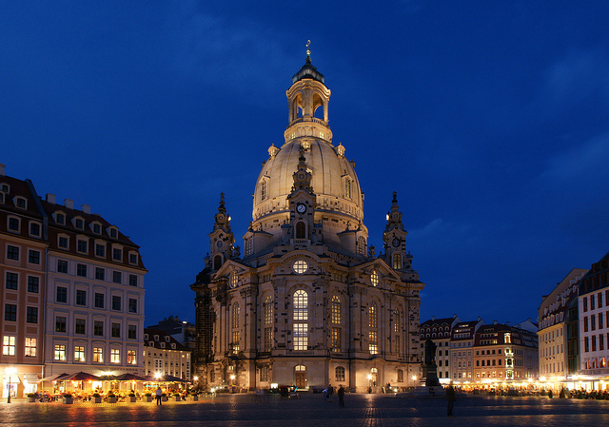
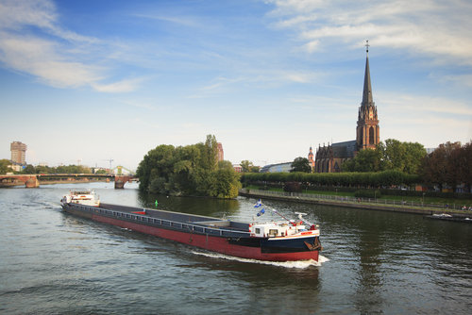
Germany

Slide 21
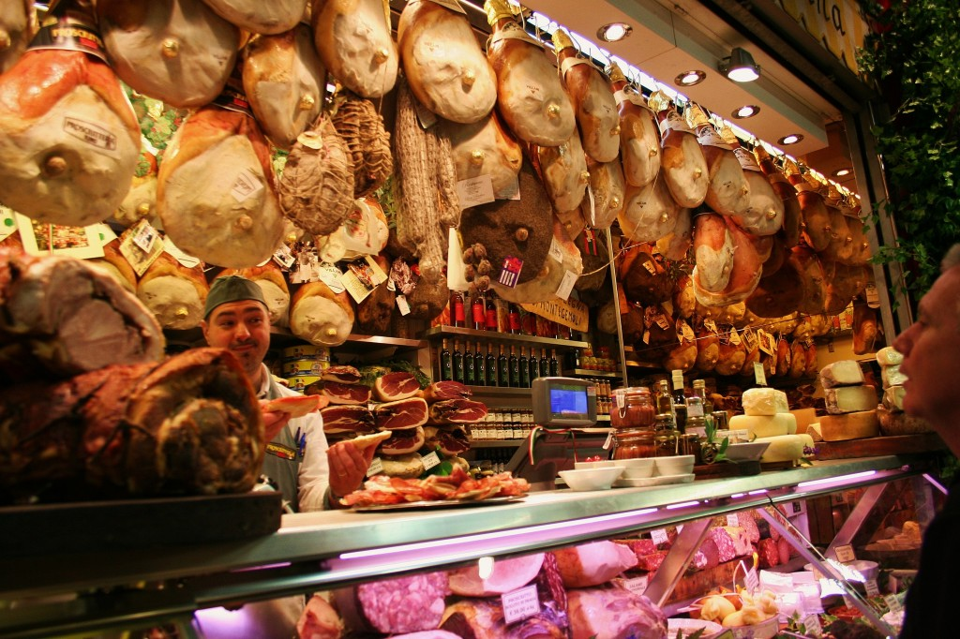

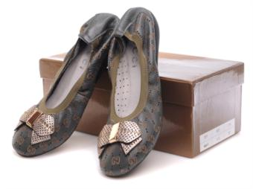
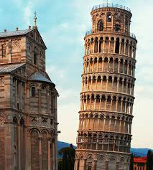



Italy

Slide 22






Japan

Slide 23






Mexico

Slide 24






Morocco

Slide 25







Norway

Slide 26
key words
Disneyfication
simulation
immersiveness
tourism experience
augmented reality/holograms
animatronics
storytelling
creative economy
https://www.travelchannel.com/interests/amusement-parks/photos/best-theme-parks-for-the-holidays

Slide 27
2. page 133, Find a Theme
Decide your policy on facilities&services
currency/payment (e.g. token)
age limit/height limit
pregnant women/small children/mother&child (child care)
pets
tickets
cloakroom&lockers
disabled persons
surgery&ambulance
accommodation
(theming of) cafes and restaurants
celebrations (birthdays)
food&beverage consumption
group visits&special offers
architecture&style
other facilities (ATMs, exchange offices, hospitality desk, passport, ticket upgrades, special dietary requests)

Slide 28
References
THEME PARKS https://www.travelchannel.com/interests/amusement-parks/photos/best-theme-parks-for-the-holidays
TOP TEN Disneyland RIDES https://www.youtube.com/watch?v=9we8JPMAH4M
EPCOT, Disneyland
https://disneyworld.disney.go.com/destinations/epcot
HOW TO BUILD A TOURIST ATTRACTION
http://www.wikihow.com/Build-a-Tourist-Attraction-in-Lesotho

