Slide 1
A Four Day Tour of Scotland and the English Lakes – Lake District
A Tour of Scotland

Slide 2


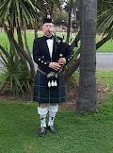
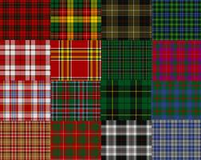
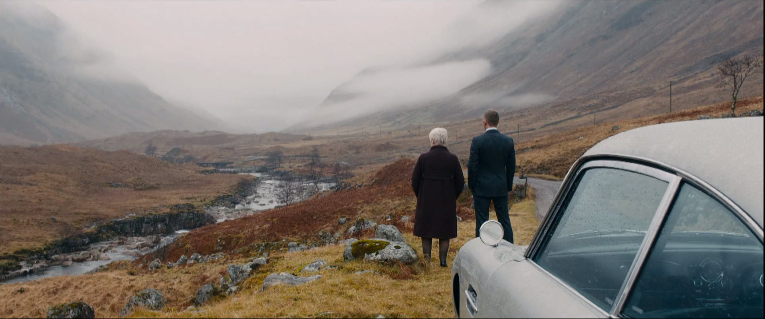
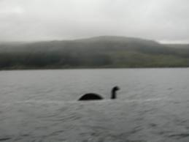
Scotland

Slide 3
LOCH is a Scottish word for:
monster
sea
lake

Slide 4
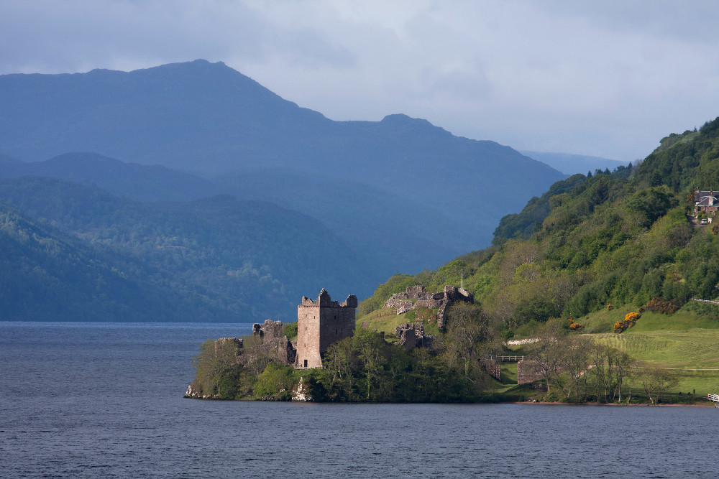
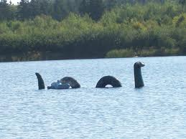

Slide 5
TARTAN is a Scottish word for:
sauce for fish and chips
cloth denoting a clan
fruit of very sour taste

Slide 6

CLOTH DENOTING A CLAN

Slide 7
HAGGIS AND TATTIES is a Scottish word for:
short trousers
meat dish
brand of beer

Slide 8
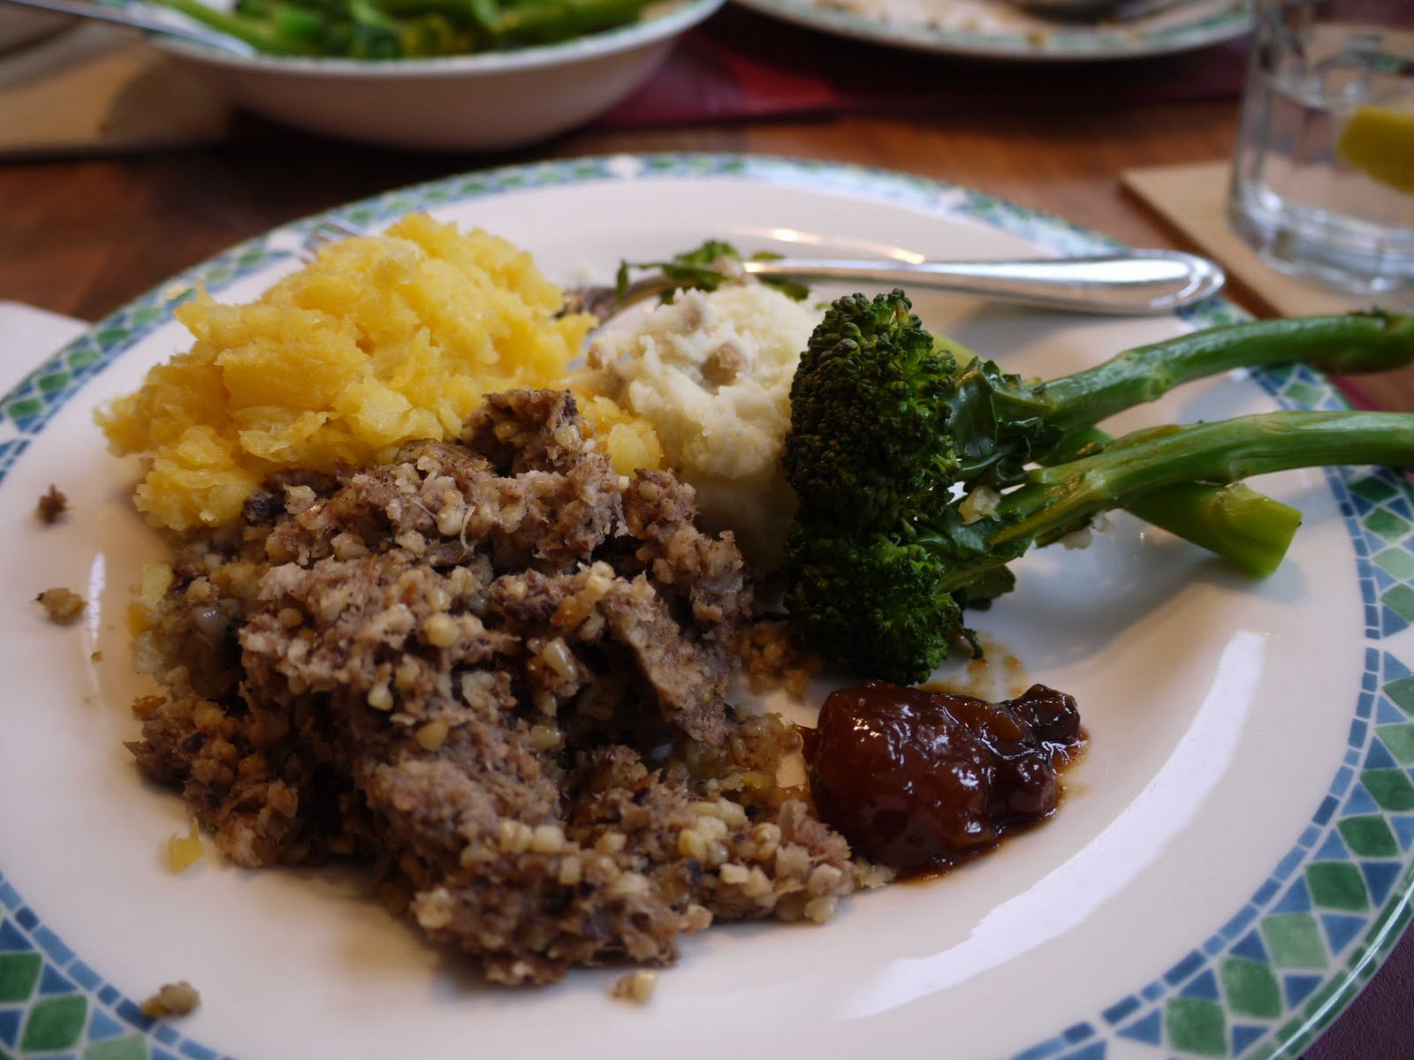
MEAT DISH (sheep’s heart, kidney, liver cooked in sheep’s stomach)

Slide 9
KILT is a Scottish word for:
men’s skirt
Celtic dance
old English word for church

Slide 10
BAGPIPES is:
a rucksack
a music instrument
a Scottish wild animal

Slide 11
MEN’S SKIRT & MUSIC INSTRUMENT

Slide 12
HOGMANAY is celebrated on:
May 1st
September 30th
December 31st

Slide 13
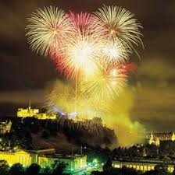
DECEMBER 31st (New Year’s Eve)

Slide 14
Glen is an old word for:
Whiskey
Mountain
Valley

Slide 15
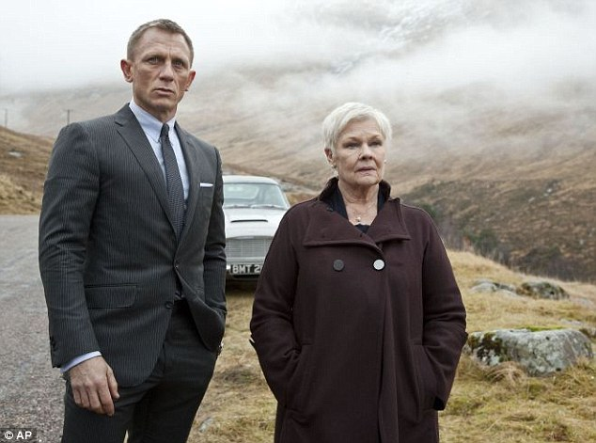
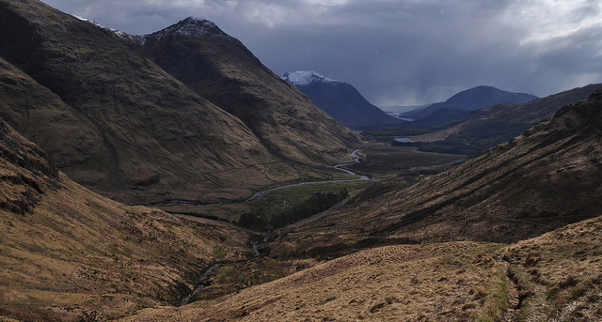
A U-Shaped Valley – Glen Etive, Skyfall

Slide 16

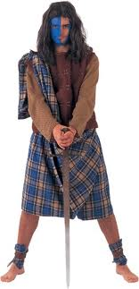
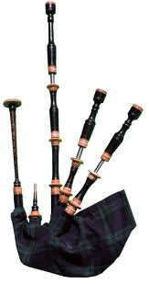

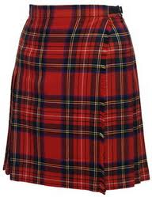
SCOTLAND

Slide 17
SCOTLAND
independence?
tartan
clan
tweed
Mc
bagpipes
kilt
whiskey - Scotch
thistle
highlanders
Nessie
Harry Potter (Glencoe)
Skyfall (Glen Etive)

Slide 18
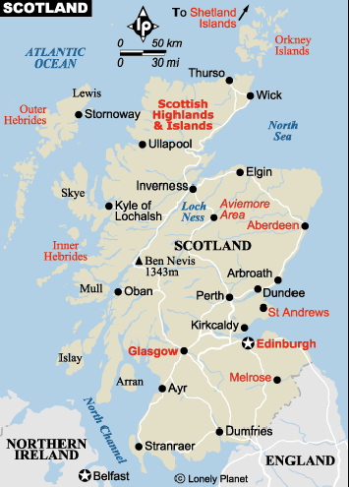

Slide 19
What would you like to know about the tour?
1. as a potential passenger?
2. as a tour guide?
https://www.youtube.com/watch?v=XKYIL1qnh1Y

Slide 20
The package includes:
Accommodation in a four-star hotel in Edinburgh
Northumbria National Park
A guided sightseeing tour of Edinburgh
A visit to a whiskey distillery (including a free tasting with instruction)
A full-day excursion to the rugged Trossach mountains and Loch Lomond (optional cruise on the loch)
A visit to traditional tweed and woolen mill

Slide 21
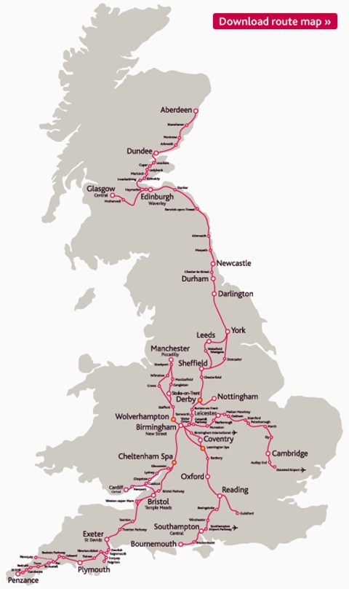
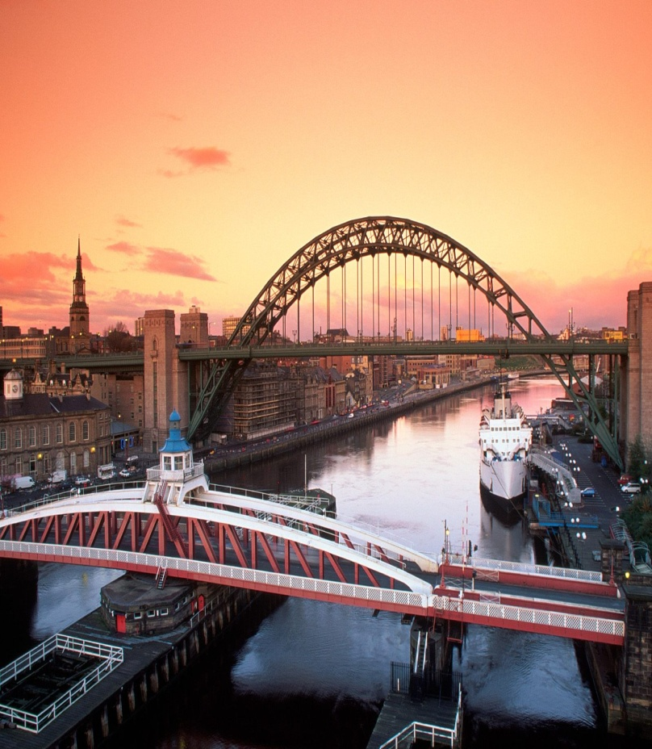
DAY 1
NEWCASTLE
https://www.youtube.com/watch?v=R_O-PPYN0Rw

Slide 22
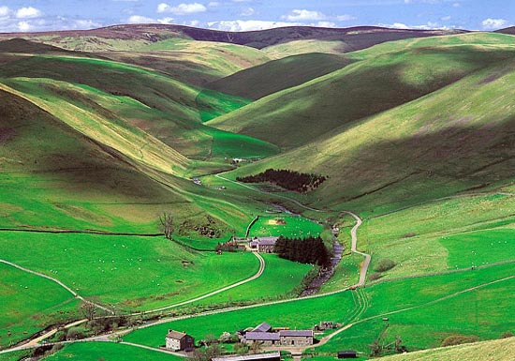
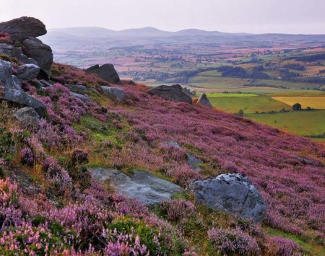
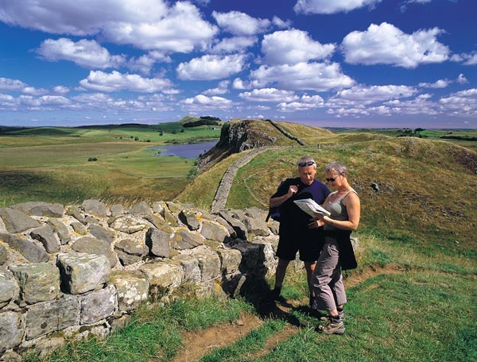
Northumbria National Park – scenic drive www.northumberlandnationalpark.org.uk
England’s most tranquil
place, whose dramatic hills
and sheltered valleys stretch
from Hadrian Wall to the
Scotish border.

Slide 23
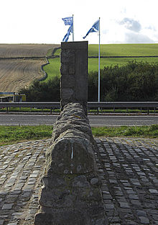
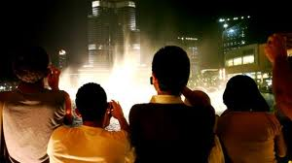
photo-stop = a stop to take photos

Slide 24
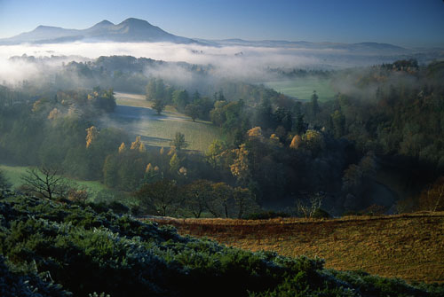
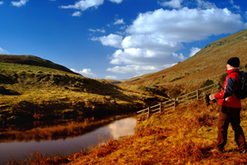
Cheviot Hills

Slide 25
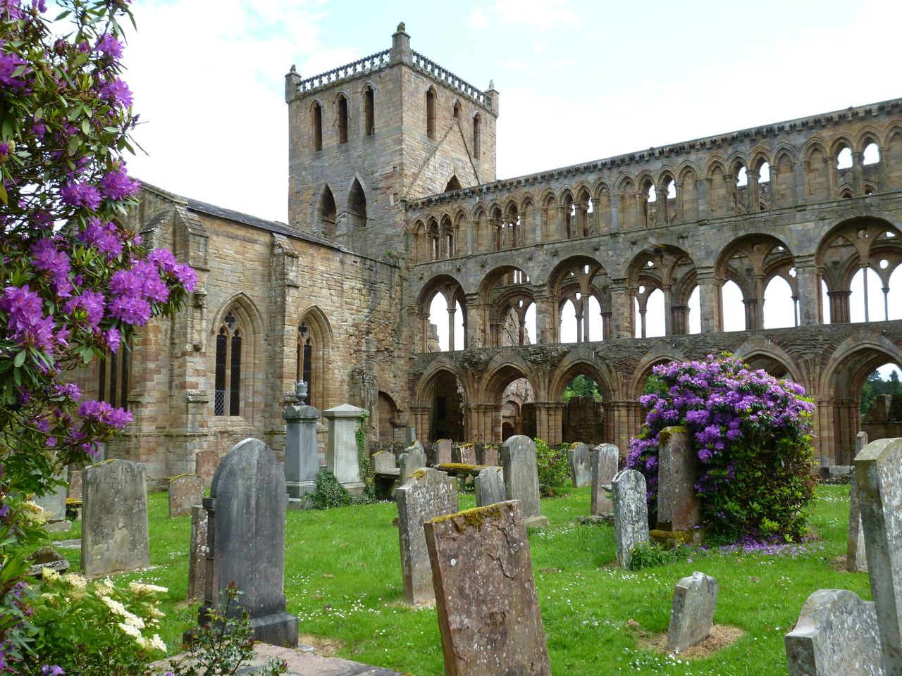
Passing through Jedburgh with its beautiful abbey (srb.opatija, samostan)
abbey = large church with buildings for monks or nuns

Slide 26
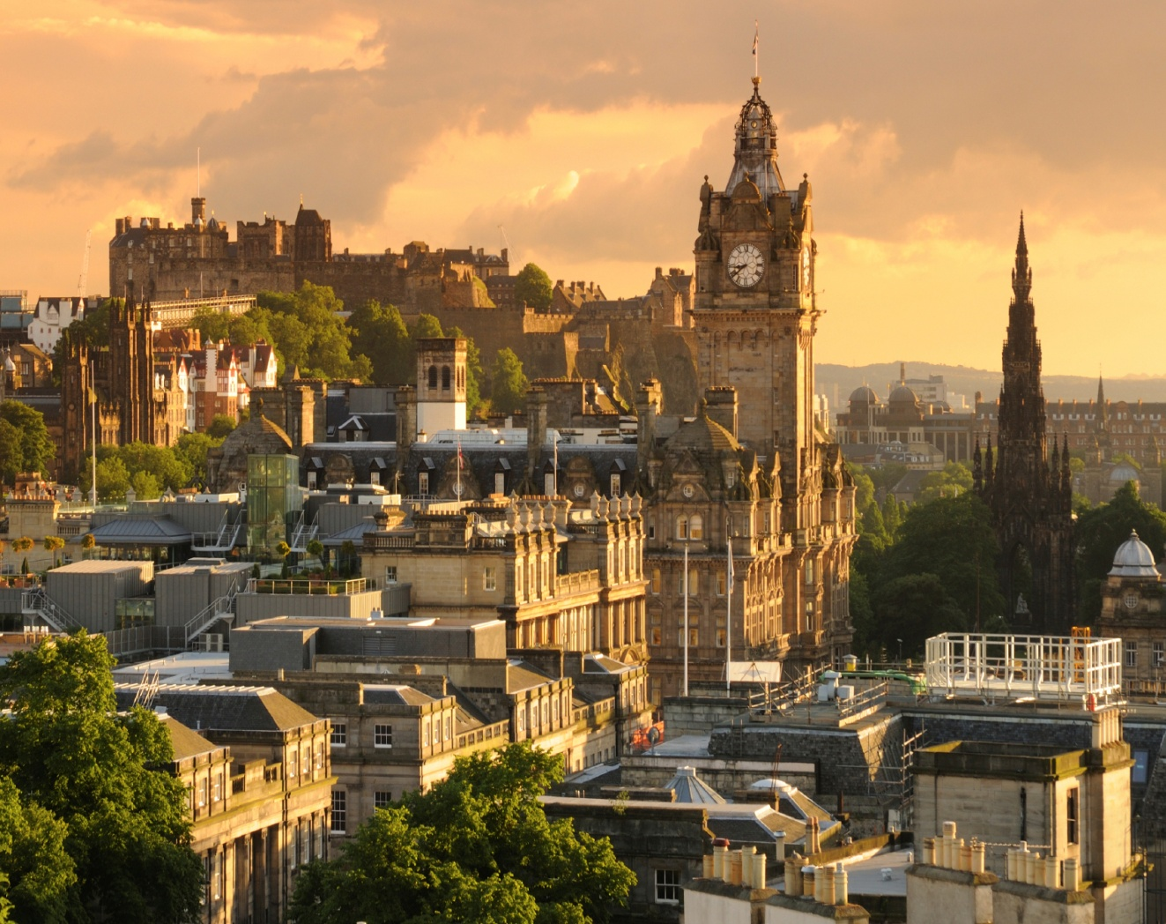
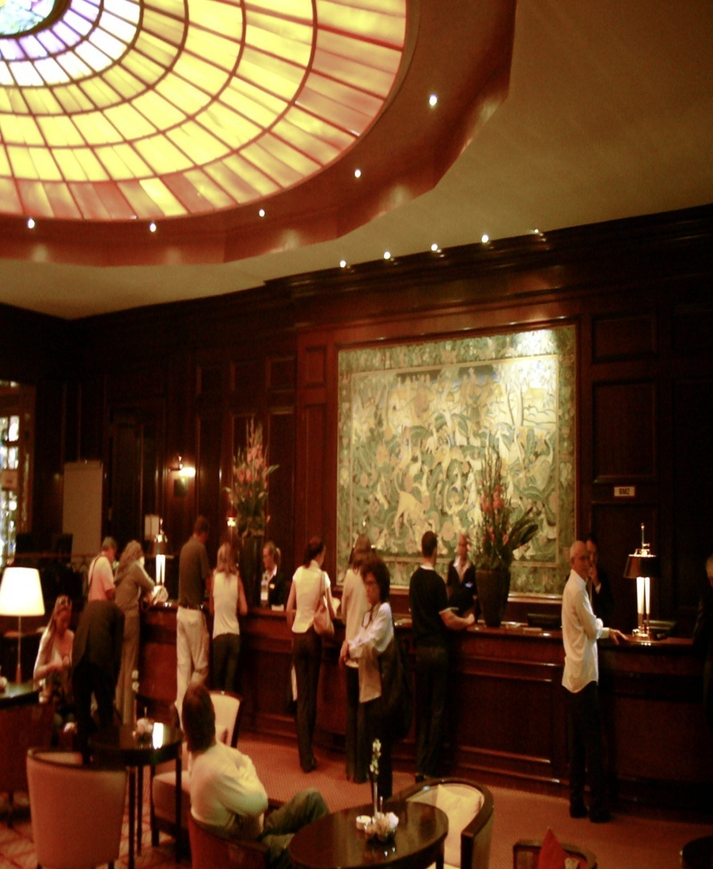
Edinburgh /edinbrä/ https://www.youtube.com/watch?v=9COgMvRnnrY

Slide 27
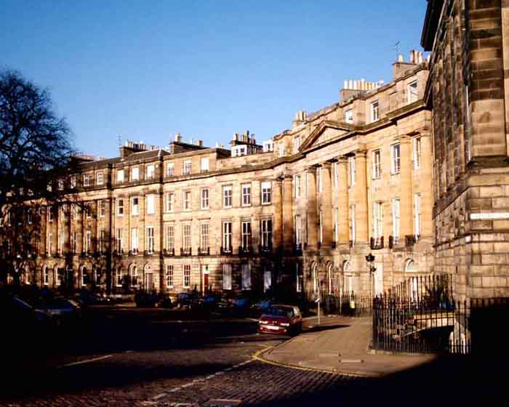
DAY 2 - Sightseeing
EDINBURGH
NEW TOWN

Slide 28
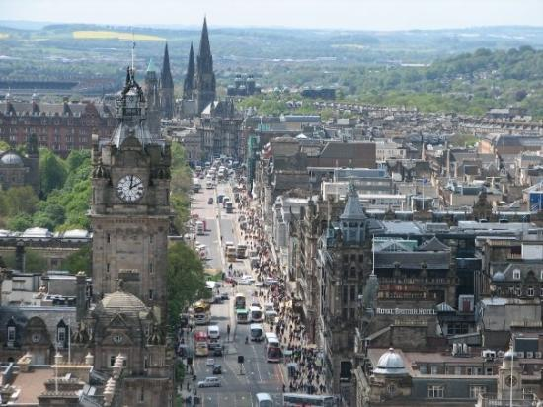
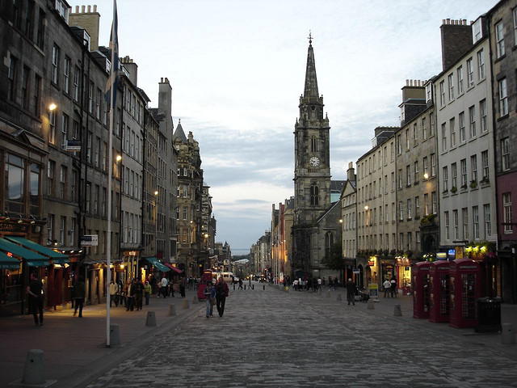
Princess Street&Royal Mile

Slide 29
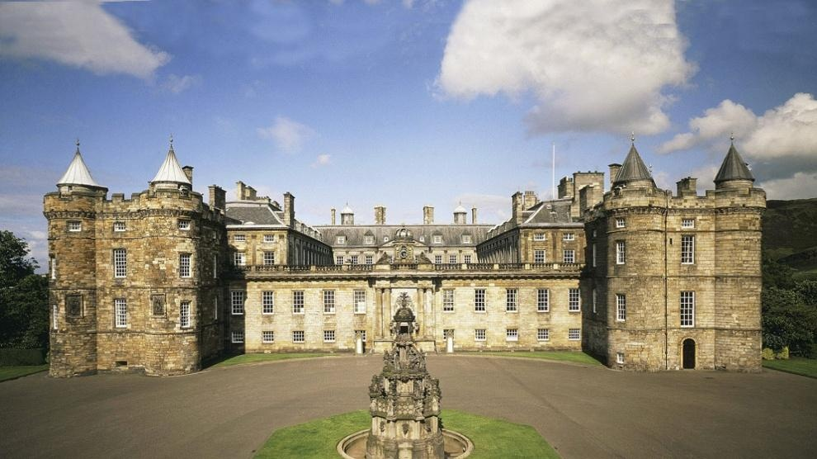
Holroyd House

Slide 30
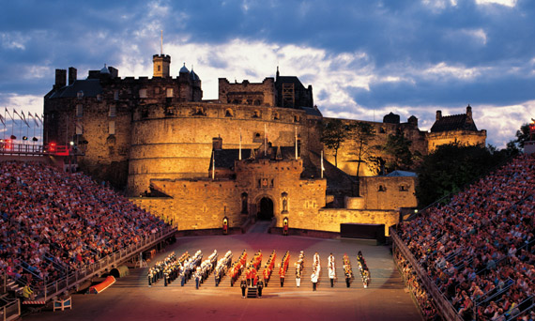
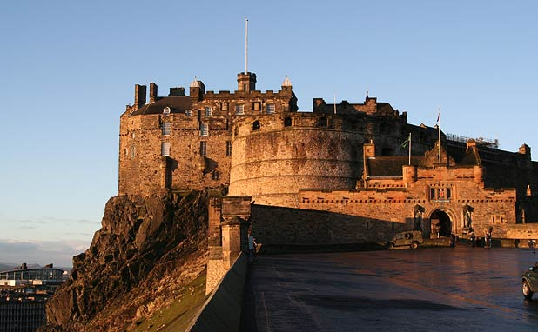
Edinburgh Castle

Slide 31
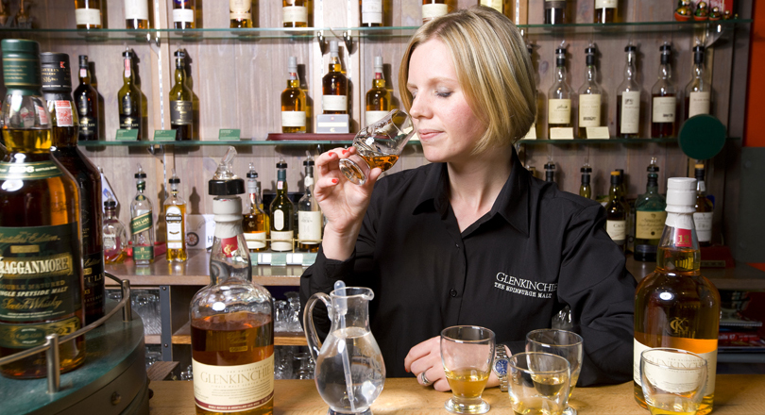
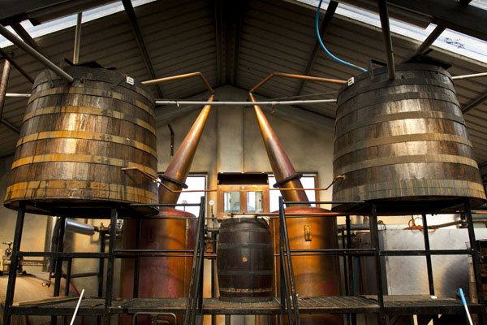
Glenkinchie Whiskey Distillery
distillery – factory producing strong alcoholic drinks

Slide 32



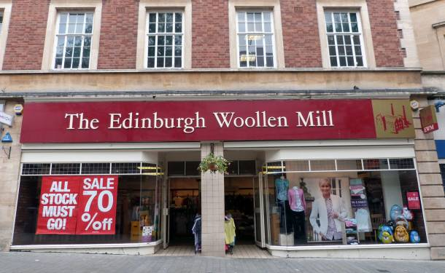
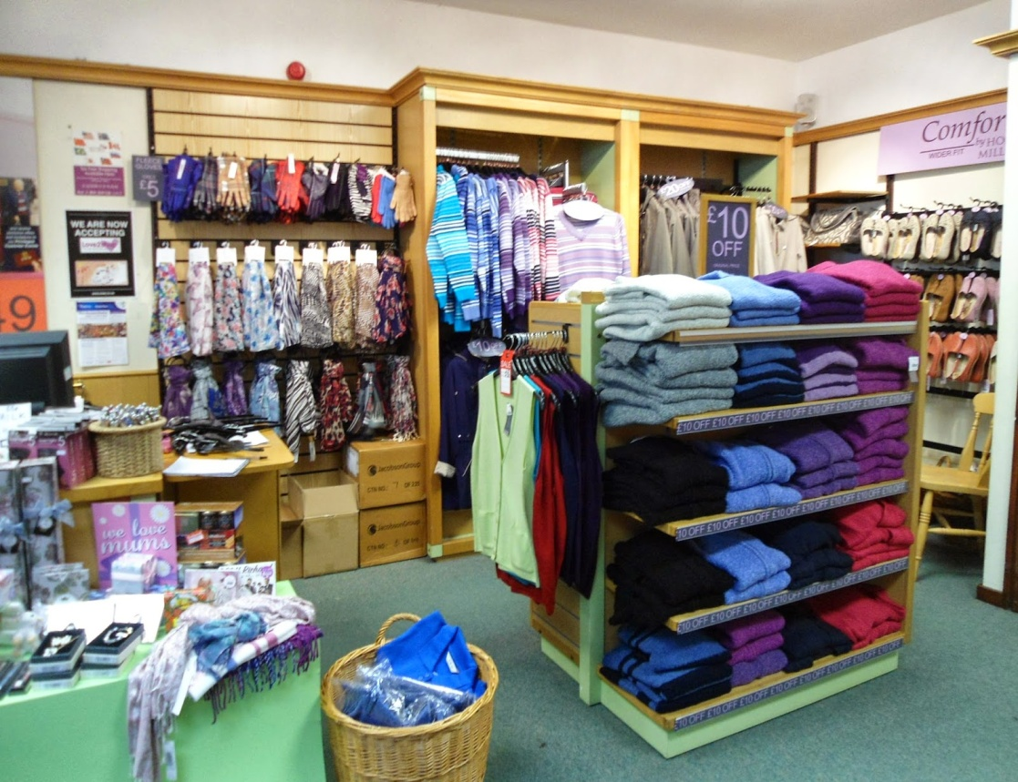

Slide 33
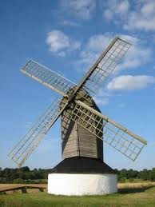
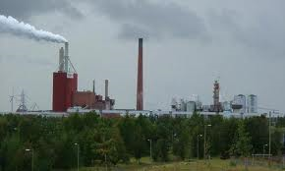
mill – 1. windmill, watermill
2. factory (paper, steel, cotton)

Slide 34

tweed (štof) – rough woollen fabric with different colour patterns
tartan (karirano) – cloth denoting a clan, checked pattern

Slide 35
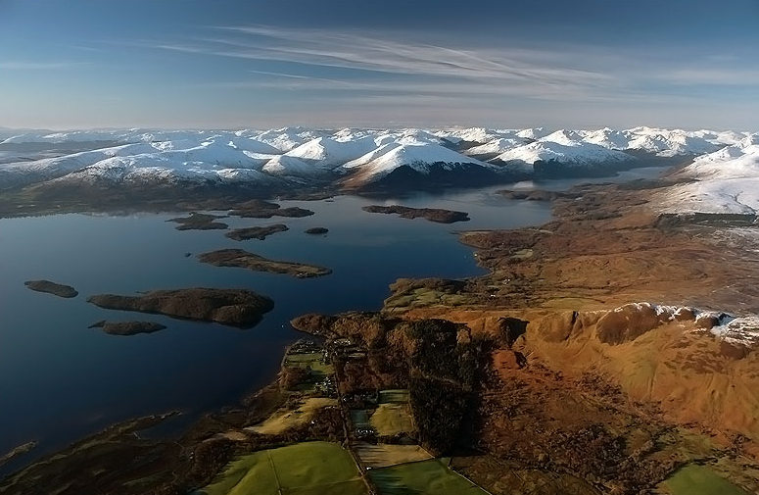
DAY 3
Trossach Mountains&Loch Lomond https://www.youtube.com/watch?v=k2bn0byoTB8
LOCH = LAKE
OPTIONAL you can choose to do it or not
opp. Mandatory, Obligatory
you have to do it

Slide 36
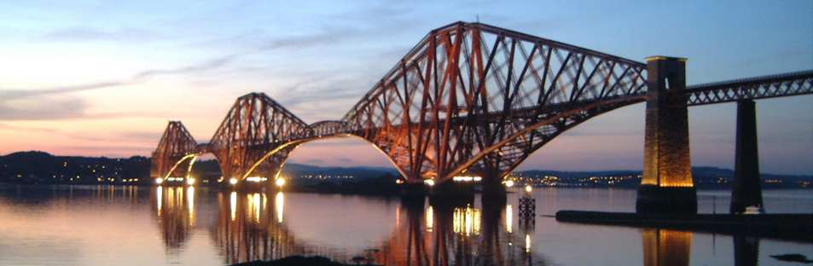
Photo- Stop at Forth Williams railway bridge

Slide 37
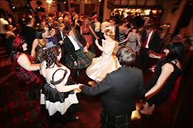
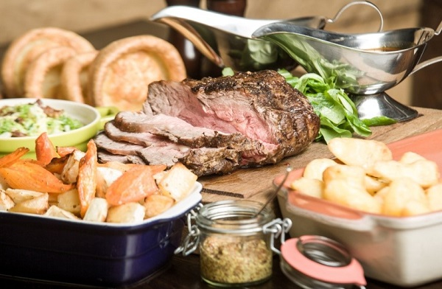
Scottish Evening https://www.youtube.com/watch?v=E5lmA8LEMEE

Slide 38
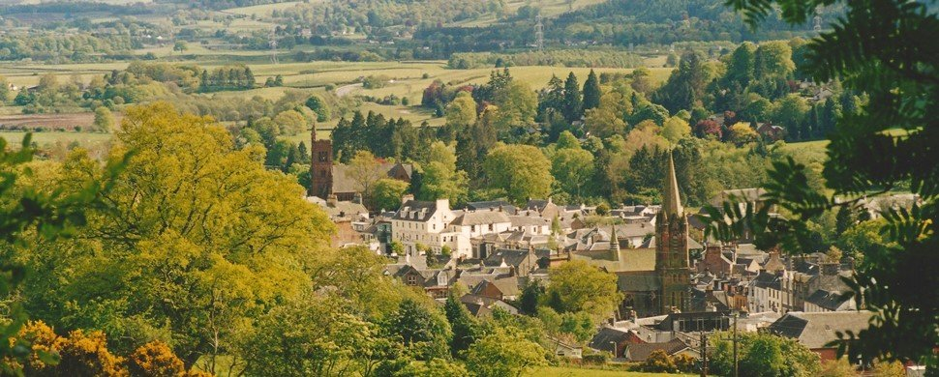
Day 4 stunning (impressive) scenery in Moffat

Slide 39
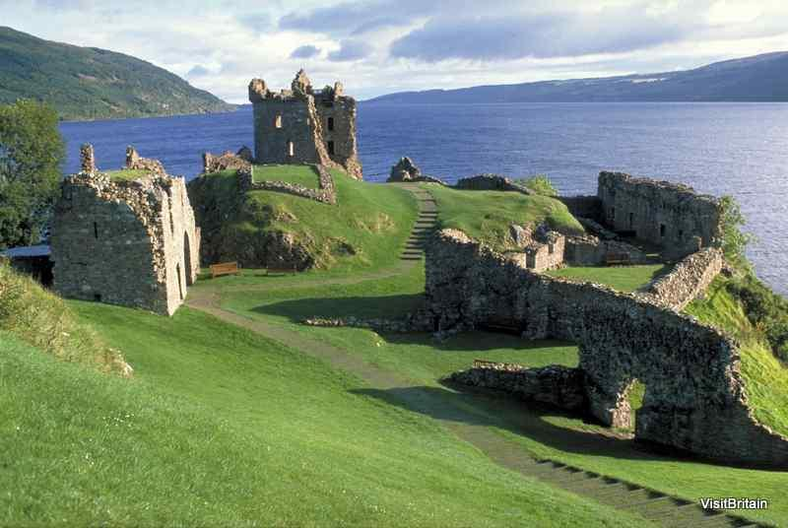
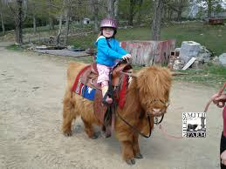
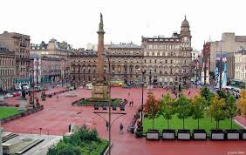
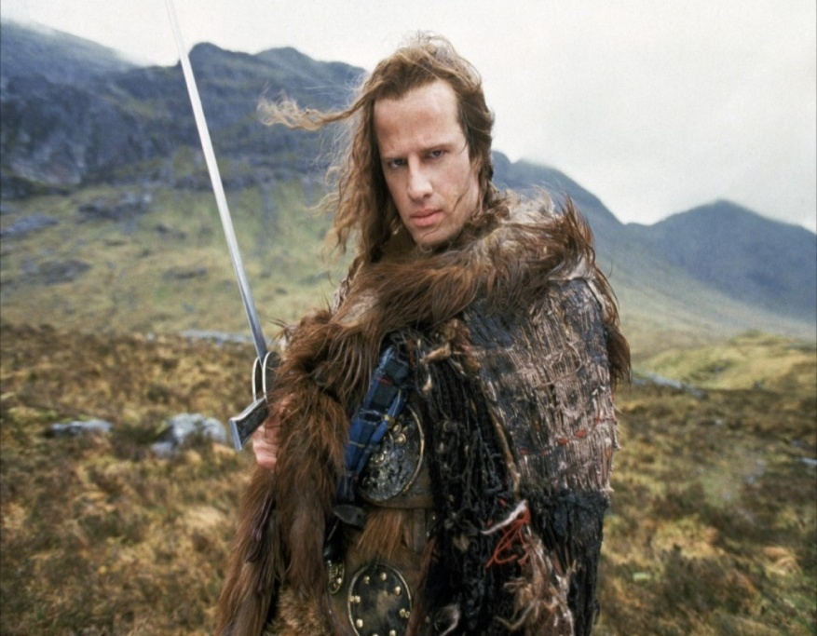
It is also worth visiting...
The Highlands – Ben Nevis

Slide 40
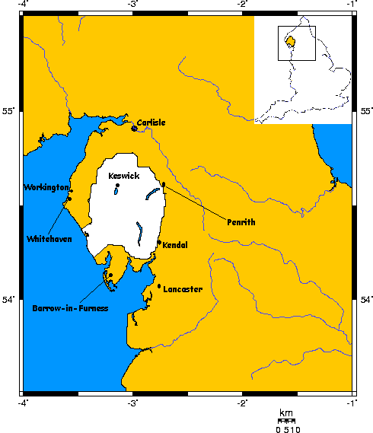
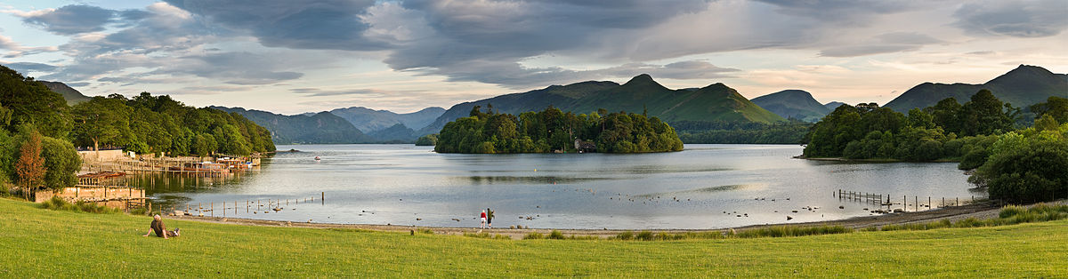
Lake District https://www.youtube.com/watch?v=JycSl4egVVI
21 large water bodies
I wondered lonely as a cloud...
William Wordsworth

Slide 41
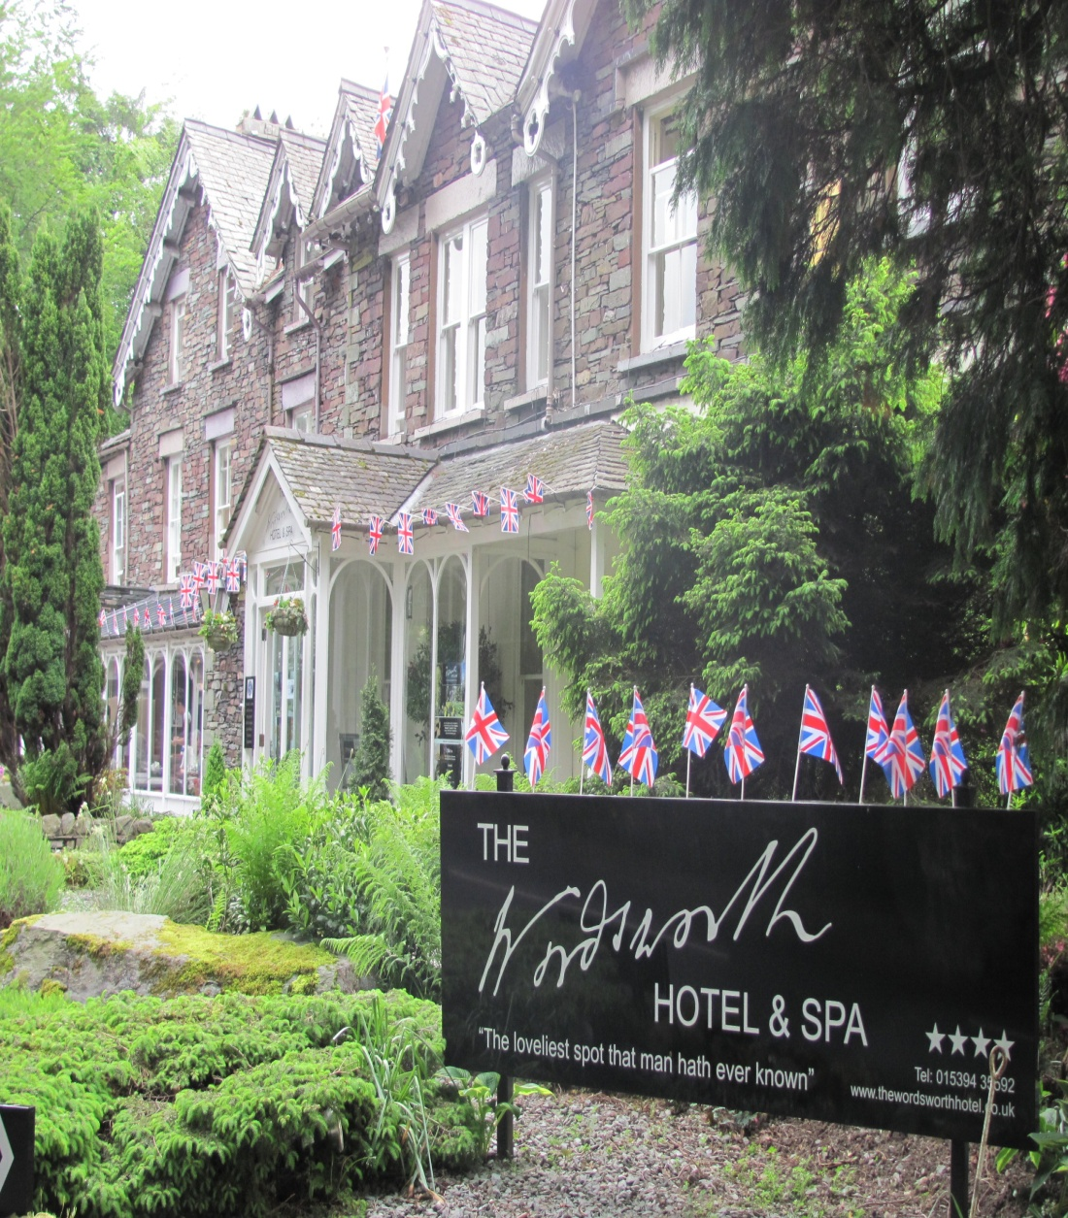

Grasmere

Slide 42
3. page 143, Read the description again and answer these questions.
1 Which cities are visited?
2 How many nights’ accommodation are included?
3 What is the accommodation like?
4 What meals are included?
5 Are there any special visits or excursions?
6 What attractions are there on the journey back?
7 Where and when is the pick-up point?
8 Are gratuities included in the price?

Slide 43
References
Introducing Scotland https://www.youtube.com/watch?v=XKYIL1qnh1Y
Top 10 Reasons to Make Scotland Your Next Destination
https://www.youtube.com/watch?v=SiQlogeUwuI&t=71s
Newcastle https://www.youtube.com/watch?v=R_O-PPYN0Rw
Edinburgh
https://www.youtube.com/watch?v=9COgMvRnnrY
Loch Lomond https://www.youtube.com/watch?v=k2bn0byoTB8

Slide 44
Reference:
Scottish whiskey: https://www.youtube.com/watch?v=ZNe4ZRFx9oY
Scottish evening
https://www.youtube.com/watch?v=E5lmA8LEMEE
The Lake District https://www.youtube.com/watch?v=pb_BnVQ_Mv4
https://www.youtube.com/watch?v=JycSl4egVVI

Slide 45


Thank you for your Attention!

