Slide 1
Voicemail Messages
Unit 10 Guiding, p. 137-141

Slide 2
Vocabulary
Page 140

Slide 3
Here are some words and expressions often used when booking a guide
a) abbreviation for passengers
b) place, usu. at a hotel or conference, where visitors can get help and advice
c) place where the guide and the coach meet the passengers
d) a percentage paid to someone for bringing customers to a shop or other service
e) written details of which rooms visitors are staying in at a hotel
f) a general sightseeing tour
g) a ticket which a guide can use instead of cash to take a group into a famous place
h) a trip offered to a group of employees as a reward for a good work
i) taking a group of visitors from their place of arrival to their hotel
j) money given to someone to say ‘thank you’
i pick up point
ii voucher
iii transfer
iv gratuity (‘grat’)
v pax
vi incentive tour
vii hospitality desk
viii commission
ix panoramic tour
x rooming list

Slide 4
Here are some words and expressions often used when booking a guide
a) abbreviation for passengers
b) place, usu. at a hotel or conference, where visitors can get help and advice
c) place where the guide and the coach meet the passengers
d) a percentage paid to someone for bringing customers to a shop or other service
e) written details of which rooms visitors are staying in at a hotel
f) a general sightseeing tour
g) a ticket which a guide can use instead of cash to take a group into a famous place
h) a trip offered to a group of employees as a reward for a good work
i) taking a group of visitors from their place of arrival to their hotel
j) money given to someone to say ‘thank you’
i pick up point
ii voucher
iii transfer
iv gratuity (‘grat’)
v pax
vi incentive tour
vii hospitality desk
viii commission
ix panoramic tour
x rooming list

Slide 5
Voicemail messages
LISTENING 1, page 139

Slide 6
How to Be a Good Guide page 137,
1&2 What does the tour guide have to do? What does the job involve?
Make two lists
a. the things a tour guide must do/is responsible for?
b. the personal and professional qualities needed
Compare with the things Jenny Townsend mentions in the text How to Be a Good Guide.
Add the extra items to your list.

Slide 7
How to Be a Good Guide page 137,
 | PERSONAL&PROFESSIONAL QUALITIES | RESPONSIBILITIES | QUALIFICATIONS
1.
2.
3.
4.

Slide 8
How to Be a Good Guide page 137, sample answers
 | PERSONAL&PROFESSIONAL QUALITIES | RESPONSIBILITIES | QUALIFICATIONS
1. | knowledgeable | to educate | at least secondary school education
2. | friendly | to entertain | trained for the licence
3. | helpful | to manage the group | language certificates
4. | well-organized | to promote a destination | first aid course

Slide 9
3. page 137, Read the text again and find words that match the following items.
a) working for oneself, not a particular company
b) a description of action and moving events
c) silly, not serious
d) easy to talk to and ask questions of
e) a planned travel route
f) a person representing his or her country
g) feeling tired and unwell as a result of air travel
h) immediate medical help (after an accident, etc.)
i) to advertize, to publicize
j)careful and skillful management of people and their problem
k) treating someone like a child
l) a very important person

Slide 10
3. page 137, answers
a) working for oneself, not a particular company FREE-LANCE
b) a description of action and moving events COMMENTARY
c) silly, not serious FRIVOLOUS
d) easy to talk to and ask questions of APPROACHABLE
e) a planned travel route ITINERARY
f) a person representing his or her country AMBASSADOR
g)feeling tired and unwell as a result of air travel JET-LAGGED
h)immediate medical help (after an accident, etc.) FIRST AID
i) to advertize, to publicize TO PROMOTE
j)careful and skillful management of people and their problem
HR
k) treating someone like a child PATRONIZING
l) a very important person VIP

Slide 11

4. page 137, Would you like to be a guide? In what ways do you think it would be a good job or a bad job?
The advantages of being a guide are…
The disadvantages are…

Slide 12
1. page 139, Here’s Jenny Townsend Diary Pages for the 5th to the 18th of August. She already had some bookings
AUGUST
5 MONDAY
6 TUESDAY
7 WEDNESDAY Half-day London panoramic (a.m.)
8 THURSDAY York city tour 8.30 a.m. pick-up – back late
9 FRIDAY
10 SATURDAY
11 SUNDAY
AUGUST
MONDAY 12
TUESDAY 13
WEDNESDAY 14
THURSDAY 15 York city tour 8.30 a.m. pick-up – back late
FRIDAY 16
SATURDAY 17 London walking tours – evening pub crawl – 8. p.m.
SUNDAY 18 Lunch at mum’s – no work

Slide 13
Listen to her voicemail messages. Note dates of the job offered. Look at her diary pages (slide 5) and decide if she can do the job.
Message | Date of job | Can do? | Details of job | Who to contact
1.
2.
3.
4.
5.
6.

Slide 14
Listen to her voicemail messages. Note dates of the job offered. Look at her diary pages (slide 5) and decide if she can do the job.
Message | Date of job | Can do? | Details of job | Who to contact
1. | 6th August, half-day | YES
2. | 15th August, afternoon | NO
3. | 12th August, whole day | YES
4. | 9th August, half-day | YES
5. | 16-19th August, Scotland tour | NO
6. | 11th or 18th of August, whole day | 11th
 | Hampstead Sunday tour

Slide 15
Listen again and make more detailed notes about the jobs and who she must contact. You may need to listen the third time.
Message | Date of job | Can do? | Details of job | Who to contact
1.
2.
3.
4.
5.
6.

Slide 16
answers
Message | Date of job | Can do? | Details of job | Who to contact
1. |  |  | Half-day panoramic tour, open-top bus | Alison City Tours
 |  |  | Baker Street 9 a.m. pick-up point
2. |  |  | London of Charles Dickens | John Bevan
3. |  |  | Incentive group, transfer, airport | Capital Guide
 |  |  | London tour, theatre, dinner, Oxford | booking service
4. |  |  | half-day sightseeing and shopping trip | Alison City Tours
 |  |  | pick up 2 p.m, Harrods drop-off
5. |  |  | a four-day Scotland tour | CTS Tours
 |  |  | Edinburgh and Lowlands trip
6. |  |  | Hampstead Sunday tour, a walk on the | Paul Rogers
 |  |  | Heath, pub lunch, American friends

Slide 17
Language focus 1
Telephone language – requests and responses

Slide 18
1. page 140, listen again to parts of the voicemail messages and complete the sentences with the expression used to ask if Jenny is available.
a) I was _________ a half-day panoramic tour for us?
b) Any __________ a repeat this year?
c) Call us soon if _____________________.
d) Do you __________________ do another job for us?
e) Would _________________ ?
f) I wanted to ________________ do a Hampstead Sunday tour for us?
Which of the expressions are more formal?

Slide 19
1. page 140 answers
a) I was WAS WONDERING IF YOU WERE ABLE TO DO a half-day panoramic tour for us?
b) Any CHANCE a repeat this year?
c) Call us soon if YOU’RE INTERESTED.
d) Do you THINK YOU COULD do another job for us?
e) Would YOU BE INTERESTED?
f) I wanted to KNOW WHETHER YOU COULD do a Hampstead Sunday tour for us?
Which of the expressions are more formal? a), c), e) f)

Slide 20
page 140, practice: Now Jenny has to confirm whether she can do the jobs or not. Use the information you have on her diary page, and the phrases below, to act out the conversations with a colleague.
This is…
I’m returning your call.
I just wanted to confirm that I am available for…
I’d love to do a job on…
Could you give me some more information about…
I’m sorry, but I’m afraid I can’t do
I’m afraid I’m already booked
Unfortunately, I’m doing a…on that day.

Slide 21
OUTPUT TASK
BOOKING A GUIDE, page 141

Slide 22
Use the language in the previous section to act out the following role-play. One of you is tour operator, the other is a guide
TOUR OPERATOR
Think of four jobs you want to offer to a guide for next week and write them down
TOUR GUIDE
In your diary write down write down three appointments you already made.
1 day
2 day
3 day
4 day
AUGUST
5 MONDAY
6 TUESDAY
7 WEDNESDAY
8 THURSDAY
9 FRIDAY
10 SATURDAY
11 SUNDAY

Slide 23
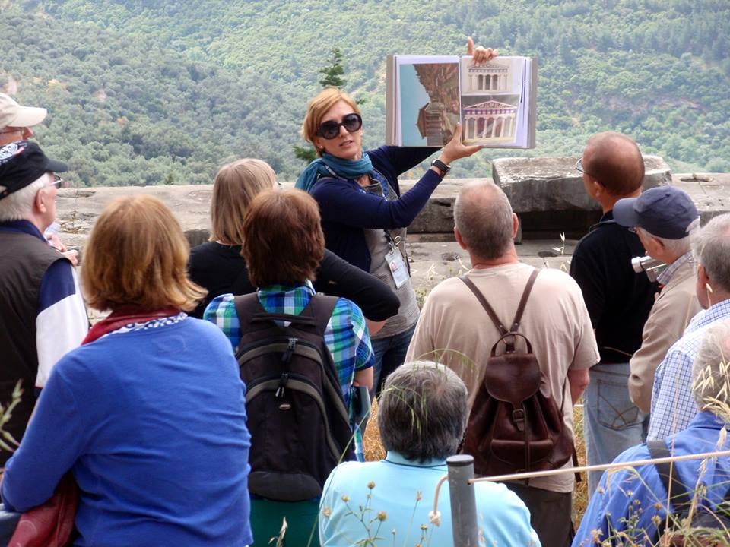
Thank you for your Attention! https://www.toursfrombelgrade.com/ https://www.nationalgeographic.com/travel/tours/great-tour-guides

