Slide 1
TIC Advice and Suggestions
Practice, pp 122-125

Slide 2
Task 1. Make a list of facilities and attractions that you could expect to find in Bangkok
FACILITIES | ATTRACTIONS
OPEN-AIR MARKETS | WAT ARUN
UPMARKET RESTAURANTS | THE GRAND PALACE
HIGH-RISE HOTELS | TUK TUK

Slide 3
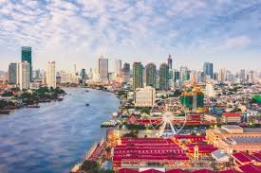
Unit 9, Page 125. Exercise 3, Task 2 –
Make questions
Student B – think about the topics ‘Temples’, ‘Grand Palace&Other Sights’ and ‘The River&Canals’ without reading prepare questions that you would ask Student A if you were a tourist in Bangkok

Slide 4
Sample Questions
I’m interested in visiting the major tourist sights, what do you recommend?
Is there a possibility of experiencing the city from the river side?
What is the Grand Palace?
Are there any places to go out/eat out near the river bank?

Slide 5
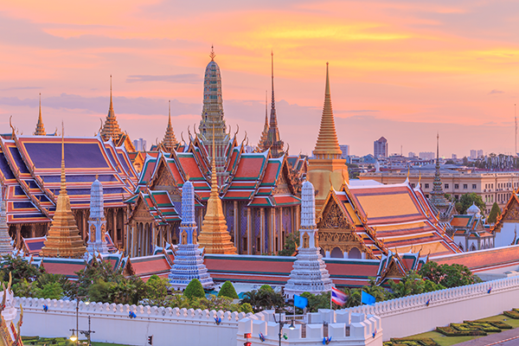
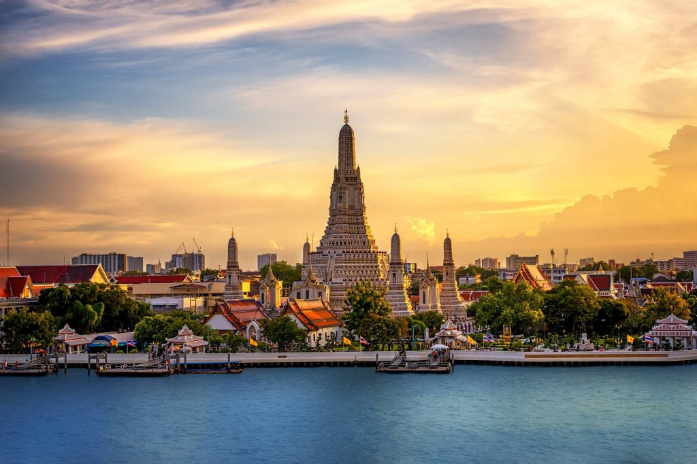
Unit 9, Page 125. Exercise 3, Task 1
Reading
Student A – Read in detail sections about –Temples, The Grand Palace&Other Sights and ‘The River&Canals’, make notes so that you answer Student B’s questions

Slide 6
Suggestions
No doubt, wats i.e. Thai temples are a must in Bangkok
If I were you, I’d go on a river trip to experience the fascinating life of the city and observe the glittering Wat Arun
The Grand Palace is a city within a city and well worth visiting because of its specific architecture (gilded roofs) and the National Museum, a treasure trove of Thai arts and culture.
In the evening, enjoy in a classy restaurant near the river.

Slide 7
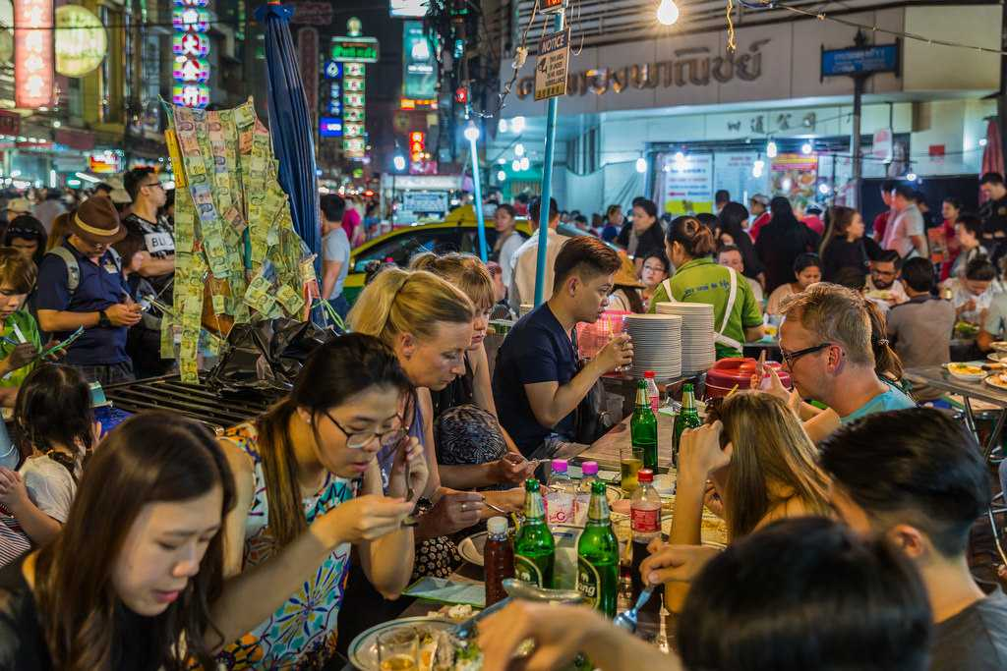
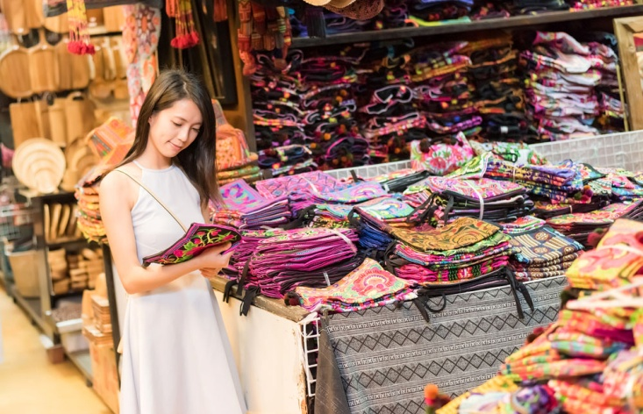
Unit 9, Page 125. Exercise 3, Task 2 –
Make questions
Student A – think about the topics ‘Shopping’, ‘Food’ and ‘Night-life’ without reading prepare questions that you would ask if you were a tourist in Bangkok

Slide 8
Sample Questions
I’d like to buy some souvenirs for my family and friends, what do you recommend?
Where can we go out/eat out in the evening?
I wonder if there is anything we mustn’t miss?
Is it safe for solo travelers to wander the streets alone?

Slide 9
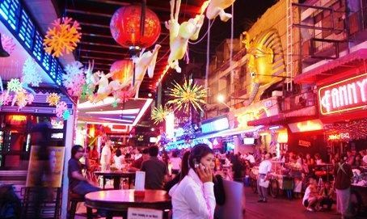
Unit 9, Page 125. Exercise 3
Reading
Student B – Read in detail sections about –’Shopping’, ‘Food’, and ‘Night-life’, make notes so that you answer Student A’s questions

Slide 10
Suggestions
If you are souvenir-hunting why not buy some Thai wood carving or perhaps a brightly-coloured sarong?
You can find many clubs, cafes and restaurants. Actually, the entire place at night is converted into a huge open-air restaurant, so you can taste local dishes such as freshwater crab.
Don’t miss the charming and picturesque floating market, if you are looking for something authentic
Be careful at night, the park can be a bit dangerous. Also, the red light district is famous for its sordid nightlife.

Slide 11
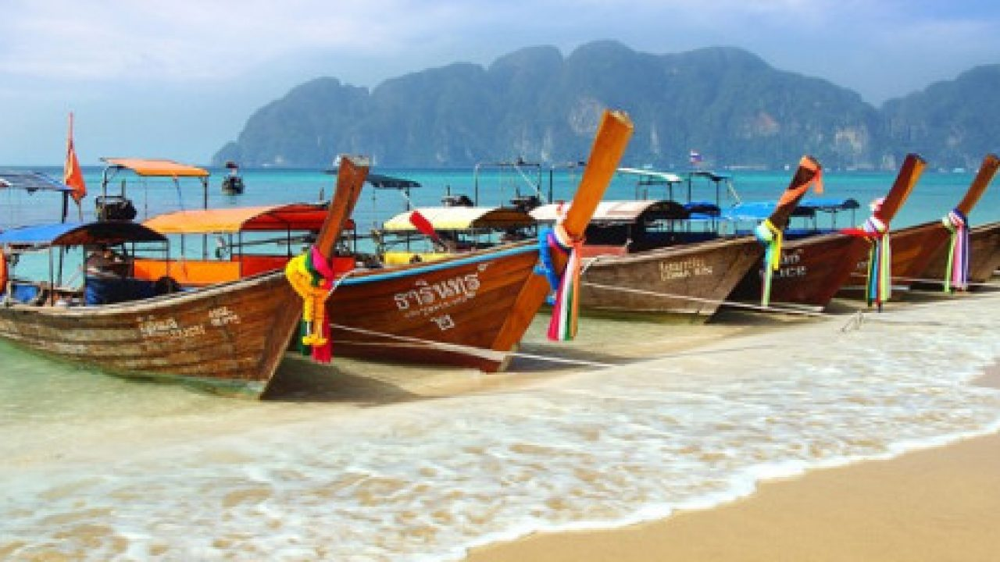
Long-tailed Boats

Slide 12
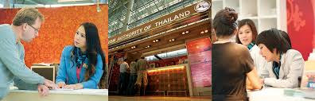
4. Use notes to act out a dialogue between a tourist and TIC officer
Visit: https://www.tourismthailand.org/Destinations/Provinces/Bangkok/219

Slide 13
Output Task
Writing a tourist information leaflet

Slide 14
Prepare TIC promotional material (PP presentation) for a city you know well
1. Make a list of all the attractions and facilities
2. Put them into groups under different subheadings
3. Brainstorm useful expressions or phrase
4. Write a general introductory paragraph
5. Include practical info

Slide 15
Useful Expressions for Presentations
[PLACE] is situated, located, nested, cradled, positioned
[PLACE] sits, lies at
Are you in pursuit of...?
[PLACE] has it all!
Go off the beaten track, find a perfect get-away, a perfect escape from the hustle&bustle
It is a must, it highly recommended, it is well worth visiting
journey like no other, out of this world, where anything is possible
At its best, at its worst
It’s legendary, iconic, breathtaking, dazzling, stunning
This is just a glimpse of what [PLACE] has to offer

Slide 16
Useful Expressions for Presentations
It’s no secret [PLACE] is fascinating, mesmerizing...
Experience it at an enjoyable pace
It’s time to hit the streets of [PLACE]
You’ll be left in awe by this impressive [PLACE]
Reward yourself with days well spent by visiting [PLACE]
Unwind =relax
Lose yourself in the streets of ....
Kaleidoscope of contrasts

