Slide 1

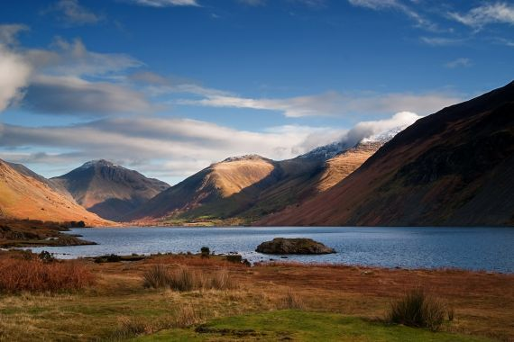
Guide Instructions
A Four Day Tour of Scotland and the English Lakes – Lake District

Slide 2
listening: guide instructions, page 143, Transcript page 195
1. Imagine you are going to be a guide on the tour. You have been sent the following guide instructions which give more detailed information about the various parts of the tour. Read them through once.

Slide 3
Guide Instructions Tour: Scotland and the English Lakes
Sue Jameson is handling this group
Office tel. no. 0171 434 6370
Dates: 10/1 Friday – 13/1 Monday
Pick-up point: Victoria Station
B&B service: 3 overnights +breakfast
Meals: coffee break in Stamford, lunch in Hotel Lomond, Scottish evening at George Hotel
Pax: 43
Supplement: Loch cruise (£4)
Tips for the Driver: £ 8+8+8 = £ 24
Tips for the Waiter: £10
Picturesque, quaint towns and villages
Impressive scenery and pristine nature

Slide 4
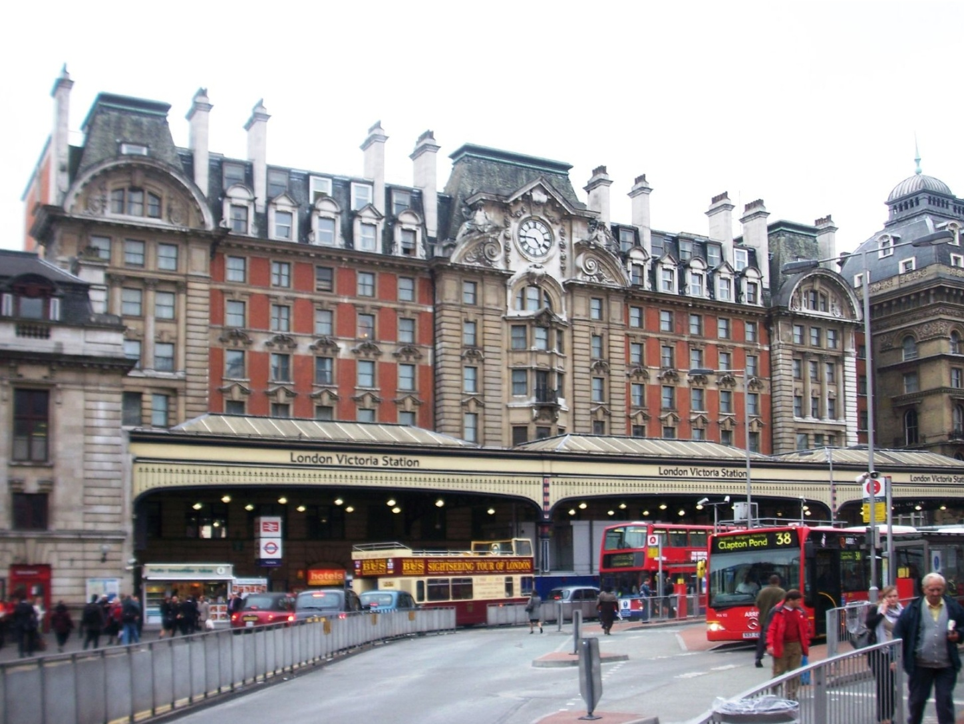
Itinerary: Day 1 (London-Edinburg)
January 10th
pick up point
Victoria Station

Slide 5
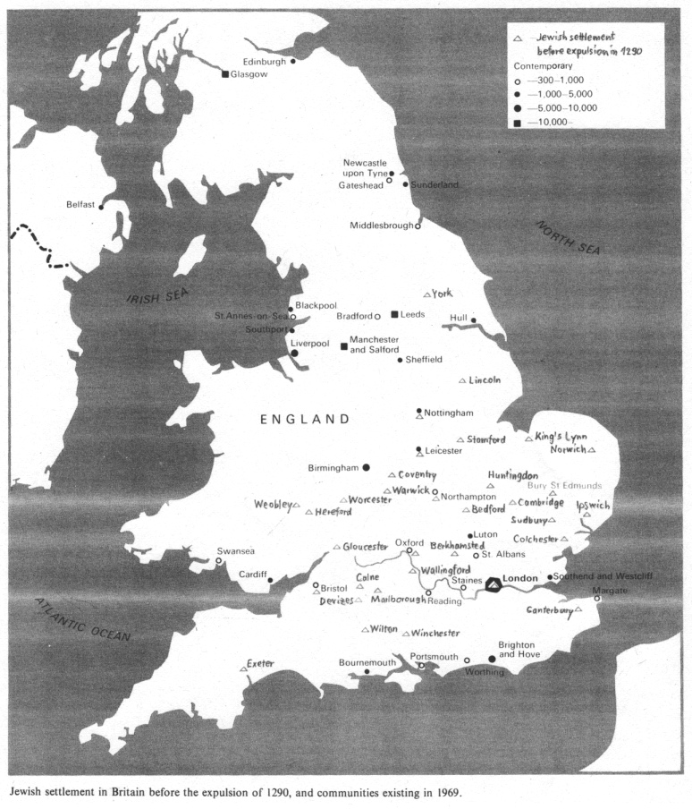
London-Stamford-Edinburgh

Slide 6
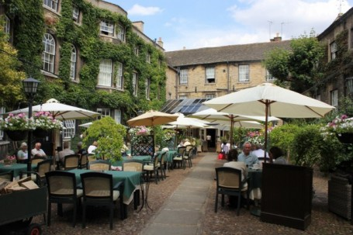
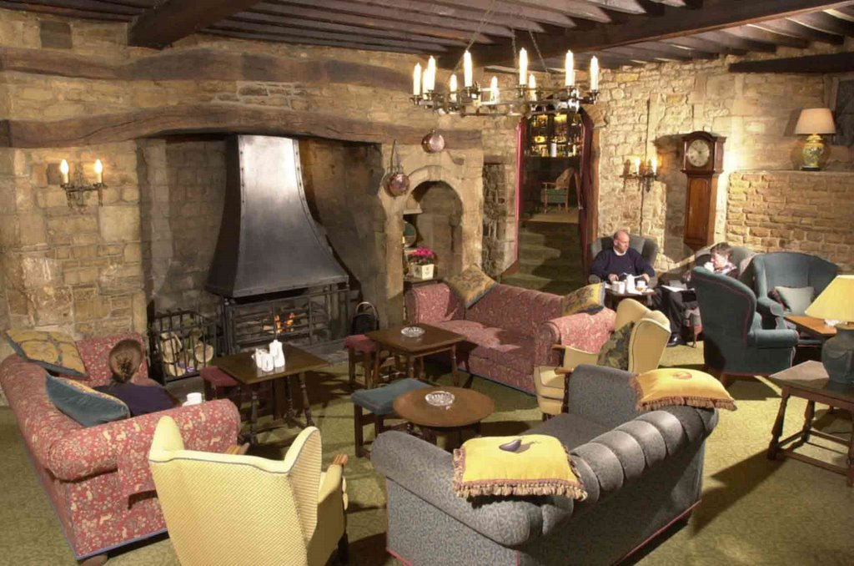
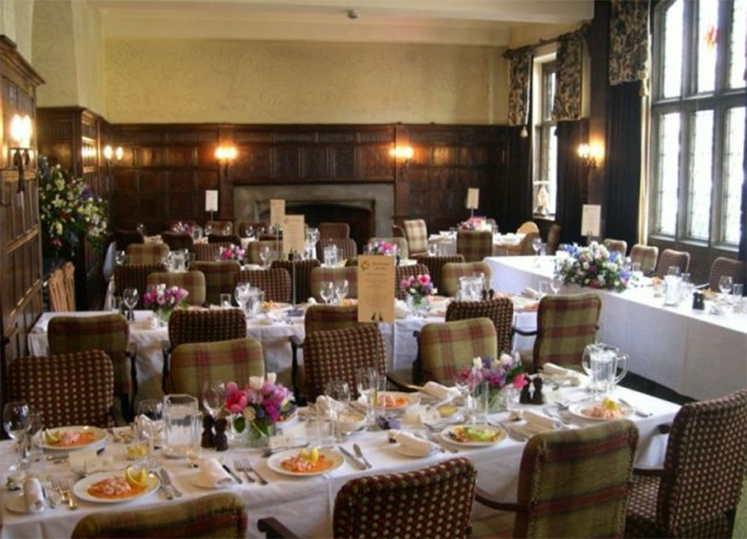
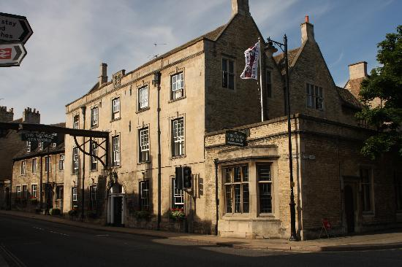
http://www.georgehotelofstamford.com coffee stopin Old Hall: 45 min app; present voucher

Slide 7
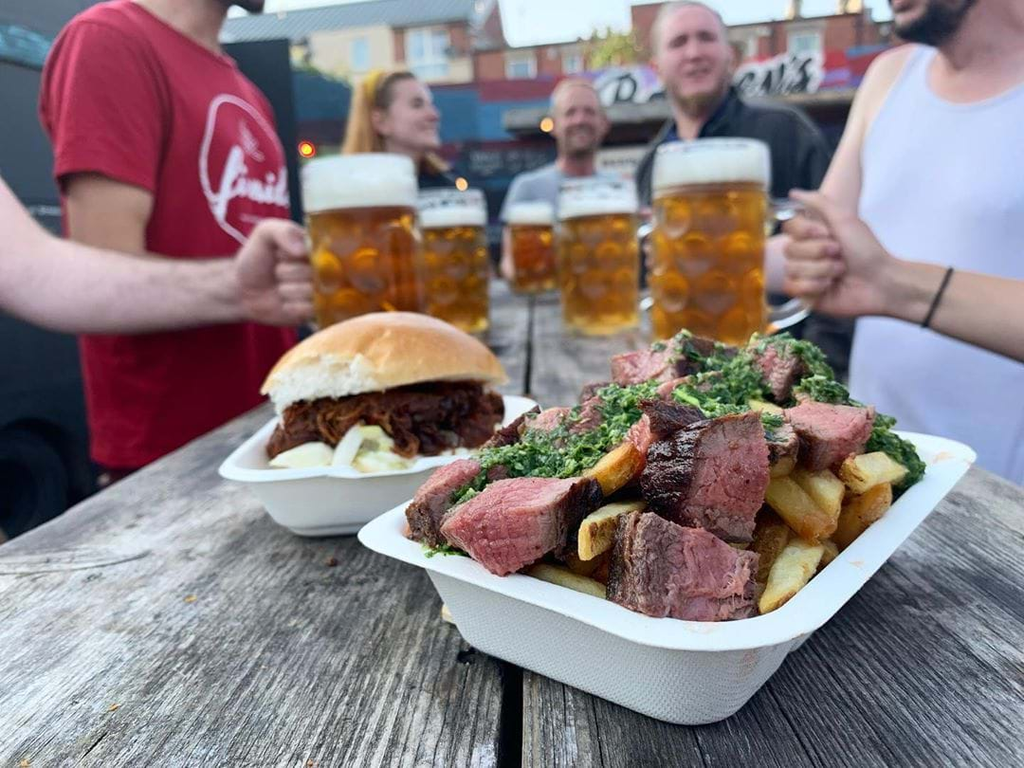
lunch en route (on the way), one hour app lunch is not included in the package

Slide 8
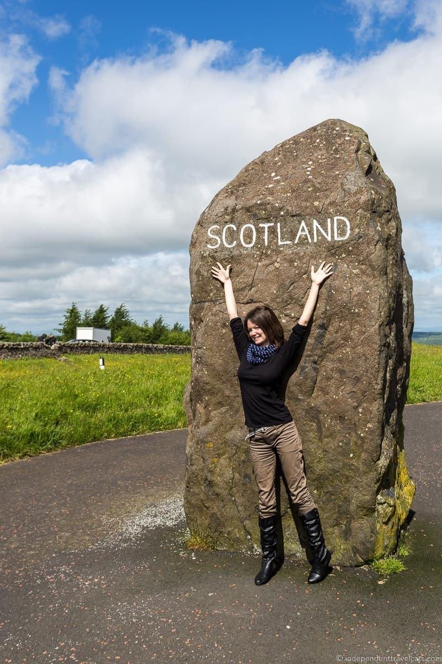
Scottish border, photo session 15min

Slide 9
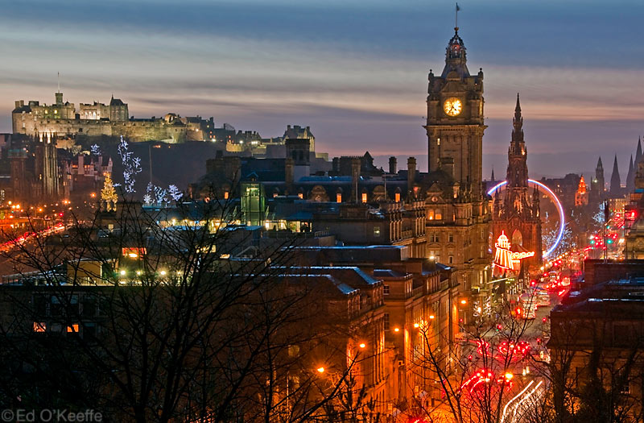
Edinburgh /edInbrä/ info on public transport&sights, check in, pax at leisure (=free time, time on your own); arrange porterage (carrying luggage) and alarm

Slide 10
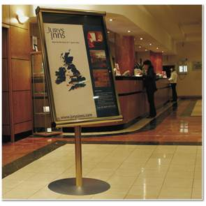
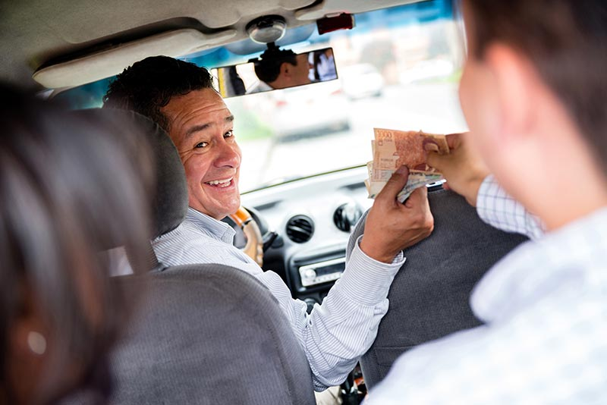
set up noticeboard in the lobby/pay driver a grat tip
gratuity = grat
napojnica, bakšiš

Slide 11
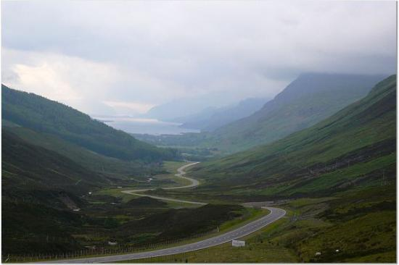
Day 2 (Edinburg – Glenkinchie -Edinburgh)
January 11th
approximately = around, about 3 hours

Slide 12
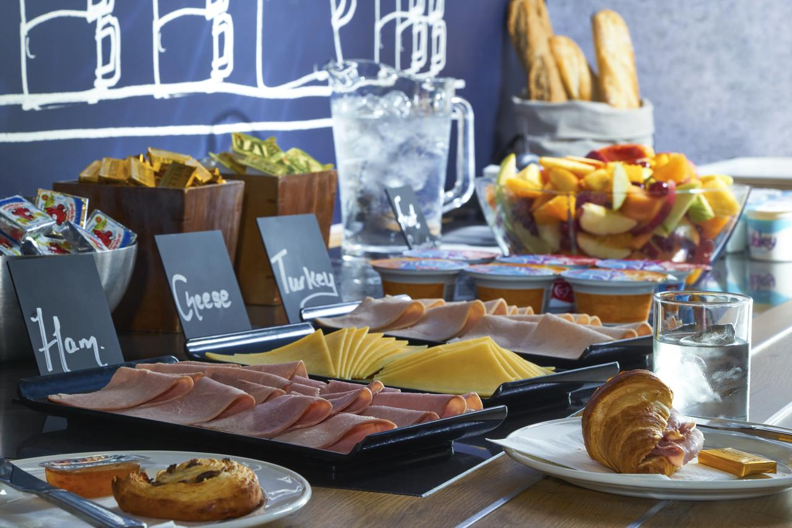
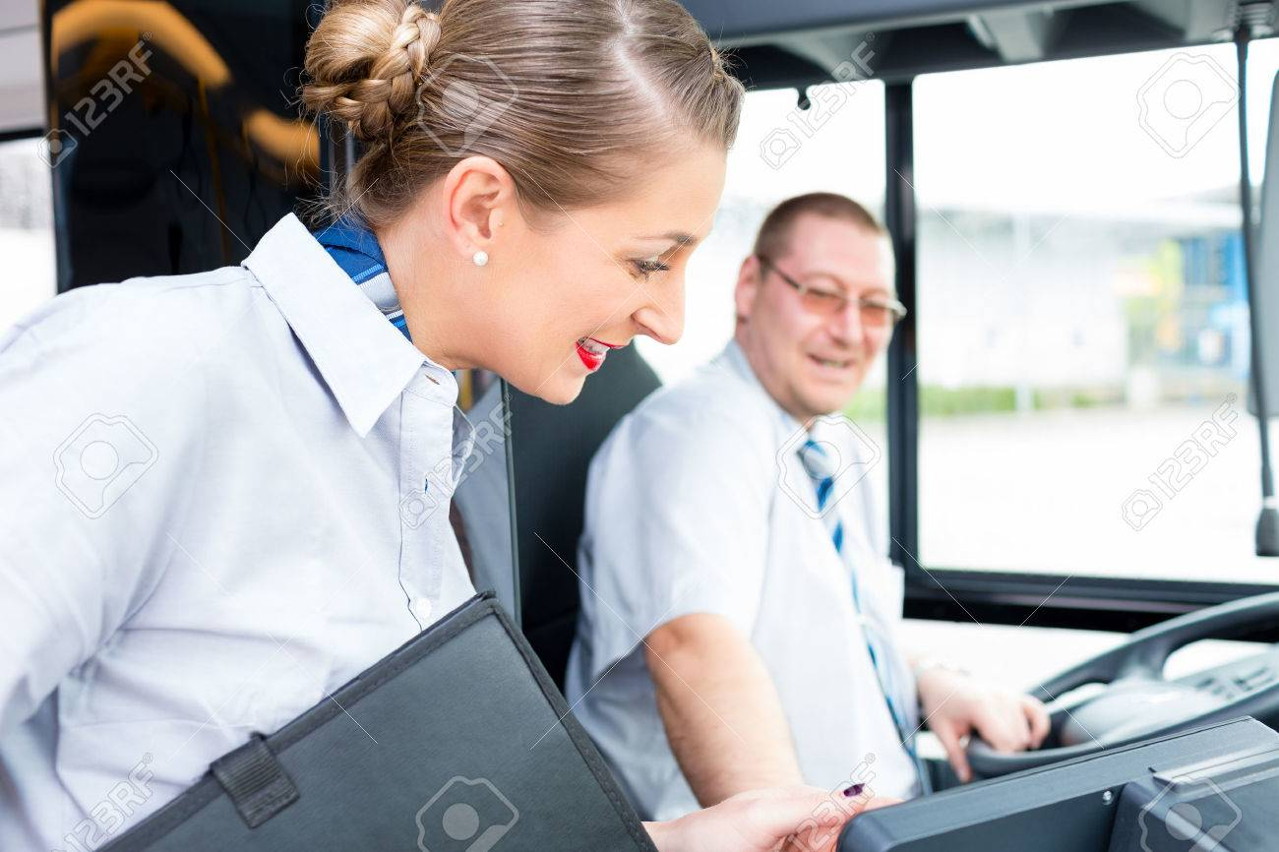
morning: continental breakfast, liaise /lɪˈeɪz/ with the driver and local guide = communicate with

Slide 13
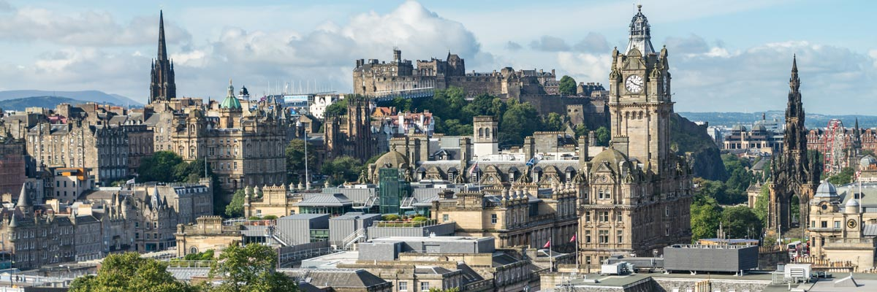
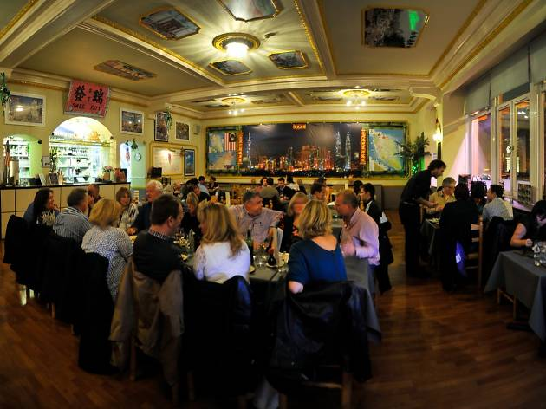
Edinburgh one hour and free time for lunch
OUR PARTY
=
OUR GROUP OF TOURISTS

Slide 14
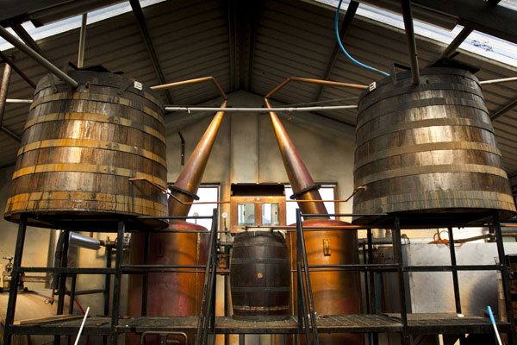
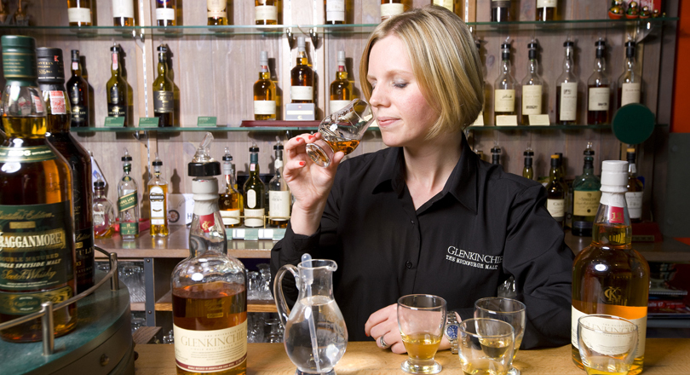
Glenkinchie Whiskey Distillery
BE PUNCTUAL, the tour starts at 13:45!

Slide 15



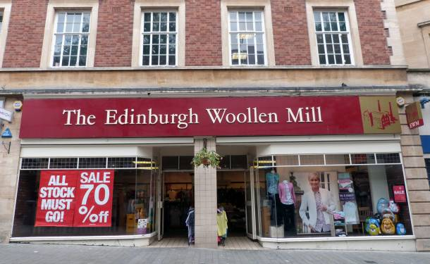
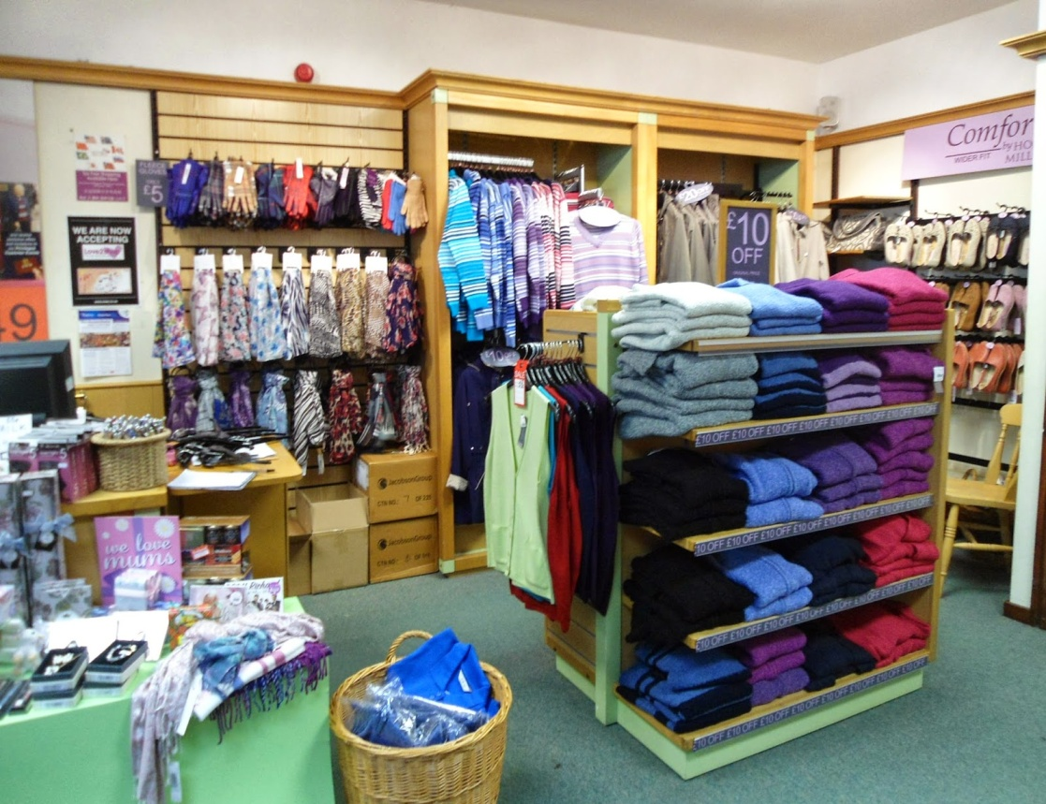
en route, 30 minutes for shopping

Slide 16
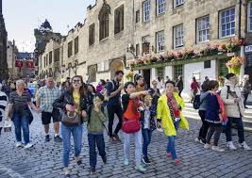
Evening: arrive at hotel, recommend a restaurant, pax at leisure

Slide 17
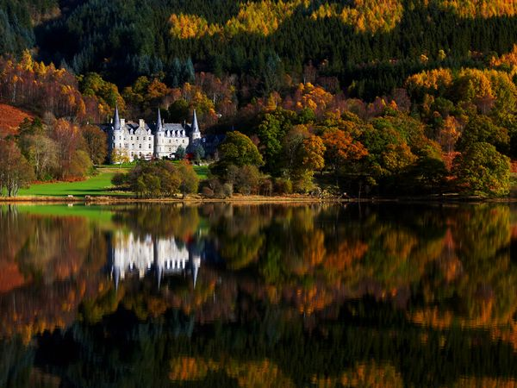
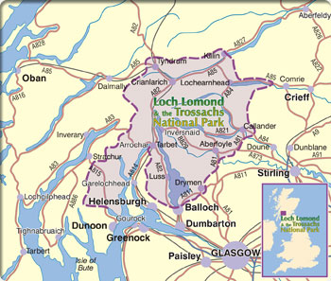
Day 3 (Edinburg – Trossachs - Edinburgh)
January 12th

Slide 18
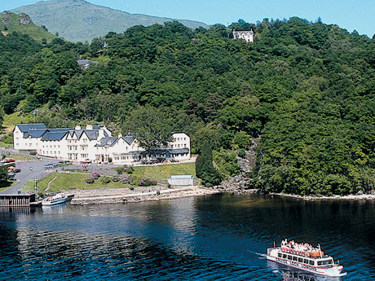
optional boat cruise on Loch Lomond, 4£ at 12 p.m. or walk or sit in Lomond hotel, lunch 2 p.m. present voucher
https://www.lochlomondarmshotel.com/our-lodges

Slide 19
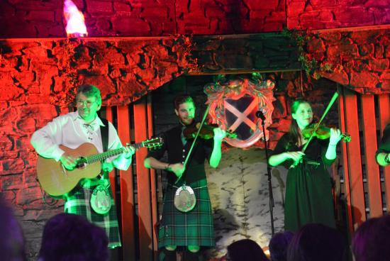
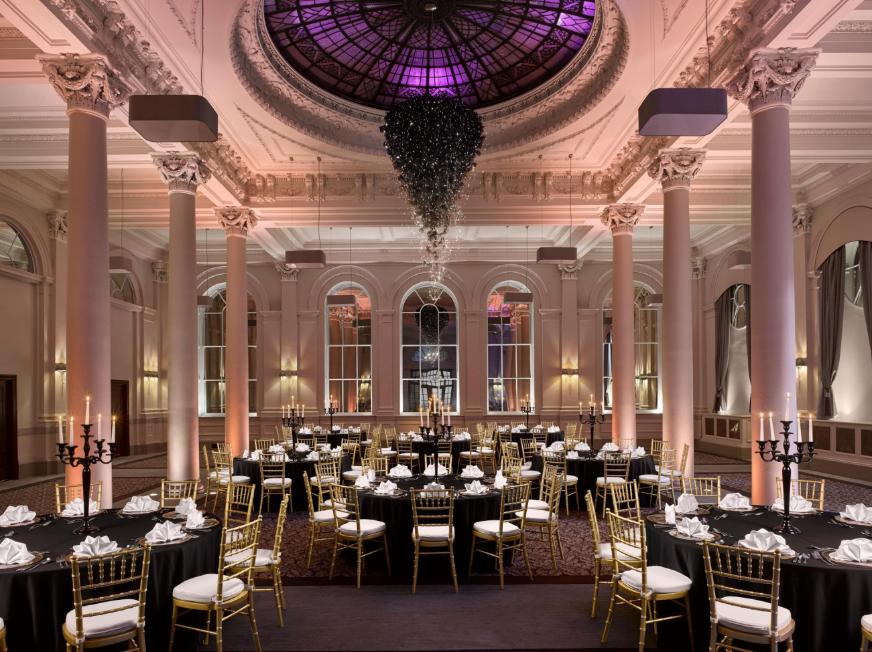
Evening: must return by 5 p.m.
Scottish evening at the George Hotel prepare vouchers

Slide 20
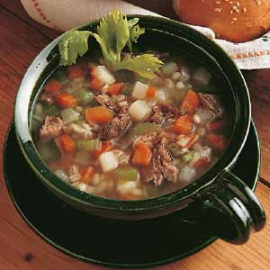
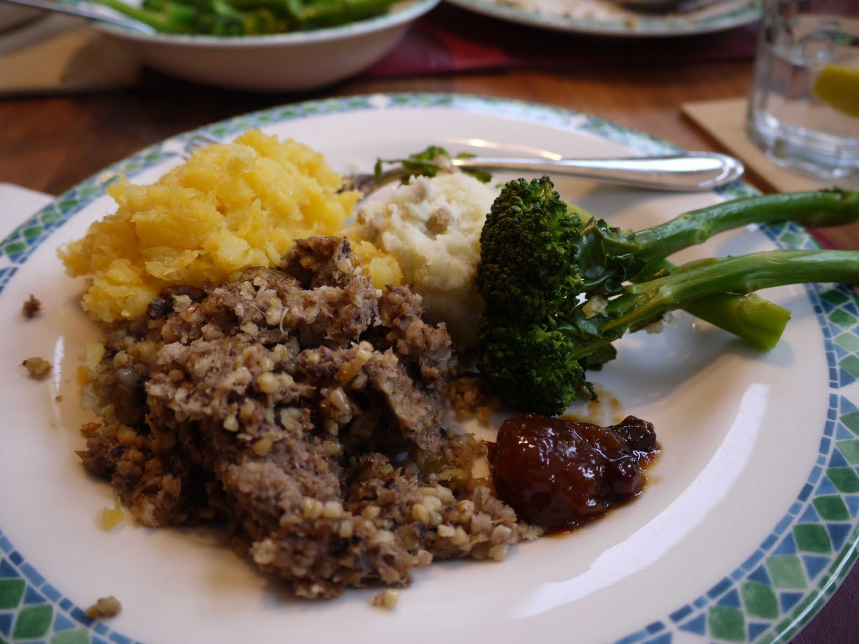

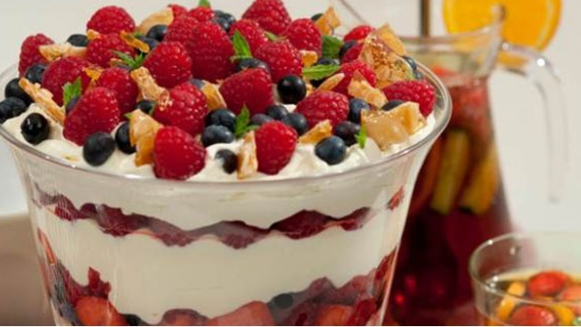
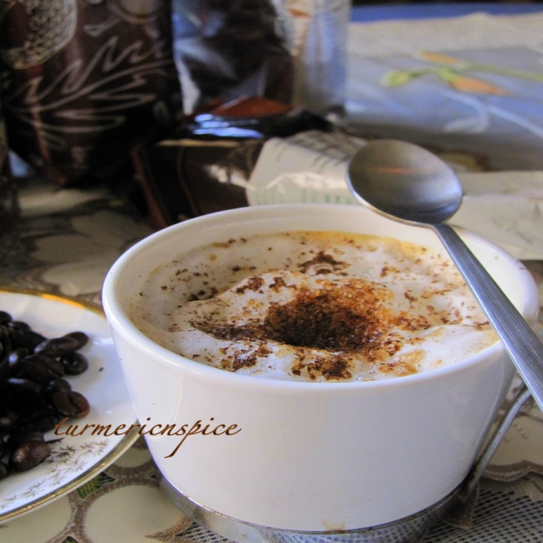

Slide 21
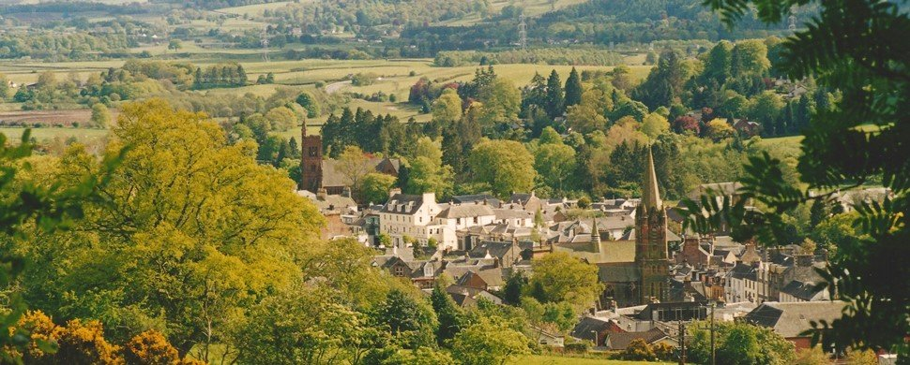
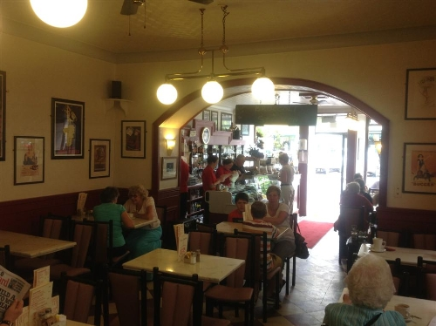
Day 4 – Edinburgh, baggage pull (removal) by 7, check out, pay porterage from your float (iz svoje kase, od službenog novca)– Moffat (coffee break 30min) – Grasmere - London
January 13th

Slide 22
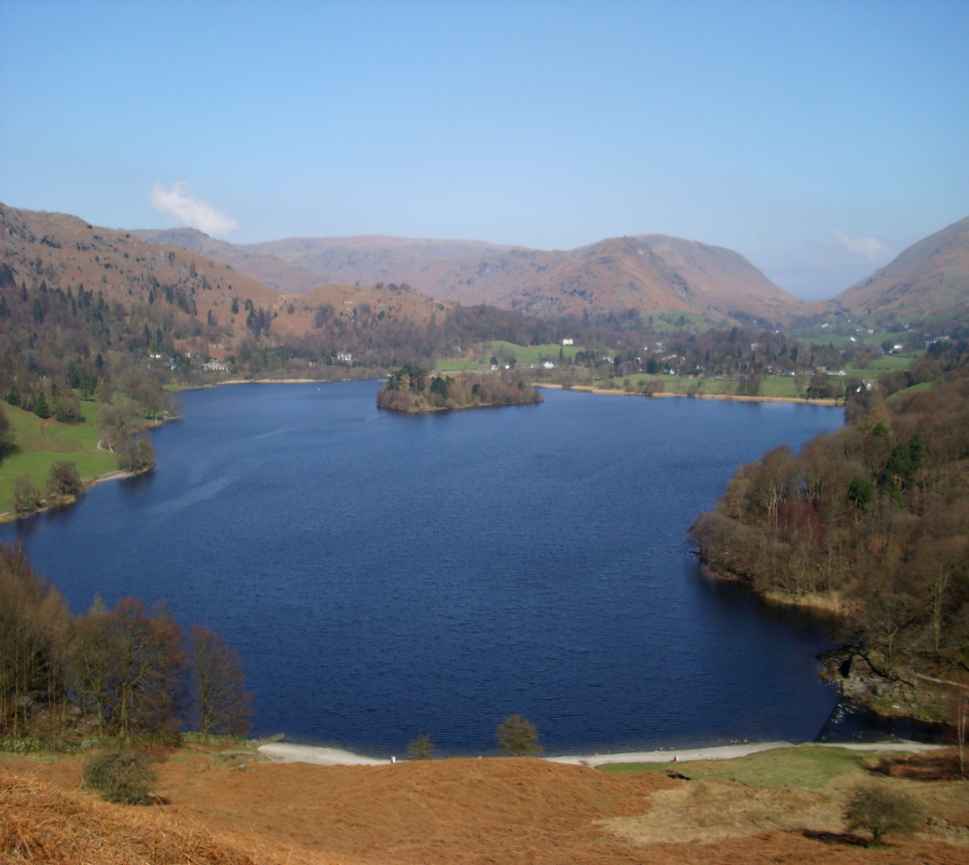
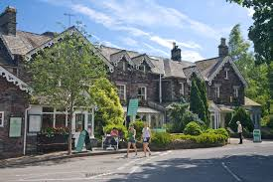
Lake District – Grasmere two hours free time for lunch and sightseeing

Slide 23
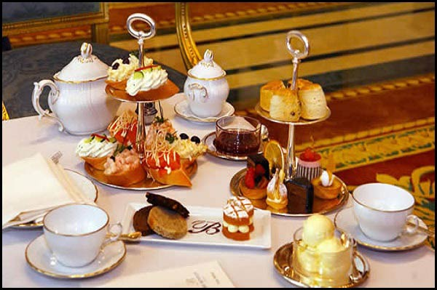
tea en route to London
45min

Slide 24
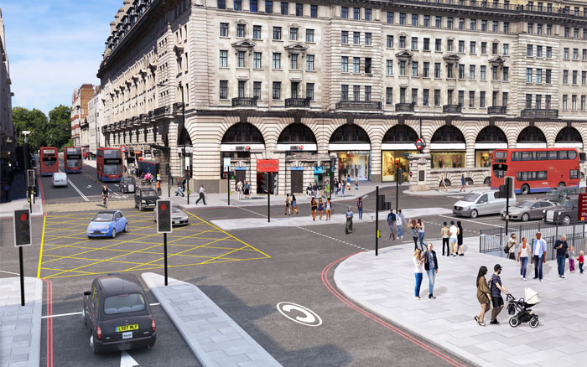
London, arrive at 19.30 drop off?

Slide 25
2. page 143, Unfortunately there have been some last-minute alterations. Listen to the audio (Listening on the website) and make the necessary changes to the instructions.
office tel. no. 0171 434 6307
pax: 41, revised passenger list!
a client wants to leave earlier, 8.15, sharp (exactly at 8.15) time has shifted in day one
10.45 Hotel George, Stamford, coffee break 30min
(tight schedule – full of activities for a shord period of time), 1.30 p.m lunch (a place where they get you through quickly quickly = finish quickly)
arrive in Edinburgh much earlier

Slide 26
2. page 143, Unfortunately there have been some last-minute alterations. Listen to the audio (Listening on the website) and make the necessary changes to the instructions.
day 2 – no changes, get to the distillery at 1.45 at the latest (=not later than)
day 3 – Loch Lomond cruise at 1 p.m. (early lunch, phone the company about the number)
day 4 – the client wants to have more time in Lake District on the way back, 8 a.m. departure, 7 a.m breakfast, bags 6.30)
(sleepy heads after the Scottish night)
Grasmere 1 p.m. drive around the lakes, keep the tea stop to 30min

Slide 27
OUTput task: SPEAKING, page 144
ADDITIONAL ARRANGEMENTS

Slide 28
page 144, Work in pairs. The guide (student A) and the representative (student B) of the various companies and services used or visited on the tour should look at the information below.
STUDENT A: GUIDE
STUDENT B: TOURIST COMPANY REPRESENTATIVE
You want to confirm the arrangements on your guide instructions and also find out additional information about the services offered
Look at the information on page 182.

Slide 29
Work in pairs. The guide (student A) and the representative (student B) of the various companies and services used or visited on the tour should look at the information below.
STUDENT A: GUIDE
ask about:
STUDENT B: TOURIST COMPANY REPRESENTATIVE
The George Hotel, Stamford
1. information about the hotel
2. what is included
3. private room?
The George of Stamford
Period charm and modern comfort come in equal measure at this delightful eighteen century coaching-inn, where a gallows sign across the road offers a warning to any prospective highwaymen. Characterful public rooms include two inviting lounges, one conservatory-style with exotic plants, a stylish cocktail bar, and a cosy little beamed snug. The pretty walled garden is just the place for sitting in summer.
GROUPS CATERED FOR PRIVATELY
Try our NEW coffee shop! Fresh coffee and home-made biscuits
£1.50

Slide 30
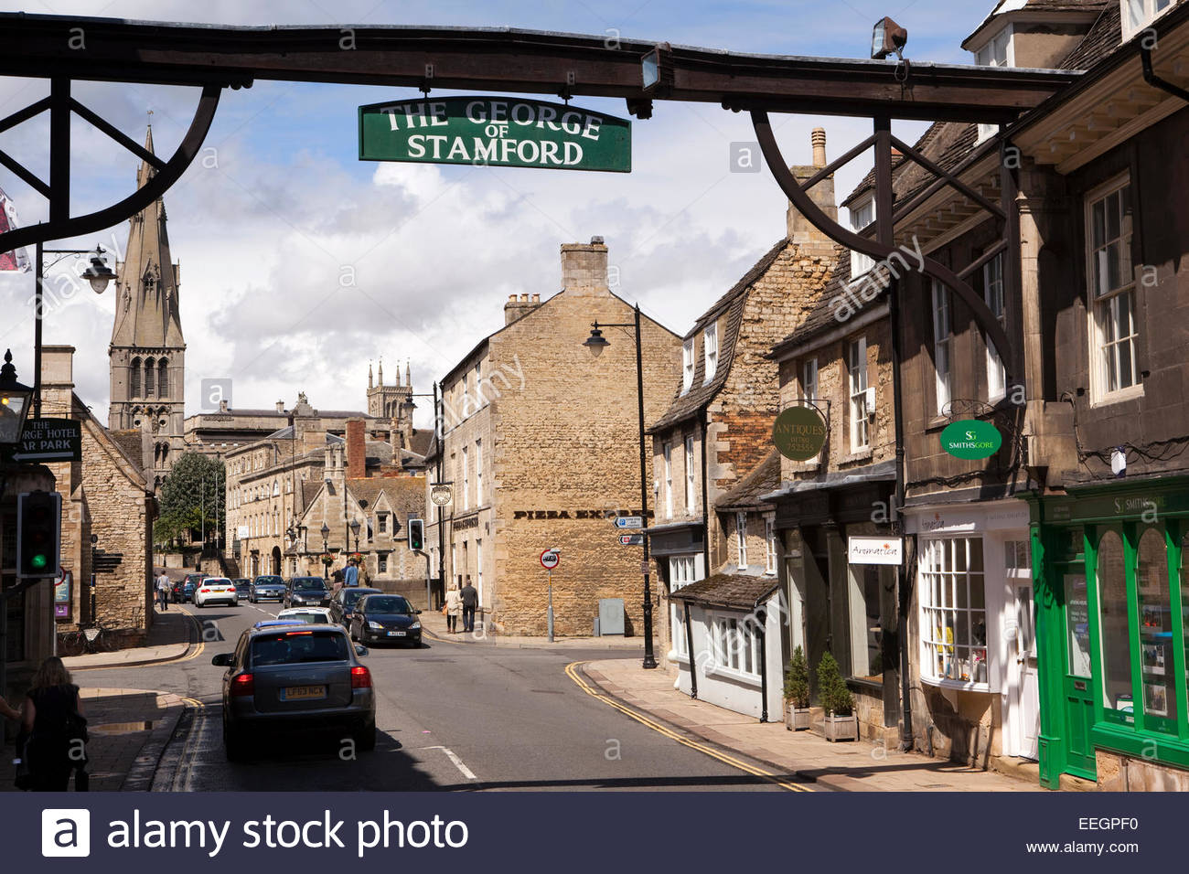
gallows sign – hanging sign

Slide 31
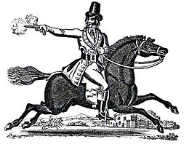
highwaymen, pl.n. – desperado, bandit (bukvalno drumski razbojnik, ovde je metaforička upotreba u značenju pustolov) prospective – potential, accidental

Slide 32
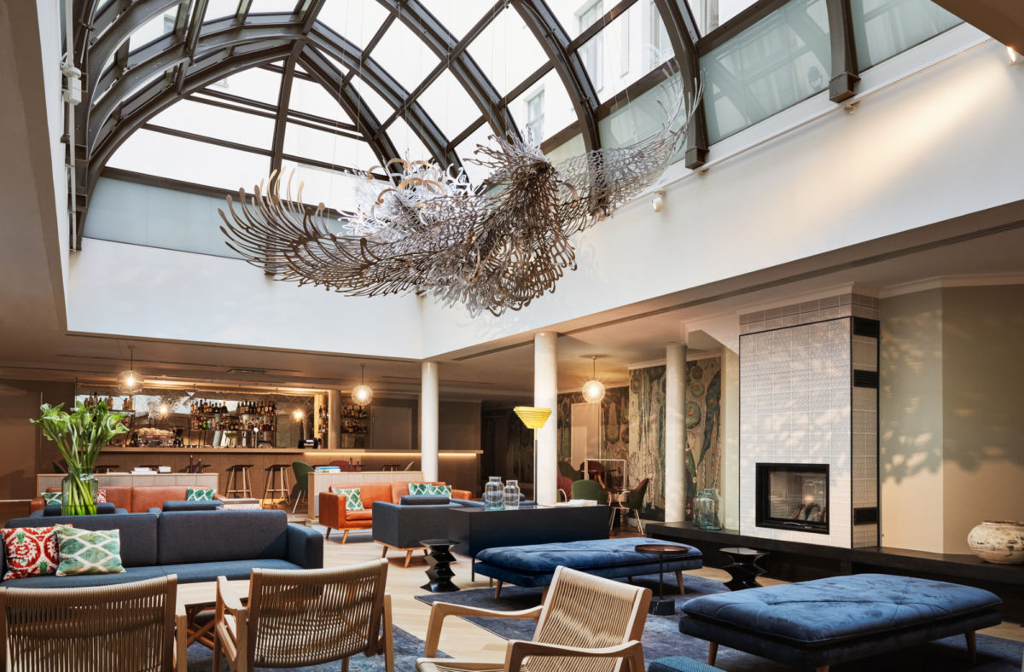
conservatory-style lounge= a room or building with glass walls and a glass roof

Slide 33
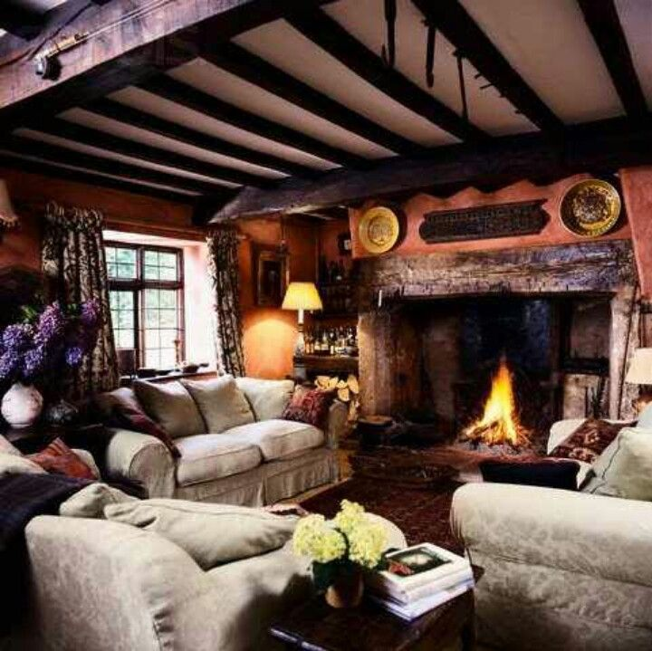
a traditional beamed snug (a small, comfortable public room in a pub or inn) beam = greda

Slide 34
Work in pairs. The guide (student A) and the representative (student B) of the various companies and services used or visited on the tour should look at the information below.
STUDENT A: GUIDE
ask about:
STUDENT B: TOURIST COMPANY REPRESENTATIVE
DISTILLERY TOURS
Enjoy fascinating guided tour GLENKINCHIE DISTILLERY and sample its unique single malt whisky. Our superb distillery museum is open through the year.*
*Free tours*Visitor centre*Car parking* Shop*Distillery museum*Bowling green*Picnic site
Guided tours Mon-Fri, 9:30 – 16:30 (other times by appointment
NB For group visits please arrange in advance
FREE TASTINGS!
Glenkinchie Distillery
1. facts about distillery?
2. free tastings?

Slide 35
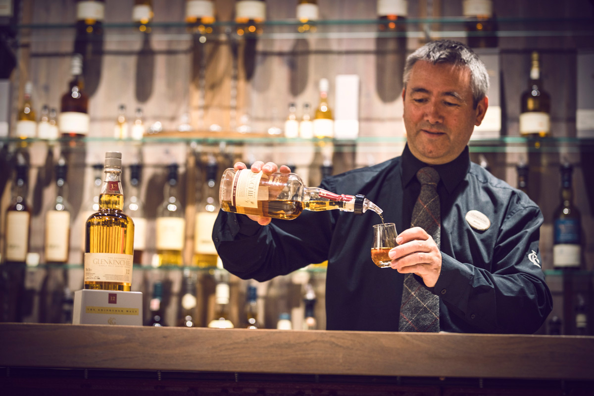
single malt Scotch (=slad) single distillery whisky, made of barley (ječam)

Slide 36
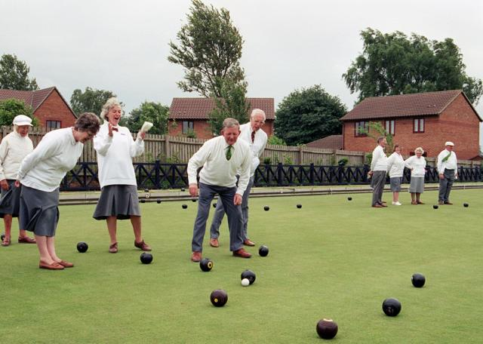
bowling green boćanje na travi

Slide 37
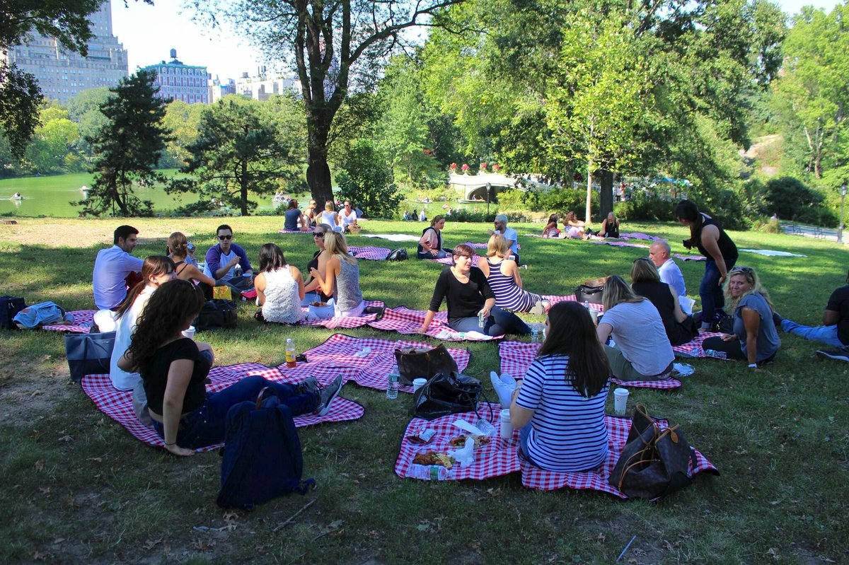
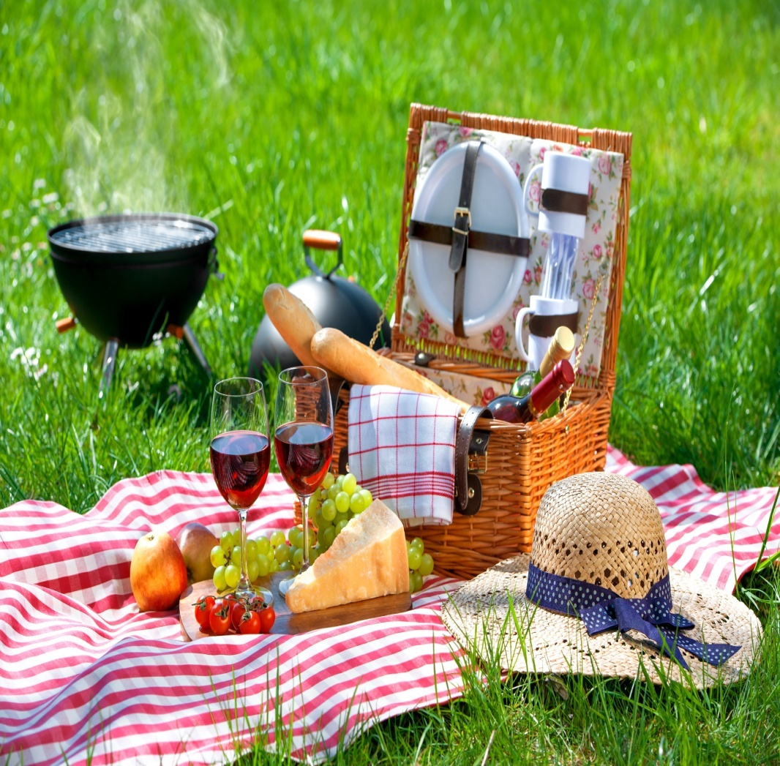
picnic an occasion when a packed meal is eaten outdoors, especially during an outing to the countryside.

Slide 38
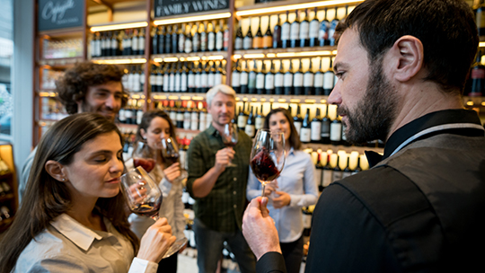
tastings = degustacija

Slide 39
Work in pairs. The guide (student A) and the representative (student B) of the various companies and services used or visited on the tour should look at the information below.
STUDENT B: TOURIST COMPANY REPRESENTATIVE
STUDENT A: GUIDE
ask about:
LOCH LOMOND
Why not bring your group on a romantic steamer cruise? Enjoy the scenic beauty of Loch Lomond, ‘Queen of Scottish Lakes’, 24 miles long. See the haunting beauty of Lennox Castle! Gaze at the height of Ben Lomond!
The one-hour cruise costs £4.00, and we pay 10% commission on pre-booked tours of 20 or more.
Loch Lomond Boat Tours
1. how long?
2. what will we see?
3. commission?

Slide 40
References
https://www.youtube.com/watch?v=SDBIlIPQMDs
https://www.georgehotelofstamford.com/
https://www.lochlomondarmshotel.com/our-lodges
https://www.scotsman.com/whats-on/arts-and-entertainment/sad-secrets-glasgows-abandoned-mental-hospital-1439724
https://www.lochlomond-trossachs.org/things-to-do/walking/hillwalking/ben-lomond/
https://www.visitscotland.com/info/see-do/glenkinchie-distillery-visitor-centre-p418531
https://www.visitcumbria.com/amb/grasmere/

Slide 41
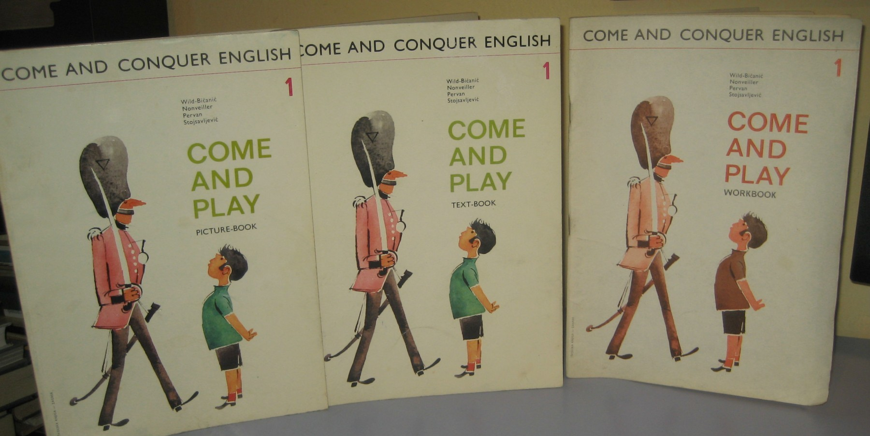
Thank you for your Attention!

