Slide 1
PRACTICE
Describing Cities, Buildings&People
SECTION 3 On a Tour, pages 143-144
Listening 5, page ‘Predmeti’

Slide 2
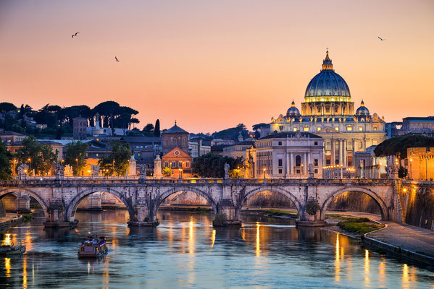
1. page 144, Rome is a nice city. How many positive words can you think of the word nice in the sentence. Make a list.
spectacular
breathtaking
amazing
beautiful
exciting…

Slide 3
2. page 144, Listening 5, Complete the chart by ticking the boxes to indicate which adjective can be used with the nouns
 | CITIES | BUILDINGS | PEOPLE | NIGHT& LIFE ENTERTAINMENT
ANCIENT
ELEGANT
FAMOUS
FINE
GLORIOUS
IMPORTANT
LOVELY
MAGNIFICENT
POWERFUL
PROUD
SPLENDID
SUPERB
WONDERFUL

Slide 4
3. Guide Commentaries
Listening 5, page 145

Slide 5
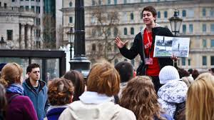
commentary /ˈkɒmənt(ə)ri/= account, explanation, expressing opinion

Slide 6
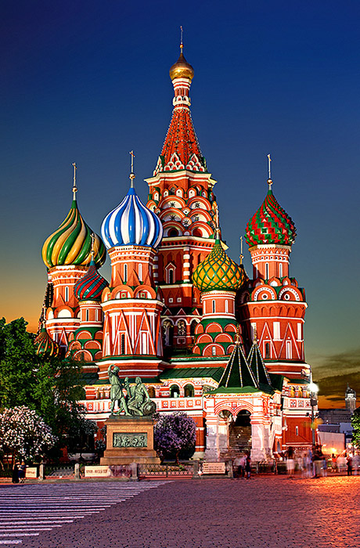
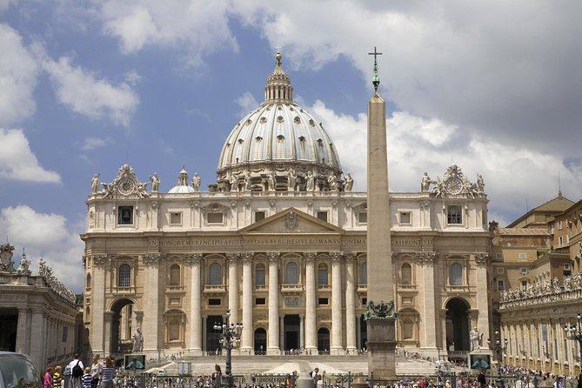
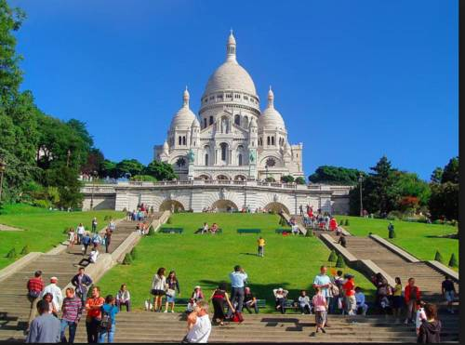
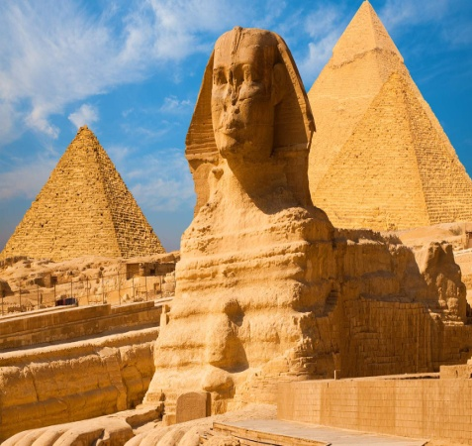
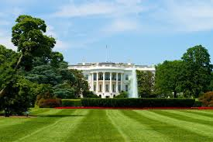
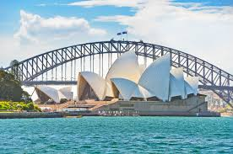
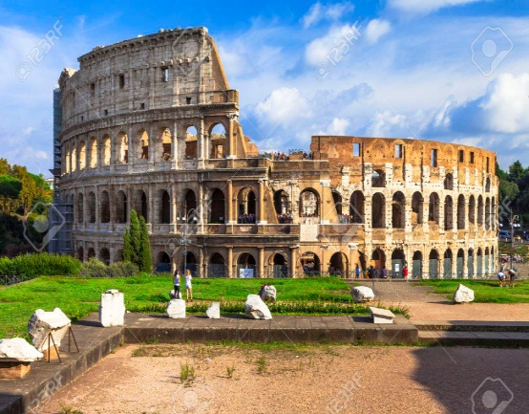
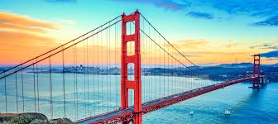
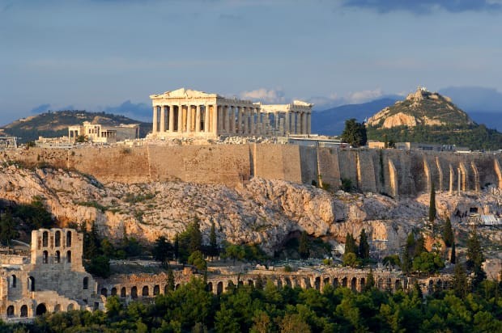
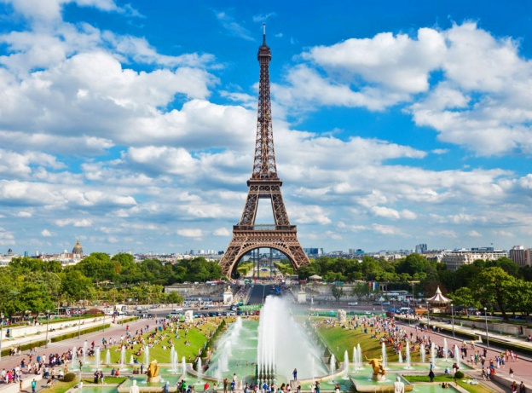
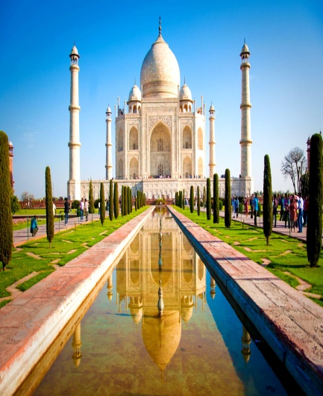
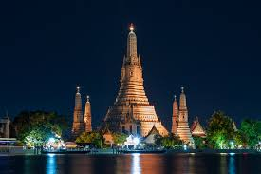
1. Here are the pictures of 12 famous places. Can you identify them and say which cities countries are they in?
A
C
D
B
F
G
E
H
I
K
J
L

Slide 7
1. page 145, Listening 5, Fill in the first two columns of the table
 | PLACE | CITY/COUNTRY | COMMENTARY | NOTES
a
b
c
d
e
f
g
h
i
j
k
l

Slide 8
answers
 | PLACE | CITY/COUNTRY | COMMENTARY | NOTES
a | St. Basil’s | Moscow/Russia
b | Sistine Chapel | Vatican City/Vatican
c | Sacre Coeur | Paris/France
d | The Sphinx/Pyramids | Cairo/Egypt
e | The White House | Washington DC/USA
f | Sydney Opera House | Sydney/Australia
g | Colloseum | Rome/Italy
h | Golden Gate Bridge | San Francisco/USA
i | The Acropolis | Athens/Greece
j | The Eiffel Tower | Paris/France
k | Taj Mahal | Agra/India
l | Wat Arun | Wat Arun/Thailand

Slide 9
2. page 145, Listening 5, You will hear seven guides each giving a commentary at one of the places. Can you identify which ones they are talking about? Write numbers 1 – 7 in the third column of the table.
 | PLACE | CITY/COUNTRY | COMMENTARY | NOTES
a | St. Basil’s | Moscow/Russia
b | Sistine Chapel | Vatican City/Vatican
c | Sacre Coeur | Paris/France
d | The Sphinx/Pyramids | Cairo/Egypt
e | The White House | Washington DC/USA
f | Sydney Opera House | Sydney/Australia
g | Colloseum | Rome/Italy
h | Golden Gate Bridge | San Francisco/USA
i | The Acropolis | Athens/Greece
j | The Eiffel Tower | Paris/France
k | Taj Mahal | Agra/India
l | Wat Arun | Wat Arun/Thailand

Slide 10
answers
 | PLACE | CITY/COUNTRY | COMMENTARY | NOTES
a | St. Basil’s | Moscow/Russia
b | Sistine Chapel | Vatican City/Vatican | 4
c | Sacre Coeur | Paris/France
d | The Sphinx/Pyramids | Cairo/Egypt
e | The White House | Washington DC/USA | 1
f | Sydney Opera House | Sydney/Australia
g | Colloseum | Rome/Italy | 7
h | Golden Gate Bridge | San Francisco/USA | 6
i | The Acropolis | Athens/Greece | 5
j | The Eiffel Tower | Paris/France | 3
k | Taj Mahal | Agra/India | 2
l | Wat Arun | Wat Arun/Thailand

Slide 11
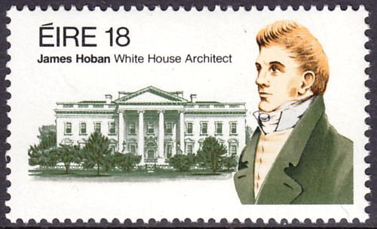
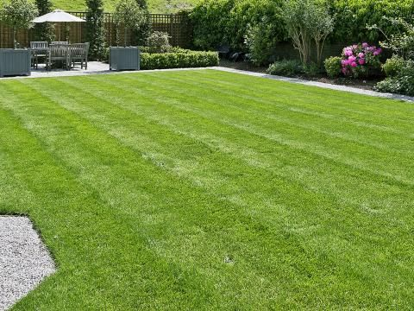
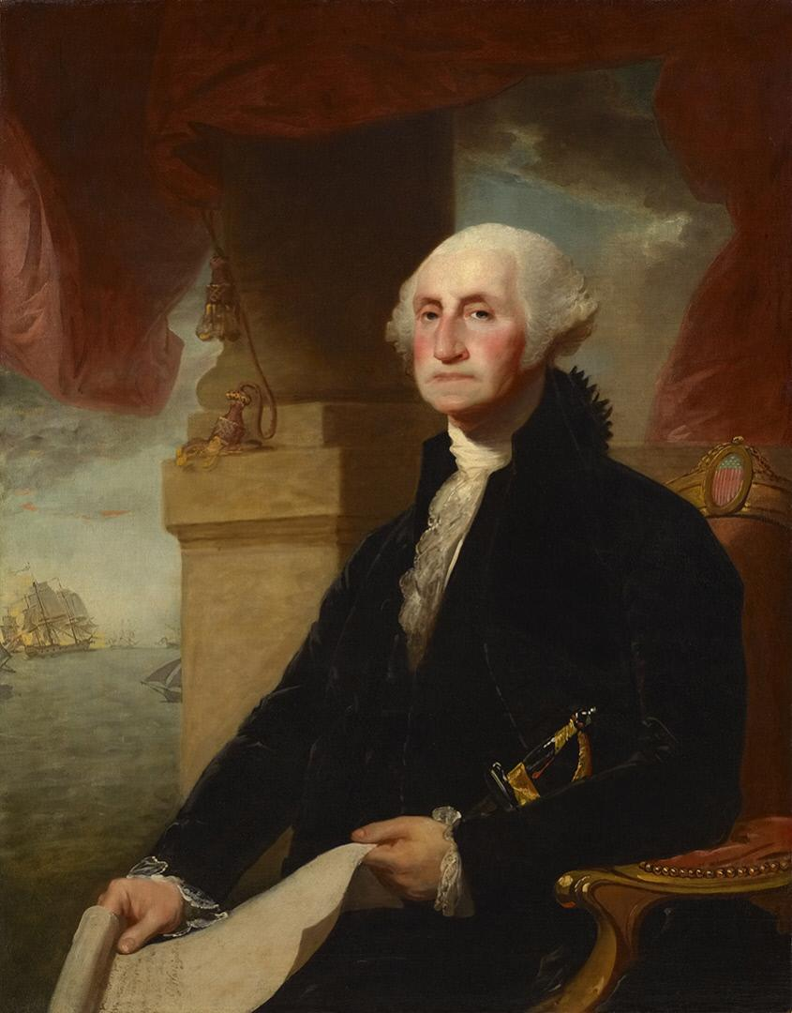
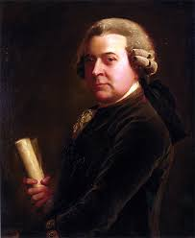
lawn/lɔːn/travnjak to mow /məʊ/ the lawn - kositi
It was designed by James Hoban (=projektovao ju je...)
The site was chosen by (=lot, plac) George Washington.
It was burned and later restored (=rebuilt, reconstructed).
burn – burned – burned
burn – burnt – burnt

Slide 12
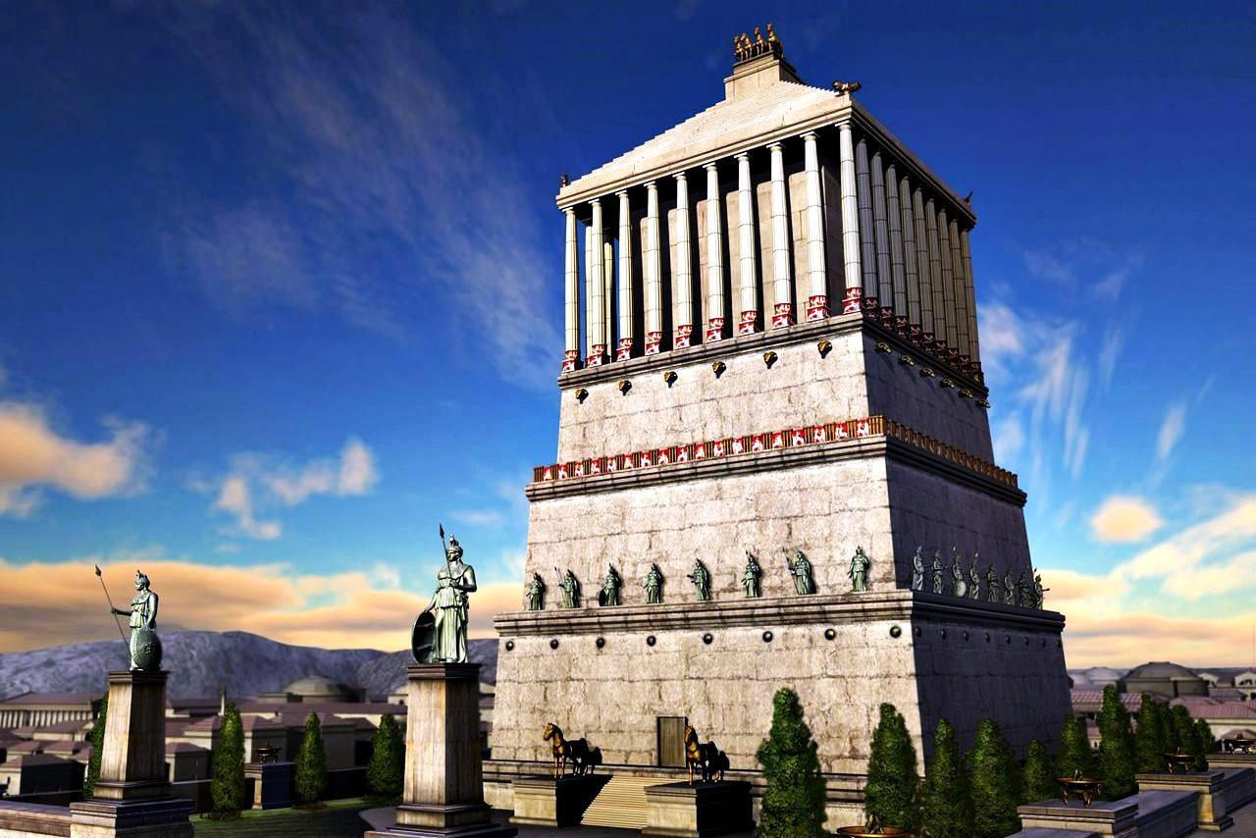
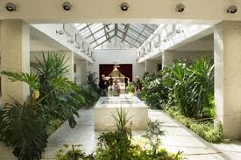
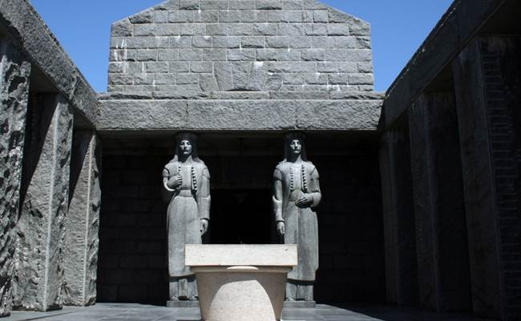
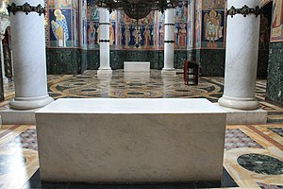
mausoleum/ˌmɔːsəˈlɪəm,ˌmɔːzəˈlɪəm/, a tomb, a burial place usu. of importan historical significance the Mausoleum at Halicarnassus, Asia Minor (Mausolus)
marble exterior (on the outside)
marble interior (on the inside)
marble – white smooth stone (=mermer)

Slide 13
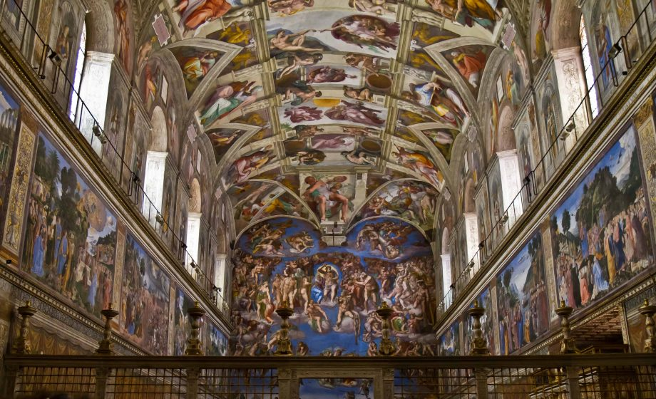
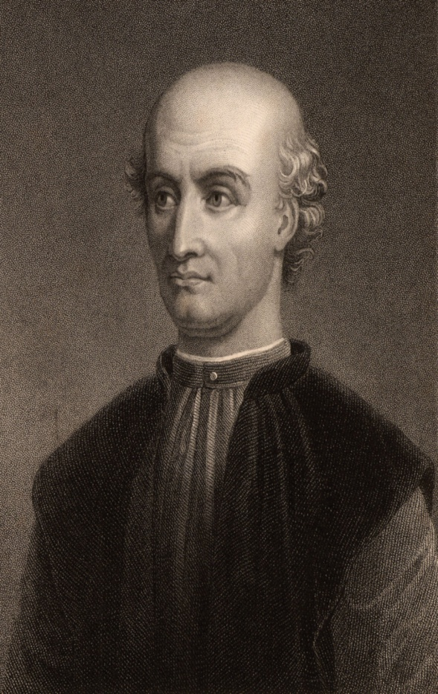
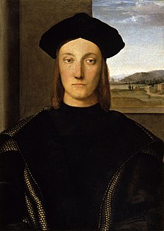
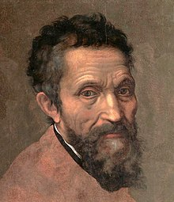
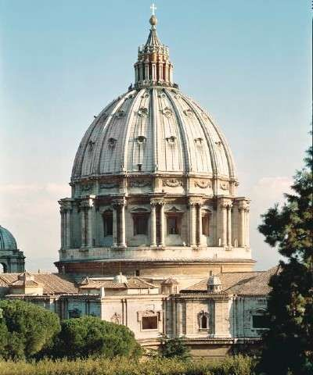
Sistine Chapel ceiling /ˈsiːlɪŋ/ (=tavanica, plafon)
Bramante, Michelangelo, Raffaello
St. Peter-s dome /dəʊm/ – round roof on the top of the church (= kupola)

Slide 14
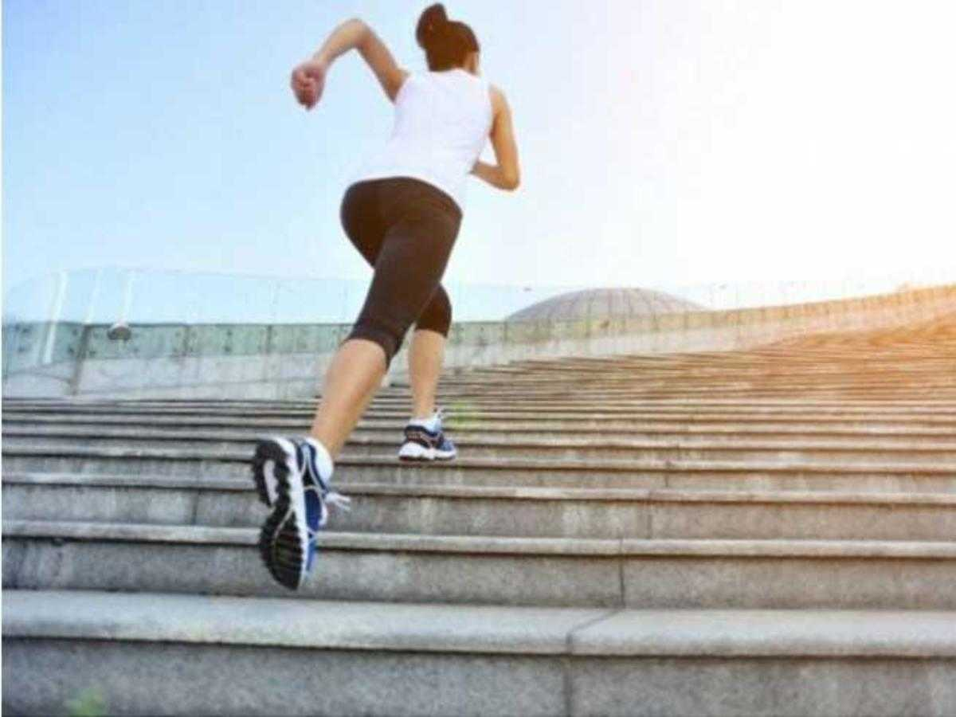
to feel fit = u kondiciji to be in good shape, in good condition

Slide 15
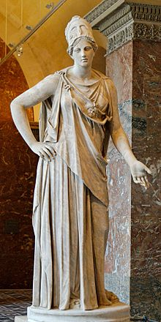
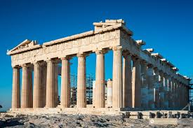
advanced = state-of-the art, cutting edge design masterpiece of architecture to reflect – reflecting the goddess Athena /əˈθiːnə/or Athene /əˈθiːnɪ/, the capital of Greece – Athens/ăth′ənz/

Slide 16
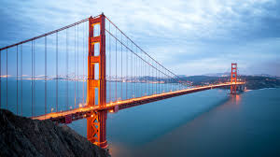
suspension (hanging) bridge
(= viseći most) span - stretch, extent(= rastojanje, razmak, raspon) cross the bridge, go across
blue horizon /həˈrʌɪzn/ = horizont
bay - zaliv

Slide 17
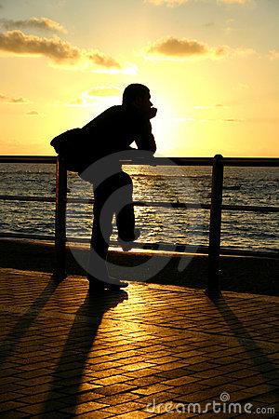
to gaze at= look steadily and intently, especially in admiration, surprise, or thought.

Slide 18

to look
skim and scan
glimpse
glance
peep
peek
gaze
gape
goggle
stare
glare
observe
watch

Slide 19
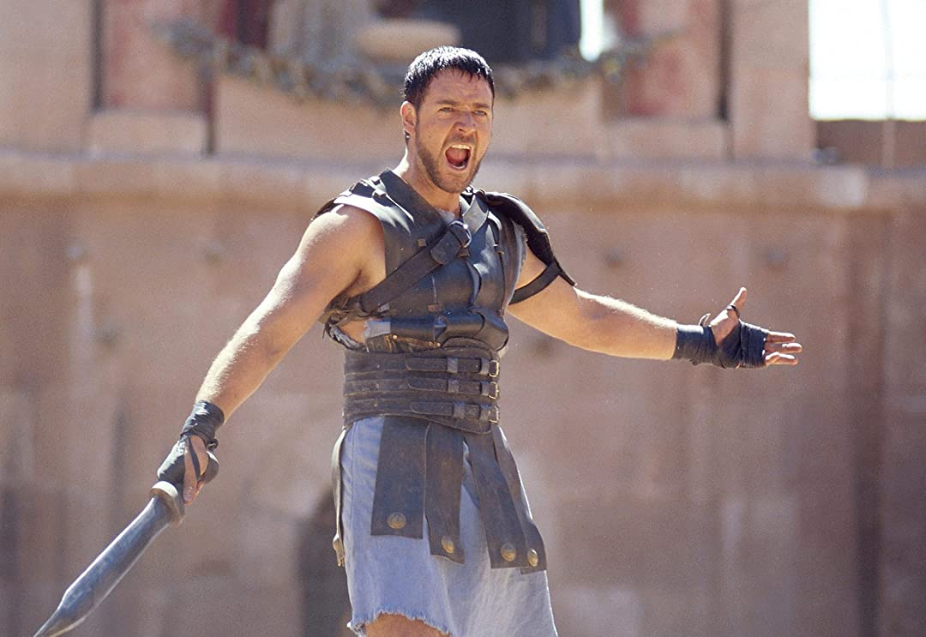
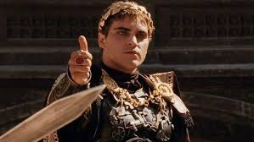
gladiator /ˈɡladɪeɪtə/ (in ancient Rome) a man trained to fight with weapons against other men or wild animals in an arena.
to seek favour of their emperor = to ask for mercy (tražiti naklonost cara)
cruelty /ˈkrʊəlti/ brutality
cruel, adj. – ohol, surov
fight,v. ir. – fought –fought
boriti se

Slide 20
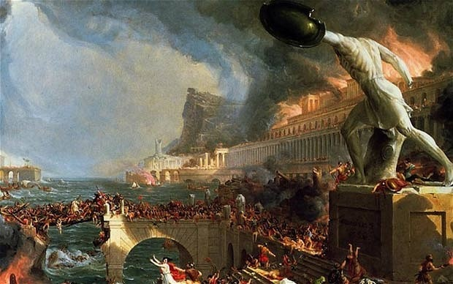
declining empire empire which is starts to weaken and collapse to decline – to weaken, to go down pad, nazadovanje

Slide 21
3. page 145, Listening 5, Listen to the audio again and make notes in the 4th column
 | PLACE | CITY/COUNTRY | COMMENTARY | NOTES
a | St. Basil’s | Moscow/Russia
b | St. Peter’s | Vatican City/Vatican | 4 | Renaissance painters
c | Sacre Coeur | Paris/France
d | The Sphinx/Pyramids | Cairo/Egypt
e | The White House | Washington DC/USA | 1 | elegant, powerful etc.
f | Sydney Opera House | Sydney/Australia
g | Colloseum | Rome/Italy | 7 | Gladiators fought to death
h | Golden Gate Bridge | San Francisco/USA | 6 | superb views on the bay
i | The Acropolis | Athens/Greece | 5 | used as a church and mosque
j | The Eiffel Tower | Paris/France | 3 | engineering achievement
k | Taj Mahal | Agra/India | 2 | symbol of love
l | Wat Arun | Wat Arun/Thailand

Slide 22
4. page 145, When describing a place, a guide should make it sound interesting and exciting. Discuss how the guides in the audio did this.
dramatisation e.g. Imagine the scene, if you can over 1100 years ago, as gladiators fought to the death seeking the favour of their emperor. Imagine the blood and cruelty…
storytelling e.g. it was built by the Emperor Shah Jahal as mausoleum to his beloved wife.
vivid description e.g. …and to your right you’ll be able to gaze out the blue horizon of the Pacific Ocean

Slide 23
HW, Listen again and write down examples of Passive Voice
It was designed by James Hoban.
It was burned by the British.
It was restored later.
It was built by the emperor Shah Jahal.
It is said that the British planned to build a similar structure.

Slide 24
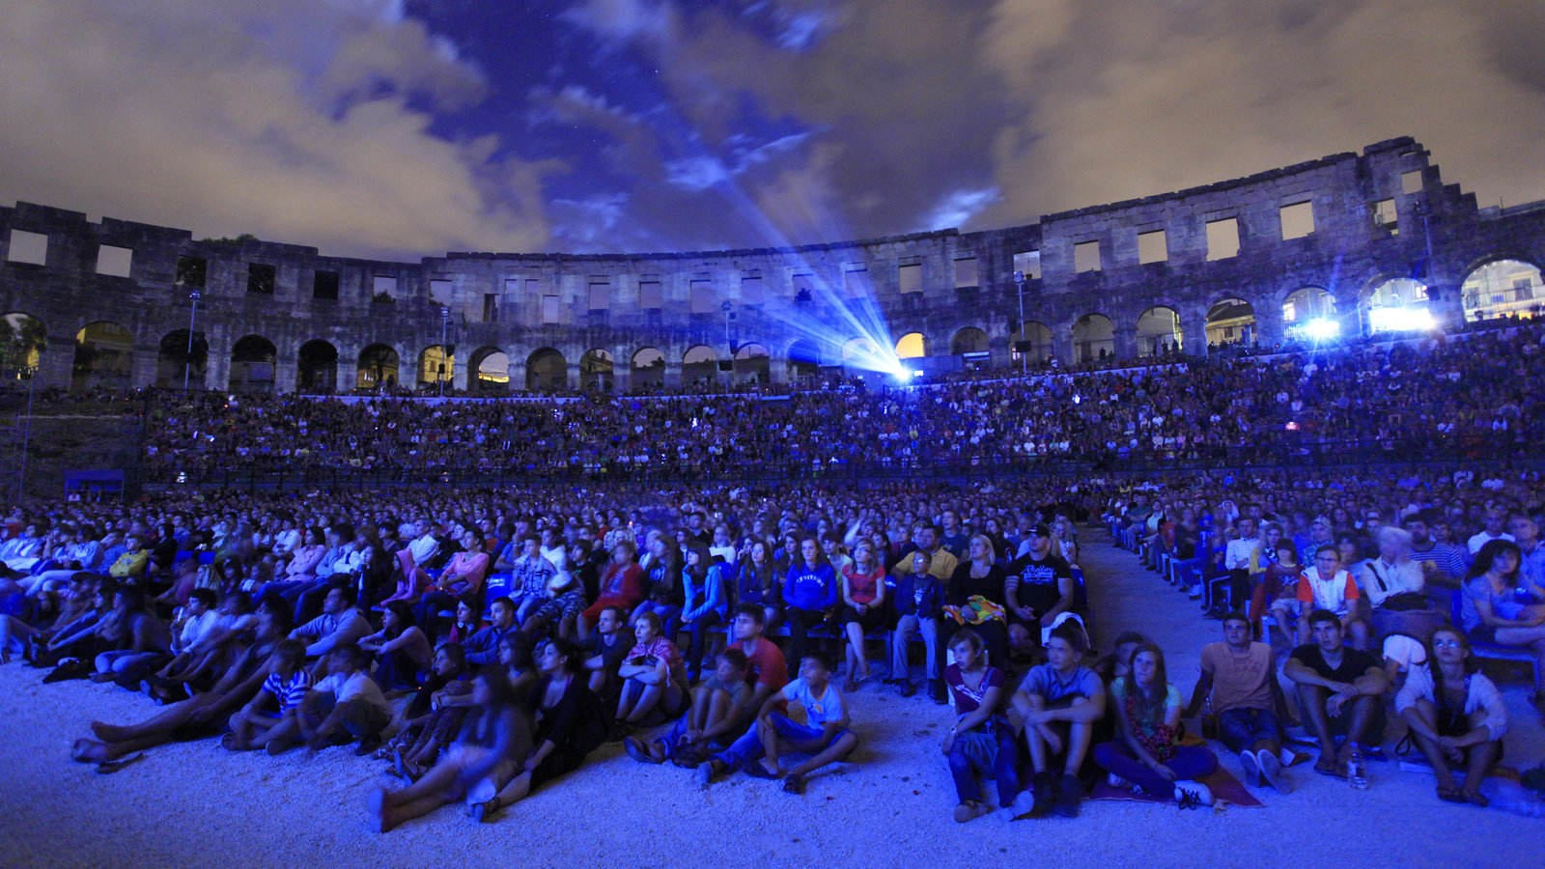
Thank you for your Attention!

