Slide 1
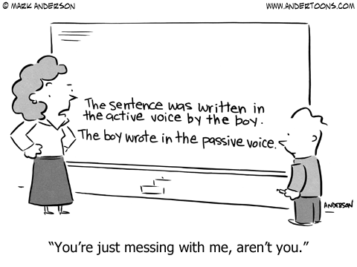
The Passive

Slide 2
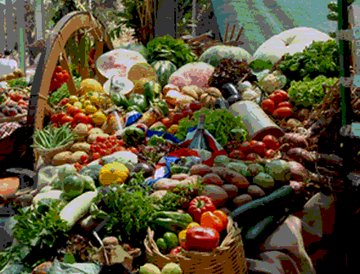

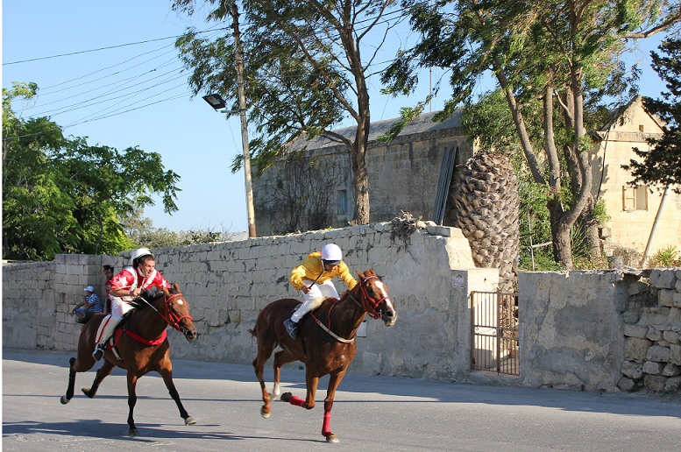
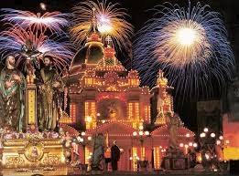

Slide 3
Match the words to make sentences
flowers
candles
torches
horses
pastry
wine
costume
to light
to drink
to ride
to lay out
to make
to carry
to wear

Slide 4
Sample sentences
The window was broken last night.
Our IT system is being renewed at the moment.
A loan can be arranged within six days.
The prices were raised.
I have been offered a new job.
A new job has been offered to me.

Slide 5
We use the passive:
1. When who does the action is not important.
The new bridge hasn’t been repaired yet.
2. When who does the action is clear from the situation:
I was being asked some difficult questions at the interview.
3. When who does the action is unknown:
The window was broken last night.

Slide 6
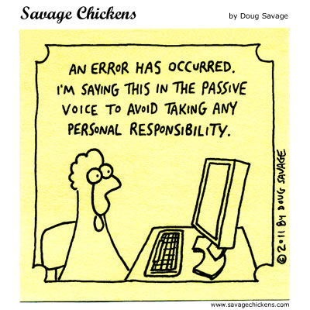
We use the passive:

Slide 7
Passive can be formed ONLY with transitive verbs – those that have an OBJECT
Someone is walking in the street.-NO OBJECT
Somebody damaged in transit.
our new TV
OBJECT

Slide 8
ACTIVE PASSIVE
ACTIVE: Subject Object
speak .
PASSIVE:
Mexicans
Spanish
is spoken
by Mexicans.

Slide 9
ACTIVE PASSIVE
Subject Object
founded .
by .
Richard Branson
Virgin Records
was founded

Slide 10
Form:
TO BE + past participle

Slide 11
Steps in making an active sentences passive:
Shakespeare wrote “Romeo and Juliet”. (active)
Find the object of the active sentence.
Put the object at the beginning of the passive sentence.
Put the verb TO BE in the tense of the main verb of the active sentence.
Add past participle of the main verb of the active sentence
Add BY + subject of the active sentence (if necessary)
1. “Romeo and Juliet”
2. “Romeo and Juliet”…
3. was (because of WROTE)
4. written
5. by Shakespeare.
“Romeo and Juliet” was written by Shakespeare. (passive)

Slide 12
ACTIVE PASSIVE
Subject Object
wrote .
by
“Romeo and Juliet” was written by Shakespeare.
Shakespeare
“Romeo and Juliet”
was written

Slide 13
ACTIVE PASSIVE
Subject Object
was preparing for the guests.
by
The food was being prepared by the cook.
The cook
the food
was being prepared

Slide 14
ACTIVE PASSIVE
Subject Object
will not finish by next month.
by next month.
The project won’t be finished by next month.
They
the project
won’t be finished

Slide 15
ACTIVE PASSIVE
Subject Object
can arrange within six days.
within six days.
A meeting can be arranged within six days.
We
a meeting
can be arranged

Slide 16
Verbs with two objects
They promised
give, lend, offer, promise, sell, send, take smth. to smbd.
book, buy, keep, make, prepare, save smth. for smbd.
me
a better salary.
indirect object
direct object

Slide 17
ACTIVE PASSIVE
Subject Indirect object Direct object
offered
1.
I was offered a new job.
2.
A new job was offered to me.
They
me
a new job
I
was offered
was offered
to
me

Slide 18
ACTIVE PASSIVE
Subject Indirect object Direct object
gave
1.
We were given a nice present.
2.
A nice present was given to us.
They
us
a nice present
We
were given
was given
to
us

Slide 19
Put the following sentences into passive voice:
1. When will you tell them the truth?
When will they be told the truth?
2. Why didn’t they inform us?
Why weren’t we informed?
3. Why have they made the changes?
Why have the changes been made?
4. Are they building a new school there?
Is a new school being built there?

Slide 20
Put the following sentences into passive voice:
5. He didn’t tell her the truth.
She wasn’t told the truth.
6. When will they repair the museum?
When will the museum be repaired?
7. She has made many mistakes.
Many mistakes have been made.
8. Did they give her the scholarship?
Was she given the scholarship?

Slide 21
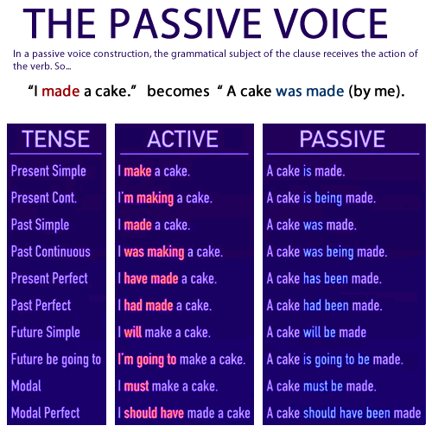

Slide 22
Put the verbs in brackets into the correct form of the passive:
will have been found
By the end of the decade the means ________________ (find) to cure cancer with genetic drugs.
In 1996 your voice (recognize) _____________ by PCs, but a way still ____________ (not find) for your PC to get information back to you.
Technological improvements ____________ (make) all the time, even as we speak.
The weather never totally ____________ (control) by human beings.
The meeting ______________ (put back) until next Friday.
The project ______________ (complete) yesterday.
Final adjustments ____________ (carry out) at the moment.
The post usually ____________ (not deliver) until 11 o’clock.
was recognized
has not been found
are being made
will be controlled
has been put off
was completed
are being carried out
is not delivered

Slide 23
Put the verbs in brackets into the past simple – passive or active:
The Times, Britain’s most favourite newspaper, first (publish) _________ in 1785. In 1814, it (pioneer) _______ new technology which (use) _________ steam-driven presses to print 1,100 sheets an hour. These presses (install) ________ secretly because the owners (be) _____ afraid of machine-breakers. Over the next 170 years, it (develop) ______ its reputation as a quality newspaper. In 1978 a strike by print union members (keep) _______ the Times out of circulation for nearly a year.
was published
pioneered
used
were installed
were
developed
kept

Slide 24
Put the verbs in brackets into the past simple – passive or active:
In 1986 the paper’s new owner (move) _______ to a new computerized plant. This change in technology (mean) ________ that machines (can/operate) _________ by members of the electricians’ unions, and print union members (make redundant) __________ . There (be) _______ demonstrations and picketing by the print unions, but in the end the new technology (adopt) ________ throughout the newspaper industry.
moved
meant
could be operated
were made redundant
were
was adopted

Slide 25
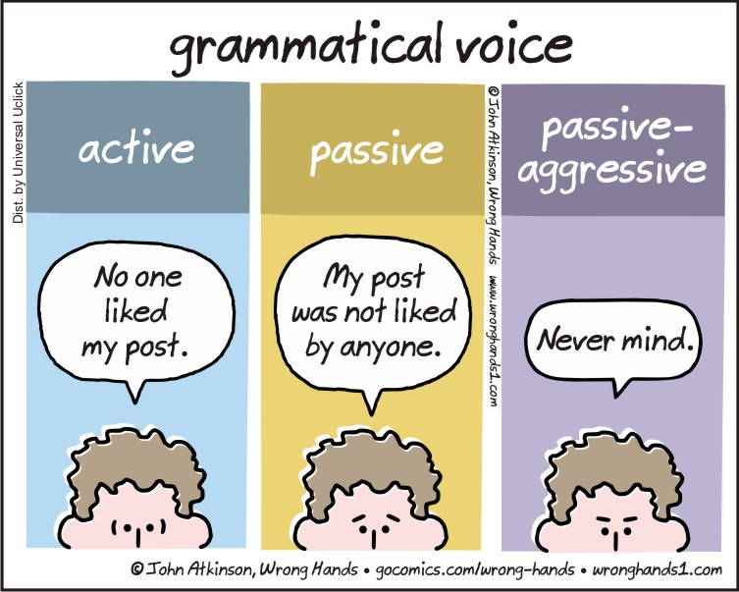
Thank you for your Attention!

