Slide 1
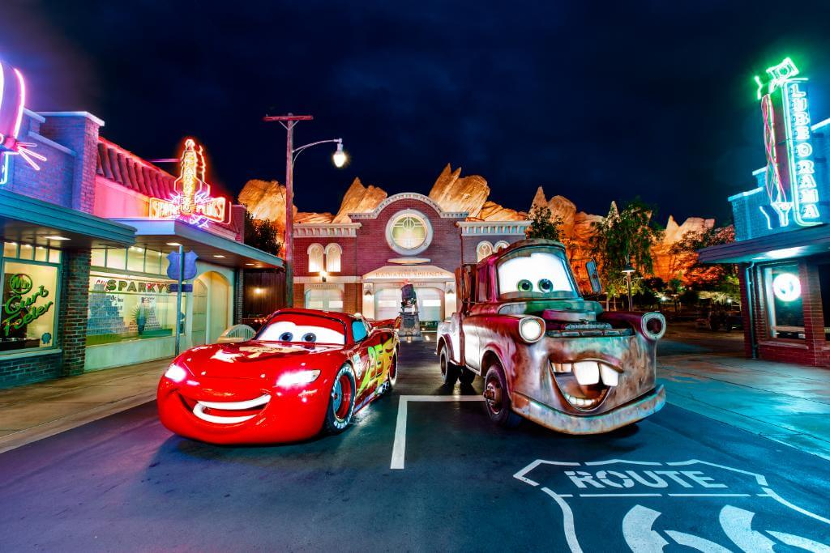
PRACTICE
Accommodation Options at Disneyland Paris

Slide 2
Reading and speaking
page 132-3

Slide 3
Group A
Read about the hotels in Disneyland Paris in page 132 and complete the table
Hotel New York/the Sequoia Lodge/the Hotel Santa Fé
Name of hotel
Theme
Facilities in the hotel
Facilities in the room
Restaurants
Classification
Price category
Any other information

Slide 4
Group A sample answers for the Hotel Santa Fé
Name of hotel the Hotel Santa Fé
Theme e.g New Mexico trails
Facilities in the hotel e.g. live entertainment
Facilities in the room e.g. private bathroom
Restaurants e.g La Cantina
Classification a two-star hotel
Price category the lowest price at the resort
Any other information e.g. room-only accommodation

Slide 5
Group B
Read about the hotels in Disneyland Paris in page 181 and complete the table the Disneyland Hotel/the Newport Bay Club/the Hotel Chayenne
Name of hotel
Theme
Facilities in the hotel
Facilities in the room
Restaurants
Classification
Price category
Any other information

Slide 6
Group B sample answers for the Newport Bay Club
Name of hotel the Newport Bay Club
Theme e.g. marina yachting
Facilities in the hotel e.g. leisure facilities
Facilities in the room e.g. mini-bar
Restaurants e.g Fisherman’s Wharf
Classification a three-star hotel
Price category e.g good value for money
Any other information e.g credit card details to enable purchases

Slide 7
target groups potential customers
young old (age groups)
male female children (gender)
corporate travellers (profession)
nature lovers (hobbies)
culture vultures (interests)
brand lovers
fans (music, movies, sports)
lifestyle (urban, easygoing, green)

Slide 8
2. target groups
Who the accommodation would be suitable for?
Describe in detail three different groups of imaginery tourists for each accommodation types:
Hotel New York_______________________
the Sequoia Lodge______________________
the Hotel Santa Fé______________________
the Disneyland Hotel____________________
the Newport Bay Club ___________________
the Hotel Chayenne _____________________

Slide 9
3. Describe a themed hotel/restaurant or bar (any other hospitality establishment in your country)
Write a short account (up to 300 words) or do a presentation about the themed place.
Say something about the underlying story or theme as well as the offer for visitors.
How the customers experience the theme/story?

Slide 10
