Slide 1
Describing a Festival
Practice: Passive Voice
Practice: Written and Spoken Register
Harding, Going International Workbook
Harding,Tourism, Student’s Book, pp-64-65

Slide 2
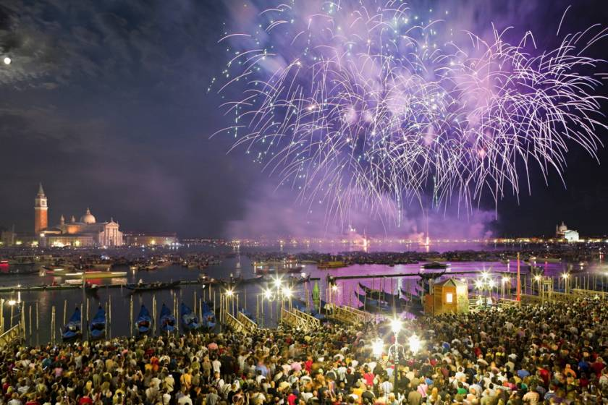
Festa del Redentore https://www.youtube.com/watch?v=MJNJ99dAviU

Slide 3
Festa del Redentore
Location: Venice, Italy
Timing: third weekend of July
Duration: two days
information:
https://www.vivovenetia.com/redentore-2018-two-magic-days-venice/

Slide 4
1. Listen to a guide describing the Festa del Redentore in Venice. As you listen, follow the written text and indicate places where the guide
1. adds something that is not in the text (↑)
2. misses out, changes, or uses different words (_)
The first paragraph is done for you as an example.

Slide 5
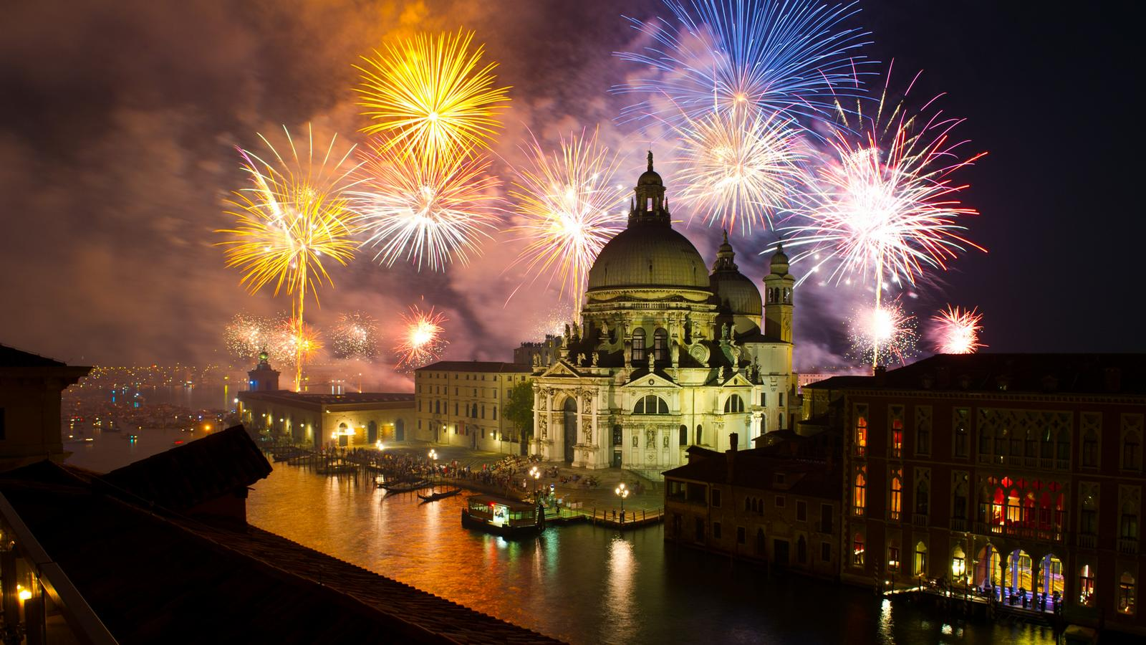
Introduction
↑ The Festa del Redentore – The Festival of the Reedemer – is a high point of the Venice summer. Thanks to a spectacular firework display, the Redentore is a major tourist attraction.

Slide 6
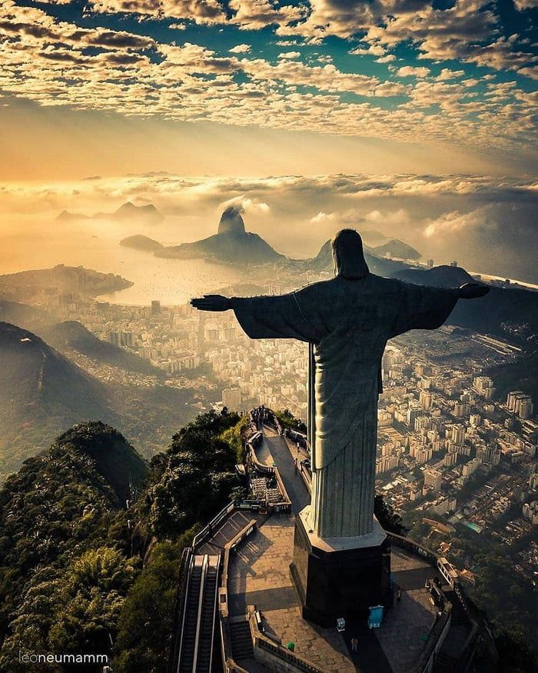
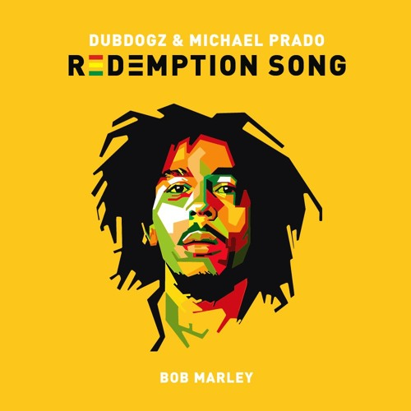
to redeem, v. = compensate for the faults or bad acts (iskupiti se) redeemer, n. – a person who redeems sb./sthg. redemption, n. = iskupljivanje (za počinjene grehove)

Slide 7
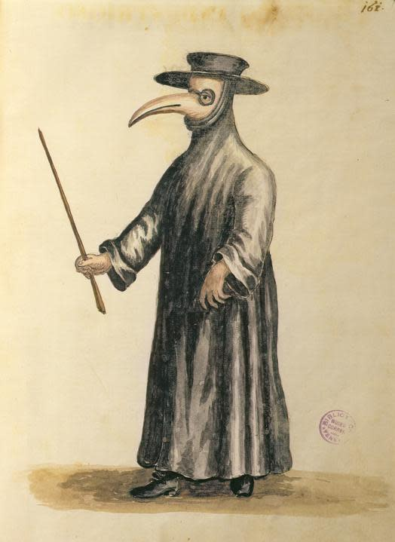
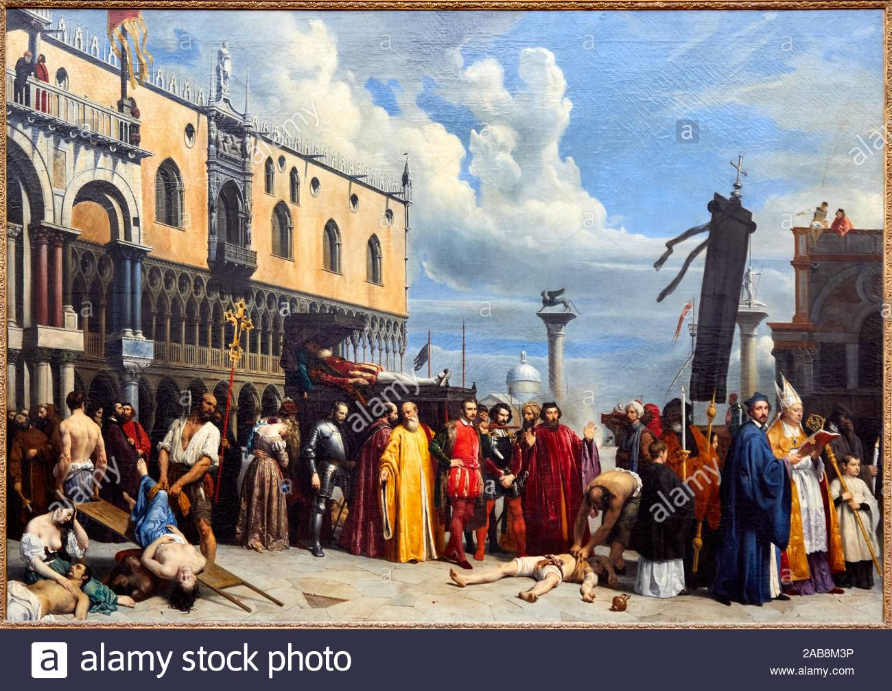
History
From 1575-77, Venice was hit by a terrible plague which killed more than a third of the city’s inhabitants.

Slide 8
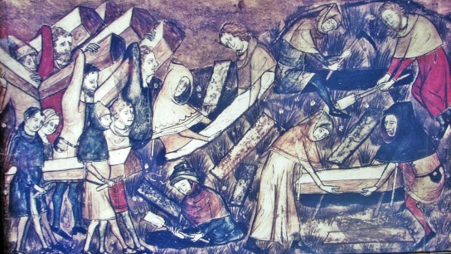
plague (three great waves) the Great Plague ( 17th London)
Black Death from bubonic plague (peak1347 – 1351, millions of casualties)
https://www.youtube.com/watch?v=MYnMXEcHI7U

Slide 9
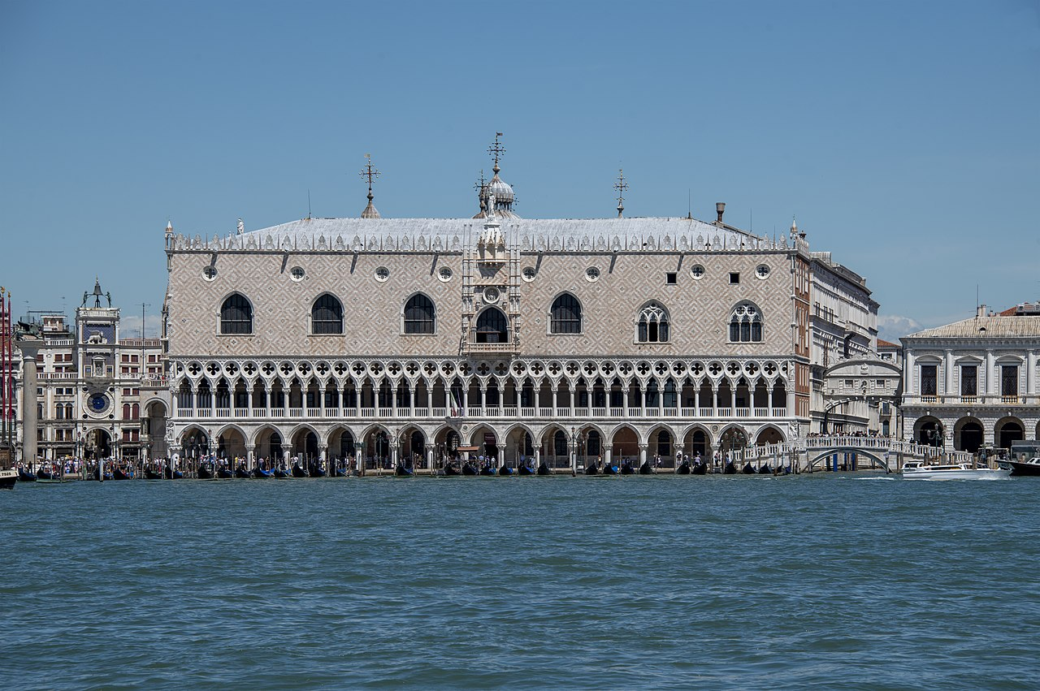
History
In 1576, the city’s leader, the Doge (=dodge, dužd), promised to erect a church dedicated to (to honour) a Redeemer, in return for help in ending the plague.
The Dodge’s Palace = Duždeva palata

Slide 10
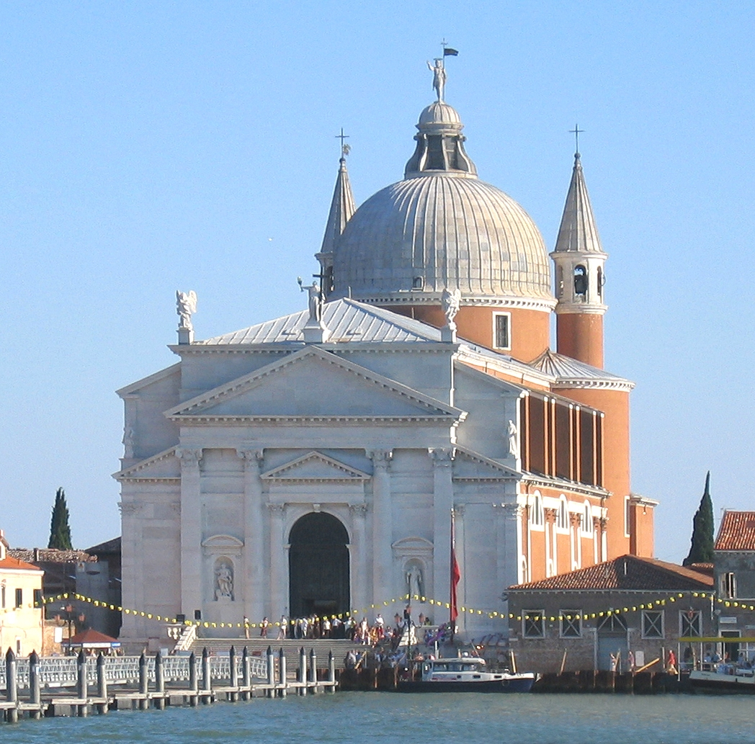
History
On July 13, 1577, the plague was declared over, and work began to construct the church. It was also decided that Venice would forever give thanks on the third Sunday of July.

Slide 11
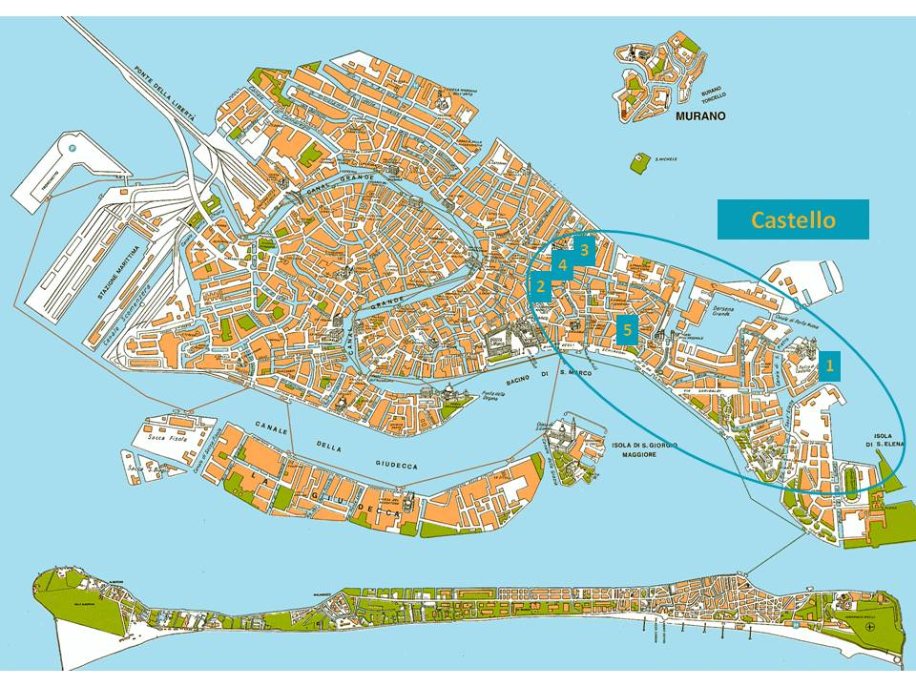
St Mark’s lagoon (=an area of shallow water separated from the sea by low sandy dunes/barrier)

Slide 12
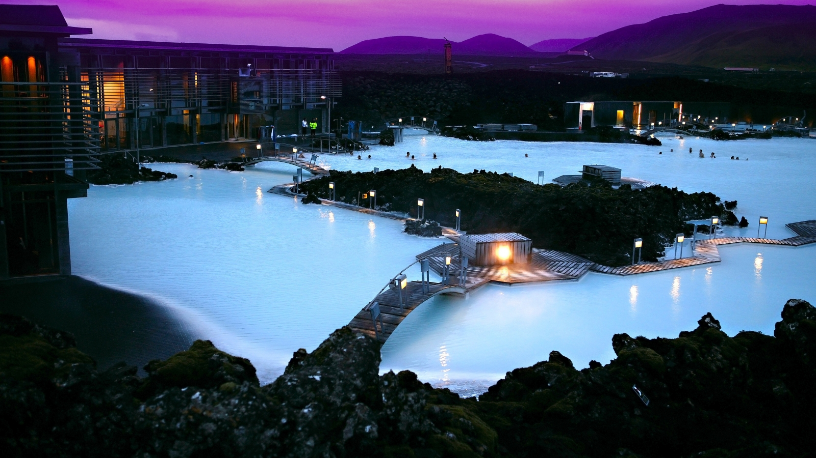
Blue Lagoon Iceland

Slide 13
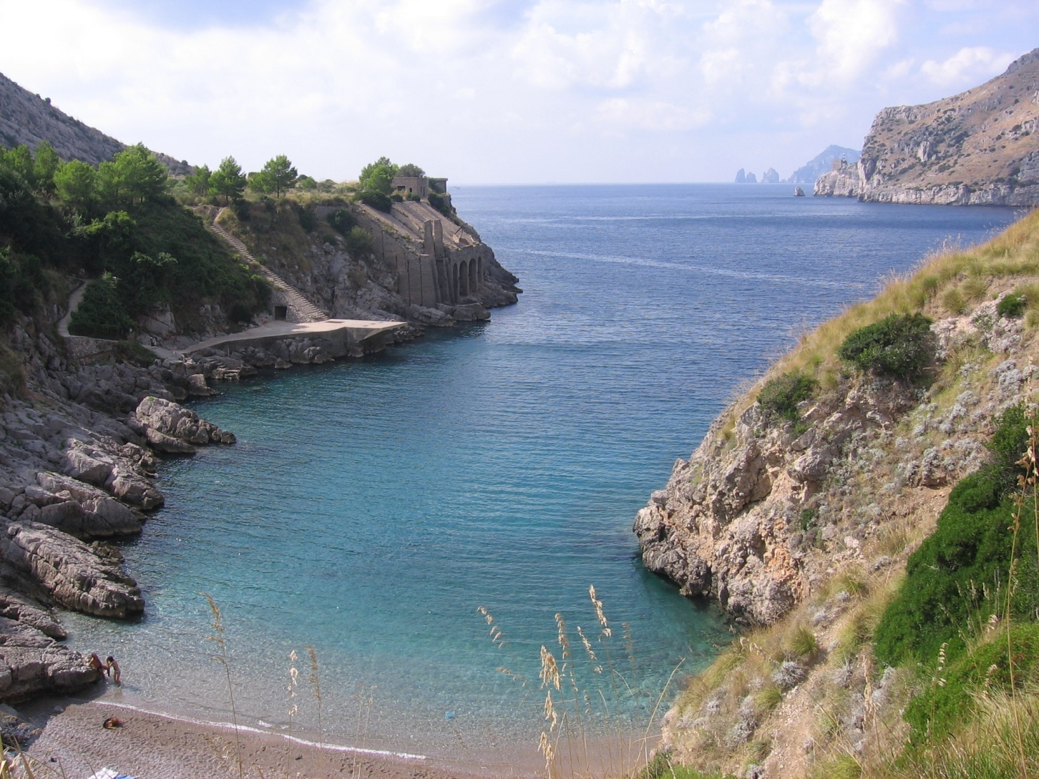
bay (manji zaliv) connected to the ocean by an inlet (uvala)

Slide 14
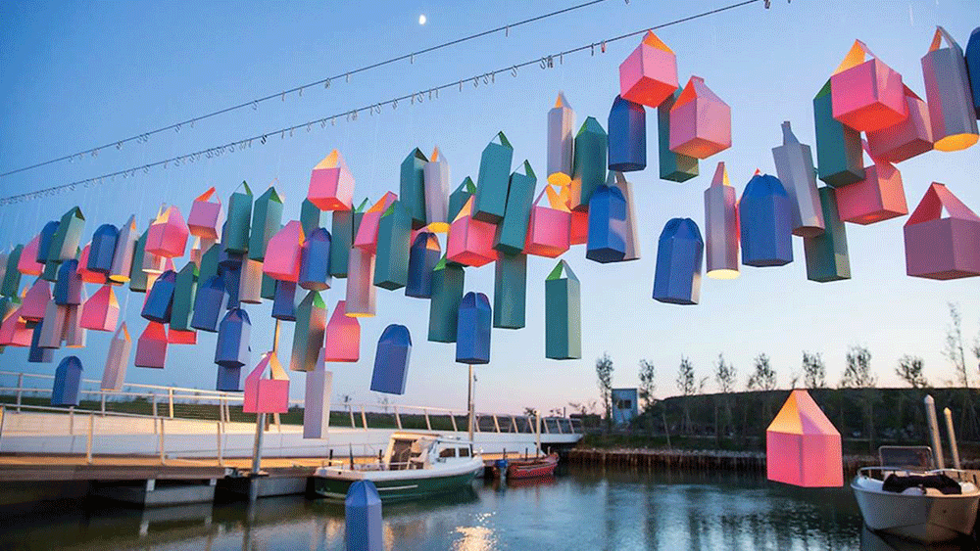
lantern lampa, fenjer, svetiljka

Slide 15
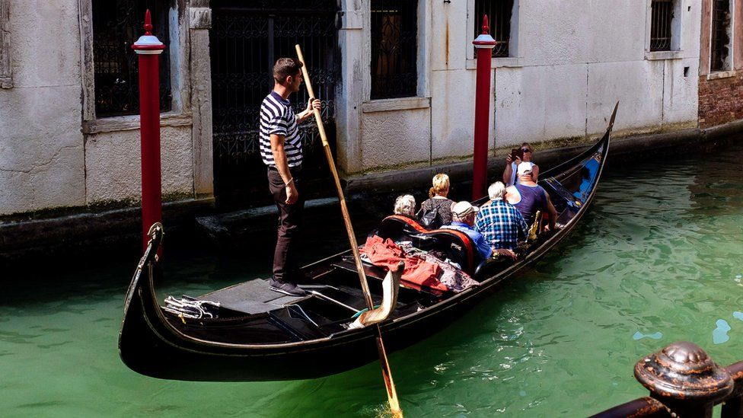
occupant = a person who resides or is present in a house, vehicle, seat, etc., at a given time. e.g. gondola occupants

Slide 16
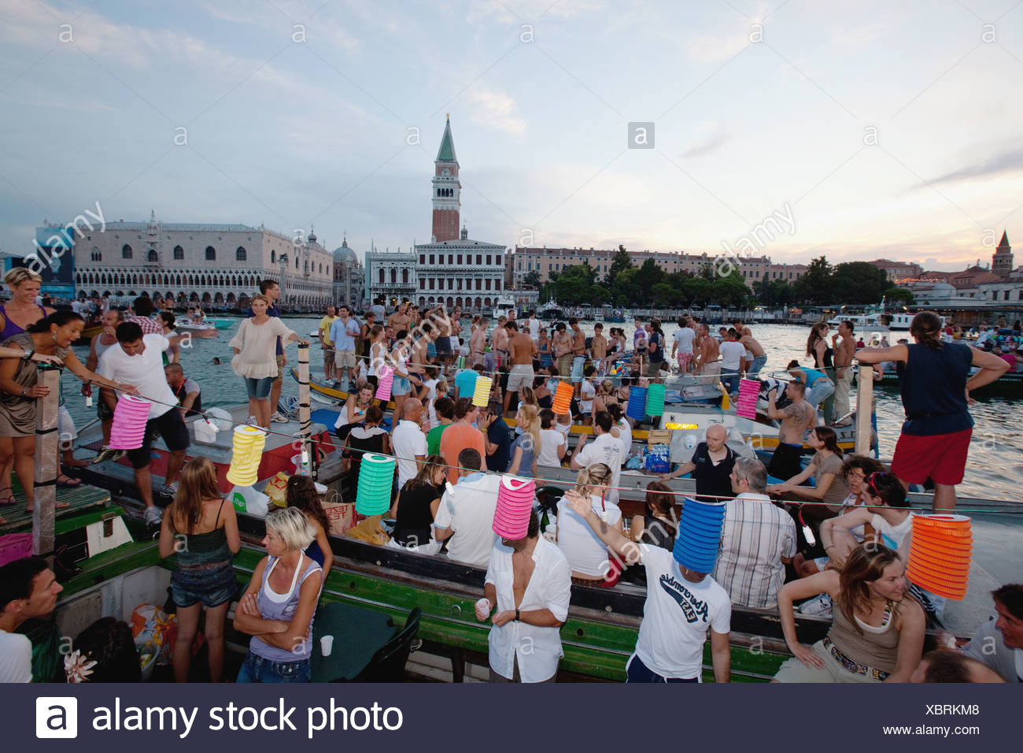
What Happens
From early on the Saturday, boats are decorated with flowers, lanterns, and balloons. St Mark’s lagoon fills with as many as two thousand boats, their occupants eating drinking as they wait for the traditional spectacular display of fireworks. (Arrangements can easily be made through your hotel for an evening with dinner on a boat).

Slide 17
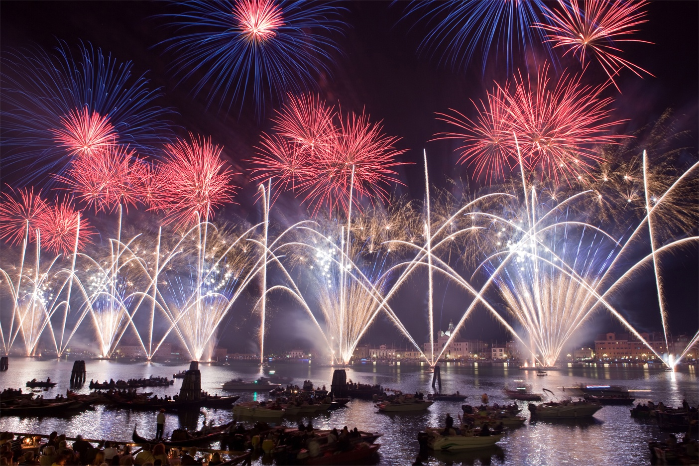
What Happens
At around 11.30 p.m., the display begins and the lagoon becomes one of the most atmospheric stages in the world, fireworks illuminating the spire, domes, and bell towers of the city.

Slide 18
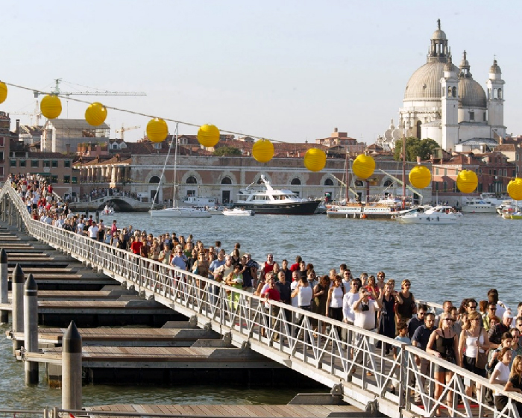
What Happens
On Sunday, a pontoon of decorated gondolas and other boats is strung across the Giudecca canal to allow the faithful to walk to the church of the Redentore. The climax (main event) of the festival is the mass (misa) held in the presence the Patriach of Venice (bishop), a reminder that the Festa has a serious side.
For more information visit the website.

Slide 19
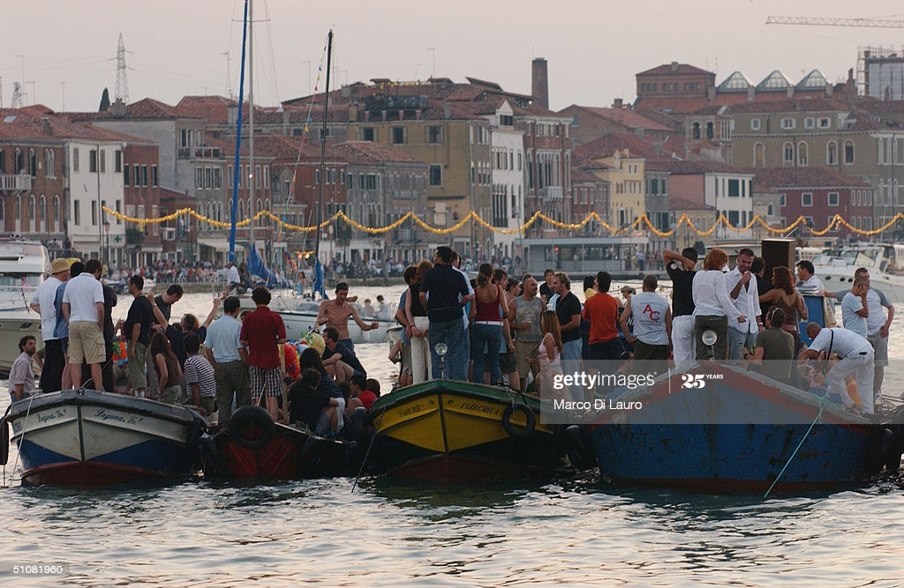
Boats are strung. string, v. – strung – strung
(hang, stretch, thread, nanizati, poređati)

Slide 20
Listen again. Complete key expressions used by the guide.
1. Good morning, ____________ Welcome to Venice.
2. My name is Carlotta and I ___________ your guide for this weekend.
3. Before I start, can __________ me at the back?
4. Let me start _______________ a little about the history of the festival.
5. From 1575 to 77, as _______________, Venice was...
6. Now, ______________the festival itself. What ____________ is this:

Slide 21
Listen again. Complete key expressions used by the guide.
7. By ______________, if you’ve wondering about...
8. The climax of the festival and the most significant part if you remember _________ about the history of the festival, is...
9. Oh, one thing I __________ is that...
10..
11. Are there _So, that’s the Festa del Redantore. As _________, it’s a wonderful event_______________?

Slide 22
Listen again. Complete key expressions used by the guide.
1. Good morning, EVERYONE Welcome to Venice.
2. My name is Carlotta and I’LL BE your guide for this weekend.
3. Before I start, can YOU ALL HEAR me at the back?
4. Let me start BY TELLING YOU a little about the history of the festival.
5. From 1575 to 77, as YOU MAY KNOW, Venice was...
6. Now, MOVING ON TO the festival itself. What HAPPENS is this:

Slide 23
Listen again. Complete key expressions used by the guide.
7. By THE WAY, if you’ve wondering about...
8. The climax of the festival and the most significant part if you remember WHAT I SAID about the history of the festival, is...
9. Oh, one thing I FORGOT is that...
10. So, that’s the Festa del Redantore. As YOU CAN SEE, it’s a wonderful event.
11. Are there ANY QUESTIONS?

Slide 24
4. Look the comparison between the characteristics of written and spoken descriptions
5. Find examples in the text
WRITTEN
SPOKEN
Introductory phrases (e.g. Let me start by telling you about...)
Shorter sentences; sentence breaks
Passive is used, but not so frequently – instead use of ‘you’ (e.g. You can make arrangements...)
Interaction with the audience (e.g. Can you all hear me at the back?)
Use headings and paragraphs
Longer sentences
Passive forms
No interaction with the reader
Punctuation (e.g. brackets)

Slide 25
passive
was hit by the plague
was declared over
it was decided
it was/is dedicated to
arrangements can be made
boats are decorated
pontoon is strung
the mass is held
FESTA DEL REDENTORE
https://www.youtube.com/watch?v=562kOqkWMNk

Slide 26
HW- Writing
Write a similar description of a festival for a hotel information brochure. Choose a festival that you know about, or use the notes below about, or use the notes below about the Edinburgh Festival. Divide your passage into three main paragraphs.
THE EDINBURGH FESTIVAL
Edinburgh Festival – Scotland
International artists
August/September every year
series of French films
New York Symphony Orchestra – Beethoven’s 9th
available at hotel – programmes, tickets
travel arrangements
festival plays, concerts, exhibitions started 1947
this year – Royal Ballet, Swan Lake
new plays from around the world
early booking essential for some shows

Slide 27
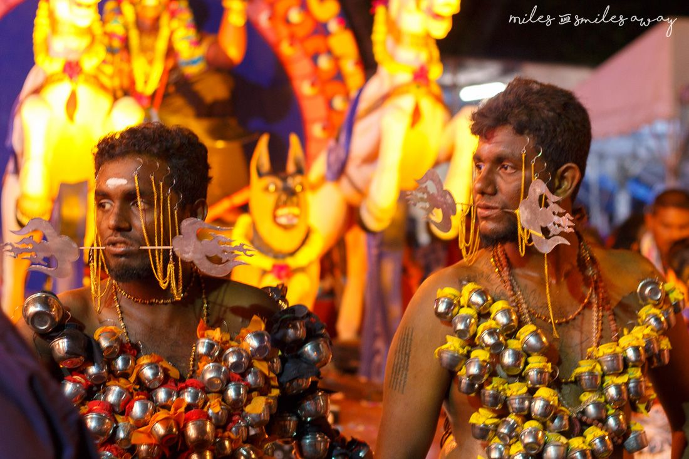
Simple Present Active or Passive
Read this extract from a hotel information brochure. Put the verbs in brackets into the Simple Present Active or Passive.
The Hindu Festival of Thaipusam is one of Malaysia’s most famous and colourful festivals, and ceremonies (1) ARE HELD in the temples all over the country in honour of the Hindu god Subramaniam

Slide 28
Simple Present Active or Passive
Read this extract from a hotel information brochure. Put the verbs in brackets into the Simple Present Active or Passive
The devotees who (2) ___________ (want) to take part in the festival (3) ______________ (eat) special food for several weeks before Thaipusam so that their bodies will be prepared. When the day (4) ___________ (arrive), they go into a temple, where special chants (5) _________ (sing) by a priest. The devotees go into a trance, and the priest (6) __________ (push) long metal rods through their cheeks, nose or tongue. Sometimes hooks (7) ____________ (attach) to their backs, and they (8) __________ (pull) a kind of a cart, which (9) ______________ (call) a kavadi, along the street.

Slide 29
Simple Present Active or Passive
Read this extract from a hotel information brochure. Put the verbs in brackets into the Simple Present Active or Passive
The devotees who (2) WANT (want) to take part in the festival (3) EAT (eat) special food for several weeks before Thaipusam so that their bodies will be prepared. When the day (4) ARRIVES (arrive), they go into a temple, where special chants (5) ARE SUNG (sing) by a priest. The devotees go into a trance, and the priest (6) PUSHES (push) long metal rods through their cheeks, nose or tongue. Sometimes hooks (7) ARE ATTACHED (attach) to their backs, and they (8) PULL (pull) a kind of a cart, which (9) IS CALLED (call) a kavadi, along the street.

Slide 30
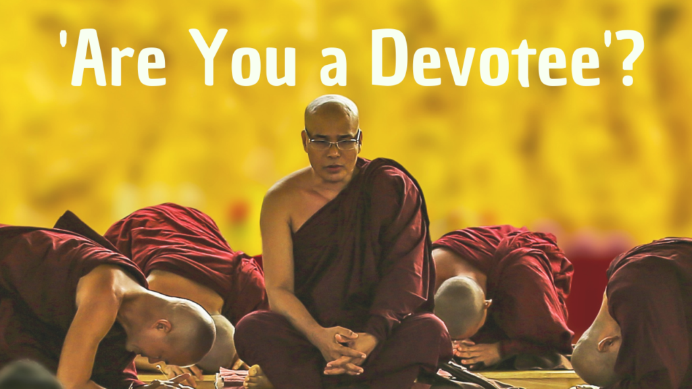
to devote oneself to sb. sthg = commit to devotion – love, loyalty to sb. sthg devotee = worshipper, believer

Slide 31
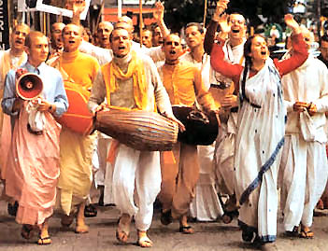
chants = religious songs

Slide 32
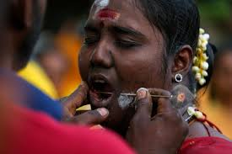
rod (= bar, stick) in the cheek štap, šipka

Slide 33
to attach = 1. to fix, 2. to enclose, add attachment

Slide 34
Simple Present Active or Passive
Read this extract from a hotel information brochure. Put the verbs in brackets into the Simple Present Active or Passive
At other temples, fire-walking ceremonies (10) _____________(organize), and the devotees (11) ____________ (walk) several metres over red hot coal. Perhaps the most astonishing thing about these ceremonies is that the devotees (12) ______________ (not/harm) in any way. There is no blood, and the cuts (13) _______ (heal) very quickly.

Slide 35
Simple Present Active or Passive
Read this extract from a hotel information brochure. Put the verbs in brackets into the Simple Present Active or Passive
At other temples, fire-walking ceremonies (10) ORGANIZE (organize), and the devotees (11) WALK (walk) several metres over red hot coal. Perhaps the most astonishing thing about these ceremonies is that the devotees (12) ARE NOT HARMED (not/harm) in any way. There is no blood, and the cuts (13) ARE HEALED (heal) very quickly.

Slide 36
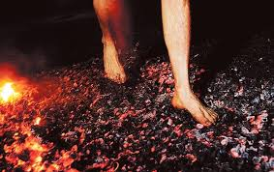
Fire-walking ceremony coal = ugalj

Slide 37
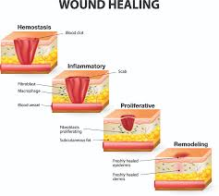
Zaceljivanje rana astonishing = amazing, surprising

Slide 38
Simple Present Active or Passive
Read this extract from a hotel information brochure. Put the verbs in brackets into the Simple Present Active or Passive
Thaipusam (14) ________ (take) place early in the year, and this year it falls on 28 January. One of the best places to see the ceremonies is at the Batu Caves, which (15) _____________ (situated) only a few miles from Kuala Lumpur. Transport to the caves can (16) _______________ (arrange) by the hotel.

Slide 39
Simple Present Active or Passive
Read this extract from a hotel information brochure. Put the verbs in brackets into the Simple Present Active or Passive
Thaipusam (14) TAKES (take) place early in the year, and this year it falls on 28 January. One of the best places to see the ceremonies is at the Batu Caves, which (15) IS SITUATED (situated) only a few miles from Kuala Lumpur. Transport to the caves can (16) BE ARRANGED(arrange) by the hotel.

Slide 40
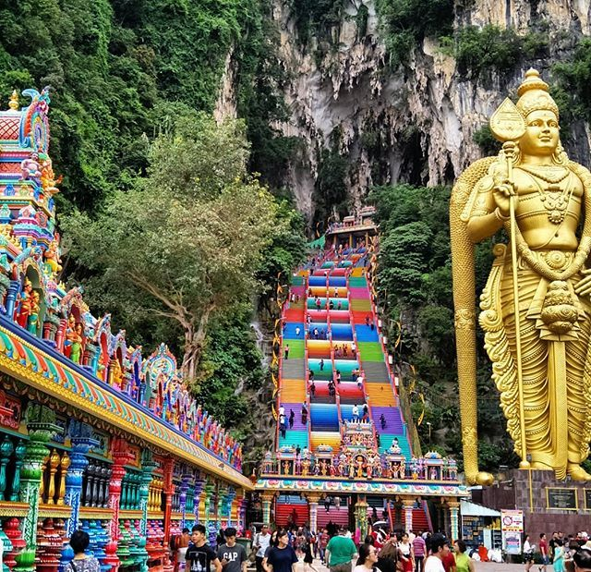
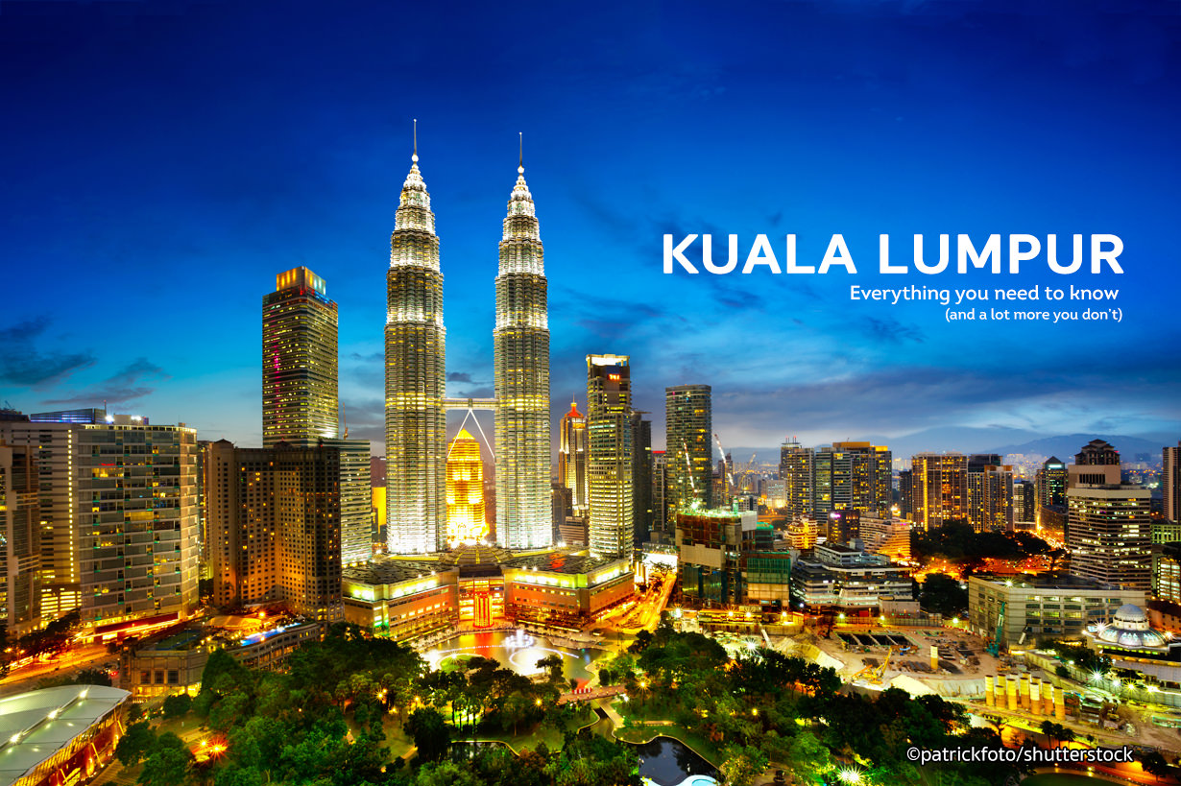
Batu Caves

Slide 41
verb forms
ARE HELD
ARE SUNG
ARE ATTACHED
IS CALLED
ARE NOT HARMED
ARE HEALED
IS SITUATED
CAN BE ARRANGED
WANT
EAT
ARRIVES
PUSHES
PULL
ORGANIZE
WALK
TAKES

Slide 42
Review
Write eight true sentences using words from each column and the simple past passive.
a | b | c
Laker Airways The First Olympics Suez Canal César Manrique The first package tours The Jardin de Cactus The Pyramids The Mona Lisa | design build paint open organize hold be born found | César Manrique Thomas Cook Leonardo da Vinci Ancient Egyptians Arrecife 776 BC 1966 1869

Slide 43
Review
Write eight true sentences using words from each column and the simple past passive.
1. Laker Airways was founded in 1966.
2. The First Olympics....
3.

Slide 44
Review
Write eight true sentences using words from each column and the Simple Past Passive.
1. Laker Airways was founded in 1966.
2. The First Olympics was held in 776 BC.
3. The Suez Canal was opened in 1869.
The first package tour were organized by Thomas Cook.
The Jardin de Cactus was designed by César Manrique.
The Pyramids were built by Ancient Egyptians.
The Mona Lisa was painted by Leonardo da Vinci.
César Manrique was born in Arrecife.

Slide 45
References
Festa del Redentore
https://www.youtube.com/watch?v=MJNJ99dAviU
https://www.youtube.com/watch?v=562kOqkWMNk
Black Death https://www.history.com/news/black-death-timeline
https://www.youtube.com/watch?v=MYnMXEcHI7U

Slide 46

Thank you for your Attention!

