Slide 1
Where East Meets West
Unit 9, page 124,
Information on Bangkok
VIDEO: https://www.youtube.com/watch?v=NPbov3zeivA

Slide 2
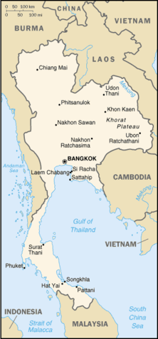
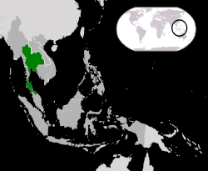
BANGKOK

Slide 3
Country
VIDEO: https://www.youtube.com/watch?v=Kjuuq-jWJ5c&t=87s
Heat Humidity Far East
Chopsticks Buddhist Bugs
Spices Melting Pot Nicole Kidman
Sex Tourism Drugs Bridget Jones
Silk Route the Venice of the East Tuk Tuk

Slide 4
Tourist Information - Sources
Tourist Information Centre
Tour Organization (Board, Bureau) of Belgrade e.g.
The Internet – Trip Advisor, Fodor’s Travel, Rough Guides, social media, blogs
TV – specialized channels and shows
the word of mouth, local community and people

Slide 5
Thailand/Bangkok
Location
Size
Climate
Money
Attractions
Night-life/Going Out
Things to do
Cuisine
Culture - Etiquette
Religion
Facilities and attractions you expect to find here?

Slide 6
BANGKOK
location: Southeast Asia, Indochina peninsula
neighbouring countries: Laos, Cambodia, Malaysia and Myanmar (close China and Vietnam)
size: 7,750 km², 10 million inhabitants + 10 million tourists/year
climate: tropical (average min 20°C, max 30°C)
Monsoon season from May to Sep (average rainfall 220 to 340mm)
religion: Buddhism
currency: Thai Baht

Slide 7
BANGKOK
the Capital of THAILAND
former SIAM (sayam, dark, brown)
Land of Freedom
Thai =man
VIDEO: watch https://www.youtube.com/watch?v=21mKbR-4VTA

Slide 8
Blend of East and West
(= mixture)
Bangkok, a city of contrasts
the melting pot
hustle and bustle of the city (=hubbub, commotion, opp. = off the beaten track)
the city of ancient heritage

Slide 9
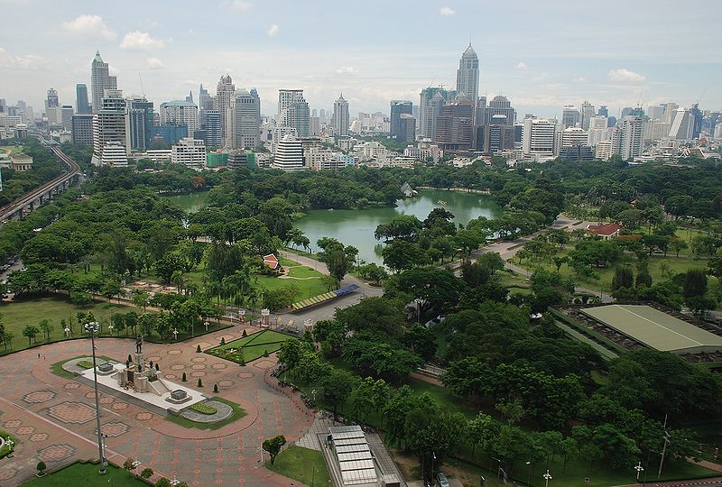
The city is growing at breathtaking (incredible) speed...
It’s a sprawling metropolis

Slide 10
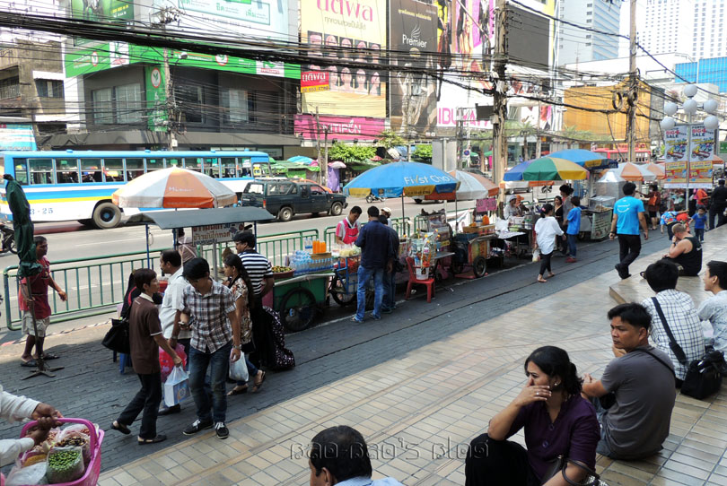
midday = noon noise and crowd at its worst feverish, chaotic

Slide 11
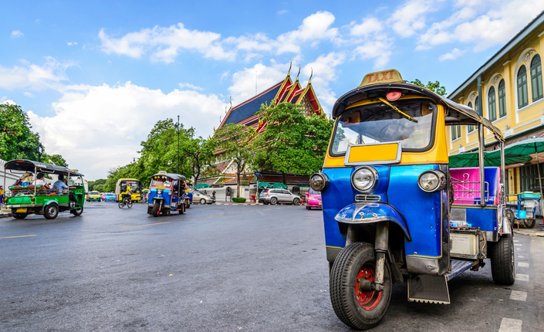
TUK TUK

Slide 12
to be at its/their worst
as bad or unpleasant as someone or something can be
The pain was at its worst in the late evenings.
This is television at its worst.
https://www.macmillandictionary.com/dictionary/british/at-its-their-worst

Slide 13
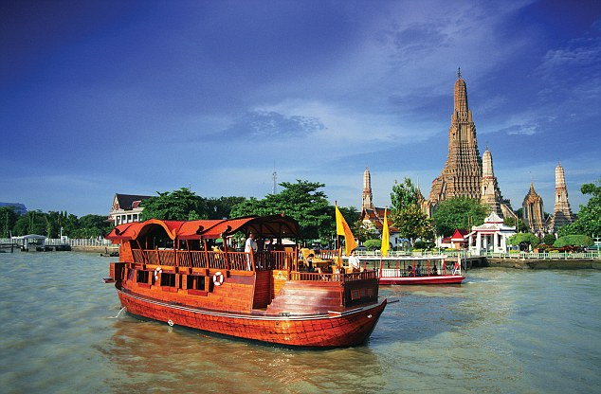
It is a city of ancient heritage.
Take a ride on Chao Phraya River and its connecting canals.

Slide 14
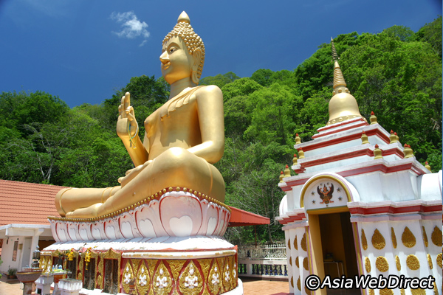
Wats = Temples

Slide 15
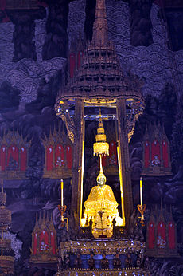
numerous statues of Buddha
Buddhist
Buddhism

Slide 16
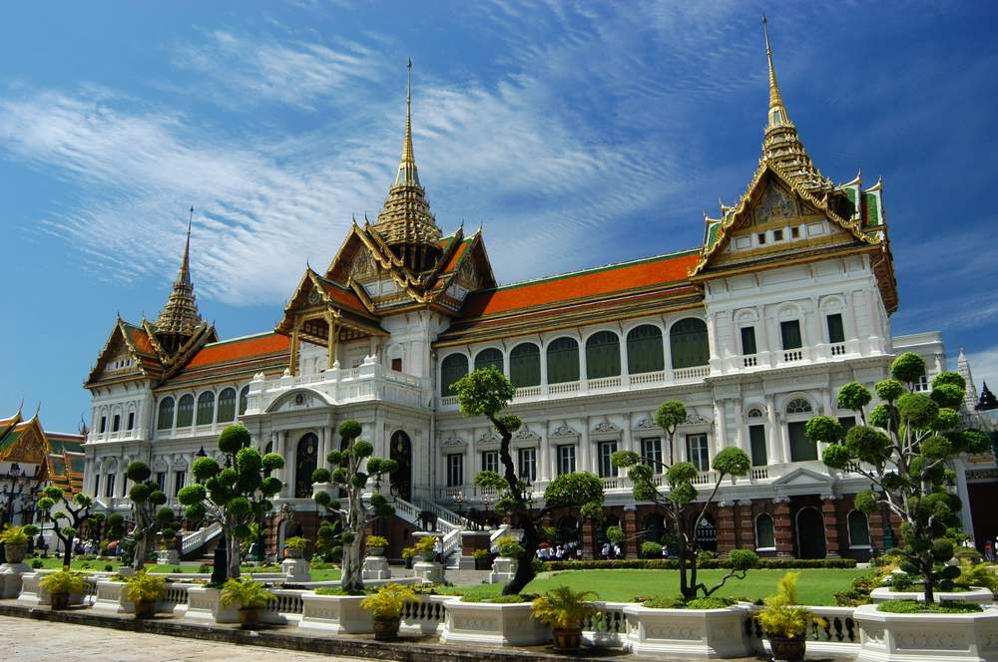
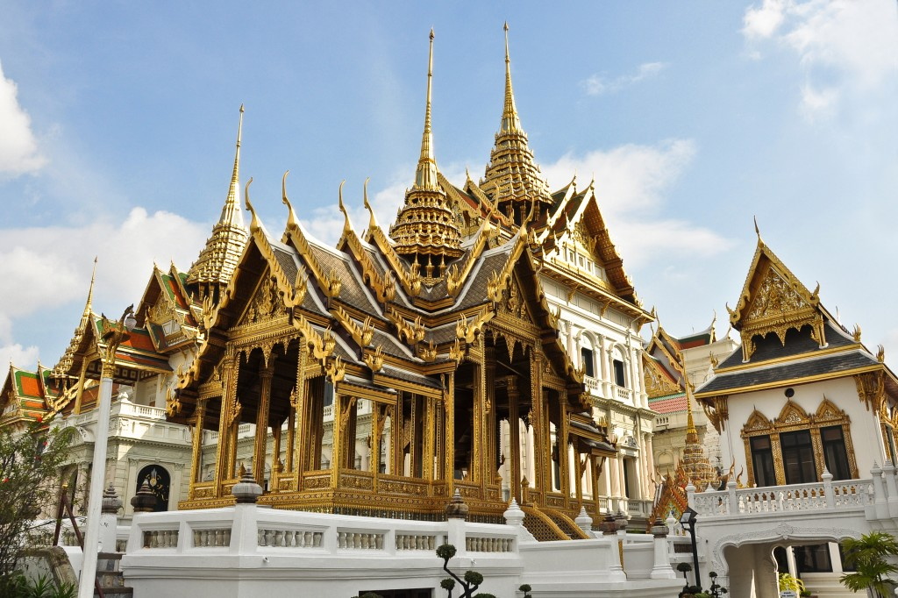
the splendour (=brilliance) of the Grand Palace

Slide 17
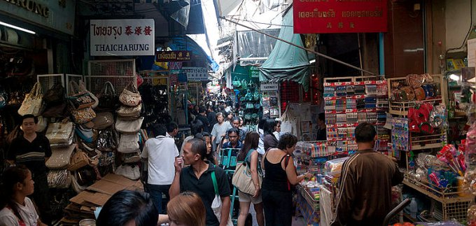
vibrant = full of energy, bustling, with busy streets, the fast pace of the city, lively

Slide 18
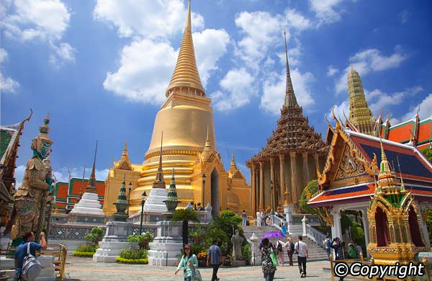
TEMPLES
The greatest concentration of Buddhist temples in
the world.

Slide 19
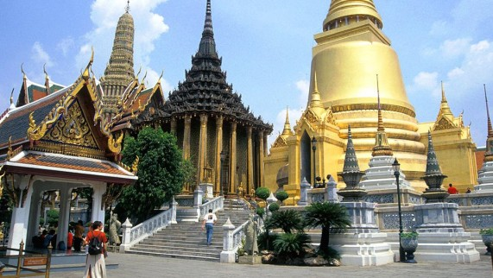
Wats = temples for Buddhist monks
The most renowned (famous, distinguished, with good reputation) is
Wat Phra Keo
The Temple of the Emerald of Buddha

Slide 20
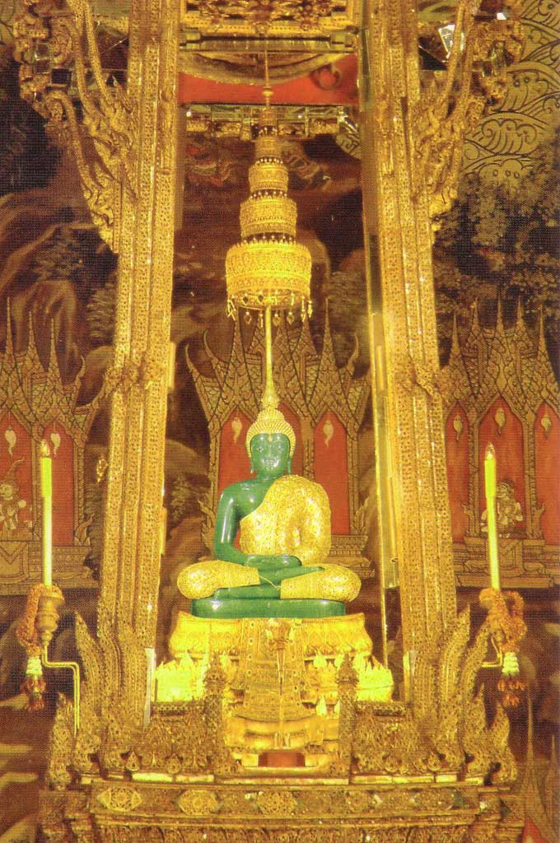
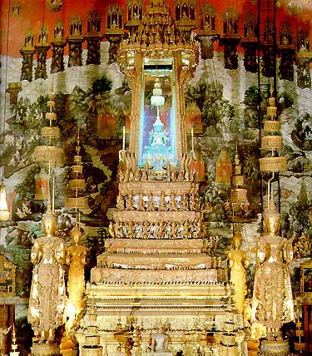
emerald = precious stone, green
(Serb. smaragd)
Thai national symbol

Slide 21
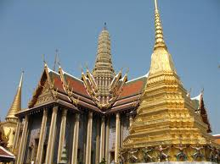
to establish (= to found, to set up, to build)
1782
adjoining (=next to) the Grand Palace
the ceremonial temple of Thai Kings

Slide 22
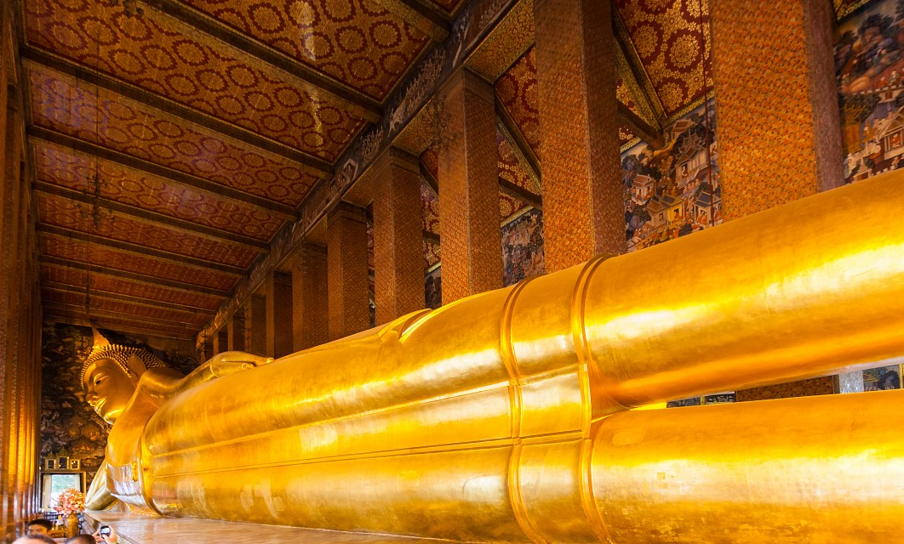
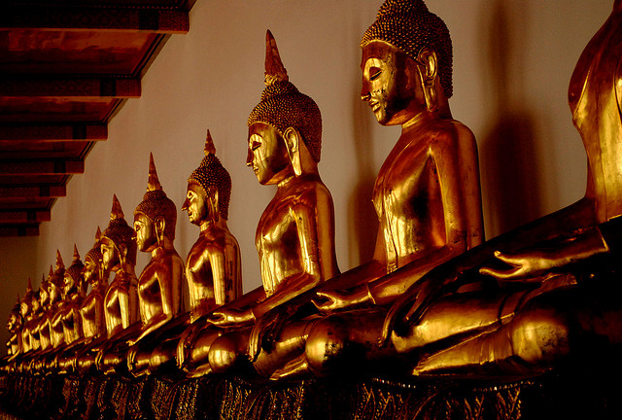
Wat Pho, largest collection of Buddhist images in Thailand.

Slide 23
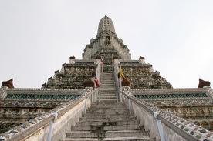
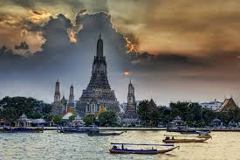
Don’t miss WAT ARUN
The Temple of Dawn glittering tower amidst (=among) skyscrapers a breathtaking sight up the river

Slide 24
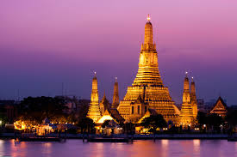
glittering = shining, twinkling, dazzling

Slide 25
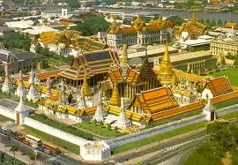
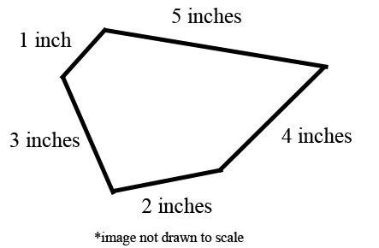
THE GRAND PALACE&OTHER SIGHTS
A city within a city
2km of perimeter (Serb. obim) walls
It is a must ...

Slide 26
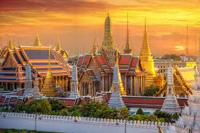
It contains the finest (=best) examples of Eastern architecture

Slide 27
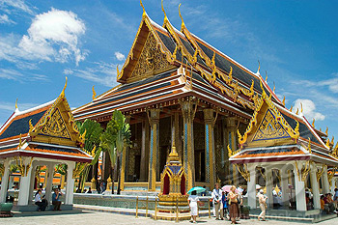
Among other delights (thrills, pleasures, sights)
Grand Palace – Chapel Royal

Slide 28
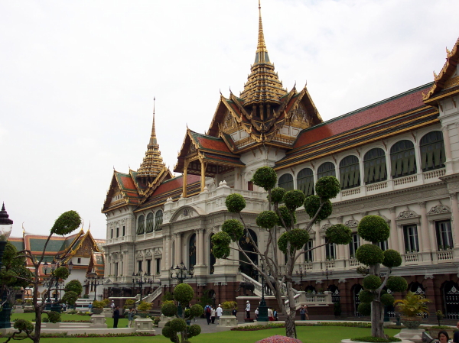
Chakri Maha Prasat – the Royal Harem
Multi–tier (= level, layer) gilded roof (gilt, covered with thin layer of gold leaf or paint)

Slide 29
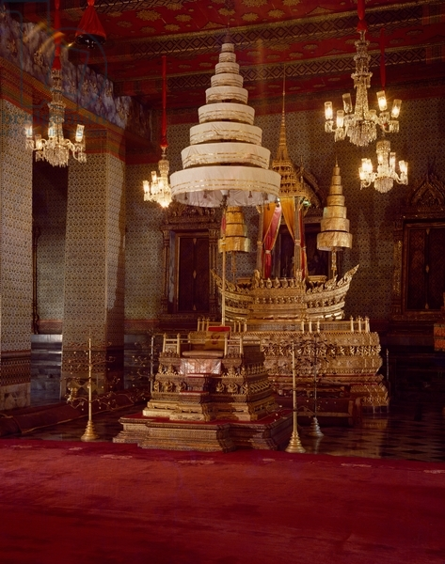
Audience Hall of Amarinda
the coronation of the kings (=where they are crowned)

Slide 30
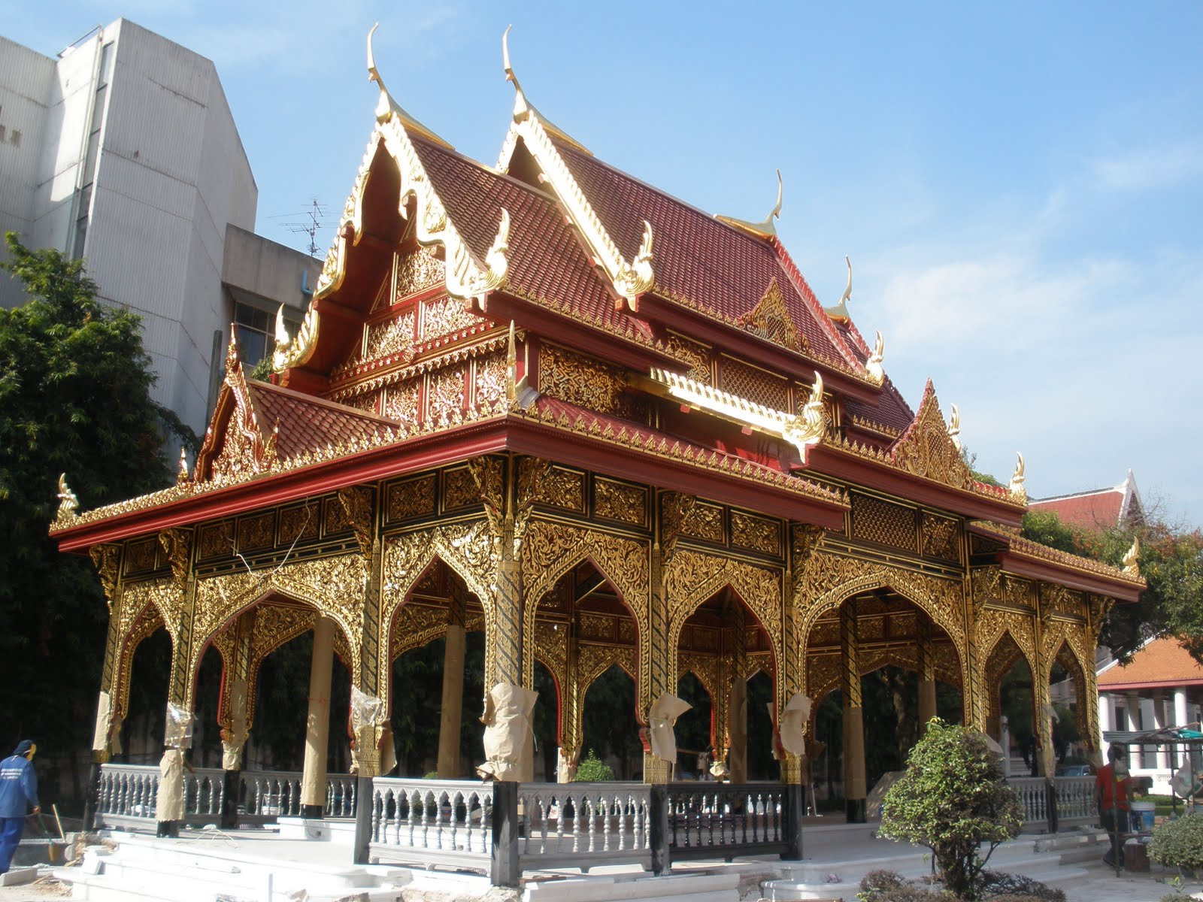
National Museum explaining two hundred history of the Palace.
It is well worth visiting.

Slide 31
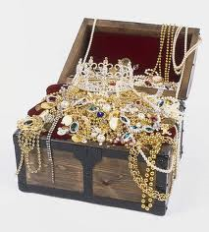
treasure trove /trəʊv/ (Serb. riznica) of Thai culture 1. place containing many useful and beautiful things. treasure trove 2. valuables, found hidden with unknown owner

Slide 32
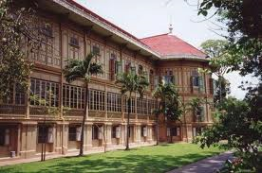
WIMANMEK PALACE
Palace in the Clouds, made of golden teak

Slide 33
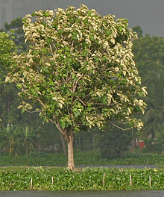
teak = type of tree/wood (Serb. tikovina)

Slide 34
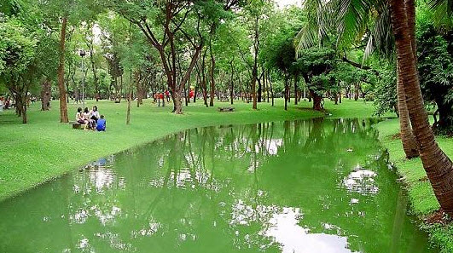
Take a rest in Lumphini Park
at the meeting (crossroads) of the port and the downtown (central) areas
spooky at night

Slide 35
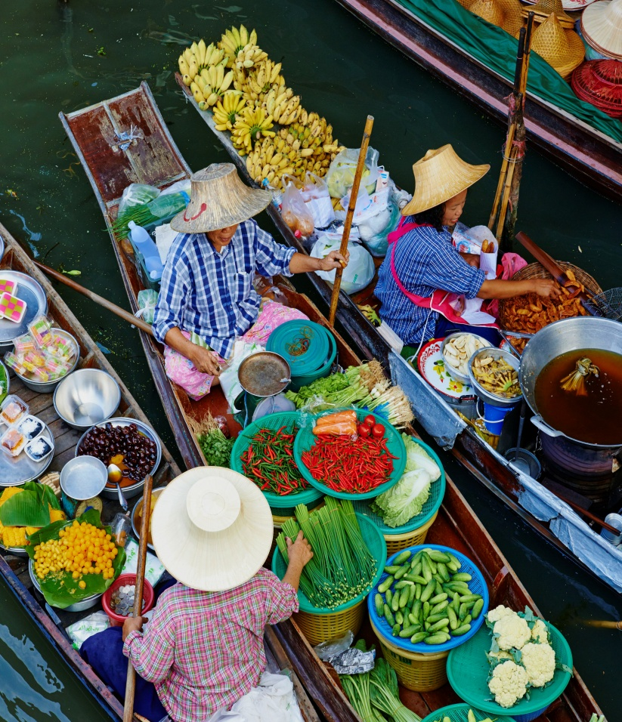
THE RIVER AND THE CANALS
bustling = full of people, busy, lively
picturesque = colourful
The Venice of the Orient (East)

Slide 36
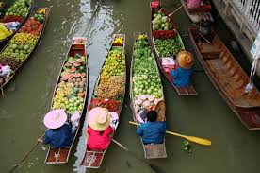
THONBURI FLOATING MARKET
to float = stay on the surface of water (Serb. plutati)
Despite commercialization it possesses a unique charm and fascinating character.

Slide 37
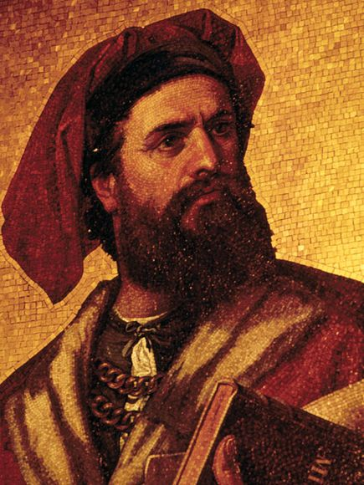
The Silk Route

Slide 38
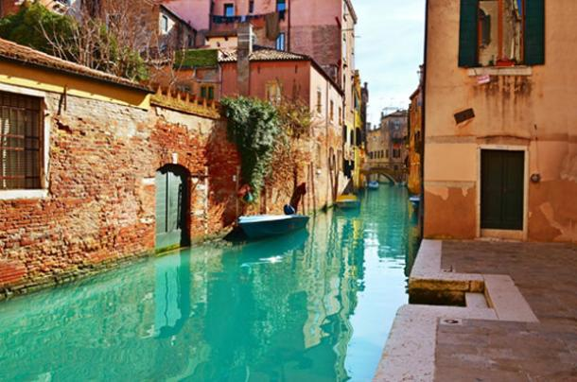
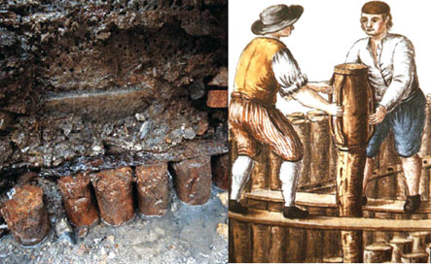
Construction of the Floating City

Slide 39
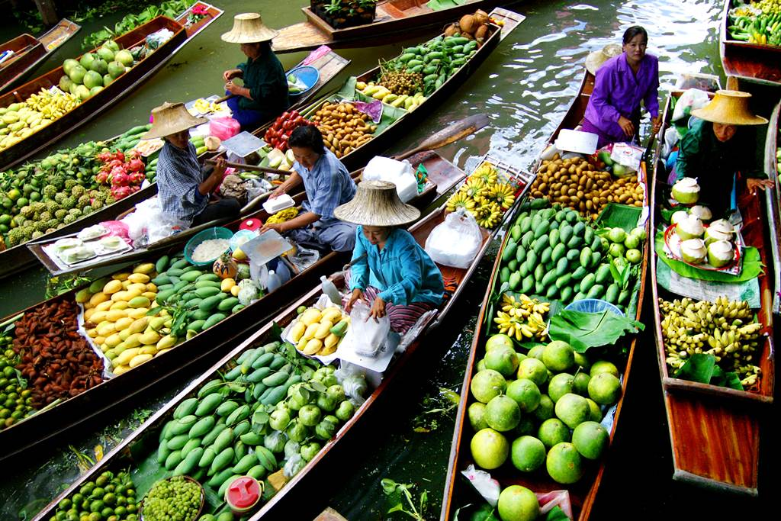
SHOPPING
sweltering = unpleasantly hot, humid, steamy climate

Slide 40
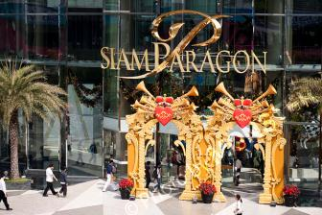
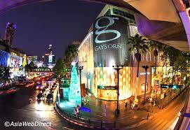
ultra – modern department stores

Slide 41
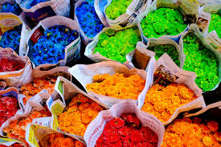
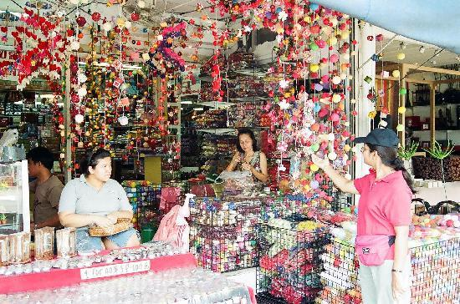
Markets are selling everything from artificial flowers... artificial = not natural, man-made

Slide 42
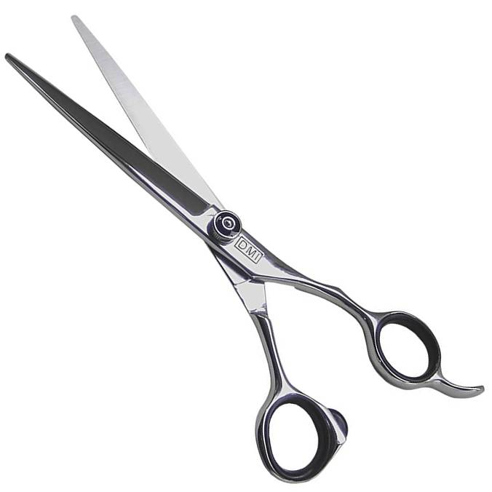
...to barber’s scissors

Slide 43
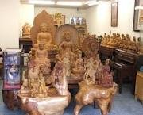
If you are souvenir-hunting (= buying many souvenirs), why not buy some Thai wood-carving.
carving = art of making shapes by cutting out wood or stone
(Serb. duborez, drvorez)

Slide 44
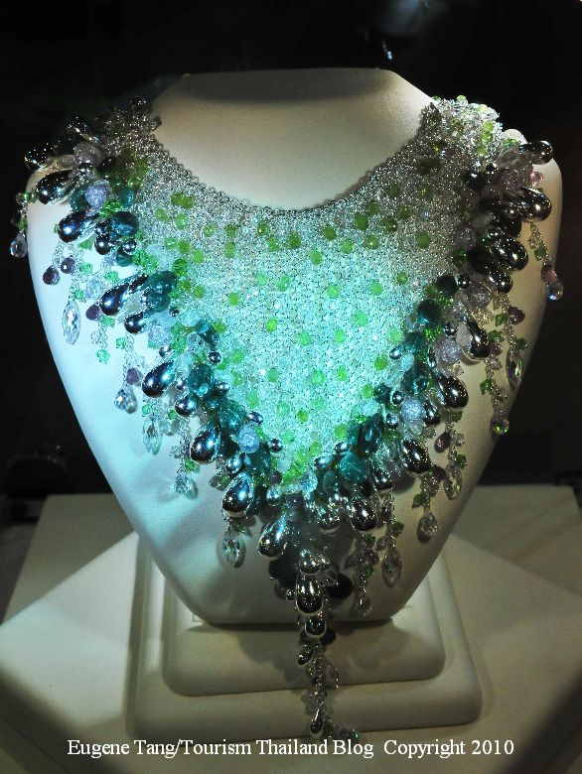
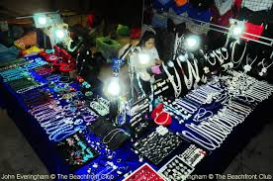
local jewellery

Slide 45
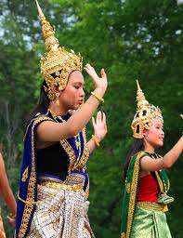
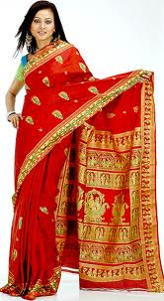
sarong = a long piece of fabric wrapped around the body, worn in Indonesia and Malaysia sari = in India

Slide 46
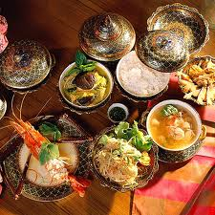
FOOD
THAI CUISINE
a gourmet paradise
extremely spicy and hot
(Serb. ljuto)
delicious, tasty, mouth-watering

Slide 47
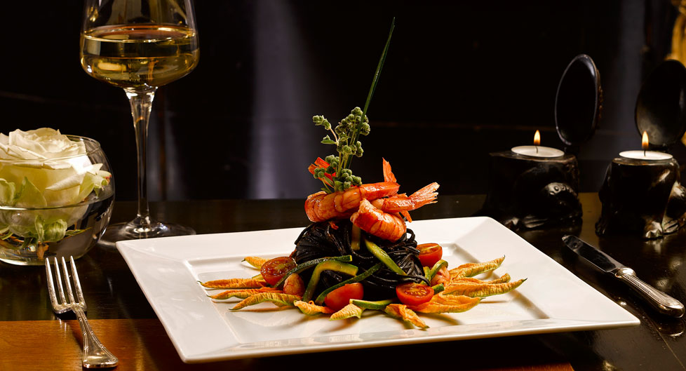
a gourmet, n. = someone who knows a lot about good food and wine.
gourmet food, adj. = high quality and often expensive, exquisite and rich courses, haute cuisine.

Slide 48


Try shophouse restaurants (SE Asia) –a house and a hospitality establishment
fried noodles (pasta) with soy sauce

Slide 49

Thai Delicacy – Thai Dish
freshwater crab= shellfish from the river, not the sea
(Serb. slatkovodni, rečni)

Slide 50

upmarket restaurants
                upmarket = for people belonging to a high social class,
                upmarket product =
                high quality&costly
                upmarket restaurant = expensive &classy restaurant
                opposite - downmarket

Slide 51

There are numerous street food stalls /sto:lz/ (=stands, Serb. tezge) which turn Bangkok into a huge open-air (outdoor) restaurant.

Slide 52

Walk the Streets
to wander /ˈwɒndə/= roam, walk aimlessly, stroll around
to wonder /ˈwʌndə/ = think about; be surprised

Slide 53

NIGHT LIFE
It has a reputation of a sordid nightlife (= shameful,immoral,
dirty, source of crime)

Slide 54


red-light district = neighbourhood with prostitutes

Slide 55

Moulin Rouge

Slide 56

try Saeng Thip
rum-like local spirit
spirits (= alcoholic drinks)

Slide 57

Thai Entertainment
Dancing&Drama
VIDEO: watch https://www.youtube.com/watch?v=21mKbR-4VTA

Slide 58

Railay

Slide 59

Similan Islands

Slide 60

Ko Phi Phi

Slide 61

Phuket

Slide 62

THAI MASSAGE?

Slide 63

It is just a glimpse (quick look) of Thai offer

Slide 64


Thank you! http://www.expedia.com/Grand-Palace-Bangkok.d6051382.Vacation-Attraction

