Slide 1
7.4 Study and Writing Skills
Presentation: Harrods
Writing: E-mails
Pages 64-65

Slide 2
STUDY SKILLS
Harrods https://www.youtube.com/watch?v=tLlwKUZHltg
Giving a short, informal talk
Harrods
https://www.youtube.com/watch?v=WiYYue1RQC8

Slide 3
1a. page 64, Preparing a talk
Make a list of things we do when we prepare a talk
Match 1 – 6 with a – f
1 Put your ideas
2 Check the pronunciation
3 Find out
4 Practise
5 Prepare some pictures or tables
6 Make some
a) the talk.
b) notes to help you remember things in the talk.
c) to make your points clearer.
d) in the best order.
e) of difficult words.
f) some interesting information.

Slide 4
1a. page 64, Preparing a talk
Make a list of things we do when we prepare a talk
Match 1 – 6 with a – f
1 Put your ideas
2 Check the pronunciation
3 Find out
4 Practise
5 Prepare some pictures or tables
6 Make some
a) the talk.
b) notes to help you remember things in the talk.
c) to make your points clearer.
d) in the best order.
e) of difficult words.
f) some interesting information.

Slide 5
1b. page 64,Work with the partner and discuss the best order to do the six stages in Exercise 1a
I believe that…
I think the best order is…
We can start with….and finish with…

Slide 6
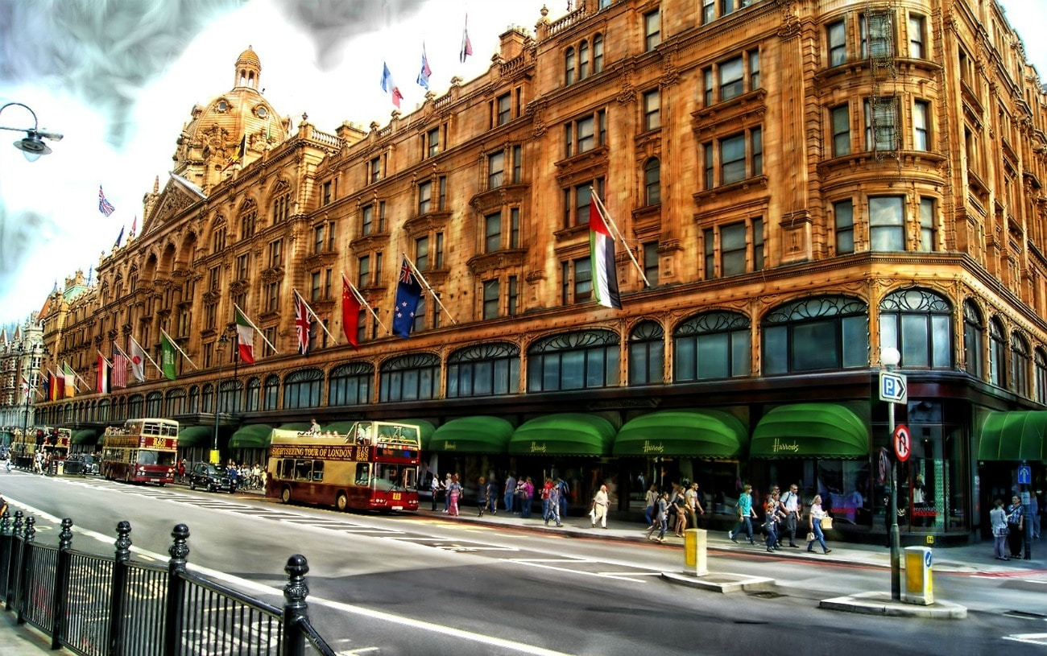
2. page 64 Transcript 2.7, page 151,
Listen to a student giving a short talk about Harrods. What does the student talk about? Tick the topics.
1. the building
2. the area
3. what you can buy
4 places to eat
5 opening times
6 Internet shopping
https://www.harrods.com/

Slide 7
2. page 64, Transcript 2.7, page 151,
Listen to a student giving a short talk about Harrods. What does the student talk about? Tick the topics.
1. the building√
2. the area √ (+/-)
3. what you can buy √
4 places to eat √
5 opening times √ (+/-)
6 Internet shopping √ (+/-)
https://www.harrods.com/

Slide 8
3. page 64
Making notes
Some people write down every word of their talk. Others make notes. Complete the notes for the talk with these words
every building food department floors
Harrods
Huge (1)_______________ store -London
Beautiful (2)___________________ (at night)
open (3)_______________________ day
7 (4)_______________________________
Can find everything – give examples
Also (5) ____________ halls+cafés/restaurants (25)+doctor/bank

Slide 9
3. page 64
Making notes
Some people write down every word of their talk. Others make notes. Complete the notes for the talk with these words
every building food department floors
Harrods
Huge store (1) DEPARTMENT store -London
Beautiful (2) BUILDING (at night)
open (3) EVERY day
7 (4) FLOORS
Can find everything – give examples
Also (5) FOOD halls+cafés/restaurants (25)+doctor/bank

Slide 10
4. page 64, Listen again and complete the sentences from the talk.
a) In this short talk, I’d like to ______ _______
About my favourite store – Harrods …
b) It’s ________ for its fantastic food halls…
c) One of the ________ _________ things is that there’s even a doctor …
d) To _________, I think Harrods is the best department store in the world!

Slide 11
4. page 64, Listen again and complete the sentences from the talk.
a) In this short talk, I’d like to TELL YOU about my favourite store – Harrods …
b) It’s FAMOUS for its fantastic food halls…
c) One of the MOST INTERESTING things is that there’s even a doctor …
d) To FINISH, I think Harrods is the best department store in the world!

Slide 12
5. page 64, Giving the talk
These things can be problems when someone gives a talk. Can you think of any other problems?
The speaker …
looks down at the floor
looks at just one or two people
speaks very fast
wears old or dirty clothes
talks for too long

Slide 13

6. page 64, Give a talk on Harrods to a partner. Use your notes from Exercise 3 and the completed phrases in italics in Exercise 4. Then listen to your partner’s talk.

Slide 14
7. page 64, Prepare and give a short talk of about one minute on:
My favourite shop
The best/worst/most unusual shop in my town/city.
Before you start, look at the stages in Exercise 1 again.

Slide 15
8. page 65, Discuss these questions with a partner.
1. Do you ever shop for books? What kind of books do you buy?
2. Are they for you, or presents for someone else?
3. Where do you buy them – in a bookshop, in a supermarket or on the Internet?

Slide 16
9. page 65, Read these emails. What is the relationship between Miranda, Nick and Paula, do you think?
From: m.jones@ola.com
To: n.jones@tbnet.co.uk
Subject: Paula’s present
Hello Nick,
How’s life? Just a quick message because I’m very busy today. I’d like to buy Paula a book for her birthday. Can you give me any ideas?
Thanks a lot.
Love
Miranda

Slide 17
9. page 65, Read these emails. What is the relationship between Miranda, Nick and Paula, do you think?
From: n.jones@tbnet.co.uk
To: m.jones@ola.com
Subject: Paula’s present
Hi Miranda,
I’m fine, thank you. Paula likes historical novels and love stories, but also thrillers. She doesn’t like war or science fiction books.
She’s reading a lot of foreign novels these days – but in English, of course! We want to go to South America or Japan next year, so maybe you can get her something about those parts of the world. Is this any help?
See you soon.
Nick.

Slide 18

10. page 65, Miranda finds these books on a website. Which book is best for Paula?
Would you like to read any of these books?
Of Love and Shadows
A great love story about two young people in a country in South America.

Slide 19

10. page 65, Miranda finds these books on a website. Which book is best for Paula?
Would you like to read any of these books?
My Name is Red
An excellent novel about Istanbul in the 1590s.
A thriller, but also a story about love and art.

Slide 20

10. page 65, Miranda finds these books on a website. Which book is best for Paula?
Would you like to read any of these books?
Black Rain
A sad, funny and beautiful book about Hiroshima, Japan, in 1945.

Slide 21
11. page 65, Look at the emails in Exercise 9 and complete the three lists below with the phrases in the box.
Bye for now Dear... How are things? Love Hi! How are you? Take care Hope you’re OK
Greeting: Hello, …
Opening phrase: How’s life? …
Ending: See you soon, …

Slide 22
12. Page 65, Linkers
The words because and so are linking words – they join two ideas. Find the examples in the emails, then put because or so in these sentences.
1. Books are expensive in my country ______ I don’t buy many.
2.I like Bridget Jone’s Diary_______it’s funny and true.
3. I love long books _________ I read a lot of Russian novels.
4. I don’t read many books _________ I haven’t got much free time.

Slide 23
12. page 65, Linkers
The words because and so are linking words – they join two ideas. Find the examples in the emails, then put because or so in these sentences.
1. Books are expensive in my country ______ I don’t buy many.
2.I like Bridget Jone’s Diary_______it’s funny and true.
3. I love long books _________ I read a lot of Russian novels.
4. I don’t read many books _________ I haven’t got much free time.

Slide 24
12. Page 65, Linkers The words because and so are linking words – they join two ideas. Find the examples in the emails, then put because or so in these sentences.
1. Books are expensive in my country. SO, I don’t buy many.
2.I like Bridget Jone’s Diary BECAUSE it’s funny and true.
3. I love long books. SO, I read a lot of Russian novels.
4. I don’t read many books BECAUSE I haven’t got much free time.

Slide 25
HW
13a page 65, You want to buy a music CD or film DVD for someone in your class for their birthday present.
Write an e-mail to a partner, asking for ideas.
(and/or send it to setjetting@gmail.com )
13b page 65, Reply to your partner’s email. Use the emails in Exercise 9 as models.

Slide 26
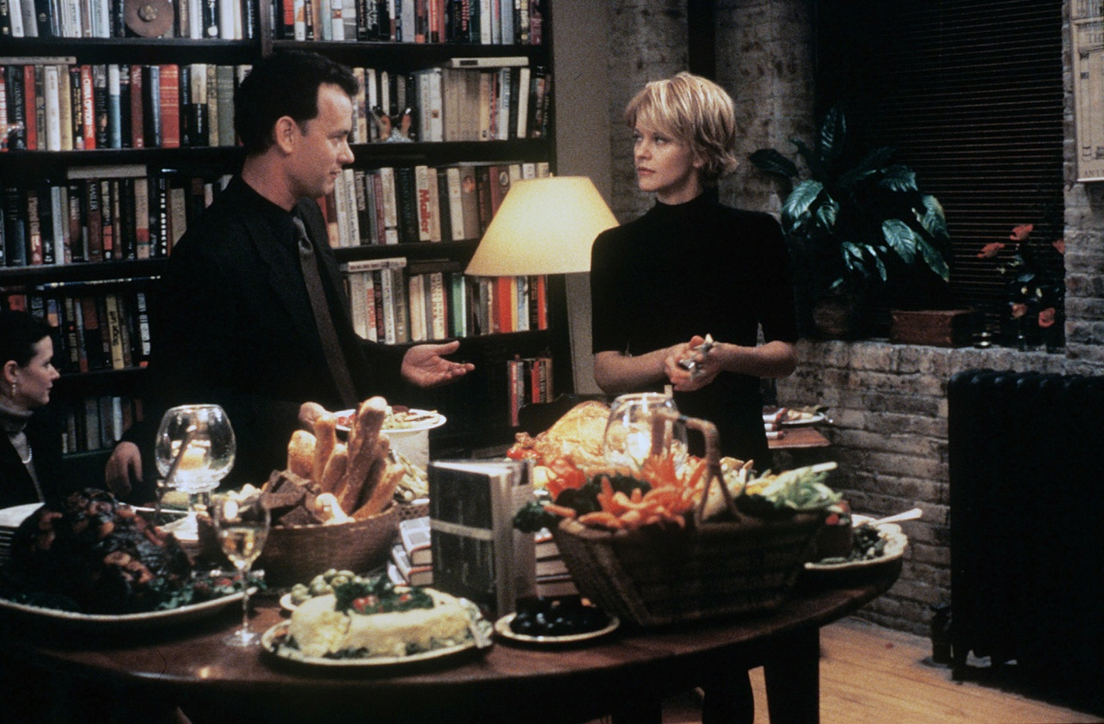
Thank you for your Attention!

