Slide 1
7.2. SHOPPING TRENDS
PRESENT CONTINUOUS (2)

Slide 2
shops and shopping (2)
Unit 7, pages 60-61
VOCABULARY

Slide 3
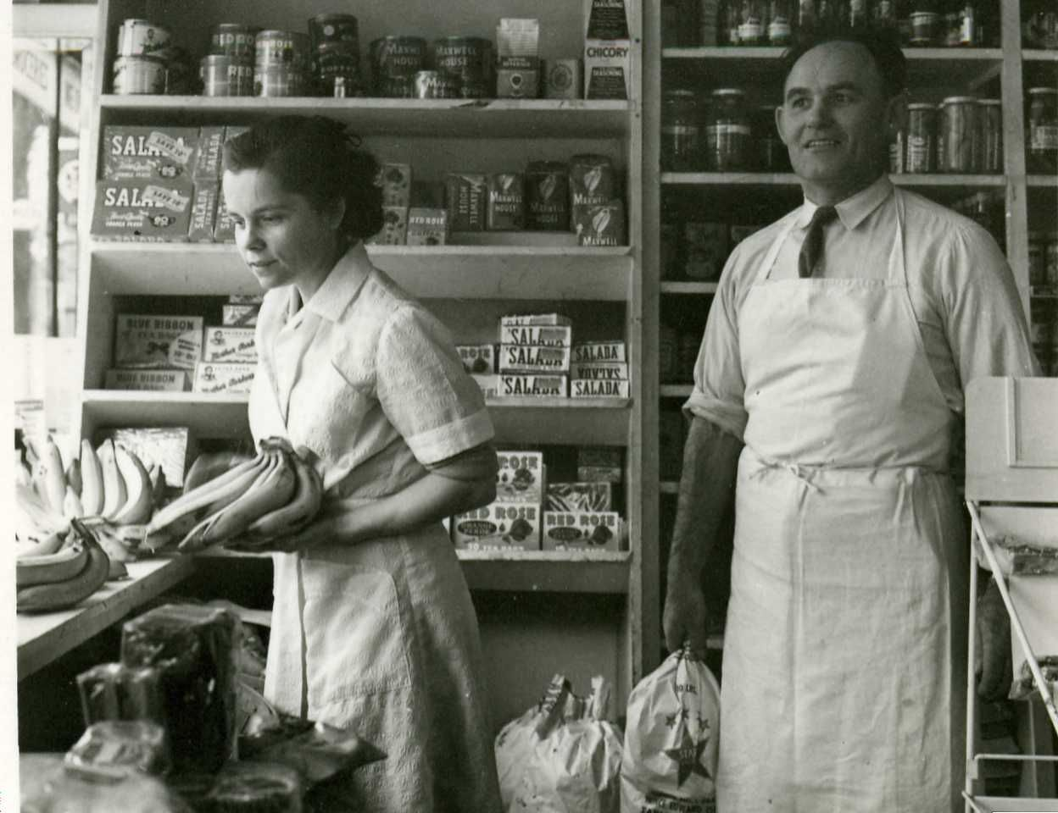
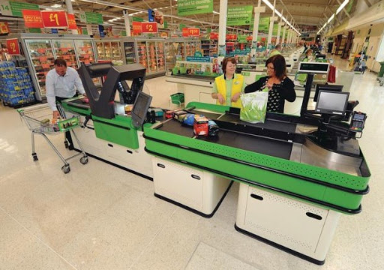
grocery store 1950s ASDA supermarket, dućan, drakstor present day

Slide 4
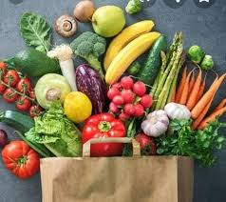
groceries

Slide 5
1. page 60, Look at these words connected with shopping. Which ones have similar meaning?
customer discount hypermarket product
Internet shopping price service (to) shop
store supermarket online shopping

Slide 6
1. page 60, Look at these words connected with shopping. Which ones have similar meaning?
customer discount hypermarket product
Internet shopping price service (to) shop
store supermarket online shopping

Slide 7
2. page 60, Discuss these questions with a partner.
1 How often do you go shopping? What do you usually buy?
2 Do you prefer supermarkets or smaller shops? Why?
3 What are the most famous supermarkets in your country?
Which do you like/dislike? Why?

Slide 8
sample answers
I go shopping for groceries every day.
I sometimes buy things online.
I sometimes buy things over the Internet.
The famous supermarkets in my country are Maxi, Idea, Roda, Lidl etc.
I prefer smaller shops to supermarkets.

Slide 9
BUSINESS NEWS
READING

Slide 10
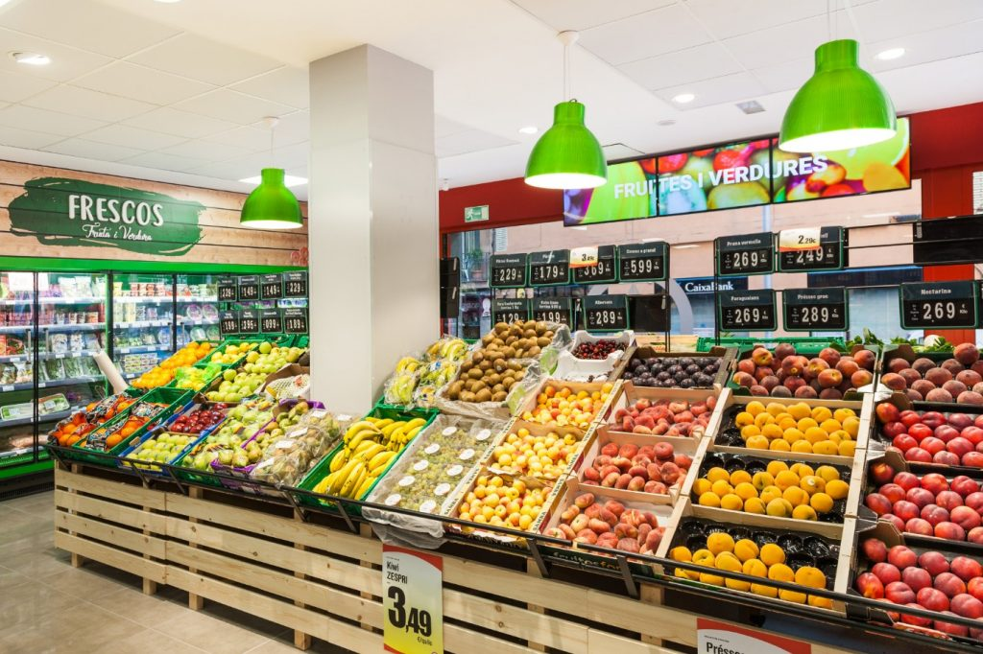
3. page 60, Read the article quickly. What is it about?
1. online shopping
2. a growing supermarket (= supermarket becoming bigger than it is)
3. town centres in Britain

Slide 11
4a, page 60 Put these headings in the right place (A – D) in the article
Number and location of stores
Products and services
The effects of supermarkets
A success story

Slide 12
4b. page 60, Put these figures in the gaps (1-4).
30 percent £1 15 million 1000

Slide 13
Business News page 60
A _____________Tesco is the most successful supermarket in Britain. It takes (1) ________ out of every eight pounds that British people spend, and makes about 65 pounds (100 euros) a second.
B ______________Tesco has over (2) _________ stores in the UK and about 600 in countries in central/Eastern Europe and East Asia. There are 100 Tesco hypermarkets and new stores are opening all the time.

Slide 14
Business News page 60
A) A SUCCESS STORY
Tesco is the most successful supermarket in Britain. It takes (1) 1£ out of every eight pounds that British people spend, and makes about 65 pounds (100 euros) a second.
B) NUMBER AND LOCATION OF STORES
Tesco has over (2) 1000 stores in the UK and about 600 in countries in central/Eastern Europe and East Asia. There are 100 Tesco hypermarkets and new stores are opening all the time.

Slide 15
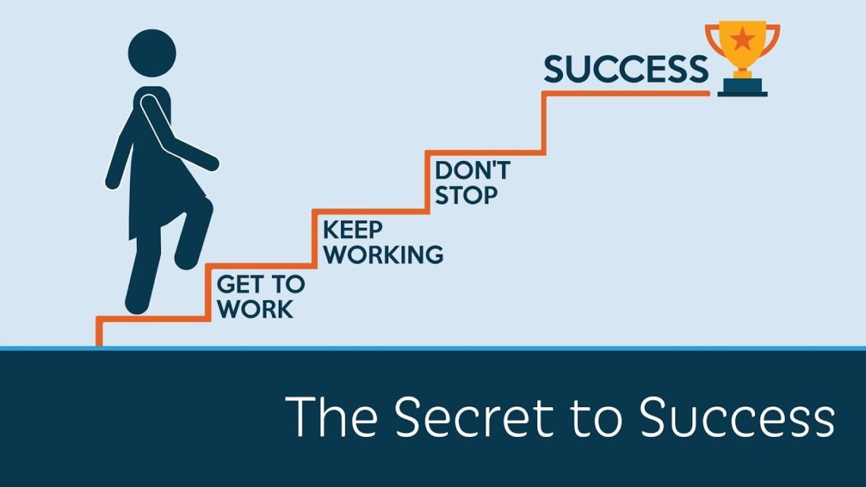
success/səkˈsɛs/ – Serb. uspeh

Slide 16
Business News page 60
C _____________________ Tesco has (3) _______ of the UK food market but it sells more than just food. The non-food business is growing very quickly and Tesco now also sells clothes, DVDs, mobile phones, and (4) _______ books a year. There are new services like online shopping 150 000 people a week shop with Tesco.com

Slide 17
Business News page 60
C PRODUCTS AND SERVICES
Tesco has (3) 30 PERCENT of the UK food market, but it sells more than just food. The non-food business is growing very quickly and Tesco now also sells clothes, DVDs, mobile phones, and (4) 15 MILLION books a year. There are new services like online shopping 150 000 people a week shop with Tesco.com

Slide 18
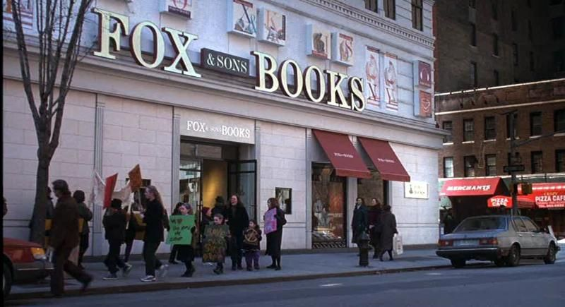
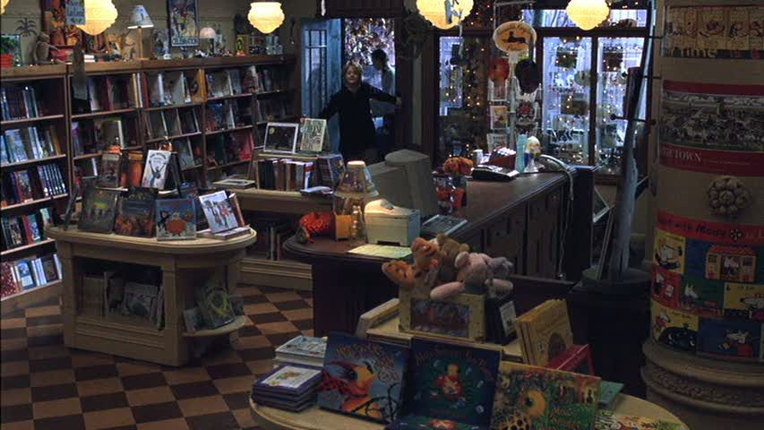
Business News page 60
D_______________ Tesco and other large supermarkets are doing very well, but at the same time a lot of small independent shops are closing down. As a result, some town centres are dying.

Slide 19
Business News page 60
D) THE EFFECTS OF SUPERMARKETS
Tesco and other large supermarkets are doing very well, but at the same time a lot of small independent shops are closing down. As a result, some town centres are dying.

Slide 20
5, page 60, Look at these sentences. Say if they are true, false or if the text does not say.
1 Tesco makes 65 euros a second
2 Most Tesco stores are outside the UK.
3 The food business is growing very quickly.
4 A lot of small shops are not doing well
5 Some British farmers are going out of business
6 Some town centres have serious problems

Slide 21
5, page 60, Look at these sentences. Say if they are true, false or if the text does not say.
1 Tesco makes 65 euros a second F
2 Most Tesco stores are outside the UK. F
3 The food business is growing very quickly. F
4 A lot of small shops are not doing well T
5 Some British farmers are going out of business the text does not say
6 Some town centres have serious problems T

Slide 22
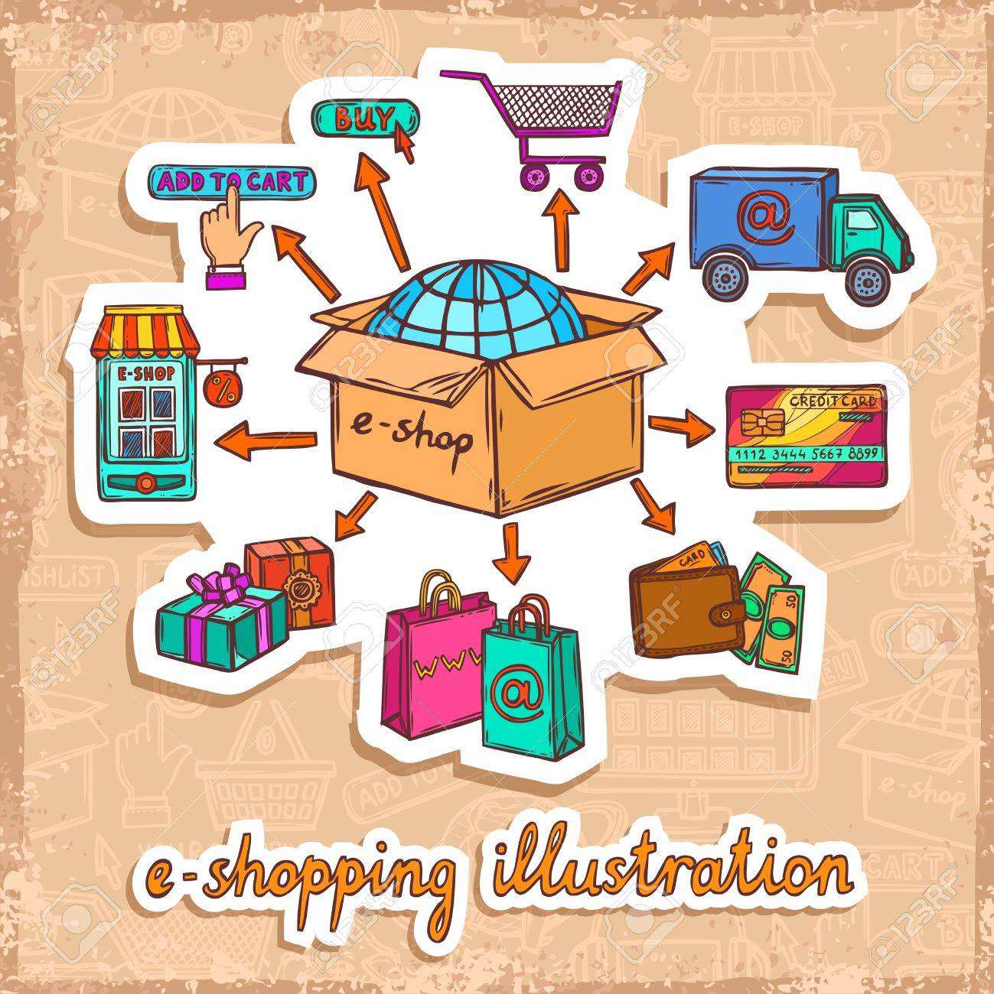
6. page 61, Discuss these questions with a partner.
1. Do you use the Internet for shopping?
2. What are advantages and disadvantages of internet shopping?

Slide 23
Advantages vs Disadvantages
☺ ☹
ONLINE SHOPPING
be casual, at home
no queuing
enjoy discounts
compare prices easily
avoid crowds (too many people)
no working hours
safer?
can’t feel, taste, check, try on things immediately
privacy
safety

Slide 24
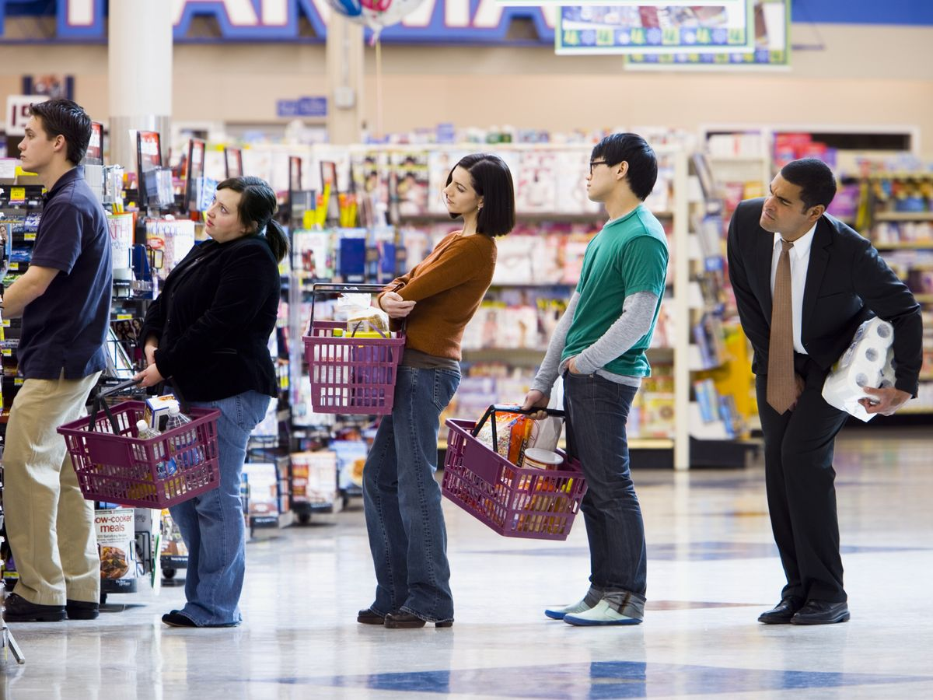
Queuing (Serb. čekanje u redu) to queue – to wait in a line

Slide 25
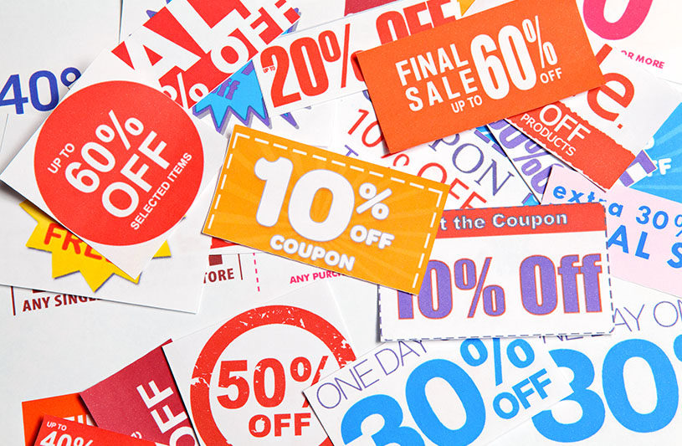
discount – (percent) off the price, special offer
Serb. popust

Slide 26
7a, page 61, Track 2.4. transcript page 151, Listen to this discussion. Put the topics in the order (1-5) you hear them
a) what companies are doing to get business on the Internet
b) the Internet and traditional shopping
c) what people are buying
d) how people are using the Internet to shop
e) women and online shopping

Slide 27
7a, page 61, Track 2.4. transcript page 151,
Listen to this discussion. Put the topics in the order (1-5) you hear them
a) what companies are doing to get business on the Internet
b) the Internet and traditional shopping
c) what people are buying
d) how people are using the Internet to shop
e) women and online shopping
3
5
1
2
4

Slide 28
7b. page 61, Now listen again and complete these notes
Internet shopping
1 Most popular items: __________
2 Usual first item: __________
3 Useful: it’s easy to compare ___________
4 Convenient for: ____________ with job and children
5 Offers from companies: big ____________
6 Reason for using Internet: saves __________
and ____________

Slide 29
7b. page 61, Now listen again and complete these notes
Internet shopping
1 Most popular items: BOOKS, CDS, TRAVEL
2 Usual first item: BOOKS
3 Useful: it’s easy to compare PRICES
4 Convenient for: BUSY WOMEN with job and children
5 Offers from companies: big DISCOUNT
6 Reason for using Internet: saves TIME
and MONEY

Slide 30
PRESENT CONTINUOUS (2)
GRAMMAR

Slide 31
8a, page 61, Complete these questions, then check with Track 2.4, page 151.
1 Is ___________ becoming really popular?
2 _________ are they buying?
3 How are people _________ the Internet?
4 __________ women using the Internet for shopping?

Slide 32
8a, page 61, Complete these questions, then check with Track 2.4, page 151.
1 Is INTERNET SHOPPING becoming really popular?
2 WHAT are they buying?
3 How are people USING the Internet?
4 ARE women using the Internet for shopping?

Slide 33
8b, page 61, Complete these grammar rules about the word order in Present Continuous questions. Use the words in the box.
after questions subject TO BE
1. Questions can start with the verb ________ or with a _________ word.
2. The verb to be usually comes before the _________ of the questions.
3. The main verb + -ing comes __________ to be and the subject.

Slide 34
8b, page 61, Complete these grammar rules about the word order in Present Continuous questions. Use the words in the box.
after questions subject TO BE
1. Questions can start with the verb TO BE or with a QUESTION word.
2. The verb to be usually comes before the SUBJECT of the questions.
3. The main verb + -ing comes AFTER to be and the subject.

Slide 35
language reference and extra practice
Pages 134-135

Slide 36
We use Present Continuous to talk about trends and changing situations
More and more people are buying online.
Internet shopping is becoming more popular.
What changes are happening in town centre?

Slide 37
G3, page 135, Present Continuous questions
INVERSION
yes-no questions
TO BE + SUBJECT + V-ing
ARE YOU LEAVING NOW?
IS SHE WORKING IN NEW YORK?

Slide 38
G3. page 135, Present Continuous WH questions
Questions can start with the WH-word
When are you leaving?
If the subject is the question word WHAT+NOUN, the verb to be comes after.
What changes are happening in town centres?

Slide 39
HW – answers
G1 page 135, 1 Complete sentences 1-8 with these verbs in Present Continuous Tense
He is talking on the phone at the moment.
They are buying a new house.
Prices are going up again at the local supermarket.
She is meeting some visitors at the station this morning.
We are doing our homework.
The computer isn’t working. There’s a problem.
You are sitting in my chair.
It isn’t raining now. It’s sunny!

Slide 40
HW – answers
G2 page 135, 2 Choose the correct verb.
My day (1) is/is being always busy. For example, at the moment (2) I organise/I’m organising dinner for some visitors from Japan. They (3) visit/are visiting my country for the week. My assistant usually (4) helps/is helping me but today (5) she does/she’s doing a training course. Our visitors (6) stay/are staying in a hotel near the office, so (7) I try/I’m trying to book a restaurant near here. We often (8) eat/are eating in a good Indian restaurant near here, so maybe that’s a good idea.

Slide 41
9. page 61, Complete these questions with the words in brackets. Then ask and answer the questions with a partner.
1. ______ a lot these days? (you/travel)
Yes, I am. I’m going to a lot of new places. /No, I’m not.
2. ________ a lot of English at the moment (you/learn)
3. _______ much in the evenings? (you/ go out)
4. What books __________ at the moment? (people/read)
5. What films __________ at the moment? (people/watch)

Slide 42
9. page 61, Complete these questions with the words in brackets. Then ask and answer the questions with a partner.
1. ARE YOU TRAVELLING a lot these days? (you/travel)
Yes, I am. I’m going to a lot of new places. /No, I’m not.
2. ARE YOU LEARNING a lot of English at the moment (you/learn)
3. ARE YOU GOING OUT much in the evenings? (you/ go out)
4. What books ARE PEOPLE READING at the moment? (people/read)
5. What films ARE PEOPLE WATCHING at the moment? (people/watch)

Slide 43
Homework
Exercises 10a and 10b, page 61
Exercises G3 – 3, G2.3 – 4 and KL – 5, page 135

Slide 44
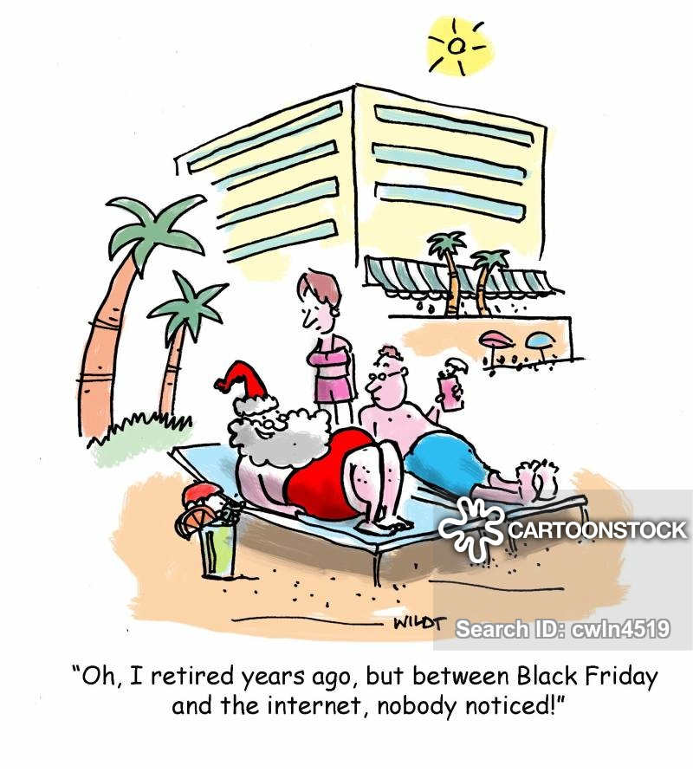
Thank you for your Attention!

