Slide 1
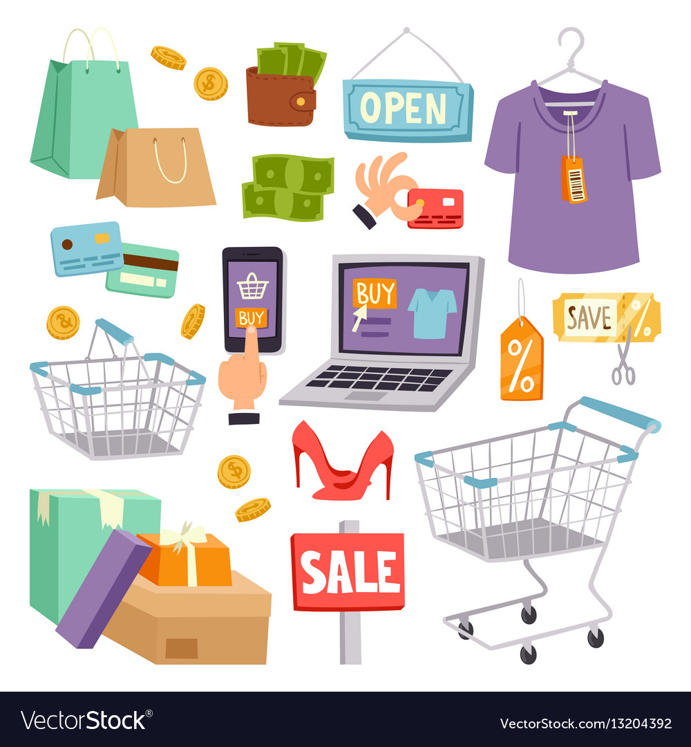
7.Shopping
7.1 Consumer Habits

Slide 2
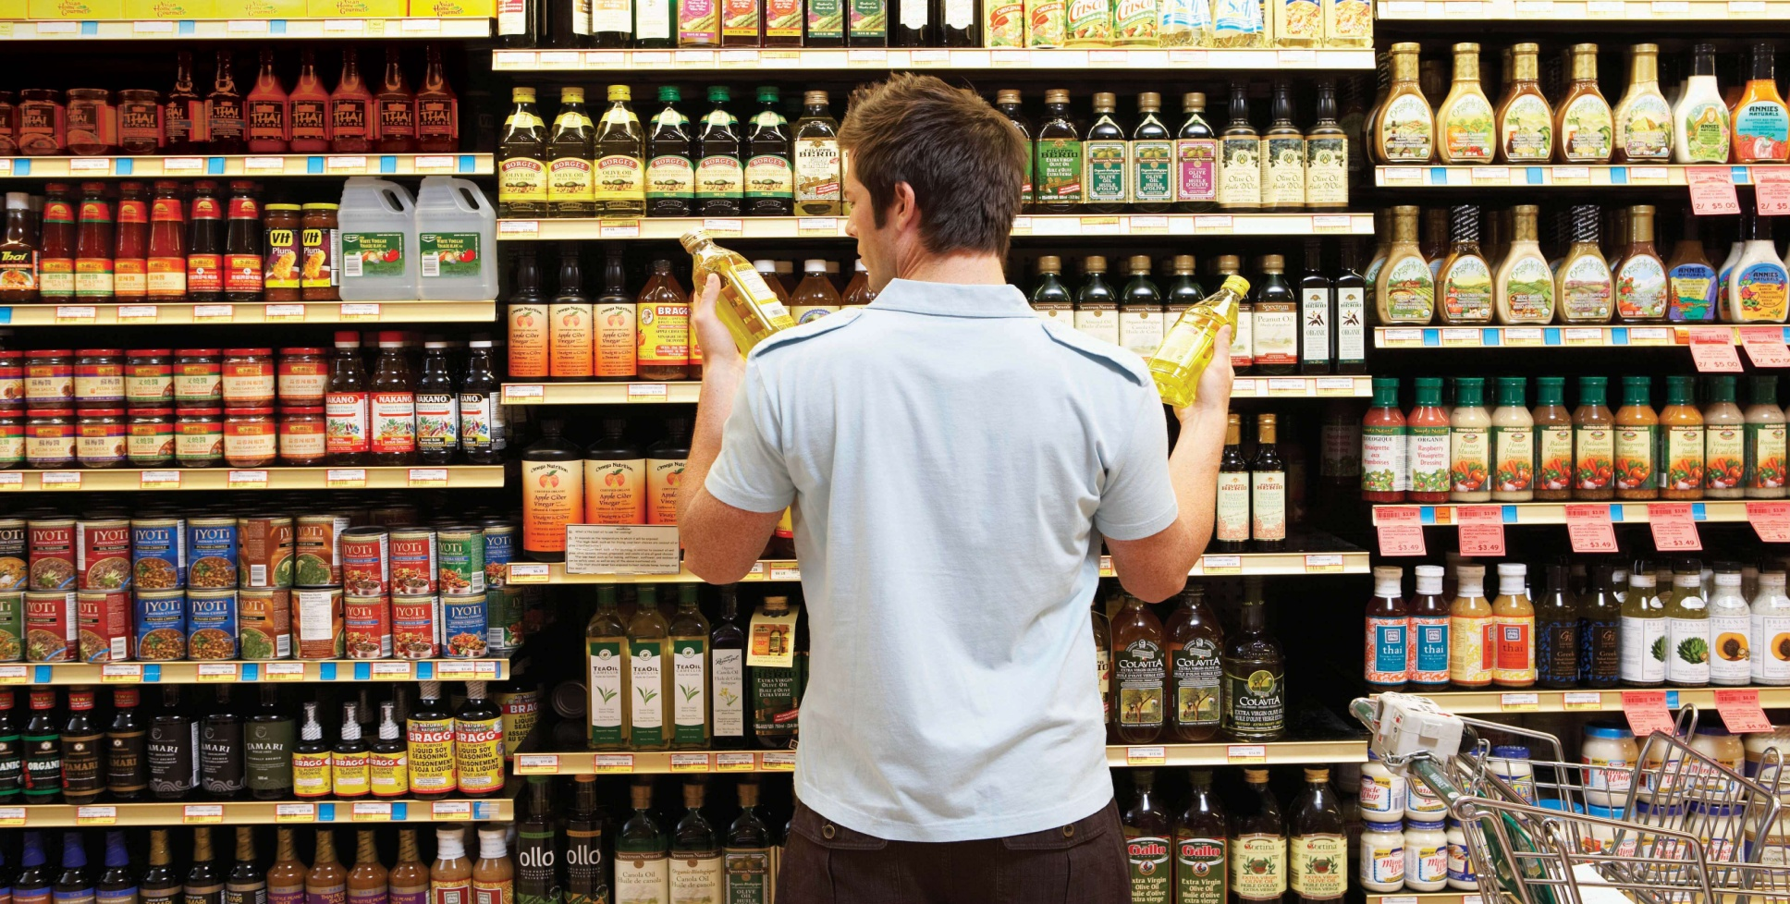
CONSUMER = potrošač
/kənˈsjuːmə/

Slide 3
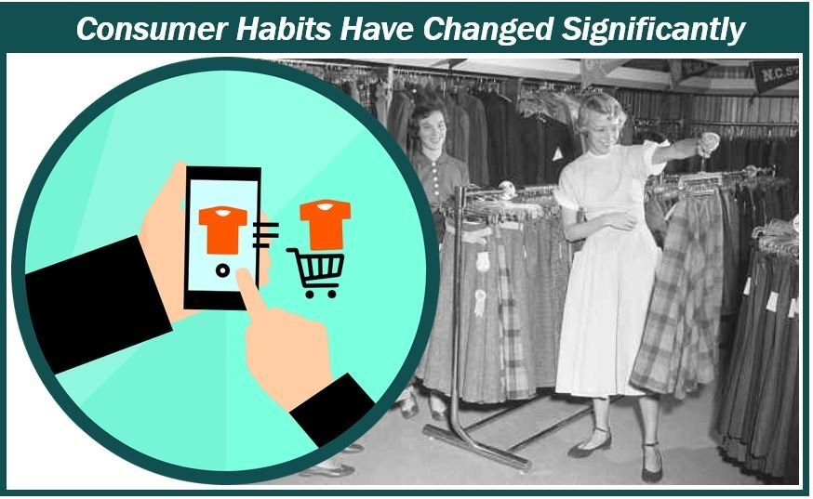
CONSUMER HABITS
/ˈhæb.ɪt/

Slide 4
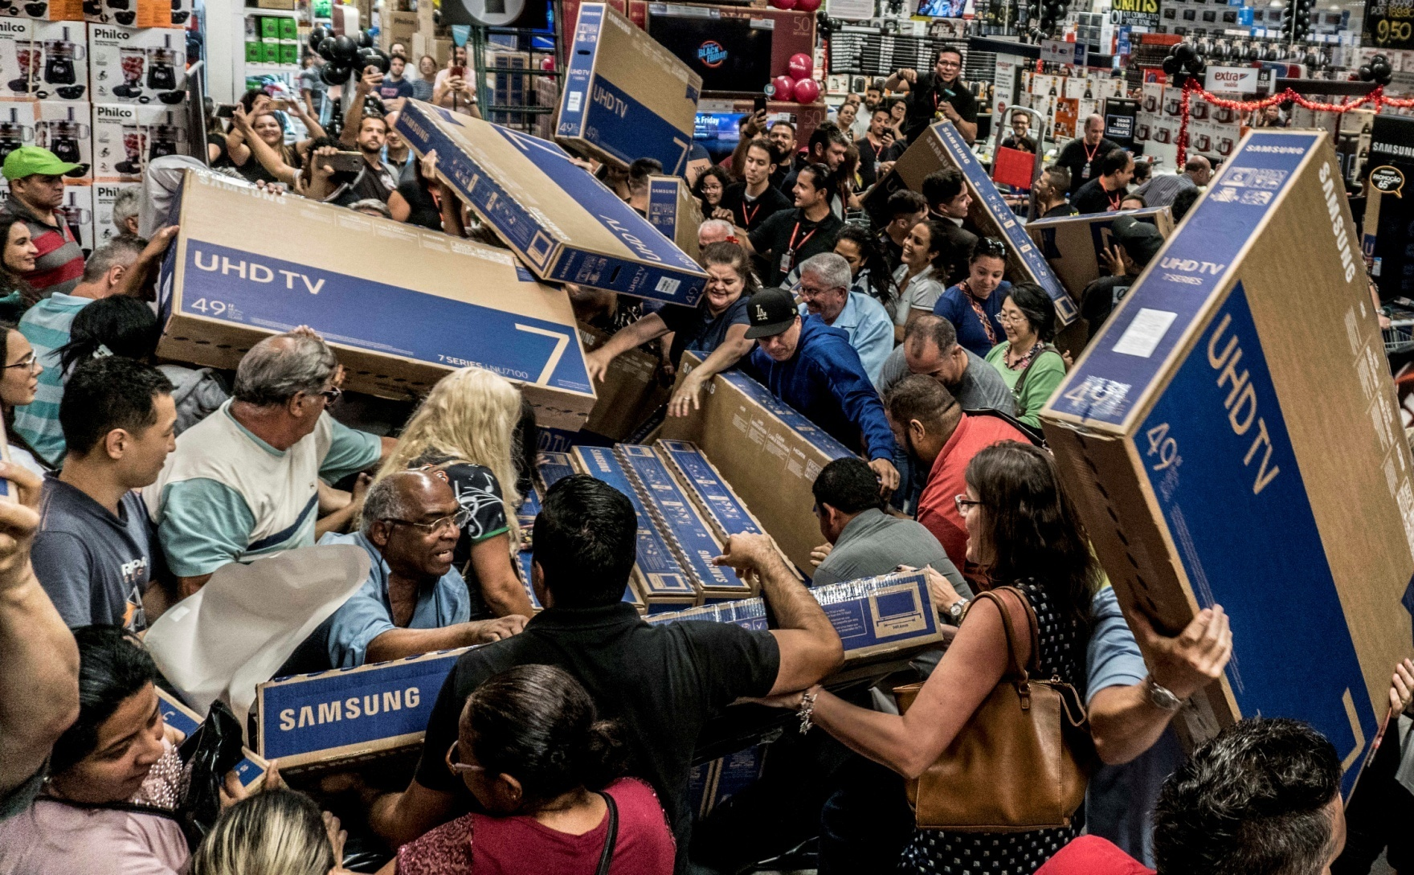
CONSUMER SOCIETY = potrošačko društvo /səˈsaɪ.ə.ti/

Slide 5
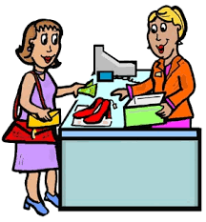
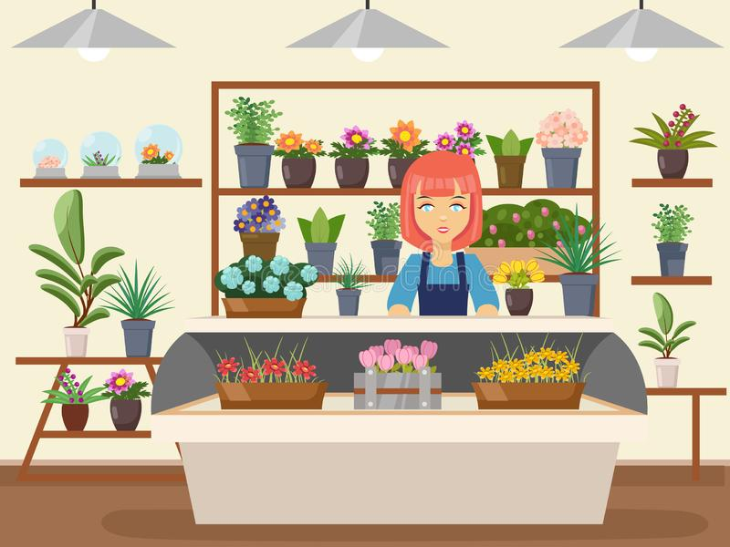
buy, purchase/ˈpəːtʃɪs/ sell

Slide 6
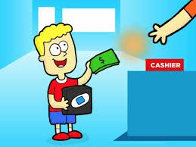
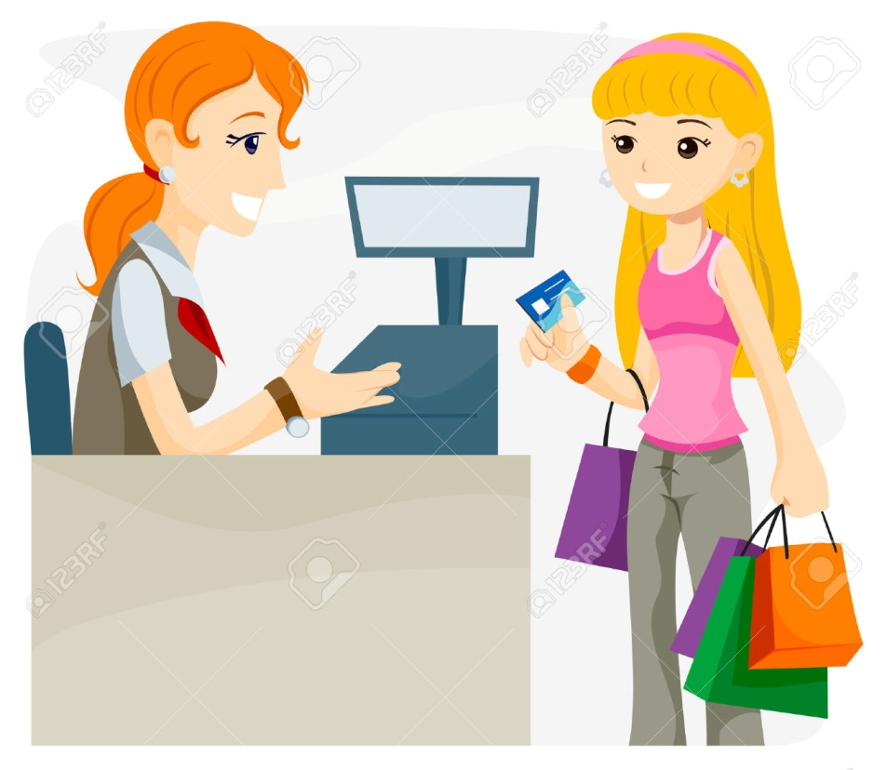
PAY pay in cash pay by credit card

Slide 7
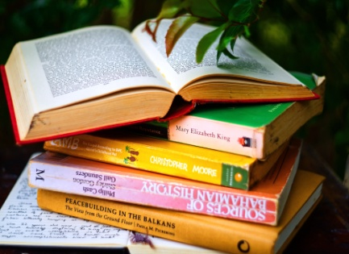
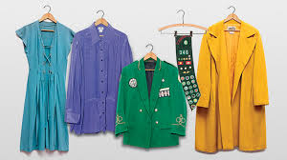
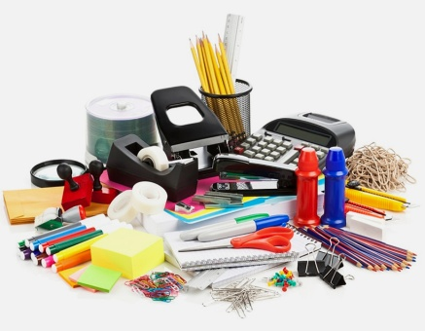
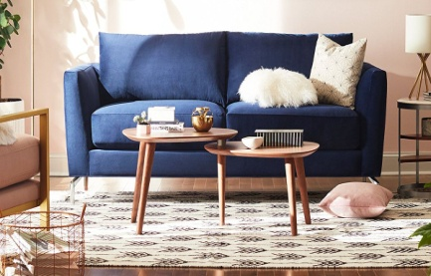
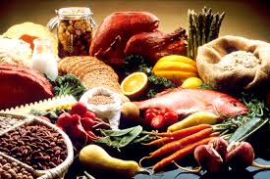
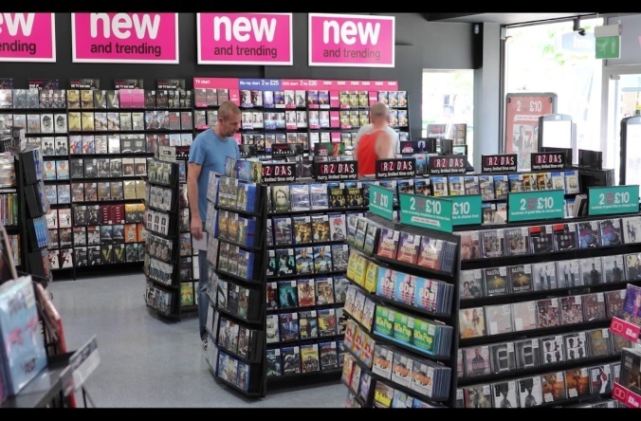
p.58 SPEAKING
1. Discuss these questions
1 Do you like shopping?
2 How often do you buy these things?
What other things do you regularly buy?

Slide 8
Sample Answers
Yes I do.
No, I don’t.
I buy food in the supermarket everyday.
I go shopping at weekends and I usually go to the shopping mall.

Slide 9
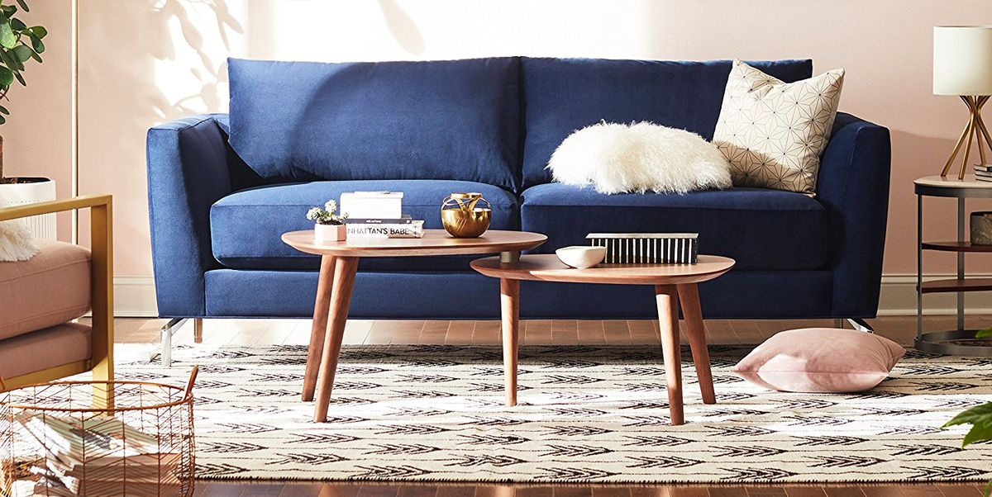
furniture (Serb. nameštaj)
/ˈfəːnɪtʃə/

Slide 10
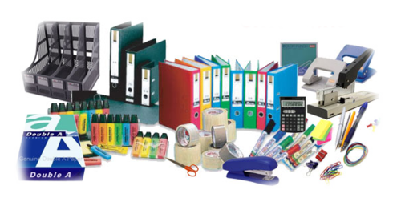
STATIONERY, n. (Serb. kancelarijski pribor)
STATIONARY, adj. not moving (Serb. nepokretan, stacionaran)
/ˈsteɪʃ(ə)n(ə)ri/

Slide 11
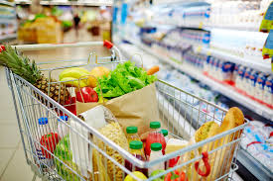
GROCERIES, pl. - namirnice
/ˈɡrəʊs(ə)riz/

Slide 12
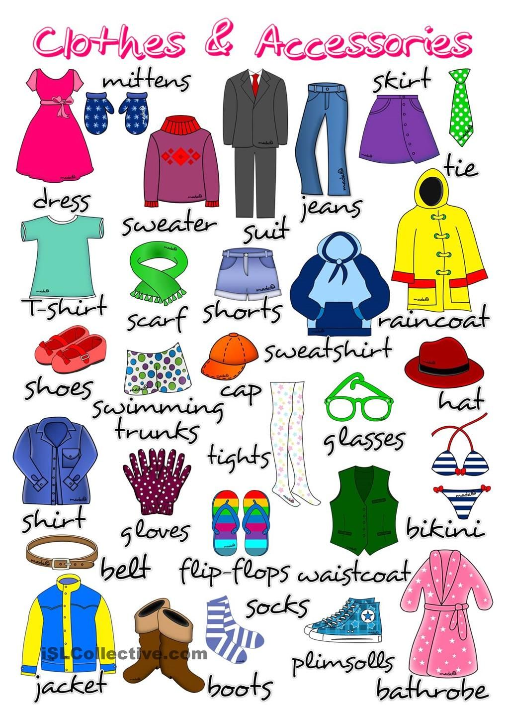
clothes, pl.
/kləʊ(ð)z/

Slide 13
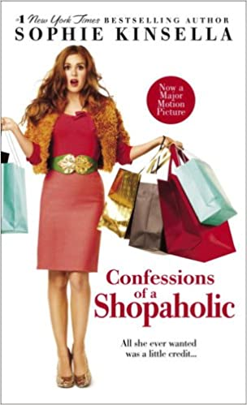
Are you a shopaholic?
You like shopping so much that you cannot stop.

Slide 14
The main thing today is – shopping
Arthur Miller

Slide 15
READING
2.page 58, Read the magazine article and match each person in the photos above with a type of shopper (or look at SLIDE 9).
The window shopper
The frequent shopper
The speed shopper
The careful shopper

Slide 16
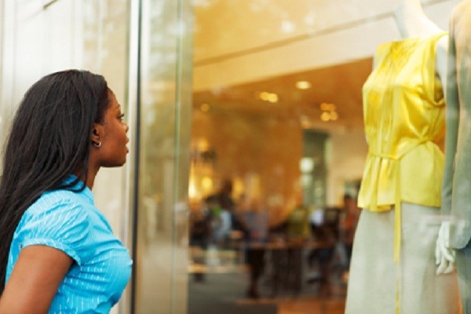
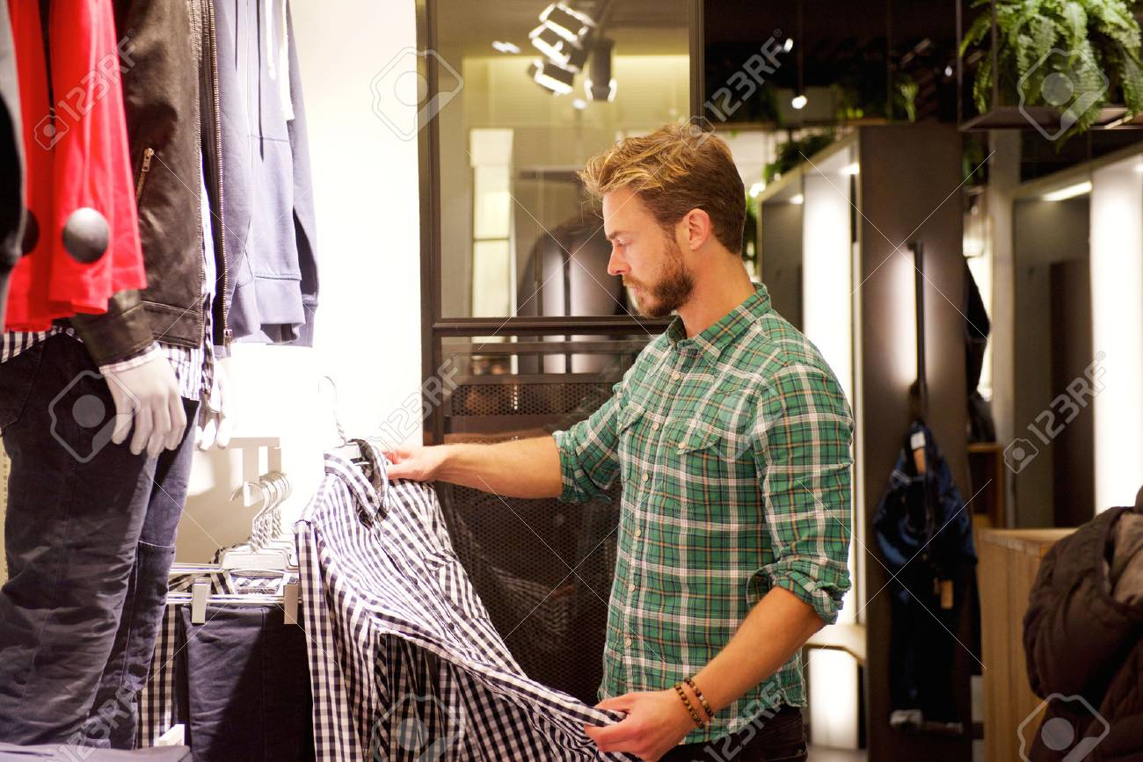
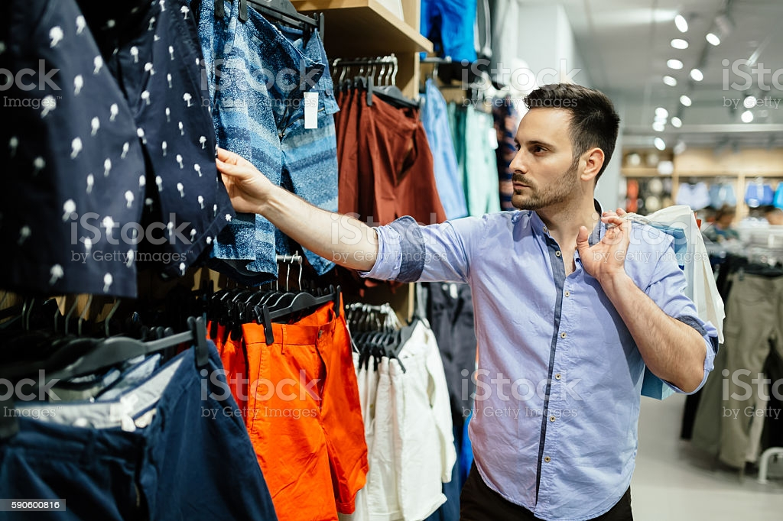
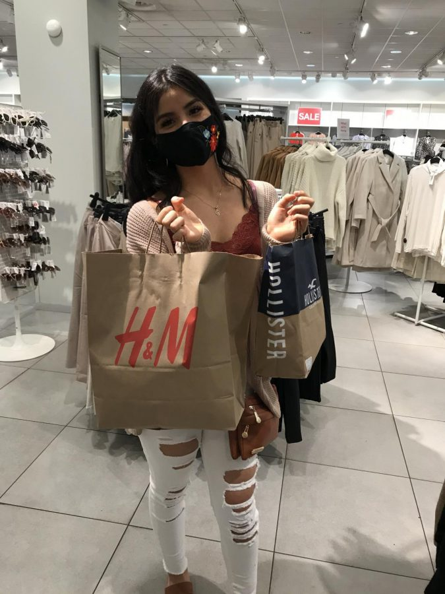
1
2
3
4

Slide 17
window shopping (Serb. razgledanje izloga) window shopper

Slide 18

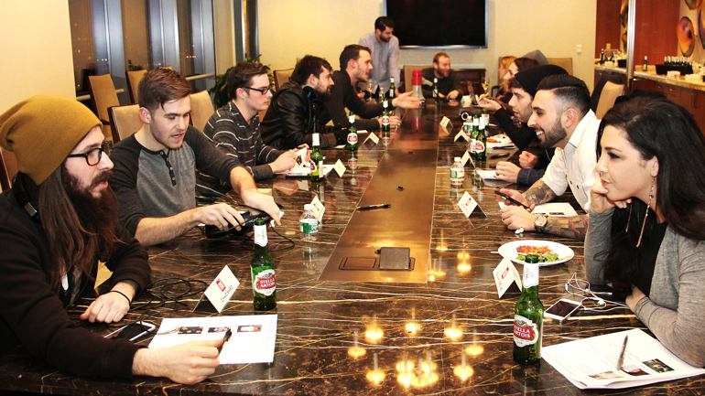

speed speed date
slow vs. fast
(sporo /brzo)

Slide 19
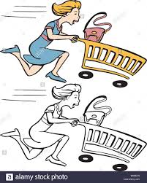
speed shopper

Slide 20
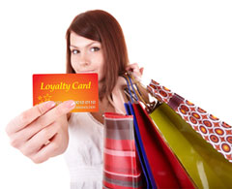
Frequent shopper
/ˈfriːkw(ə)nt/
He or she goes shopping often/frequently.

Slide 21
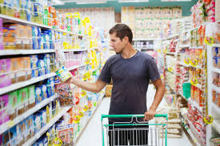
careful shopper (moneywise)
/ˈkeə.fəl/ (Serb. pažljiv, oprezan)

Slide 22
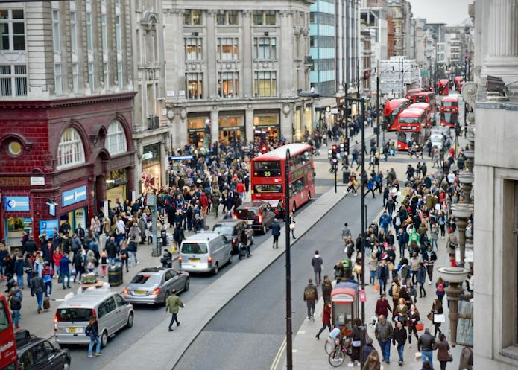
What kind of shopper are you?
There are many types of shopper. These four people are shopping on Oxford Street, London – one of the busiest shopping areas in the world

Slide 23
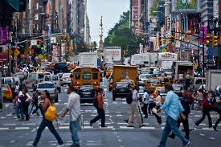
busy street – full of people and life bustling

Slide 24
José, the__________shopper
Shopping habits: I really don’t like shopping. I don’t spend a lot of time in the shops and I choose things very fast.’
Today: ‘ At the moment, I’m looking for a new suit. There’s a good dark brown suit in this shop. It’s expensive but I can pay for it.

Slide 25
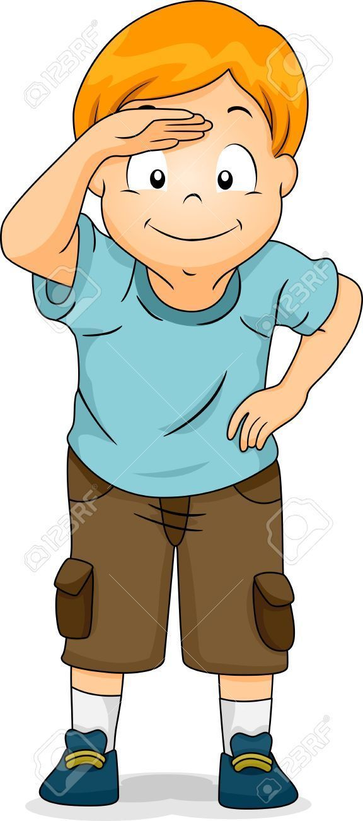
to look for (Serb. tražiti) = search

Slide 26
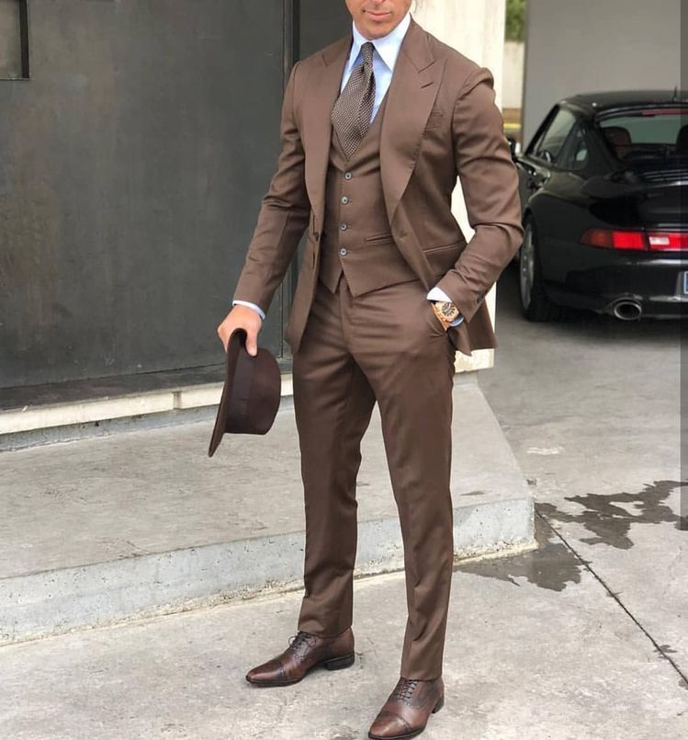
dark brown suit - odelo
/suːt/ /sjuːt/

Slide 27
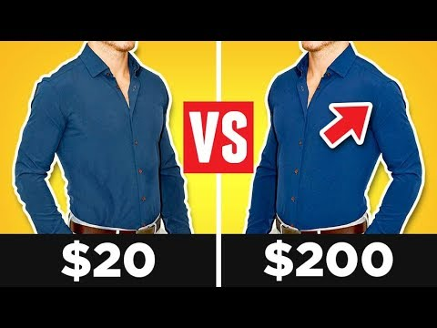
cheap vs. expensive
/tʃiːp/ /ɪkˈspɛnsɪv,ɛkˈspɛnsɪv/

Slide 28
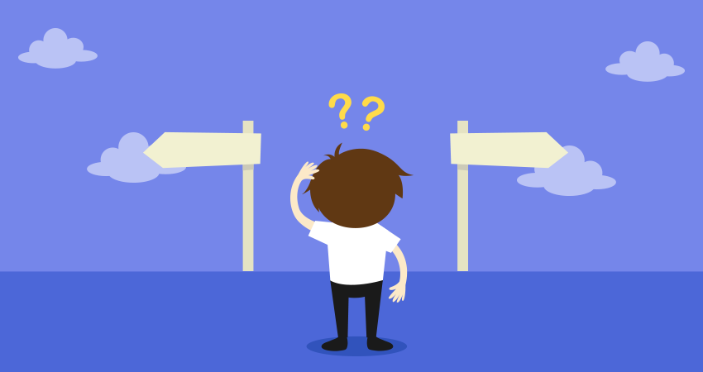
to choose – izabrati, birati
/tʃuːz/

Slide 29
Hiromi, the____________shopper
Shopping habits: ‘I go shopping every weekend. I usually buy clothes or things for my house. I love big department stores.’
Today: ‘Right now, I’m carrying five new things – a coat, a shirt, a cookery book, a pair of shoes and a belt. Time to go home!’

Slide 30
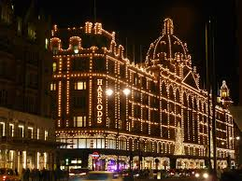
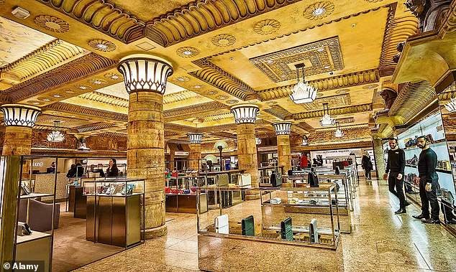
Harrods, department store (Serb. robna kuća)

Slide 31
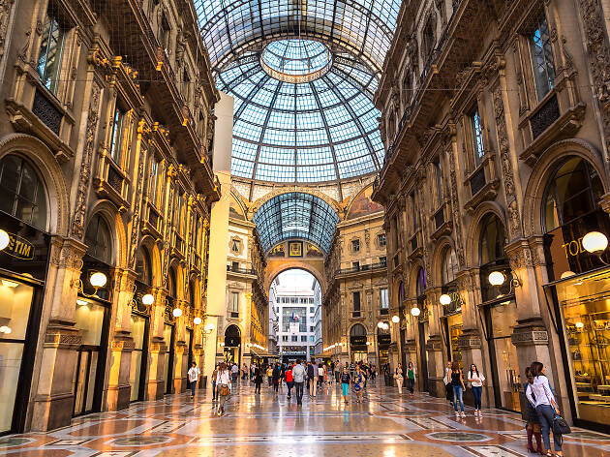
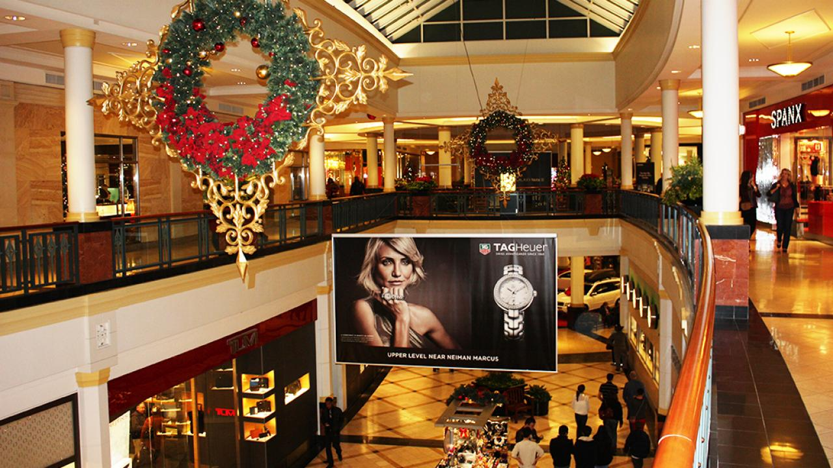
shopping mall/centre
/mɔːl/

Slide 32
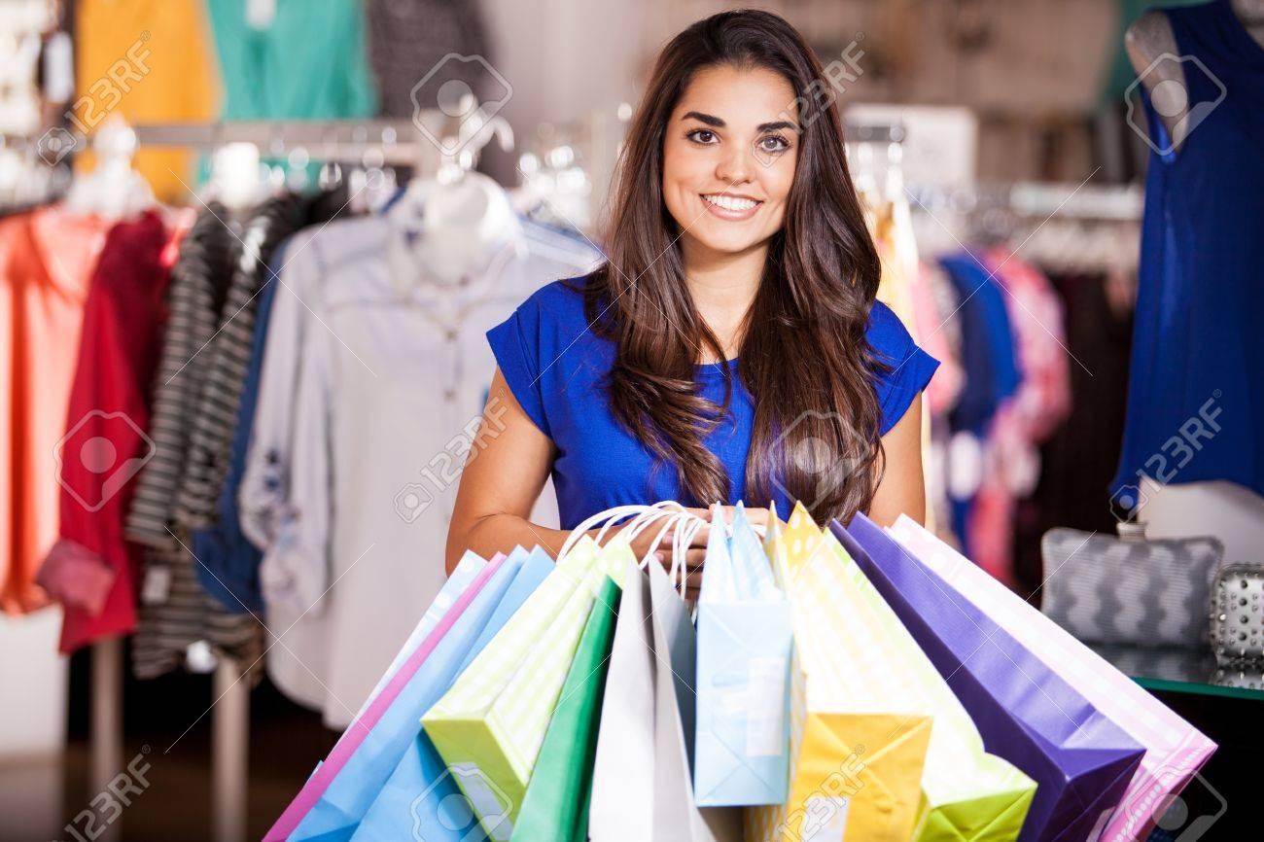
to carry – hold (nositi)
/ˈkær.i/
She is carrying bags.

Slide 33
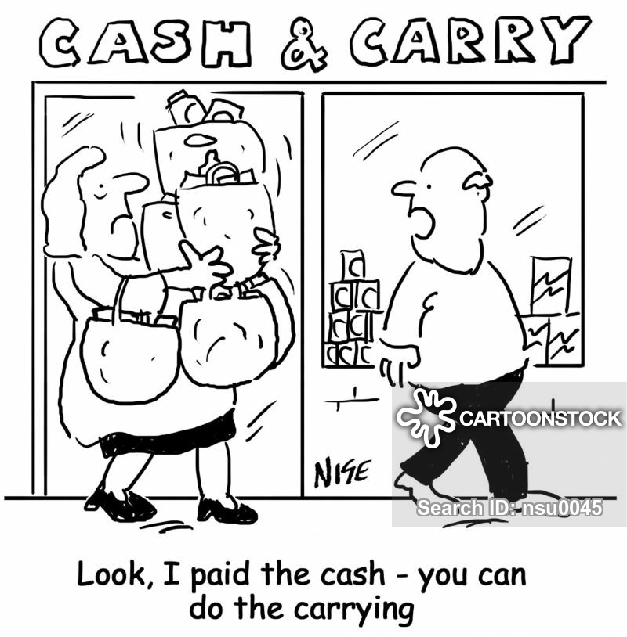

Slide 34
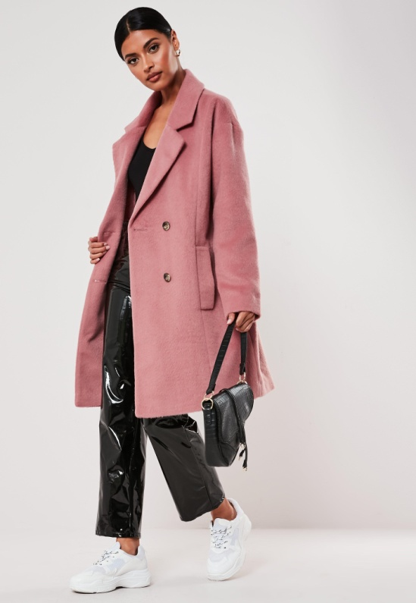
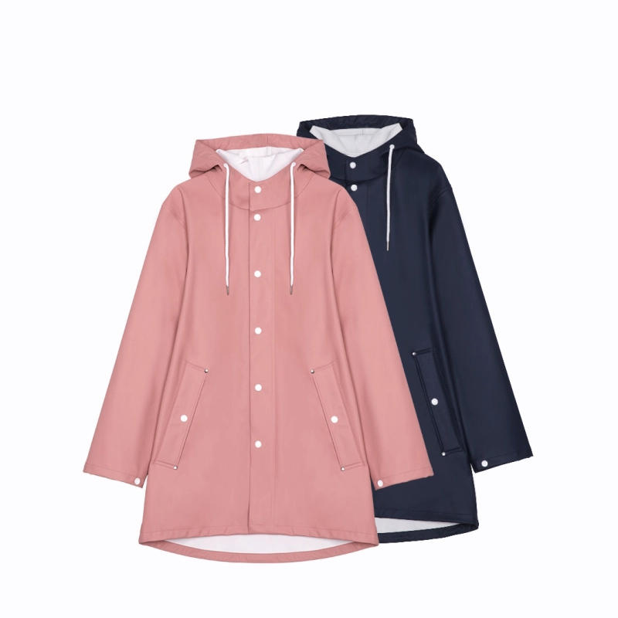
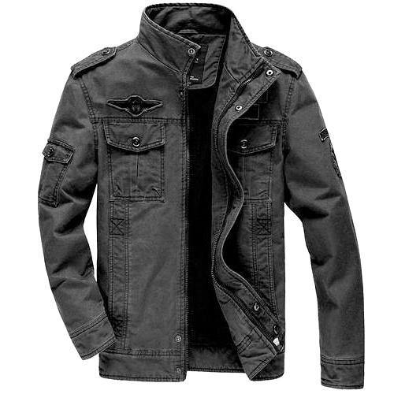
coat/overcoat raincoat jacket
/kəʊt/ /ˈdʒæk.ɪt/

Slide 35
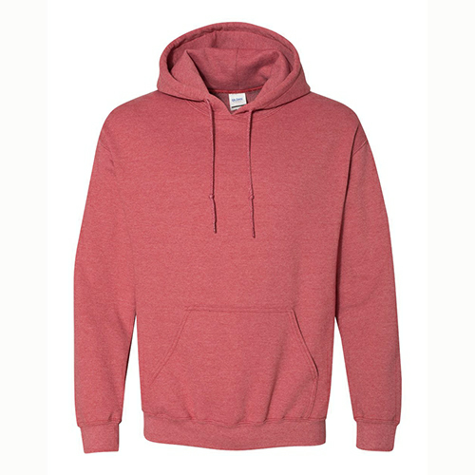
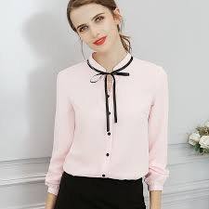
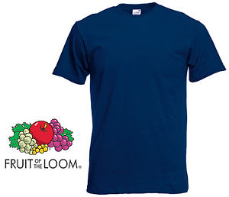
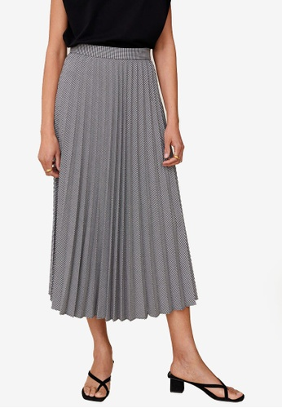
shirt T-shirt sweatshirt skirt
/ʃəːt/ /ˈtiːʃəːt/ /ˈswɛtʃəːt/ /skəːt/

Slide 36

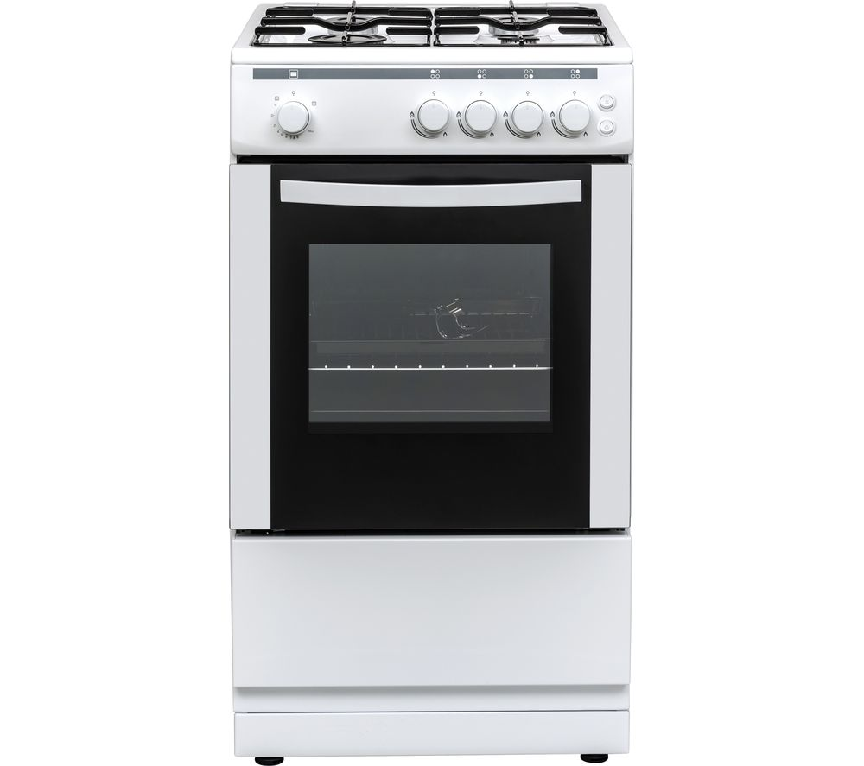
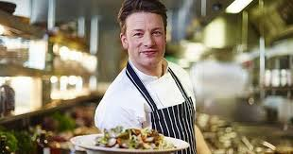
cookery (book) cooker cook
/ˈkʊk(ə)ri/ /ˈkʊkə/ /kʊk/

Slide 37
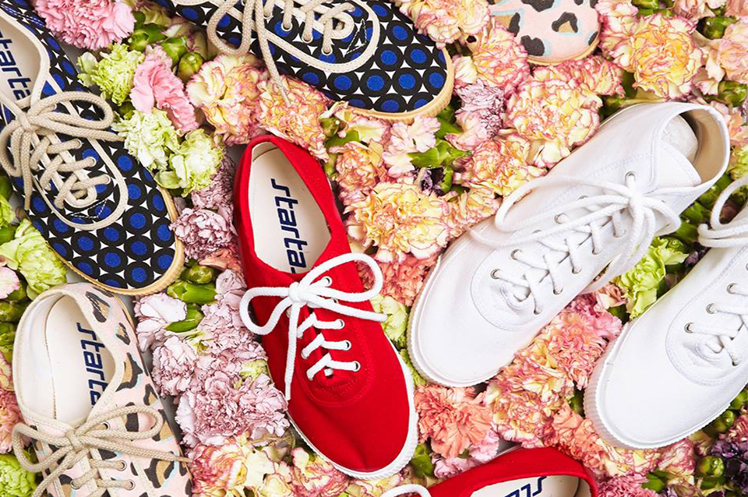
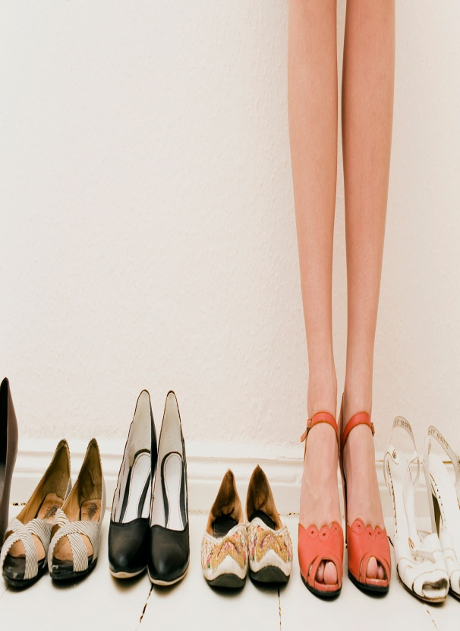

shoes sneakers/ˈsniːkə//trainers boots tennis shoes /buːts/

Slide 38




belt hat/cap scarf

Slide 39

outfit (combination of items)
/ˈaʊtfɪt/

Slide 40
Vince, the____________shopper
Shopping habits: ‘I come to Oxford Street about once a month but I don’t usually spend a lot. I just like to look at the different things in the shops.’
Today: ‘I’m not looking for anything special. Right now, I’m waiting for my friend. She’s trying on a pair of jeans.’

Slide 41

to wear clothes
/weər/

Slide 42

to try on clothes = to check if it suits you (Serb. probati, isprobati)

Slide 43


put the clothes on take the clothes off

Slide 44


a pair of jeans trousers
/dʒiːnz/ /ˈtraʊzəz/

Slide 45
Ulrike, the___________shopper
Shopping habits: ‘I always check the prices in different shops. I always look for the lowest price.’
Today: ‘Today, I’m looking for a digital camera. I’m thinking about buying this one, but I’m not sure – it’s a little expensive.’

Slide 46

check prices

Slide 47

digital camera

Slide 48
answers
José, the SPEED shopper
Hiromi, the FREQUENT shopper
Vince, the WINDOW shopper
Ulrike, the CAREFUL shopper

Slide 49
3. page 58, Read the article again. Are these sentences true or false
1. Jose cannot buy the suit because it is too expensive
2. In her bags, Hiromi has got three things to wear
3. Ulrike is interested in the digital camera in the shop.
4. Vince wants to buy a pair of trousers

Slide 50
3. page58, Read the article again. Are these sentences true or false
1. Jose cannot buy the suit because it is too expensive. F
2. In her bags, Hiromi has got three things to wear. F
3. Ulrike is interested in the digital camera in the shop. T
4. Vince wants to buy a pair of trousers. F

Slide 51
SHOPS AND SHOPPING (1)
VOCABULARY

Slide 52
4a, page 59, Match the verbs with the correct objects.
to buy to check to pay for to spend to spend to try on
a new shirt by credit card
the prices in different shops
time in a shop
50 pounds on DVDs
a new computer on the Internet
a pair of jeans before you buy them

Slide 53
4a page 59, Match the verbs with the correct objects.
to buy to check to pay for to spend to spend to try on
a new shirt by credit card PAY FOR
the prices in different shops CHECK
time in a shop SPEND
50 pounds on DVDs SPEND
a new computer on the Internet BUY
a pair of jeans before you buy them TRY ON

Slide 54
4b page 59, Complete the questions with a verb from Exercise 4a. Then ask a colleague/friend the questions.
1. How much time do you ________ in clothes shops?
2. Do you __________ prices in different shops before you buy something?
3. Do you always _________ clothes before you buy them?
4. Do you often ________things by credit card?
5. Do you _________ things on the Internet?
6. Do you _________ a lot of money on clothes and music?

Slide 55
4b page 59 Complete the questions with a verb from Exercise 4a. Then ask a colleague/partner the questions.
1. How much time do you SPEND in clothes shops?
2. Do you CHECK prices in different shops before you buy something?
3. Do you always TRY ON clothes before you buy them?
4. Do you often PAY FOR things by credit card?
5. Do you BUY things on the Internet?
6. Do you SPEND a lot of money on clothes and music?

Slide 56
Present Continuous (1)
(sadašnje trajno/progresivno vreme)
GRAMMAR:

Slide 57
5a page 59, Look at these sentences from the article and answer the questions.
a) Right now, I’m carrying five new things.
b ) I always check the
prices in different
shops.
Which sentence describes things that happen again and again? What do we call this tense?
2. Which sentence describes an action happening now?

Slide 58
Compare
PRESENT SIMPLE ADVERB (prilog) | PRESENT CONTINUOUS ADVERB (prilog)
usually, often, sometimes, rarely, never, from time to time | now, right now, just now, at the moment, currently
Which sentence describes things that happen again and again? What do we call this tense?
PRESENT SIMPLE TENSE
2. Which sentence describes an action happening now?
PRESENT CONTINUOUS TENSE

Slide 59
5b page 59, Find more examples of the Present Continuous in the article.
Right now, I’m carrying five new things.
I’m not looking for anything special.
Right now, I’m waiting for my friend.
She’s trying on a pair of jeans.’
I’m looking for a digital camera.
I’m thinking about buying this one
At the moment, I’m looking for a new suit.

Slide 60
5c page 59, Complete the Table
 | SUBJECT | To be | Verb+-ing
+ | I | 1________ (am)
 | You/We/They | ‘re (2 ________)
 | He/She/It | ‘s (3 ________) | looking at it.
– | I | 4 _______ (am not)
 | You/We/They | aren’t (are not)
 | 5____ / _____/ _____ | isn’t (6 __________ )

Slide 61
5c page 59, Complete the Table
 | SUBJECT | To be | Verb+-ing
+ | I | 1’M (am)
 | You/We/They | ‘re (2 ARE)
 | He/She/It | ‘s (3 IS) | looking at it.
– | I | 4 I’M NOT (am not)
 | You/We/They | aren’t (are not)
 | 5 HE / SHE/ IT | isn’t (6 IS NOT)

Slide 62
HW go to Language Reference and Extra Practice pages 134-135.
1. Read G1 about Present Continuous. page 134
2. Read G2 about Present Continuous and Present Simple. page 134
3. Read G3 about Present Continuous questions. page 134
4. Do exercise G1/1 page 135
5. Do exercise G2/2 page 135

Slide 63
6. page 59, Complete these mobile phone conversations. Use the Present Continuous of the verbs in brackets. Listen Track 2.2, read Transcript page 150 to check your answers
1. I can’t talk now. I ______ ________ ______ some trainers. (try on)
2. Call me back later. I _______ ____________. (drive)
3. Can you see me? I ________ __________ at the corner, opposite the bank. (stand)
4. Can I call you back? The waiter _________ _________ for me to order. (wait)
5. We ________ just ________ at the bus station. See you in five minutes. (arrive)
6. I’m in the car park. I ________ ________ the food in the car. (put)

Slide 64

7. page 59, Complete this paragraph with the correct form, Present Simple or Continuous of the verbs in the brackets.
Tom The Christmas shopper I don’t usually come (not come) to Oxford Street but today I ______ (look for) some Christmas presents. That’s why I ______ (look at) these CDs – my Dad _____ (listen) to music all the time. I _____ (not live) in London, but it ______ (be) always fun to visit Oxford Street and I _______ (have) fun today. There’s a lovely Christmas atmosphere in the city – that’s why I ______ (wear) this silly hat!

Slide 65
LISTENING
8. Track 2.3, Transcript page 150
Listen to three short conversations. Use the phrases below to describe situations. Use phrases from the list.
in a bookshop in a cafe in a cinema in a clothes shop in a shoe shop to ask for to buy to order to try on
He’s in a shoe shop. He’s trying_____________________.
He______________________________________________.
She_____________________________________________.

Slide 66

shoe shop
SIZE (veličina)
Do they fit?
(=Are these the right size?)
Do they suit you?
How do they feel?
(Serb. kakav je osećaj, tj. da li su udobne?)

Slide 67

matching colours
(boje koje se dobro slažu, odgovarajuće)

Slide 68


bookstore
We can order – (Serb. poručiti)
take an order – primiti porudžbinu
make/place an order - poručiti

Slide 69

PITY /ˈpɪt.i/ (exp.disappointment)
(Serb. šteta je)

Slide 70

wings (Serb. krila)

Slide 71

clothes shop
How would you like to pay?
by credit card, by cheque, in cash, through QR, with Apple Pay
enter your number (PIN)
Here’s your receipt.
/rɪˈsiːt/

Slide 72
LISTENING
8. Track 2.3, Transcript page 150
Listen to three short conversations. Use the phrases below to describe situations. Use phrases from the list.
in a bookshop in a café in a cinema in a clothes shop in a shoe shop to ask for to buy to order to try on
He’s in a shoe shop. He’s trying on new shoes.
He’s looking for a book.
She’s buying a shirt.

Slide 73
WRITING
9. page 59 With your colleague/friend, write a short conversation and practice it.
Sample 1
Shop assistant: Good afternoon, how can I help you?
Customer: Yes, I’m looking for black leather shoes...
Sample 2
Waiter: Hi, what can I get you to drink?
Customer: I’d like a cup of cappucino and a glass fresh orange juice...

Slide 74
WATCH
VIDEO 1
https://www.youtube.com/watch?v=sHQ384U4-O0&t=1s
VIDEO 2
https://www.youtube.com/watch?v=xDVidC9-d0A
VIDEO 3 https://www.youtube.com/watch?v=YjXiCZpelf0

Slide 75

Thank you for your Attention!

