Slide 1
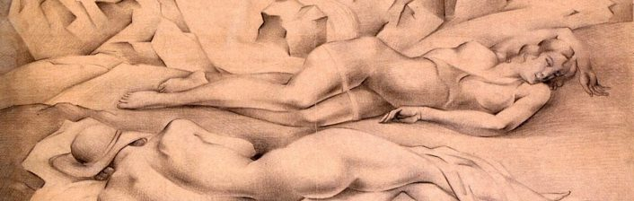
Scenario
At a Museum, pp 70-71
Language Reference&Extra Practice pp. 136-137

Slide 2
preparation
page 70

Slide 3
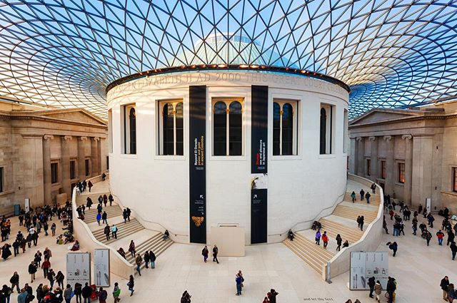

1. page 70, Work with other students and answer these questions.
1. What country/city is this museum in?
(The museum in the photos)
2. What can you see inside?

Slide 4
1. page 70, sample answers
1. This museum is in London, UK.
2. We can see doors, stairs, people…
There are paintings, sculptures, books in the museum.

Slide 5
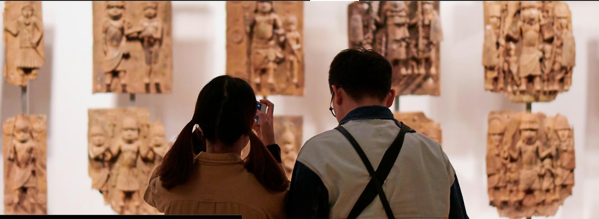
https://www.britishmuseum.org/collection/galleries

Slide 6
2. page 70, Match the sentences 1-8 with notices a-i. There is one notice you don’t need.
1. You can’t go in or out this way. D
2. You can leave your coats and bags here.
3. You can’t make a lot of noise here.
4. You can’t put your hand on this.
5. You can go through here in your wheelchair.
6. You can leave the museum through this door.
7. You can use this to go upstairs.
8. You can’t use a camera here.

Slide 7

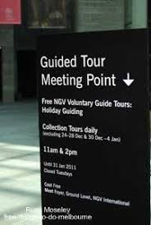




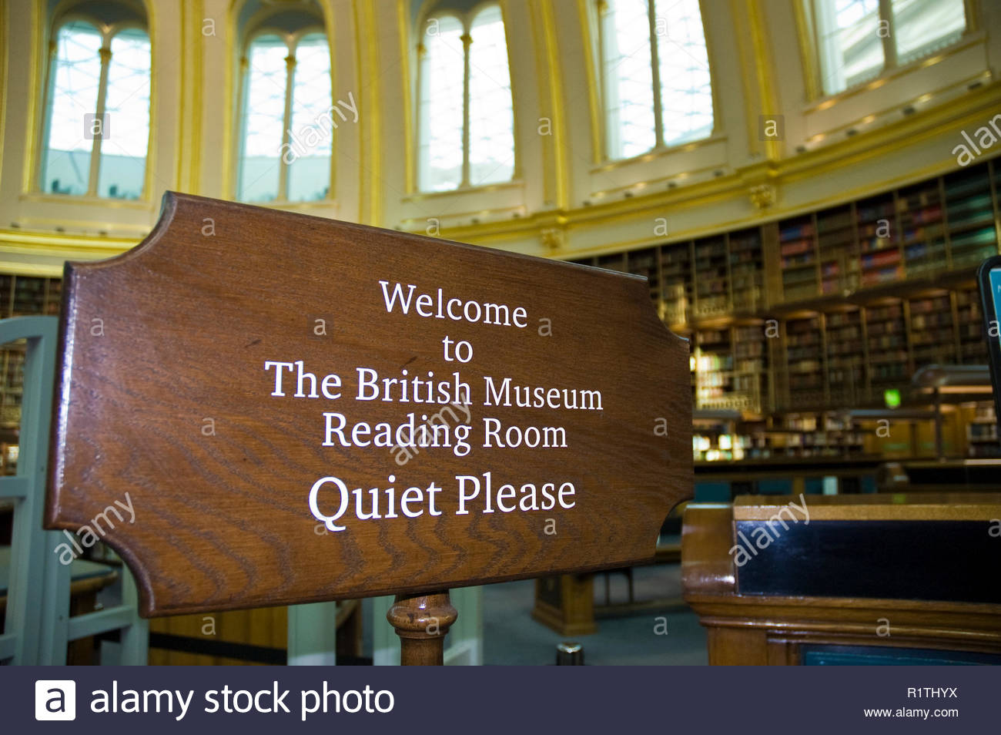


2. page 70, Match the sentences 1-8 (slide 6) with notices A-I (slide 7). There is one notice you don’t need.
A
D
B
C
E
I
F
H NORTH LIFT
TO ALL FLOORS
G

Slide 8
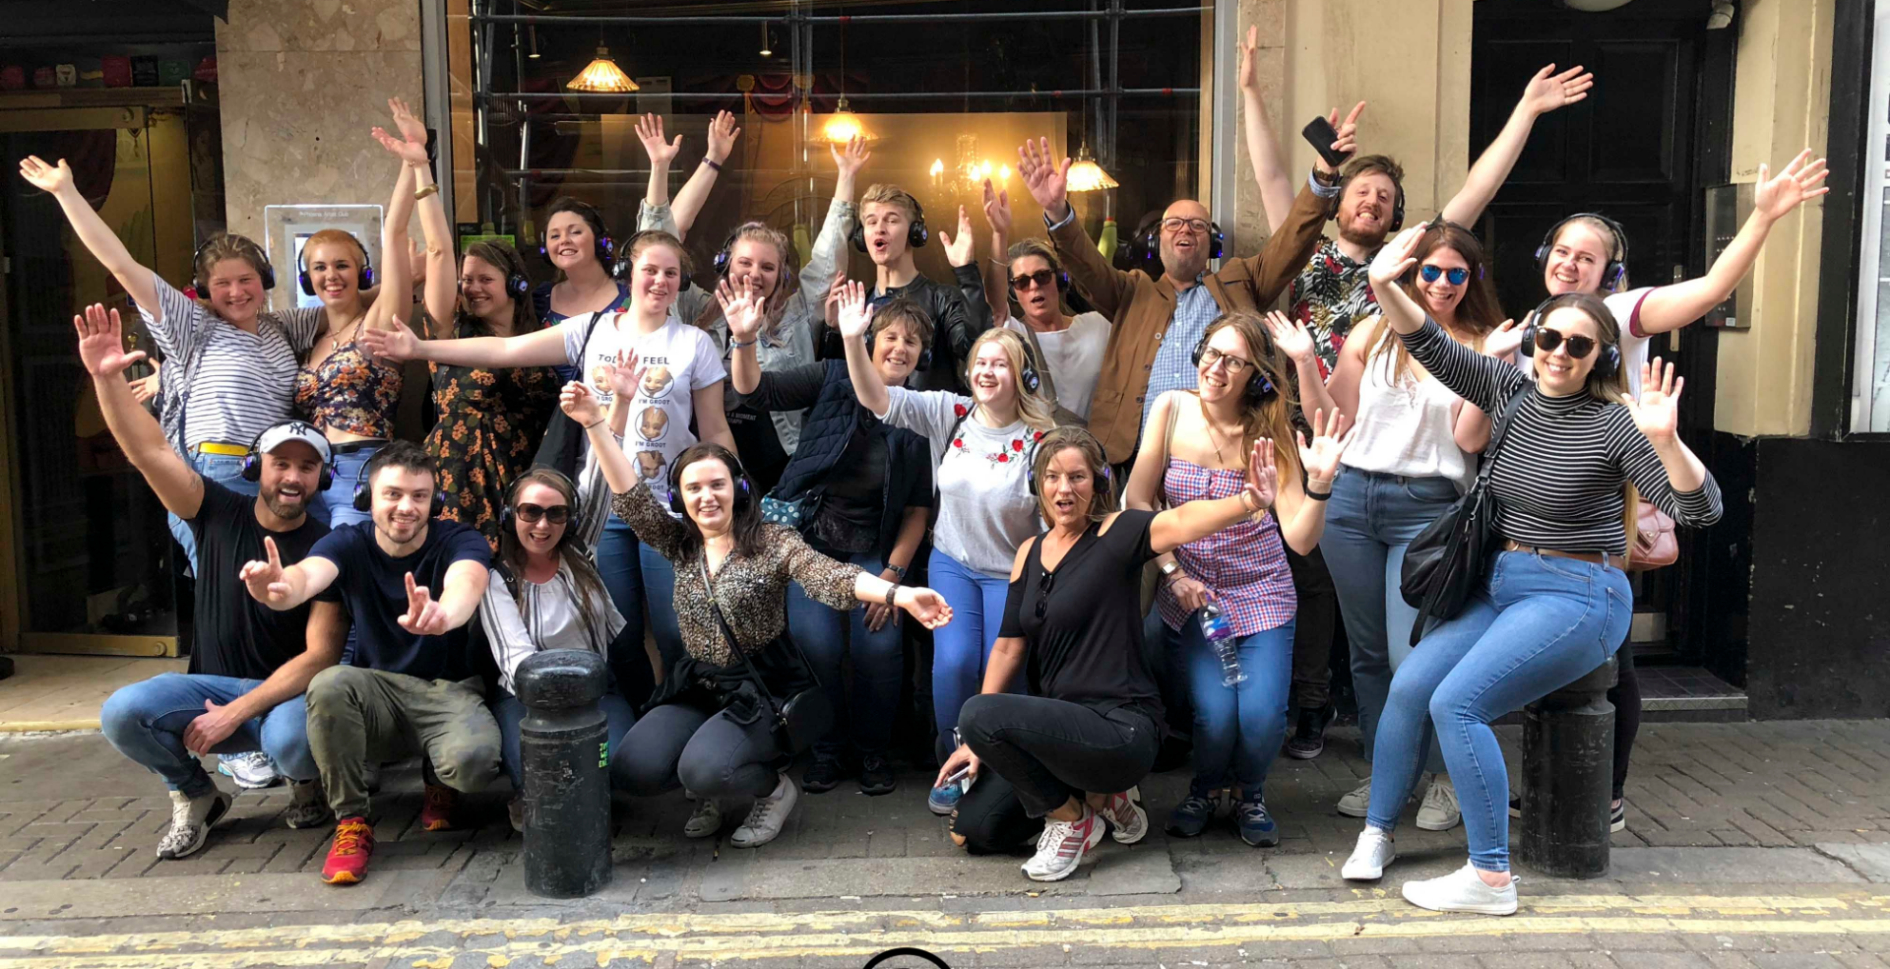
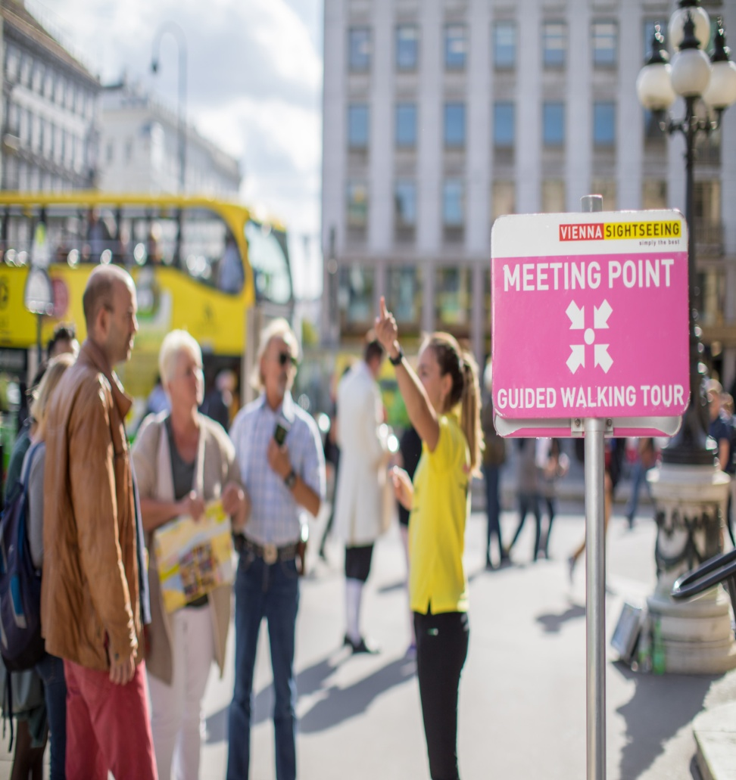
pick-up point drop-off point

Slide 9
key
1. You can’t go in or out this way. D
2. You can leave your coats and bags here. E
3. You can’t make a lot of noise here. I
4. You can’t put your hand on this. G
5. You can go through here in your wheelchair. C
6. You can leave the museum through this door. B
7. You can use this to go upstairs. H
8. You can’t use a camera here. F

Slide 10
3. page 70, Track 2.13, transcript 151,
Richard and Jessica work at a museum. Listen to their conversations with six visitors to the museum. Match each conversation with one of these topics.
a) how much something costs
b) getting a map
c) how old something is
d) when something starts
e) taking a photograph
f) where something is

Slide 11
3. page 70, Track 2.13, answers
a) how much something costs 2
b) getting a map 5
c) how old something is 4
d) when something starts 3
e) taking a photograph 6
f) where something is 1

Slide 12
4. page 70, Listen again and answer these questions.
1. Where is the cloakroom?
2. How much does a long tour cost?
3. When does the film start?
4. How old is the statue?
5. How many maps does the Italian woman take?
6. Where can you take a photograph?

Slide 13
4. page 70, answers
1. The cloakroom is next to the toilets (down the stairs and turn left).
2. A long tour costs 5 pounds (the short tour costs £2)
3. The film start at 2.30 p.m.
4. The statue is about 2000 years old.
5. The Italian woman takes two maps, in Italian and in English.
6. You can take a photograph outside, after your visit.

Slide 14
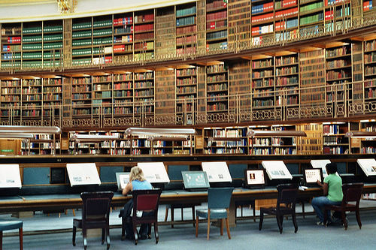
https://www.youtube.com/watch?v=2b6jTRggT2Y
Watch a clip about British museum!

Slide 15
Key language: polite questions
page 70-71

Slide 16
5. page 70, Put the lines of conversation 1 (below) in the right order. Check your answers with Track 2.13 on page 152, Transcript.
a) Yes, madam. How can I help you?
b) You’re welcome.
c) Could you tell me where the cloakroom is, please?
d) Thank you.
e) Certainly, madam. Can you see those stairs over there?
f) Excuse me.
g) Yes, I can.
h) Well, go down those stairs and then turn left. The cloakroom is next to the toilets.

Slide 17
5. page 70, key
a) Yes, madam. How can I help you? 2
b) You’re welcome. 8
c) Could you tell me where the cloakroom is, please? 3
d) Thank you. 7
e) Certainly, madam. Can you see those stairs over there? 4
f) Excuse me. 1
g) Yes, I can. 5
h) Well, go down those stairs and then turn left. The cloakroom is next to the toilets. 6

Slide 18
6a page 71, Complete the table with requests from the conversation in Exercise 3.
Could you | ________ me, please? ________ us a map of the museum? ________ a photo of us?
Could you tell me | 4. ________ much it 5. __________ ? 6. ________ the cloakroom 7._____, please? 8. _________ the next film 9. __________? 10. ________ old it 11. ___________?

Slide 19
6a page 71, key
Could you | help me, please? give us a map of the museum? take a photo of us?
Could you tell me | 4. how much it 5. is ? 6. where the cloakroom 7. is, please? 8. when the next film 9. starts? 10. how old it 11. is?

Slide 20
6b page 72, How can you respond to the requests in Exercise 6a? (Look at the page 53, Exercise 9 and the Other useful phrases box of page 71.)
Certainly,... /ˈsəːt(ə)nli/ surely, definitely
That’s no problem.
Sure, no problem.

Slide 21
8. page 71, Track 2.15 Put the words in the right order to make requests. Listen and check.
1. Could open you please the door ?
2. my coat you Could take please ?
3. me Could tell you when closes the museum ?
4. Could me what you tell this means please ?
5. where Could tell you me is the shop ?

Slide 22
8. page 71, Track 2.15 (sample) answers.
1. Could you open the door, please? – Yes, that’s no problem.
2. Could you take my coat, please? – Yes, most certainly.
3. Could tell me you when the museum closes?
No, I’m afraid I don’t know. Check it out on the internet.
4. Could you please tell me what this means? - Sorry, I’m not sure either.
5. Could you tell me where the shop is? – Yes, of course, go straight for about 100m then turn left, it’s right next to the museum.

Slide 23
task: finding out important information
page 71

Slide 24
the information on the page 71 about British Museum
The Great Court
Tickets
Entrance to the museum is free but there is a charge for some special exhibitions.
Forgotten Empire: The world of ancient Persia £10 (£6 Student and senior citizen)
Michelangelo Drawings: Closer to the Master £10 (£9 Senior citizen)

Slide 25
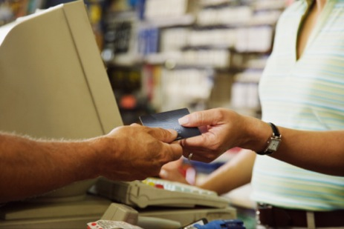
charge, n./tʃɑːdʒ/ - naplata, to charge = naplatiti free of charge = besplatno
a price asked for goods or services
to demand an amount of money as a price for a service/ goods provided.

Slide 26
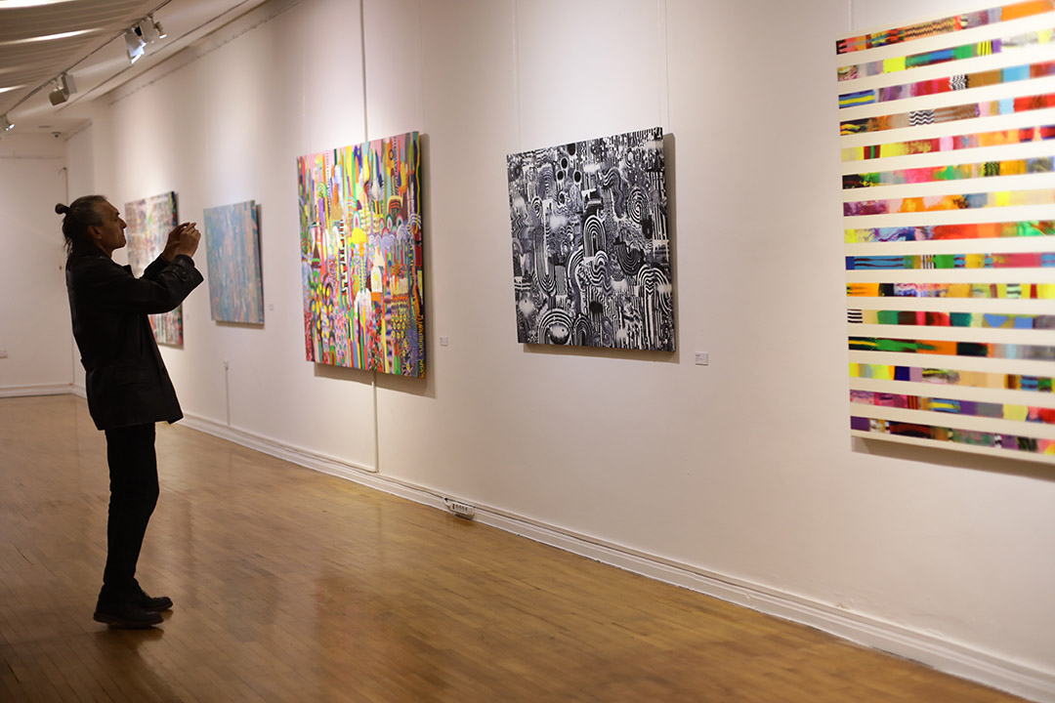
exhibition /ɛksɪˈbɪʃ(ə)n/ izložba to exhibit /ɪɡˈzɪbɪt,ɛɡˈzɪbɪt/ izložiti exhibit, n. - eksponat

Slide 27
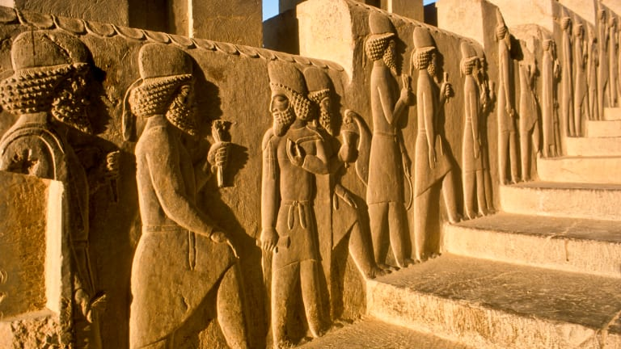
empire /ˈɛmpʌɪə/ = kingdom, carstvo ancient /ˈeɪnʃ(ə)nt/= drevni, antički, stari
Persia/ˈpɜː. ʃə/ / = Persija

Slide 28
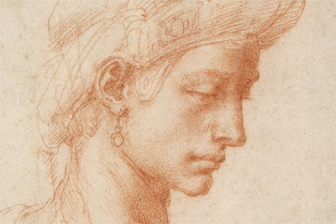
Michelangelo drawings = Mikelanđelovi crteži
/ˈdrɔː(r)ɪŋ/, sketch to draw /drɔː/ - to make pictures, crtati
Michelangelo is a master. This his masterpiece (remekdelo). master = genius, majstor, slikarski genije

Slide 29
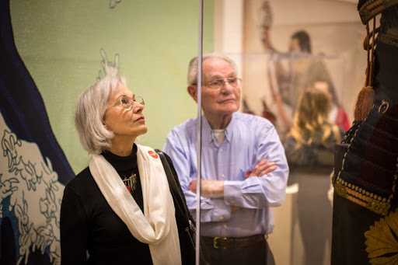
senior citizens – elderly stariji sugrađani

Slide 30
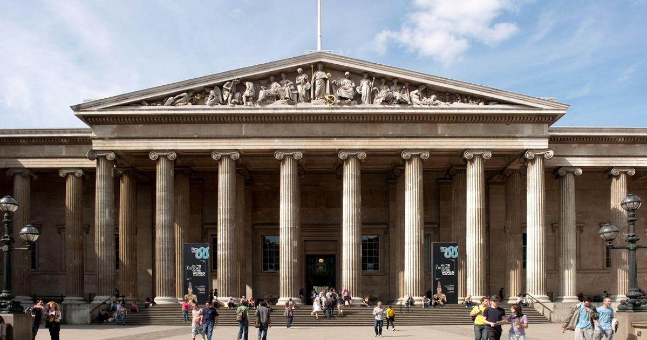
the information on the page 71 about British Museum
Main rooms
Britain and Europe Upper floor (first floor)
Egyptian Mummies Upper floor
Asia Main floor
Greece and Rome Main floor
Africa Lower floor
Front entrance

Slide 31
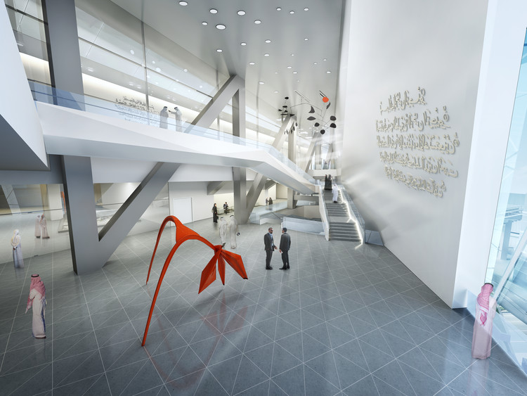
floor BrE = storey AmE (sprat)
UPPER FLOOR
gornji sprat
MAIN FLOOR
glavni sprat
LOWER FLOOR
donji sprat

Slide 32
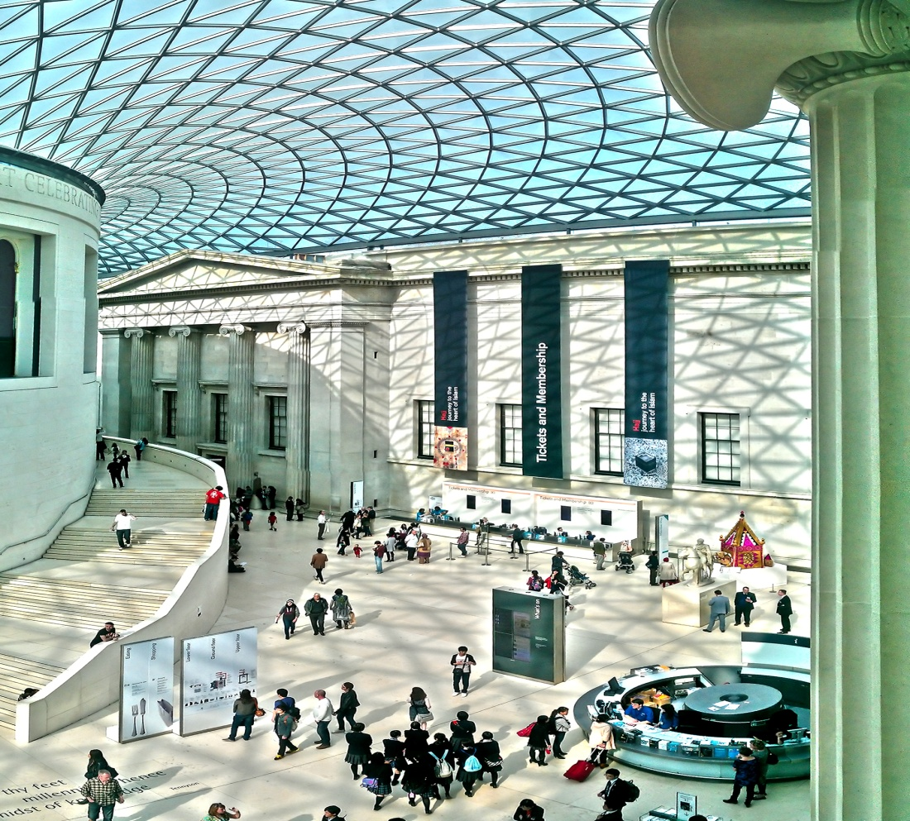
The Queen Elizabeth II Great Court covered courtyeard in the centre of the Museum
The word COURT, n. has several different meanings.

Slide 33
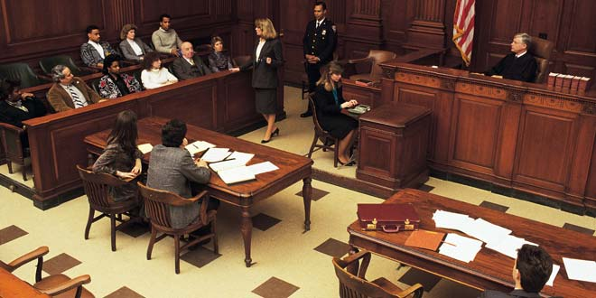
1. court/kɔːt/ = sud

Slide 34
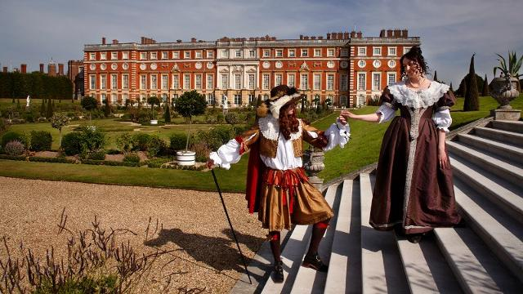
2. court/kɔːt/ = dvor

Slide 35
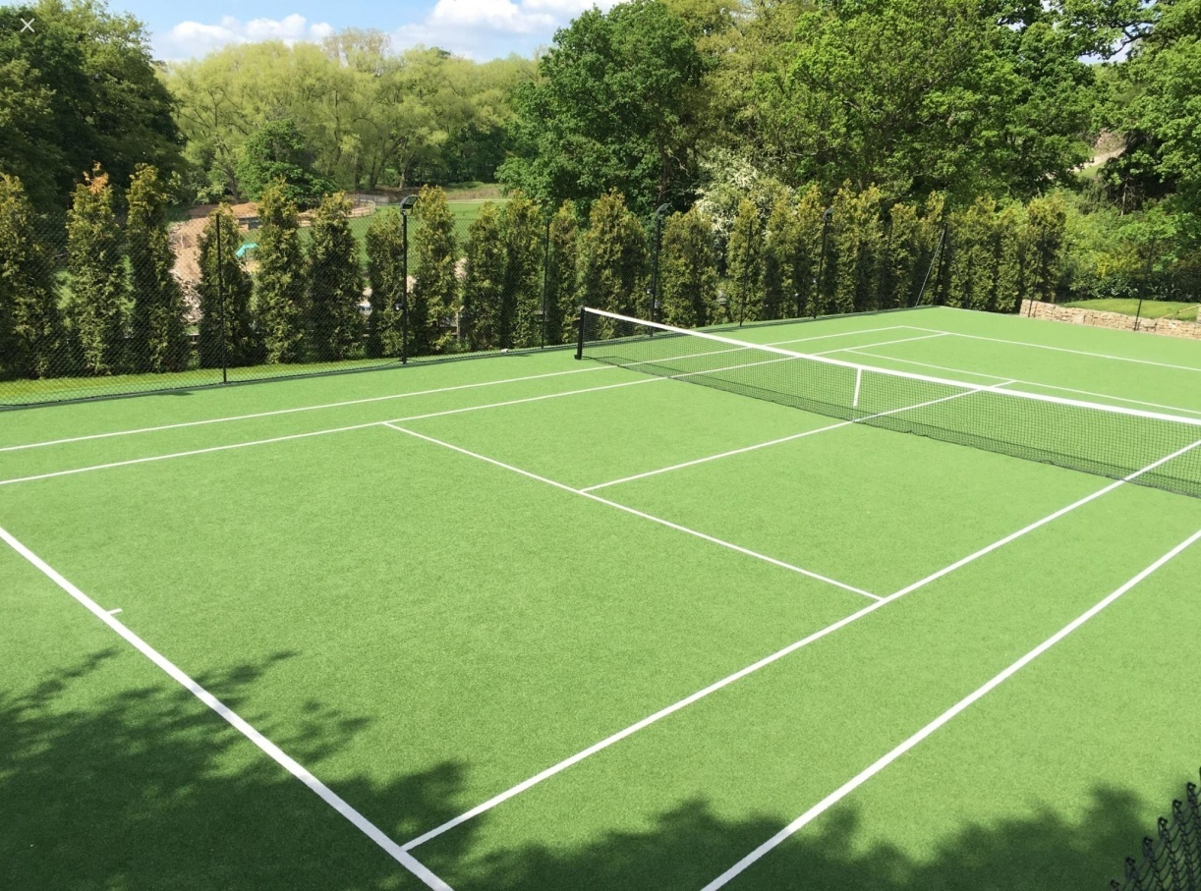
3. court/kɔːt/ = teren, igralište e.g. tennis court, volleyball court, basketball court, handball court

Slide 36
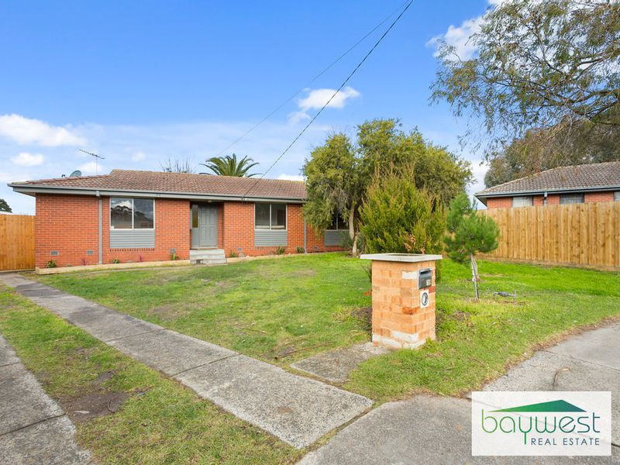
4. court /kɔːt/= dvorište, trg

Slide 37
WORKING HOURS
Library – The Reading Room
The Reading Room is open to the general public.
Shops
The souvenir shop is on the west side of the Great Court.
The bookshop is on the north side of the Great Court.
The children’s shop is on the east side of the Great Court
Food
The restaurant sells hot meals and afternoon teas.
The Great Court café sells sandwiches, cakes and drinks.
10.00 -17.30
10.00 -18.00
10.00 -18.00
10.00 -18.00
12.00 -20.00
10.00 -18.00

Slide 38
10. page 71, Work with your group of students and make short conversations in a museum.
Student A
Student B
You work for a British Museum.
Use the information on the page 71 about British Museum to answer questions from a visitor.
You are a visitor to the museum. Look at page 117 and ask your partner questions.

Slide 39
page 117
Have six short conversations with your partner and find the following information
1. the cost of a student ticket for the Forgotten Empire exhibition
2 where Egyptian Mummies are
3 the Reading Room’s opening time
4. where the bookshop is and its closing time
5 what food the restaurant sells and its opening and closing times.
6. Ask the assistant to look after your children because you want to go to the toilet.

Slide 40
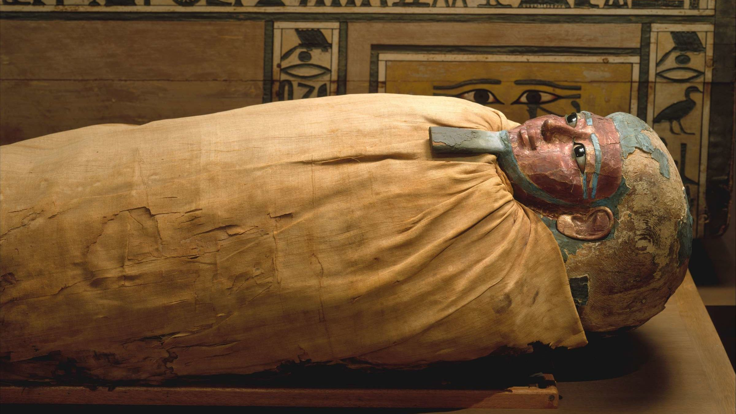
mummy /ˈmʌmi/ - mumija mummies, pl.

Slide 41
10. page 71, Work with your group of students and make short conversations in a museum.
Student A
Student B
Now, you are the visitor. Look at page 112.
Now, you work at the museum. Use the information in page 71 about British Museum.

Slide 42
page 112
Have six short conversations with your partner and find the following information
1. the cost of a senior citizen ticket for the Michelangelo Drawings exhibition
2. where the Africa room is
3. the Reading Room’s closing time
4. where the children’ s shop is and its closing time
5. what food the Great Court café sells and its opening and closing times.
6. Ask the assistant to phone your friend. You can’t find your mobile and your friend is late.

Slide 43
USEFUL PHRASES
VISITOR CENTRE ASSISTANT
THE VISITOR
Yes, of course
That’s no problem
Not at all.
You’re welcome
Hello, how can I help you?
Let me see...
Yes, sir/madam
--------------------------
(negative)
I’m afraid not
I’m afraid I can’t do that.
Excuse me, Can you help me?
Where can I find…?
I’m interested in…
How much does it costs…?
Could you tell me how much it costs?
I’d like to do...

Slide 44
HW (last week), Language Reference&Extra Practice
page 137, KEY

Slide 45
G1 page 137, 1. Complete the three conversations with was, wasn’t, were or weren’t.
1
A: Sorry I (1) WAS late this morning.
B: That’s OK. (2) WAS your bus late?
A: No, it (3) WASN’T. My train (4) WAS late.
2
C: I didn’t know it (5) WAS Jan and Pierre’s birthdays last weekend.
D: Yes, they (6) WERE 25.
C: (7) WERE they at the restaurant on Saturday?
D: No, they (8) WEREN’T. They WERE in Paris for the night!

Slide 46
G1 page 137, 1. Complete the three conversations with was, wasn’t, were or weren’t.
3
E: When (10) WAS your chemistry exam?
F: Last Tuesday.
E: (11) WAS it OK? (12) WERE there any difficult questions?
F: There (13) WERE two difficult questions but it (14) WAS OK.

Slide 47
G1 page 137, 2. Write questions with was orwere for these answers.
1. Were you late for the class?
No, I wasn’t late for the class.
2. Was the teacher here?
No, the teacher wasn’t here.
3. Where were you yesterday evening?
I was at the cinema yesterday evening.
4. Was it a good film? (Did you like it?)
Yes, it was a very good film.
5. Who was with you? (Who did you go with?)
I was with my brother.

Slide 48
G1 3. page 137, sample answers
holiday exam party lesson visit to the dentist
When was your last holiday? – It was in 2019.
Where was your last holiday? – It was in Greece.
How was your last holiday? – It was fantastic.

Slide 49
G2 page 137, 4. Choose the correct word.
1. He couldn’t sees/SEE the film.
2. I’m afraid I couldn’t/CAN’T come tonight.
3. Could they ski when they were children? – Yes, they COULD/couldn’t.
4. Ten years ago it was safe in the city. You can/COULD walk in the streets at night.
5. Now we CAN/could phone anywhere in the world but my parents can’t/COULDN’T when they were young.
6. Sorry we COULDN’T/can’t come last night.
7. Computers CAN/could do anything!

Slide 50
HW page 136-137, KL 1,2
Exercise 5, 6, 7, 8 (page 137)
Read about THE KEY LANGUAGE, KL1 KL2 in Language Reference, page 136

Slide 51
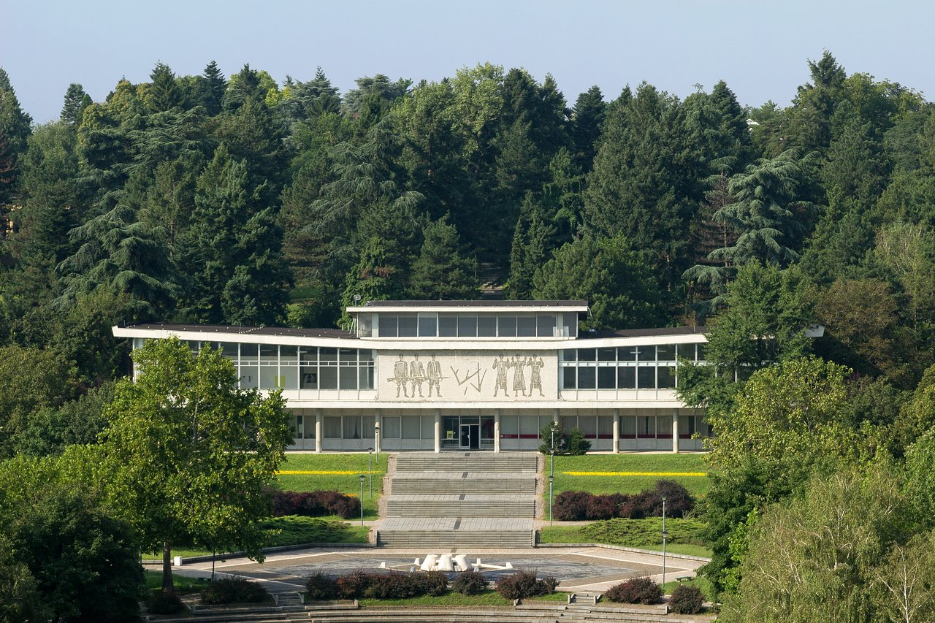
Presentation suggestion https://www.muzej-jugoslavije.org/en/za-studente/
Choose a museum in Belgrade or in Serbia and do a presentation using the British Museum as a model.

Slide 52
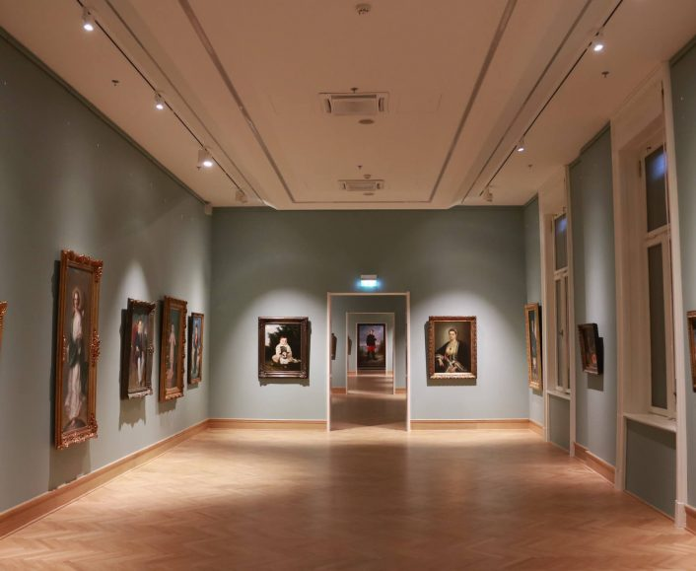
Thank you for your Attention! http://www.narodnimuzej.rs/?lang=en

