Slide 1
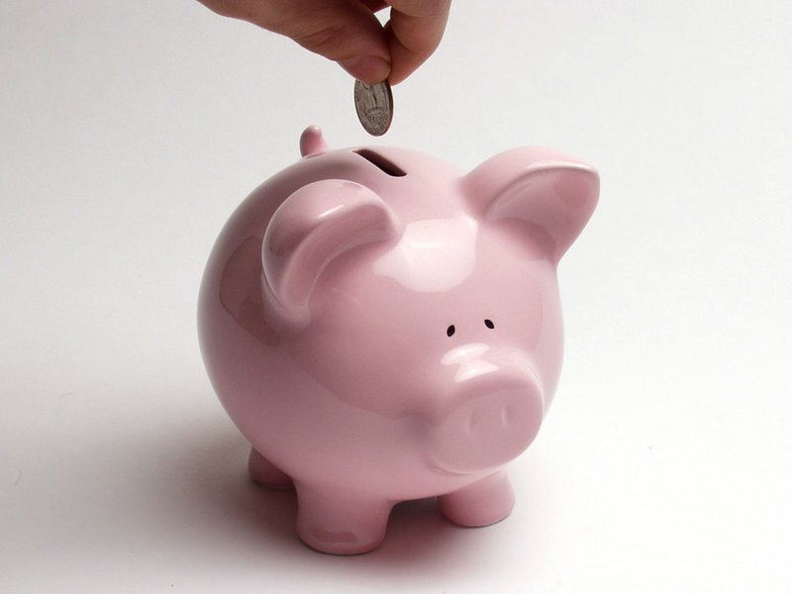
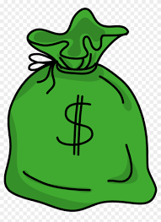
Money
Keeping it Safe

Slide 2
vocabulary
Money

Slide 3
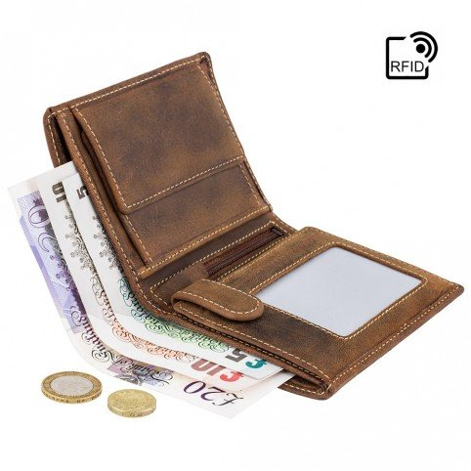
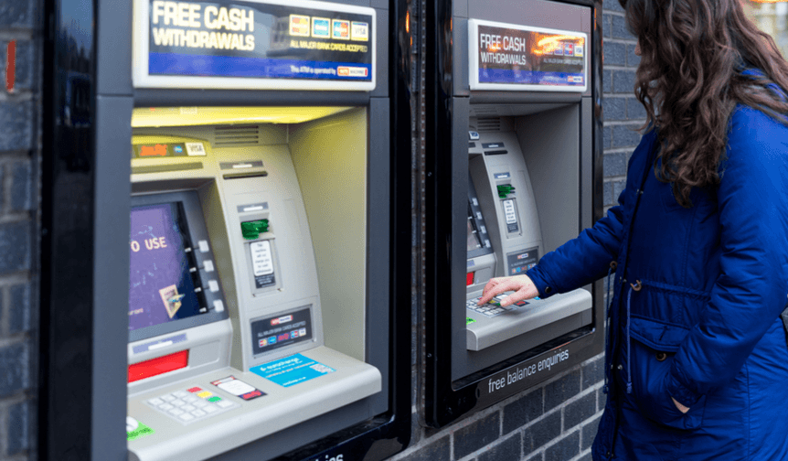
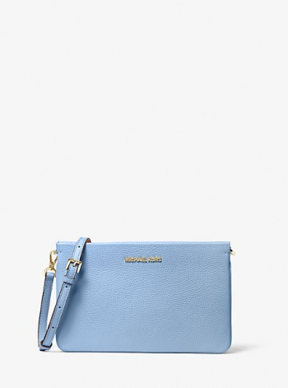
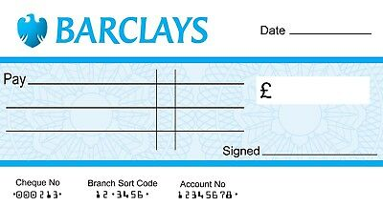
1a, page 84, Look at these words in the box. Check any new words in your dictionary. Which two are cash?
cashpoint cheque coin credit card note PIN number purse wallet

Slide 4
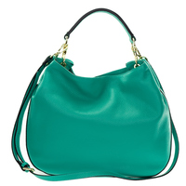
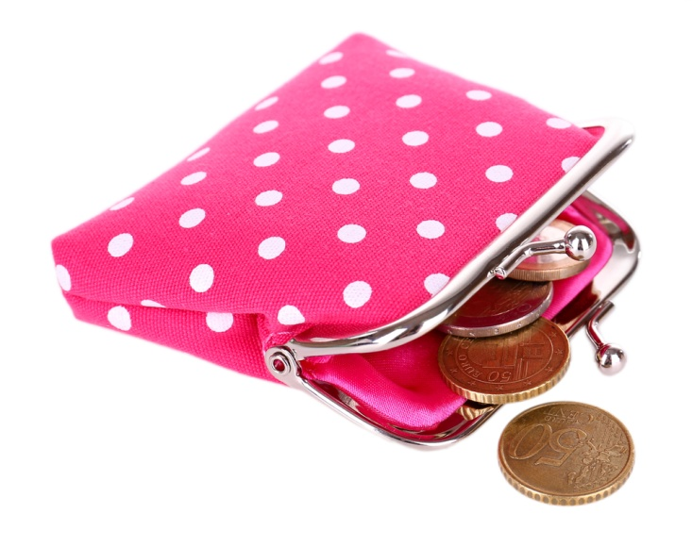
purse/pəːs/
1. BrE = wallet 2. AmE = handbag

Slide 5
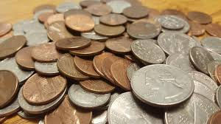
coins/change metalni novac/sitniš
Keep the change = zadrži kusur

Slide 6
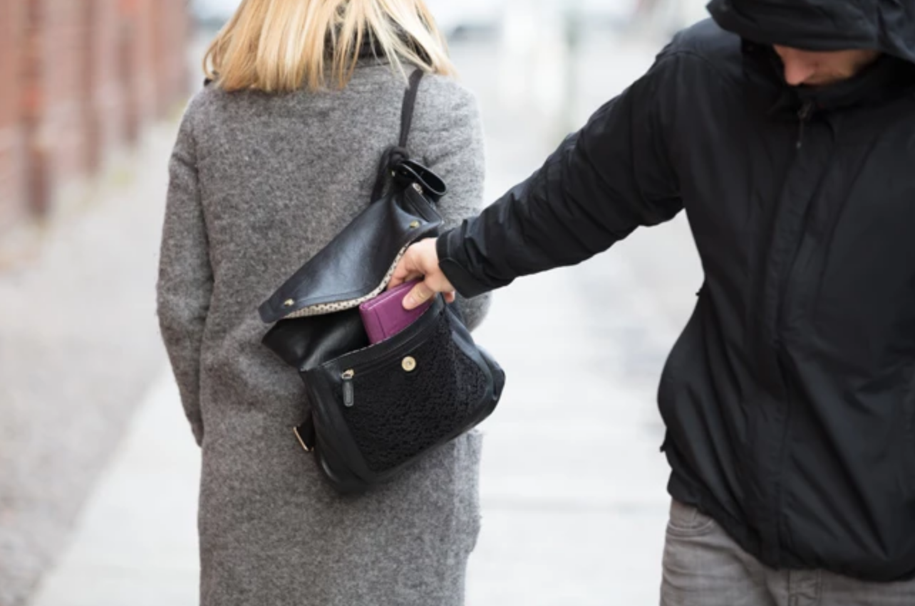
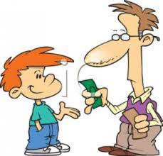
pickpocket pocket money džeparoš džeparac

Slide 7
1b page 84, Make true sentences, using the words above. Compare with a partner.
1. I’ve got/I haven’t got a lot of___________.
2. I don’t often use _____________.
3. There are a lot of ______ in my ________ .
4. It’s easy/difficult to remember my _______ .
5. I always destroy old ____________ .
6. _____ is/are more useful to me than ______ .

Slide 8
reading
page 84

Slide 9
2 page 84, Look at the poster below.
Where can you see it?
Sheffield Metropolitan University
International Students!
Are you new to this city?
Are you worried about:
* keeping your money safe?
* going out at night?
* using taxis alone?
* people stealing your mobile?

Slide 10
2 page 84, Look at the poster below. Where can you see it?
Come along to a talk by Sue Cutler. Sheffield Met International Student Welfare Officer Staying safe: looking after yourself and your money Wednesday 3 October Peak building Lecture Theatre 4 p.m. Tea and Biscuits from 3.30 p.m. Everyone welcome!

Slide 11
3 page 85, Are these sentences about the talk true or false?
1. The talk is for all students of the University.
2. The talk is only about money.
3. Sue Cutler works for the University.
4. The talk is on Wednesday morning.
5. There is nothing to eat or drink there.

Slide 12
3 page 85, answers
1. The talk is for all students of the University. T
2. The talk is only about money. F
3. Sue Cutler works for the University. T
4. The talk is on Wednesday morning. F
5. There is nothing to eat or drink there. F

Slide 13
Listening
page 85

Slide 14
4. page 85, track 2.29, transcript page 154 Read these sentences, then listen to the first part of Sue’s talk and choose the best summary.
1. The city is dangerous and it’s important to be very careful with your money.
2. The city is safe, but it’s important to be careful with your money.
3. The city is safe, so it’s not important to be careful with your money.

Slide 15
5 page 85, track 2.30, transcript page 154, Now listen to the rest of Sue’s talk and fill the gaps.
You should be careful ______ ________ places.
2. You should keep your ______ ________ safe.
3. You shouldn’t keep your _______ in your back pocket.
4. You shouldn’t carry a lot of ___________ .
5. You shouldn’t take your money out in a ______ _________ places.

Slide 16
5 page 85, track 2.30, transcript page 154, answers
You should be careful in crowded places.
2. You should keep your PIN number safe.
3. You shouldn’t keep your wallet in your back pocket.
4. You shouldn’t carry a lot of cash .
5. You shouldn’t take your money out in a busy public places.

Slide 17
6. page 85, Look at what these people say. Do they follow Sue’s advice?
I can never remember my PIN numbers so I keep them on a piece of paper in my wallet.
I always carry my wallet in my inside jacket pocket.
3. I don’t like cheques or credit cards so I always carry a lot of cash.
4. I sometimes check how much money I’ve got in my purse when I’m on the bus.

Slide 18
grammar
should, shouldn’t

Slide 19
7. page 85, Look at the examples and explanations. Answer the questions below
Examples | Explanations
You should be careful. | It’s the right thing to do.
He shouldn’t put his money in his back pocket. | It isn’t the right thing to do.
Should I wear a money belt? | Is it the right thing to do?
Do we add –s to should after he, she and it?
Can you think of another verb with grammar like this?

Slide 20
8. page 85, Complete the sentences with should or shouldn’t and the verb.
1. Should I keep this money? I found it in the street. (I/keep)
2. _________ to the restaurant on your birthday – the food is really bad. (you/go)
3. Max lost his wallet yesterday. - ________ more careful with his money. (he/be)
4. ________ a new camera. Her other camera is only six months old. (she/buy)
5. Someone stole my purse from my car. - ______ the police. (you/tell)
6. __________ all our money on a round-the-world trip or on a swimming pool in the garden? (we/spend)

Slide 21
8. page 85, answers
1. Should I keep this money? I found it in the street. (I/keep)
2. You shouldn’t go to the restaurant on your birthday – the food is really bad. (you/go)
3. Max lost his wallet yesterday. – He should be more careful with his money. (he/be)
4. She shouldn’t buy a new camera. Her other camera is only six months old. (she/buy)
5. Someone stole my purse from my car. – You should tell the police. (you/tell)
6. Should we spend all our money on a round-the-world trip or on a swimming pool in the garden? (we/spend)

Slide 22
9. page 85, Look at some more problems of international students in the UK. Give them advice with should and the ideas in the box.
don’t use your computer late at night go out in a group join a sports club watch TV and practise listening
I don’t know any British people.
I can’t understand what British people say.
I don’t feel safe in the city.
I send emails to my friends back home until 2 am, and then I can’t sleep.

Slide 23
speaking
page 85

Slide 24
10a page 85, Work with a partner.
Think of some advice for Nadia.
I’m a student in London. This is a very expensive city and I don’t get a lot of money: my parents pay my university fees but they can’t afford to give me any extra money. I have a part-time job in a restaurant, but it doesn’t pay very much. I’m using my credit cards a lot and now I’m in debt. What should I do? Nadia

Slide 25
10b page 85, Look at page 121 and check your advice. Then give advice to the other people on that page.
Dear Nadia,
I’m sorry to hear about your problems. I think that you should try to find a better job. Supermarkets usually pay more than restaurants. You shouldn’t use your credit cards to buy things – they’re very expensive. You should talk to your teachers at the university – they can help you.

Slide 26
1
I’m a student from China . I’m now living in the UK. I’m sharing a flat with three other Chinese students. We’re afraid to go out after dark because we can hear a lot of police cars. We don’t think the city is safe.
What should we do?
Li

Slide 27
2.
I’m a student from Poland. I’m learning English, but I find it very difficult to remember new vocabulary.
What should I do?
Veronica

Slide 28
3.
I’m from Germany and I’m spending a year in London. I have a lot of friends and I go out a lot. I like eating in expensive restaurants and going to the theatre. The problems is, I’m an ordinary office worker and I haven’t got much money.
What should I do?
Klara

Slide 29
11. Write a reply to one of the people in page 121.
Sample answer
Dear ....,
I understand your concerns. In my opinion, you should.... I would try....
How about ....?
All the best,

Slide 30
writing
page 85

Slide 31
HW, page 140-141
Read about the verb SHOULD in Language Reference, G1 page 140
Do exercises G1 – 1,2&3 in page 141

Slide 32

Thank you for your attention

