Slide 1
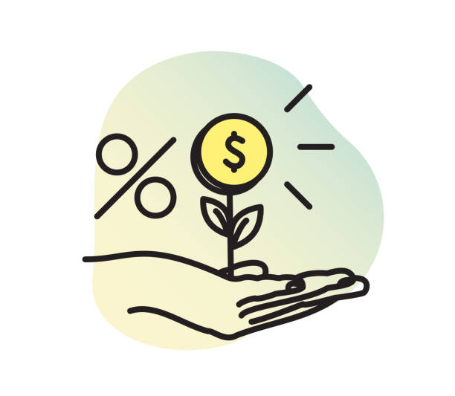
Micro-credit
Unit 10.2.
pages 86-87

Slide 2
Useful Vocabulary, Unit 10.1
Listening Track 29&30,
to steal, ir.v. - stole – stolen = ukrasti
thief,n.sg. /θiːf/ = lopov thieves / θiːvz /, n.pl. = lopovi
theft /θɛft/ = krađa
safety /ˈseɪf.ti/ = bezbednost, sigurnost
safe, n. /seɪf/ - bezbedan safer the safest
op. dangerous /ˈdeɪn.dʒər.əs/ = opasan more dangerous the most dangerous
to be scared = to be afraid (plašiti se), have fears
(op. to be brave = biti hrabar)
to be careful = biti obazriv, pažljiv
to look after sb., take care of sb. = brinuti se, čuvati
possesssions, n.[U ] = belongings, imovina, stvari, ono što posedujemo
common sense = reason, zdrav razum
crowd /kraʊd/ = gužva
busy, n. (market, street) = prometan
banknote = papirna novčanica
moneybelt = pojas/torbica za novac, kolokvijalno “pederuša”
It’s up to you = na vama je da odlučite, to zavisi od vas

Slide 3
Homework key, page, exercises
SHOULD – a modal verb (+infinitive), functions – advice, right thing to do
G1 1. page 141, Write some advice for these problems. Use should and the words from the brackets.
1. My boss isn’t nice to me. (you/get/new/job)
You should get a new job.
2. I live in an ugly city. (you/move/more beautiful.)
3. My bank charges a lot of interest. (you/change/account)
4. He often loses his wallet. (he/be/careful)
5. He borrowed money from me. He didn’t pay me back. (you/ask/money)
6. Shopping at the supermarket is slow. (you/shop/Internet)

Slide 4
G1 1. page 141, key
1. My boss isn’t nice to me. (you/get/new/job)
You should get a new job.
2. I live in an ugly city. (you/move/more beautiful.)
You should move to a more beautiful city.
3. My bank charges a lot of interest. (you/change/account)
You should change the account.
4. He often loses his wallet. (he/be/careful).
He should be (more) careful.
5. He borrowed money from me. He didn’t pay me back. (you/ask/money)
You should ask for your money.
6. Shopping at the supermarket is slow. (you/shop/Internet)
You should shop on the Internet.

Slide 5
2. page 141, Write two sentences giving advice for these problems. Use shouldn’t in the first sentence and should in the second. Invent the second piece of advice.
1. I’m always late for work.
2. They go out all the time and never study.
3. He smokes 50 cigarettes a day.
4. We watch about six hours of television a day.
5. She spends all her money on clothes.

Slide 6
2. page 141, answers
1. I’m always late for work.
You shouldn’t leave late.
You should leave on time.
2. They go out all the time and never study.
They shouldn’t only go out and hang around.
They should find time to study.
3. He smokes 50 cigarettes a day.
He shouldn’t smoke that much.
He should cut cigarettes. He should quit smoking.
4. We watch about six hours of television a day.
You shouldn’t watch TV for so long.
You should do more exercise.
5. She spends all her money on clothes.
She shouldn’t spend so much on clothes.
She should try to save some money instead,

Slide 7
3. page 141, Write Should...? Questions for the answers.
1. Q: Should I tell him?
A: No, it’s OK. I can tell him.
2. Q: Should _________________________?
A: No, we can take the car. I don’t want to walk.
3. Q: Should _________________________?
A: Yes, I think he can do the exam this term.
4. Q: Should__________________________?
A: Yes, a credit card is a good idea.

Slide 8
3. page 141, Write Should...? Questions for the answers.
1. Q: Should I tell him?
A: No, it’s OK. I can tell him.
2. Q: Should we take a walk?
A: No, we can take the car. I don’t want to walk.
3. Q: Should he do the exam this term?
A: Yes, I think he can do the exam this term.
4. Q: Should I use my credit card?
A: Yes, a credit card is a good idea.

Slide 9
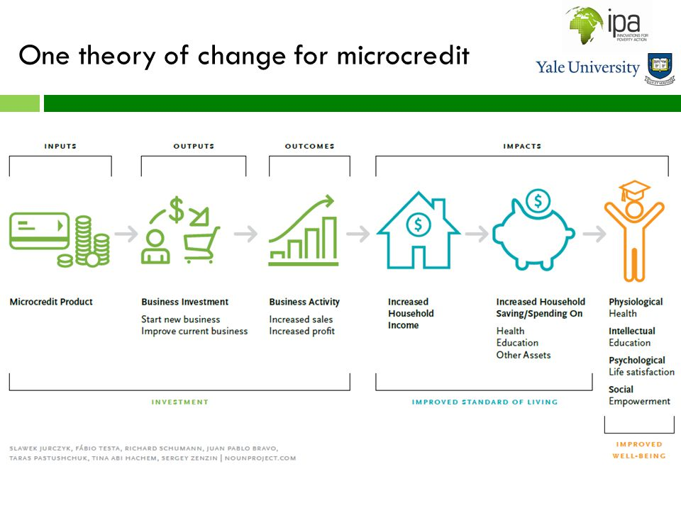
Micro credit = small loan usu. for poor and undeveloped regions

Slide 10
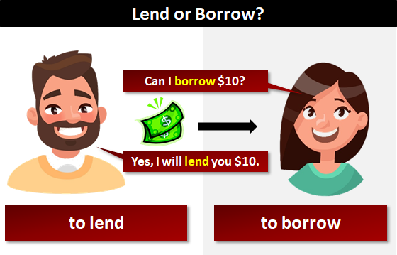
BORROW/ˈbɒrəʊ/VS. LEND = pozajmiti
U srpskom jeziku ne postoji terminološka diferencijacija, tj. isti termin se koristi i za situaciju u kojoj neko od nekoga pozajmljuje (uzima) novac i kada neko nekome pozajmljuje (daje) novac, u engleskom jeziku je drugačije!
I borrow FROM sb. (take, receive)
I lend (give) TO sb.
borrow, regular verb
BORROWED, past t.
lend, irregular verb
LEND LENT LENT

Slide 11
IN THE BANK
BANK ACCOUNT = bankovni račun
CREDIT/LOAN = kredit, pozajmica
INTEREST/INTEREST RATE = kamata/kamatna stopa
TO OWE /əʊ/ - have debts, dugovati
TO OWN /əʊn/ - possess, have
TO WITHDRAW /wɪðˈdrɔː/ MONEY from the cashpoint, from the bank account = podići novac
TO BE IN THE RED = biti u minusu
SAVINGS = ušteđevina
TO CHARGE sb. = to make sb. pay/ naplatiti nekome nešto
FREE OF CHARGE = besplatno, bez nameta
CURRENCY /ˈkʌr(ə)nsi/ = valuta

Slide 12
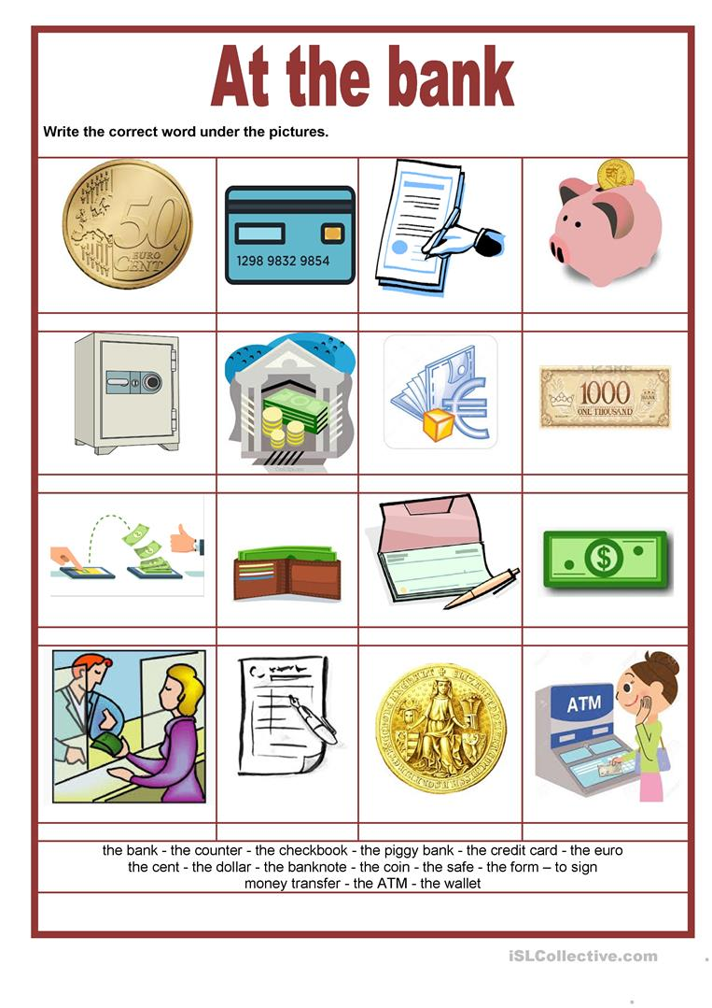

Slide 13
earnings
to earn/əːn/ (money) = zaraditi
to earn one’s living = zarađivati za život
e.g. How does he earn his living?
earnings = zarada
salary/ˈsaləri/ = plata
fee /fi:/= taksa; honorar
student fee, tuition fee = školarina
library membership fee = članarina za biblioteku
tax = porez

Slide 14
1. page 86, Complete the definitions with the phrases in the box
borrow money (from someone) charges your interest earn money get a loan lend money (to someone) pay back
When you ______________, you get money from your job.
When you ______________, you get some money from someone and return it later.
When you ___________ some money, you return the money that you borrowed before.
When you _____________, you give someone some money and he/she returns it later.
When you _______________, you borrow money, for example from a bank.
When a bank ___________, you pay back more money than you borrowed.

Slide 15
1. key
borrow money (from someone) charges your interest earn money get a loan lend money (to someone) pay back
When you EARN MONEY, you get money from your job.
When you BORROW MONEY, you get some money from someone and return it later.
When you PAY BACK some money, you return the money that you borrowed before.
When you LEND MONEY to someone, you give someone some money and he/she returns it later.
When you, GET A LOAN, you borrow money, for example from a bank.
When a bank CHARGES your INTEREST, you pay back more money than you borrowed.

Slide 16
reading
Page 86

Slide 17
2. page 86, Look at the FAQs (Frequently Asked Questions) page for Credit Aid and answer these questions.
1 Who does Credit Aid help?
2 What does Credit Aid do?
aid,n. /eid/ = pomoć

Slide 18

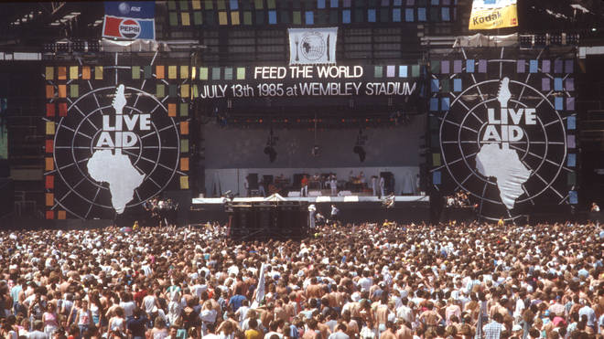

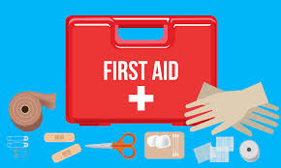
Live Aid
When you give aid, you help someone recover and survive.

Slide 19
Credit Aid
Helping the poor to change their lives
-----------------FAQs---------------
Is Credit Aid the same as a bank?
No, it isn’t. Many poor people want to start their own business in order to make their lives better, but banks don’t lend money to these people because they don’t have jobs or houses.
How do we help people?
We work in poor or developing countries. We lend money to poor men and women for their businesses. The micro-credit loans are very small. They are usually less than 250 dollars. We charge interest of only two percent.
How can someone borrow money from Credit Aid?
He/She...
- has to be over 21 years old
- has to earn less than one dollar a day
- has to have a good business idea
- doesn’t have to be in work
- doesn’t have to own a house
FAQ = Frequently Asked Questions

Slide 20
3. page 86, Are these sentences about the text true or false?
1. A 20-year-old can get a loan.
2. A person without a job can get a loan.
3. A person without a house can get a loan.
4. A person without a business idea can get a loan.
5. A rich person can get a loan.

Slide 21
3. page 86, key
1. A 20-year-old can get a loan. F
2. A person without a job can get a loan.T
3. A person without a house can get a loan. T
4. A person without a business idea can get a loan. F
5. A rich person can get a loan. F

Slide 22
4. page 86, Match the sentences with the correct explanations.
1. She doesn’t have to do it.
2. He has to do it.
3. We have to do it.
4. You don’t have to do it.
a) It is necessary
b) It isn’t necessary.

Slide 23
4. page 86, key
1. She doesn’t have to do it. b)
2. He has to do it. a)
3. We have to do it. a)
4. You don’t have to do it. b)
a) It is necessary
b) It isn’t necessary.

Slide 24
GRAMMAR TIP
Notice the question form:
Does he/she have to...?
Do I/you/we/they have to...?
To say that something is necessary use MUST, HAVE TO, NEED
To say that something is not necessary use HAVE TO and NEED plus a negative word
!!! The verb MUST in its negative form has a different meaning from its affirmative form.
I must = Moram (obaveza) I mustn’t = NE SMEM
(zabrana)
I don’t have to = Ne moram

Slide 25
5. page 86, Complete the sentences with the correct form of have to (affirmative, negative or question form) and a verb from the box.
check give keep pay pay show use
When you open a bank account, you have to show some identification.
When you borrow money from a friend, you ______ interest.
In a foreign country, you ______ foreign currency because you can use a credit card.
The bank ___________ your money safe.
_____the bank manager _______ my loan application?
How much interest ___________ I _____________?
A bank manager _____________ you a loan; he/she can choose.

Slide 26
5. page 86, key
check give keep pay pay show use
When you open a bank account, you have TO SHOW some identification.
When you borrow money from a friend, you HAVE TO PAY interest.
In a foreign country, you DON’T HAVE TO USE foreign currency because you can use a credit card.
The bank HAS TO KEEP your money safe.
DOES the bank manager HAVE TO my loan application?
How much interest DO I HAVE TO PAY?
A bank manager DOESN’T HAVE TO you a loan; he/she can choose.

Slide 27
6. page 86, What are the differences between these jobs? What do/don’t the people have to do?
a doctor a footballer a musician a pilot
a police officer a student a teacher
A teacher has to prepare lessons/doesn’t have to wear a uniform.
A doctor has to wear a uniform. She/he doesn’t have to work in a classroom.
A footballer has to get up early. He/she doesn’t have to treat patients.
A pilot has to be brave. He/she doesn’t have to practice a lot.
A student has to learn. He/she doesn’t have to learn.

Slide 28
reading
page 87

Slide 29
7. page 87, Micro-credit can change the life of a family. Read the text to find out about two women’s stories
Student A Read about Jane in page 87 and answer the questions.
Student B Read about Maya in page 118 and answer the same questions in page 87.

Slide 30
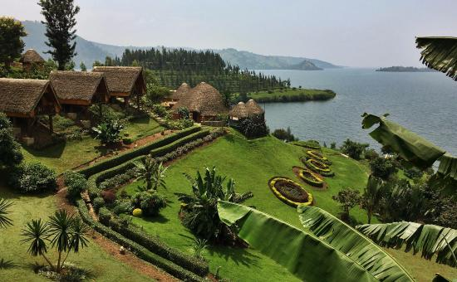
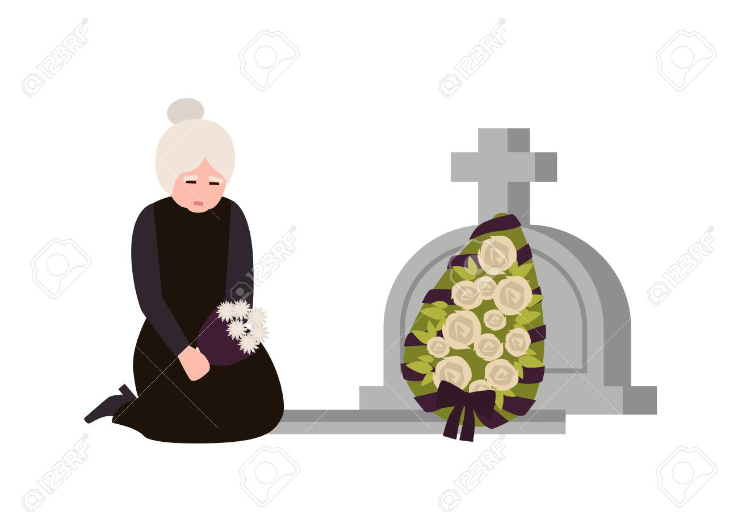
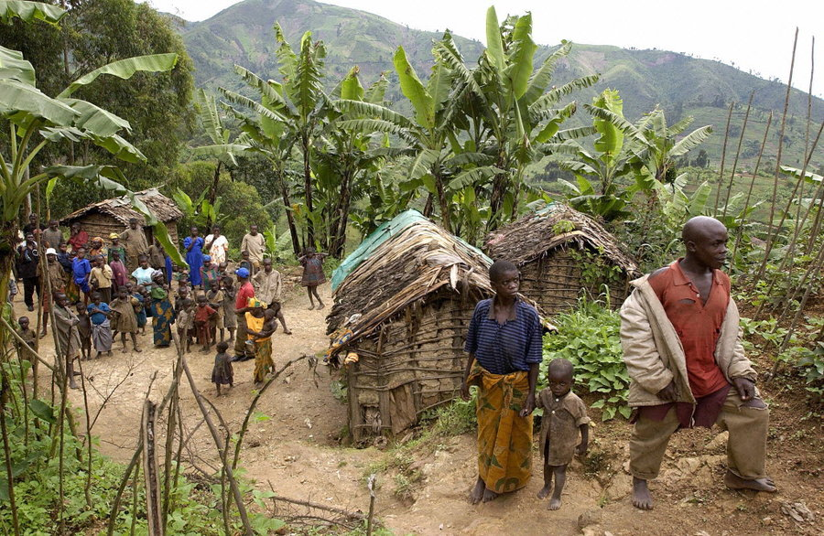
People who borrow from us: Jane
I live in Rwanda and I’m a widow – my husband died in an accident. I live with an elderly mother and I’ve got two children. I have to look after all of them.
widow /ˈwɪdəʊ/ = a woman who has lost her spouse
widower /ˈwɪdəʊə/ = a man who has lost his spouse

Slide 31
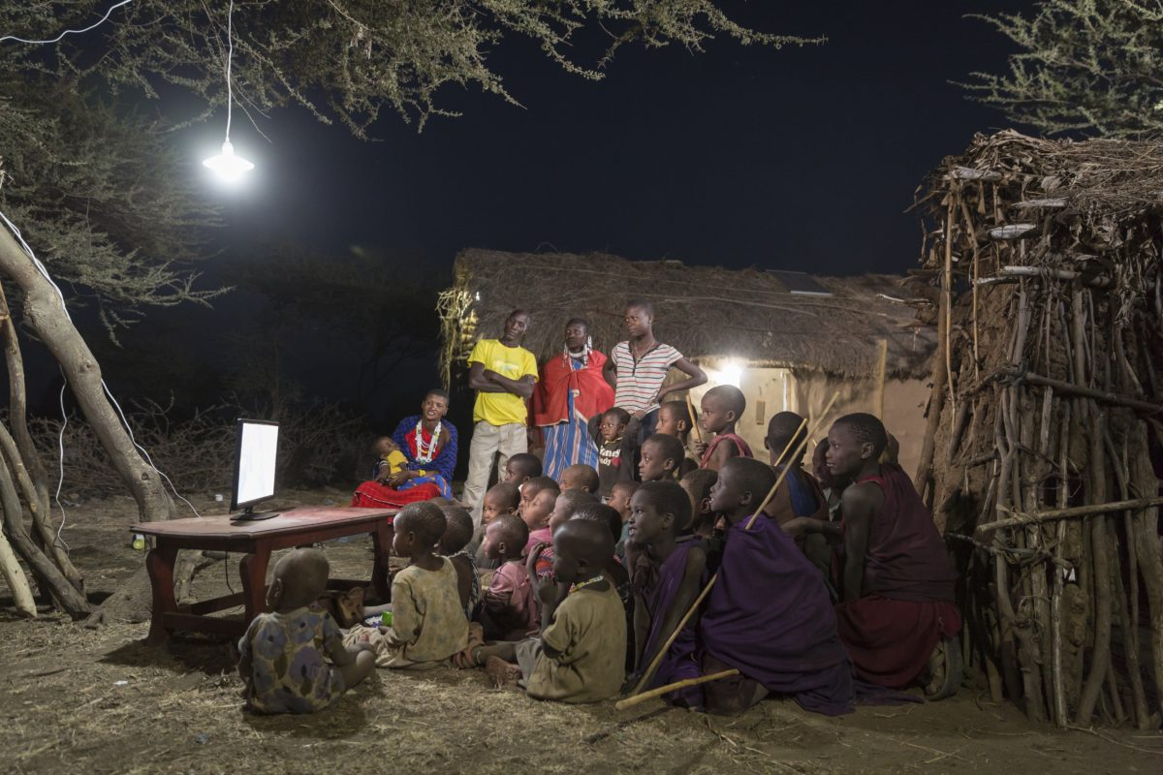
People who borrow from us: Jane
Two months ago, I started my business. I opened a cinema. I borrowed 300 dollars from Credit Aid and I have to pay back dollars every week for one year. I bought a TV, a video player and some chairs. My brother built the room and now I show a film every evening. The cinema is always full and I make dollars every week. It’s quite easy to run a cinema. I don’t have to work in the daytime, but I have to choose good films!

Slide 32
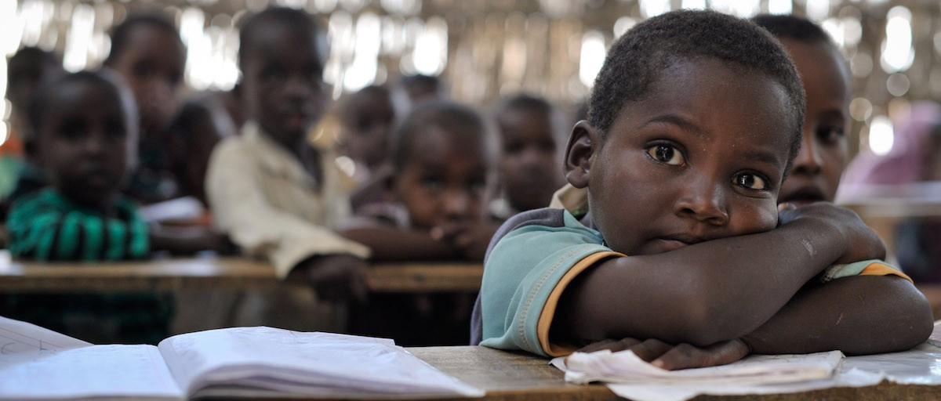
People who borrow from us: Jane
Now my children can go to school because they don’t have to work. I can afford better food and because the cinema is only open in the evening, I can still look after my mother.
to afford = to have money for, to be able to buy, priuštiti

Slide 33
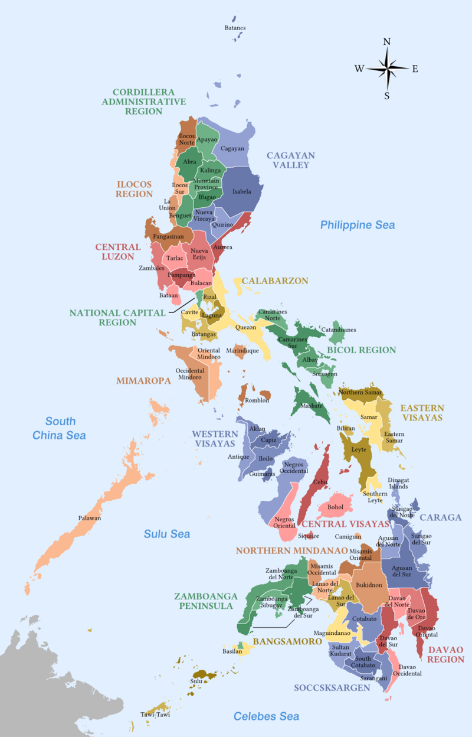
People who borrow from us: Maya
I live in the Philippines. I’m a widow – my husband died in a war. I’ve got three teenage children and I have to pay for their school. We haven’t got a house, so we live with my sister.

Slide 34
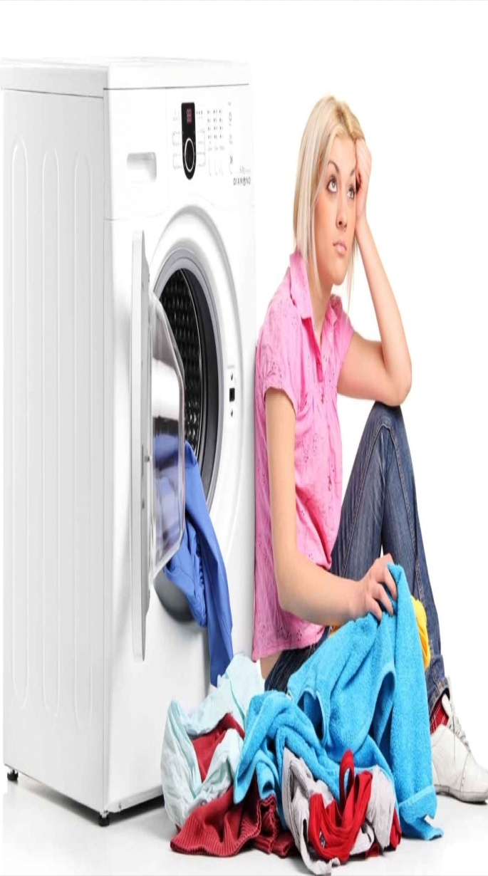
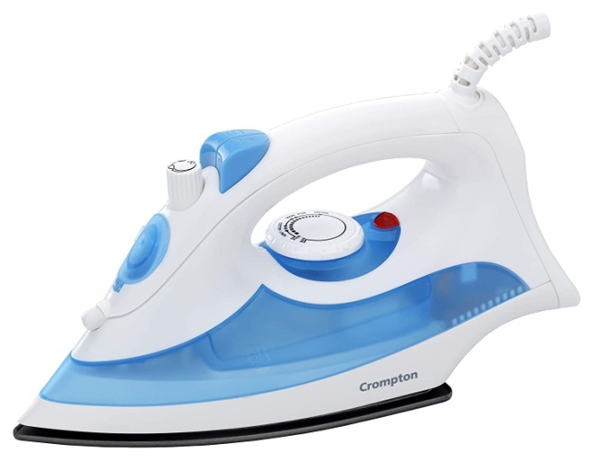
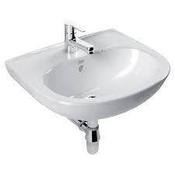
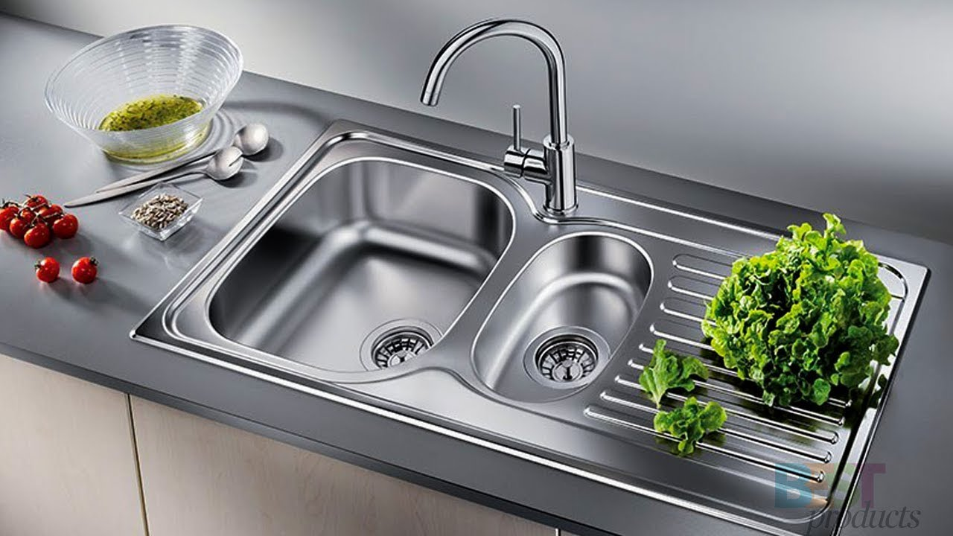
People who borrow from us: Maya
I started my business six months ago – it’s a laundry business. I wash the clothes of the local taxi drivers! They’re all single men, they’re very busy and they have to look smart for work. I borrowed 100 dollars from Credit Aid and I have to pay back two dollars a week. I spent the money on two irons, two sinks and a lot of soap! I have to work very hard every day but now I’ve got an assistant – my sister! We make about 50 dollars a week, and I save three dollars each week. Now I don’t have to worry about the school fees, and perhaps my children can go to university in the future.

Slide 35
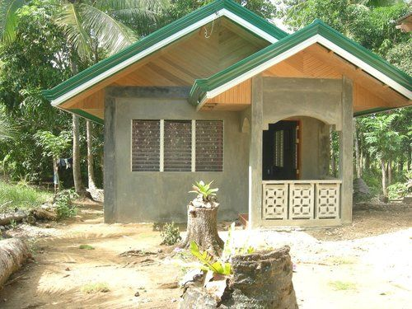
People who borrow from us: Maya
I’m using the money to build a house for my family. It’s only a small house but we need it very much.

Slide 36
Vocabulary
business [U] = posao, biznis
business [C], pl. businesses = firma, kompanija, preduzeće.
to run a cinema, store, company = to manage (upravljati, voditi posao)
iron /ˈʌɪən/= press, 1. gvožđe 2. pegla
to iron, v. – peglati
sink = 1. sudopera 2. lavabo
to look smart = to be elegant and businesslike

Slide 37
Questions
1. Where does she live?
2. Does she have a family?
3. What is her business?
4. When did she start it?
5. How much money did she borrow?
6. How much does she have to pay back every week?
7. What did she spend the money on?
8. How much money does she earn?
9. Is her life better now? Why?

Slide 38
7b page 87, Tell your partner about the woman in your text
Sample answer:
Jane lives in Rwanda. She runs a cinema...
Maya lives in Philipines with her family. She opened a laundry ...

Slide 39
8a page 87, Work with your colleagues. You work for Credit Aid. Read about four people and then together decide who can get a loan. Note any important information for your discussion.
Student A: Look at the information on page 112
Student B: Look at the information on page 118

Slide 40
8b page 87, Discuss four people and their ideas with your colleagues. You can only choose two ideas for loans. Who should you give the loans to?
Sample answer
I think we should give a loan to Asmina because she is a single grandmother...
In my opinion, the best business idea is to open a snack food restaurant.

Slide 41
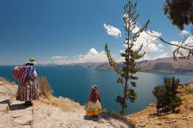
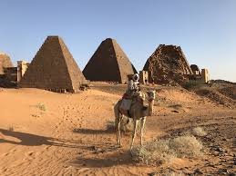
Manuela from Bolivia Personal information 28 – married – husband is a builder. Two children, aged 8 and 10. Elderly parents – father very ill. What is her business idea? A snack food shop. What does she have to do? Pay rent for first three months. Buy food for first month - $ 50. Buy cash till and fridges - $ 200. | Asmina from Sudan Personal information 50 – looks after two teenage grand children. Has an empty room in her house. What is her business idea? An Internet café. What does she have to do? Buy two computers with software - $300. Pay for a phone line - $50. Buy furniture - $50.

Slide 42
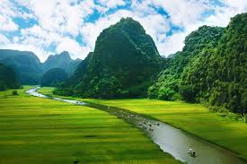
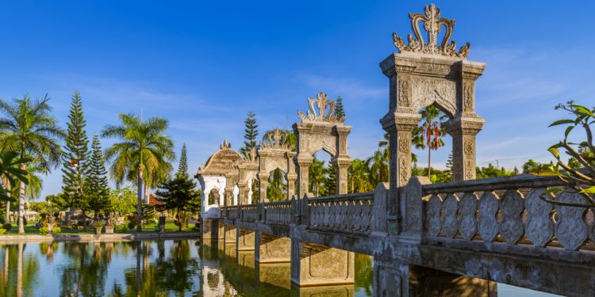
Cara from Vietnam Personal information 25 – single mother – two children, aged 3 and 4. What is her business idea? A flower stall at the station. What does she have to do? Buy market stall - $ 50. Buy first flowers - $ 20. Pay for a babysitter (for the first month) - $ 20. | Amira from Indonesia Personal information 28 – married, four children (aged 8, 6, 4, 2). What is her business idea? Home and business cleaning service. What does she have to do? Buy cleaning equipment (bucket, brush, etc.) - $20. Buy a bicycle - $50. Pay for advertising (posters, local newspaper) - $30.

Slide 43
HW
Read about the verb HAVE TO in Language Reference, G2, V1, V2, V3 page 140
Do exercises G2-4, V1,2,3 – 6 in page 141.

Slide 44
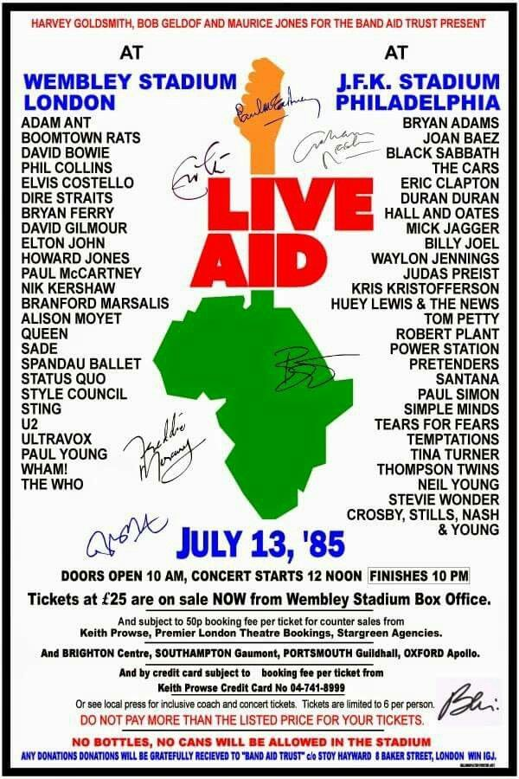
Thank you for your Attention!

