Slide 1
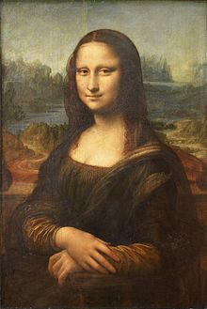
INVENTIONS
9.1. MARVELOUS MINDS

Slide 2
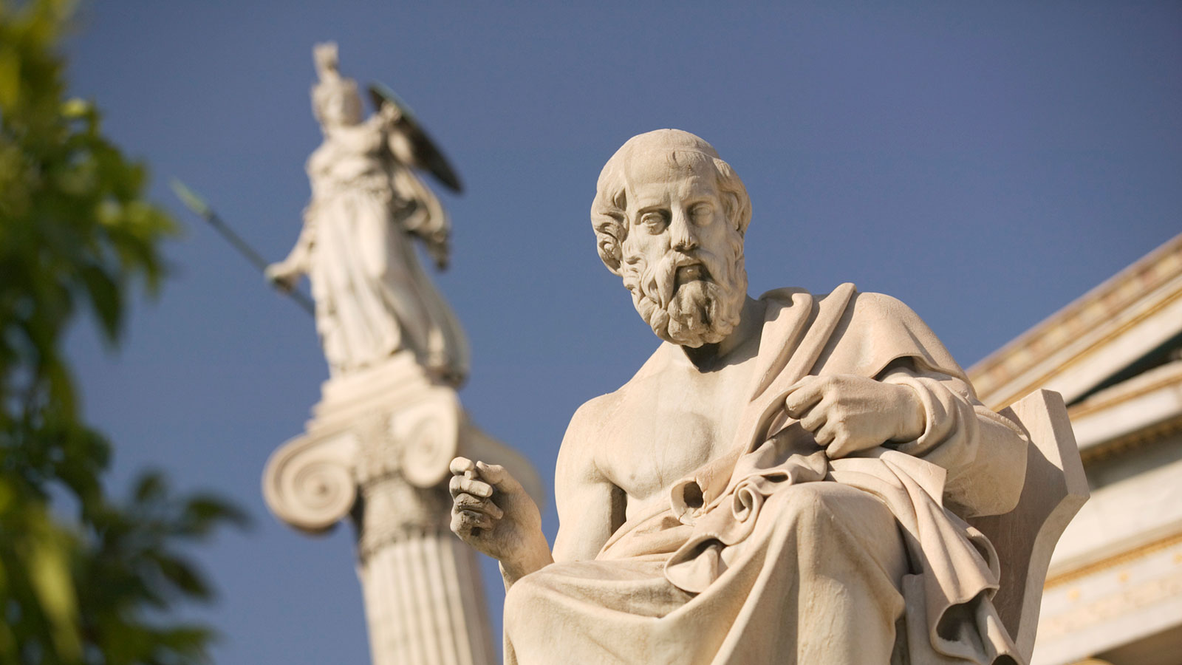
reading
NECESSITY IS THE MOTHER OF INVENTION. PLATO, 427 BC – 347 BC, Greek philosopher

Slide 3
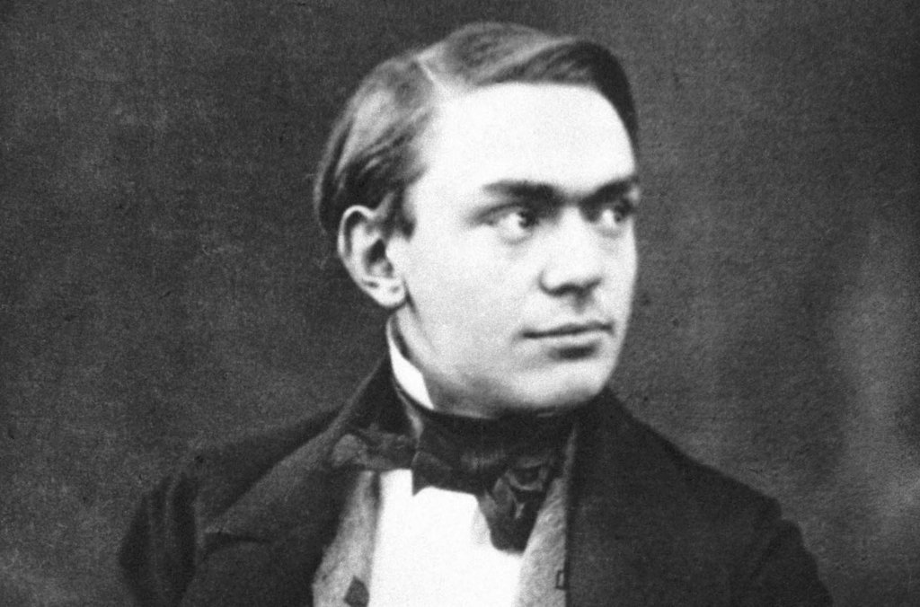
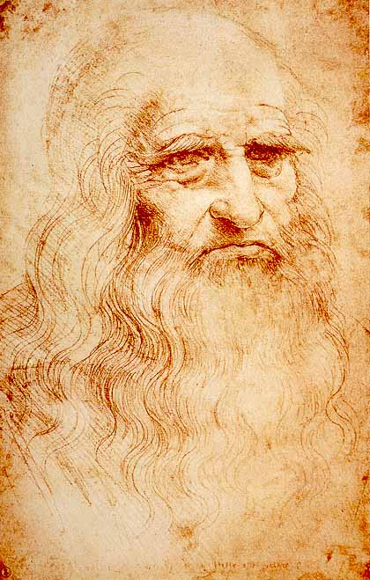
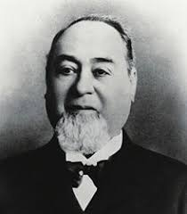
1. page 74, What do you know about the three people in the pictures?
Alfred Nobel
Leonardo da Vinci
Levi Strauss

Slide 4
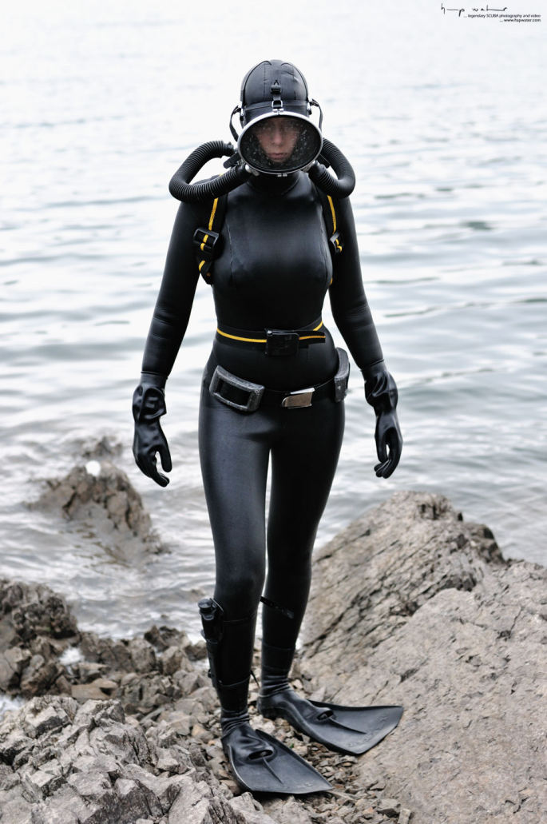

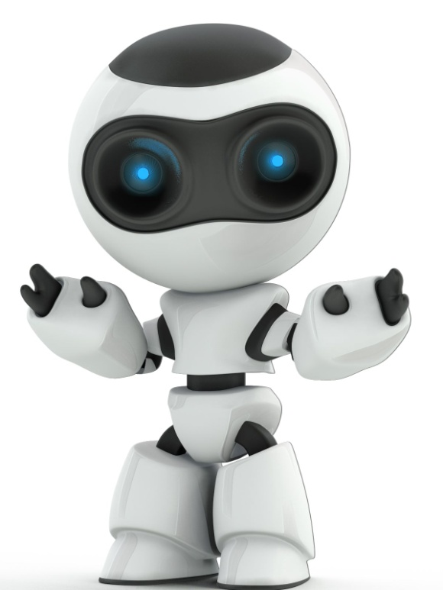
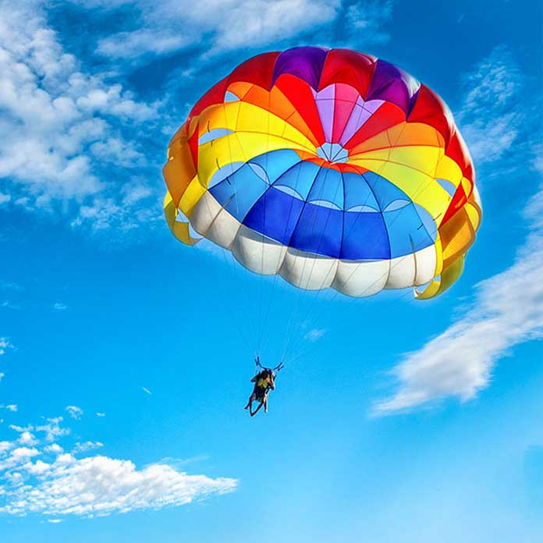
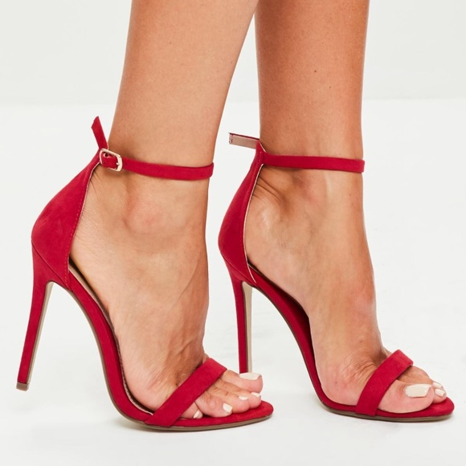
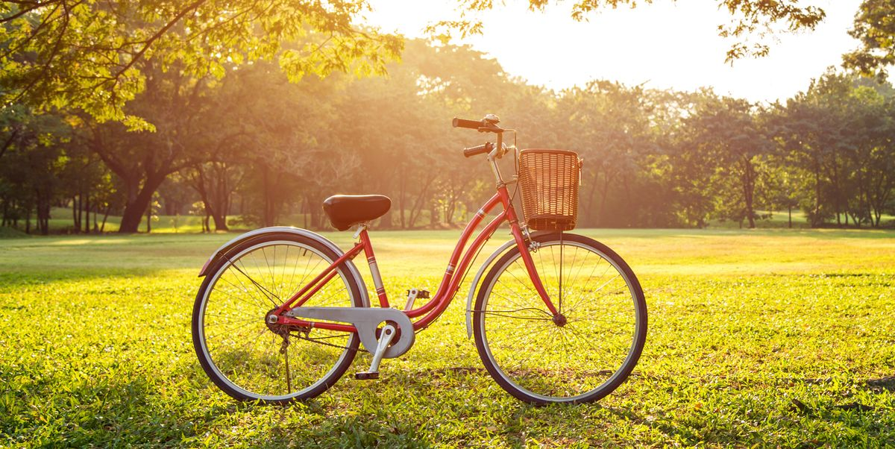
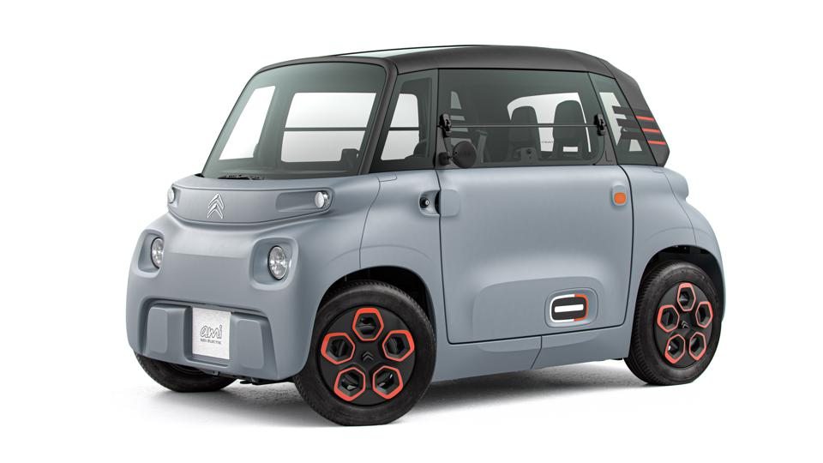
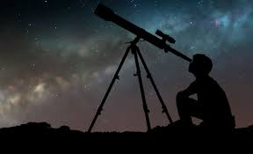
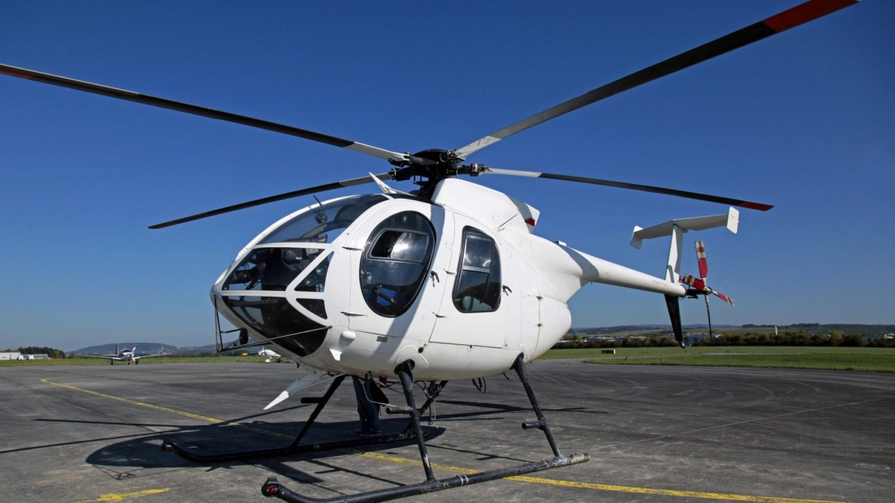
2. page 74, Leonardo da Vinci was a famous inventor. Look at these inventions? Which are his ideas or inventions?
the bicycle
the car
the diving suit
the helicopter
high heels
the parachute
/ˈparəʃuːt/
the radio
the robot
the telescope
Read the text Leonardo da Vinci quickly and check your ideas.

Slide 5
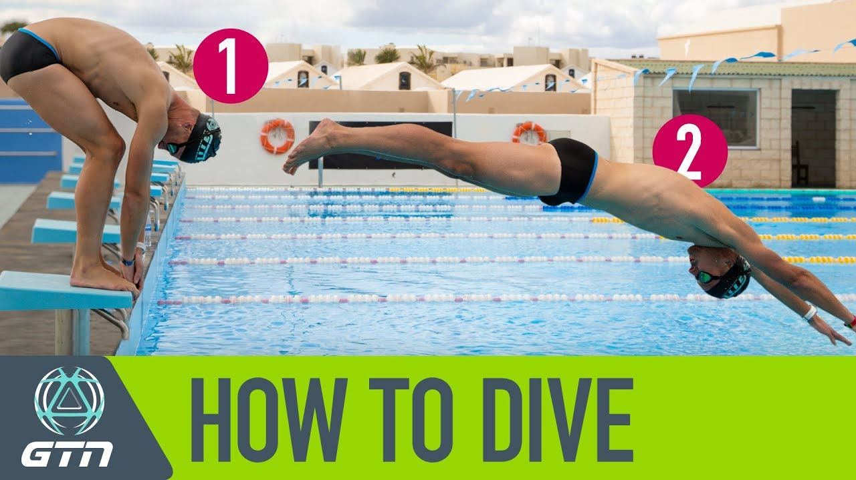
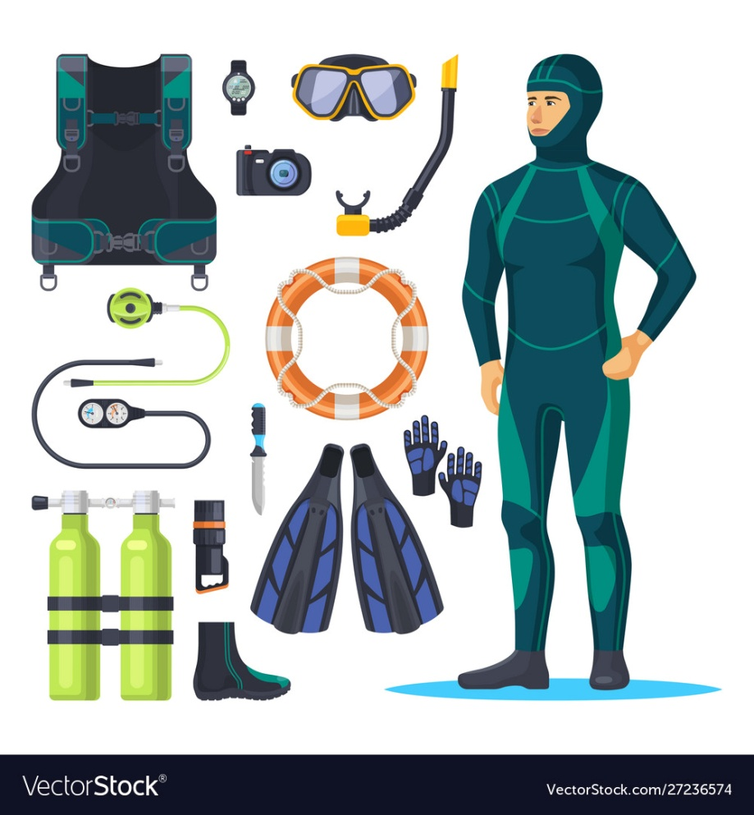
to dive /dʌɪv/– roniti, zaroniti

Slide 6
2. page 74, answers
the bicycle
the car √
the diving suit √
the helicopter √
high heels √
the parachute √
the radio
the robot √
the telescope

Slide 7
3. page 74, Read the text again. Are the sentences true or false?
1. When he was young, Leonardo was at a large school.
2. Leonardo was an engineering student.
3. A lot of modern inventions use his ideas.
4. The robot could only move its legs.
5. The car could only travel a short distance.
6. Leonardo’s helicopter is the same as the modern ones.
7. Modern divers use Leonardo’s diving glove.

Slide 8
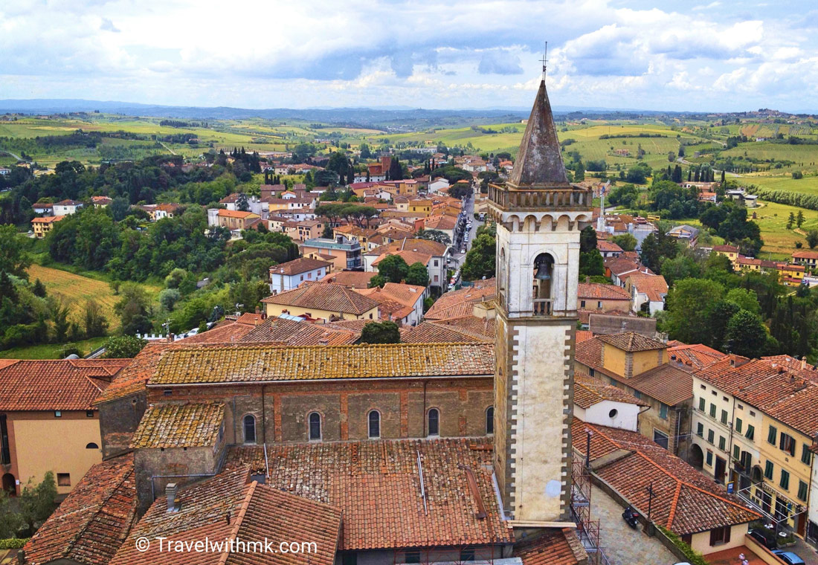
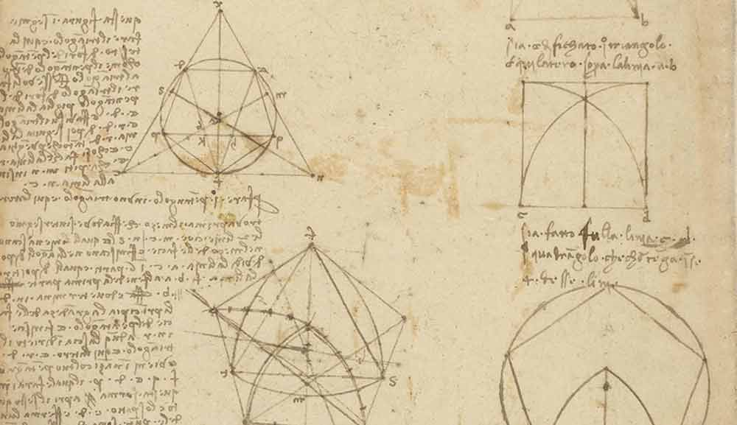
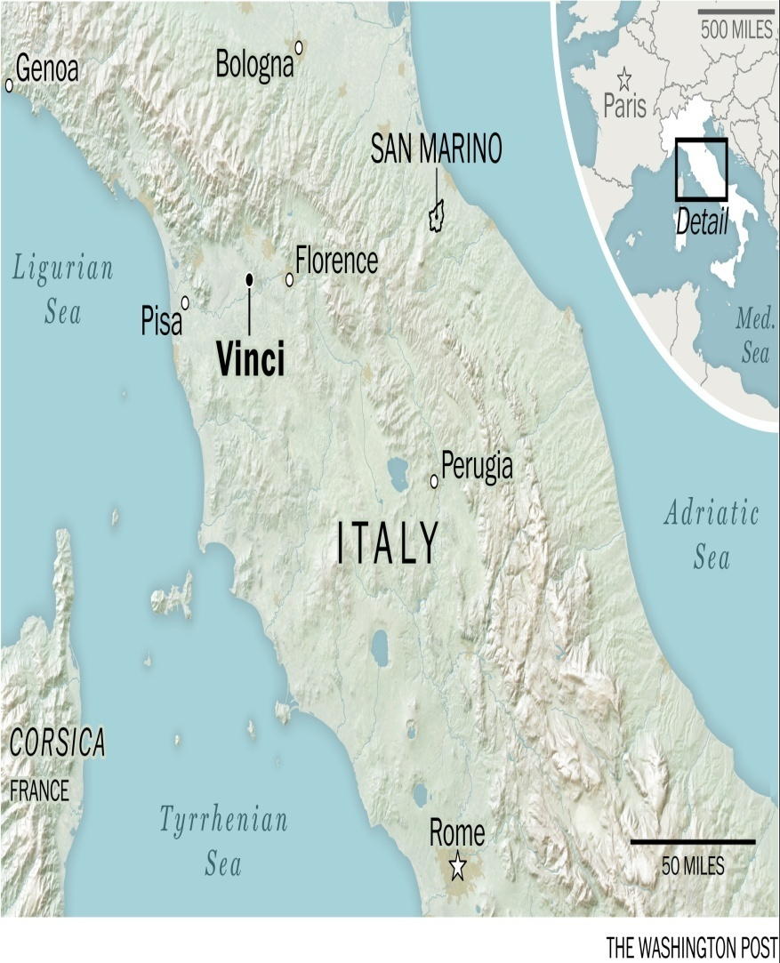
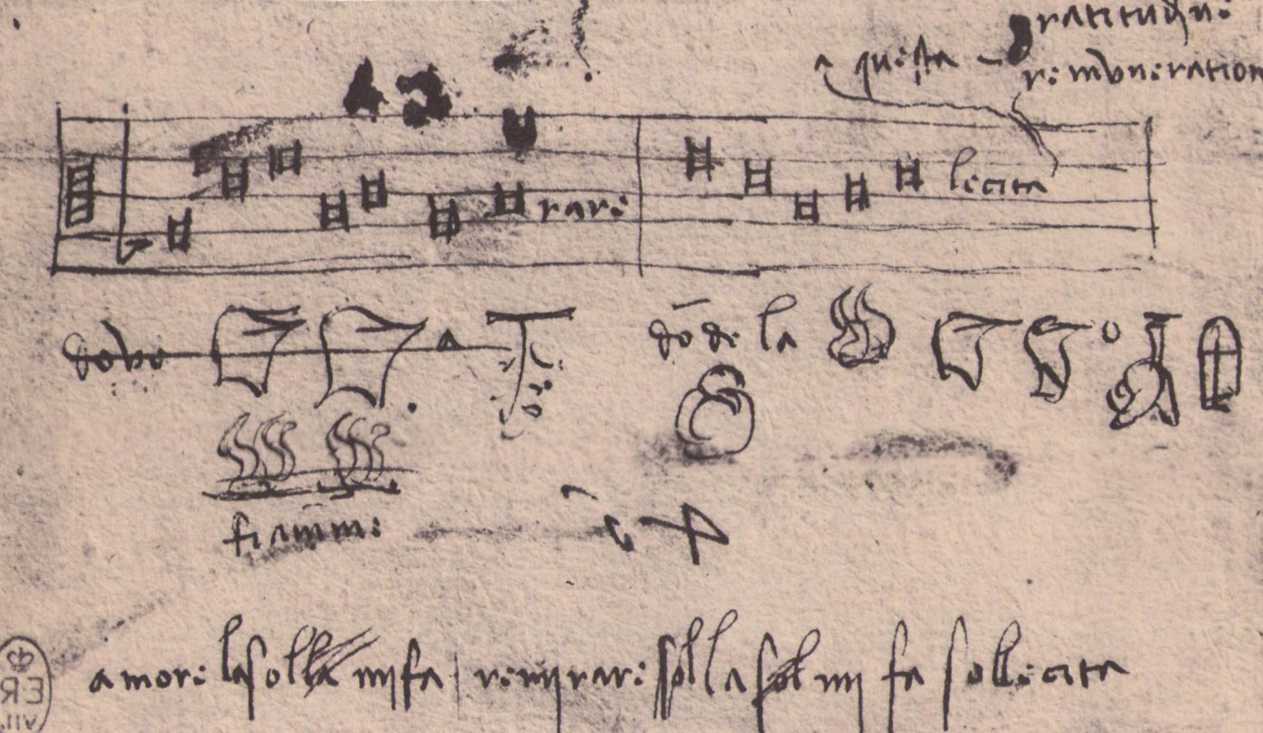
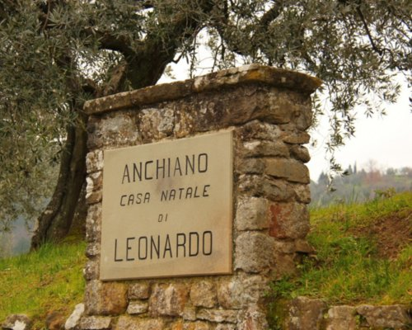
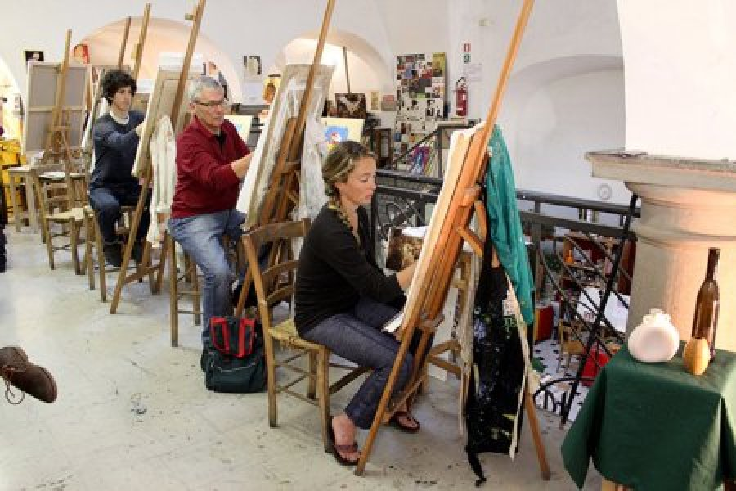
LEONARDO DA VINCI
Man of art. Man of ideas. Man of inventions
His life
Leonardo da Vinci (1452 – 1519) lived in a small town in Italy with his grandparents. He studied at home and enjoyed music, singing and mathematics. At the age of 16, he wanted to study art, so he moved to the city of Florence for art classes.

Slide 9
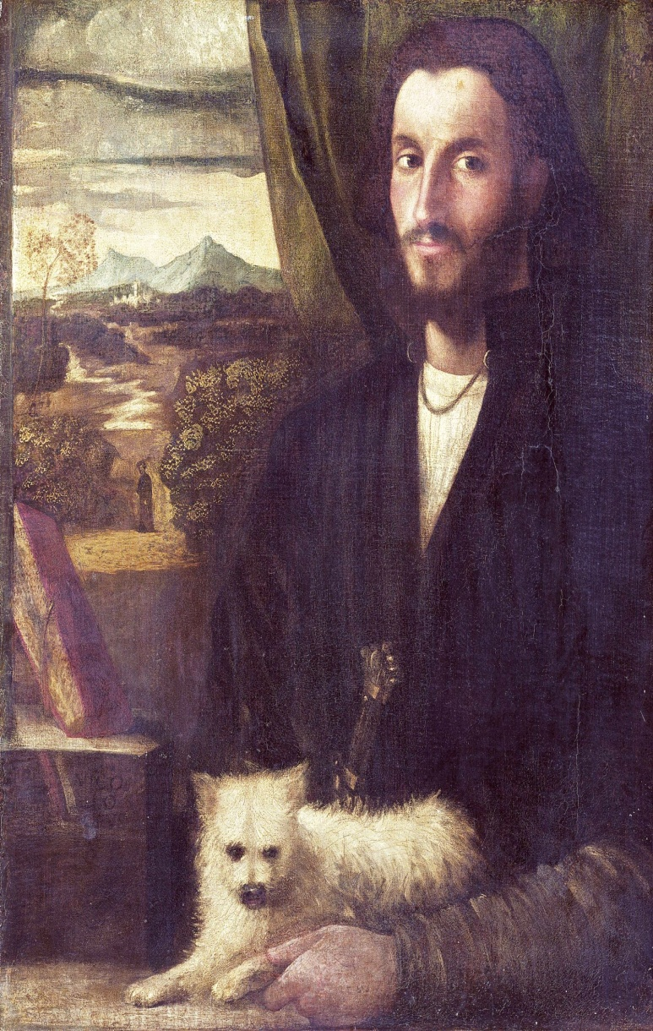
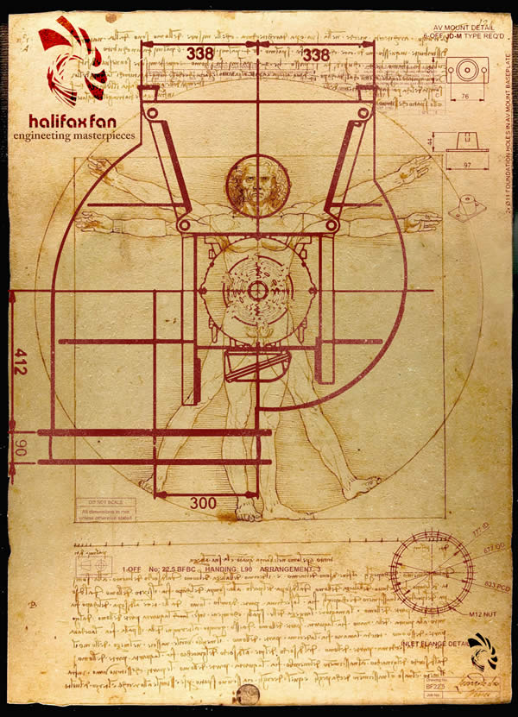
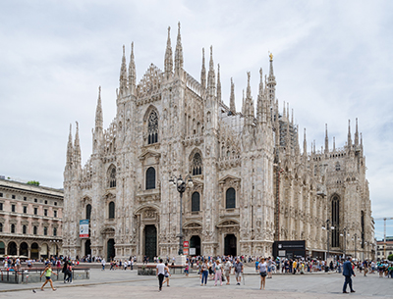
LEONARDO DA VINCI
Man of art. Man of ideas. Man of inventions
His life
He finished his studies after four years. He then worked in Milan as an engineer and he started his life as an inventor. In 1500 he returned to Florence and in 1516 he travelled to France, where he stayed for the rest of his life.

Slide 10
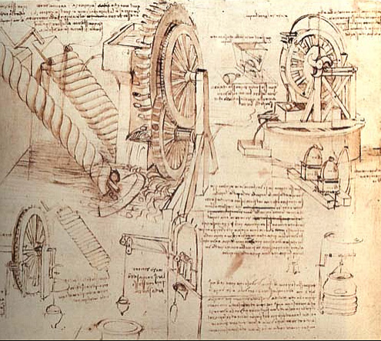

LEONARDO DA VINCI
Man of art. Man of ideas. Man of inventions
His inventions
Leonardo da Vinci lived and worked before people used electricity and petrol for power, but he had the first ideas for many machines that we use today.

Slide 11
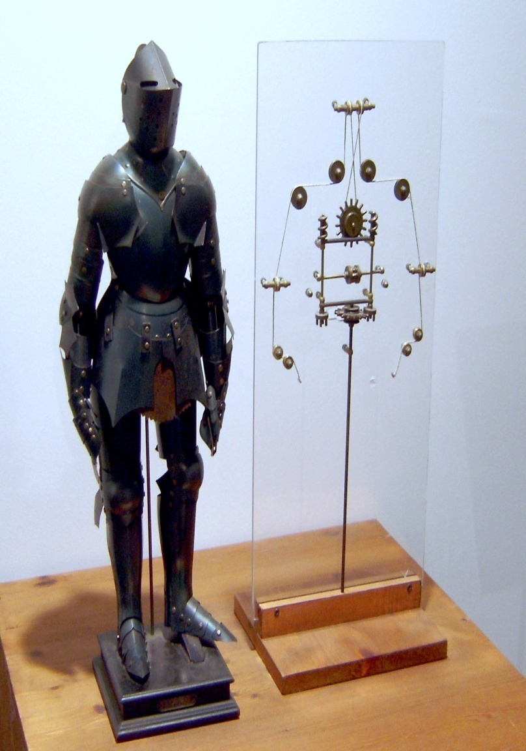
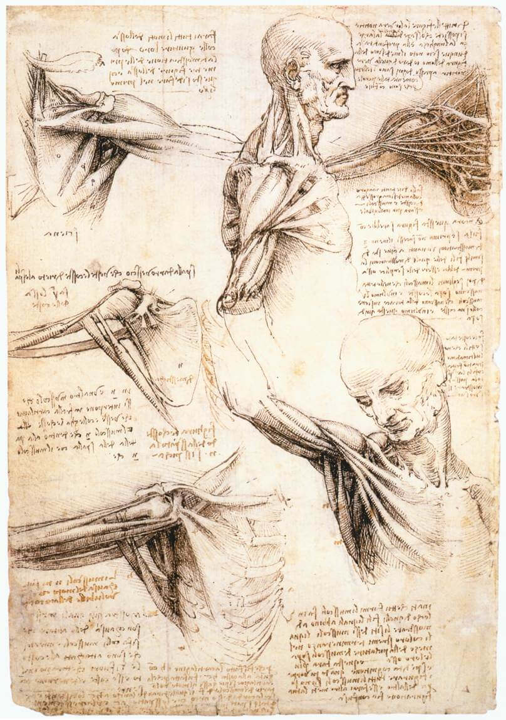
LEONARDO DA VINCI
Man of art. Man of ideas. Man of inventions
His inventions
The robot
Leonardo built his robot in 1495. The robot stood up, sat down and held things in its arms.

Slide 12
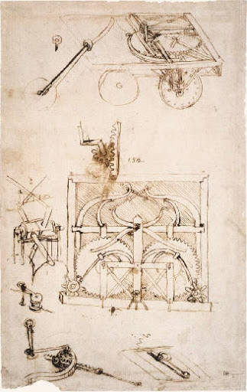
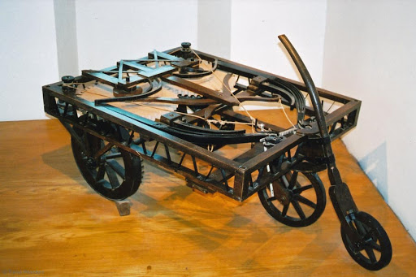
LEONARDO DA VINCI
Man of art. Man of ideas. Man of inventions
His inventions
The car
A single passenger drove the car. It travelled 40 metres at a time.

Slide 13
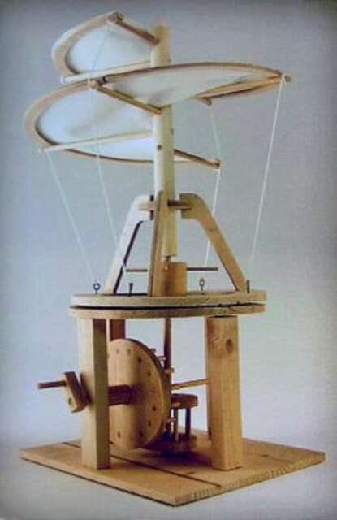
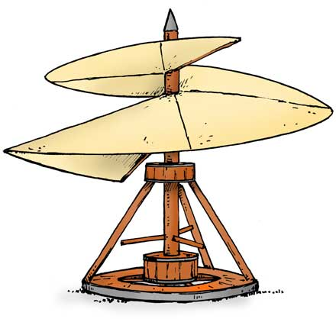
LEONARDO DA VINCI
Man of art. Man of ideas. Man of inventions
His inventions
The helicopter
Leonardo designed the first helicopter but he never made it. His design used a screw into air. This is different from the modern design, but the general idea is similar.

Slide 14
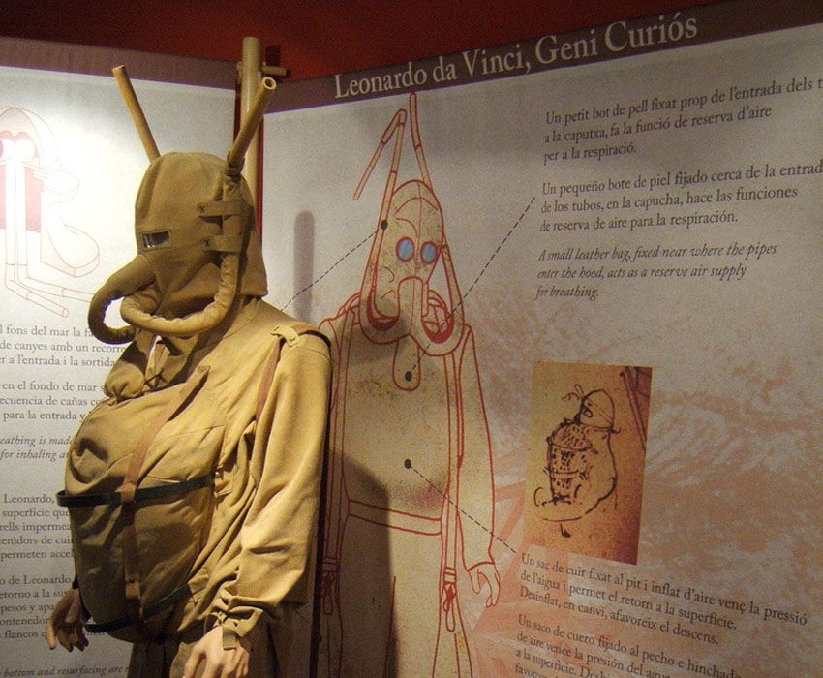
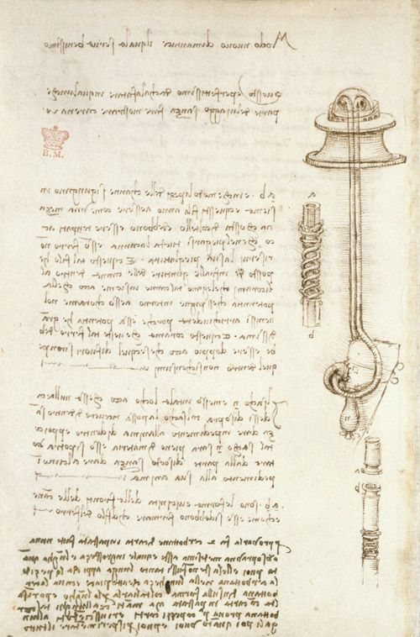
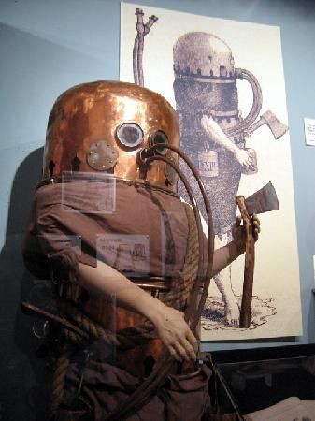
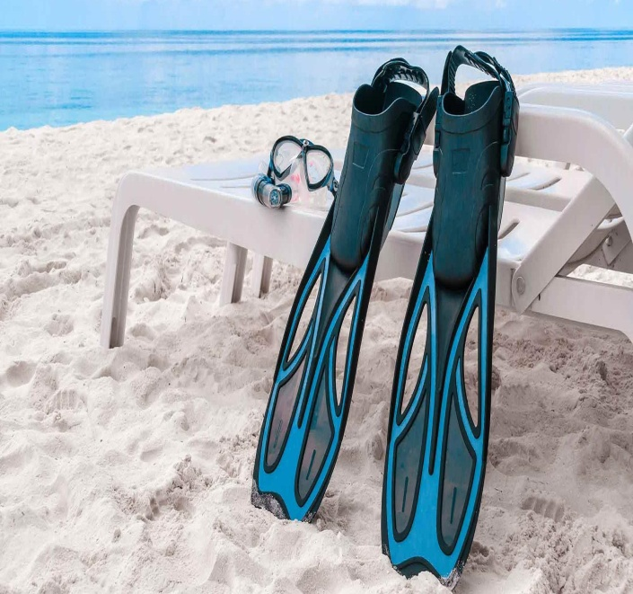
LEONARDO DA VINCI
Man of art. Man of ideas. Man of inventions
His inventions
The diving suit
Leonardo made the suit of leather and added pipes to carry the air to the diver. He also invented special gloves for divers. Today, divers use them on their feet!

Slide 15
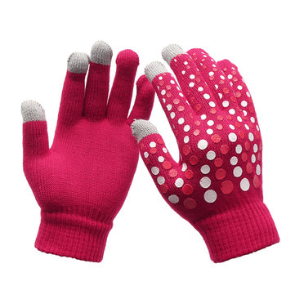
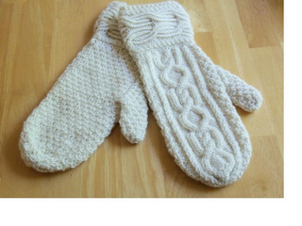
gloves /ɡlʌvz/ mittens /ˈmɪt(ə)nz/

Slide 16
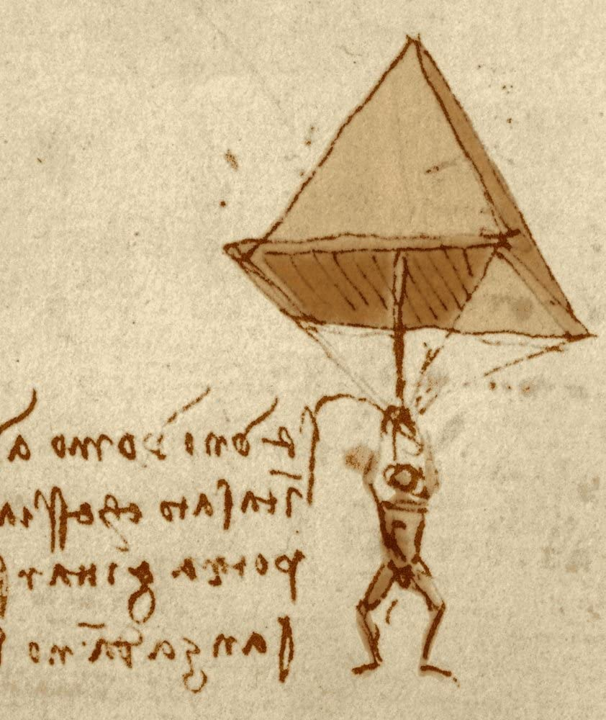
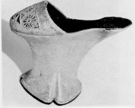
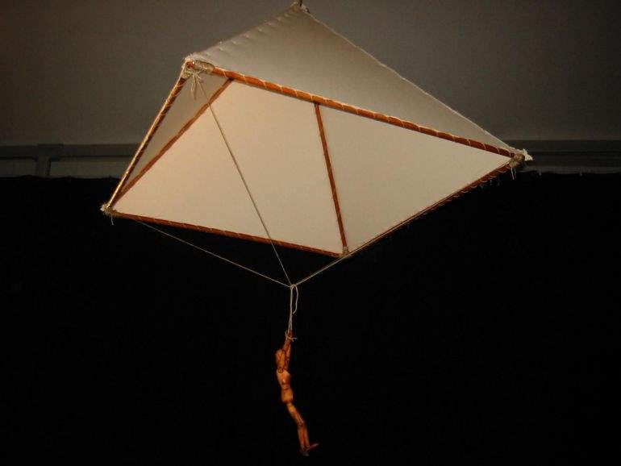
LEONARDO DA VINCI
Man of art. Man of ideas. Man of inventions
These are just some of Leonardo’s hundreds of inventions. He also invented a parachute and even high heels!

Slide 17
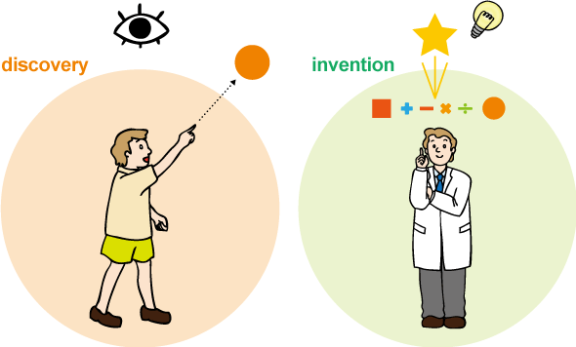
to discover, v. discovery, n. discoverer, n. otkriće (nečega što već postoji u prirodi) to invent, v. invention, n. inventor, n. pronalzak (kreiranje ili projektovanje onoga što prethodno nije postojalo)

Slide 18
3. page 74, answers
1. When he was young, Leonardo was at a large school. F
2. Leonardo was an engineering student. T
3. A lot of modern inventions use his ideas. T
4. The robot could only move its legs. F
5. The car could only travel a short distance. T
6. Leonardo’s helicopter is the same as the modern ones. F
7. Modern divers use Leonardo’s diving glove. F

Slide 19
4. page 74, Put inventions in the text in order of importance.
the robot
the car
the helicopter
the diving suit
the parachute
high heels

Slide 20
grammar, page 74
PAST SIMPLE (AFFIRMATIVE)

Slide 21
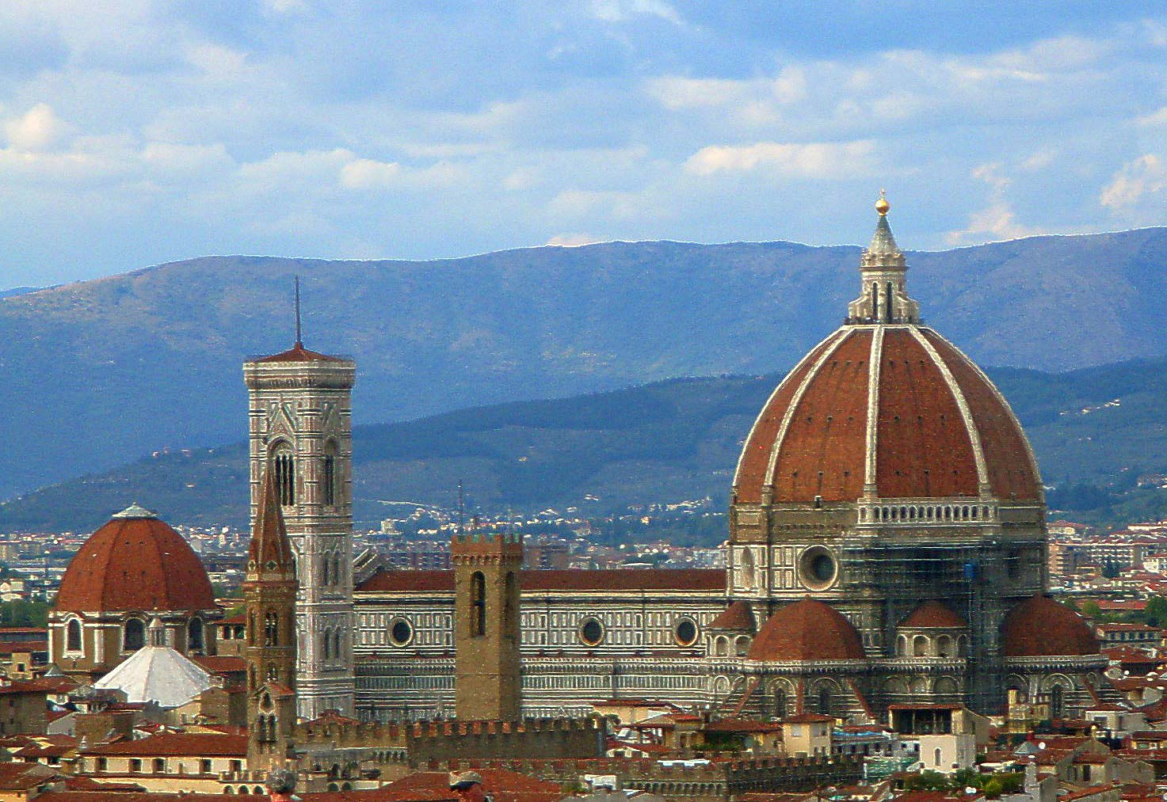
page 74, When we talk about finished events and times in the past we use the Past Simple.
In 1500 he returned to Florence.
infinitive RETURN
Past Simple RETURNED

Slide 22
5a page 74, Read the first paragraph of the text (His life) again and find other examples of the Past Simple. Complete the table below.
Infinitive | Past Simple
return | returned
Note: we usually add –ed to the infinitive to form the past Simple but sometimes there are spelling changes:
STUDY STUDIED, TRAVEL TRAVELLED, LIVE LIVED

Slide 23
5b page 74, Listening Track 2.16 ,– transcript page 152, Complete the sentences with your answers from Exercise 5a. Then listen and check.
1. Leonardo _______ his studies of art in 1468.
2. He _________ these studies in 1472.
3. He _________ money so he started work as an engineer.
4. Leonardo ________ as an engineer for 32 years.
5. He __________ in Milan from 1472 to 1500.
6. He __________ to Florence after 28 years in Milan.

Slide 24
5b page 74, Listening Track 2.16 – transcript page 152, answers.
1. Leonardo STARTED his studies of art in 1468.
2. He FINISHED these studies in 1472.
3. He WANTED money so he started work as an engineer.
4. Leonardo WORKED as an engineer for 32 years.
5. He LIVED in Milan from 1472 to 1500.
6. He RETURNED to Florence after 28 years in Milan.

Slide 25
pronunciation
page 75

Slide 26
6a page 75, track 2.17, transcript page 12 Verb endings
The Past Simple ending –ed has three possible pronunciations. Listen to these examples and repeat them.
enjoyed helped needed
/ɪnˈdʒɔɪd/ /hɛlpt/ /ˈniːdɪd/

Slide 27
6b page 75, Put the verbs from Exercise 5b in in the correct column, then listen to Track 2.16 again, transcript page 152, check and repeat the sentences.
enjoyed /ɪnˈdʒɔɪd/ | helped /hɛlpt/ | needed /ˈniːdɪd/

Slide 28
6b page 75, Track 2.16, transcript page 152 answers
enjoyed /ɪnˈdʒɔɪd/ | helped /hɛlpt/ | needed /ˈniːdɪd/
lived | finished | started
returned | worked | wanted

Slide 29
GRAMMAR TIP
Some verbs in the Past Simple are IRREGULAR. We don’t add –ed to the infinitive.
He had the first ideas. (NOT haved!)
He built his robot in 1495. (NOT builded!)

Slide 30
7. page 75, Read the rest of the text (His inventions) again and find the Past Simple forms of these verbs.
1. stand ________
2. sit _________
3. hold __________
4. drive __________
5. make ___________

Slide 31
7. page 75, answers
1. stand STOOD
2. sit SAT
3. hold HELD
4. drive DROVE
5. make MADE

Slide 32
8. page 75, Complete the sentences with the Past Simple of the verbs in brackets. Is each verb regular or irregular (See irregular verb list on page 159.)
1. Last month, I ________ three films in the cinema. (SEE)
2. Last year, we ________ to Hawaii on holiday. (GO)
3. He __________ Russia in 2006. (VISIT)
4. They ___________ in a hotel by the sea last summer. (STAY)
5. Yesterday, I _________ home at midnight. (GET)
6. My father ___________ mathematics at university. (STUDY)
7. When I was a child, I ________ in a small town. (LIVE)
8. I ________ to class by bus this morning. (COME)

Slide 33
8. page 75, ANSWERS
1. Last month, I SAW three films in the cinema. IRREGULAR
2. Last year, we WENT to Hawaii on holiday. IRREGULAR
3. He VISITED Russia in 2006. REGULAR
4. They STAYED in a hotel by the sea last summer. REGULAR
5. Yesterday, I GOT home at midnight. IRREGULAR
6. My father STUDIED mathematics at university. REGULAR
7. When I was a child, I LIVED in a small town. REGULAR
8. I CAME to class by bus this morning. IRREGULAR

Slide 34
speaking
page 75

Slide 35
9. page 75, Tell a partner about last weekend. What verbs do you need to use? Make a list.
Last weekend, I visited my grandparents on Saturday. I had lunch with them.
Last Sunday, I went skiing. I had a great time.

Slide 36
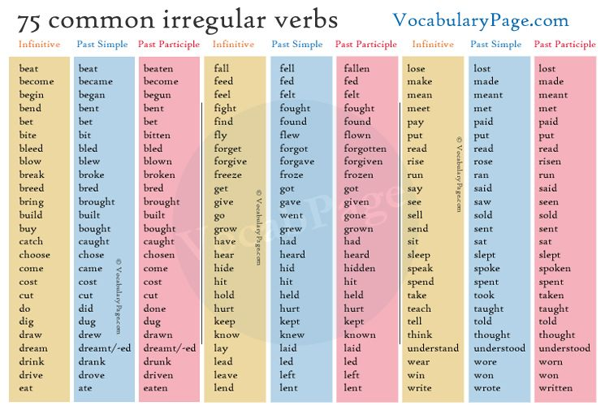

Slide 37
writing
page 75

Slide 38
HW
10a page 75, Look at the information on page 121 about Alfred Nobel and Levi Strauss. Match the information with these inventors and then write a short text about them.
INVENTOR______________________
INVENTOR _____________________
born 1833, Sweden
(study) chemistry
(write) poetry, novels, plays
(try) to make safe explosive)
(kill) brother in an experiment 1864
(invent) dynamite 1866
(start) Nobel Prize Foundation 1895
born 1829, Germany
(travel) New York 1846
(move) San Francisco 1853
(start) shop for gold miners
(sell) equipment and clothes
(invent) jeans 1873
(use) material from Nîmes, France
(call) material ‘denim’

Slide 39
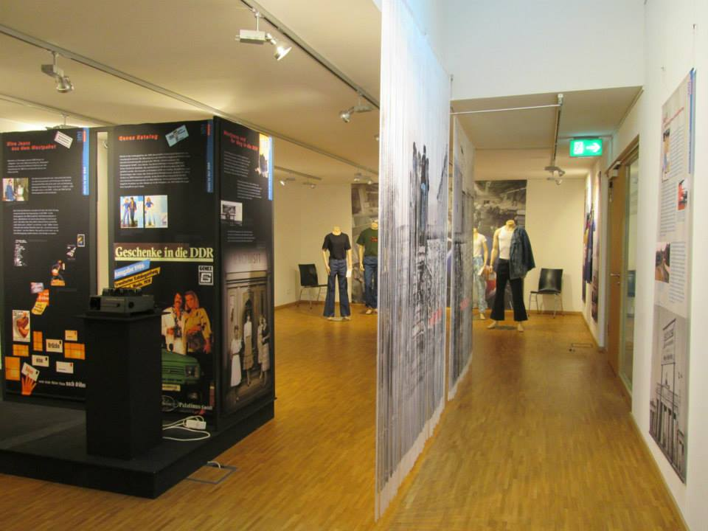
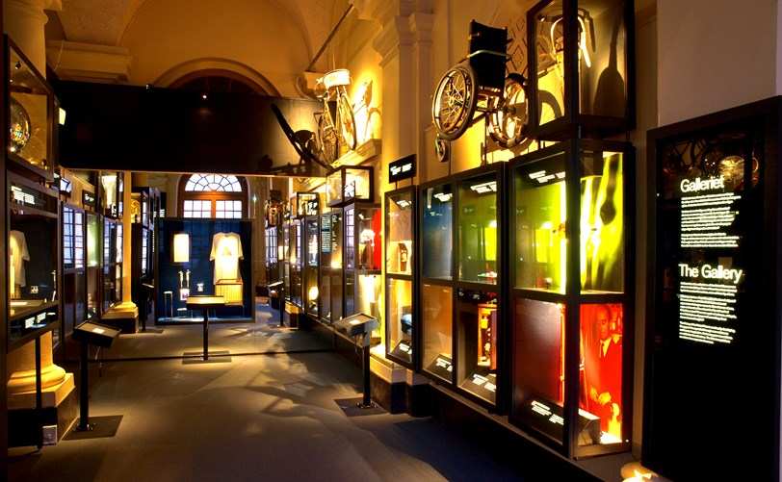
10b page 75, Track 2.18 Listen and compare your texts.

Slide 40
Language reference and extra practice, pages 138-139
pp.138-139

Slide 41
HW
Read about the Past Simple in page 138, G1 and G2
Do exercises in page 139, G1,2: exercises1 and 2
G1-3: exercise 4

Slide 42
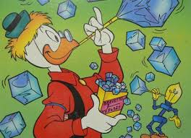
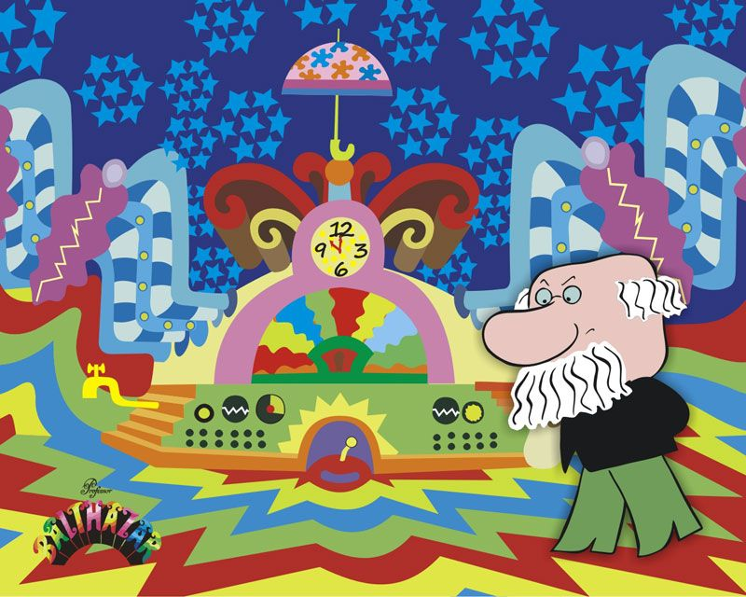
Thank you for your Attention!

