Slide 1
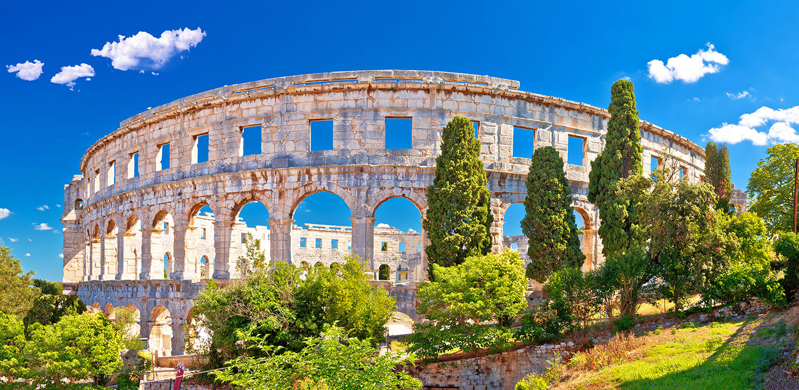
History and Culture
Unit 8.1
Pages 66-67
Language Reference
Output Task 112,118

Slide 2
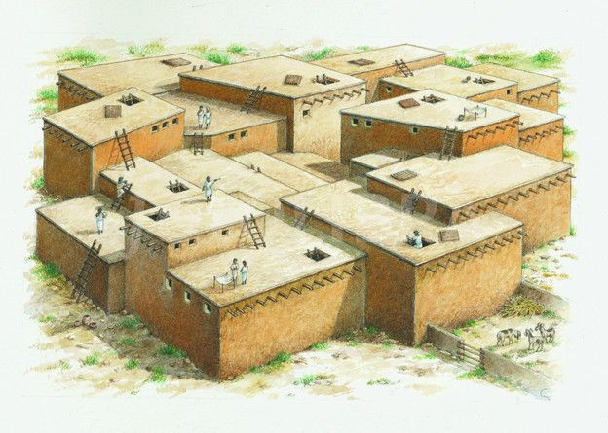
1a page 66, Which of these things can you see in the picture?
courtyard door entrance furniture garden gate ladder painting roof room wall window

Slide 3
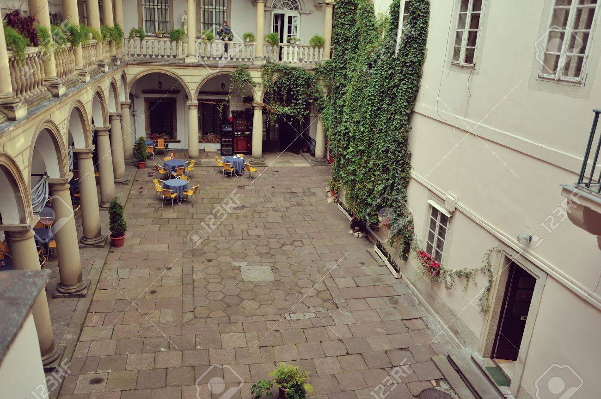
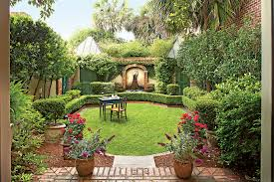
courtyard garden
/ˈkɔːtjɑːd/ = dvorište /ˈɡɑːd(ə)n/ = bašta

Slide 4


roof window
/ruːf/ = krov /ˈwɪndəʊ/ = prozor

Slide 5
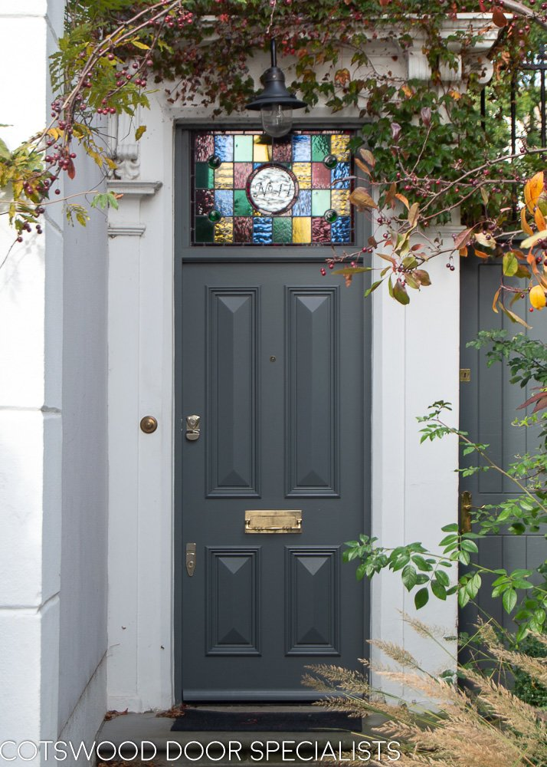
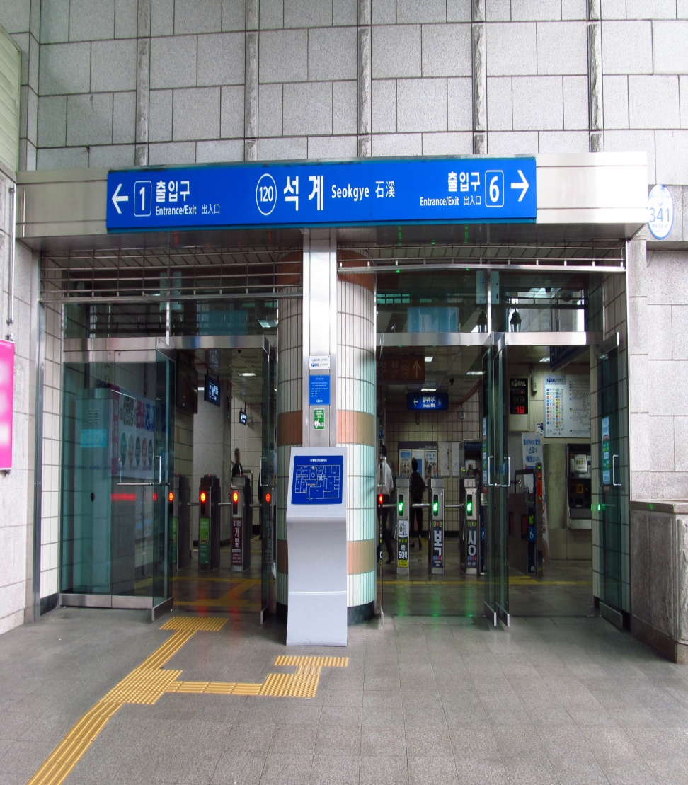
door entrance
/dɔː/= vrata /ˈɛntr(ə)ns/= ulaz

Slide 6
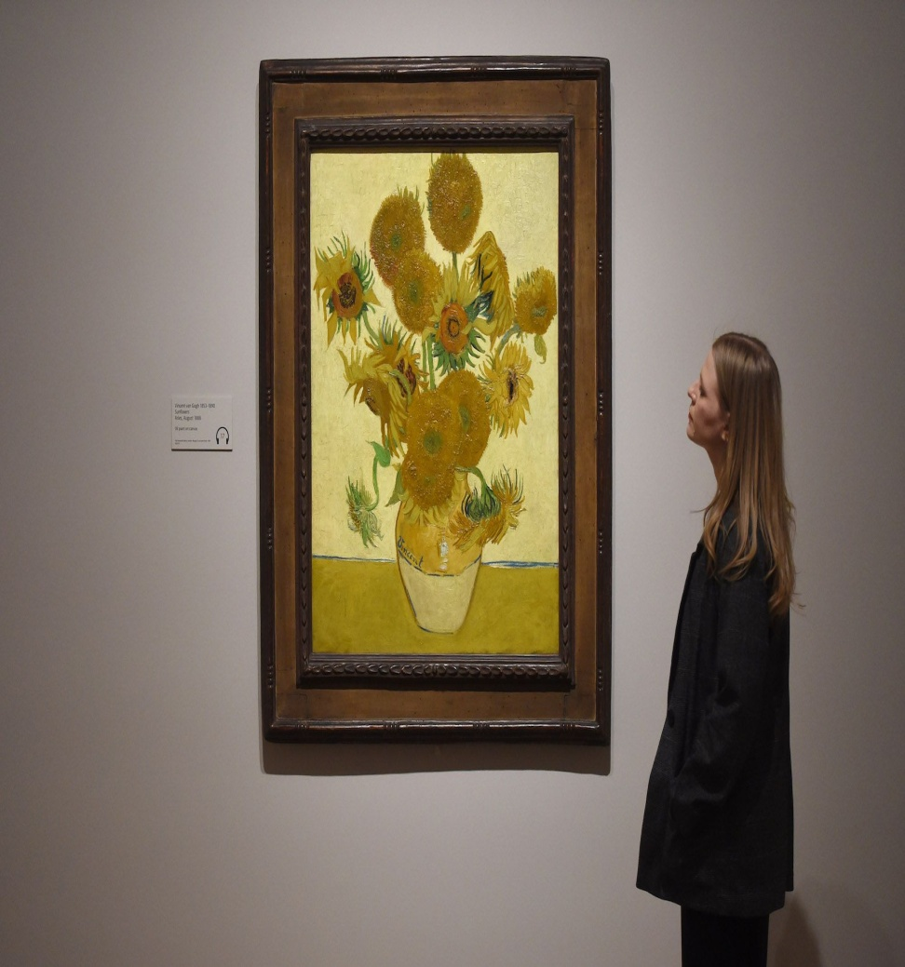

furniture painting
/ˈfəːnɪtʃə/= nameštaj /ˈpeɪntɪŋ/= slika

Slide 7
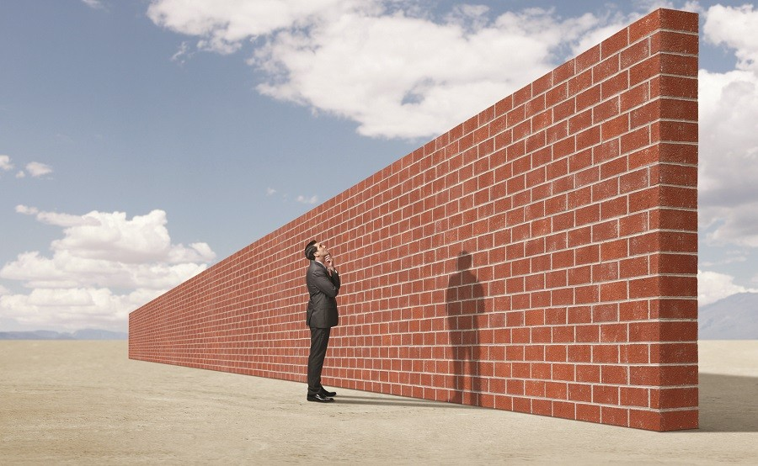
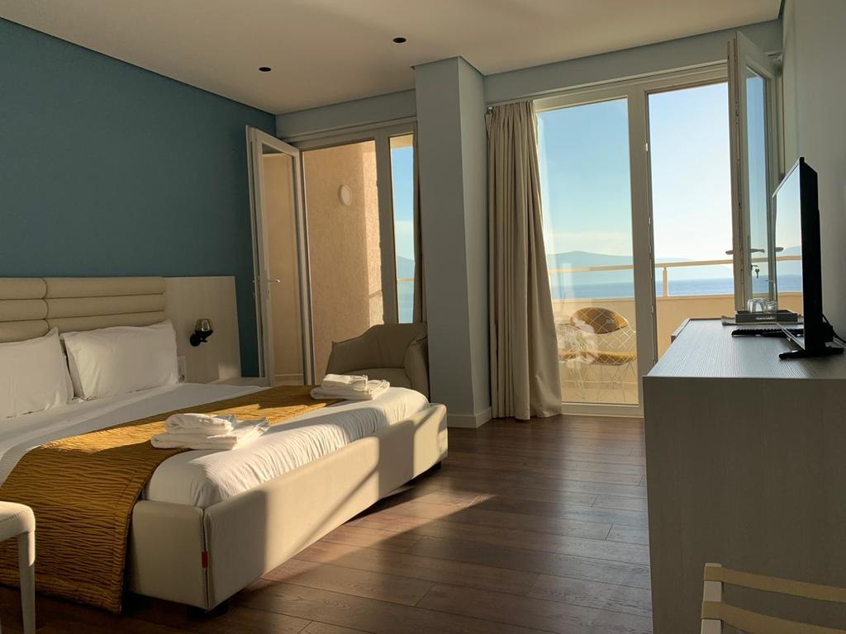
wall room
/wɔːl/ /ruːm,rʊm/ zid soba, prostor, prostorija

Slide 8
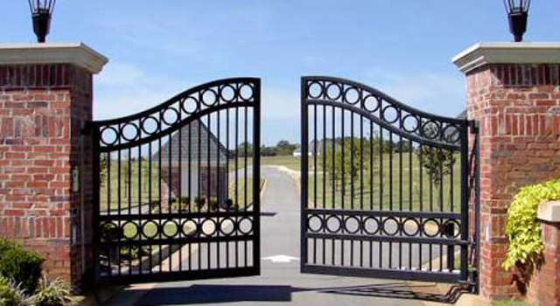
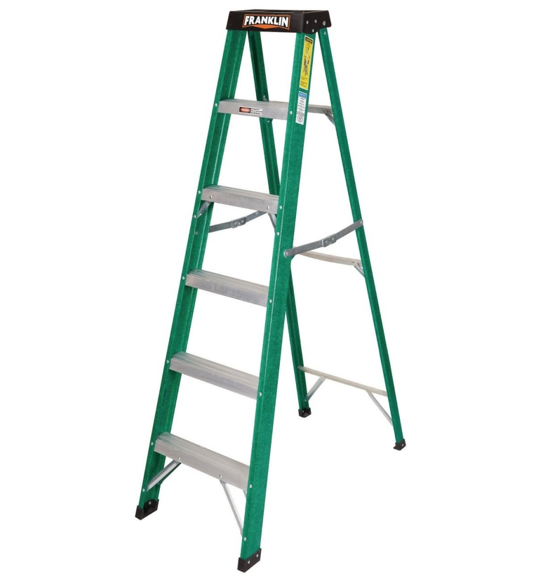
gate ladder
/ɡeɪt/= kapija /ˈladə/= merdevine

Slide 9
1a page 66, Which of these things can you see in the picture?
courtyard√ door entrance√ furniture garden gate ladder√ painting√ roof room wall √ window

Slide 10
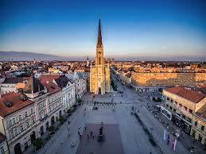
1b page 66, How are these buildings different from your home and street?
Sample answers:
In my home, there is an entrance, a gate...
I enter my house through the door.

Slide 11
reading
Çatal Hüyük, page 66

Slide 12
2a, page 66, Guess the answers to these questions. Then read paragraph A of the text about Çatal Hüyük and check your guesses.
1. This city is in modern-day …
a) Iraq b) Pakistan c) Turkey
2. The picture shows the place in about …
a) 10 000 BC b) 6000 BC c) 2000 BC

Slide 13



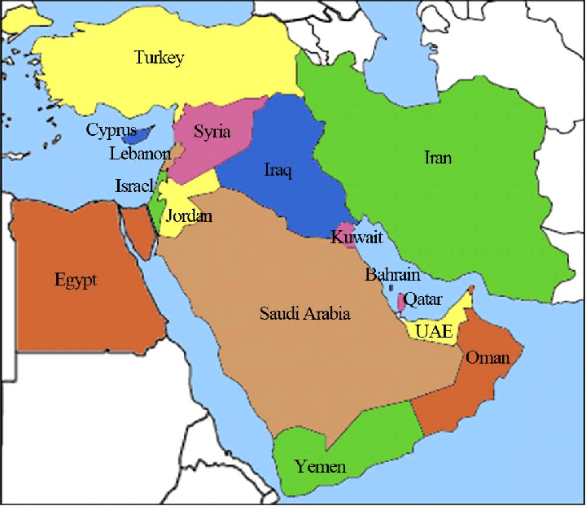
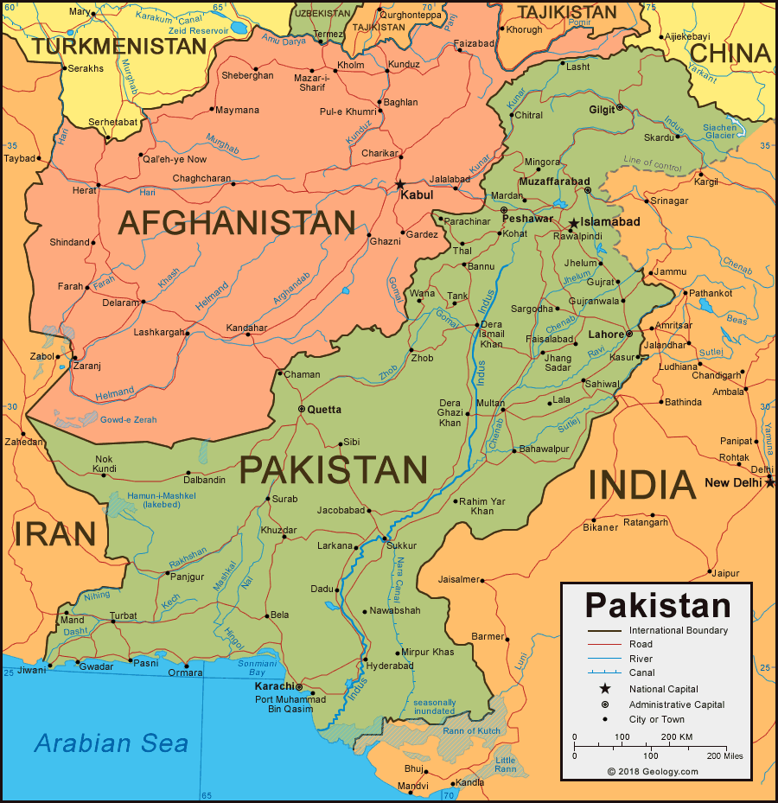
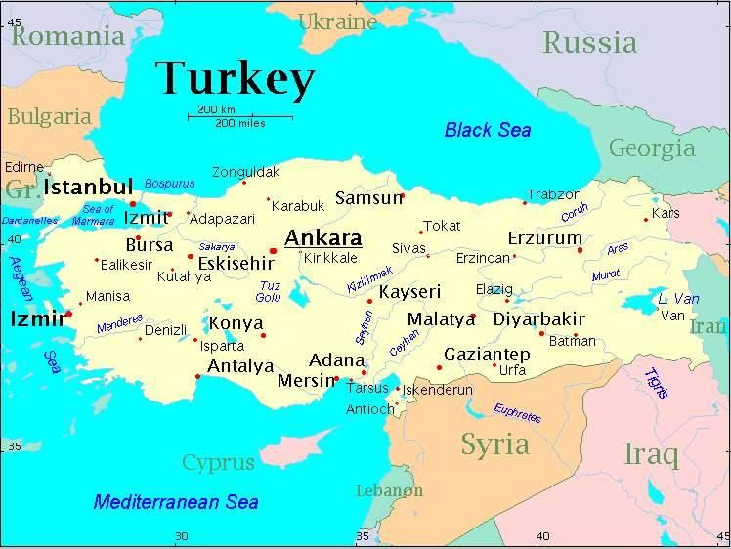
Iraq Pakistan Turkey adjective, Iraqi Pakistani Turkish

Slide 14
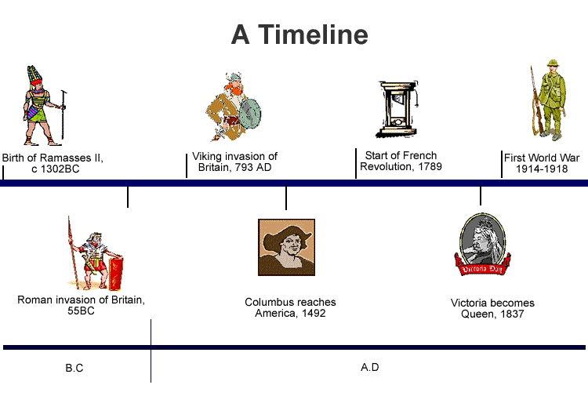
BC = before Christ (pre nove ere. p.n.e; pre Hrista)
AD = lat. anno Domini (nove ere, n.e.)

Slide 15
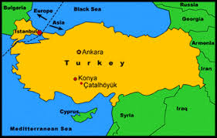
Çatal Hüyük page
A
Çatal Hüyük (now in Anatolia, Turkey) was one of the world’s first cities. In fact, many people think it is the oldest city. It was an important and busy place for 2,000 years from about 7000 BC to 5000 BC. Compared with today’s cities, it wasn’t big, in 6250 BC, there were only about 6,000 people there.

Slide 16
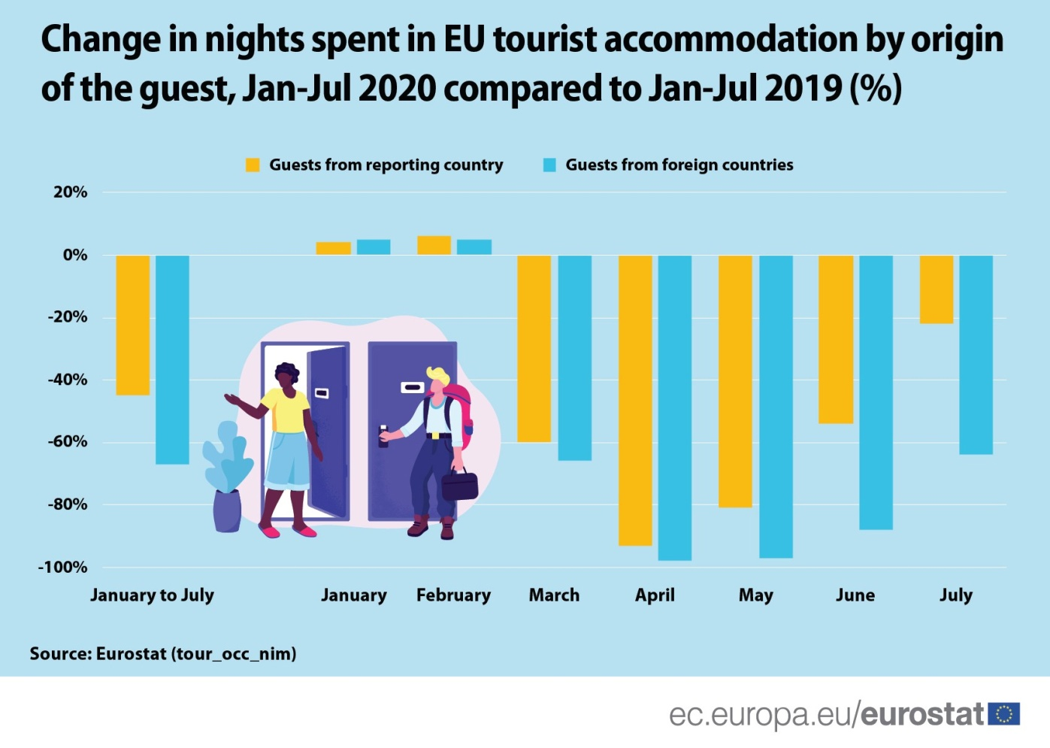
to compare - uporediti compared with – kada se uporedi

Slide 17
2a, page 66, answers
1. This city is in modern-day …
a) Iraq b) Pakistan c) Turkey
2. The picture shows the place in about …
a) 10 000 BC b) 6000 BC c) 2000 BC

Slide 18
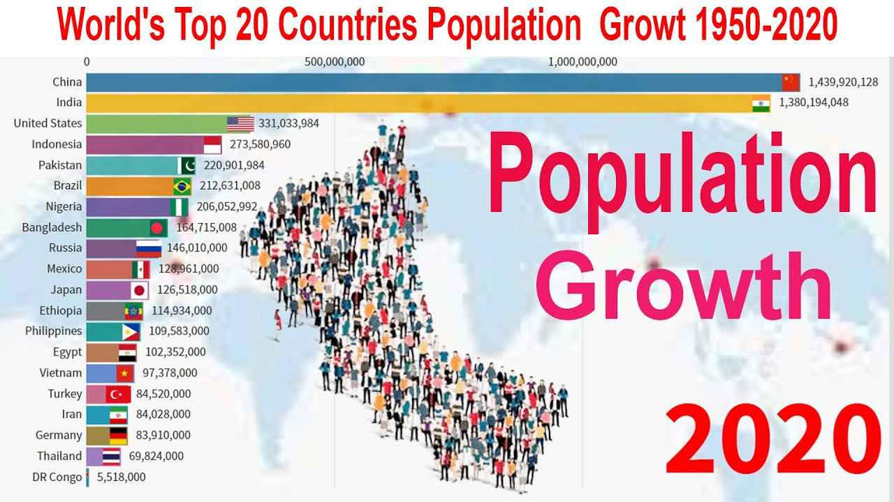
2b page 66, Now read paragraphs B and C quickly. Which paragraph, A, B or C, has information about these things?
1. location A
2. houses
3. size of population
4. people
population /pɒpjʊˈleɪʃ(ə)n/ - stanovništvo, naseljenost

Slide 19
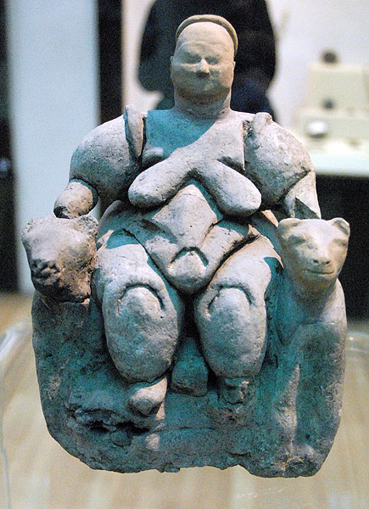
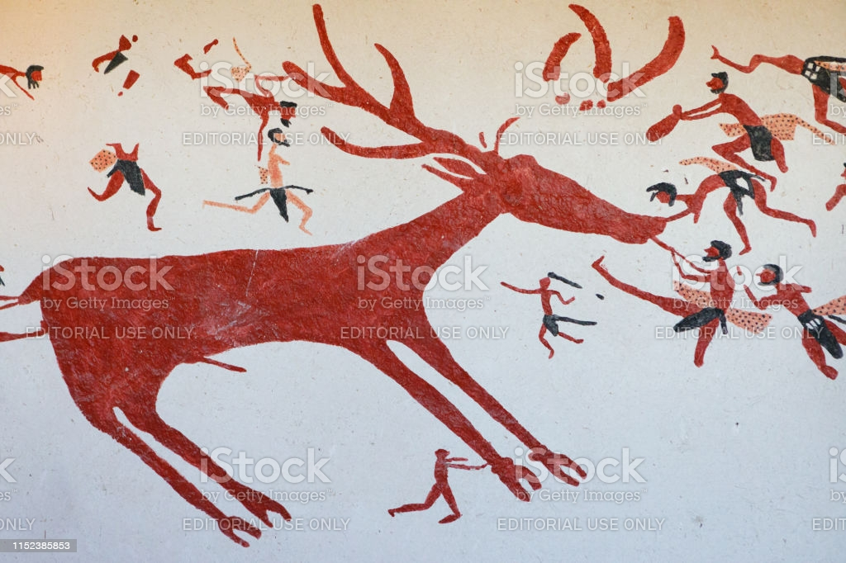
Çatal Hüyük page 66
B
The people were, we believe, kind and peaceful. Many of the people were farmers, but the city was rich and well organised, but life was very short: an average age of 34 years for men and 29 for women. Women were important in this city: many were in high positions and there were a lot of special goddesses.

Slide 20
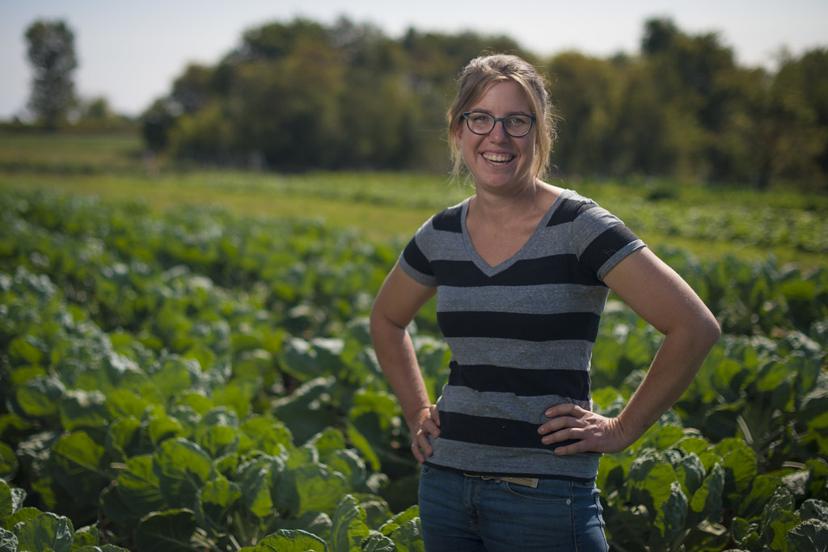
farmer, n. – a person who works on a farm (peasant)

Slide 21
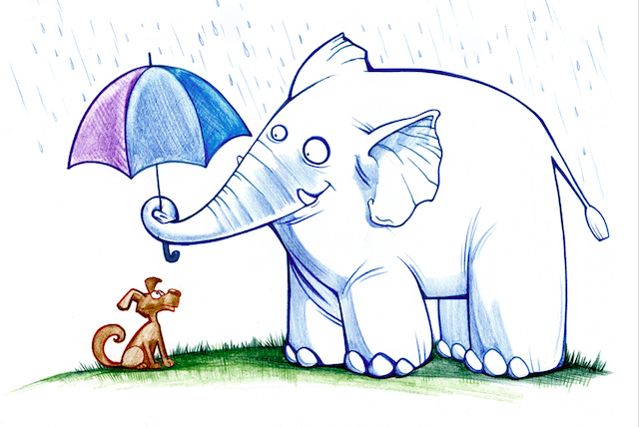
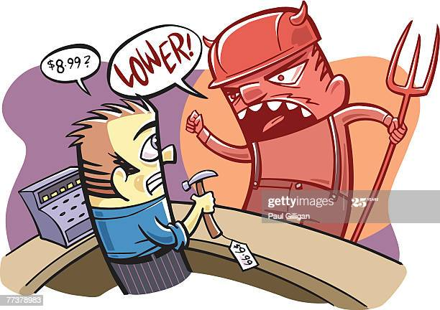
kind, adj. /kʌɪnd/ un+kind=not kind ljubazan
kind, polite
unkind, rude, cruel

Slide 22
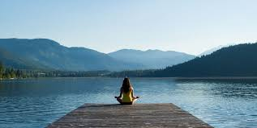
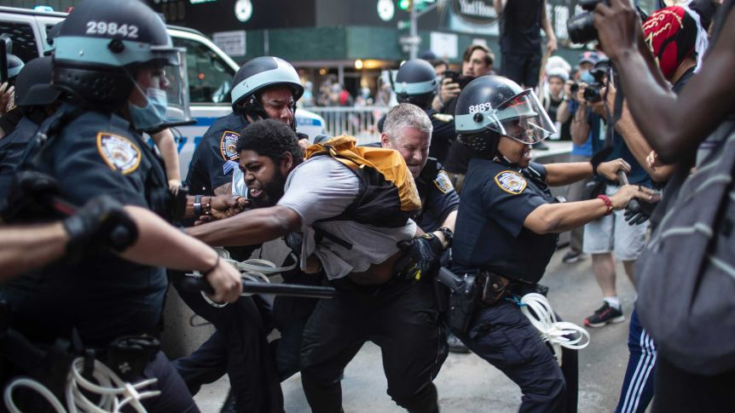
peaceful, adj. mirno, smireno
peaceful, calm
warlike, quarrelsome

Slide 23
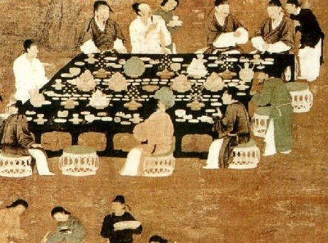
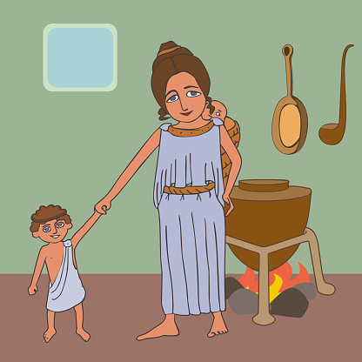
rich, adj. bogat
rich = to have a lot of (money, food, love, etc.)
poor = to have little (money, food, etc.)

Slide 24
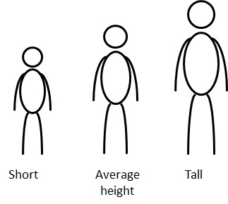
average /ˈav(ə)rɪdʒ/ = prosečno in between, in the middle

Slide 25

well-organised organisation of life was/is good
She is a well-organised person

Slide 26

important in high position powerful
VIP – very important person

Slide 27
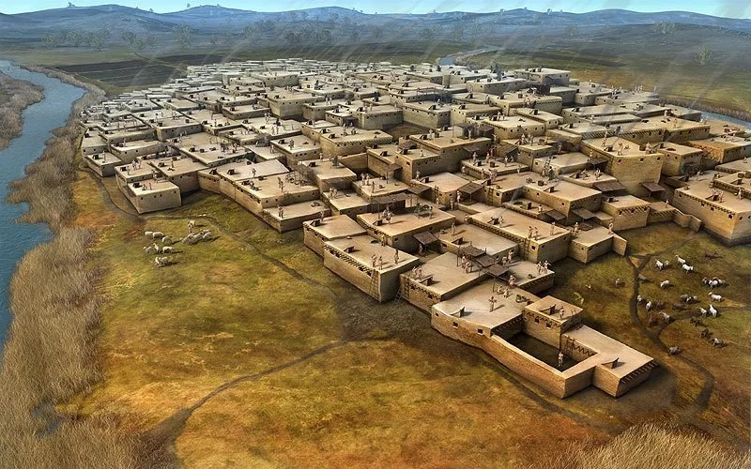
Çatal Hüyük page
C
WATCH! https://www.youtube.com/watch?v=JIR9wfxIB9I
There weren’t any streets in the city, most of the houses were around a central courtyard. There weren’t any doors in the houses. There was an entrance to each house through a hole in the roof and down a ladder. Inside, there were paintings of animals and people on some of the walls.

Slide 28
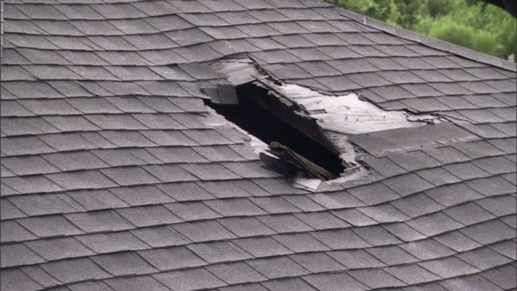
a hole in the roof
/həʊl/ = rupa, otvor

Slide 29
2b page 66, Answers
1. location A
2. houses C
3. size of population A
4. people B

Slide 30
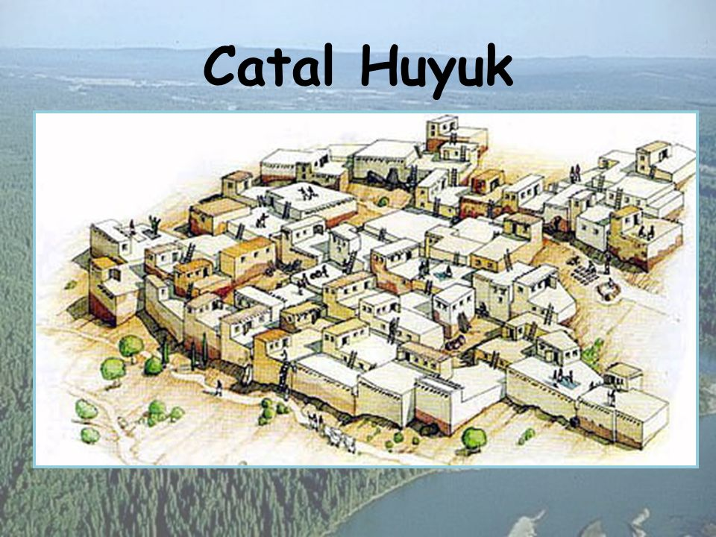
3. page 67, Use the words in the box to complete the summary of the text
farming good population place unusual
Çatal Hüyük was an important (1) _______ about 8,000 years ago, when the (2) __________was about 6,000. It was one of the first (3)____________ communities and also important for trade. Life was (4) _____________ for the people here, but it was also short. The people’s homes were (5) _______ but comfortable.

Slide 31


usual unusual

Slide 32

comfortable /ˈkʌmf(ə)təb(ə)l/ = udoban, komforan comfy

Slide 33
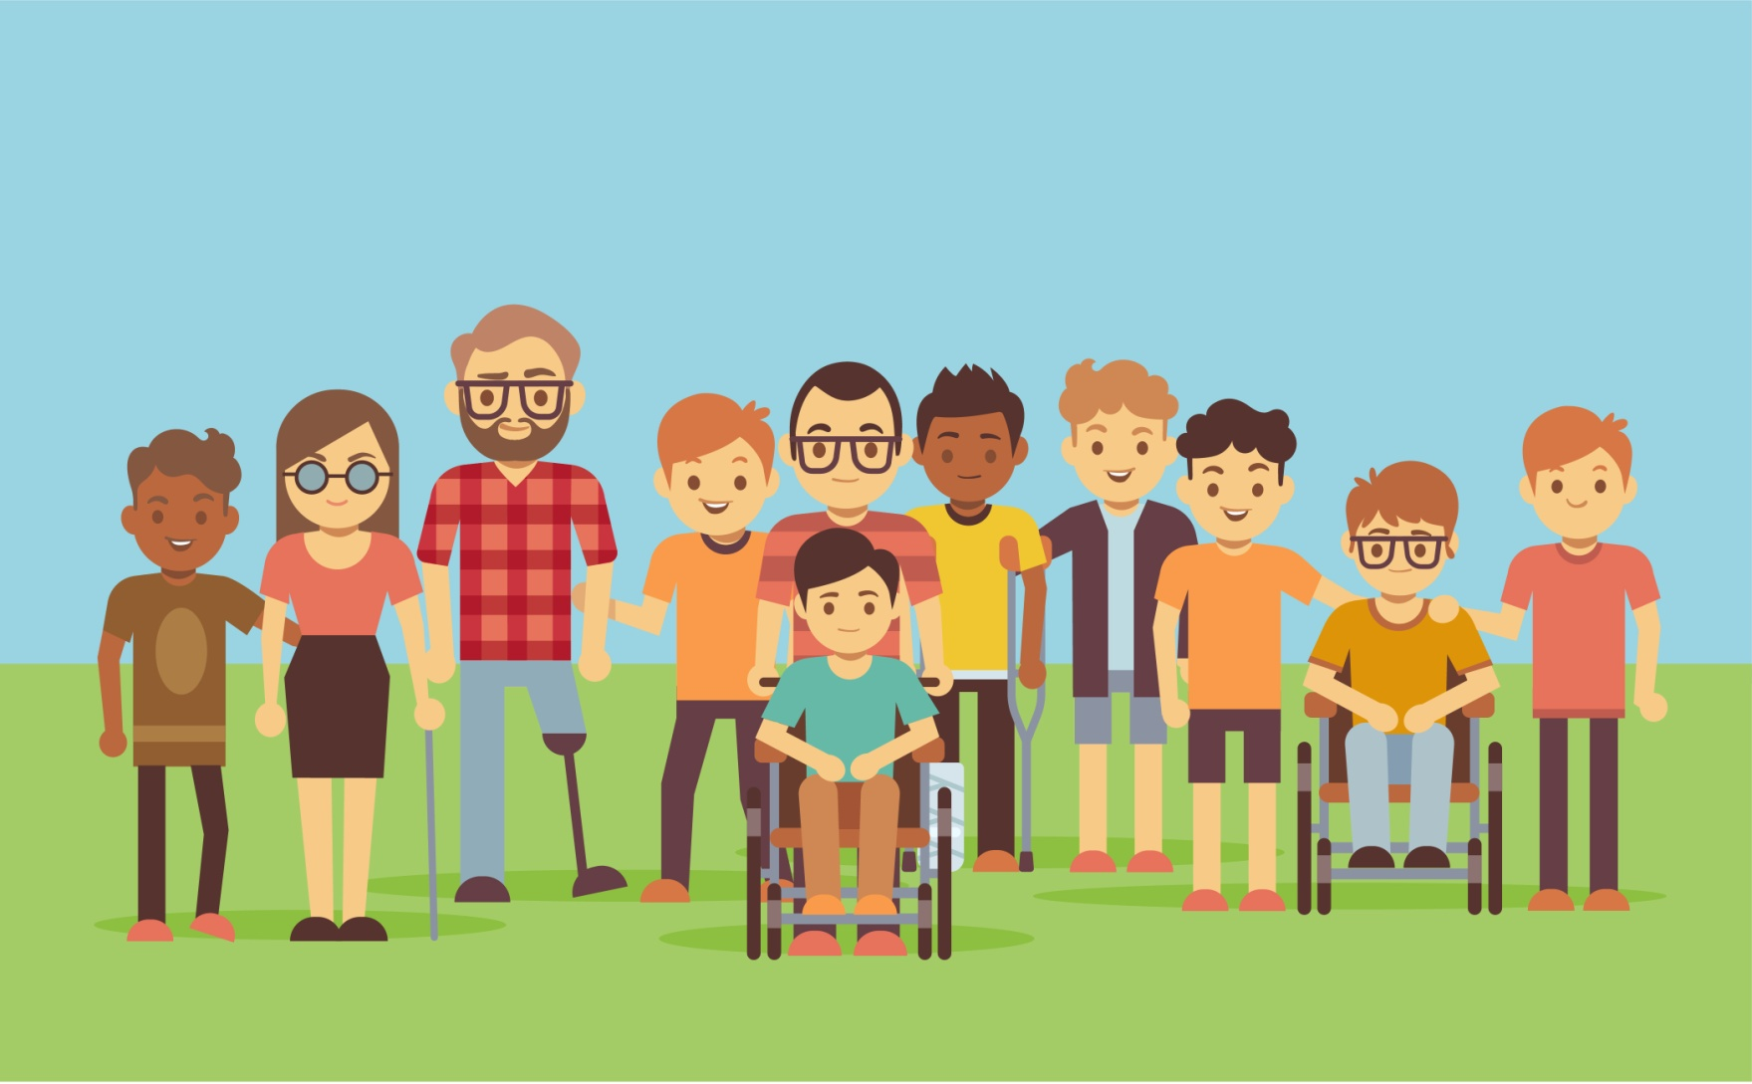
community /kəˈmjuːnɪti/ = zajednica communities, pl.

Slide 34
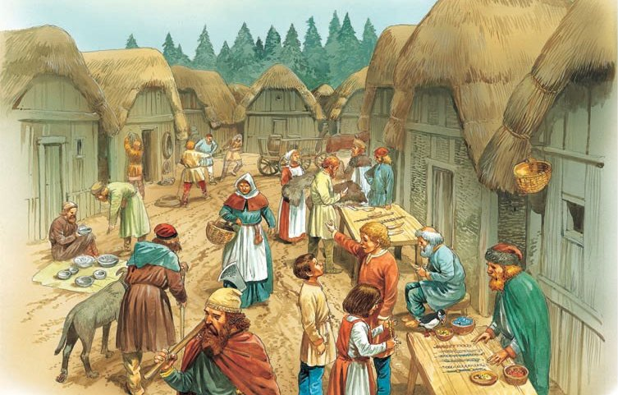
trade /treɪd/= trgovina, zanat

Slide 35
3. page 67, answers
farming good population place unusual
Çatal Hüyük was an important (1) PLACE about 8,000 years ago, when the (2) POPULATION was about 6,000. It was one of the first (3) FARMING communities and also important for trade. Life was (4) GOOD for the people here, but it was also short. The people’s homes were (5) UNSUAL but comfortable.

Slide 36
Grammar: past simple of to be
page 67, Language Reference and Extra Practice, pages 136 - 137

Slide 37
4a page 67, Look at the three sentences from the text, then underline more examples of the past simple of to be in the text
Çatal Hüyük was rich and well organised.
The people were peaceful.
There weren’t any streets.
WAS /wɒz,wəz/ past tense of the verb TO BE
WERE /wə/ (prošlo vreme glagola TO BE)

Slide 38
answers
Çatal Hüyük (now in Anatolia, Turkey) was one of the world’s first cities. In fact, many people think it is the oldest city. It was an important and busy place for 2,000 years from about 7000 BC to 5000 BC. Compared with today’s cities, it wasn’t big, in 6250 BC, there were only about 6,000 people there. The people were, we believe, kind and peaceful. Many of the people were farmers, but the city was rich and well organised, but life was very short: an average age of 34 years for men and 29 for women. Women were important in this city: many were in high positions and there were a lot of special goddesses. There weren’t any streets in the city, most of the houses were around a central courtyard. There weren’t any doors in the houses. There was an entrance to each house through a hole in the roof and down a ladder. Inside, there were paintings of animals and people on some of the walls.

Slide 39
4b page 67, Complete the table with past simple forms of TO BE
Affirmative (+) | Negative (-) | Question (?)
I was he/she/it 1__________ You were We were They 2 ___________ | I wasn’t he/she/it 4__________ You weren’t We 5 ___________ They 6___________ | Was I? 8 _________he/she/it? Were you? Were we? Were they?
There 3 ____________ There were | There wasn’t There 7 _____________ | 9 ________ there ? Were there?

Slide 40
4b page 67, Complete the table with past simple forms of TO BE
Affirmative (+) | Negative (-) | Question (?)
I was he/she/it 1. WAS You were We were They 2. WERE | I wasn’t he/she/it 4. WASN’T You weren’t We 5. WEREN’T They 6. WEREN’T | Was I? 8. WAS he/she/it? Were you? Were we? Were they?
There 3. WAS There were | There wasn’t There 7. WEREN’T | 9. WERE there ? Were there?

Slide 41
Language Reference and Extra Practice
G1 page 136, Past Simple Tense
Use the Past Simple to talk about events and situations that are finished (in the past, in history).
I was late this morning.
You were in the hospital last week.
The city wasn’t important in 2000 BC.
She wasn’t at the shop on Saturday.
Was the food expensive? – No, it wasn’t.

Slide 42
G1. page 136, Past Simple Tense questions TO BE
For questions, use an inversion (the subject and the verb change places)
S + V
You were in the hospital last week
V + S
Were you in the hospital last week?
The food was expensive.
Was the food expensive?

Slide 43
G1. page 136, Past Simple Tense there is, there are
there is, there are ima, nalazi se
There is a bank in this street
There are many people in the hotel.
There was, there were bilo je nalazilo se
There was a bank in this street.
There were many people in the hotel.

Slide 44
5. page 67, Complete these sentences with was, wasn’t, were or weren’t
1. The people of Çatal Hüyük _______ peaceful.
2. Roman roads are famous – the Romans _________ very good at building them?
3. ‘Who __________ Cleopatra?’ – ‘The queen of Egypt.’
4. __________ there any important cities in your country in AD 1000?
5. I _________ good at history at school – it was my worst subject!
6. There _______ a horrible history teacher at my school. Now, what _______ his name?
7. ‘You ________ in the lecture on early cities. Where ______ you ?’ – ‘We _________ in the café!-

Slide 45
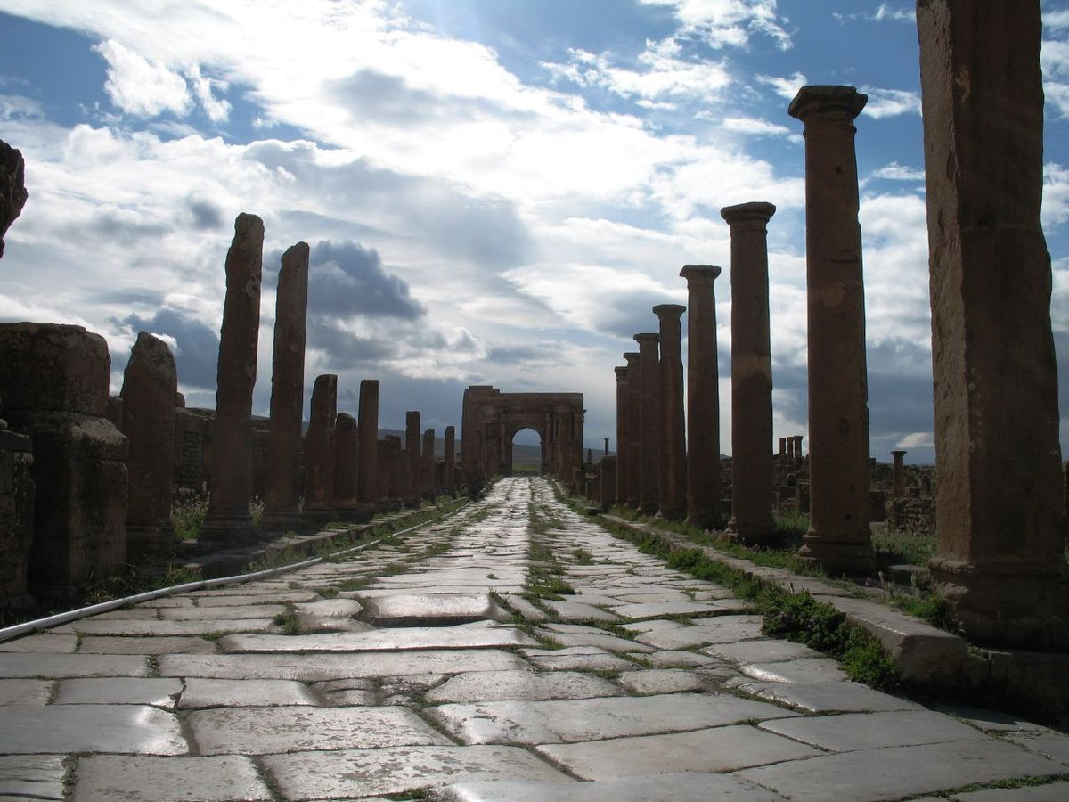
Roman roads

Slide 46
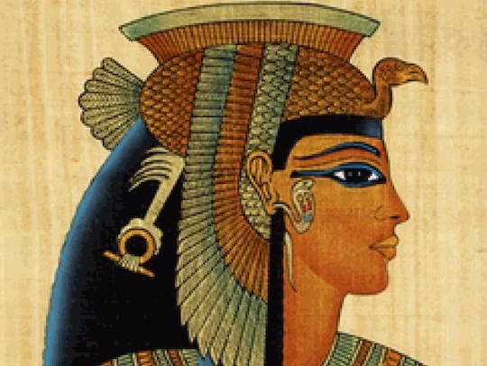
Cleopatra /ˌklɪəˈpatrə/ Kleopatra
The Queen/kwiːn/ of Egypt/ˈiː.dʒɪpt/ = kraljica Egipta

Slide 47
5. page 67, answers
1. The people of Çatal Hüyük WAS peaceful.
2. Roman roads are famous – the Romans WERE very good at building them?
3. ‘Who WAS Cleopatra?’ – ‘The queen of Egypt.’
4. WERE there any important cities in your country in AD 1000?
5. I WASN’T good at history at school – it was my worst subject!
6. There WAS a horrible history teacher at my school. Now, what WAS his name?
7. ‘You WEREN’T in the lecture on early cities. Where WERE you ?’ – ‘We WERE in the café!-

Slide 48
7a page 67, Look at these past time phrases. Put them in order, starting with most recent.
1, 000 years ago last month last week last year six weeks ago yesterday the day before yesterday two hours ago

Slide 49
7a page 67, Answers
two hours ago
yesterday
the day before yesterday
last week
last month
six weeks ago
last year
1, 000 years ago

Slide 50
7b page 67, Put the words in the right order to make questions, then ask a partner. Use time phrases in your answer.
1. holiday When your last was?
2. last school exam your was When?
3. When your visit to a museum was last?

Slide 51
7b page 67, Answers.
1. When was your last holiday?
2. When was your last school exam your?
3. When was your last visit to a museum?

Slide 52
Speaking and writing
Page 67, Output task 112,118

Slide 53
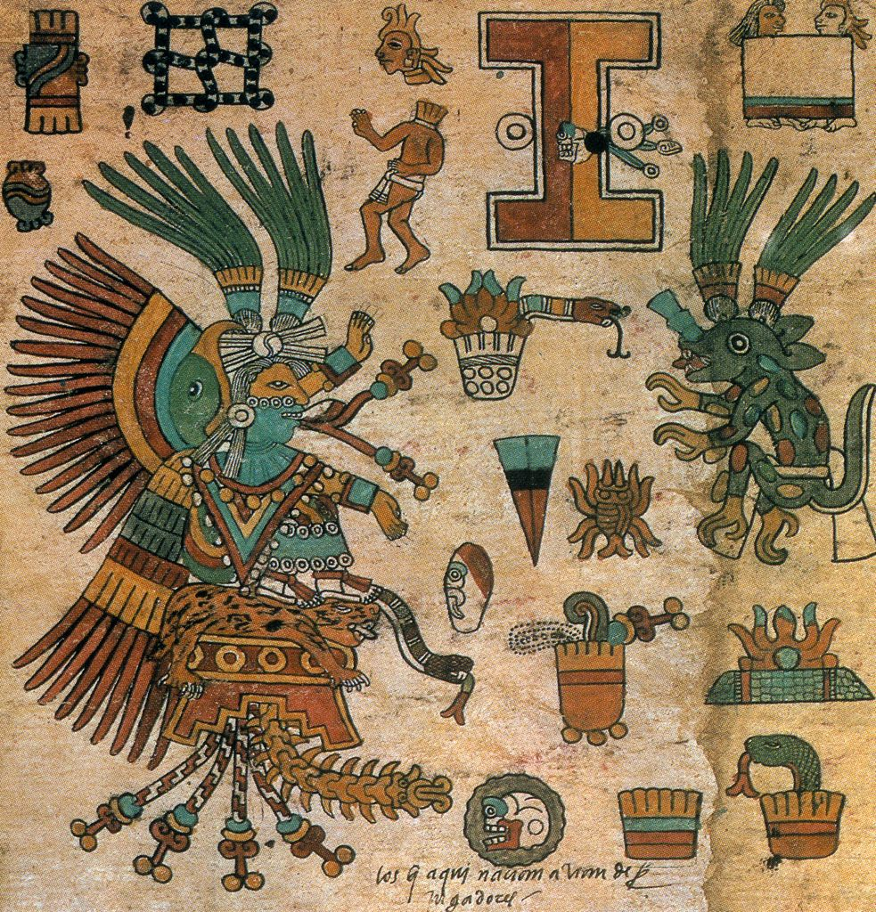
8a page 67, What do you know about the Mayan, Inca and Aztec civilisations?

Slide 54
8b page 67, HW, Find out more about these civilizations.
Look at the information on page 112 and page 117, and fill in the table
WATCH! (Maya)
https://www.youtube.com/watch?v=Q6eBJjdca14
WATCH! (Inca)
https://www.youtube.com/watch?v=cnMa-Sm9H4k
WATCH! (Aztec)
https://www.youtube.com/watch?v=B8cO1pAHVok

Slide 55
9 page 67,Now choose one civilisations and write a few sentences about it.
The Mayan civilisation was in Mexico, Guatemala, Honduras and Belize. It was important…

Slide 56
HW, Language Reference and Extra Practice, pages 136-137
Read Language Reference, page 136
Extra Practice G1, 1, 2, 3 page 137
Extra Practice V1, 7, page 137

Slide 57
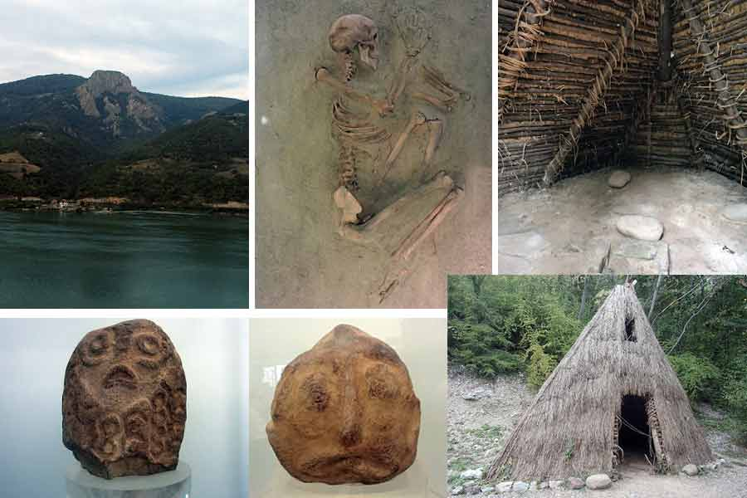
Thank you for your Attention!

