Slide 1
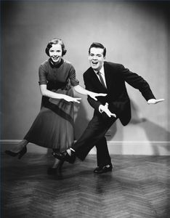
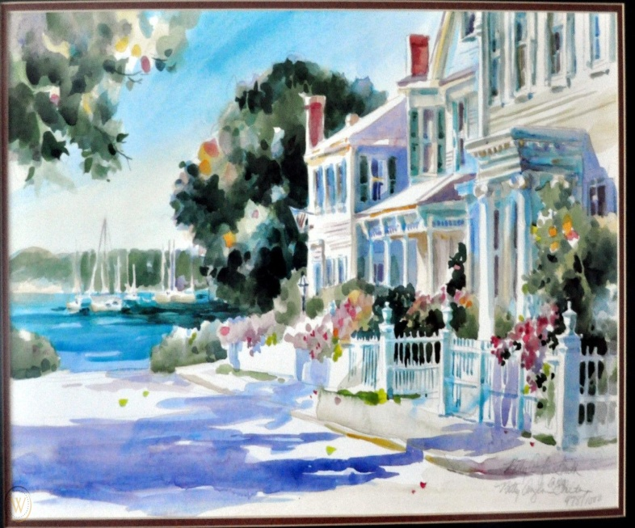
7.3. Charleston City Guide
SCENARIO At a meeting, pp. 62-63

Slide 2
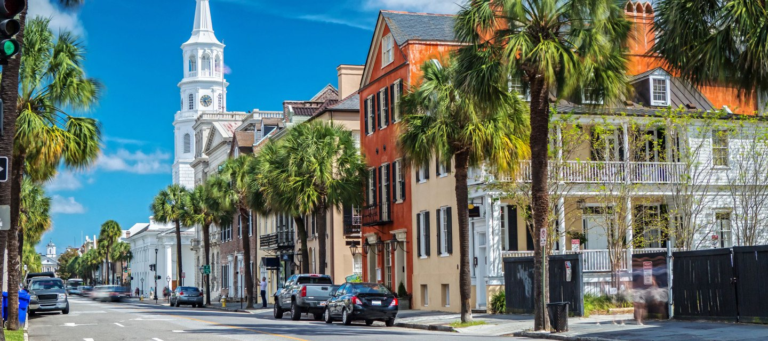
Preparation
1. page 62, Read about Charleston, a city in the USA. Would you like to visit it, or live there?

Slide 3
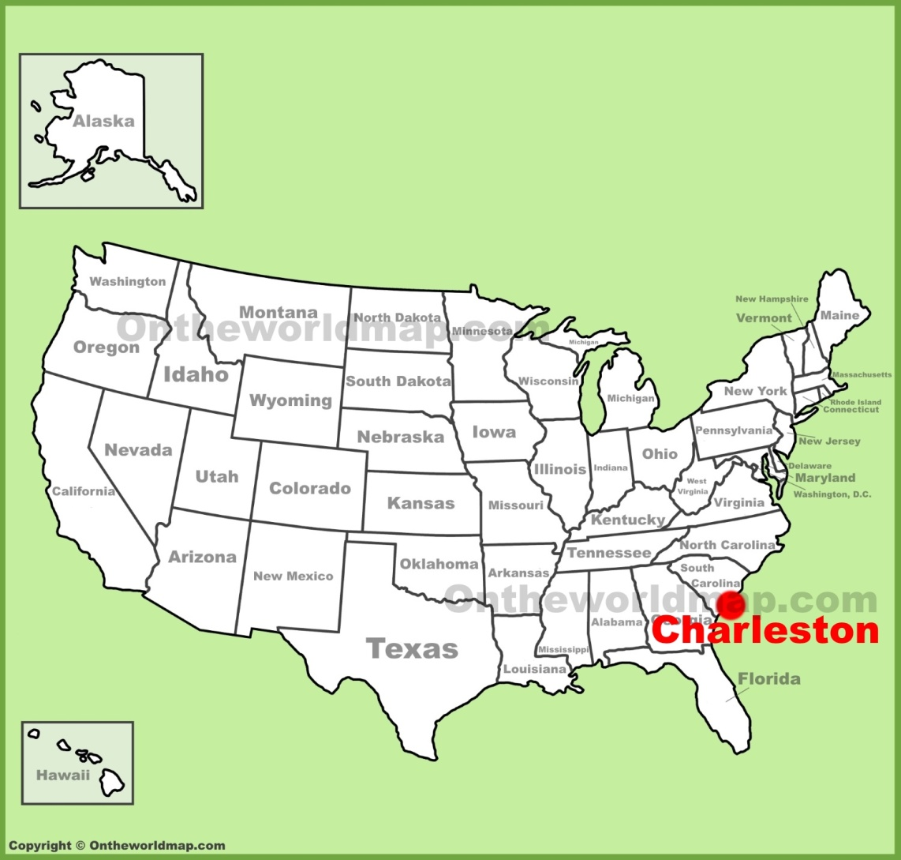
Map
Charleston, South Carolina

Slide 4
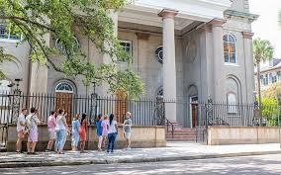
Charlston CITY GUIDE page 62
Reasons to come
Historical Charleston is a beautiful town in the south of the USA. It’s a seaside town and it has many old buildings. The best way to see the town is on foot. Walk around and enjoy the lovely buildings and secret gardens. Life is relaxed here.

Slide 5
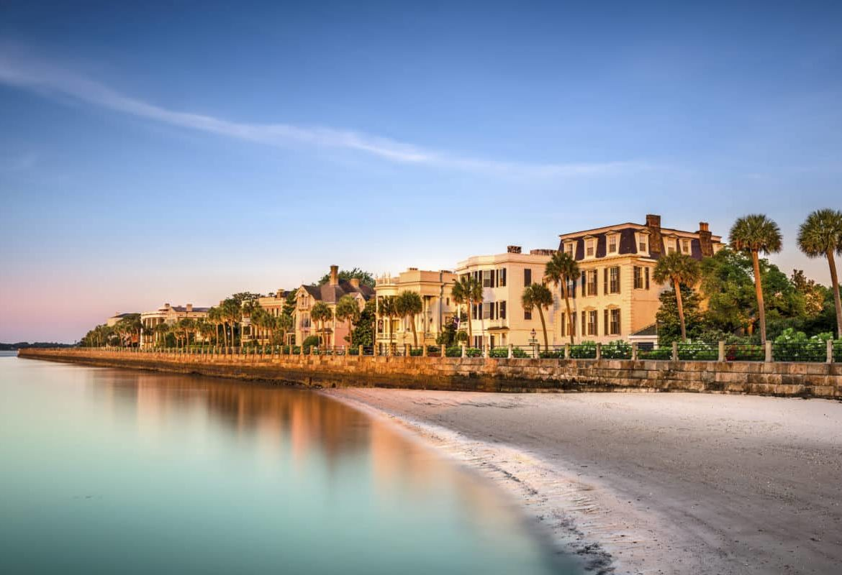
seaside town near the sea e.g. I’ll go to the seaside for the summer vacation (na more)

Slide 6
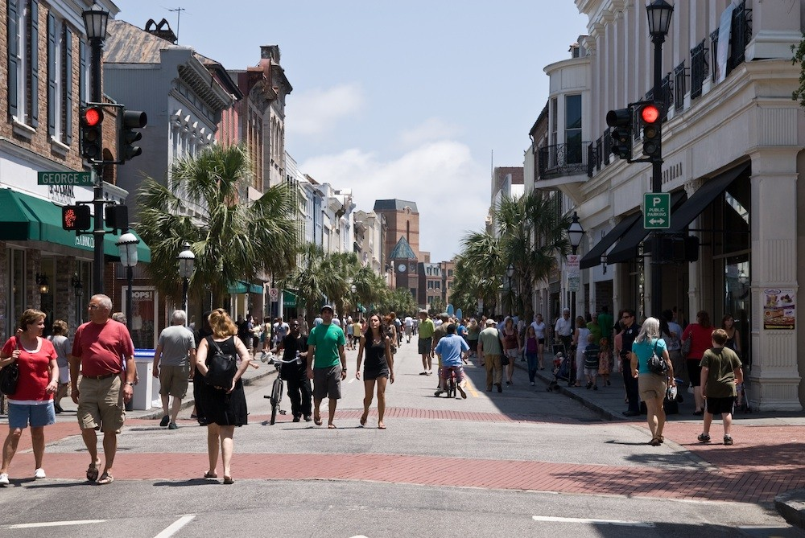
on foot = walking

Slide 7
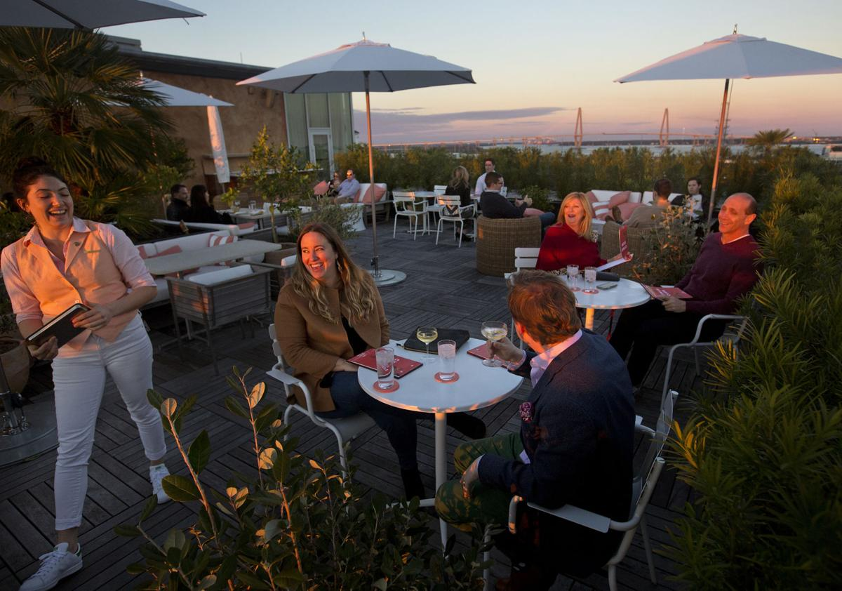
relaxed relaxing, calm, peaceful opušteno

Slide 8
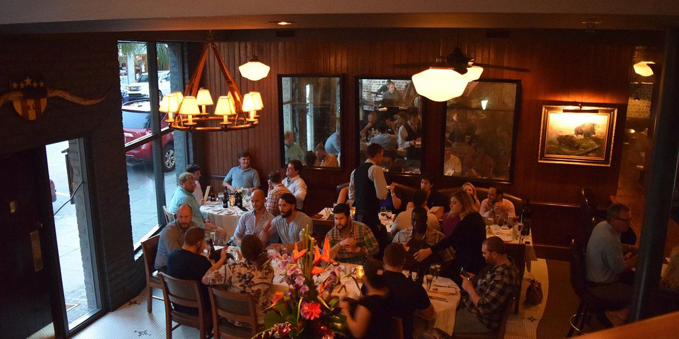
Charlston CITY GUIDE page 62
Eating and nightlife
Many restaurants serve the local food – especially the rice dish Jambalaya. Charleston has a history of Dixieland Jazz, so there are a lot of music bars. The Dock Street Theater is the oldest theater in America, dating back to 1736.

Slide 9
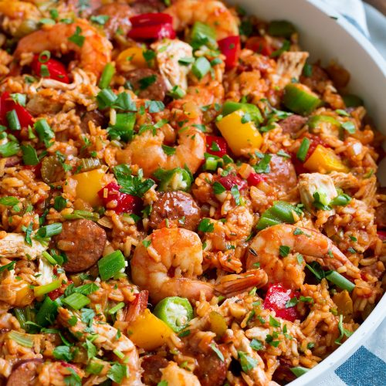
rice dish Jambalaya similar to Paella

Slide 10
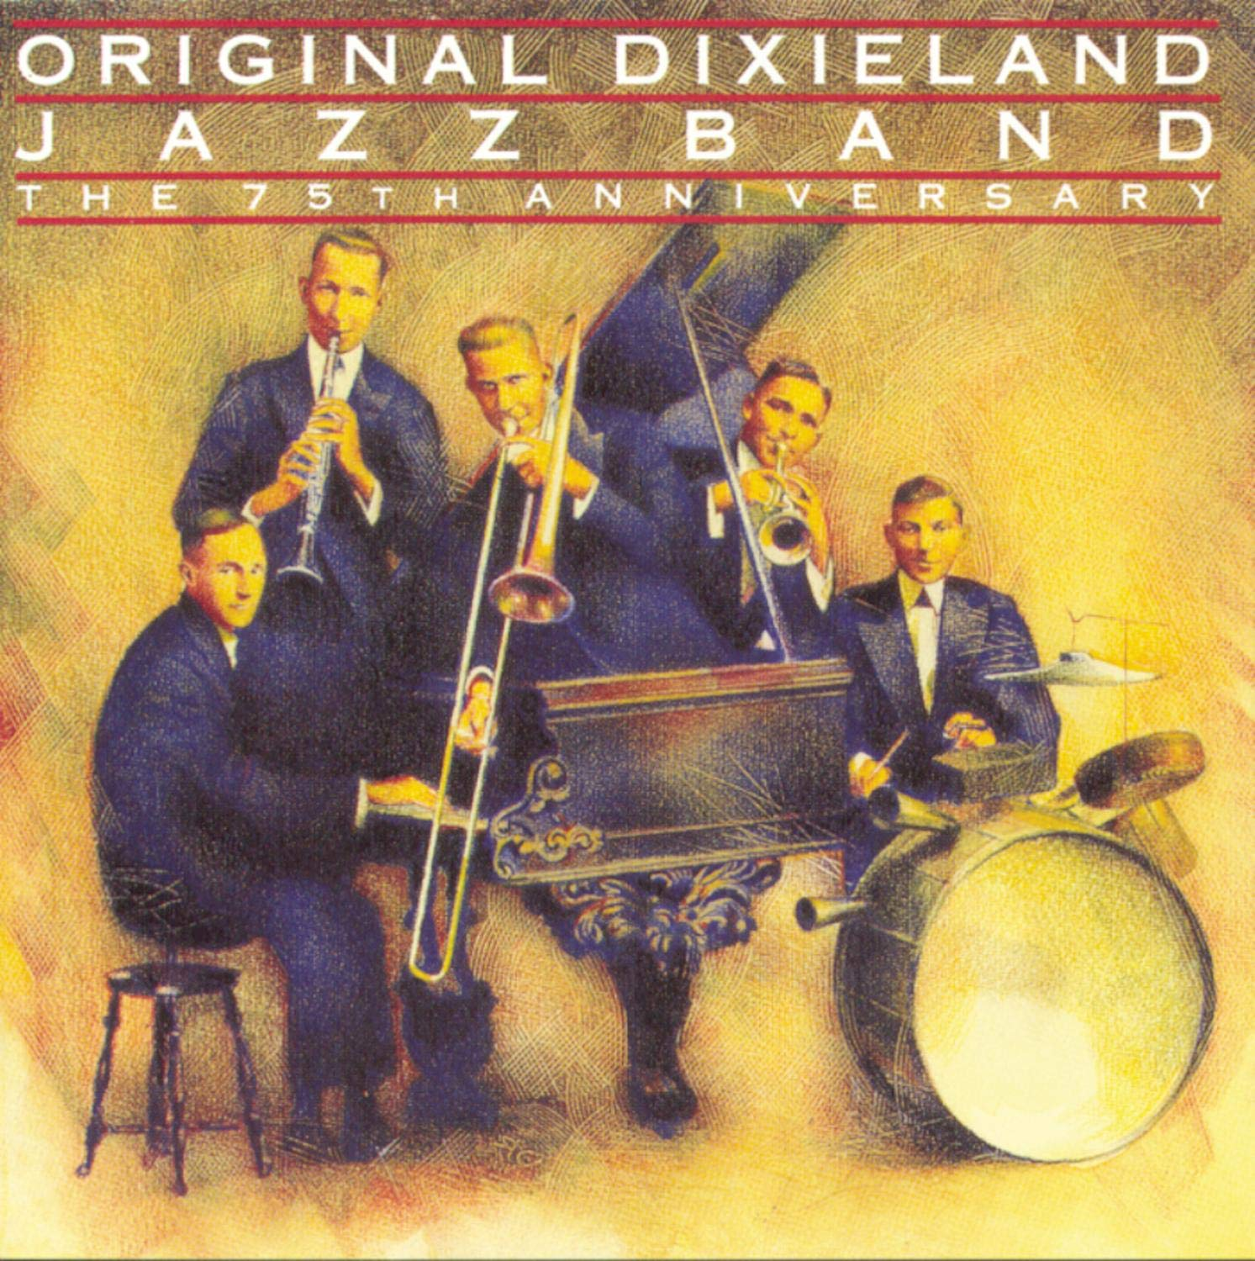
Dixieland Jazz https://www.youtube.com/watch?v=WN_PIWkKO5s

Slide 11
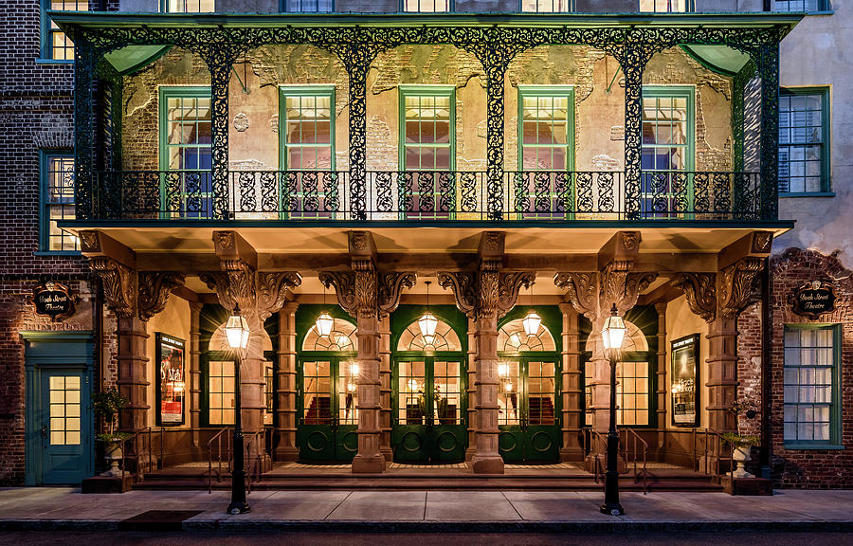
Dock Street Theater = a hotel that became a theater date back from = has beginnings/origins from

Slide 12
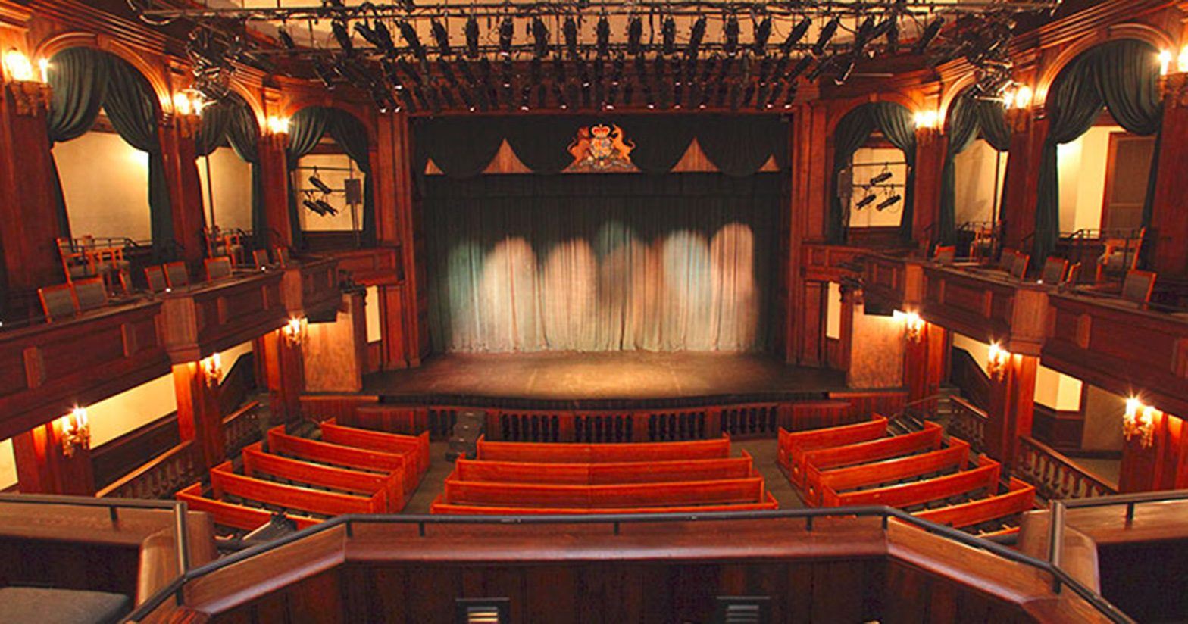
theatre - theater

Slide 13
BrE vs. AmE spelling
centre = center
theatre = theater
color = colour
favor = favour

Slide 14
Charlston CITY GUIDE page 62
Places to shop
Downtown Charleston is a lovely shopping area with many stores and cafés. There’s also the City market, which sells many unusual things. In the north, there’s the popular Northwoods shopping mall, with a variety of stores and a huge parking lot. There are many small highway shopping areas outside the town, where you can do your shopping and fill your car with gas at the same time.

Slide 15
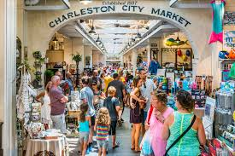
City Market

Slide 16
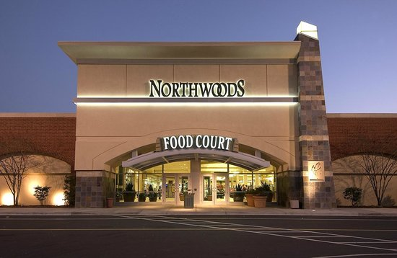
Northwoods Shopping Mall

Slide 17
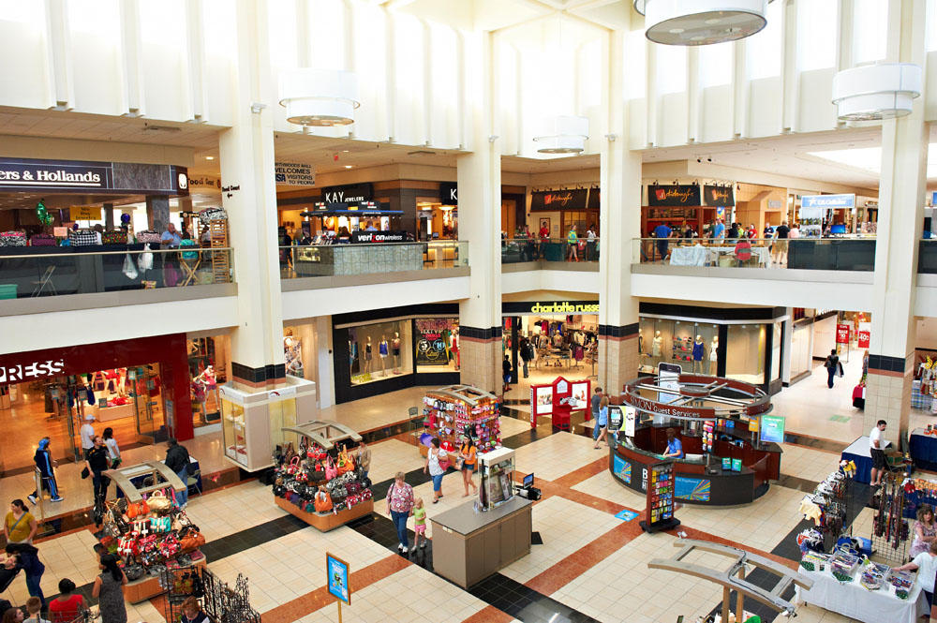
variety /vəˈrʌɪəti/ - raznovrsnost, raznolikost a variety of stores different kinds of stores

Slide 18
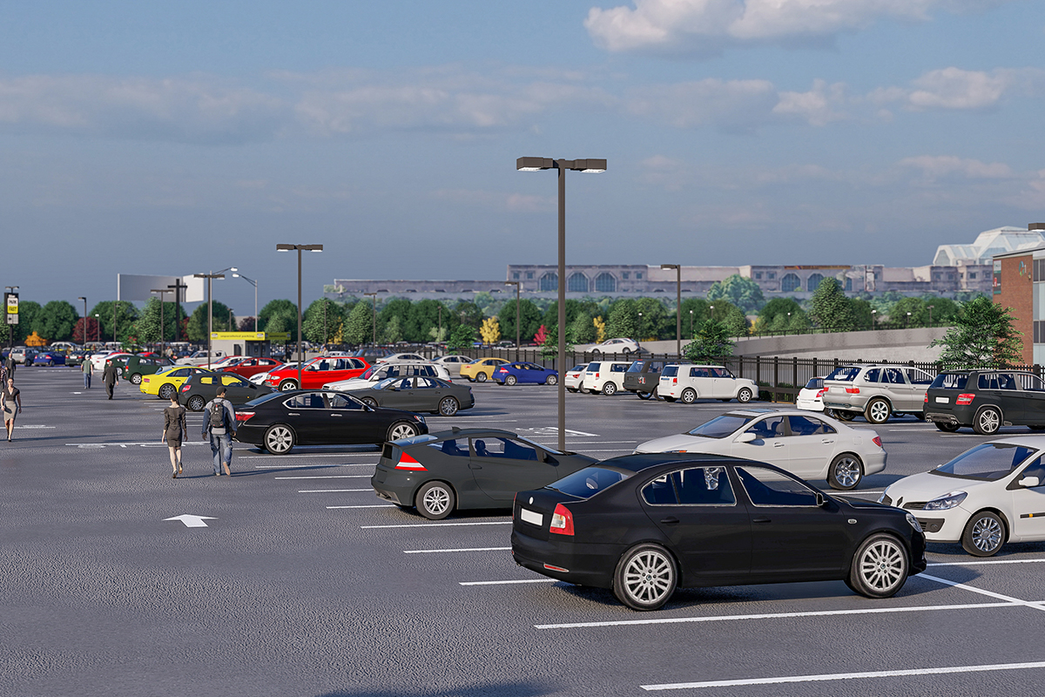
parking lot = car park

Slide 19
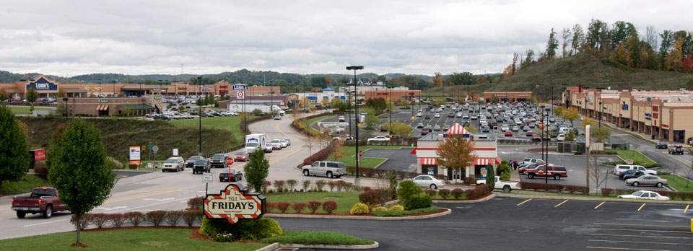
highway shopping areas
= freeway (Serb. autoput)
(Serb. šoping zona oko autoputa)

Slide 20
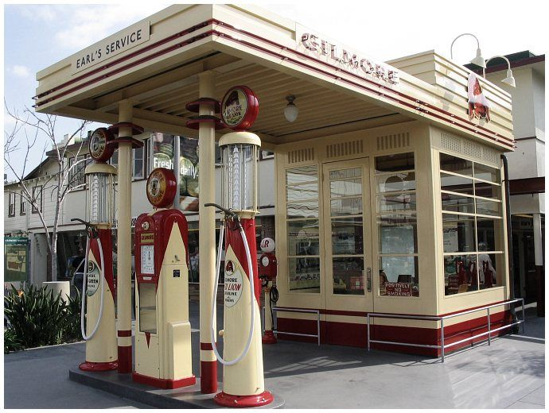
gas station = petrol station gas = fuel, petrol (Serb.benzin)

Slide 21
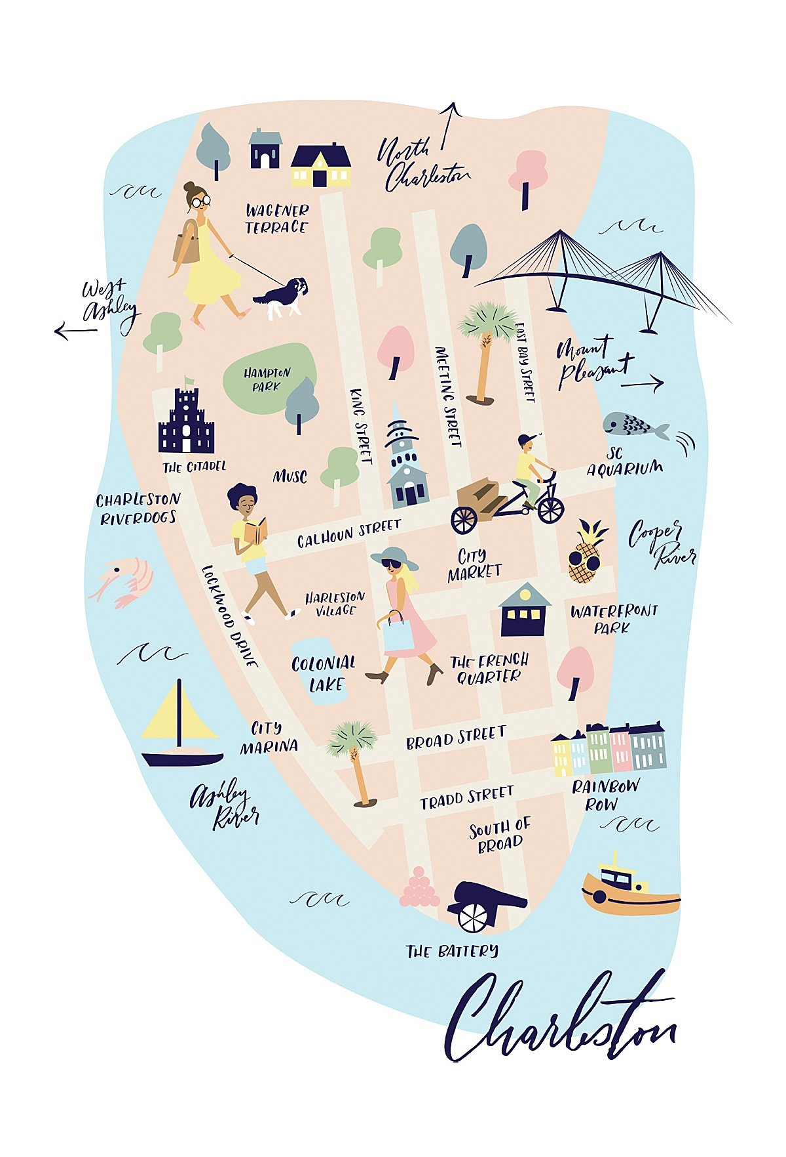
WATCH https://www.youtube.com/watch?v=shn96I-Js1k https://www.youtube.com/watch?v=UtcKgiINiY0

Slide 22
2. page 62, The words on the left are American English. Find them in the text, then match them with these sentences. Can you say anything else about these types of shopping place?
1 shopping mall
2 store
3 gas
4 downtown
5 highway
6 parking lot
a) car park
b) petrol
c) shopping centre
d) shop
e) town centre
f) motorway/ main road

Slide 23
2. page 62, The words on the left are American English. Find them in the text, then match them with these sentences. Can you say anything else about these types of shopping place?
1 shopping mall
2 store
3 gas
4 downtown
5 highway
6 parking lot
a) car park
b) petrol
c) shopping centre
d) shop
e) town centre
f) motorway/ main road

Slide 24
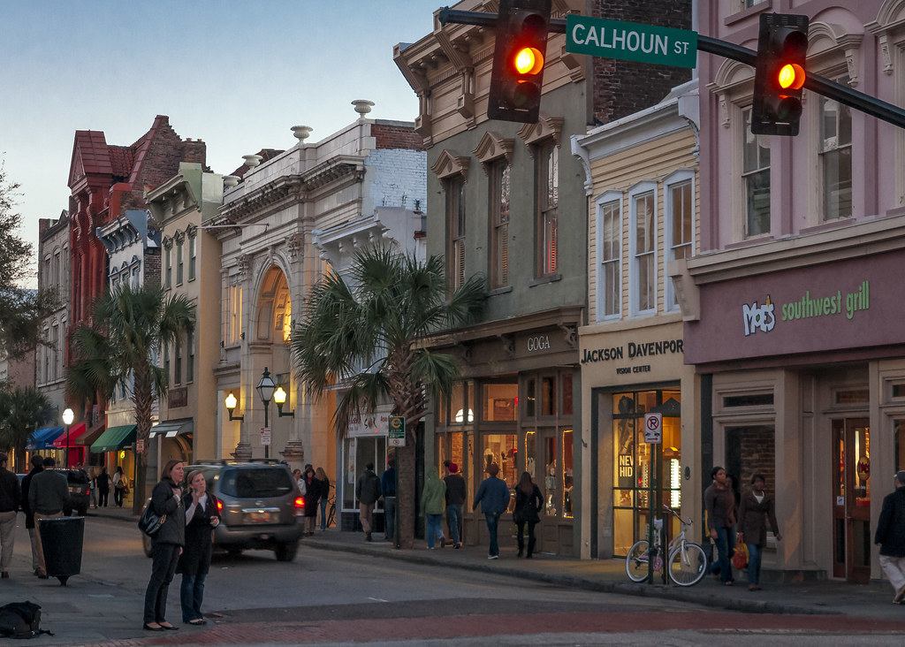
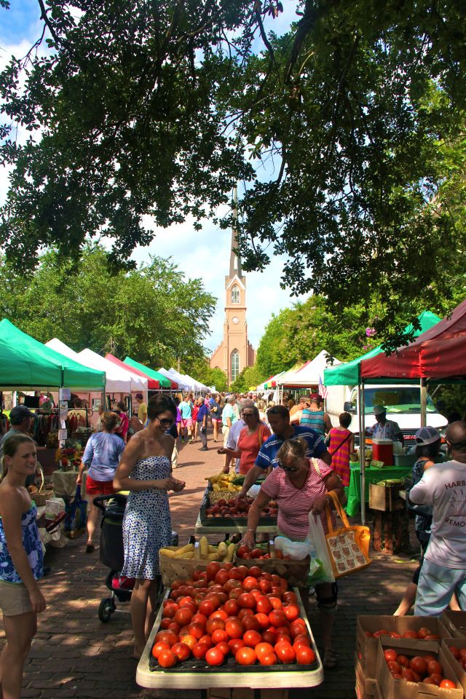
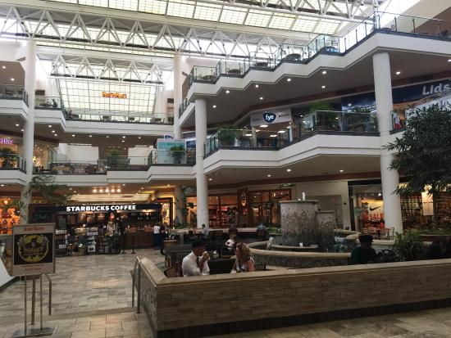
A
B
c
D

Slide 25
3. page 62, Look at the photos A-D (slide 4) and match them with these sentences
1. In this place there are many stalls (open-air shops).
2. This is the tradional place for shopping.
3. This place has very large car parks and large, often famous stores.
4. There are often motels and petrol stations here.

Slide 26
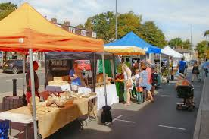
stalls/stɔːlz/ - stands, tezge

Slide 27
3. page 62, Look at the photos A-D (slide 4) and match them with these sentences
1. In this place there are many stalls (open-air shops). A
2. This is the tradional place for shopping. B
3. This place has very large car parks and large, often famous stores. C
4. There are often motels and petrol stations here. D

Slide 28
4. page 62, Brad and Zara want to start a small bookshop in Charleston. They want to sell books about film, TV and music. Read the information in Exercise 5 about downtown Charleston and answer the questions.
1. What are the disadvantages of this area for their shop?
2. What are the disadvantages?
3. Do you think it is a good place for the shop?

Slide 29
5. page 62, Track 2.5, page 151
Listen to Brad and Zara talking about their plans for the shops. Tick the advantages and disadvantages of downtown that they discuss.
1. It’s a nice place. People like to come here.
2. There are interesting local shops: some cafés, an art shop, a music shop.
3. The area is safe – there’s not much crime.
4. There aren’t any bookshops in the area.
5. It’s near the bus station.
6. The rent is high ($500 a month).
7. Many people go to the shopping mall outside the town

Slide 30
5. page 62, Track 2.5, page 151
Listen to Brad and Zara talking about their plans for the shops. Tick the advantages and disadvantages of downtown that they discuss.
1. It’s a nice place. People like to come here.√
2. There are interesting local shops: some cafés, an art shop, a music shop. √
3. The area is safe – there’s not much crime. √
4. There aren’t any bookshops in the area. x
5. It’s near the bus station. √
6. The rent is high ($500 a month). x
7. Many people go to the shopping mall outside the town x

Slide 31
GIVING ADVANTAGES AND DISADVANTAGES
KEY LANGUAGE:

Slide 32
6a. page 62, Track 2.5, page, 151
Listen again and complete the sentences.
BRAD: So what advantages does downtown (1) _____________?
ZARA: Well, (2) ______________ of all, I (3) ___________ it’s a nice place for people to visit.
BRAD: OK. Are there any (4) ________________ advantages?
ZARA: Yes, (5) _________ advantage is that the area is safe.
BRAD: Right. What (6) _______________ the disadvantages?
ZARA: I think there are two (7) __________________ disadvantages.
ZARA: One (8) _______________ is that a lot of people go to the shopping mall outside the town.
ZARA: … and the (9) _________ is that a lot of people go to the shopping mall outside the town.
ZARA: This (10) ___________ that sometimes there aren’t very many customers downtown.

Slide 33
6a page 62, Track 2.5, page 151
Listen again and complete the sentences.
BRAD: So what advantages does downtown (1) HAVE?
ZARA: Well, (2) FIRST of all, I (3) THINK it’s a nice place for people to visit.
BRAD: OK. Are there any (4) MORE advantages?
ZARA: Yes, (5) ANOTHER advantage is that the area is safe.
BRAD: Right. What (6) ARE the disadvantages?
ZARA: I think there are two (7) MAIN disadvantages.
ZARA: One (8) DISADVANTAGE is that the rent is high
ZARA: … and the (9) OTHER is that a lot of people go to the shopping mall outside the town.
ZARA: This (10) MEANS that sometimes there aren’t very many customers downtown.

Slide 34
6b page 62, Match the sentences in Exercise 6a with the description below
1. asking about advantages/disadvantages
_________ __________ _______________
2. giving advantages/disadvantages
_________ __________ ______________
3. explaining why something is a disadvantage
__________

Slide 35
Giving Advantages ☺ and Disadvantages ☹ page134
What are advantages/ disadvantages?
What are the pros and cons?
What are positive and negative sides/aspects?
Are there any advantages/ disadvantages?
There are two main advantages/ disadvantages?
The first/the second is that...
One/Another advantage is that...
The disadvantage is that...
I think/don’t think (it’s a nice place).
This means that...
This is more...
I think X is better because...

Slide 36
Task: describing places
Advantages and disadvantages

Slide 37
9a. page 63, Work in groups of three. You are helping Brad and Zara with the bookshop plans. You are looking at information about different shopping areas
student A: Read about the market on page 111 and make notes.
student B: Read about the highway shopping area on page 117 and make notes.
student C: read about the shopping mall on page 120 and make notes.

Slide 38
Describing Places
Shopping Area | Advantages | Disadvantages
The market
The highway shopping area
The shopping mall

Slide 39
9b, page Tell your group your information. Make notes about their information in the table.
9c Discuss the information in your group, using the Key language and the Other useful phrases. Decide which is the best shopping area for the bookshop.
WRITING
10. Write a short paragraph (app 100 words) to explain your choice of the best shopping area for the bookshop.

Slide 40
HW
page 135, V1,2 exercise 6, Choose the correct verb
page 135, exercise 7, Read these definitions and write the word
page 135, V3 exercise 8, Complete the table

Slide 41
HW – answers
G3 3. page 135,
Write the words in the correct order to make questions.
1. Is your friend driving?
2. What are you doing?
3. Who are you phoning?
4. Where are they going?

Slide 42
HW answers
G2,3 page 135
4Match questions 1-6 with responses a-f.
1. Do you often come here? d
2. Are you always busy? b
3 Is he studying? a
4 Where’s he studying? f
5 Are people buying online these days? c
6 What do you want? e

Slide 43
HW – answers
KL 5
Complete the conversation with sentences a-g
A: I’m bored with the city. I’d like to move nearer to the sea.
B: The sea...I don’t know. (1) b
A: Really? What are they?
B: The first is that it’s often cold. (2) a
A: (3) g Houses here are more expensive.
B: Not these days. A lot of people want a house near the beach. (4) c
A: Well, OK, not the sea. (5) e
B: Let’s move to the mountains.
A: (6) f
B: One advantage is that it’s cheaper. (7) d

Slide 44
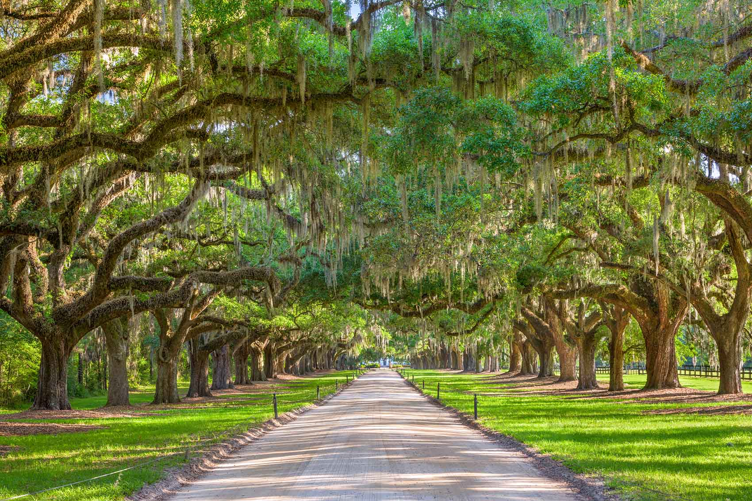
Thank you for your Attention!

