Slide 1
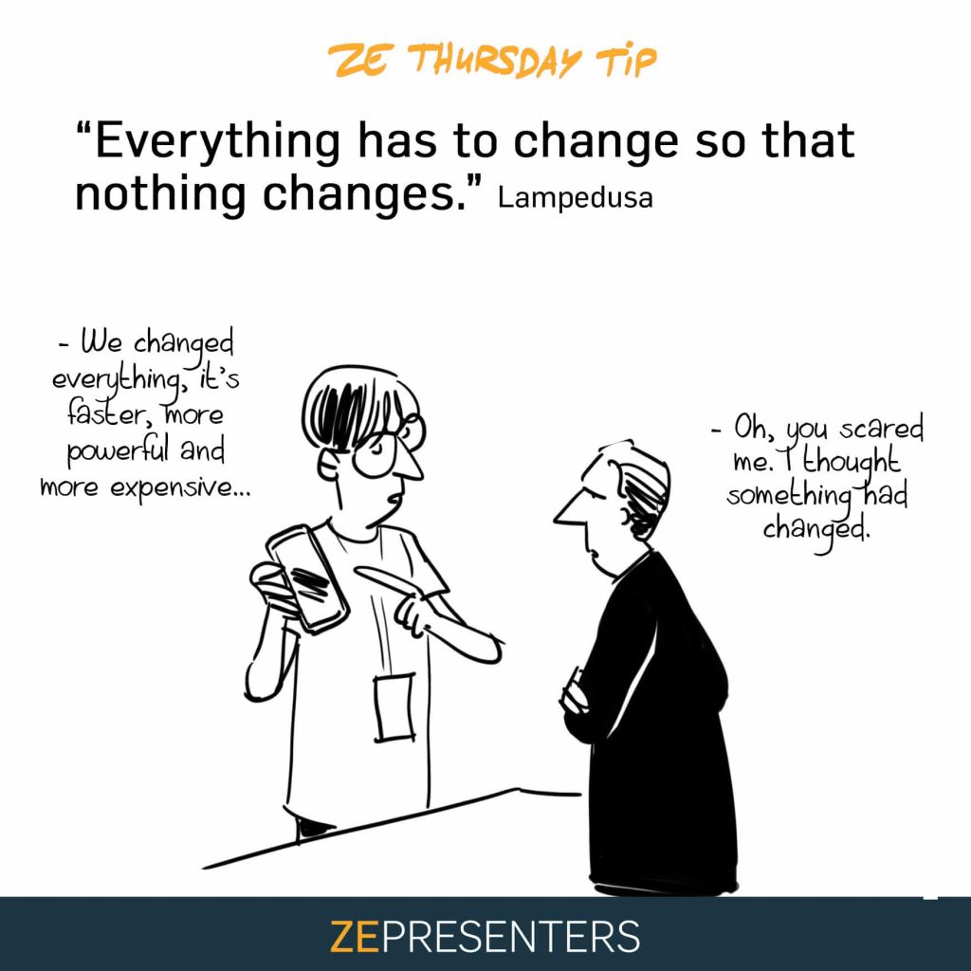
All Change
8.2. pages 68-69

Slide 2
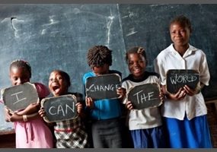
reading
page 68

Slide 3
1. page 68, Which of these changes are true for your country? Can you think of any other changes?
1 Families are smaller now than they were 50 years ago.
2. People work shorter hours than in the past.
3 Nowadays, many people cook food from other countries.
4. Religion is more important now than in the past.
5. United States’ culture (films, food, music) is popular.
6. These days, people usually go abroad on holiday.
nowadays, adv. = these days, in our time

Slide 4
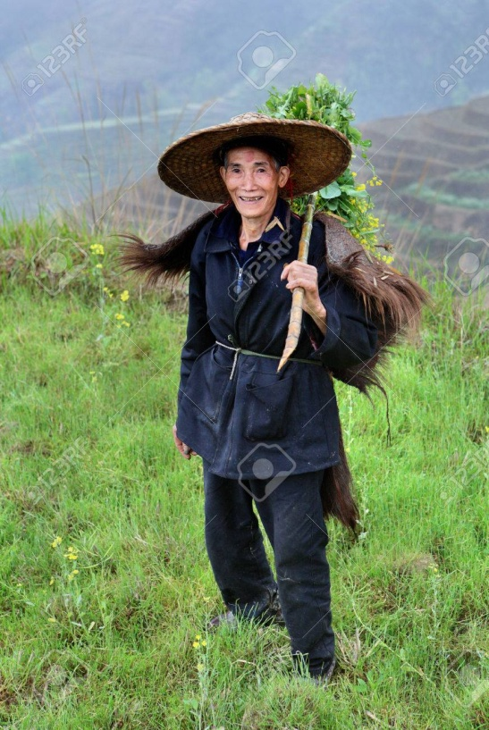
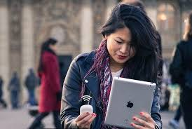
2a page 68, Read the article about changes quickly. Which countries or cultures does the reporter write about?
ALL CHANGE! Countries and cultures for many different reasons. Our reporter, Sara Stephens, talks to people about changes in their countries.
Changes because of _______________
The Chinese economy is one of the fastest –growing economies in the world. Han Li’s life is completely different from her grandparents’ life. ‘They couldn’t travel to other countries, but I can. I can drive a car, but my grandfather could only ride a bicycle.’ Bo Li, Han’s grandfather, smiles and says, ‘We can afford to buy an air-conditioner. Before, we couldn’t relax in the house during the hot summer.

Slide 5
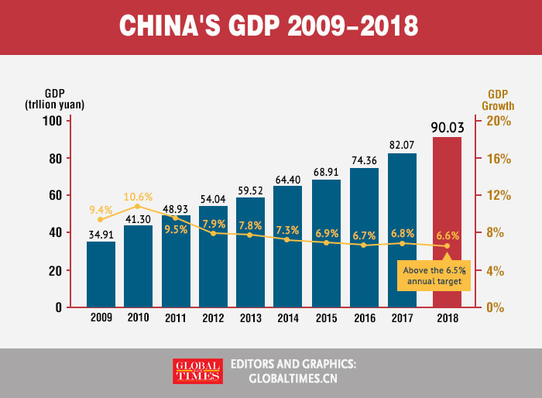
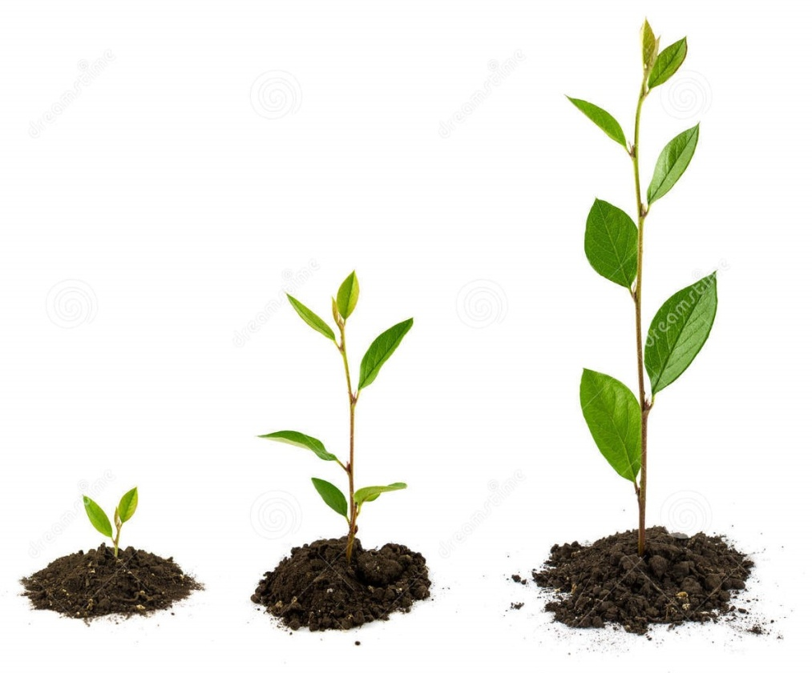
fastest-growing, adj. = it grows very fast najbrže rastuća economy, n. = privreda (ekonomija neke države) economies, pl. –privrede određenih zemalja economics, n. = ekonomija, ekonomika (predmet izučavanja)

Slide 6
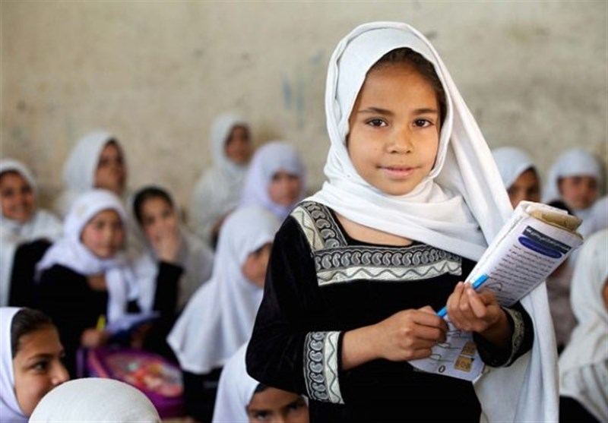
2a page 68, Read the article about changes quickly. Which countries or cultures does the reporter write about?
ALL CHANGE! Countries and cultures for many different reasons. Our reporter, Sara Stephens, talks to people about changes in their countries.
2. Changes because of _______________
Under the old government of Afghanistan, there were many strict laws. For example, people couldn’t listen to music or watch TV.
Farida, a mother of two children, says, ‘Life is much better now. Boys and girls can play together, and I can go out on my own. But, best of all, teenage girls can go to school.

Slide 7
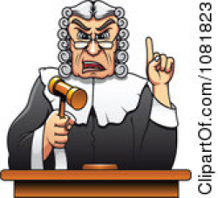
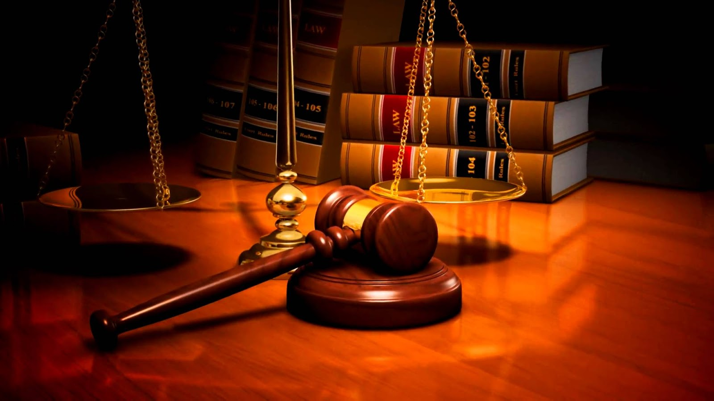
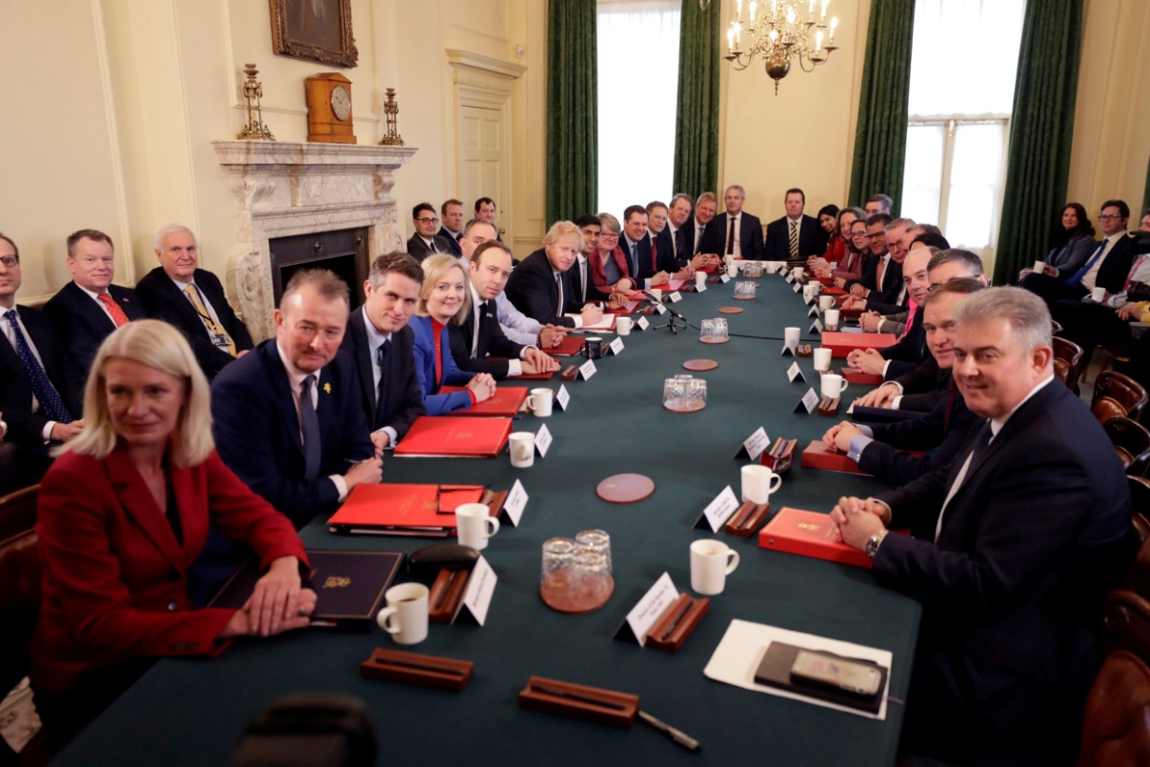
to govern, v.- to rule, to control (upravljati, vladati) government, n. – governing body(vlada) law, n.- rules, regulations (zakon strict, adj.- severe (strog)

Slide 8
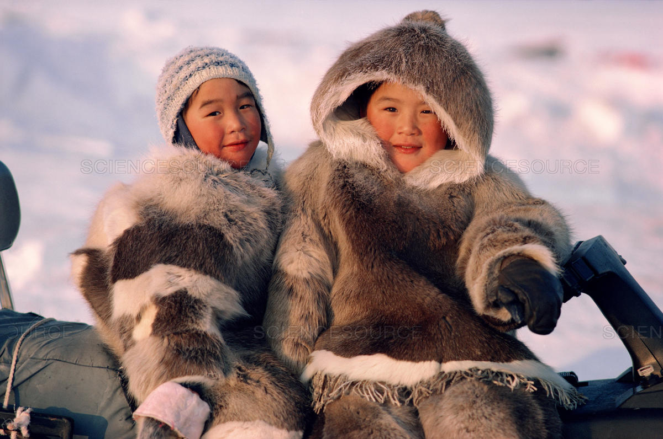
2a page 68, Read the article about changes quickly. Which countries or cultures does the reporter write about?
ALL CHANGE! Countries and cultures for many different reasons. Our reporter, Sara Stephens, talks to people about changes in their countries.
3. Changes because of _______________
The Inuits of Northern Canada are losing their old way of life because the environment is changing. ‘The ice is disappearing now, so we can’t get food in the old way,’ says Tootega. ‘When I was young, I could travel on the ice for days, and find seals. Now, there is almost, no ice. Our children can’t learn the old skills and they are leaving our villages to find work in the cities, it makes me sad.’

Slide 9
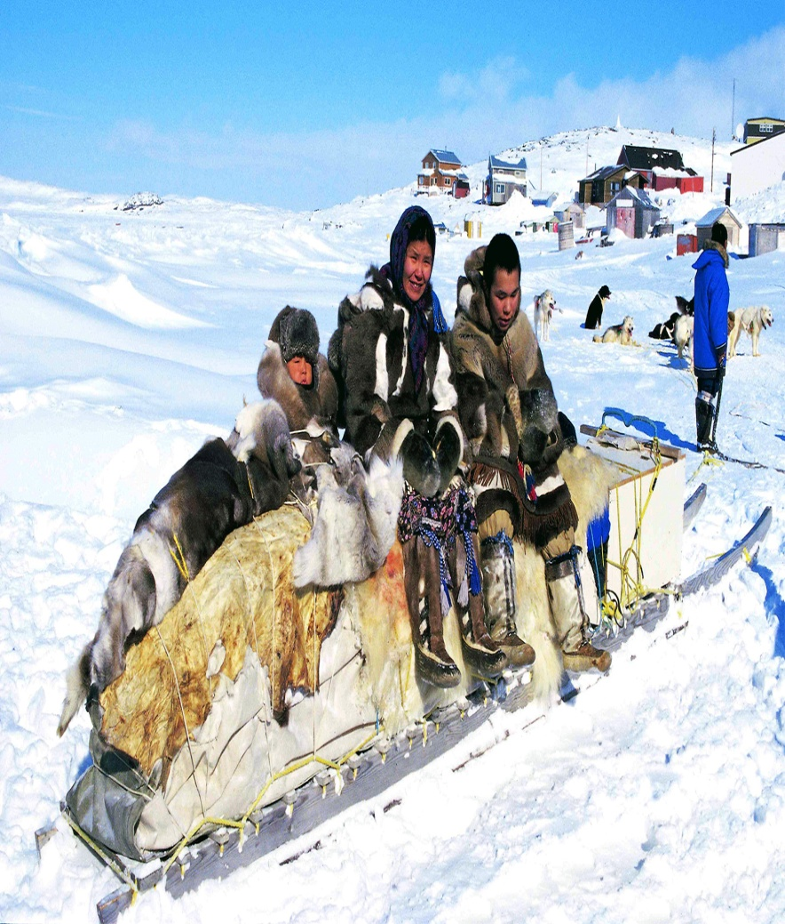
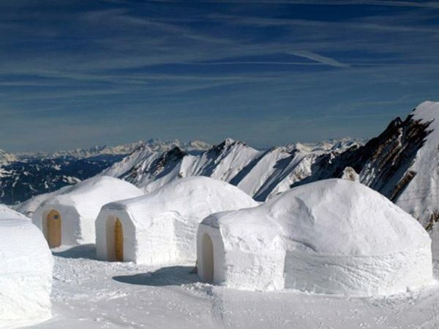
Eskimo /ˈɛskɪməʊ/
Inuit/ˈɪnjʊɪt,ˈɪnʊɪt/

Slide 10

disappear/dɪsəˈpɪə/ vanish
(nestati, nestajanje)

Slide 11
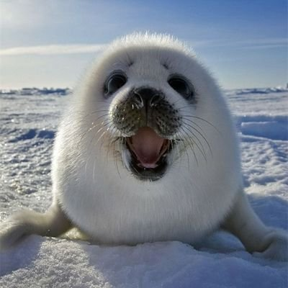
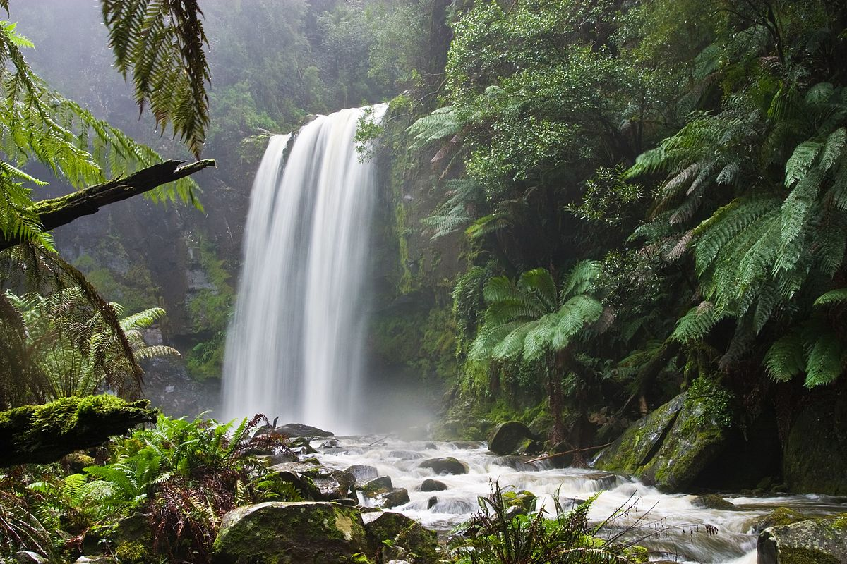
environment= nature, habitat (=životna sredina, okolina)
/ɛnˈvʌɪrənm(ə)nt/ environmental = ekološki
seal /siːl/

Slide 12
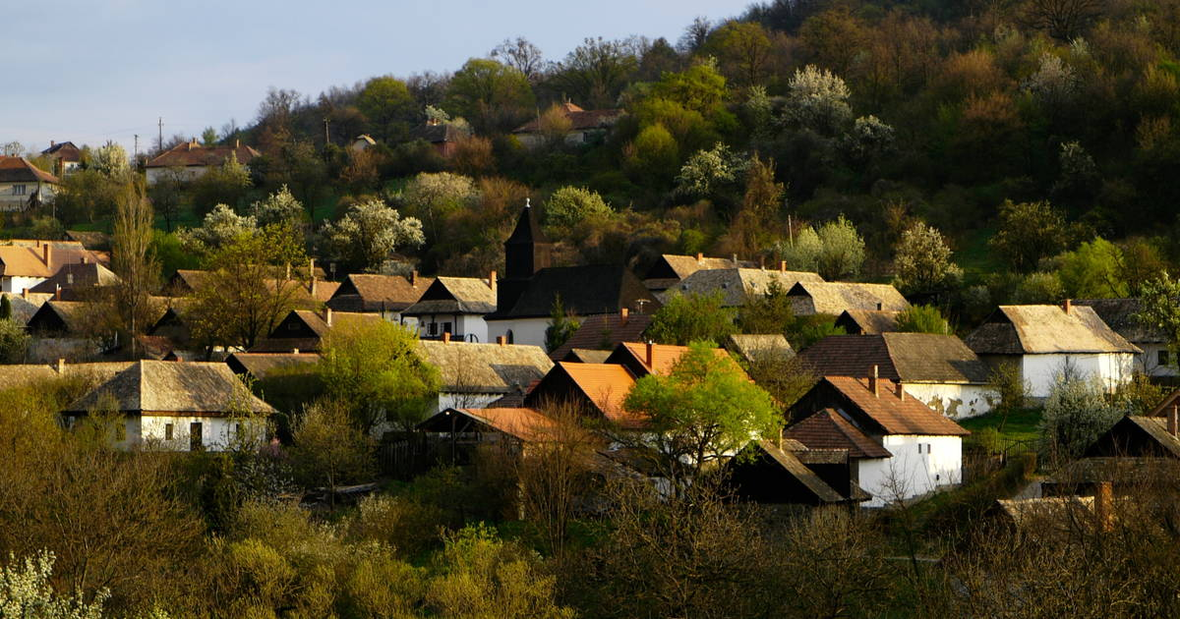
village /ˈvɪlɪdʒ/ countryside

Slide 13
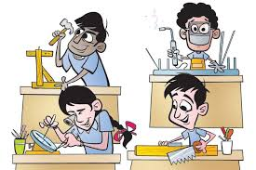
skills - veštine the ability to do something well; expertise
communication skills
writing skills
language skills
listening skills
people skills

Slide 14
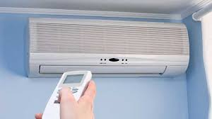
Air conditioner!
It is not air –condition !!! klima uređaj

Slide 15
2b. page 68, Complete the headings in the article with these words. There is one word that you do not need.
CLIMATE ECONOMICS GOVERNMENT TECHONOLOGY
Changes because of _______________
Changes because of _______________
3. Changes because of _______________

Slide 16
2b. page 68, Complete the headings in the article with these words. There is one word that you do not need.
CLIMATE ECONOMICS GOVERNMENT TECHONOLOGY
Changes because of _______________
Changes because of _______________
3. Changes because of _______________

Slide 17
2b. page 68, answers
CLIMATE ECONOMICS GOVERNMENT TECHONOLOGY
Changes because of TECHONOLOGY.
Changes because of GOVERNMENT.
3. Changes because of CLIMATE.

Slide 18
3. page 68, Read the article again. Who thinks the changes are positive and who thinks they are negative?Write P (positive) N (negative)
1 Han Li
2 Bo Li
3 Farida
4 Tootega

Slide 19
answers
1 Han Li P
2 Bo Li P
3 Farida P
4 Tootega N

Slide 20
4. page 68, Who says these things? Match the sentences with the names.
1. ‘Be a good boy and play with your sister’
2. ‘Go to Toronto, son. There’s no work here.’
3. ‘I need to buy some petrol’.
4. ‘I like school. I want to study medicine at university.
a) Tootega
b) Bo Li
c) Farida’s daughter
d) Farida
e) Han Li

Slide 21
4. page 68, answers
1. ‘Be a good boy and play with your sister’
2. ‘Go to Toronto, son. There’s no work here.’
3. ‘I need to buy some petrol’.
4. ‘I like school. I want to study medicine at university.
a) Tootega
b) Bo Li
c) Farida’s daughter
d) Farida
e) Han Li

Slide 22
Grammar
COULD, COULDN’T, page 69

Slide 23
5a page 69, Complete these sentences from the article with the correct verb. Which sentences are about the present and which are about the past?
1. I can _________ a car.
2. I could ________ on the ice for days.
3. They couldn’t ________ to other countries.
4. Our children can’t __________ the old skills.

Slide 24
5a page, answers
1. I can DRIVE a car.
2. I could TRAVEL on the ice for days.
3. They couldn’t TRAVEL to other countries.
4. Our children can’t LEARN the old skills.

Slide 25
5b page 69, Find more examples of could and couldn’t in the text. Which form of the main verb do we use after could couldn’t?
a) to+infinitive (e.g. to read)
b) Present Simple Tense (e.g. read/reads)
c) infinitive without to (bare infinitive, e.g. read)

Slide 26
5b page 69, answers
We use:
c) infinitive without to (bare infinitive, e.g. read)
examples:
Before, we couldn’t relax in the house during the hot summer.
I could find seals
People couldn’t listen to music or watch TV.
My grandfather could only ride a bicycle.

Slide 27
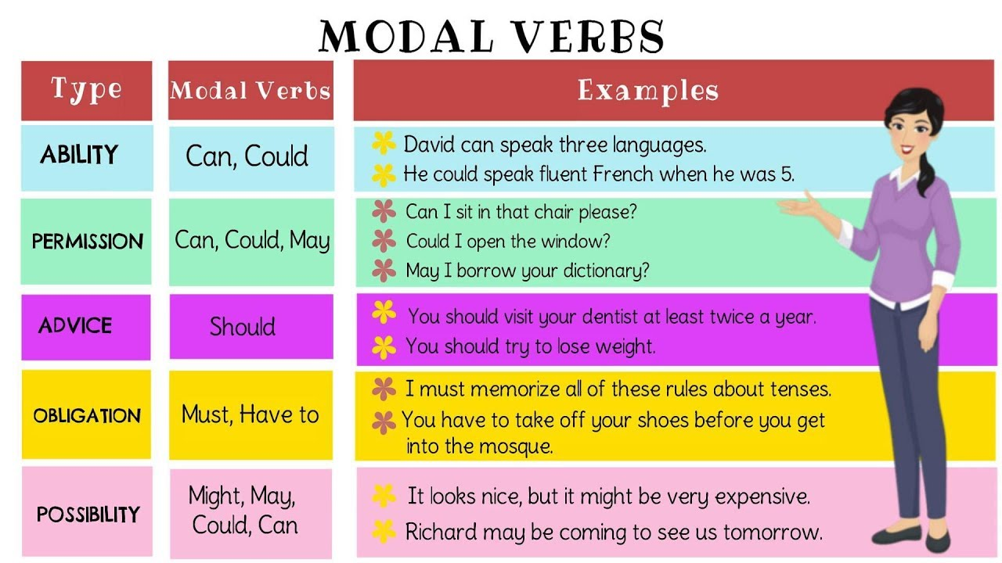
Modal verbs+bare infinitive

Slide 28
6. page 69, Complete the sentences with can, can’t, could or couldn’t
1. He _________ find seals on the ice when he was young.
2. We ______ take photos at the museum yesterday – you can’t take cameras with you.
3. We ______ fly to other countries today. Our grandparents______fly.
4. I _________ run far now, but I _______ run ten kilometres when I was younger.

Slide 29
6. page 69, answers
1. He COULD find seals on the ice when he was young.
2. We COULDN’T take photos at the museum yesterday – you can’t take cameras with you.
3. We CAN/CAN’T fly to other countries today. Our grandparents COULDN’T/COULD fly.
4. I CAN’T run far now, but I COULD run ten kilometres when I was younger.

Slide 30
7. page 69, Ask a partner what he/she could do at the ages of five, ten and 15. Use these ideas.
Cook
Drive
Ride a bicycle
Write
Speak a little English
Swim
Use a computer
When you were five, could you ride a bicycle?
- Yes, I could./No, I couldn’t.
WATCH!
https://www.youtube.com/watch?v=OVoyw0L0DCI

Slide 31

listening
Page 69

Slide 32
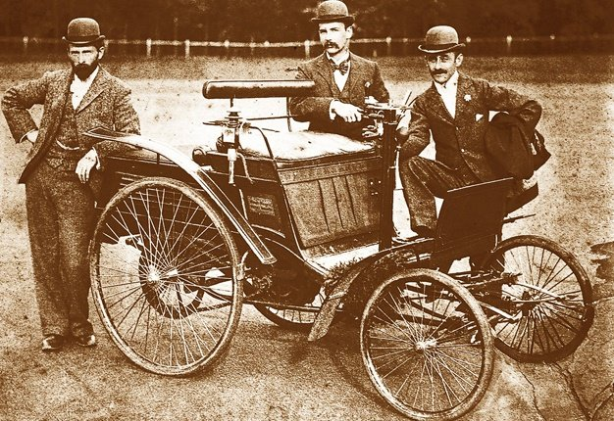
8. page 69,track 2.10 Listen to a short presentation by two students about technology and cultural changes.
1. What is the title of their talk?
2 Which four inventions do they talk about?

Slide 33
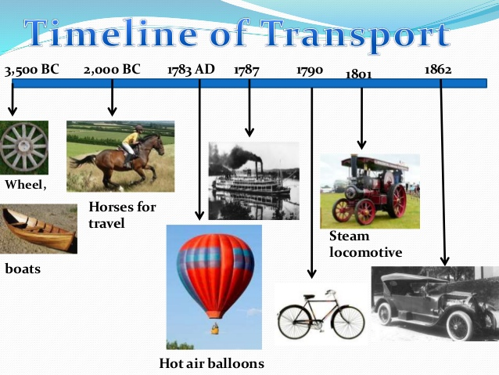
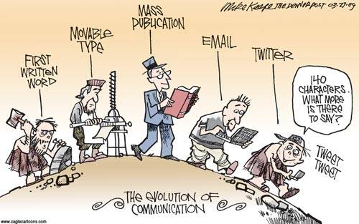
Technology
/tɛkˈnɒlədʒi/

Slide 34
9a page 69, Track 2.11 Listen again to Marjorie’s part of the talk. Tick the things she says.
1. People can travel longer distances.
2. People can live and work in different places.
3. Travelling is more comfortable.
4. Modern transport is not safe sometimes.
5. Modern transport is bad for the environment.

Slide 35
9a page 69, Track 2.11 Listen again to Marjorie’s part of the talk. Tick the things she says.
1. People can travel longer distances.√
2. People can live and work in different places.√
3. Travelling is more comfortable.
4. Modern transport is not safe sometimes.√
5. Modern transport is bad for the environment.√

Slide 36
9b page 69, Track 2.12, Listen again to Nathan’s part of the talk and answer the questions.
1. What can we do because of television and the Internet?
2. What is the negative point about these things?
3. Do you agree with him?

Slide 37
9b page 69 Track 2.12. answers
1. We can see the news and shows from all round the world. We can write and chat with people from all over the world. We can find anything we want in seconds.
2. The negative point is that we spend more time talking to strangers rather than friends and family.
3. Yes, I do. I agree with him because of…
No, I don-t. I disagree because of…

Slide 38
vocabulary
VERBS+PREPOSITIONS

Slide 39
10a page 69, Listen to the whole presentation for these verbs, and underline the object you hear. Check your ideas with track 2.10, or go to page 151, Transcript.
1. to focus on the topic/technology/an idea
2. to go on a business trip/a tour/ a holiday
3. to read about places/subjects/people
4. to move onto the next point/ another topic/the next type of technology
5. to stay in one place/ our house/a group
6. to chat to friends/people/colleagues
7. to talk to strangers/someone/your teacher

Slide 40
10a page 69, answers
1. to focus on the topic/technology/an idea
2. to go on a business trip/a tour/ a holiday
3. to read about places/subjects/people
4. to move onto the next point/ another topic/the next type of technology
5. to stay in one place/ our house/a group
6. to chat to friends/people/colleagues
7. to talk to strangers/someone/your teacher

Slide 41
10b page 69, Complete these sentences with a verb and preposition from Exercise 10a
1. This essay __________ _________ religion and cultural changes.
2. I’m ________ _________ the Mayan civilisation.
3. Before I __________ _________the next point, I want to say...
4. Do you _________ __________ strangers on the Internet?
5. We usually _______ _________ holiday in August.
6. We _________ __________ the garden all day in summer.
7. I _______ ________ my friends on the phone every day.

Slide 42
10b, page 69, answers
1. This essay IS ABOUT religion and cultural changes.
2. I’m INTERESTED IN the Mayan civilisation.
3. Before I MOVE ONTO the next point, I want to say...
4. Do you TALK TO strangers on the Internet?
5. We usually GO ON a holiday in August.
6. We STAY IN the garden all day in summer.
7. I CHAT TO my friends on the phone every day.

Slide 43
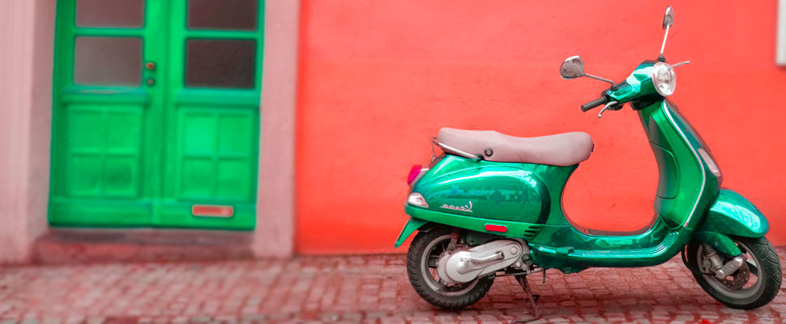
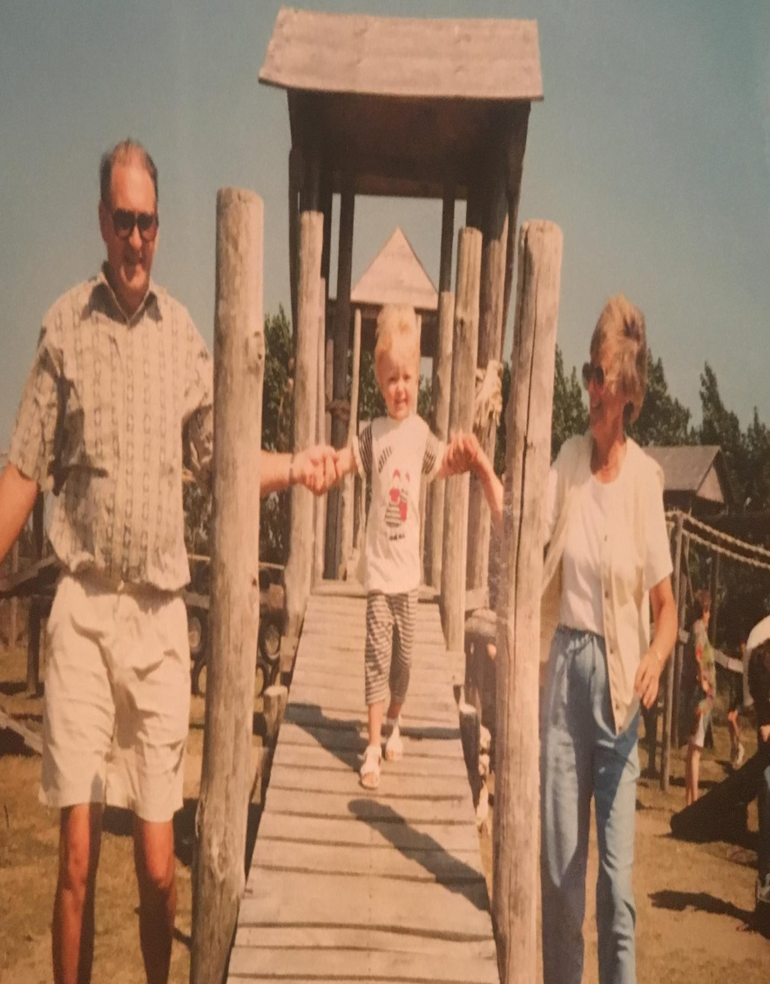
speaking
Page 69

Slide 44
11. page 69, Compare your way of life now with your grandparents’ way of life when they were young.
e.g. My grandparents could travel to London, UK without a visa, but I can’t.
My grandparents couldn’t ride an electric scooter and I can.

Slide 45
HW, pp 136 - 137
1. Read about the modal verb could Language Reference, p.136.
2. Do exercise G2, 4, page 137

Slide 46
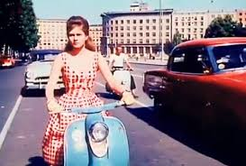
Thank you for your Attention!

