Slide 1
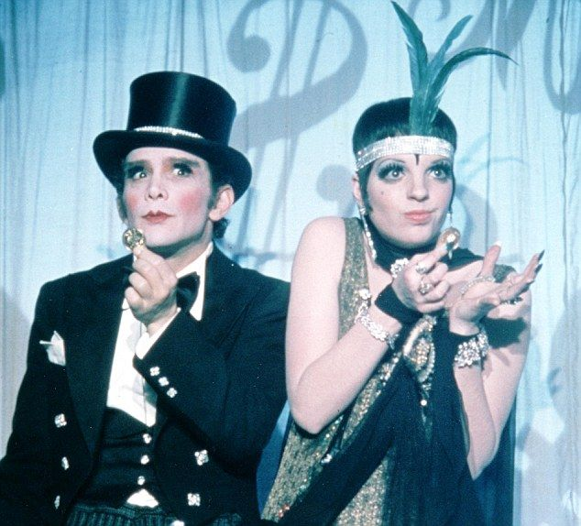
SCENARIO
In my Opinion

Slide 2
HW
Language focus pages 140-141
1. I have to phone a friend. Can I use your phone?
2. The taxi is here. We ______ leave now.
3. It’s OK. You _______ pay for the meal. We can pay.
4. It’s very busy now so he _______ work long hours.
5. A birthday present ________ be expensive. It can be special and cost very little.
6. ______ we _________ decide now? I’d like time to think about the problem.
7. There isn’t a lesson today so we_______ go to school.
8. I don’t like Bill. ________ you _________ invite him?
9. How much interest _______ she ________ pay on the loan?

Slide 3
HW answers
1. I have to phone a friend. Can I use your phone?
2. The taxi is here. We HAVE TO leave now.
3. It’s OK. You DON’T HAVE TO pay for the meal. We can pay.
4. It’s very busy now so he HAS TO work long hours.
5. A birthday present HAS TO be expensive. It can be special and cost very little.
6. DO we HAVE TO decide now? I’d like time to think about the problem.
7. There isn’t a lesson today so we HAVE TO go to school.
8. I don’t like Bill. DO you HAVE TO invite him?
9. How much interest DOES she HAVE TO pay on the loan?

Slide 4
HW
V1, 2, 3 6. Complete sentences 1-9 with these pairs
know/number
pay/credit
lend/dollars
afford/insurance
e) write/cheque
f) charge/ interest
g) earn/money
h) get/ cash
i) get/loan
1. I need to get some cash from the cashpoint.
2. They _____ more ______ than me but I do the same job.
3. Can I ______ by _______ card?
4. Can we ______ a _______ from the bank for a new car?
5. Can you _____ me ten _______ ? I left my wallet at home.
6. The banks ______ about 20 percent ______ on overdrafts.
7. I can’t _________ house ________. It’s too expensive.
8. Do you ___________ your PIN ___________ ?
9. You __________ a ____________ for £ 200 and send it to us.

Slide 5
HW
V1, 2, 3 6. Complete sentences 1-9 with these pairs
know/number
pay/credit
lend/dollars
afford/insurance
e) write/cheque
f) charge/ interest
g) earn/money
h) get/ cash
i) get/loan
1. I need to get some cash from the cashpoint.
2. They EARN more MONEY than me but I do the same job.
3. Can I PAY by CREDIT card?
4. Can we GET a LOAN from the bank for a new car?
5. Can you LEND me ten DOLLARS? I left my wallet at home.
6. The banks CHARGE about 20 percent INTEREST on overdrafts.
7. I can’t AFFORD house INSURANCE. It’s too expensive.
8. Do you KNOW your PIN NUMBER ?
9. You WRITE a CHEQUE for £ 200 and send it to us.

Slide 6
preparation
Unit 10.3. page 88

Slide 7
1. page 88, Do you agree or disagree with these quotes? How true, partly true or not at all true?
1. “Money can buy you happiness” – Anon
2. “Time is more valuable than money”. Jim Rohn
3. “You can be young without money, but you can’t be old without it”. Tennesee Williams
4. “Money makes the world go round”. Kander and Ebb, from the musical Cabaret

Slide 8
2a, page 88, Track 2.31, transcript page 154,
A bank is doing a survey about money. Listen to an interview.
1. What is the relationship between David and Katie, do you think?
2. Which person is more careful with their money, David or Katie?
3. Which person are you most similar to?

Slide 9
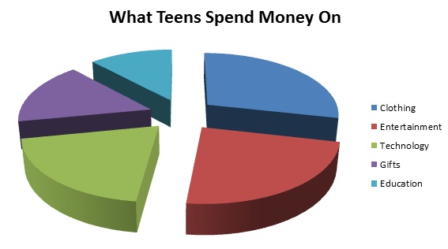
Track 2.31. Vocabulary
I’m working for a bank vs. I work for a bank
to do a survey or to conduct a survey
survey /ˈsɜː.veɪ/= interview, anketa
We are rather busy = We are very busy
rather /ˈrɑːðə/= prilično
borrow, save, pay back, charity
Things can get very difficult, can’t they?
I guess so = I believe so, I think so.
immediately, adv. /ɪˈmiːdɪətli/ = right away, istog trenutka, odmah

Slide 10
2b page 88, Listen to the interview again. Are these sentences true or false?
1. David thinks that you can spend too much money with a credit card.
2. Katie likes to buy things immediately.
Katie never saves any money.
David says he is saving money for a holiday.
David thinks that borrowing money from friends is a very bad idea.
Katie thinks that it is a good idea to borrow a lot of money from friends.
Katie never gives money to charity.
David gives money to charity every month.

Slide 11
KEY LANGUAGE
asking for and giving opinions

Slide 12
3. page 88, track 2.31, transcript page 154,
Complete the questions and answers from the interview. Listen and check.
1. – What’s your opinion about ________ credit cards? – Well, personally, I ______ that they’re a bad idea. – Well, in my ________, they’re great.
2. Do you _________ _________ saving money is important? – Erm, yes, I suppose _______ _______, ... – Oh yes, _________.
3 – Do you think that borrowing money from friends is a ___________ __________ ? – Oh, no, not at _______. – Well, I’m not _________.
4. Do you agree that people ________ ______ money to charity? – No, not at all. I _______ that the government should look after everyone. – Well, yes, I _________.

Slide 13
3. track 2.31, answers
1. – What’s your opinion about HAVING credit cards? – Well, personally, I THINK that they’re a bad idea. – Well, in my OPINION, they’re great.
2. Do you THINK THAT saving money is important? – Erm, yes, I suppose IT IS, ... – Oh yes, DEFINITELY.
3 – Do you think that borrowing money from friends is a GOOD IDEA? – Oh, no, not at ALL. – Well, I’m not SURE.
4. Do you agree that people SHOULD GIVE money to charity? – No, not at all. I BELIEVE that the government should look after everyone. – Well, yes, I DO.

Slide 14
5. page 89, work with your colleagues.
Ask and answer questions in Exercise 3.
Student A: Do you think that saving money is important?
Student B: Oh yes, definitely. And do you think that it’s important?
Student A: No, not at all. I think that you should spend money while you can!

Slide 15
6. page 89, in exercise 3, there are three different types of questions. In each pair of questions below, complete the second question so that it means the same as the first.
1a Do you think that saving money is important?
1b Do you agree that people should _______ ______
2a Do you think that borrowing money from friends is a good idea?
2b What’s your opinion ______ _______ ______ ______?
3a Do you agree that people should give money to charity?
3b Do you think that ______ _______ ______ ______ _______ important?
4a Do you agree that students should have part-time jobs?
4b What’s your opinion about students having _______ ________?
5a What’s your opinion about children credit cards?
5b Do you think that children ______ _______ ______ ______ a good idea?

Slide 16
6. answers
1a Do you think that saving money is important?
1b Do you agree that people should SAVE MONEY
2a Do you think that borrowing money from friends is a good idea?
2b What’s your opinion ABOUT BORROWING MONEY FROM FRIENDS?
3a Do you agree that people should give money to charity?
3bDo you think that GIVING MONEY TO CHARITY IS important?
4a Do you agree that students should have part-time jobs?
4b What’s your opinion about students having PART-TIME JOBS?
5a What’s your opinion about children credit cards?
5b Do you think that children HAVING CREDIT CARDS IS a good idea?

Slide 17
task
expressing thoughts and opinions

Slide 18
7. page 89, Work with your colleagues and make a questionnaire about money.
Choose from these ideas in Exercise 6 and complete the questions in the questionnaire.
give money to homeless people
borrow money from a computer
students pay for university
directors earn a very high salary
buy expensive clothes
parents give children pocket money
children work
save money for retirement

Slide 19
Money Questionnaire
Notes
________________________________________________________________________________________________________________________
Section A
What’s your opinion about _________?
What’s your opinion about _________?
Yes No Not sure/
Don’t know
Section B (tick one)
3. Do you think that
_______ important?
4. Do you think that
_______ ia good idea?
5. Do you agree that ____________?
6. Do you agree that ____________?

Slide 20
8a page 89 Interview as many students as you can using the Money Questionnaire
 | OTHER USEFUL PHRASES I think that... I don’t know. In my opinion, ... Yes, definitely. Personally, I think ... Yes, I suppose it is. I’m not sure. No, not at all.

Slide 21
8b page 89, Share your notes
Ten students think we should save money for our retirement. Three students think that it isn’t necessary...

Slide 22
9. page 89, Write a short parapgraph about the results of your survey. You can use tables or charts to show some of the information. Show your results to other students.
Sample answer
Fifteen students think that giving money to homeless people is important. Five students think that it isn’t a good idea and ten students aren’t sure.

Slide 23
HW
Language Reference and Extra Practice
Read about the KEY LANGUAGE: Asking and giving opinions in page 140
Do exercise KL 5 in page 141

Slide 24
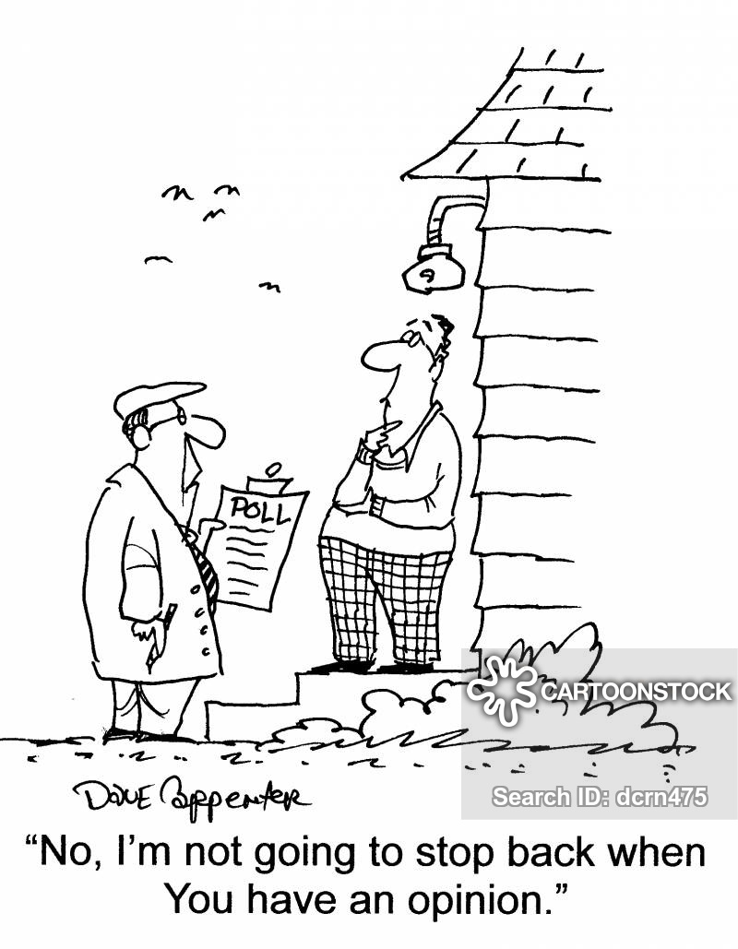
Thank you for your Attention

