Slide 1
STUDY AND WRITING SKILLS
LEARNING NEW WORDS

Slide 2
1. page 72, Managing new vocabulary: How do you record and learn new vocabulary? Are these sentences true for you?
1. I have a special vocabulary notebook.
2. I read my vocabulary notes every day.
3. I learn ten new words every day.
4. I test my memory of new words every week.
5. I make grammar and pronunciation notes
about new words, e.g. beåutiful (adj.)
6. I write translation for words.
7. I write English definition for words, e.g. wonderful – very good.

Slide 3
2. page 72, Working with vocabulary: The best way to learn new vocabulary is to do thing with the words. Try these exercises. Use your dictionary. After each, check your ideas with a colleague.
a. Put words into groups by their meaning: Sort these words into groups – materials and shapes.
circle leather metal plastic rectangle
square wood
Can you add more words to these groups?

Slide 4
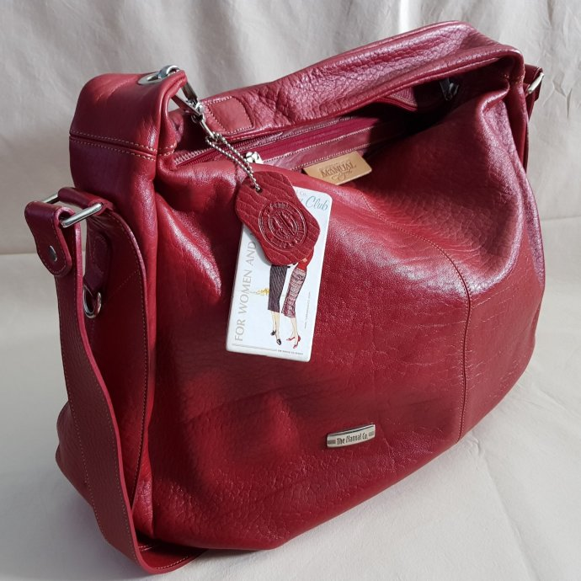
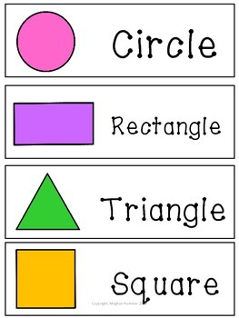
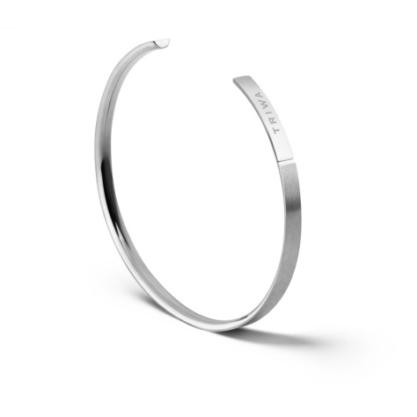
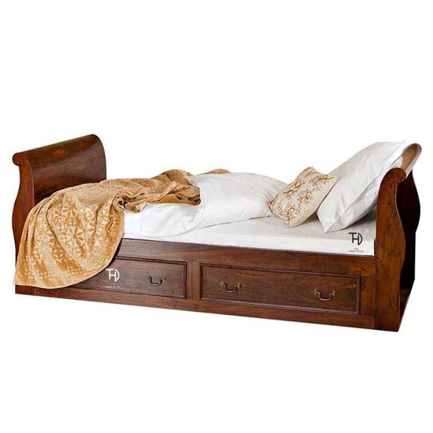
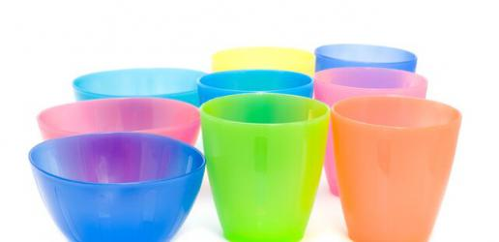

Slide 5
2. page 72, Working with vocabulary: The best way to learn new vocabulary is to do thing with the words. Try these exercises. Use your dictionary. After each, check your ideas with a colleague.
b. Do some word building
Look at these dictionary extracts.
Circle is the noun, what is the adjective?
cir•cle UK /ˈsɜː.kəl/ US/ˈsɝː.kəl/, noun
1 a round flat shape like letter O, or a group of people or things arranged in this shape: Draw a circle on this piece of paper|We sat in a circle round the table. see picture at

Slide 6
2. page 72, Working with vocabulary: The best way to learn new vocabulary is to do thing with the words. Try these exercises. Use your dictionary. After each, check your ideas with a colleague.
cir•cuit UK /ˈsɜː.kɪt/ US /ˈsɝː.kɪt/ noun 1. a track where people race cars, bicycle etc. The racing cars go three times round the circuit. 2. the complete circle that an electric current flows around: an electrical circuit.
circular 3. UK /ˈsɜː.kjə.lər/ US /ˈsɝː.kjə.lɚ/ adjective
shaped like a circle: a circular table.

Slide 7
2. page 72, Working with vocabulary: The best way to learn new vocabulary is to do thing with the words. Try these exercises. Use your dictionary. After each, check your ideas with a colleague.
What are the adjectives for these nouns? Use your dictionary.
rectangle square wood
Complete the table with these words.
long widen width lengthen weight
Noun | Verb | Adjective
1 | 2 | wide
length | 3 | 4
5 | weigh

Slide 8
2. page 72, Working with vocabulary: The best way to learn new vocabulary is to do thing with the words. Try these exercises. Use your dictionary. After each, check your ideas with a colleague.
c Make mind maps Add more words to this mind map. Can you add more than four?
Colours
red
black
purple

Slide 9
2. page 72, Working with vocabulary: The best way to learn new vocabulary is to do thing with the words. Try these exercises. Use your dictionary. After each, check your ideas with a colleague.
d. Find opposites for words. Match the opposite pairs in this group of adjectives.
heavy light long narrow short wide

Slide 10
2. page 72, Working with vocabulary: The best way to learn new vocabulary is to do thing with the words. Try these exercises. Use your dictionary. After each, check your ideas with a colleague.
e Use the words Make sentences with the new words.
circular - A coin is circular
plastic – I use plastic bags from the supermarket.

Slide 11
Rečnici, priručnici i referentna literatura
Možete koristiti jednojezične, dvojezične i višejezične rečnike, na internetu ili kao publikacije.
englesko-engleski rečnik – reč u rečniku je data na engleskom jeziku (entry word) sa pojašnjenjem i/ili sinonimom na engleskom, po redosledu engleskog alfabeta (a, b, c...)
englesko-srpski rečnik – reč u rečniku na engleskom sa pojašnjenjem/terminom na srpskom jeziku, po redosledu engleskog alfabeta (a, b, c...)
srpsko-engleski rečnik – reč u rečniku je data na srpskom jeziku sa pojašnjenjem/terminom na engleskom jeziku, po azbučnom ili abecednom redosledu
srpsko-francusko-englesko-italijansko-španski rečnik
(višejezični rečnik)

Slide 12
Rečnici, priručnici i referentna literatura
Na primer ukoliko ukucate reč CASTLE
https://dictionary.cambridge.org/dictionary/english/castle
dobićete osim objašnjenja na engleskom:
a) izgovor na dijalektu British English i American English
b) informaciju o vrsti reči – n. = NOUN imenica
c) kakva je imenica brojiva [C] ili nebrojiva [U]
d) drugo značenje te reči ako postoji
e) sinonime i antonime
f) primere
g) itd. (u zavisnosti od vrste reči, ENTRY WORD može imati više informacija, što je više informacija to je bolji rečnik)

Slide 13
Rečnici, priručnici i referentna literatura
Takođe postoji rečnik sinonima (reči sličnog značenja) koje možete potražiti npr. ovde za entry word GREAT:
https://www.thesaurus.com/browse/great
tu možete videti i sinonime za sva značenja te reči
kao i antonime (reči suprotnog značenja)

Slide 14
Rečnici, priručnici i referentna literatura
Ukoliko želite da proverite koje se vrste reči mogu kombinovati sa nekom rečju, otvorite rečnik kolokacija.
https://www.freecollocation.com/search?word=great
U engleskom jeziku, mnoge kombinacije različitih vrsta reči su vrlo striktne, možemo koristiti samo određene glagole sa određenim imenicama npr.
TO THROW A PARTY (organizovati žurku),
TO PAY A VISIT (posetiti, navratiti)

Slide 15
3 page 72, Make sentences with five of the new words in this unit. Compare with your colleagues.
Sample answers
Nikola Tesla is the famous inventor.
We can enter the museum free of charge.
I’m waiting for the laboratory results.
Stands sell decorations, sweets and gloves for Christmas and New Year.
I ‘m texting you now.

Slide 16
4. page 72, Which of these exercises do you like? Which do you think are more useful for you?
Sample answers
I prefer the practice with opposite words.
I dislike learning irregular verbs.

Slide 17
writing skills
A description of objects

Slide 18
5 page 72, Look at the photos A-C. These three objects are for sale on the Internet auction site.
Which sections can you find them in
Antiques: Asia, Antiques: Games,
(antikviteti)
Collectables: North America
(kolekcionarski predmeti)

Slide 19

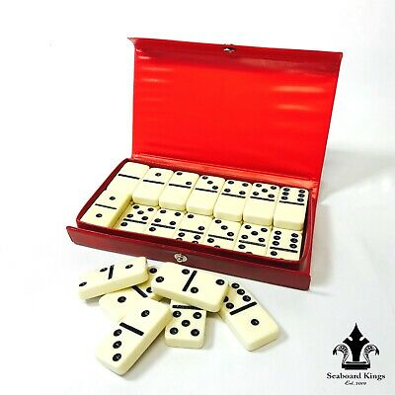



6a page, Match the description with one of photos A-C.
Photograph album
This item is very 1 ________ . It is a 2 ________ photograph album from Japan – when you turn the pages, you hear a beautiful song! It is about 50 years old. It is 3 ______ (45 cm long, 20 cm wide) and it is in good condition. The album has got ten pages. These pages are now 4 _________ with age. On the front of the album there’s a wonderful picture. It is of a ______ temple and Mount Fuji. Thanks for looking and good luck!

Slide 20
https://www.quibids.com/en/landing/?nc=1
bid UK /bɪd/ US /bɪd/
[ I or T ] present participle bidding | past tense bid | past participle bid to offer a particular amount of money for something that is for sale and compete against other people to buy it, especially at a public sale of goods or property:
tender
synonym – offer, proposal

Slide 21
6b page 72, Put these words in the correct places in the description
musical red rectangular unusual yellow
This item is very 1 ________ . It is a 2 ________ photograph album from Japan – when you turn the pages, you hear a beautiful song! It is about 50 years old. It is 3 ______ (45 cm long, 20 cm wide) and it is in good condition. The album has got ten pages. These pages are now 4 _________ with age. On the front of the album there’s a wonderful picture. It is of a ______ temple and Mount Fuji. Thanks for looking and good luck!

Slide 22
7. page 72, it, this, these
In the first sentence of the description, the words This item refer to the name of the item – photograph album.
What do the other underlined words refer to?
Compare your ideas with a colleague.

Slide 23
8. page 73, Use the words in the box to fill the gaps.
It (x5) these they this (x2)
Metal Coca-Cola sign
1. _________item is unusual. 2. _________ is a Coca-Cola sign from the 1950s. The metal sign is circular and 3. _________ is 30cm wide. 4. __________ weighs one kilogram. 5 __________ is red and 6. ________ has a great picture of the famous Coca-Cola bottle. picture of the famous Coca-Cola bottle. 7. _________ picture is in good condition but there are some scratches on the side of the sign. 8. ___________ scratches are very small and 9. ____________ are not a problem. Hope you like it!

Slide 24
9a page 73, Complete the first sentence of the description of the object in photo A. Use the notes below.
This is a lovely item. It is a set of dominoes from 1. ______________ . It is 2. _______________ years old and it weighs ____________________kilogram.
Item: set of dominoes
Country: China Age: 90 years
Weight of set: 1kg
Box:
Material: wood Colour: red
Picture: some flowers Shape: square
Width: 20 cm
Condition: picture – excellent; box – good
Dominoes:
Number: 28 Material: plastic
Colour: white (black spots)
Shape: rectangular Length: 4cm
Width: 2cm
Condition: very good

Slide 25
9b page 73, Work with your colleague. One of you writes the description of the box. The other writes the description of the dominoes. Use the information above. Read your partner’s work.
- The wooden box ...
- In the box, there are 28 ...

Slide 26
10. page 73, What were the final prices of these objects, do you think? Match a price with each object. Would you like to buy any of these objects?
$ 45 $ 350 $ 75

Slide 27
2. page 72, answers
a. Put words into groups by their meaning: Sort these words into groups – materials and shapes.
materials: leather metal plastic wood
shapes: square circle rectangle
Can you add more words to these groups?
materials: silk, cotton (pamuk)
shapes: cone (kupa), pyramid

Slide 28
2. page 72, answers
What are the adjectives for these nouns? Use your dictionary.
rectangular square wooden
pravougaoni kvadratni drveni
Complete the table with these words.
long widen width lengthen weight
Noun | Verb | Adjective
1. width | 2. widen | wide
length | 3. lengthen | 4. long
5. weight | weigh

Slide 29
2. page 72, sample answers
c Make mind maps Add more words to this mind map. Can you add more than four?
Colours
red
black
TURQUOISE
purple
ORANGE
WHITE
NAVY BLUE

Slide 30
2. page 72, answers.
d. Find opposites for words. Match the opposite pairs in this group of adjectives.
heavy light
long short
narrow wide

Slide 31
6a page, Match the description with one of photos A-C.
Photograph album PICTURE B
This item is very 1 ________ . It is a 2 ________ photograph album from Japan – when you turn the pages, you hear a beautiful song! It is about 50 years old. It is 3 ______ (45 cm long, 20 cm wide) and it is in good condition. The album has got ten pages. These pages are now 4 _________ with age. On the front of the album there’s a wonderful picture. It is of a ______ temple and Mount Fuji. Thanks for looking and good luck!

Slide 32
6b page 72, answers
musical red rectangular unusual yellow
This item is very 1 UNUSUAL . It is a 2 RECTANGULAR photograph album from Japan – when you turn the pages, you hear a beautiful song! It is about 50 years old. It is 3 RED (45 cm long, 20 cm wide) and it is in good condition. The album has got ten pages. These pages are now 4 YELLOW with age. On the front of the album there’s a wonderful picture. It is of a MUSICAL temple and Mount Fuji. Thanks for looking and good luck!

Slide 33
7. page 72, it, this, these
The other underlined words refer to THE PHOTOGRAPH ALBUM
These pages refer to the PAGES OF THE ALBUM.
It in the last sentence refers to the COVER PICTURE.

Slide 34
8. page 73, Use the words in the box to fill the gaps.
It (x5) these they this (x2)
Metal Coca-Cola sign
1. This item is unusual. 2. It is a Coca-Cola sign from the 1950s. The metal sign is circular and 3. It is 30cm wide. 4. It weighs one kilogram. 5 It is red and 6. it has a great picture of the famous Coca-Cola bottle. picture of the famous Coca-Cola bottle. 7. This picture is in good condition but there are some scratches on the side of the sign. 8. These scratches are very small and 9. they are not a problem. Hope you like it!

Slide 35
9a page 73, Complete the first sentence of the description of the object in photo A. Use the notes below.
This is a lovely item. It is a set of dominoes from 1. China . It is 2. 90 years old and it weighs one kilogram.
Item: set of dominoes
Country: China Age: 90 years
Weight of set: 1kg
Box:
Material: wood Colour: red
Picture: some flowers Shape: square
Width: 20 cm
Condition: picture – excellent; box – good
Dominoes:
Number: 28 Material: plastic
Colour: white (black spots)
Shape: rectangular Length: 4cm
Width: 2cm
Condition: very good

Slide 36
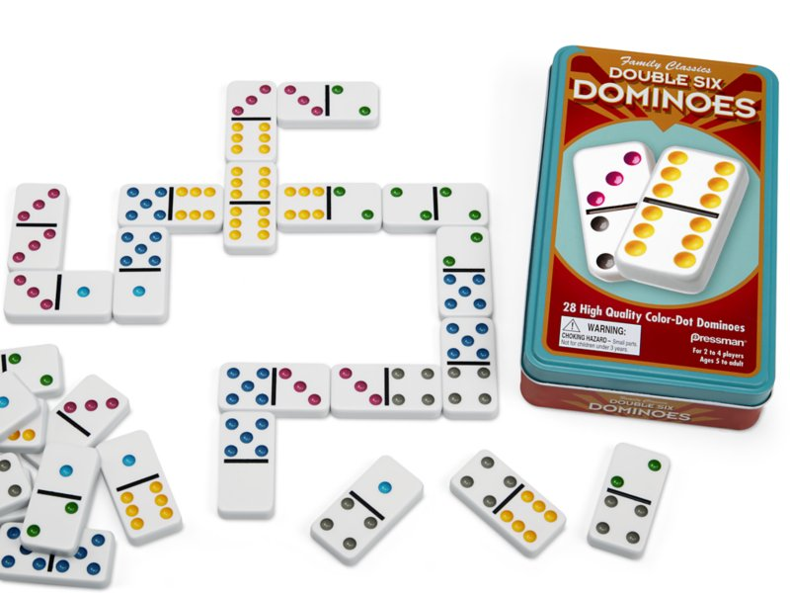
Thank you for your Attention!

