Slide 1

Review, pages
Units 7-9

Slide 2
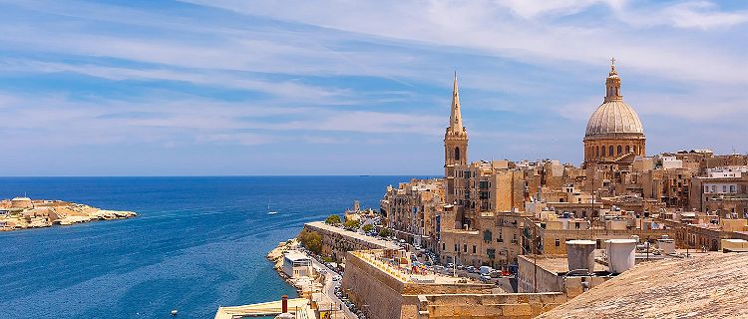
1. page 82, Write the verbs in the text in the Past Simple
MALTA
Today, Malta is a popular holiday island in the Mediterranean Sea, but it 1 ________ (not/be) always an island : thousands of years ago, there 2 ______ (be) a large desert between Europe and Africa, but at that time there 3 _______ (be) no people there. Between 7000 and 5000 BC, people 4 ________ (travel) across the sea from Sicily to Malta. They 5 _________ (build) the famous temples on the island.

Slide 3
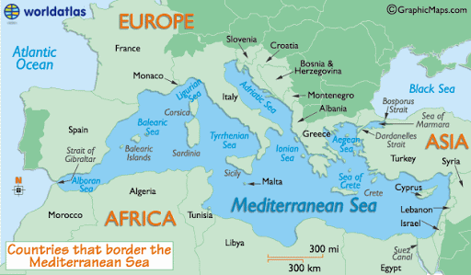
Mediterranean Sea

Slide 4
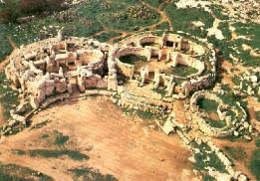
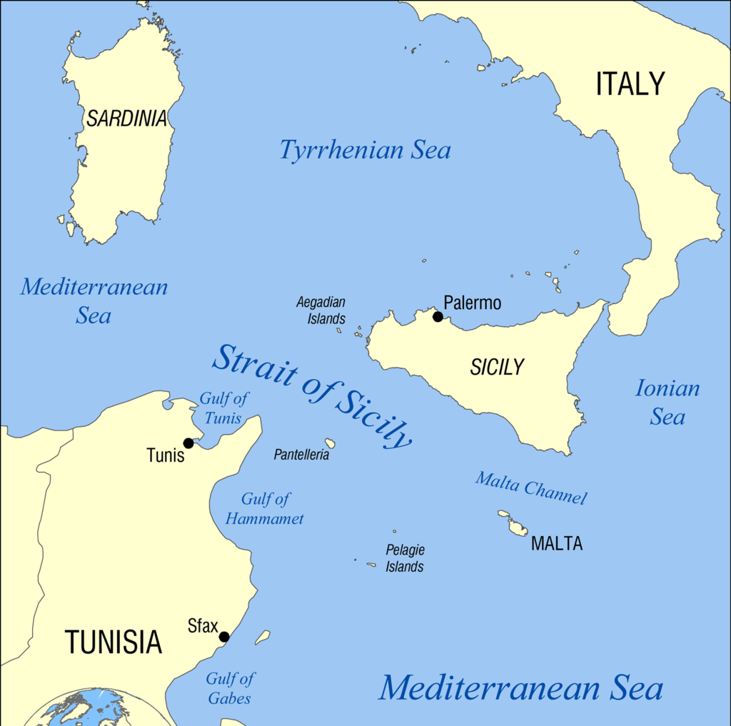
Malta/ˈmɔːl.tə/ is an island /ˈʌɪlənd/ near Sicily
temple/ˈtɛmp(ə)l/
hram

Slide 5
1. page 82, Write the verbs in the text in the Past Simple
MALTA
Today, Malta is a popular holiday island in the Mediterranean Sea, but it 1 WAS NOT always an island : thousands of years ago, there 2 WAS a large desert between Europe and Africa, but at that time there 3 WERE no people there. Between 7000 and 5000 BC, people 4 TRAVELLED across the sea from Sicily to Malta. They 5 BUILT the famous temples on the island.

Slide 6
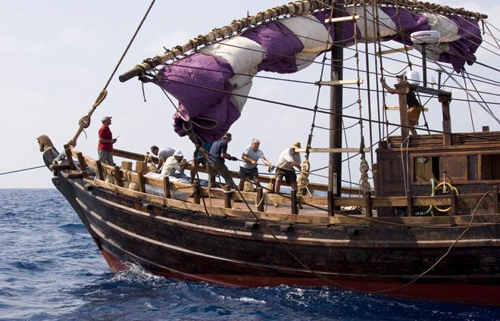
1. Write the verbs in the text in the Past Simple
MALTA
The Phoenicians 6 ________ (be) the other early visitors. They 7 ______ (use) the island’s natural harbours for their ships, and they also 8 _______ (trade) with other countries around the Mediterraean from the harbours. During the Roman Empire, Rome also 9 ________ (control) the island for seven centuries.

Slide 7
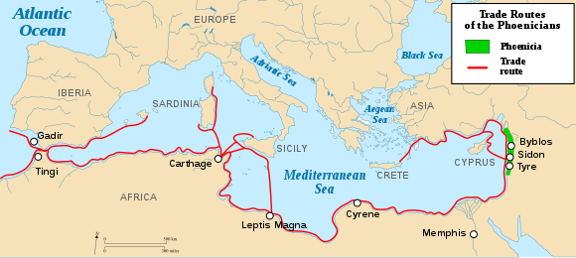
The Phoenicians /fəˈniːʃ(ə)n/ - Feničani

Slide 8
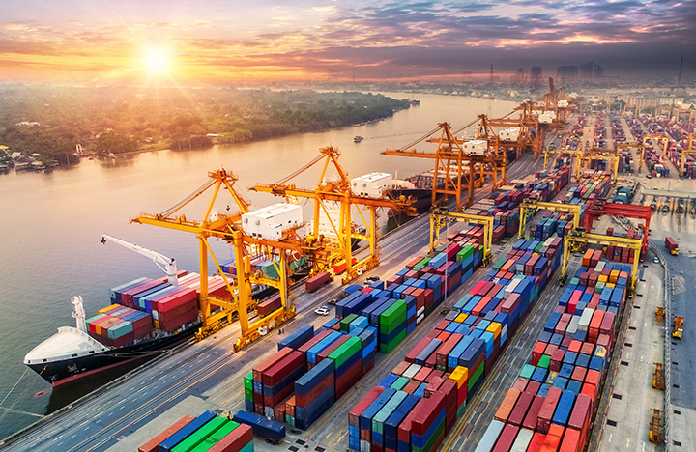
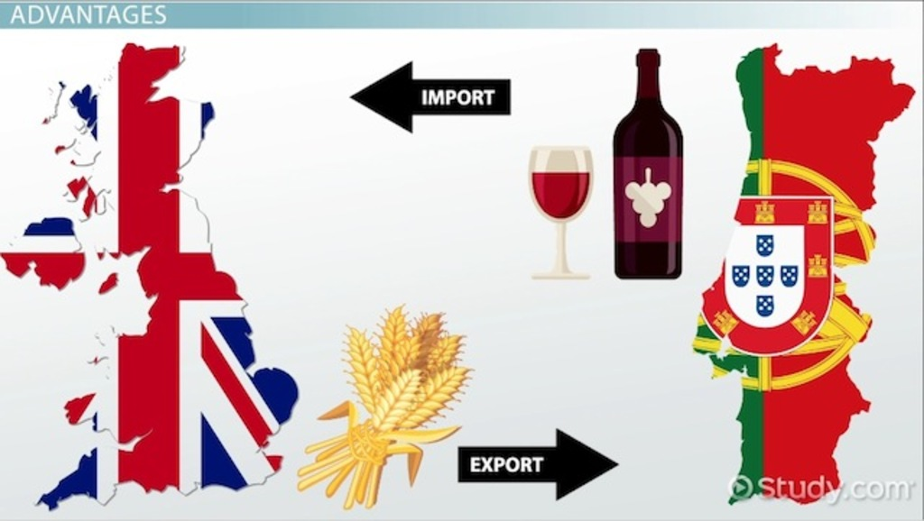
harbour /ˈhɑː.bər/– port (luka)
trade /treɪd/ trgovina

Slide 9
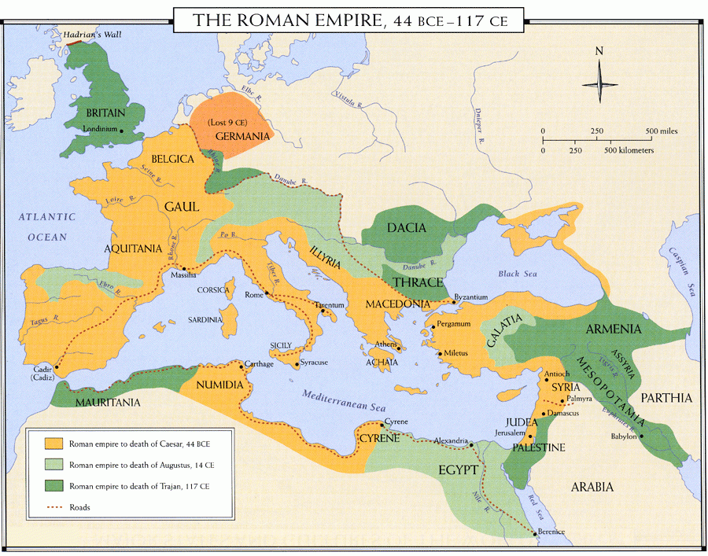
the Roman Empire /ˈem.paɪər/ Rimsko carstvo

Slide 10
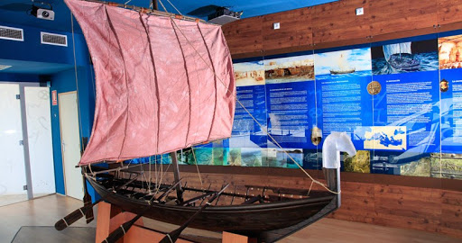
1. page 82, Write the verbs in the text in the Past Simple
MALTA
The Phoenicians 6 WERE the other early visitors. They 7 USED the island’s natural harbours for their ships, and they also 8 TRADED with other countries around the Mediterraean from the harbours. During the Roman Empire, Rome also 9 CONTROLLED the island for seven centuries.

Slide 11
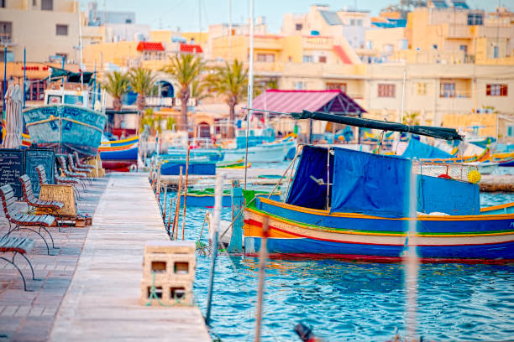
1. page 82, Write the verbs in the text in the Past Simple
MALTA
Like the Phoenicians, the Romans 10 ________ (not/could) control the islands any more and they 11 ______ (leave). Malta 12 _______ (have) many more visitors after that. The Arabs 13 ________ (live) there for two centuries and 14 ________ (give) the modern Maltese language many words .

Slide 12
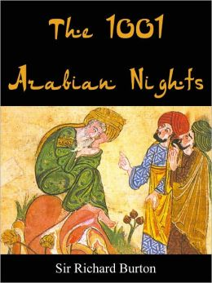
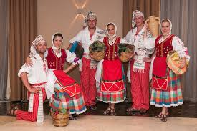
Arabs – Arabic (language) Arabian (land)
Malta - Maltese

Slide 13
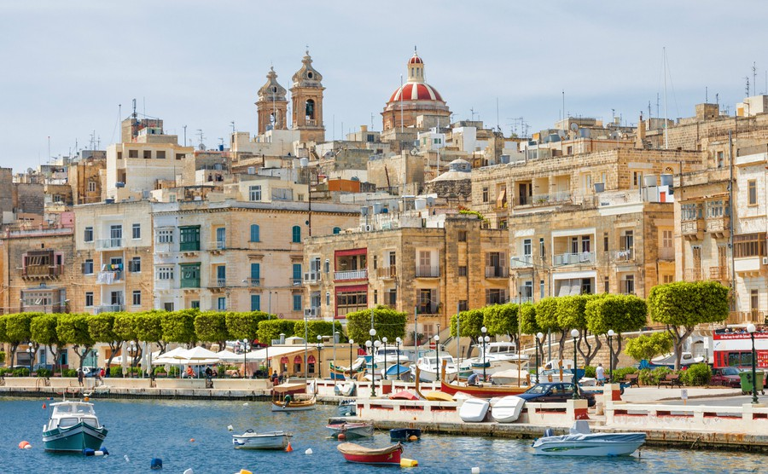
1. page 82, Write the verbs in the text in the Past Simple
MALTA
Like the Phoenicians, the Romans 10 COULDN’T control the islands any more and they 11 LEFT. Malta 12 HAD many more visitors after that. The Arabs 13 LIVED there for two centuries and 14 GAVE the modern Maltese language many words .

Slide 14
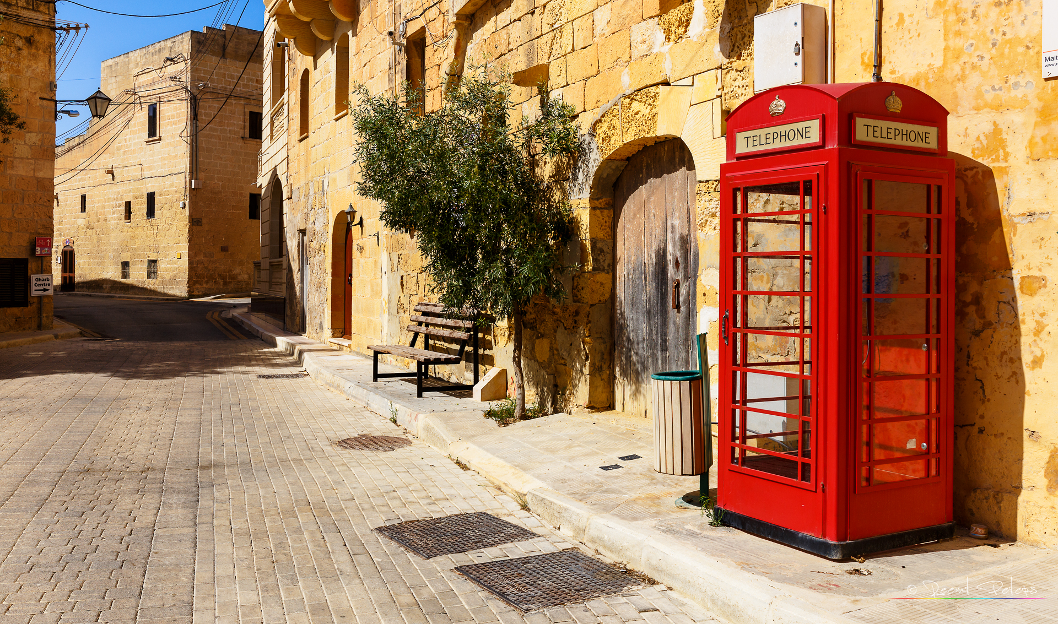
1. page 82, Write the verbs in the text in the Past Simple
MALTA
The Spanish, the French and the British all 15 ________ (come) and 16 ______ (leave) the island, and, finally, in 1964, Malta 17 _______ (become) independent and 18 ________ (can) make its own laws and protect its own people.

Slide 15
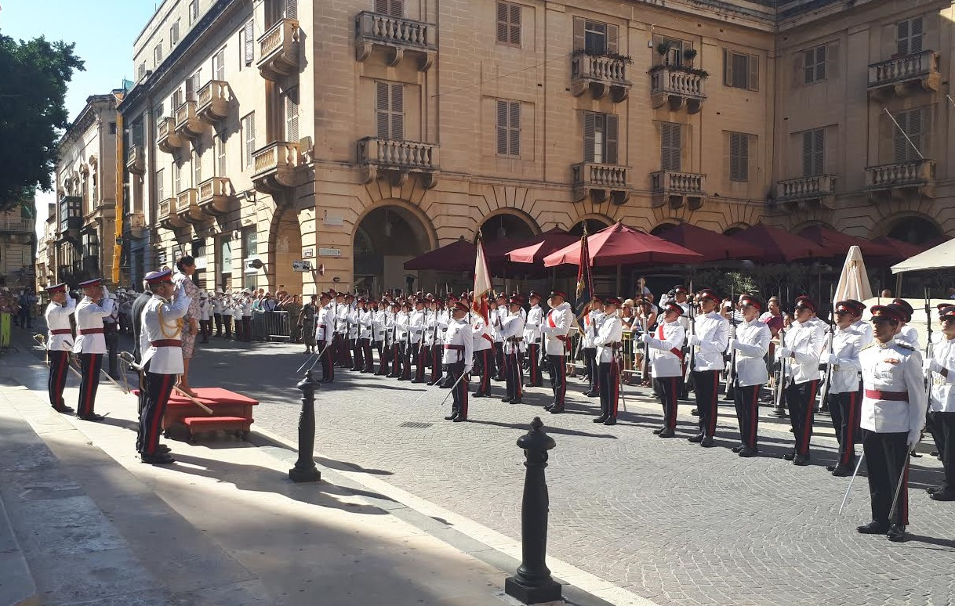
1. page 82, Write the verbs in the text in the Past Simple
MALTA
The Spanish, the French and the British all 15 CAME and 16 LEFT the island, and, finally, in 1964, Malta 17 BECAME independent and 18 COULD make its own laws and protect its own people.

Slide 16
2. page 82, Complete the questions about Malta in the Past Simple
1. Q: How did the first visitors _____________?
. A: They travelled by boat.
2. Q: Who __________________________________?
A: The Phoenicians.
3 Q: Why __________________________________?
A: For their ships and because they could trade with other countries.
4 Q: How long __________________________________?
A: For seven centuries.
5 Q: What_______________________________________?
A: Many words.
6 Q: When______________________________________?
A: In 1964.

Slide 17
2. page 82, Complete the questions about Malta in the Past Simple
1. Q: How did the first visitors TRAVEL?
. A: They travelled by boat.
2. Q: Who WERE THE OTHER EARLY VISITORS?
A: The Phoenicians.
3 Q: Why DID THEY TRAVEL?
A: For their ships and because they could trade with other countries.
4 Q: How long DID ROMANS CONTROL THE ISLAND?
A: For seven centuries.
5 Q: What DID THE ARABS GIVE MODERN MALTESE LANGUAGE?
A: Many words.
6 Q: When DID THEY BECOME AN INDEPENDENT COUNTRY?
A: In 1964.

Slide 18
3. page 82, Work with a partner. Ask and answer questions about the past, p.114.
Answer your colleague’s questions with the words in bold.
The first people were on the island____________. They lived in the holes. Later, the Greeks used Mallorca . It was part of the Roman Empire for 500 years and the Romans built _______________. Finally, Mallorca became part of Spain in 1716.
Find out information about the island of Mallorca in the Mediterrean Sea. Ask questions starting:
- When were ... ?
- Why did ... ?
- What did ... ?

Slide 19
3. page 82, Work with a partner. Ask and answer questions about the past, p.119.
Answer your colleague’s questions with the words in bold.
The first people were on the island 6,000 years ago. They lived _________. Later, the Greeks used Mallorca for trade. It was part of the Roman Empire ________________
and the Romans built roads and towns. Finally, Mallorca became part of Spain _____________________.
Find out information about the island of Mallorca in the Mediterrean Sea. Ask questions starting:
- Where did ... ?
- How long was ... ?
- When did ... ?

Slide 20
4. page 82, Where do you normally buy food and clothes? How much do you usually spend on food shopping a week?
Sample answers
I usually buy food in the supermarket...
I spend a lot of money on food shopping...

Slide 21
5. page 82, track 2.27 (transcript page 153) Listen to a conversation and choose the best answer.
1. Where is the woman?
a) in a supermarket b) in a car park c) in a manager’s office
2. What does she want to buy?
a) food b) clothes c) food and clothes
3. How is the woman paying for her shopping today?
a) by credit card b) with cash c) by direct debit
4. How much does she usually spend?
a) £100 b) under £100 c) over £100

Slide 22
5. page 82, track 2.27 (transcript page 153) Listen to a conversation and choose the best answer.
1. Where is the woman?
a) in a supermarket b) in a car park c) in a manager’s office
2. What does she want to buy?
a) food b) clothes c) food and clothes
3. How is the woman paying for her shopping today?
a) by credit card b) with cash c) by direct debit
4. How much does she usually spend?
a) £100 b) under £100 c) over £100

Slide 23
6a page 82, Choose the correct form of the verb in the conversation between a supermarket manager and a customer.
M: Hello. 1 I’m / I’m being the manager of this supermarket and today 2 we talk / we’re talking to some of our customers. 3 Do you have / Are you having five minutes?
C: Yes, OK.
M: Great. What do you buy / are you buying today? Food or clothes?
C: Food and clothes. 5 I always buy / I’m always buying food on Mondays and today 6 I also look for / I’m looking for some clothes for my children.
M: OK. And 7 do you usually pay / are you usually paying by credit card?
C: Yes, I do but 8 I use / I’m using cash today.
M: I see. And on average how much 9 do you spend / are you spending here every week – under or over £100?
C: Oh, probably over £100

Slide 24
6b page 82, Listen again track 2.27 (transcript page 153) and check your answers.
M: Hello. 1. I’m / I’m being the manager of this supermarket and today 2. we talk / we’re talking to some of our customers. 3 Do you have / Are you having five minutes?
C: Yes, OK.
M: Great. What do you buy / are you buying today? Food or clothes?
C: Food and clothes. 5 I always buy / I’m always buying food on Mondays and today 6 I also look for / I’m looking for some clothes for my children.
M: OK. And 7 do you usually pay / are you usually paying by credit card?
C: Yes, I do but 8 I use / I’m using cash today.
M: I see. And on average how much 9 do you spend / are you spending here every week – under or over £100?
C: Oh, probably over £100

Slide 25
vocabulary
page 83

Slide 26
7 page 83, Read the email from Camilla to her sister Susie in the UK. Choose the best word a), b) or c), for gaps 1-9.
From... | Camilla Nichols
To... | Susie Nichols
Subject: | Mum’s birthday
Dear Susie 1________ are things? I’m emailing you from a petrol station. The petrol, or what Americans call 2 ________ , is really cheap here. I can fill the car for about $20 and drive across California! The 3 ________ are like our motorways but a lot 4 __________ and ten times longer. I’m driving a big American car – it’s so big that yesterday, I couldn’t drive it out of the parking 5 __________ (that’s car park for you!). It’s Mum’s birthday next week. I think she’d like a 6 __________ camera. Are they expensive? In the United States everything is so cheap compared with the UK. I found trainers for about £5 at a shop called The Big Shoe 7 ________ , so I bought two pairs. And I also got some gold 8 ___________ heels. I can’t walk in them but they look wonderful! _______________ for now. Camilla

Slide 27
7 page 83, Read the email from Camilla to her sister Susie in the UK. Choose the best word a), b) or c), for gaps 1-9.
1 a) Hope b) Hi c) How
2 a) oil b) gas c) water
3 a) main streets b) highways c) high roads
4 a) widen b) width c) wider
5 a) lot b) market c) car
6 a) electric b) computer d) digital
7 a) Store b) Motel c) Station
8 a) long b) heavy c) high
9 a) Bye b) Care c) Love

Slide 28
7 page 83, Read the email from Camilla to her sister Susie in the UK. Choose the best word a), b) or c), for gaps 1-9.
1 a) Hope b) Hi c) How
2 a) oil b) gas c) water
3 a) main streets b) highways c) high roads
4 a) widen b) width c) wider
5 a) lot b) market c) car
6 a) electric b) computer c) digital
7 a) Store b) Motel c) Station
8 a) long b) heavy c) high
9 a) Bye b) Care c) Love

Slide 29
7 page 83, Read the email from Camilla to her sister Susie in the UK. Choose the best word a), b) or c), for gaps 1-9.
From... | Camilla Nichols
To... | Susie Nichols
Subject: | Mum’s birthday
Dear Susie 1 HOW are things? I’m emailing you from a petrol station. The petrol, or what Americans call 2 GAS, is really cheap here. I can fill the car for about $20 and drive across California! The 3 HIGHWAYS are like our motorways but a lot 4 WIDER and ten times longer. I’m driving a big American car – it’s so big that yesterday, I couldn’t drive it out of the parking 5 LOT (that’s car park for you!). It’s Mum’s birthday next week. I think she’d like a 6 DIGITAL camera. Are they expensive? In the United States everything is so cheap compared with the UK. I found trainers for about £5 at a shop called The Big Shoe 7 STORE, so I bought two pairs. And I also got some gold 8 HIGH heels. I can’t walk in them but they look wonderful! BYE for now. Camilla

Slide 30
key language
PAGE 83

Slide 31
8 page 83, Put the words in the right order to make sentences.
a) you some mobile show could phones me please?
b) problem no that’s
c) can you help I?
d) not afraid I’m
e) to see would like phones which you?
f) has advantages main two it

Slide 32
8 page 83, answers
a) you some mobile show could phones me please?
Could you show me some mobile phones, please?
b) problem no that’s
That’s no problem
c) can you help I?
Can I help you?
d) not afraid I’m
I’m afraid not
e) to see would like phones which you?
Which phones would you like to see?
f) has advantages main two it
it has two main advantages

Slide 33
9a page 83, Complete the conversation with the sentences in Exercise 8 (slide 32).
A: Hello 1 ___________
B: Yes, 2 _____________
A: Certainly. We have over 50 different designs. 3. ___________
B: I don’t know, There are so many!
A: This one is popular.
B: Why?
A: Well, 4 ________. The first advantage is the camera and the second is that you can listen to music on it.
B: Yes, but that means it’s the most expensive. Sorry, but I’d like something cheaper.
A: 5 ___________. This model is half the price.
B: Does it play music?
A: No, 6 _________, but it has a camera.

Slide 34
9a page 83, answers.
A: Hello 1 Can I help you?
B: Yes, 2 Could you show me some mobile phones, please?
A: Certainly. We have over 50 different designs. 3. Which phones would you like to see?
B: I don’t know, There are so many!
A: This one is popular.
B: Why?
A: Well, 4 it has two main advantages. The first advantage is the camera and the second is that you can listen to music on it.
B: Yes, but that means it’s the most expensive. Sorry, but I’d like something cheaper.
A: 5 That’s no problem. This model is half the price.
B: Does it play music?
A: No, 6 I’m afraid not, but it has a camera.

Slide 35
9b page 83, Read the conversation in Exercise 9a and listen to a similar conversation track 2.28, transcript page 153. There are five differences. Write the changes.
15 vs 50
the best vs popular
watch tv vs listen to music
simpler vs cheaper
have games vs play music

Slide 36
language check
page 83

Slide 37
10 page 83, Write in the missing preposition in the sentences 1-10. Use the prepositions in the box and look at the pages to check.
before down during for in in of on on to
1 I don’t spend a lot of time the shops. p. 58
2 How much did you pay these DVDs? p. 59
3 A lot of companies are doing business the Internet p. 61
4 First all, it’s an interesting place to visit. p. 63
5. We saw that film the day yesterday. p. 67
6 We usually go holiday to Spain. p. 69
7. Do you chat friends on the Internet? p. 69
8. You’re on the third floor. So go those stairs to the second floor. p. 70
9. Leonardo started his studies 1468. p. 75
10. She married three different men her life. p. 81

Slide 38
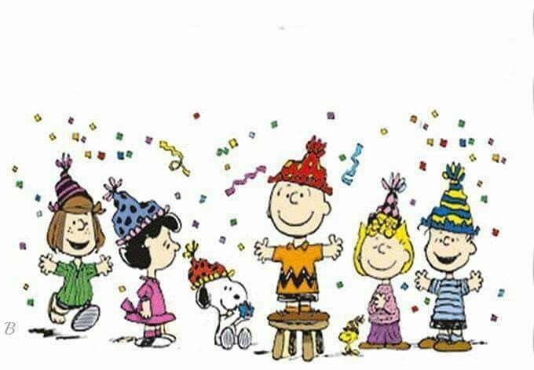
Happy 2021 ;)

