Slide 1
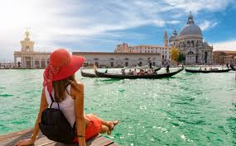
Travel
Unit 12.1, pages 100 - 101

Slide 2
HW KEY exercise V4-8, page 143.
1. I PRACTICE grammar every day because I have a test once a week.
2. She didn’t do any REVISION (ponavljanje, od glagola to revise). That’s the reason she failed.
3. I’m sure that Klaus will PASS his exam. He’s very good at English.
4. But it’s possible that Elena will FAILED the exam, as her English isn’t very good.
5. The teacher gave us a REVISION test today.
6. RELAXATION the night before an exam is the best way to prepare.

Slide 3
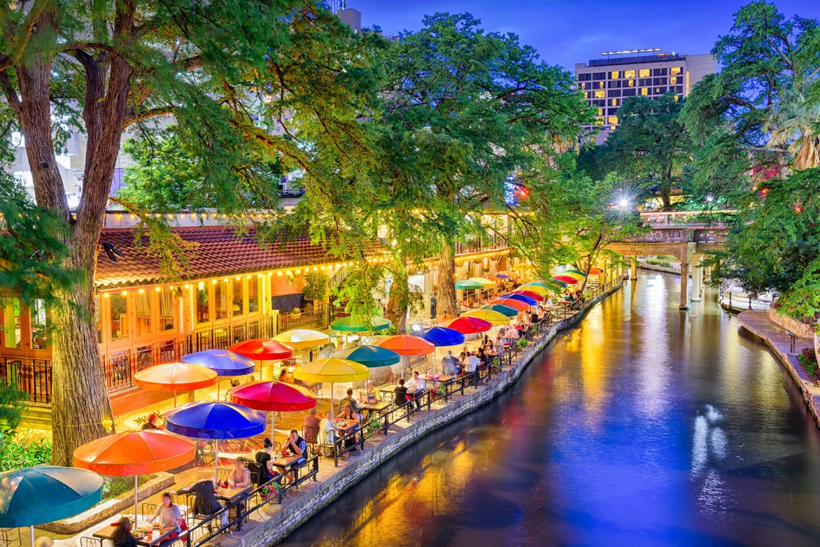
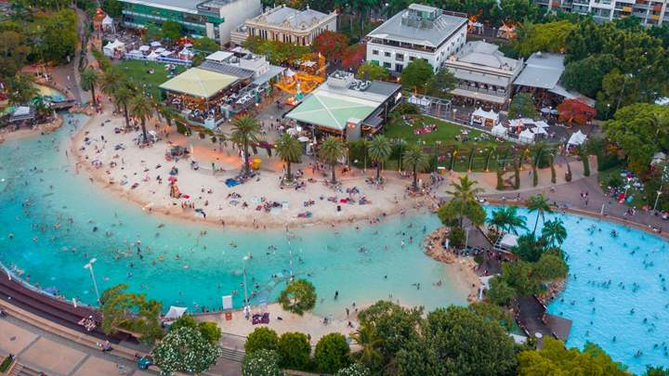
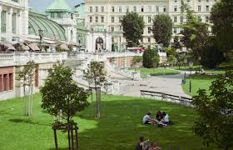
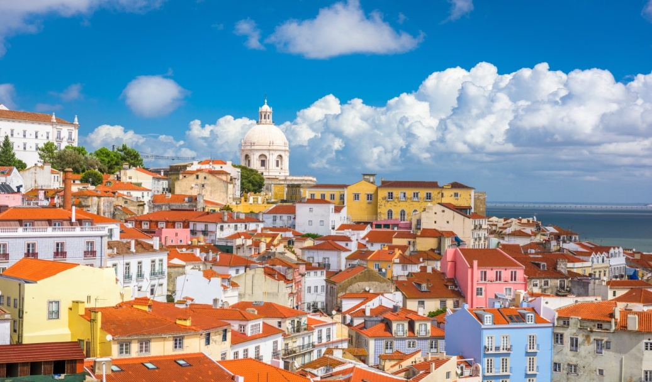
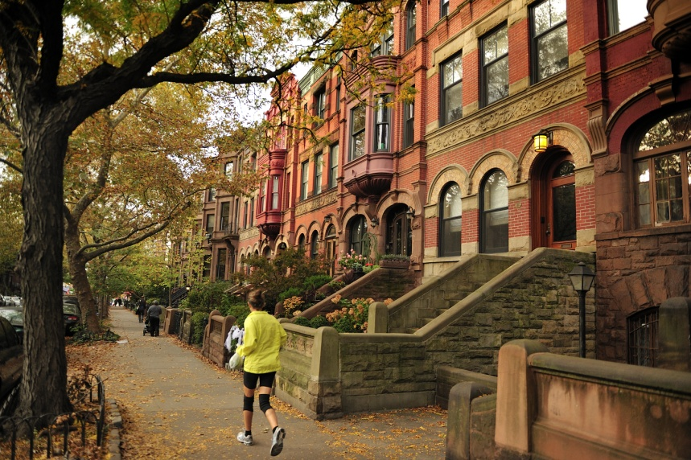
1. page 100, Which country/city would you like to live in, apart from your own? Why?

Slide 4

2a page 100, track 2.42 transcript page 156,
Listen to an interview with Kirsty, a student has lived abroad. In general, is she happy or unhappy, about her time abroad?

Slide 5
2b page 100, Listen again and complete Peter’s form about Kirsty.
Experiences of living abroad
Name: Kristy Andrews Countries: 1 __________, Oman and 2__________. Favourite country: 3 __________ Reason: 4 ____________ Languages: A little 5 ___________ Work experience: None Changes (in the person): Knows more about differences between 6 ______________. Doesn’t think that her way is best. Problems: Seeing old 7 ___________ Future: Want to live in a 8 ___________ country and in 9 __________ Armenia.

Slide 6
grammar: Present perfect
Unit 12.1, page 100

Slide 7
3. page 100, Look at these sentences. When exactly did Kirsty live abroad?
- Have you ever lived abroad?
- Yes, I have. I’ve lived in a lot of countries.
Have you ever gone sky diving?
-No, I haven’t. It is for the brave ones.
Have you ever tried Thai food?
-Yes, I have. It’s so tasty.
When we talk about experience in the past, but we don’t say when we did it, we use the Present Perfect.

Slide 8
4. page 100, Look at the audio script, Track 2.42, transcript page 156, and complete this table
 | Subject + have | Past participle III column ir.verbs
+ | I 1 _____________/we’ve/ you’ve / they’ve He’s/she’s/it | worked
- | I/ we / you / they 2 _____________ He/she/it hasn’t | 3 ______________
? | 4 __________ I / we / you / they 5 ______________ he / she / it | (ever) worked ?
Grammar Tip: Regular past participles are the same as the past simple form of the verb (see page 144)
I worked (Past Simple)– I have worked (Present Perfect)

Slide 9
5a page 101, Complete these sentences with the Present Perfect of the verb in brackets.
1. We ___________ a lot of interesting places (visit)
2. I ______________a lot in the last ten years (change)
3 She ________ to people from a lot of countries (talk)
4. He __________ films in different laguages (watch)
5. They ______________ house several times (move)

Slide 10

5b page 101, track 2.43 transcript page 156, Listen and check your answers. Then repeat the sentences.
to move house = to change one’s home, relocate
preseliti se, promeniti boravište

Slide 11
5c page 101, Use the sentences in Exercise 5a (slide 8) to ask a colleague questions.
Have you ever visited a lot of interesting places?
Yes I have/ No, I haven’t.

Slide 12
reading
Unit 12.1, page 101

Slide 13
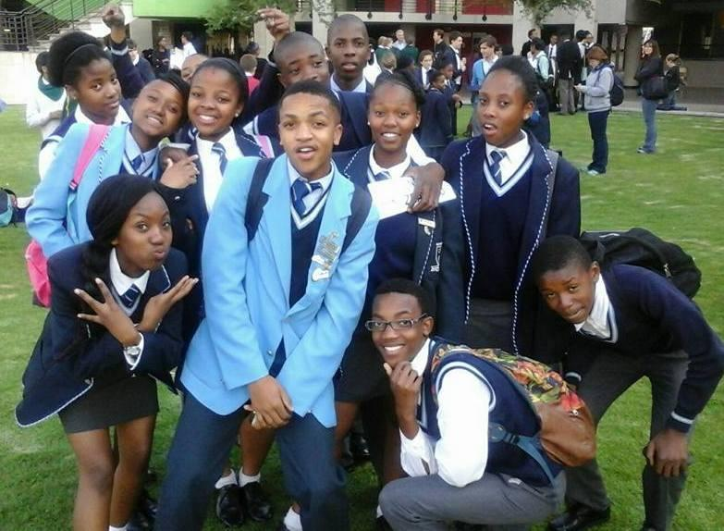
6. page 101, Read the web page. Why are these people writing? Choose the best reason.
Have your say:
Global nomads
Global nomads are people who have grown up abroad because of their parents’ job. They’ve often had a good life. With large homes and nice holidays, and they’re well-educated, international citizens of the 21st century.
However, they often feel different from other people and can’t stay in one place for a long time. Are you a global nomad? What’s your experience?

Slide 14
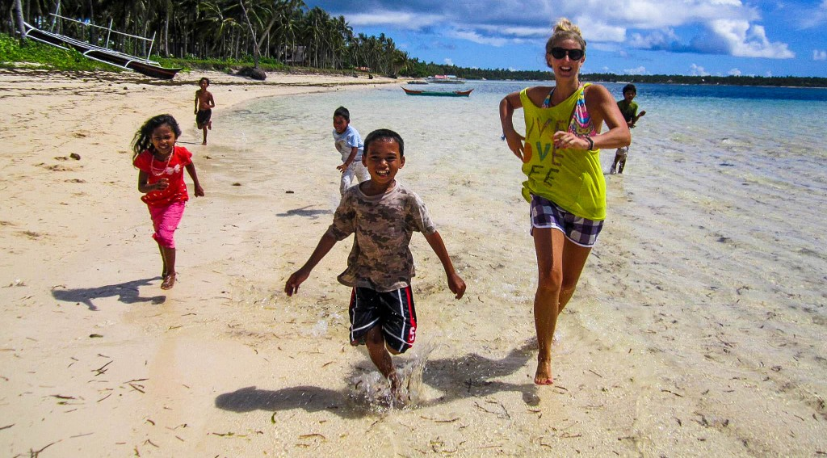
By: Nina Rendquist (mail) posted on 26/10/2006
I’m from Sweden but I left the country when I was six. I’ve lived in Saudi Arabia and the Philippines. I don’t feel at home anywhere, but I think that I’ve done a lot. Because of my past, I’m good at learning new skills and at meeting people.

Slide 15
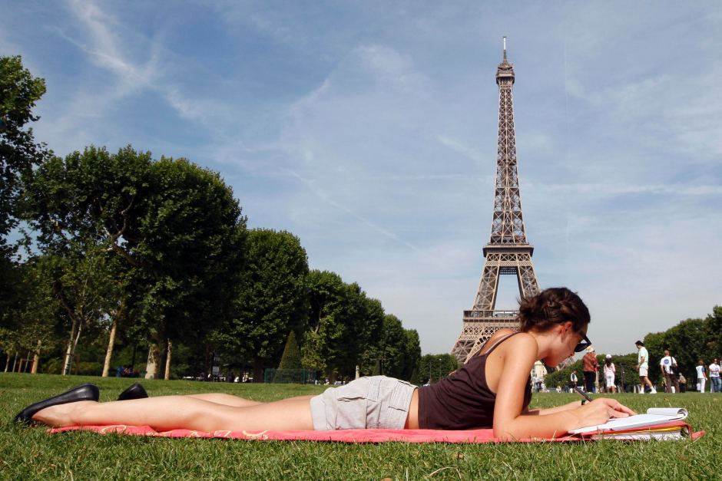
By: Maria (mail) posted on 27/10/2006
Nina, I really understand you. I spent my childhood saying hello and goodbye. I’m from Argentina but my parents took us from one country to another: Malaysia, Nigeria, Russia. Now I’m living in Paris. I feel I’m a stranger everywhere, but I’m independent and strong. I’ve travelled, I’ve seen the world and I speak three languages.

Slide 16
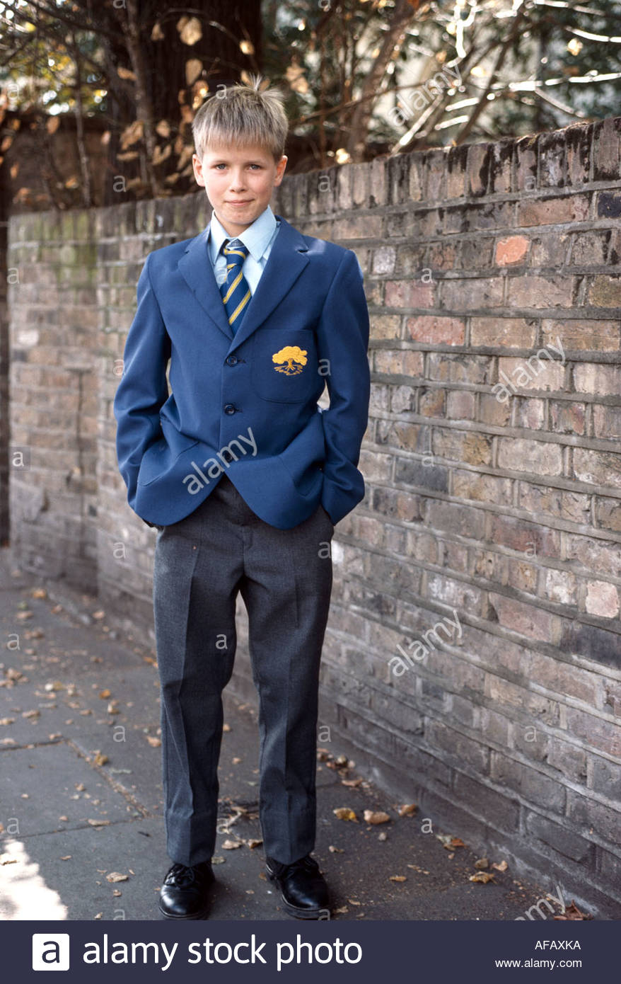
By: Andy (mail) posted on 29/10/2006
Like you, I’m proud to be a global nomad – I’ve lived in Kuwait, Venezuela and Kazakhstan. Sometimes, I’ve felt lonely but I’m comfortable with people from all over the world. And I’ve become really close to my Mum and Dad – they’re like my best friends.

Slide 17
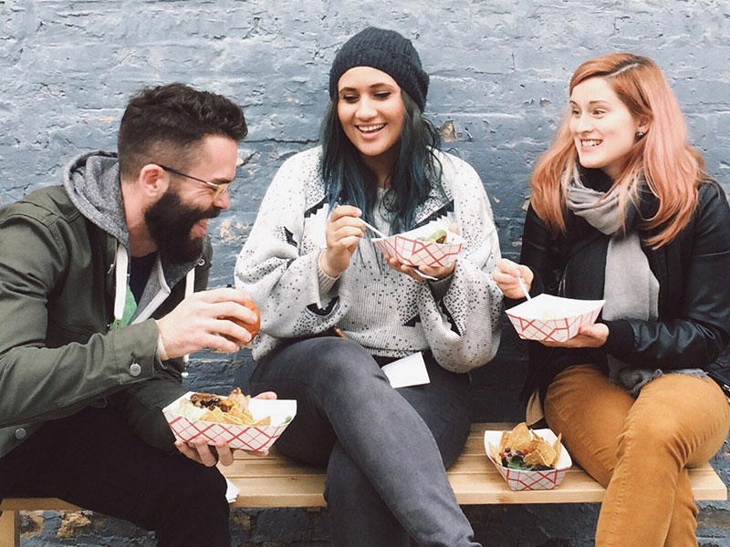
6. page 100, Why are these people writing? Choose the best reason.
to find new friends
to practise their English
to communicate with other people like themselves

Slide 18
7. page 101, Answer the questions and write Nina, Maria or Andy.
You can use each name more than once.
Who…
1. has lived in the most countries?
2. has a good relationship with his/her parents?
3. has no problems meeting people?
4. doesn’t feel comfortable anywhere?
5. is the most successful person, do you think?

Slide 19
8. page 101, According to the web page, what are the advantages and disadvantages of being a global nomad? Make two lists.
Are there more advantages or more disadvantages?
ADVANTAGES | DISADVATAGES
Grammar Tip
Many common verbs have IRREGULAR PAST PARTICIPLES:
TO HAVE HAD TO SEE SEEN

Slide 20
9a page 101, Find past participles of these verbs in the web page
to grow
to do
to feel
to become

Slide 21
9b page 101, Now use your disctionary or the verb list on page 159 to find the past participles of the verbs in Exercise 10 (slide 21).
drive
eat
fly
live
read
travel
visit
work
study

Slide 22
10. page 101, Work with a colleague. Ask and answer questions using the ideas below. Then think of some other questions to ask your fellow student.
Have you ever driven a sports car?
- Yes, I have/No, I haven’t
drive a sports car
eat Indian food
fly at night
live away from home
read a travel book
travel on a boat
visit another continent
work/ study with someone from another country

Slide 23
HW
Read about the Present Perfect, 12 Language Reference, page 144, Grammar, G1 – regular verbs G2 – irregular verbs
Do exercises G1,2 - 1; G2 – 2;

Slide 24
KEY 2a
Generally, she is very happy about the time spent abroad.
2b
Experiences of living abroad
Name: Kristy Andrews Countries: 1 ENGLAND, Oman and 2 JAPAN. Favourite country: 3 JAPAN Reason: 4 IT’S SO DIFFERENT Languages: A little 5 JAPANESE Work experience: None Changes (in the person): Knows more about differences between 6 BETWEEN CULTURES. Doesn’t think that her way is best. Problems: Seeing old 7 FRIENDS FROM DIFFERENT COUNTRIES. Future: Want to live in a 8 POOR /AN AFRICANcountry and in 9 SOUTH America.

Slide 25
4. page 100, Look at the audio script, page for Track 2.42, transcript page 156, and complete this table
 | Subject + have | Past participle III column ir.verbs
+ | I 1 _’VE/we’ve/ you’ve / they’ve He’s/she’s/it’s | worked
- | I/ we / you / they 2 HAVEN’T He/she/it hasn’t | 3 WORKED
? | 4 HAVE I / we / you / they 5 HAS he / she / it | (ever) worked ?
Grammar Tip: Regular past participles are the same as the past simple form of the verb (see page 144)
I worked (Past Simple)– I have worked (Present Perfect)

Slide 26
5a page 101, KEY
1. We HAVE VISITED a lot of interesting places.
2. I HAVE CHANGED a lot in the last ten years.
3 She HAS TALKED to people from a lot of countries.
4. He HAS WATCHED films in different laguages.
5. They HAVE MOVED house several times.

Slide 27
5c page 101 KEY
Have you ever visited a lot of interesting places?
Yes I have/ No, I haven’t.
Have you changed a lot in the last ten years?
Have you talked to people from a lot of countries?
Have you watched films in different languages?
Have you moved house several times?

Slide 28
6. page 100, KEY
to find new friends
to practise their English
to communicate with other people like themselves

Slide 29
7. page 101, KEY
Who…
1. has lived in the most countries? Maria
2. has a good relationship with his/her parents? Andy
3. has no problems meeting people? Nina, Andy
4. doesn’t feel comfortable anywhere? Nina, Maria, Andy
5. is the most successful person, do you think? Maria

Slide 30
8. page 101, KEY
ADVANTAGES | DISADVANTAGES
MEET DIFFERENT PEOPLE AND CULTURES/SEE THE WORLD | LONELINESS
LEARN FOREIGN LANGUAGES | NEVER AT HOME
HAVE COMFORTABLE/GOOD LIFE WELL-EDUCATED | NEVER STAY LONG ENOUGH TO BELONG STRANGER EVERYWHERE
BECOME INDEPENDENT SELF-RELIANT STRONG | SOMETIMES CLING TO (=RELY ON) YOUR PARENTS TOO MUCH
LEARN NEW SKILLS WELL-EDUCATED

Slide 31
9a page 101, KEY
to grow - grew - GROWN
to do - did - DONE
to feel - felt - FELT
to become - became - BECOME

Slide 32
9b page 101, KEY
drive - drove – DRIVEN
eat – ate - EATEN
fly – flew - FLOWN
live – lived – LIVED (regular)
read – read /red / - READ /red /
travel – travelled – TRAVELLED (regular)
traveled – traveled AmE
visit – visited – VISITED (regular)
work – worked – WORKED (regular)
study – studied – STUDIED (regular)
study + ed; y i

Slide 33
10. page 101, KEY
Have you ever driven a sports car?
Have you ever eaten Indian food?
Have you flown at night?
Have you lived away from home?
Have you read a travel book?
Have you travelled on a boat?
Have you visited another continent?
Have you worked/studied with someone from another country?

Slide 34

Thank you for your Attention! https://www.youtube.com/watch?v=SbPgsC9Ql9w

