Slide 1
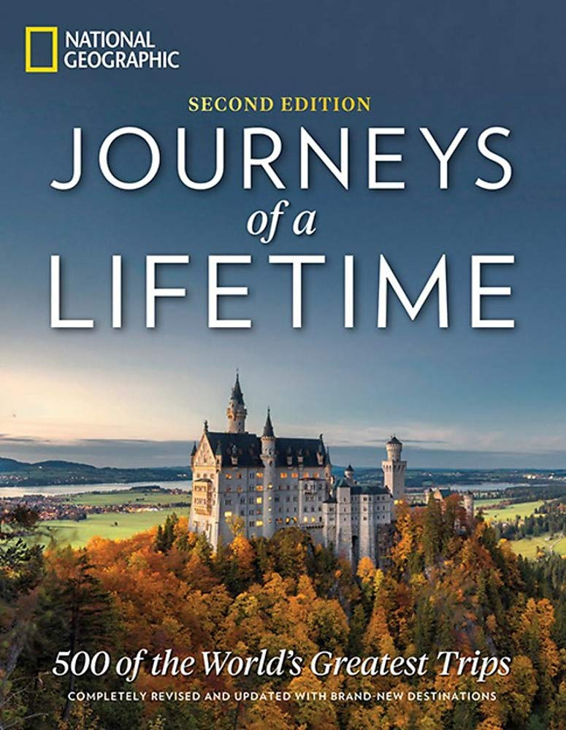
Journeys of a Lifetime
pages 102-103

Slide 2
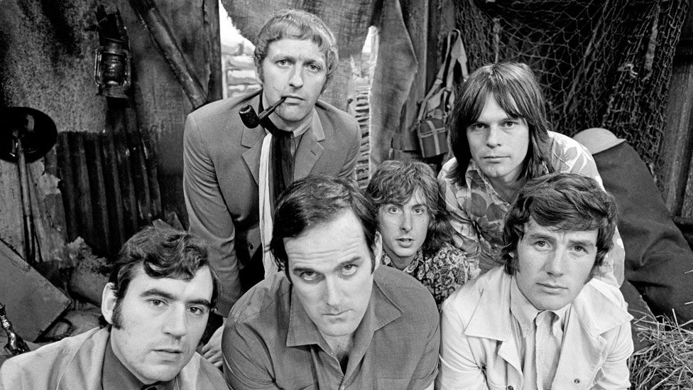
Monthy Python’s Flying Circus
Michael Palin

Slide 3
Vocabulary: adjective + noun
page 102

Slide 4
1. page 102, Look at the information about four travel books by Michael Palin. Match the books with photos A-D
1. Pole to Pole is about a 141-day journey from the North Pole to the South Pole.
2. Himalaya is the story of a journey across the world’s greatest mountains, from Afghanistan to China.
3. Sahara is about a journey across the desert that is the size of the USA and covers ten different countries.
4. Full Circle is the story of a 50, 000 km trip round the Pacific Ocean. The writer visited 17 countries on four continents.

Slide 5
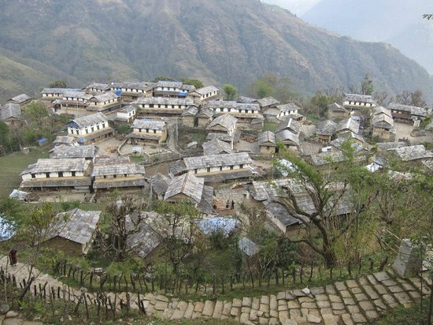
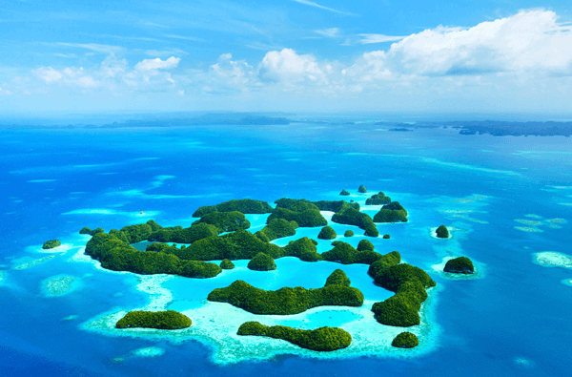
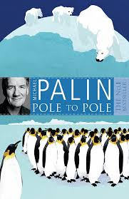
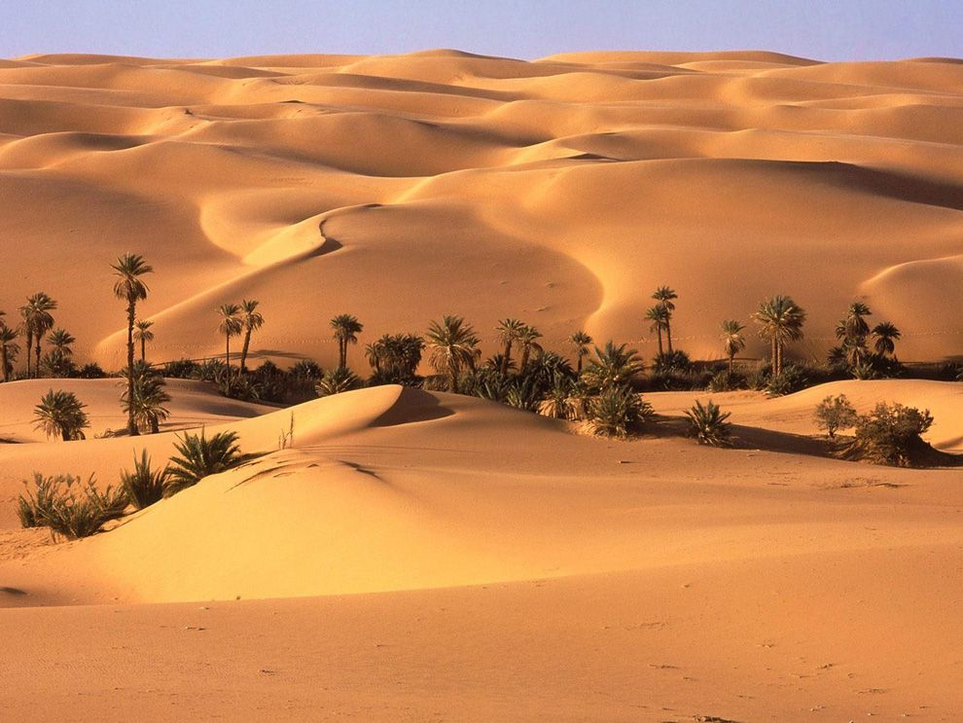
A
B
C
D

Slide 6

2. page 102, These extracts come from the four books. Match each extract with one of the books.
A The air is still, and watery sun gives the place a lonely feel. The temperature is minus 25 degrees C. They say this is warm.
B We are out of the crowded Asian Pacific area and into the great empty spaces of Australasia. In Java there are 850 people for every square kilometre of land; in Australia, just over two.
C Everest Base Camp is nowhere near as romantic as it sounds. In high season, between June and August, this area is packed with mountaineers and trekkers. This year there were 32 separate expeditions.
D Morocco has changed colour. The greens and golds of the north have become a line of pale yellow trees running beside the road. Beyond them, the land is brick-red and bare.

Slide 7
3a page 102, Read the book extracts and find adjectives with these meanings.
Extract A 1. not moving 2. sad and alone
Extract B 3. full of people 4. with nothing in it
Extract D 5. light, not strong colour
6. not covered, nothing there

Slide 8
3b page 102, Match adjectives in Exercise 3a with the best pair of nouns below.
1 __________ city/train
2 __________ face/colour
3 __________ room/bottle
4 __________ person/life
5 __________ feet/wall
6 __________ lake/water

Slide 9
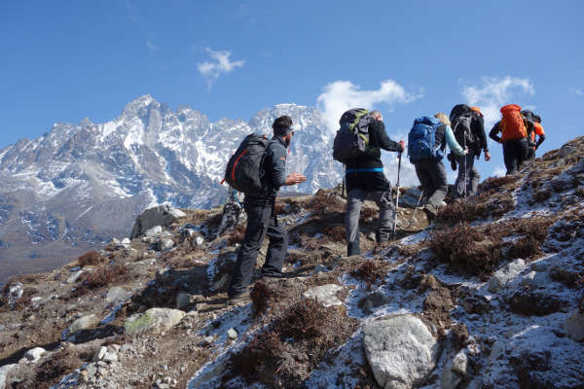
TREKKING/HIKING = a long walk usu. in the mountains.
TREKKER/HIKER = a person who takes a long exhausting walk for recreation

Slide 10
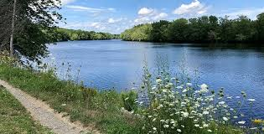
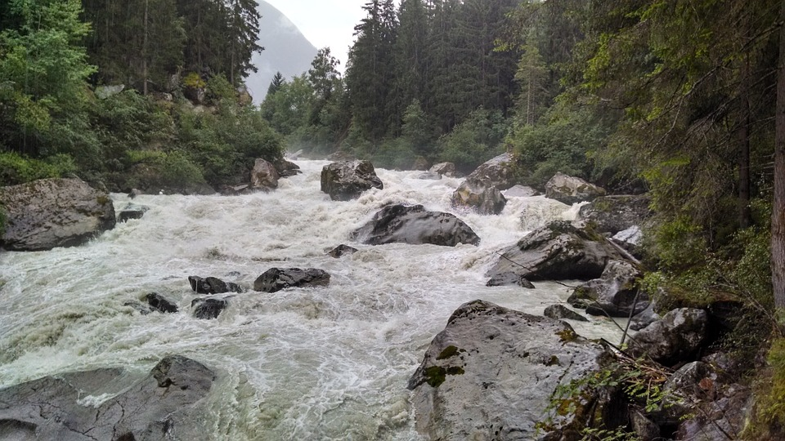
Vocabulary
still = calm e.g. stay still (budi miran); (for water also) = non-carbonated (negazirana voda).
Still water runs deep = Tiha voda breg roni
opp. =noisy, wild, raging

Slide 11
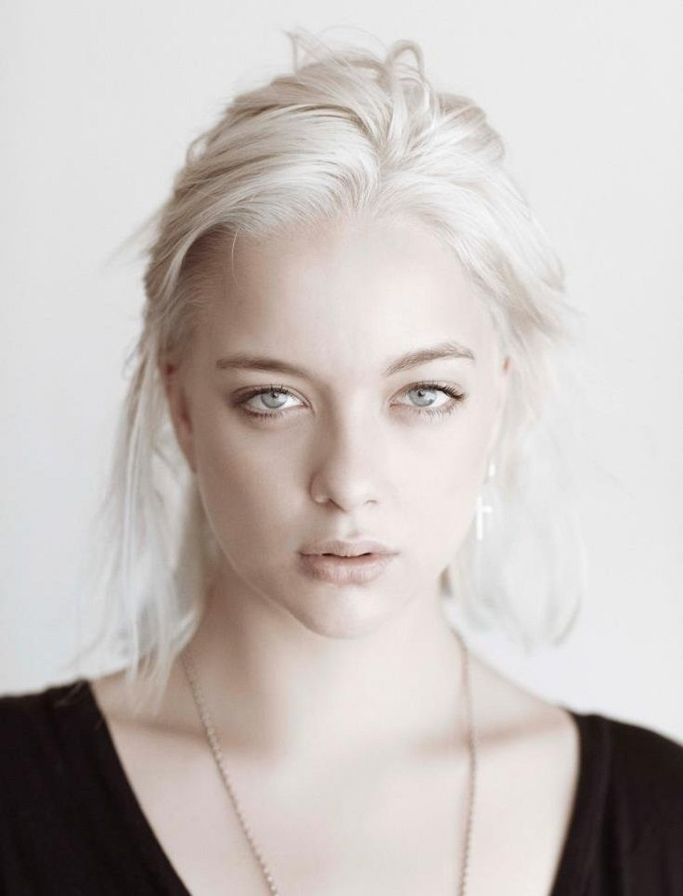
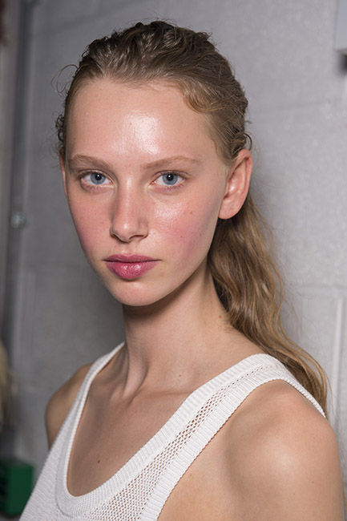
Vocabulary
pale /peil/= light-coloured
opp. = dark, bright, strong, ruddy-faced (rumeno)

Slide 12
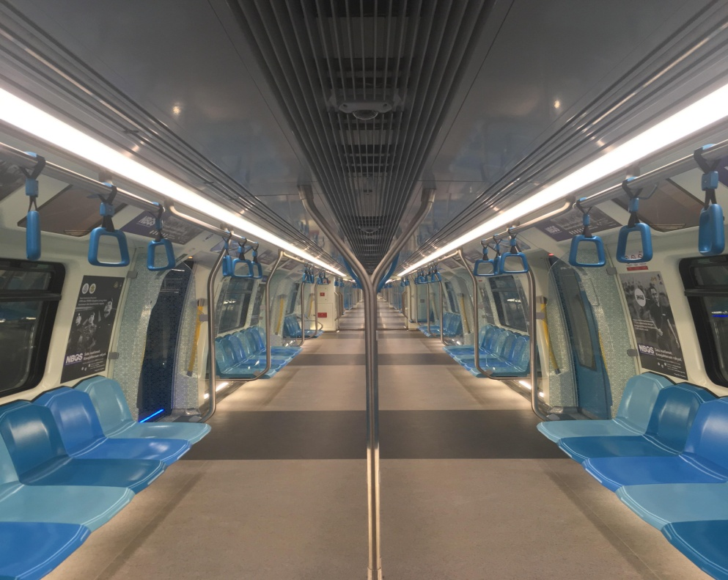
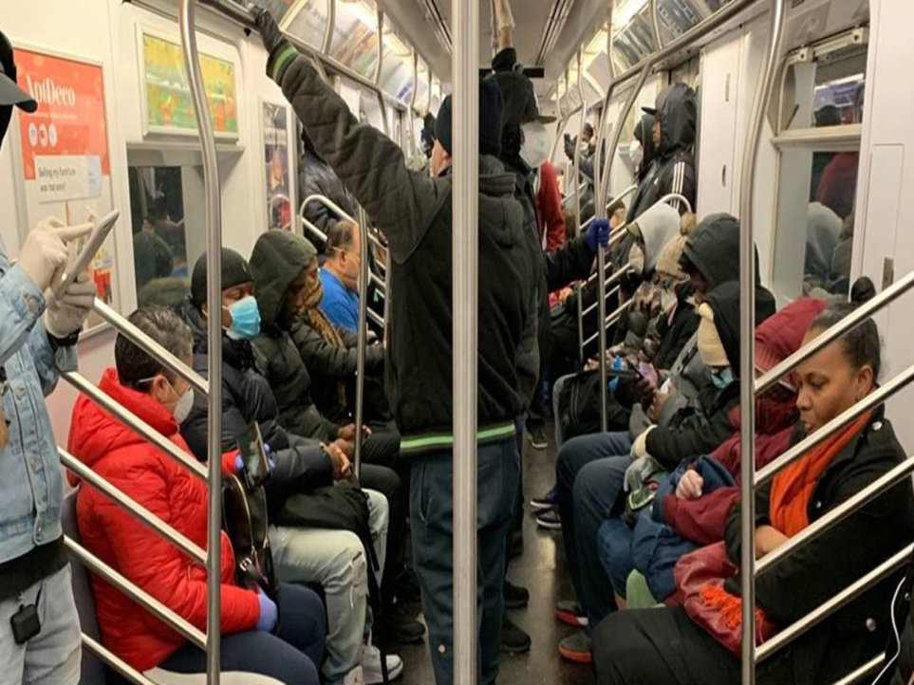
Vocabulary
crowded = packed with people, full
opp. empty /empti/, vacant /ˈveɪknt/

Slide 13
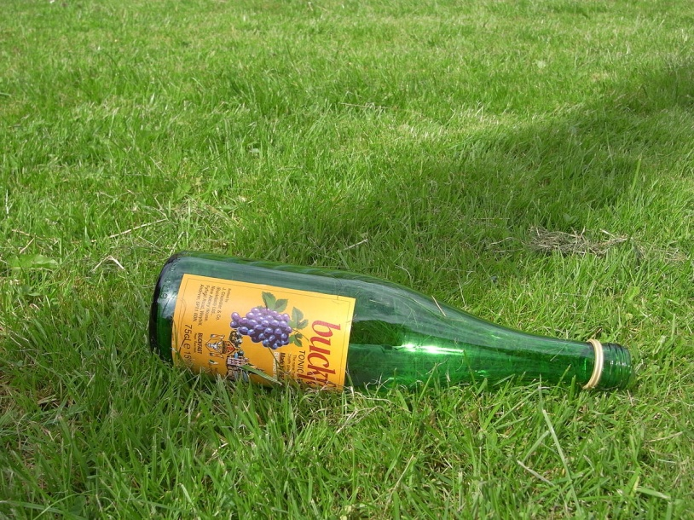
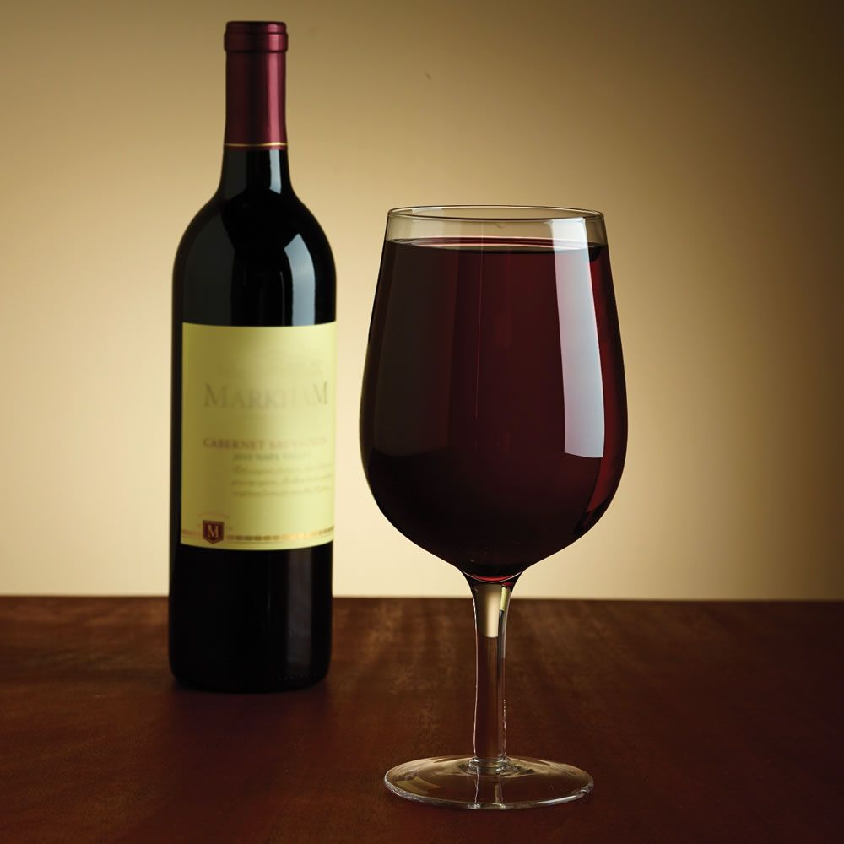
vocabulary
empty/full (bottle, fridge, room) =prazno, puno
to empty = isprazniti, clear

Slide 14
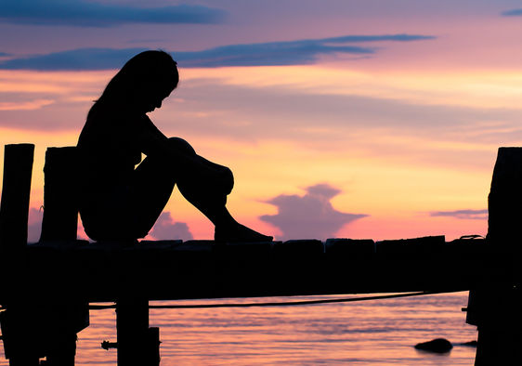
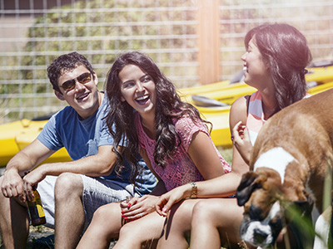
Vocabulary
lonely = solitary, lonesome (usamljen)
opp. = social, outgoing, cheerful, gregarious

Slide 15
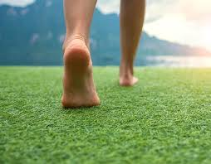

Vocabulary
bare = naked, uncovered (ogoljeno, golo, boso, neprekriveno, pusto)
opp. = covered, clothed/clad

Slide 16
reading
page 103

Slide 17
4. page 103, Read the interview with Michael Palin and put the questions 1-6 in the right place (a-f)
1. Which countries have you visited?
2. How many books have you written?
3. What have you learned from your different trips?
4. What’s the best place that you’ve visited?
5. When did you become a travel writer?
6. Have you eaten any unsual things?

Slide 18
Around the world with Palin by Stuart McCarthy
Michael Palin has visited many countries and he has become one of our most popular travel writers. I asked him about his fascinating life.
a) _______________
When I was 42, in 1988. I made a TV series – Around the World in 80 Days – and wrote a book about that trip, and so I started this great career.
b) _______________
I’ve written six travel books – one for each TV series.
c) _______________
Perhaps you should ask which countries I haven’t visited! I’ve travelled from the North Pole to the South Pole, and across every continent. A very lucky man!

Slide 19
Around the world with Palin by Stuart McCarthy
d) _______________
Oh, definitely. I ‘ve eaten insects and a snake. I ate that when I was in China, in 1985. It tasted like chicken.
e) _______________
Ah, my favourite place is in Peru – the river near Machu Picchu. It’s the most wonderful, magical place I’ve ever been to in all my travels.
f) ______________
The most important thing that I have learned is that people are warm, kind and fun all over the world, and that a smile really is universal.

Slide 20
5. page 103, Are these sentences true and false?
1. He wrote his first travel book after he made a TV travel series.
2. He has made six TV travel series.
3. He has never visited South America.
4. He ate insects in 1985.
5. His favourite place is in Africa.
6. He thinks there are friendly people everywhere.

Slide 21
grammar: present perfect and past simple
page 103

Slide 22
6. page 103, Look at these sentences and answer the questions
a) I made a TV series when I was 42.
b) I’ve travelled across every continent.
c) I’ve written six books.
d) I wrote a book in 1988.
1. Which sentences give the time when Michael Palin did something?
2. Which tense do we use when we give the time we did something?
3. Which tense can we use when we do not give the exact time we did something?
GRAMMAR TIP
I’ve been = I’ve gone and I’ve come back

Slide 23
7a page 103, Complete this personal travel history with the Present Perfect or the Past Simple
I have visited___________(visit) many different countries but I____________ (not go) SO FAR to South America and Africa – I hope to go there soon. I first ___________(go) abroad in 1991. I went to France with my school and two years later I_______ (visit) Spain – my favourite country. I also love Asia. I ______________(work) in China and I___________ (visit) Thailand and Japan. I_____________ (work) in China in 2003 – I___________ (have) a wonderful time because it ____________ (be) so different from my country. Finally, last year I _____________ (study+ed/studied) at film school in New Zealand – that was great!

Slide 24
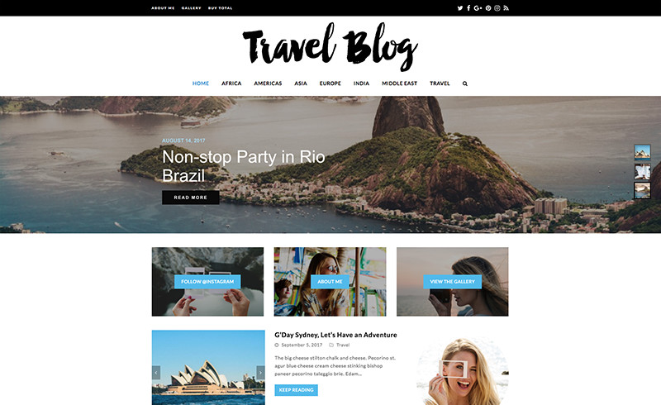
7b page 103, Write a short travel history about yourself or someone you know.

Slide 25
speaking
page 103

Slide 26
8a page 103, Work with a partner. Ask and answer questions about your experiences. Complete the table, page 113.
NAME: _________ | YES | NO | EXTRA INFORMATION?
Visit another country?
Climb a mountain?
Have a winter holiday? YES I’VE HAD
eat unusual food? No, I HAVEN’T
Stay in a four or five-star hotel?
Go on a holiday with friends?

Slide 27
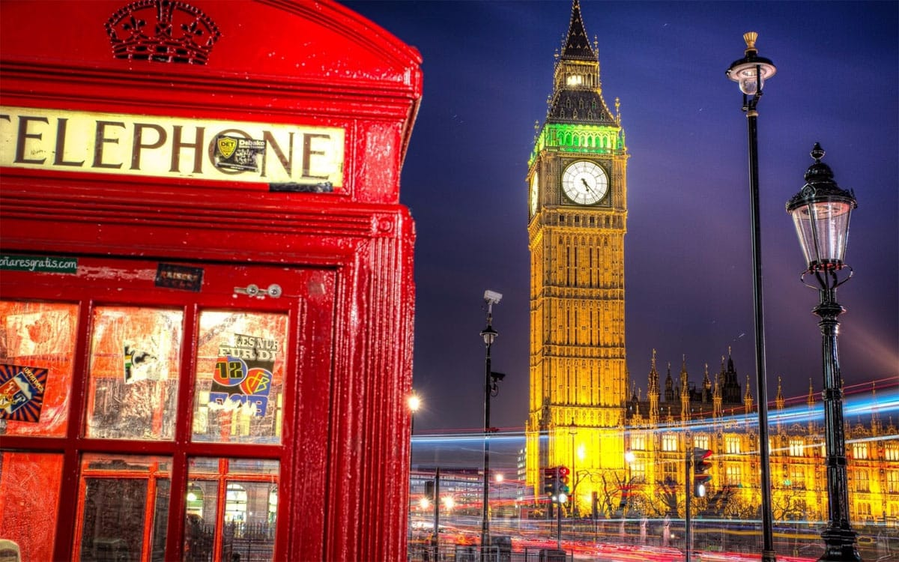
8b page 103 Tell the class about your colleague’s experiences.
...has visited Britain. He went there last year.
He has visited a lot of different places.

Slide 28
HW
Read about Present Perfect, Language Reference G1, G2 and adjectives V1, V2, page 145
Do exercise G2, V1, V2

Slide 29
page 145
G1, 2 1. Write these verbs in sentences 1-8 using the Present Perfect.
drive go look watch eat learn talk be
1. They have learned a lot with the new teacher.
2. _______ you _______ at the holiday photographs?
3. ________ she ________ a Porsche?
4. They __________ Spanish food but not Japanese food.
5. ________ you _______ that new TV travel programme?
6. _________they_______ about our new idea?
7. I _________ very busy.
8. Michael _________ to Bermuda. He doesn’t want to come back.

Slide 30
page 145
G1, 2 1. KEY
drive go look watch eat learn talk be
1. They have learned a lot with the new teacher.
2. Have you looked at the holiday photographs?
3. Has she driven a Porsche?
4. They have eaten Spanish food but not Japanese food.
5. Have you watched that new TV travel programme?
6. Have they talked about our new idea?
7. I have been very busy.
8. Michael have gone to Bermuda. He doesn’t want to come back.

Slide 31
A - 2
B - 4
C -1
D - 3

Slide 32
1. page 102, KEY
1. Pole to Pole is about a 141-day journey from the North Pole to the South Pole. C
2. Himalaya is the story of a journey across the world’s greatest mountains, from Afghanistan to China. A
3. Sahara is about a journey across the desert that is the size of the USA and covers ten different countries. D
4. Full Circle is the story of a 50, 000 km trip round the Pacific Ocean. The writer visited 17 countries on four continents. B

Slide 33
2. page 102, KEY
A The air is still, and watery sun gives the place a lonely feel. The temperature is minus 25 degrees C. They say this is warm. POLE TO POLE
B We are out of the crowded Asian Pacific area and into the great empty spaces of Australasia. In Java there are 850 people for every square kilometre of land; in Australia, just over two.
FULL CIRCLE
C Everest Base Camp is nowhere near as romantic as it sounds. In high season, between June and August, this area is packed with mountaineers and trekkers. This year there were 32 separate expeditions. HIMALAYA
D Morocco has changed colour. The greens and golds of the north have become a line of pale yellow trees running beside the road. Beyond them, the land is brick-red and bare. SAHARA

Slide 34
3a page 102, KEY
Extract A 1. STILL 2. LONELY
Extract B 3. CROWDED 4. EMPTY
Extract D 5. PALE
6. BARE

Slide 35
3b page 102, KEY
1 CROWDED city/train
2 PALE face/colour
3 EMPTY room/bottle
4 LONELY person/life
5 BARE feet/wall
6 STILL lake/water

Slide 36
Around the world with Palin by Stuart McCarthy
d) HAVE YOU EATEN ANY UNUSUAL THINGS? (6)
Oh, definitely. I ‘ve eaten insects and a snake. I ate that when I was in China, in 1985. It tasted like chicken.
e) WHAT’S THE BEST PLACE YOU’VE EVER VISITED? (4)
Ah, my favourite place is in Peru – the river near Machu Picchu. It’s the most wonderful, magical place I’ve ever been to in all my travels.
f) WHAT HAVE YOU LEARNED FROM YOUR DIFFERENT TRIPS?
The most important thing that I have learned is that people are warm, kind and fun all over the world, and that a smile really is universal. (3)

Slide 37
Around the world with Palin by Stuart McCarthy
Michael Palin has visited many countries and he has become one of our most popular travel writers. I asked him about his fascinating life.
a) WHEN DID YOU BECOME THE TRAVEL WRITER? (5)
When I was 42, in 1988. I made a TV series – Around the World in 80 Days – and wrote a book about that trip, and so I started this great career.
b) HOW MANY BOOKS HAVE YOU WRITTEN? (2)
I’ve written six travel books – one for each TV series.
c) WHICH COUNTRIES HAVE YOU VISITED? (1)
Perhaps you should ask which countries I haven’t visited! I’ve travelled from the North Pole to the South Pole, and across every continent. A very lucky man!

Slide 38
5. page 103, KEY
1. He wrote his first travel book after he made a TV travel series. F
2. He has made six TV travel series. T
3. He has never visited South America. F
4. He ate insects in 1985. T
5. His favourite place is in Africa. F
6. He thinks there are friendly people everywhere. T

Slide 39
6. page 103, KEY
a) I made a TV series when I was 42.
b) I’ve travelled across every continent.
c) I’ve written six books.
d) I wrote a book in 1988.
1. Which sentences give the time when Michael Palin did something? a) and d)
2. Which tense do we use when we give the time we did something? the PAST SIMPLE TENSE
3. Which tense can we use when we do not give the exact time we did something? the PRESENT PERFECT TENSE
GRAMMAR TIP
I’ve been = I’ve gone and I’ve come back

Slide 40
7a page 103, KEY
I have visited (visit) many different countries but I HAVEN’T GONE (not go) to South America and Africa – I hope to go there soon. I first WENT (go) abroad in 1991. I went to France with my school and two years later I VISITED (visit) Spain – my favourite country. I also love Asia. I HAVE WORKED (work) in China and I HAVE VISITED (visit) Thailand and Japan. I WORKED (work) in China in 2003 – I HAD (have) a wonderful time because it WAS (be) so different from my country. Finally, last year I STUDIED (study) at film school in New Zealand – that was great!

Slide 41

Thank you for your Attention!

