Slide 1

Green Living
11.2., pages 94-95

Slide 2
HW
G1-1. page 143, Read the dialogue between a presenter and a professor in a TV programme. Complete the dialogue with will, ‘ll or won’t.
PRES: Today, I’m talking to Professor Brumsfeld about the future of transport. First of all Professor, what kind of cars 1 will we drive in the future?
PROF: Some people think we 2 ______ fly in our cars but it won’t happen. I really don’t think so.
PRES: So, what 3 __________ we do?
PROF: Well, cars 4 __________ use petrol because the world 5 ________ have any petrol. So we need something else. Some scientists think we 6 _________ use hydrogen. The advantage is that this is cleaner than petrol and better for the environment.
PRES: So 7 _______ these cleaner cars save the planet from the global warming?
PROF: No, they 8 _________. We 9 ___________ need to do many other things for that.

Slide 3
HW key
PRES: Today, I’m talking to Professor Brumsfeld about the future of transport. First of all Professor, what kind of cars 1 will we drive in the future?
PROF: Some people think we 2 WILL fly in our cars but it won’t happen. I really don’t think so.
PRES: So, what 3 WILLwe do?
PROF: Well, cars 4 WON’T use petrol because the world 5 WON’T have any petrol. So we need something else. Some scientists think we 6 WILL use hydrogen. The advantage is that this is cleaner than petrol and better for the environment.
PRES: So 7 WILL these cleaner cars save the planet from the global warming?
PROF: No, they 8 WON’T. We 9 WILL need to do many other things for that.

Slide 4
2 page 143, Speaking practice Ask a partner Will you...when you’re older? questions with the words below.
1 children
Will you have children when you’re older?
2 another country
3. excellent English
4. new car
5. Mars or the Moon

Slide 5
V1 6. page 143, What word is missing from each group to make compound nouns?
1 business, shopping, sports ___________
2 car, theme ____________
3 police, railway ____________

Slide 6
V1 6. page 143, What word is missing from each group to make compound nouns?
1 business, shopping, sports CENTRE
2 car, theme PARK
3 police, railway STATION

Slide 7
vocabulary: green living
Unit 11.2. page 94

Slide 8
1. page 94, Match sentences 1-8 with labels A-H on the picture (slide 5)
1. Cook food in a saucepan with a lid. G
2. Have a shower not a bath
3. Use solar panels to make electricity from the sun.
4. Use a wind turbine to make electricity from the wind.
5. Save energy with low-energy light bulbs.
6. Use the on/off button to switch off your TV.
7. Recycle old newspaper.
8. Use green electricity, from wind or solar power.

Slide 9
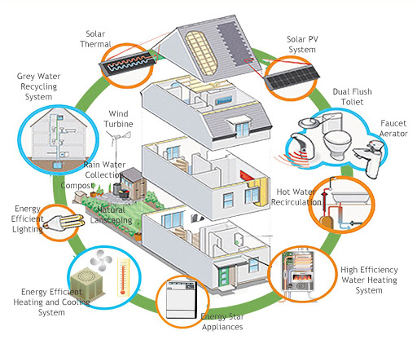
Vocabulary: green living
B
C
A
H
D
F
E
G

Slide 10
1. page 94, key
1. Cook food in a saucepan with a lid. G
2. Have a shower not a bath. F
3. Use solar panels to make electricity from the sun. B
4. Use a wind turbine to make electricity from the wind. A
5. Save energy with low-energy light bulbs. D
6. Use the on/off button to switch off your TV. F
7. Recycle old newspaper. H
8. Use green electricity, from wind or solar power.C

Slide 11

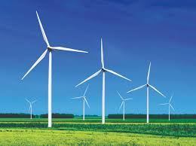
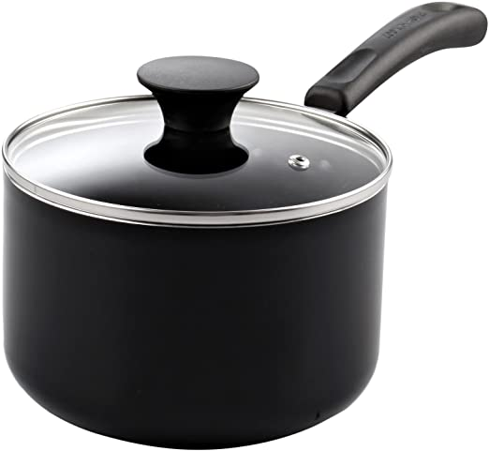

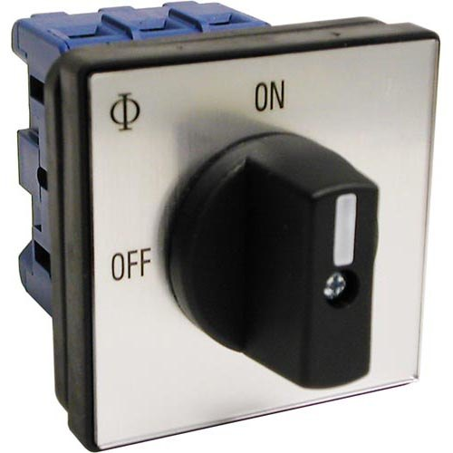
light bulb = sijalica
saucepan with a lid
šerpa sa poklopcem
wind turbine
switch on/off
on/off button = prekidač
recycle/riːˈsʌɪkl/ reciklirati

Slide 12
reading
Unit 11.2. Green Living

Slide 13
2 page 94, Read the questionnaire and do it with a partner. Who lives the greenest life at home? Check your score on page 121.
Aston Council How green is your home? Do this Questionnaire and find out! A Personal energy use in the house Count your points: Always = 5 Usually = 4 Sometimes = 3 Occasionally = 2 Never = 0 I turn off lights when I leave room. I turn off my TV with on/off button. I have showers, noth bath I turn off the tap when I brush my teeth. I cover saucepans when I cook. I recycle old paper. I recycle cans and plastic. I recycle glass.
B Green technology
Answer Yes or No. (Yes = 5 points, No = 0)
9. I buy green electricity.
My home has solar panels.
My home has a wind turbine
My home has low-energy light bulbs.

Slide 14
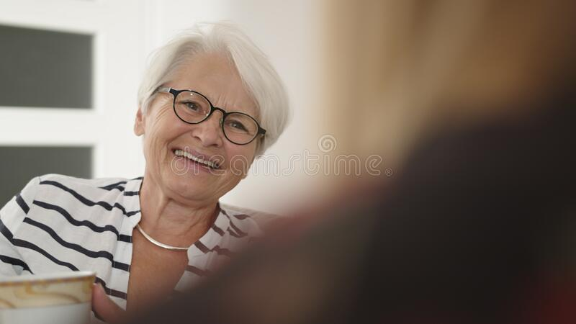

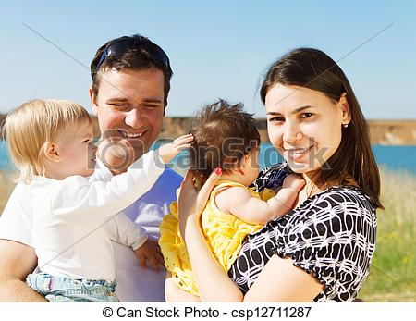
3. page 95, Track 2.37, script on page 155, Listen to three interviews with people who did the questionnaire. Listen to their plans (1-3) and match the people with the descriptions below. Who is the greenest?
Here are some people who did our questionnaire and are going to make some changes.
Vicky
Lives alone in a
small house
Martin, single man
Shares a flat with a friend, Richard
Simon and
Rachel, married
Live together in large house with
two young children

Slide 15
4. page 95, Are these sentences true or false?
1. Richard is greener than Martin.
2. Richard decided to recycle things in the future.
3. Simon and Rachel want a solar panel because it’s cheaper.
4. Simon and Rachel never have showers.
5. Vicky does not want to change her life.
6. It will be difficult for Vicky to buy green electricity.

Slide 16
4. page 95, Are these sentences true or false?
1. Richard is greener than Martin. F
2. Richard decided to recycle things in the future. T
3. Simon and Rachel want a solar panel because it’s cheaper. T
4. Simon and Rachel never have showers.T
5. Vicky does not want to change her life. T
6. It will be difficult for Vicky to buy green electricity. F

Slide 17
grammar: be going to
Unit 11.2, page 95

Slide 18
5. page 95, Track 2.37 script page 155, Match the plans 1-5 with the people who made them. Then listen again and check.
1. I’m going to have showers.
2. He’s going to cover his saucepans.
3. They’re going to recycle their paper.
4. We aren’t going to have showers.
5. I’m not going to do anything new.
Vicky
Simon and Rachel
Richard
Martin
Simon and Rachel’s
children

Slide 19
5. page 95, Track 2.37 script page 155, Match the plans 1-5 with the people who made them. Then listen again and check.
1. I’m going to have showers.
2. He’s going to cover his saucepans.
3. They’re going to recycle their paper.
4. We aren’t going to have showers.
5. I’m not going to do anything new.
Vicky
Simon and Rachel
Richard
Martin
Simon and Rachel’s
children

Slide 20
6a page 95, Look at these sentences in Exercise 5. Choose the correct words in the explanation.
We use be going to for present habits/future plans and intentions.
6b page 95, Now complete the table.
+ | subject + am / 1 ____________ / are + going to + infinitive
- | subject + am / 2 __________ / 3 ___________ + 4 __________ + going to
? | am / is / are + 5 _____________ + 6 _____________ + 7 ____________ ?

Slide 21
6a page 95, key.
We use be going to for future plans& intentions.
6b page 95, Now complete the table.
+ | subject + am / 1 IS / are + going to + infinitive
- | subject + am / 2 IS/ 3 ARE 4 NOT + going to
? | am / is / are + 5 SUBJECT+ 6 GOING TO+ 7 INFINITIVE ?

Slide 22
7. page 95, Track 2.38 script page 155,
Complete these plans with the correct form of be going to and the verbs in brackets. Listen and check your answers.
1. I AM GOING TO FIND OUT about green electricity. (find out)
2. She ISN’T GOING TO BUY a wind turbine because it’s expensive. (not buy)
3. We AREN’T GOING TO CHANGE anything. We’re already very green. (not change)
4. They’RE GOING TO TURN OFF their TVs with the on/off button. (turn off)
5. ARE you GOING TO any changes? (make)
6. He’S GOING TO CYCLE to work every day. (cycle)

Slide 23
7. page 95, Track 2.38 script page 155,
Complete these plans with the correct form of be going to and the verbs in brackets. Listen and check your answers.
1. I _____ about green electricity. (find out)
2. She _________ a wind turbine because it’s expensive. (not buy)
3. We _________ anything. We’re already very green. (not change)
4. They __________ their TVs with the on/off button. (turn off)
5. _______ you ________ any changes? (make)
6. He _______ to work every day. (cycle)

Slide 24
speaking
Unit 11.2, page 95

Slide 25
8a page 95, Look back at the questionnaire and make plans to improve your score. What can you do to use less energy?
I am going to turn off/hibernate the heating system at night
8b page 95, How can you make your school college greener? Make some plans.
We can put a recycle bin for plastics and plastic lids.
We are going to plant rosemary and lavender in our yard.

Slide 26
9a page 95, You want to organise an end-of-course celebration for your class. Think about the details for the celebration.
What exactly is it? A party? A day trip? A picnic?
Location? Where do you want to hold it / go?
Time and day?
Guests? People from other classes?
What do you need to organise? Food? Music?

Slide 27

10. page 95, Write a short description of your plans for your college principal.
Dear Mr/Ms,
We are writing this letter of request because we would like to organise an end-of-the-course celebration....

Slide 28
HW
Read about the verb GOING TO, Language Reference, page 142
Read about the Green living vocabulary, Language Reference, page 142
Do exercises G2 – 3, page 143

Slide 29

Thank you for your Attention!

