Slide 1
Study and Writing Skills examination skills writing skills – an informal letter
Unit 11.4. pages 98 - 99

Slide 2
Homework
KL 4, page 143, A student phones about an advert for a computer. Complete conversation between the seller(S) and the student (ST) with these words in gaps 1-5.
say right repeat it was
ST: You have a computer for sale. Is that (1) right?
S: a) Yes, that’s right.
ST: Is (2) _____________ a desktop or a laptop?
S: b) _____________
ST : How old is it?
S: c) ___________________
ST: Did you (3) ___________ eight or 18 months?
S: d) ________________
ST: And how much is it?
S: e) _________________
ST: Could you (4) ________________ that, please?
S: f) _______________________
ST: (5) _______________________ that 200?
S: g) _______________________
ST: Oh, OK. Can I have a look at it?

Slide 3
Homework
KL 4, page 143, A student phones about an advert for a computer. Complete conversation between the seller(S) and the student (ST) with these words in gaps 1-5.
say right repeat it was
ST: You have a computer for sale. Is that (1) right?
S: a) Yes, that’s right.
ST: Is (2) IT a desktop or a laptop?
S: b) A LAPTOP
ST : How old is it?
S: c) ABOUT EIGHTEEN MONTHS
ST: Did you (3) SAY eight or 18 months?
S: d) EIGHTEEN. ONE-EIGHT MONTHS.
ST: And how much is it?
S: e) TWO HUNDRED POUNDS
ST: Could you (4) REPEAT that, please?
S: f) I’D LIKE£200
ST: (5) WAS that 200?
S: g) YES, IT WAS.
ST: Oh, OK. Can I have a look at it?

Slide 4
Homework
V2,3 -7 page 143, Find words in V2 and V3 to write next to these headings.
1. bedroom: wardrobe,________________
2. kitchen: ____________________________
3. living room: _________________________
4. bathroom: __________________________

Slide 5
Homework
V2,3 -7 page 143, Find words in V2 and V3 to write next to these headings.
1. bedroom: wardrobe, bed, sofa, armchair, bookcase, table,
2. kitchen: cooker, cupboard, table, dishwasher, fridge-freezer,
3. living room: sofa, armchair, bookcase, table
4. bathroom: washing machine,

Slide 6
1. page 98, Discuss these questions with a colleague.
1. Do you like examinations and tests? Why?/Why not?
2. What was the last exam you did? When was it?
3. How did you feel before, during and after the exam?

Slide 7
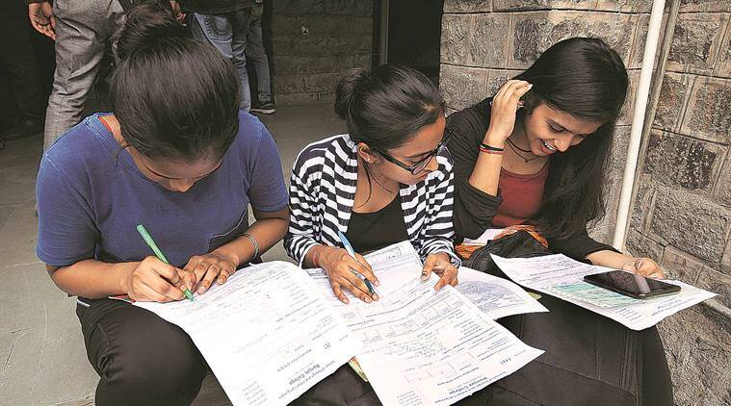
2. page 98, Do you know these words connected with exams? Check them in your dictionary.
to pass an examination
to fail an examination
to apply for an exam
to sit for exams
to take the test
instructions
a practice test
to relax/relaxation
to revise/revision

Slide 8
3a page 99, Before the exam
Look at these ideas about preparing for an exam. Which do you do? Which do you think are good ideas?
1. “I find out everything I can about the exam or test.”
2.”I make a revision plan.”
3. “I don’t revise all day. I study in the morning and relax in the afternoon.”
4. “I revise with a group of my classmates.”
5. “I do a lot of practice tests. Everytime you do a practice test, you get better.”
6. “I always start my revision a long time before the exam.”
7. “I usually study at the same time every day.”
8. “I always study in a quiet place.”
9. “I like to go to a party the night before the exam.”
10. “I drink a lot of coffee on the morning of the exam.”

Slide 9

3b page 98, Now discuss the ideas with a colleague. Decide on two or three things that both of you will try in the future.

Slide 10

4. page 98, It is important to relax and take breaks when you are revising. Look at these relaxation techniques. Can you add four or five more to the list?
watching TV
walking
playing tennis
yoga
swimming
listening to chill out music

Slide 11
5. page 98, During the exam
Look at these ‘golden rules’.
Fill the gaps with one of the words in the box.
watch take do do do make read spend
__________________ the instructions carefully.
__________________ what the questions ask you to do.
Don’t _____________ a long time on one or two difficult questions. Come back to them later.
__________________ sure that your writing is easy to read.
Don’t _____________ other students working.
Don’t _____________ the exam too quickly and make careless mistakes.
Don’t _____________ the exam too slowly, and not finish. Answer all the questions.
__________________ time at the end of the exam (about ten minutes) to check your answers (information, grammar, spelling, etc.)

Slide 12
6. page 98, After the exam
Which of these things do you do after an exam?
1. Think about which questions you answered well (or badly).
2. Think about how you used your time.
3. Think about how you can prepare better next time.
4. Worry about mistakes you made in the exam.
5. Continue to study hard.

Slide 13
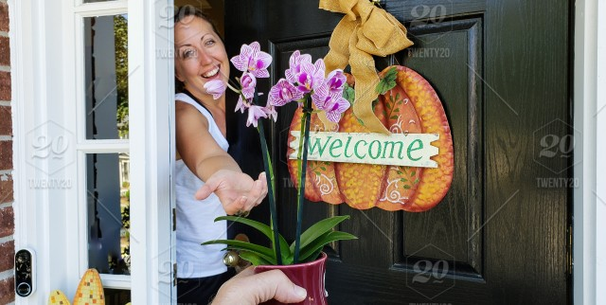
7. page 99, Look at the photo. What is happening? What is the reason, do you think?

Slide 14
8a page 99, Read Carla’s letter quickly and check your answers. How do you do this in your country?
                147 Wood Green Road
9/6/07
Dear Erdem
How are you? I’m in my new flat now, and I’m really enjoying it.
I’m going to have a housewarming party on Saturday 7th July, starting about 8 p.m. Can you come? A lot of our old friends will be here (I hope!) and I’m going to cook something very special! (It’s a secret!)
My new address is above. It’s really easy to get here. Take the tube* to Wood Green station. You can walk from there. When you come out of the station, turn right and go up the hill. Turn left at the traffic lights – then you’re on my road. Go straight on for about 200 metres. The building is on the left.
Hope to see you on Saturday 7th.
Best wishes,
Carla
PS My new phone number is 020 8888 0563

Slide 15
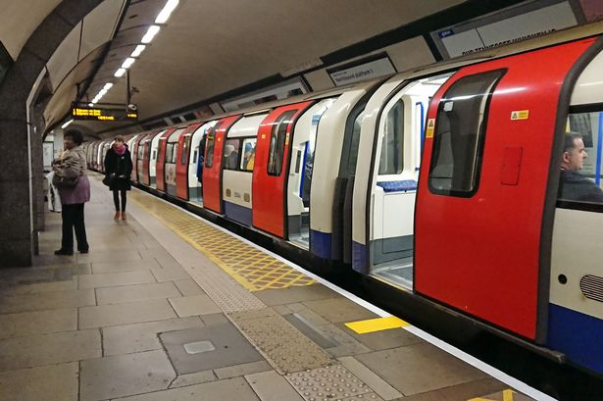
the Tube underground, subway, metro

Slide 16


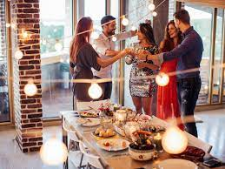
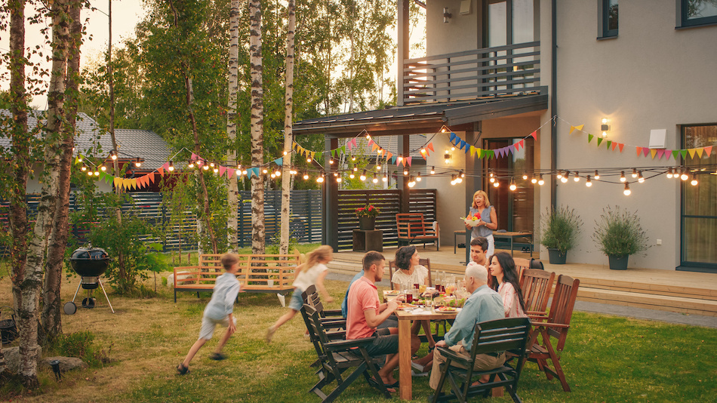

Slide 17
8b page 99, Read the letter again.
Say if these sentences are true or false or if the letter doesn’t say.
Carla is happy with her new flat.
Carla is living alone in her new flat.
You have to get a taxi from a new flat.
Erdem is going to go to the party.
The tube is a kind of bus.

Slide 18
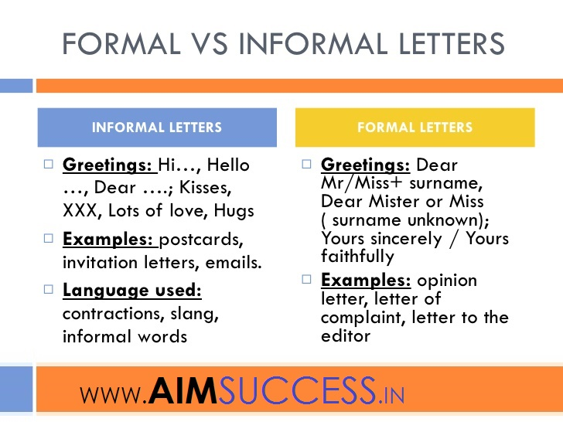
9. page 99, Look at Carla’s letter and the formal letter on page 91. What are the main differences between the two letters?
(Think about the address, dates, the ending, etc.)

Slide 19
10. page 99, Directions
Find words in the letter to complete these sentences.
1. Go _____________ on for 300 metres.
2. My house is __________ the right.
3. __________ the number 329 bus to Enfield Town station.
4. ________ down the hill.
5. ________ right at the traffic lights.

Slide 20
11. page 99, Linkers
We can use when to join sentences, and often use it for directions. Find the example of when in the letter, then match 1-3 with a-c.
1. When you get off the bus.
2. When you get in the taxi.
3. When you get in my house.
a) park your car in the next street on the left.
b) walk in the traffic lights.
c) ask the driver to take you to Wood Green.

Slide 21

12. page 99, Write a letter to a friend inviting him or her to a party at your house (see the map on the right). Use the letter as a model to help you.
traffic lights
bus stop
my house
railway station
100 metres

Slide 22
Homework
Read V4 , Language Reference , page 142.
Do exercise V4-8, page 143.

Slide 23
Sample answers
1
I don’t like examinations because I don’t like tension and stress.
The last exam I took was in April.
I felt anxious and worried before the exam and relaxed after the exam.

Slide 24
5 page 98, During the exam Look at these ‘golden rules’. Fill the gaps with one of the words in the box.
watch take do do do make read spend
READ the instructions carefully.
DO what the questions ask you to do.
Don’t SPEND a long time on one or two difficult questions. Come back to them later.
MAKE sure that your writing is easy to read.
Don’t WATCH other students working.
Don’t DO the exam too quickly and make careless mistakes.
Don’t DO the exam too slowly, and not finish. Answer all the questions.
TAKE time at the end of the exam (about tem minutes) to check your answers (information, grammar, spelling, etc.)

Slide 25
8b page 99, KEY
Carla is happy with her new flat. T
Carla is living alone in her new flat. T
You have to get a taxi from a new flat. F
Erdem is going to go to the party. T
The tube is a kind of bus. F

Slide 26
10. page 99, Directions
Find words in the letter to complete these sentences.
1. Go STRAIGHT on for 300 metres.
2. My house is ON the right.
3. TAKE the number 329 bus to Enfield Town station.
4. GO down the hill.
5. TURN right at the traffic lights.

Slide 27
11. page 99, Linkers
We can use when to join sentences, and often use it for directions. Find the example of when in the letter, then match 1-3 with a-c.
1. When you get off the bus. B
2. When you get in the taxi. C
3. When you get in my house. A
a) park your car in the next street on the left.
b) walk in the traffic lights.
c) ask the driver to take you to Wood Green.

Slide 28

Thank you for your attention!

