Slide 1
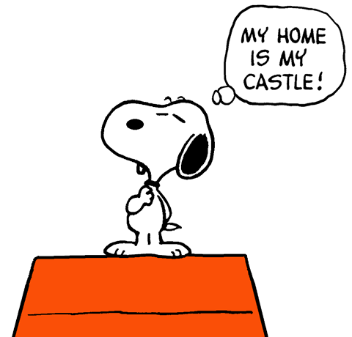
11. Homes
page 92-93, My Home, My Castle

Slide 2
Homework
Extra Practice, page 141
KL-5 Write phrases a-h in the conversation.
No, not
Do you think
What’s your opinion
Personally
e) not at all
f) I’m not sure
g) definitely
h) Do you
A: 1 C about students having jobs Ben?
B: 2 ____, I think they should have a part-time job.
C: 3 _____, student’s shouldn’t work, really. Students have to study. They should have time.
B. But in my opinion they have time to study and work. There are many countries where this happens.
A: 4______ that students should pay for their education then?
B: Yes, 5________. I don’t use education so why should I pay for other people?
A: Wow! 6_______ agree with that, Carol?
C: 7 __________at all. I think this country should have qualified people so we all have to pay for that.
A: Definitely. That’s right, Ben, isn’t it?
B: No, 8 ______________ ...

Slide 3
Homework
Extra Practice, page 141 key
A: 1 C about students having jobs Ben?
B: 2 Personally (D), I think they should have a part-time job.
C: 3 I’m not sure (F), student’s shouldn’t work, really. Students have to study. They should have time.
B. But in my opinion they have time to study and work. There are many countries where this happens.
A: 4 Do you think (B) that students should pay for their education then?
B: Yes, 5 definitely (G). I don’t use education so why should I pay for other people?
A: Wow! 6 Do you (H) agree with that, Carol?
C: 7 No, not (A) at all. I think this country should have qualified people so we all have to pay for that.
A: Definitely. That’s right, Ben, isn’t it?
B: No, 8 not at all (E) ...

Slide 4
reading
page 92

Slide 5
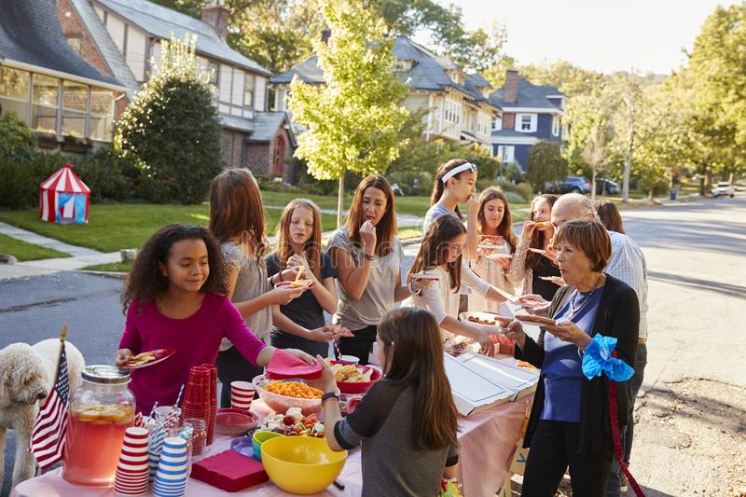
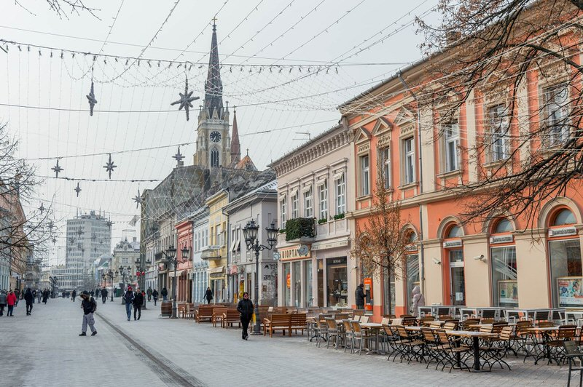
1. page 92, Work with a partner and answer the questions.
1. Describe the area where you live.
2. Do you feel safe in your area/in your home?
3. Look at the photo in the article. What is this place, do you think?

Slide 6
2. page 92, Read the article Separate Lives quickly and choose the best answer.
The article tells us about gated communities:
a) in the future
b) now
c) now and in the future
d) in the future, now and in the past

Slide 7
2. page 92, Key
The article tells us about gated communities:
a) in the future
b) now
c) now and in the future (see the Present Simple and Future Simple sentences)
d) in the future, now and in the past

Slide 8
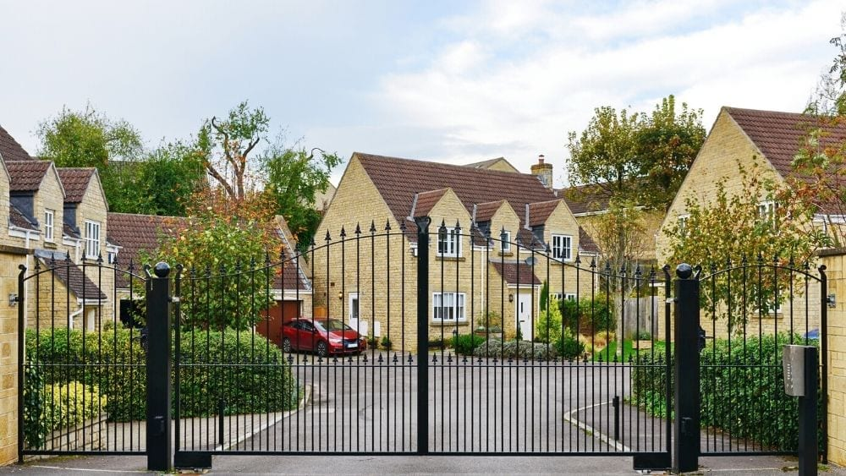
Separate Lives
A. What kind of homes will we live in 20 or 30 years from now? Some people think that many of us will live in ‘gated communities.’ There will be high walls and fences around our houses and flats. Security guards will control the entrances. Inside, there will be parks and play areas for children, supermarkets, business centres and travel agencies, restaurants, gyms and golf courses.

Slide 9
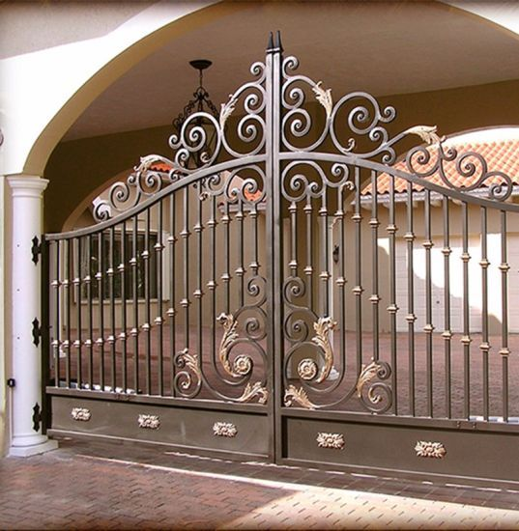
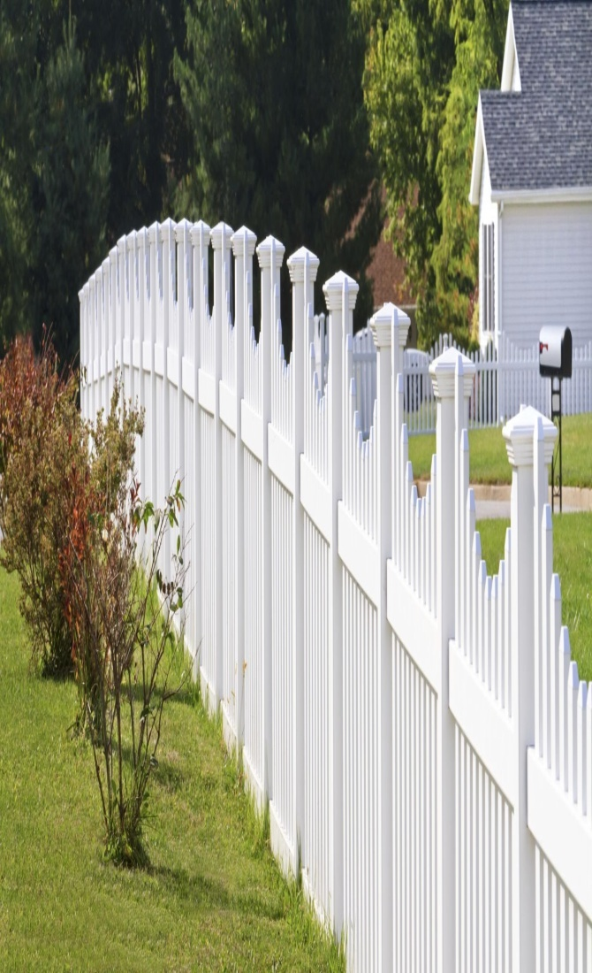
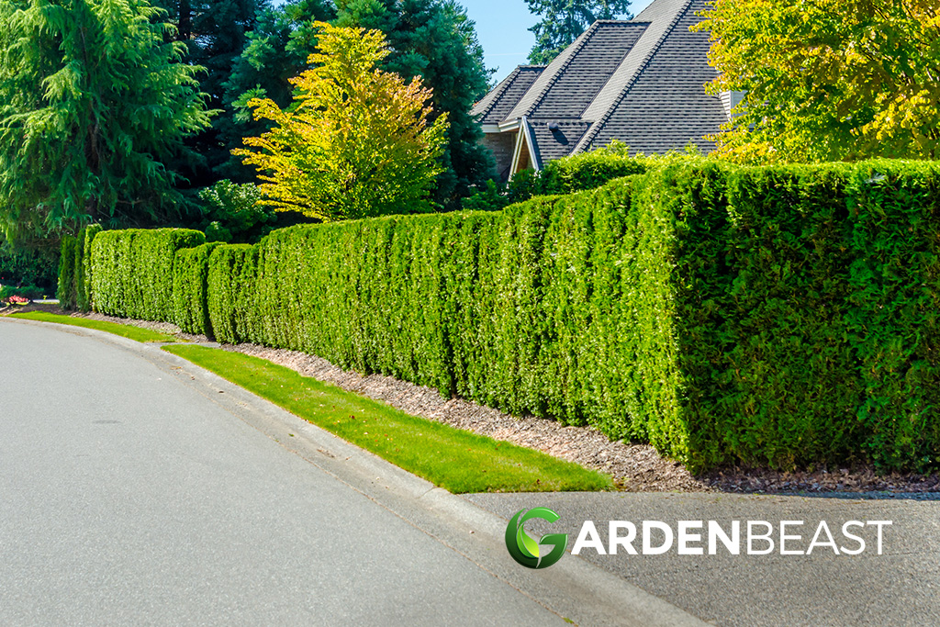
gate/ɡeɪt/, fence/fɛns/, hedge/hɛdʒ/ kapija, ograda, živica

Slide 10
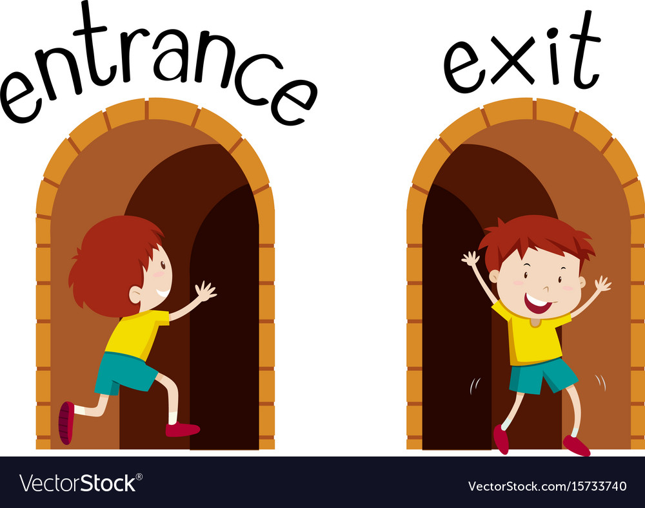
entrance exit

Slide 11
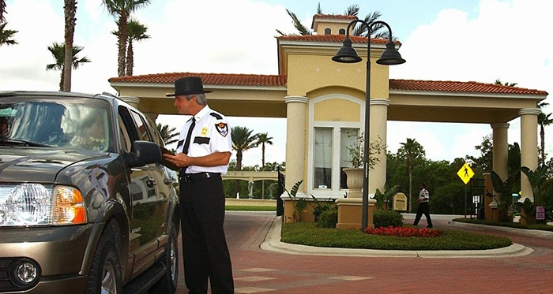
security guard/ɡɑːd/ stražar, čuvar

Slide 12
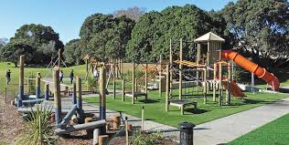
playground - igralište

Slide 13
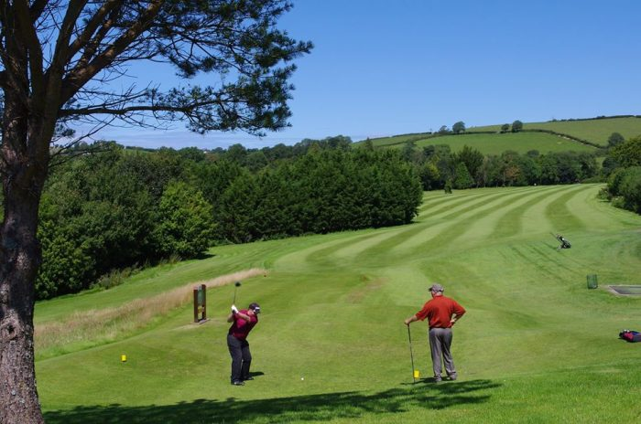
golf course teren za golf

Slide 14
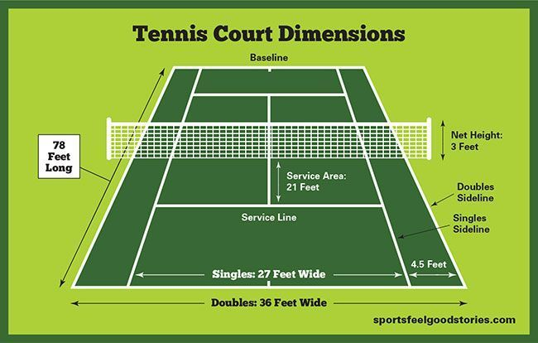
tennis court

Slide 15
teren
golf course
tennis court
basketball court
handball court
football pitch, football field
ice-skating rink (ledena dvorana za klizanje)
ski run (skijaška staza)
gym (teretana, gimnastička sala)
bowling alley (kuglana)

Slide 16
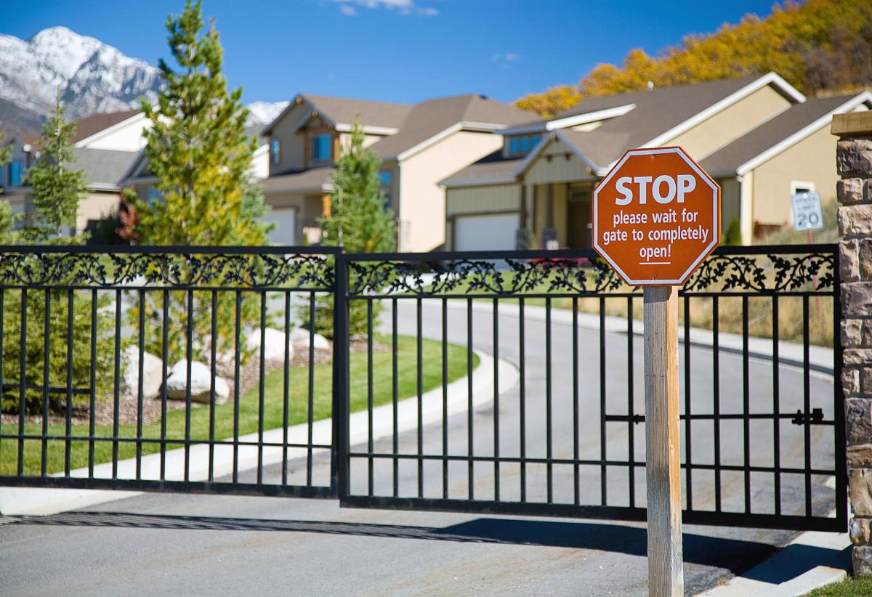
B.
These gated communities already exist in many countries. Some of them are like small towns, and in Brazil some even have there own schools. Of course, they aren’t cheap places to live in: at Beverley Park, in Los Angeles, houses cost between 12 and 32 million dollars

Slide 17
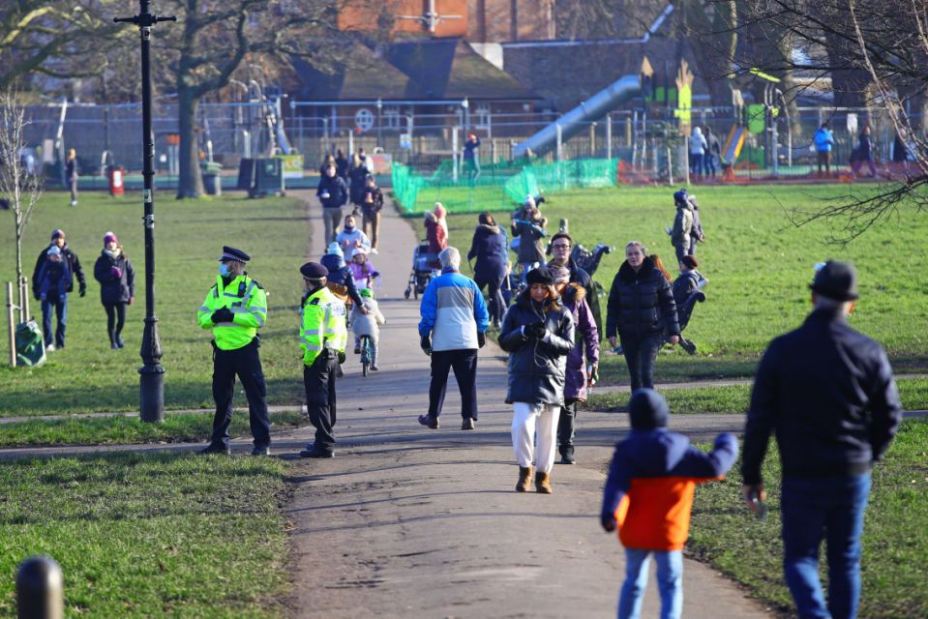
C.
It’s clear why people want to live in them. In Johannesburg, South Africa, 65 percent of residents feel unsafe in their homes at night. In many cities, public spaces like parks are sometimes dangerous. A gated community gives people a feeling of security and, after 9/11, people want to feel safe, especially in the USA.

Slide 18
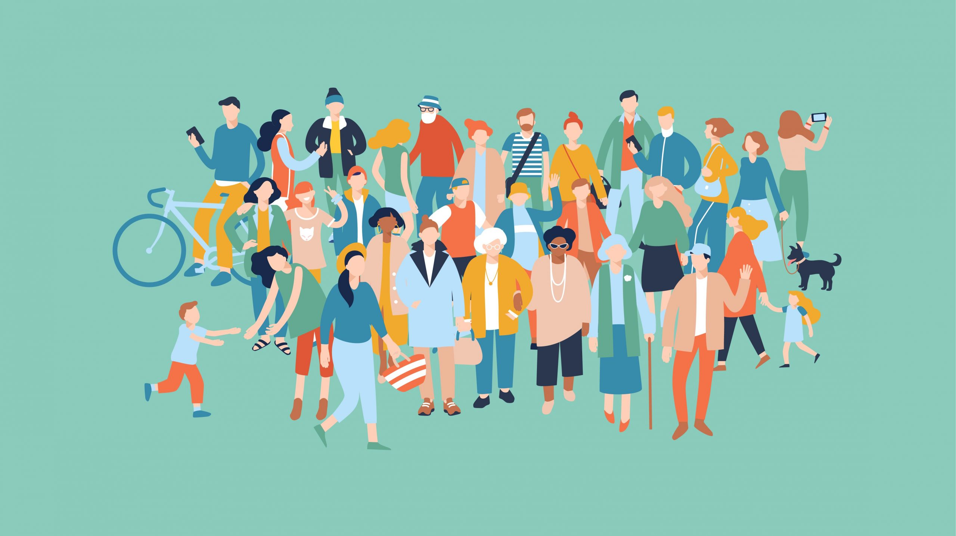
community = zajednica, naselje community centre = mesna zajednica

Slide 19
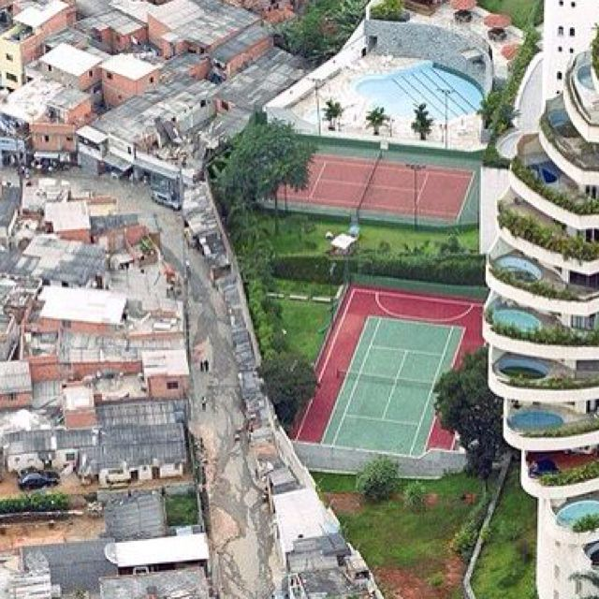
D.
But not everyone is happy about a future of gated communities, including some top police officers. They say that the people in the communities won’t mix with people outside. Also, the gap between the rich and the poor will increase, and society will become more dangerous.
to mix = to mingle, get together
gap = rift (jaz)

Slide 20
3. page 92, Read the article again.
Which of these ideas are in it?
1. Gated communities existed a long time ago.
2. Gated communities will have a lot of facilities.
3. You can already find these communities in many places around the world.
4. They are expensive to live in.
5. There is no crime in them.
6. Some people are against gated communities.

Slide 21
3. page 92, key
1. Gated communities existed a long time ago.
2. Gated communities will have a lot of facilities.
3. You can already find these communities in many places around the world.
4. They are expensive to live in.
5. There is no crime in them.
6. Some people are against gated communities.

Slide 22
4. page 92, Which paragraph (A-D) from the article is each sentence connected with?
1. People are nervous these days.
2. There will be cameras everywhere.
3. They say that people in the communities are too similar.
4. They will check people, bicycles and cars as they come in.
5. They are more common in the Americas and Africa than in Europe or Australia.
similar = alike (slično), opp. different

Slide 23
4. page 92, key
1. People are nervous these days. C
2. There will be cameras everywhere. A&C
3. They say that people in the communities are too similar.D
4. They will check people, bicycles and cars as they come in. A
5. They are more common in the Americas and Africa than in Europe or Australia. B&C

Slide 24
5. page 92, Do you think that gated communities are a good idea?
Personally, I don’t think that gated communities are a good idea because...
However, there are some good points such as...

Slide 25
6a. page 93, Look at these compound nouns (noun + noun).
Find three more compound nouns.
You can use some nouns more than once.
Which of these things can you see in your area?
security guards
play areas
business centres

Slide 26
6b page 93, Match nouns from A with nouns from B to make ten compound nouns. You can use some nouns more than once. Which of these things can you see in your area?
car internet police post railway shopping sports swimming tennis theme
café centre court office park pool station
A
B
e.g. internet café

Slide 27
grammar: will, won’t
page 93

Slide 28
7. page 93, Look at the first and the last paragraphs of the article and answer the questions.
1. Do we usually use will and won’t (will not) to talk about:
a) what is generally true in the present?
b) what happened in the past?
c) what we know or think about the future?
2. Do we add –s to will after he, she, it or there?
3. Do you know any other verbs with grammar like this?

Slide 29
7. page 93, key
1. Do we usually use will and won’t (will not) to talk about:
a) what is generally true in the present?
b) what happened in the past?
c) what we know or think about the future?
2. NO
3. CAN, MUST, COULD, SHOULD, WOULD

Slide 30
8. page 93, complete the sentences with will or won’t (will not) and a verb from the box.
be change have have to live meet
Gated communities ___________________ high walls.
There ________________ safe places where children can play.
People outside ____________ people inside.
Poor people _______________ in these communities.
People in these places _______________ leave the community very often.
The communities _____________ society in some ways.

Slide 31
8. page 93, key
be change have have to live meet
Gated communities WILL HAVE high walls.
There WILL BE safe places where children can play.
People outside WON’T MEET people inside.
Poor people WON’T LIVE in these communities.
People in these places WON’T HAVE TO leave the community very often.
The communities WILL CHANGE society in some ways.

Slide 32
9. page 93, Put the words in the right order to make questions.
Then ask and answer the questions with a partner
In the year 2100, …
1. families be will smaller than now bigger or ?
2. any fish there will in the sea be ?
3. the Internet use people will ?
4. people all their life will keep all their teeth ?
5. India will be the most important country ?
6. will love in relationships be important ?

Slide 33
9. page 93, key
In the year 2100, …
1. Will families be smaller or bigger than now?
2. Will there be any fish in the sea?
3. Will people use the Internet?
4. Will people keep all their teeth all their life ?
5. Will India be the most important country ?
6. Will love be important in relationships?

Slide 34
Discuss some ideas about your lives in the future. page 113. Read these sentences. Will these things be true for you in 2037? Tick the box that best describes what you think. Then ask your colleagues.
 | You |  |  |  | Your colleague
 | Yes | Perhaps | No | Yes | Perhaps | No
1. I’ll be in the same relationship as now.
2. I’ll own my flat/house.
3. I’ll speak four languages.
4. I wear jeans a lot of time.
5. I won’t laugh more than I do now.
6. I’ll be happy with my life.

Slide 35
Discuss some ideas about your lives in the future. page 119. Read these sentences. Will these things be true for you in 2037? Tick the box that best describes what you think. Then ask your colleagues.
 | You |  |  |  | Your colleague
 | Yes | Perhaps | No | Yes | Perhaps | No
1. I’ll be well known in my work.
2. I’ll live with my parents.
3. I’ll travel more than now.
4. I won’t have to worry about money.
5. I’ll feel old.
6. I’ll play a lot of sport.

Slide 36
HW
Read about the verb WILL, WON’T in Language Reference, page 142.
Read about Compound Nouns in Vocabulary, V1, in Language Reference, page 142.
Do exercises G1-1, G1-2, V1-6, page 143

Slide 37

Thank you for your Attention!

