Slide 1
Accommodation Options at Dysneyland® Paris
UNIT 9 Tourist Information
page 132,181

Slide 2
ACCOMMODATION
single room
double room
twin room
triple room
quad(ruple) room
family room
suite/ penthouse

Slide 3
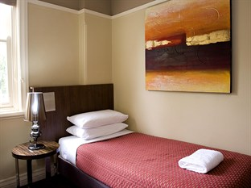
single room - one person
single supplement
10-100%

Slide 4
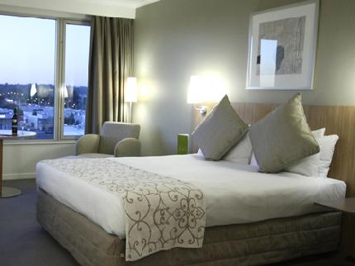
double room – two people or one person in one big bed soba sa francuskim ležajem

Slide 5
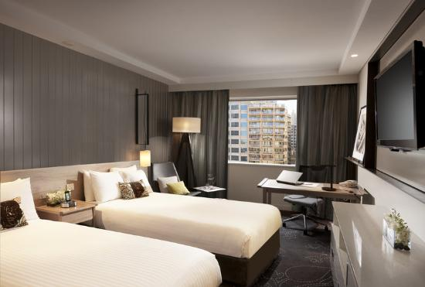
twin room two people in two separate beds

Slide 6
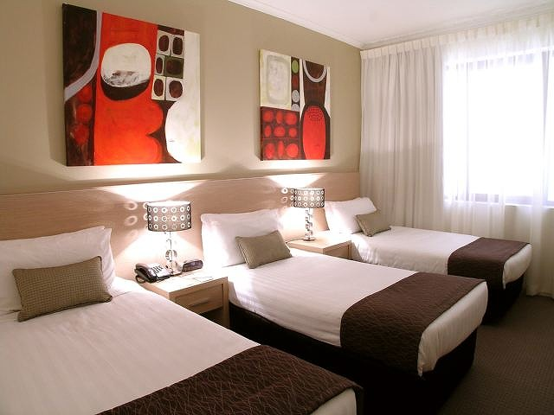
triple room

Slide 7
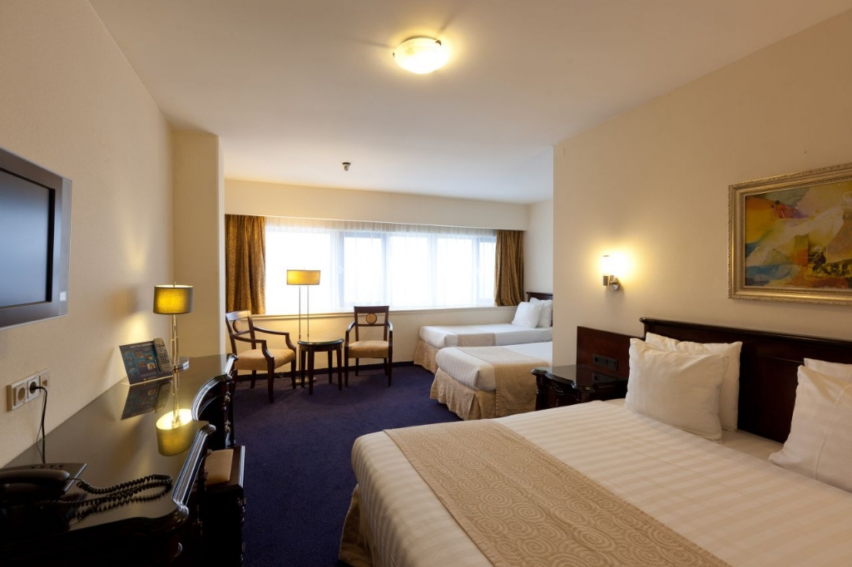
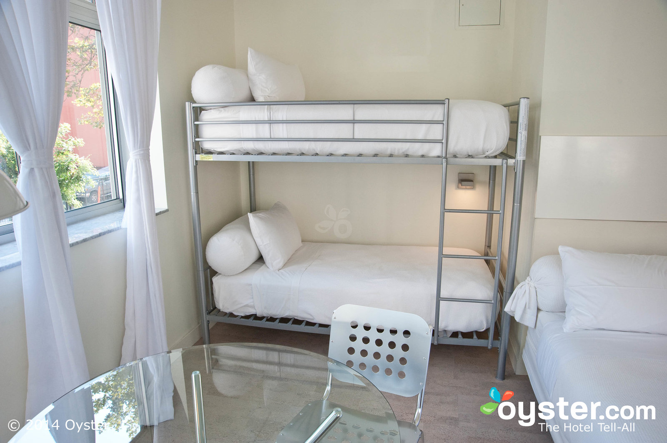
quad room

Slide 8
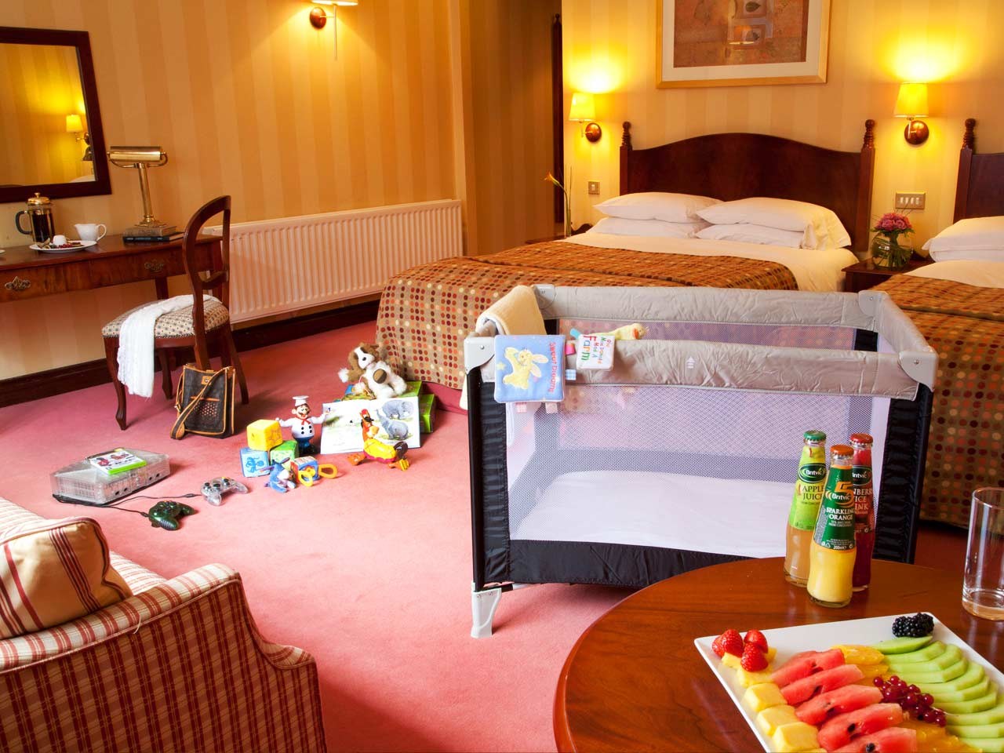
family room

Slide 9
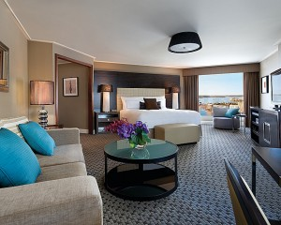
hotel suite

Slide 10
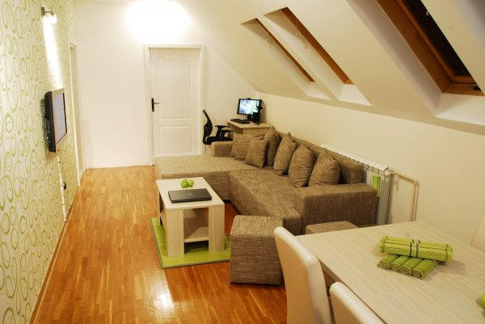
youth hostel (host+hotel) berge de jeunesse
aimed at the budget traveler and generally attracts a younger clientele - backpackers , students

Slide 11
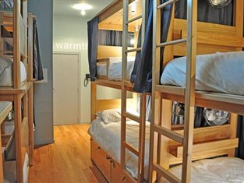
hostel
Bedrooms are in a dormitory style and bathrooms are shared, even though en suite bedrooms may also be available.

Slide 12
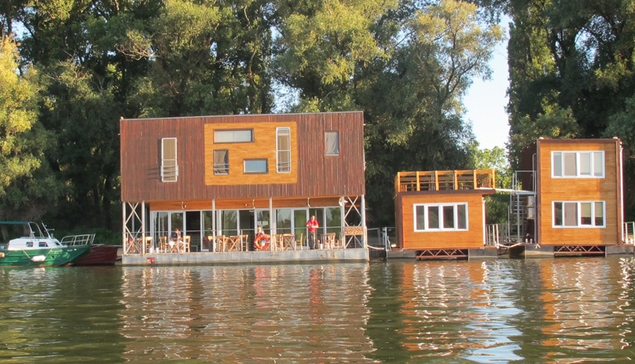
hostel
breakfast may be available in addition to the room rate
Today, the difference between the hotel &hostel is blurred.

Slide 13
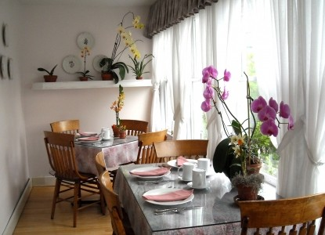
bed & breakfast (B&B accommodation)
a private home in which guests are accommodated in bedrooms (with or without private bathrooms)
the owner usually lives in the house and meets the guests
breakfast is included in the price, no other meals since they have no facilities

Slide 14
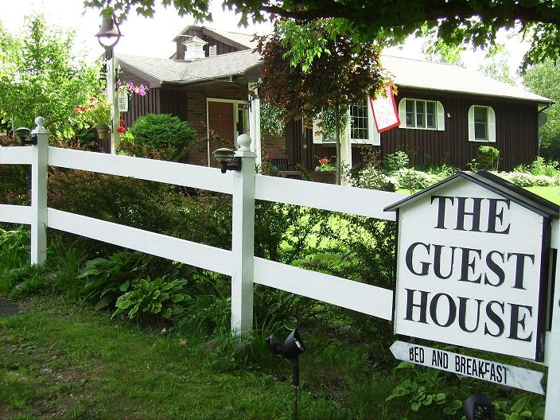
guesthouse
a guesthouse is a private home which has been converted for the use of guests
the owner either lives elsewhere, or in a separate area within the property.
guesthouse offers a wider range of services than a B&B, it usually caters for all meals.

Slide 15
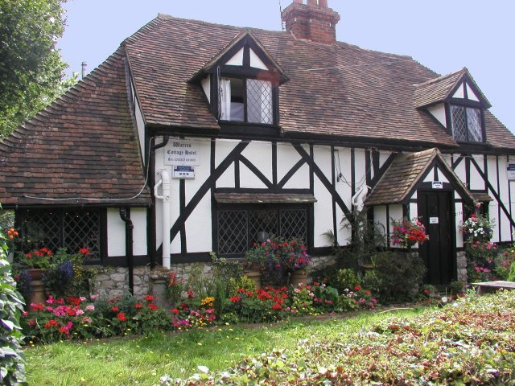
cottage
chalet
weekend house
villa

Slide 16
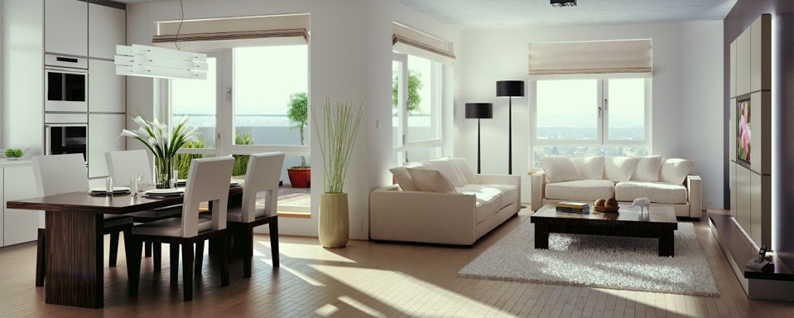
serviced apartments
furnished flat available for short or long stay
rent is paid by tourists, but not the bills

Slide 17
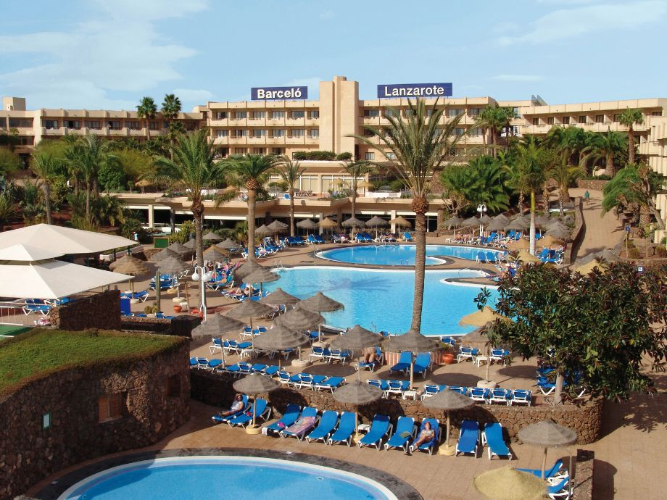
hotel
Hotel is the largest of all accommodation types.

Slide 18
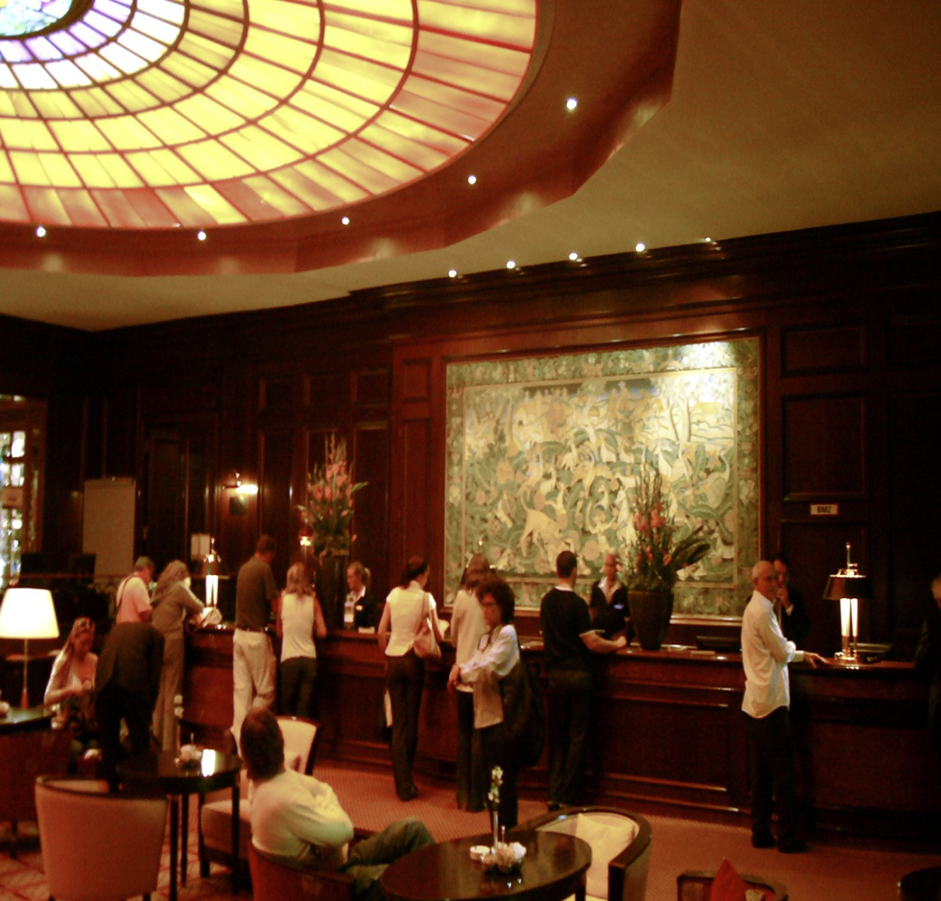
hotel
There is typically a reception area.

Slide 19
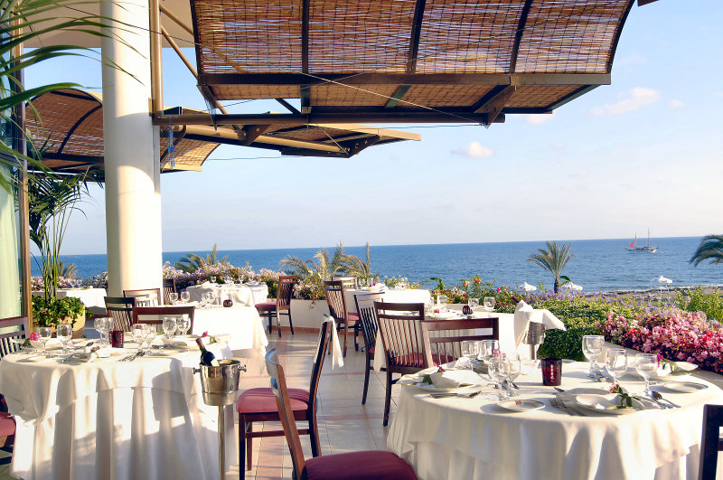
hotel
Its restaurant and other facilities are accessible for public.

Slide 20
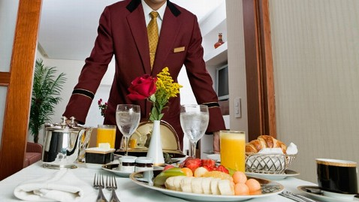
hotel
A wide range of guest services is available, such as room service.

Slide 21
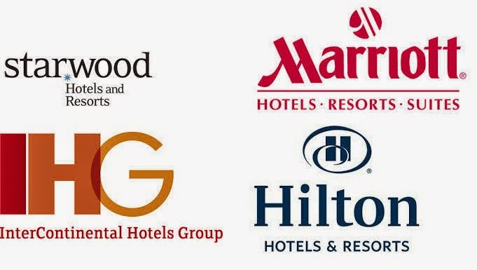
hotel chains
Hotels could be members of larger hotel groups/chains.

Slide 22
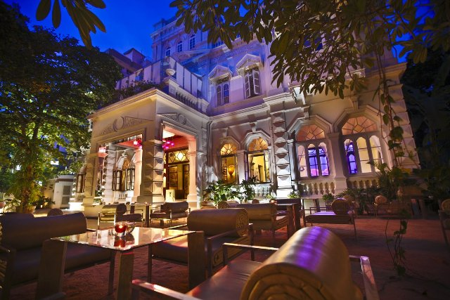
boutique hotel
It provides all the facilities of a 5 star hotel, in a unique and exclusive style.
They are generally smaller offering top class service

Slide 23
descriptions of hotels or other similar tourist/hospitality spaces.
The hotel boasts restaurants, a bar, a spa...
The hotel features a wide range of facilities.
The hotel enjoys panoramic views.
The hotel offers specialty dishes.
The hotel promises a great experience.

Slide 24
customer service
touches
benefits
opportunities
conveniences
advantages
priority access

Slide 25
description according to the PRICE
cheap/budget/downmarket/inexpensive hotel
(rock-bottom price)
economically-priced
reasonably-priced
moderately-priced
affordable
good value/value for money/worth every cent
luxury/upmarket
(exorbitant/prohibitive price)

Slide 26
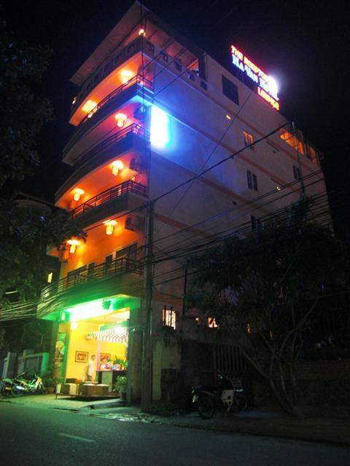
budget hotel
cheap accommodation with basic facilities.
backpacker’s lodge.

Slide 27
QUALITY
(prvoklasni, otmen, izuzetan, istančan)
top-notch
top-of-the-range
high quality
first-rate
first-class
superb
classy
fine
exceptional
exquisite
exclusive
high style

Slide 28
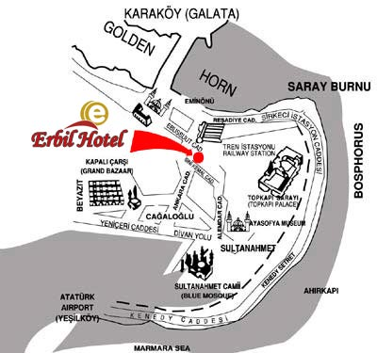
LOCATION
centrally-located = in the city centre
within the walking distance from/to...
within 10 minutes’ walk
within easy reach of the main shops
it’s a five-minute stroll (walk)...
on-site = done or situated in the same location
adjacent to (next to)
roof-top (pool)
at the convenient location

Slide 29
ORIGIN/CHARACTER
long-established - exists for a long period, with tradition and usu. renowned
family-owned
family-run = managed by the members of a family
traditional
in the grand tradition of
seaside/countryside

Slide 30
EQUIPMENT/SPACE
comfortable/comfy/cosy
spacious/roomy
self-contained
fully-equipped
fully-furnished
well-appointed

Slide 31
APPEARANCE&STYLE
magnificently-restored /redecorated/remodelled
old-style
friendly/inviting/welcoming
airy/illuminated
charming
turn-of-the century Victorian-style
art-deco
atmospheric
elegant/smart
incredible
majestic/grand/great/massive

Slide 32
APPEARANCE&STYLE
fabulous/astonishing/amazing
glass-enclosed (conservatory style)
have (nautical) flavour
glorious/notorious/famous/legendary
rustic/quaint
magical/enchanted/mesmerized
scenic
sparkling
enjoyable
opulent

Slide 33
categorization
It has three stars – it is a three-star hotel.
It has four stars – it is a four-star hotel.
It has five stars – it is a five-star hotel.

Slide 34
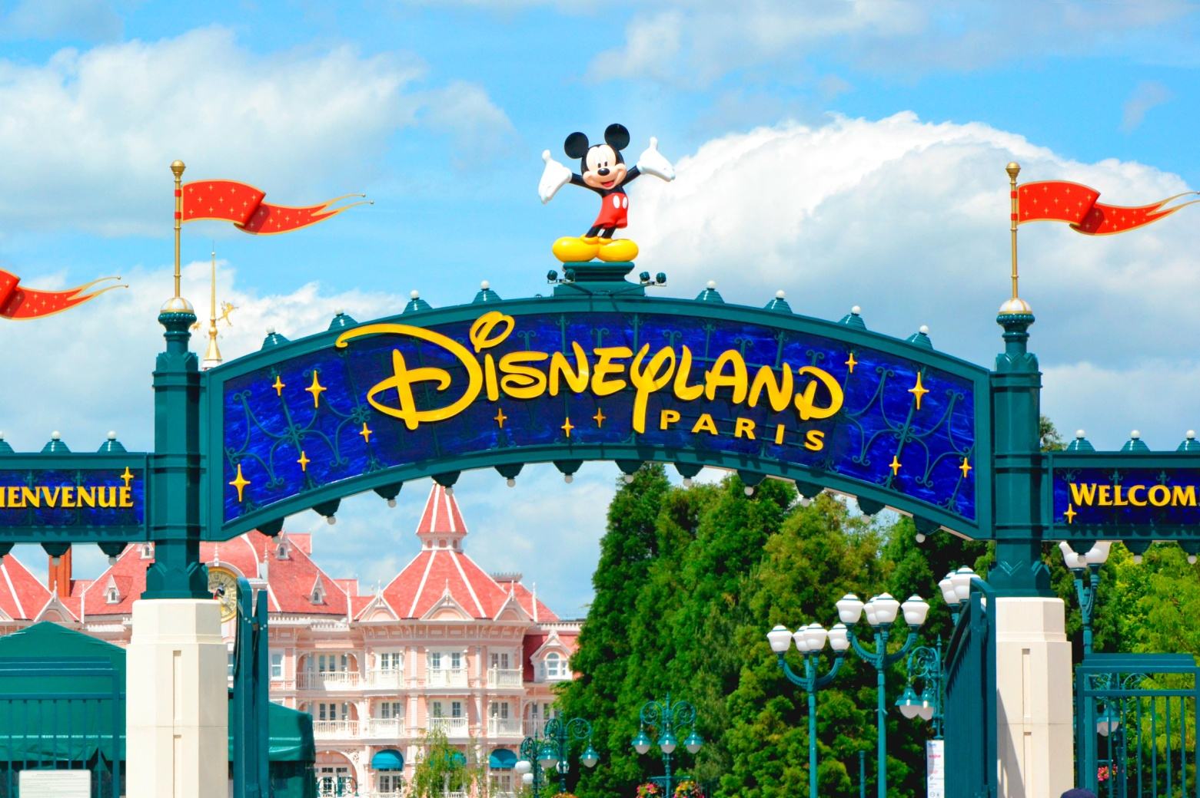
Watch https://www.youtube.com/watch?v=MU0jPWs_cjM https://www.youtube.com/watch?v=QLiXmX5A5Jg

Slide 35
page 132 and page 181 carefully themed and designed hotels with certain ambience/decor
(recreated atmosphere/reimagined) escape into a storybook vacation https://www.youtube.com/watch?v=MMYahiW9rVM
1. Hotel New York inspired by art deco architecture of New York
2. Sequoia Lodge inspired by pristine mountain landscape
3. Hotel Santa Fé inspired by Tex Mex setting
4. Disneyland Hotel inspired by turn-of-the century Victorian ambience.
5. Newport Bay Club inspired by yachting club
6. Hotel Cheyenne inspired by the Wild West

Slide 36
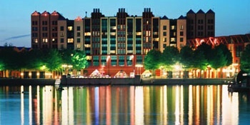

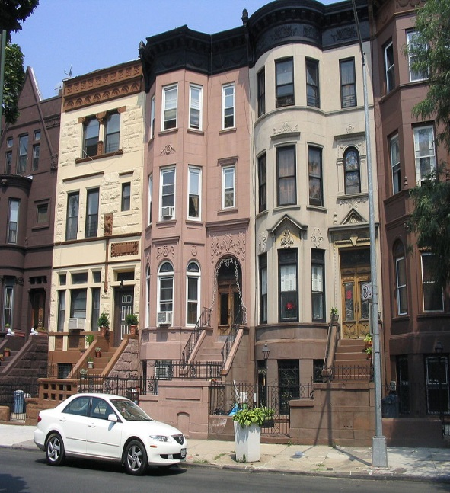
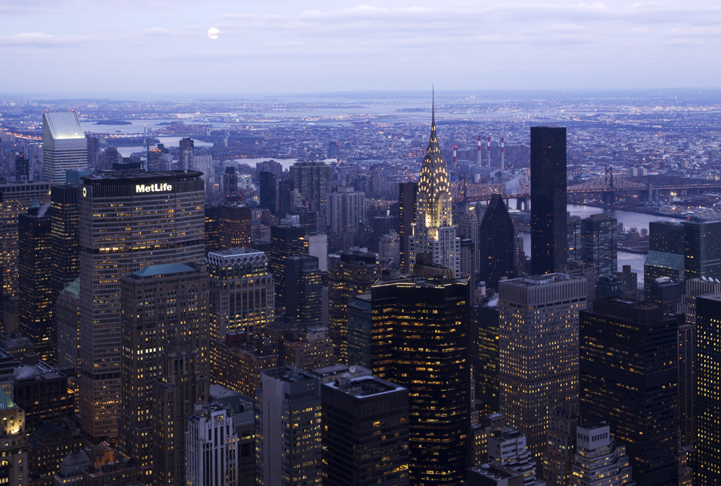
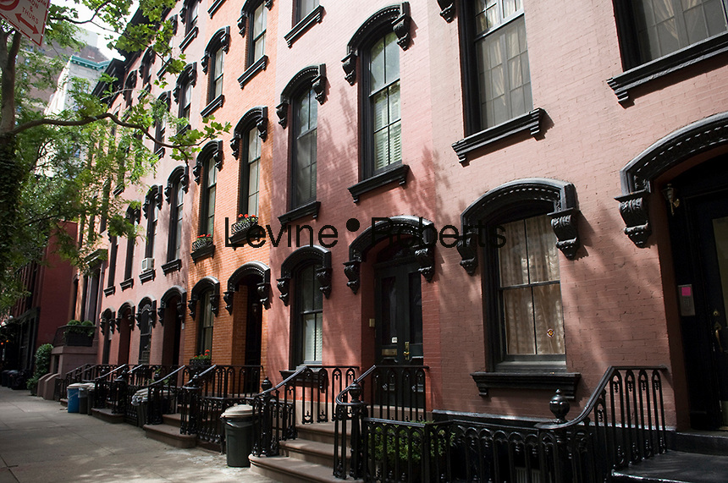
Hotel New York – Dysneyland **** from £ 228 room-only accommodation
Brownstones
Midtown Manhattan
Gramercy Park Rows

Slide 37
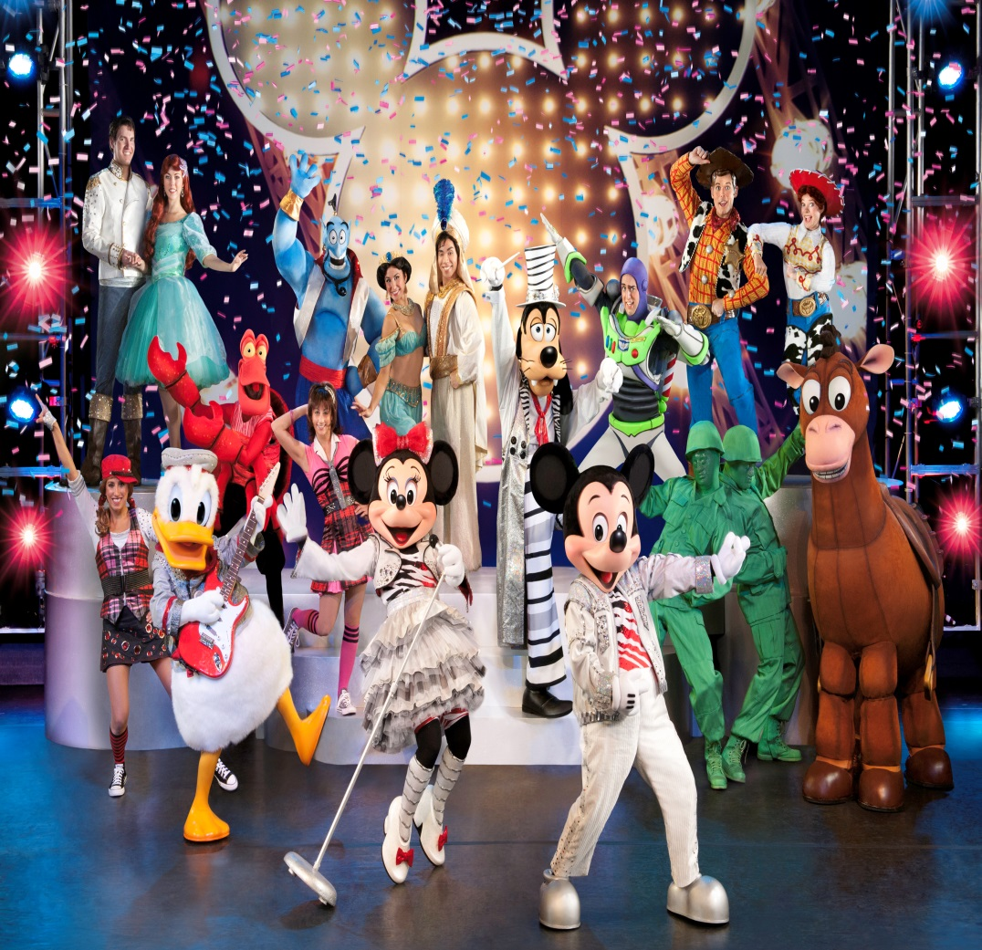
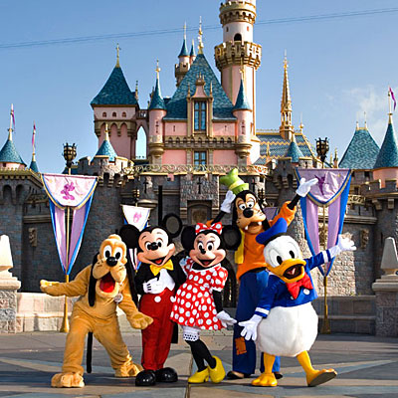
adjacent to the Festival Disney entertainment centre and a five minutes’ stroll from the theme park

Slide 38
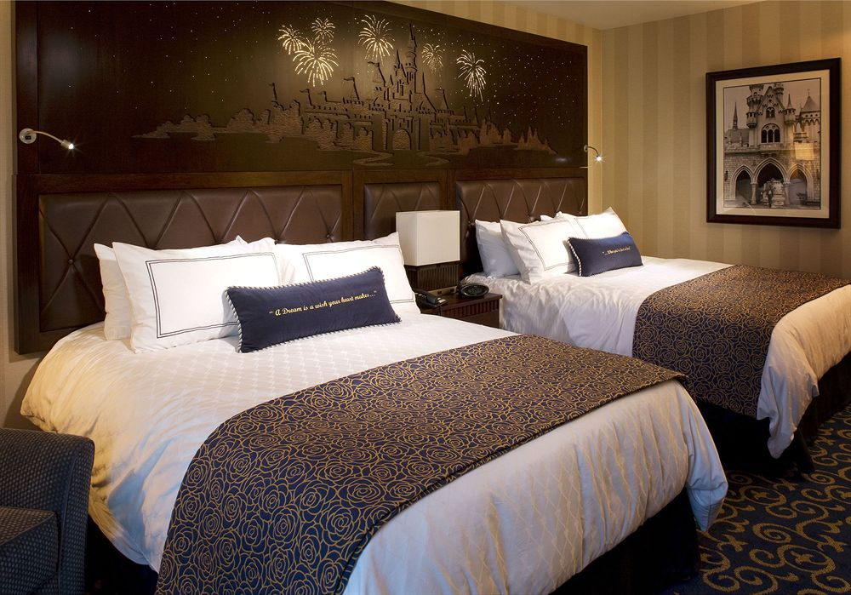
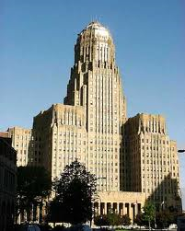
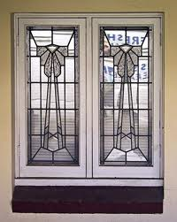
luxury rooms Art Deco design
(Cubism, Futurism, the Vienna Secession, Bauhaus)

Slide 39
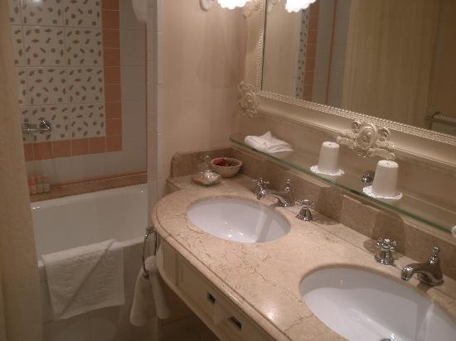
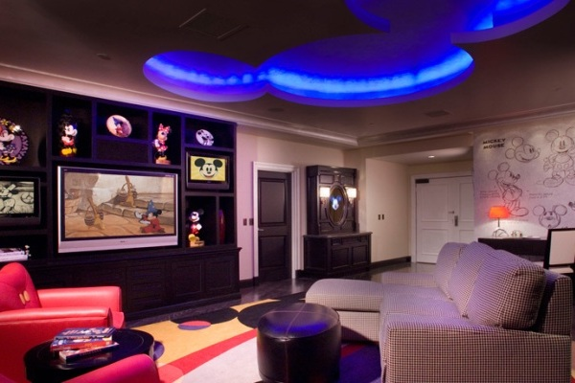
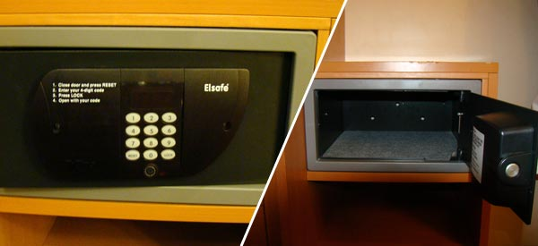
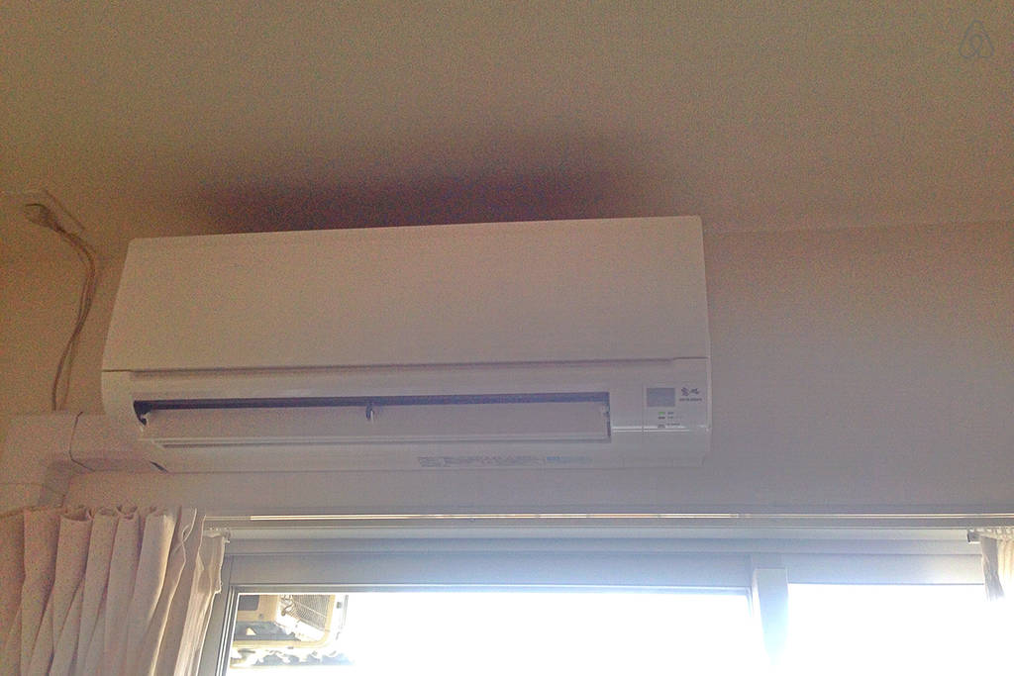
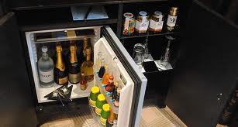
room facilities en-suite faciilities (private facilities)
air-conditioner
air-conditioning
TV set
satelite
mini bar
personal safe

Slide 40
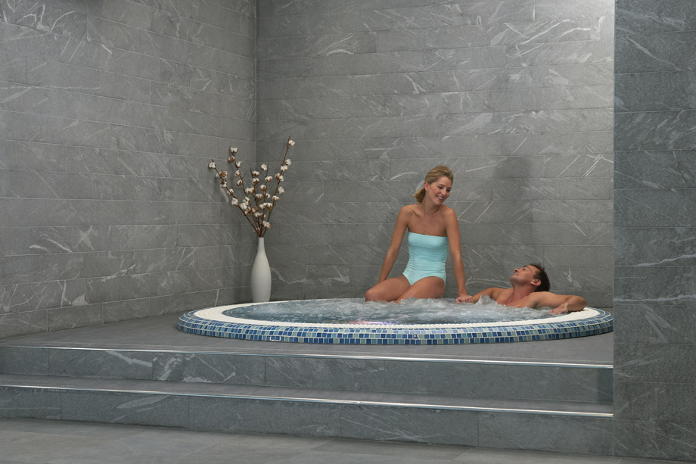
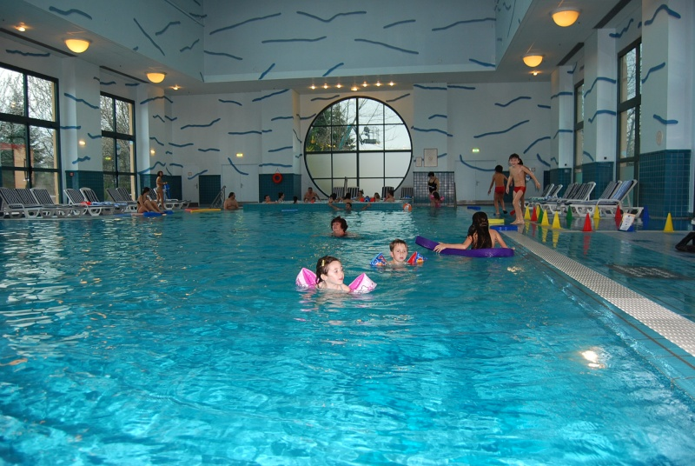
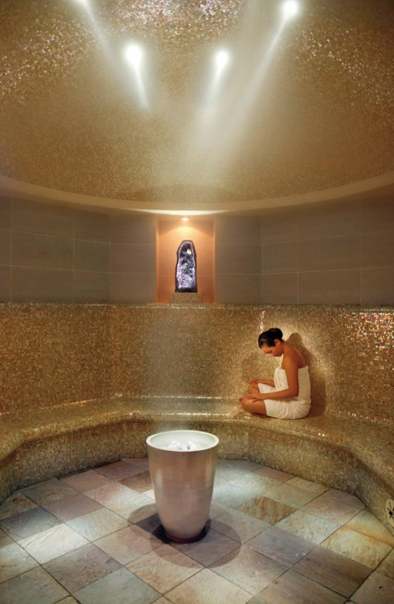
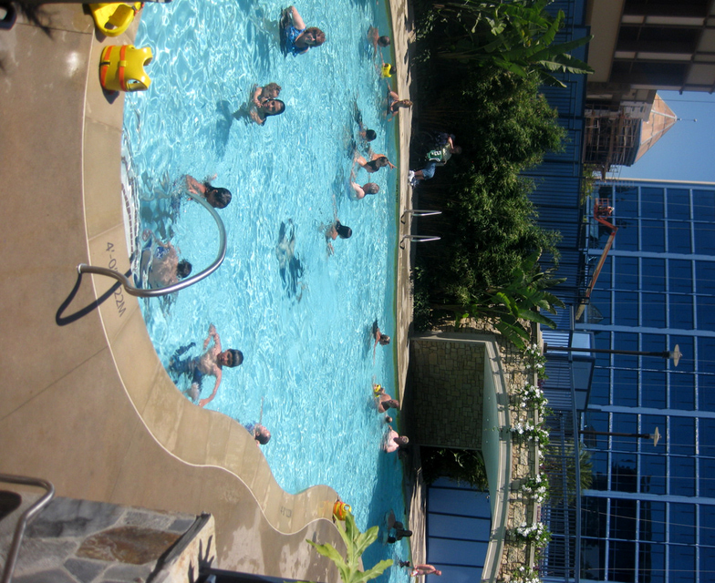
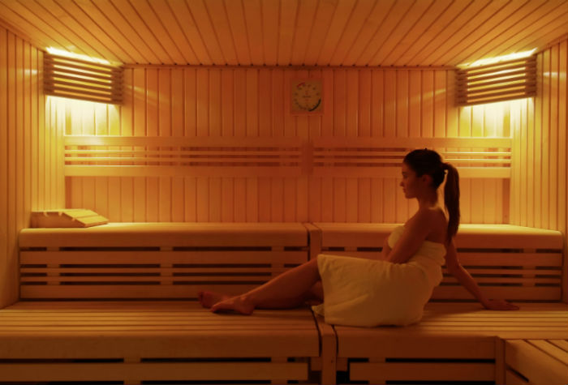
hotel facilities
health club
jacuzzi
sauna
steam room
heated indoor and outdoor pool

Slide 41
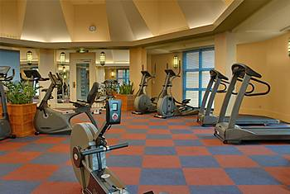
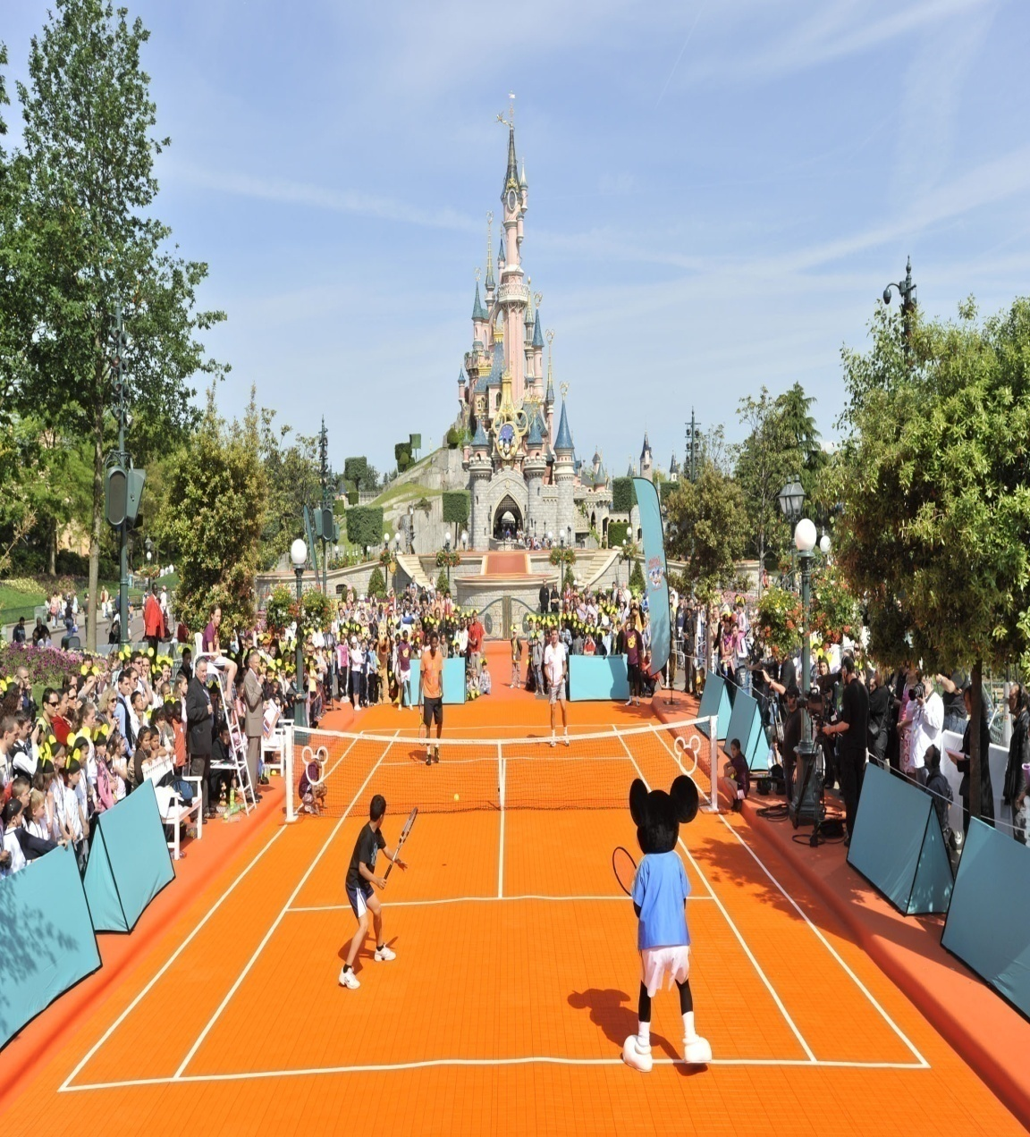
indoor gym outdoor tennis court

Slide 42
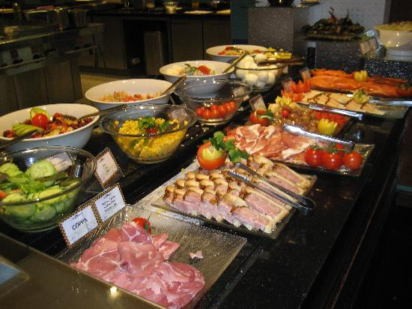
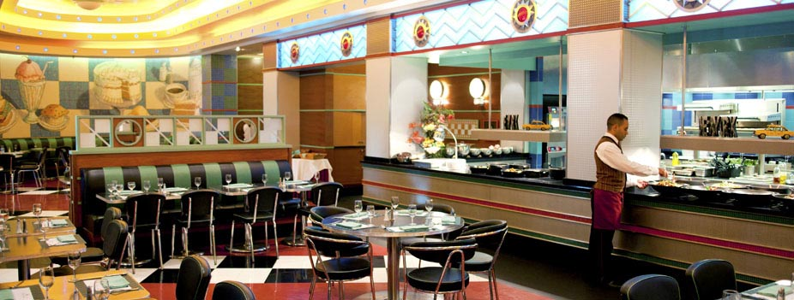
The Parkside Diner (small, informal& inexpensive restaurant that looks like a railroad car).
Buffet (švedski sto)
meals laid out on a table so that guests may serve themselves.

Slide 43
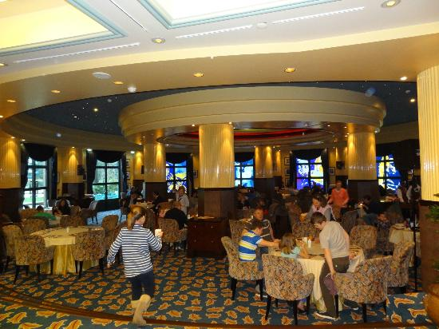
The Manhattan Restaurant
à la carte dining
a separate price for each dish on the menu

Slide 44
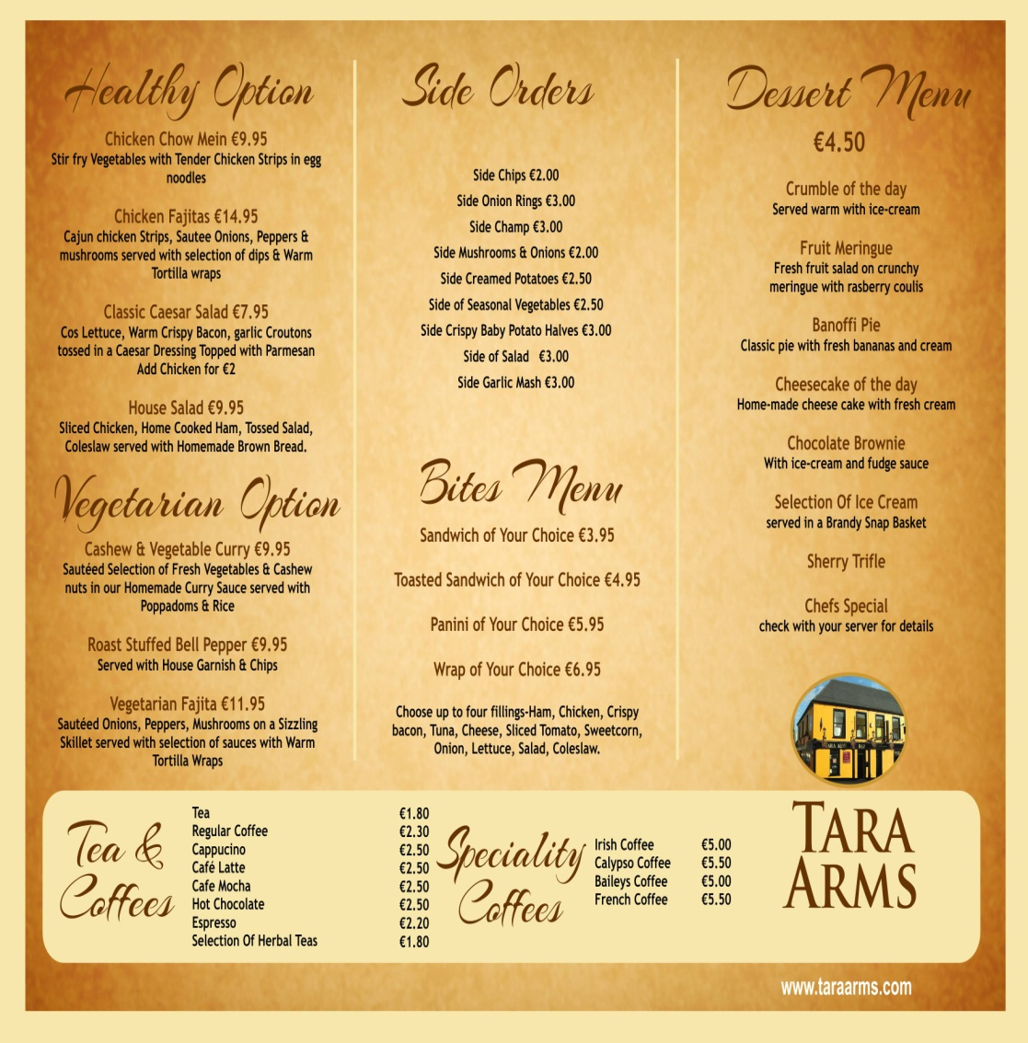
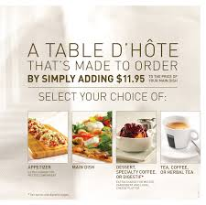
À la carte Table d'hôte (tourist menu)
courses (limited choice) served at a fixed time and price at a hotel or restaurant.

Slide 45


pre-dinner cocktail in the New York City Bar

Slide 46

Sequoia Lodge – Disneyland ***, near the lake room only accommodation from £ 185

Slide 47


Lodge – 1. small wooden house, in a forest, by a lake (a rustic cottage); ski lodge 2. (accommodation)
Sequoia - redwood tree
It evokes (reminds you of) hunting retreats (get-away) of a US National Park ; rustic (wooden, rural) ambience (atmosphere of the place)

Slide 48

room with the facilities
en suite facilities
TV with international channels
air-conditioning

Slide 49



coin operated = (vending) machine which runs when a coin is inserted
laundry

Slide 50


Hotel Facilities memorable indoor&outdoor pool with slides, cascades& jacuzzi

Slide 51

Hotel Facilities
Health club with sauna, jacuzzi,
steam room, gym
Supplement for sunbed/massage
Children’s playground

Slide 52



Hunter’s Grill Restaurant Beaver Creek Tavern
BBQ- barbecue
Grilled meat

Slide 53

unwind (relax) by the fireside in the Redwood Bar&Lounge

Slide 54


Hotel Santa Fé – Disneyland ** from £ 167 room only accommodation
Pueblo style village
(Mexican)

Slide 55


Nestling (nestle – gnezdo) on the banks of Rio Grande river
Desert trails (roads) wind (zigzag) through the site with the trading post, adobe (dry mud and straw for building) architecture evoking the American south-west.

Slide 56

smart (tidy and elegant) rooms - two large double beds, private bathroom (bath, shower), DD telephone, ceiling fan, TV with international channels, laundrette

Slide 57


La Cantina The Rio Grande
Tex-Mex specialties
Mexican food market buffet
‘on route 66’
Contemporary evening entertainment

Slide 58


Disneyland® Hotel **** watch https://www.youtube.com/watch?v=n-qXQmIWt7Q room-only accommodation
from £ 263
A distinctly (prominently, clearly)
turn-of-the-century Victorian ambience
At the gateway to the theme park

Slide 59

This superb (exquisite, fine) hotel is the centre of this fabulous (astonishing) resort.

Slide 60

stylish bedrooms
Private facilities
TV with international channels
Mini bar
Hair-dryer
DD telephone
Air-conditioning

Slide 61


The hotel boasts (can be praised for) a heated indoor pool, health club with sauna, jacuzzi, steam room, gym, sunbed&massage (surcharged)

Slide 62

The elegant California Grill

Slide 63


Inventions – a buffet restaurant

Slide 64

Café Fantasia décor inspired by the film of the same name
Guests may register credit card details on arrival and enable meals and other purchases throughout the resort to be charged to their room.

Slide 65


Newport Bay Club *** from £ 191 room only accommodation
In grand tradition of a New England
seaside resort.
yacht club atmosphere

Slide 66


pavilion = building in parks for sports, concerts, exhibitions (Cvijeta Zuzurić Pavillion)
Within 10 minutes’ walk of the theme park

Slide 67

Smart bedrooms have a nautical flavour (taste) and are furnished with two large double beds.
Private bathroom
TV with international channels
Mini-bar
Air-conditioning
Coin-operated laundry
Ice machines on every floor

Slide 68

leisure facilities- glorious (magnificent) heated indoor/outdoor swimming pool pavilion; health club with sauna, jacuzzi, gym, steam room.
extra charge for sunbed&massage
children’s playground

Slide 69


Cape Cod buffet-style menu
The Yacht Club
specialty steak and seafood

Slide 70

Fisherman’s Wharf cocktails, piano music, panoramic views
Guests may register credit card details on arrival and enable meals and other purchases throughout the resort to be charged to their room.

Slide 71


Hotel Chayenne** from £174 room only accommodation
frontier-style – Wild West
wooden walkways, covered porches (portico, veranda) Indian village, Fort Apache play area

Slide 72

It is on the left bank (river side) of the Rio Grande river, superbly (delightfully, elegantly) themed
The Western styling runs right through to the bedrooms

Slide 73

rooms are suitable for families – one double bed and two bunk beds
Private bathrooms
(bath and shower)
ceiling paddle fan
TV international channels
DD telephone

Slide 74

amenities
Coin-operated guest laundry
Free Parking Lot
Currency Exchange
Dry Cleaning
Free Wi-fi
Free Shuttle Service
International TV channels
Free Baby Cot

Slide 75


Texas-style Chuckwagon Café Red Garter Saloon
BBQ specialties country music

Slide 76
References:
Official Website:
http://www.disneylandparis.co.uk/
Disney Travel Pros Channel
https://www.youtube.com/user/DisneyTravelPros/featured
Beyond the Theme Park at the Disneyland Resort
https://www.youtube.com/watch?v=MU0jPWs_cjM
Hotels of Disneyland Resort
https://www.youtube.com/watch?v=QLiXmX5A5Jg
Disneyland Paris Hotels
https://www.youtube.com/watch?v=MMYahiW9rVM
Disneland Hotel Disneyland Paris
https://www.youtube.com/watch?v=n-qXQmIWt7Q

Slide 77

Thank you for your Attention!

