Slide 1
Holiday Advertisements
pages 156 - 157

Slide 2
Holiday Advertisement
Here are some advertisements for specialist holidays. Read them quickly and identify the type of holiday being advertised in each one. Which of these are related to adventure tourism?
EXODUS Discovery Holidays Ring for Brochures 0181 673 0859 (24h) LEADERS IN SMALL-GROUP ADVENTUROUS TRAVEL WORLDWIDE
https://www.exodus.co.uk/

Slide 3
Are you interested in joining a group for a very special religious walk?
THE PILGRIMAGE
OF THE CAMINO
DE SANTIAGO
A pilgrimage to the
tomb of St James the Apostle:
a 100-mile walk to the ancient religious
site in Santiago de Compostela
in north –west Spain.
Departing from Le Puy
in the French Auvergn late April,
and returning in late July
Contact: Maureen O’Connor
on 9762184

Slide 4
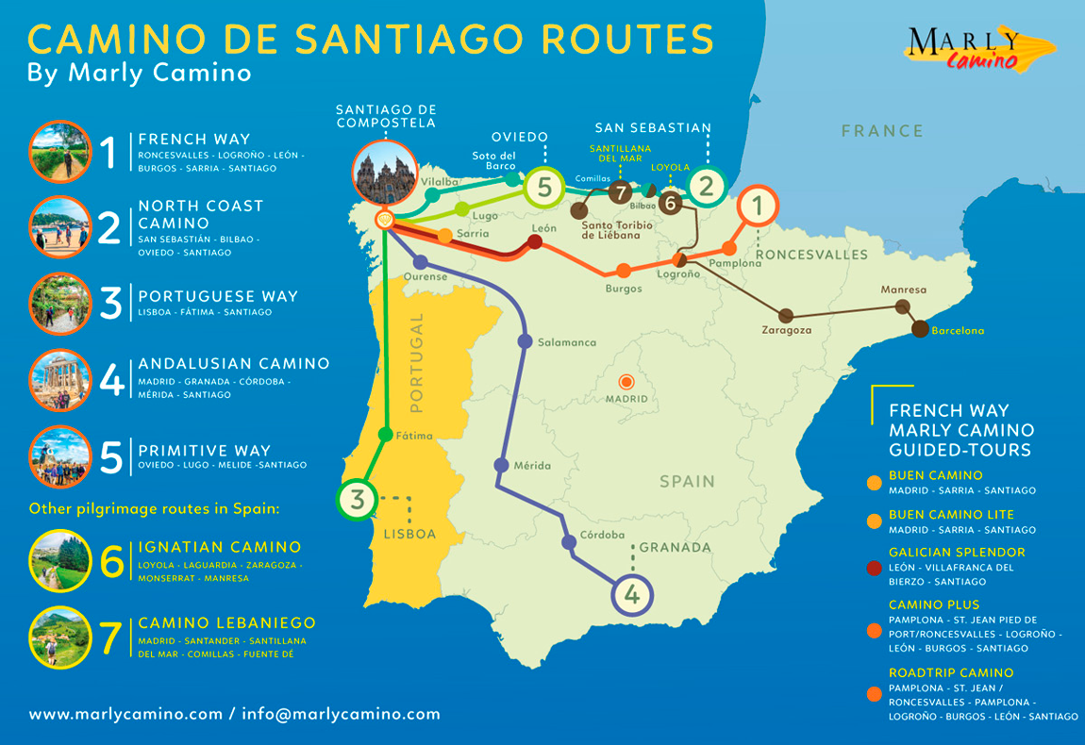
https://www.youtube.com/watch?v=E_2sGATllOM

Slide 5
To India in Search of Rhino page 156.
Our 18-day escorted tour takes you from Delhi, Agra (and the Taj), to Darjeeling and Sikkim, Shillong and Calcutta, tribal villages and Buddhist monasteries, to Kaziranga and elephant safaris to view rhino. Including first-class hotels wherever possible and British Airways’ scheduled flights , that’s unusually good value at £2095.00 pp. For a free brochure call:
0717 487 9111 (24hrs)
GREAVES TOURS
https://www.greavesindia.co.uk/
33 MARYLEBONE HIGH STREET LONDON WIM 3PF
FAX : 0171 486 0722

Slide 6
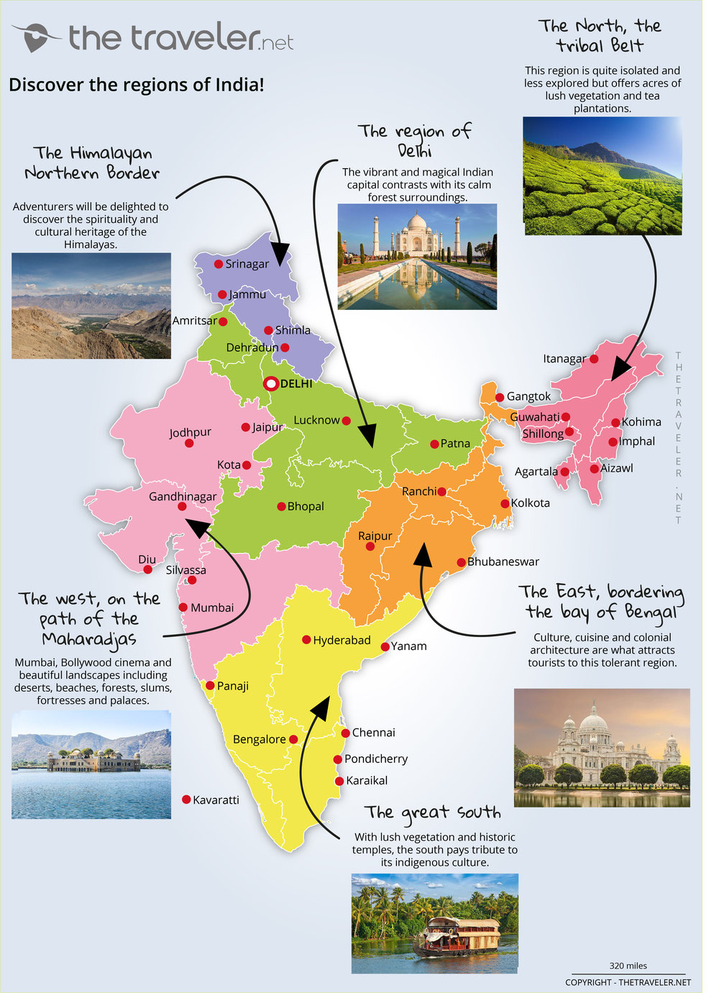
https://www.youtube.com/watch?v=SFU_60zB4vs

Slide 7
4. Leave the ordinary behind
You love to ski or snowboard but you are ...tired of hard-packed runs, lift lines and crowded slopes?
You have heliskied but you are... wondering if there is something beyond the experience of heliskiing with three or more groups using the same helicopter?
Yes...it’s time to join us in British Columbia’s Cariboo/Chilcotin mountains for Canada extraordinary Helicopter Skiing experience.
Advanced to expert skiers and boarders will find lots of powder, diversified terrain, and challenging runs in a huge area! Intermediate skiers and boarders will find our new Heli-Relax groups the perfect way to experience the most exciting skiiing on earth!
All will find our exclusive service of skiing with only two groups per helicopter and our fantastic mountain lodge facility the perfect way to enjoy the most outstanding ski vacation ever.
Your powder paradise is located 62 miles (100 km) north of Whistler Resort, British Columbia, Canada

Slide 8
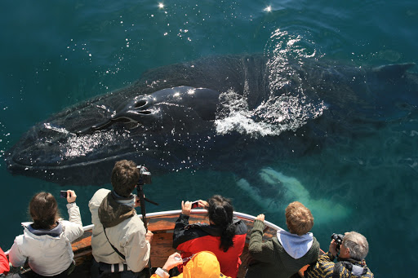
OCEAN ADVENTURES
Journeys in search of wild places and wild nature
ANTARTICA
from £2150 ! also: Arctic Regions
Brochures: Two Jays, Kemple End, Stonyhurst, Lancanshire BB7 9QY
Tel: 01254 – 826116
Fax: 01254 -826780 ATOL 2937
https://www.oneoceanexpeditions.com/antarctica
https://www.youtube.com/watch?v=Ubvv20FovPk

Slide 9

6. page 157,
EXCEPTIONAL SAFARIS – EXCEPTIONAL STANDARDS
THE EXCLUSIVE AND WORLD-RENOWNED MALA MALA PRIVATE GAME RESERVE PROVIDES THE DISCERNING TRAVELLER WITH A WILD LIFE AND BIG GAME EXPERIENCE SECOND TO NONE:
45, 000 acres of privately owned, pristine Bushveld situated on the banks of the Sand River with an unparalleled 37 Kilometres of river frontage.
Last year over 87% of guests who stayed two nights or more saw the big five –elephant, rhino, buffalo, lion, and leopard
choice of three camps – Main Camp, Kirkman’s Kamp and Cottage , and Harry’s Camp
Mount Andersen ranch lies in 20, 000 acres in Drakensberg Mountains and provides an exclusive haven for an unforgettable fishing and wildlife getaway
Limited to six guests
Accommodation and service of the highest standard.
excellent facilities for the wildlife enthusiasts with safaris offered by horseback, vehicle, or on foot.
In addition, Safari Desk also represents other fine safari destinations including the unique Mashatu Game Reserve in Botswana and the legendary Ker and Downey camps in the enigmatic Okavango Delta.
For further information:
Safari Desk
SAFARI DESK

Slide 10
2. page 157, Listen to the conversations on the phone. In each case the enquirer is asking for more detailed conversation about one of the advertised holidays.
1. Which advertised holiday is being discussed?
Conversation 1_________________________
Conversation 2_________________________
Conversation 3_________________________

Slide 11
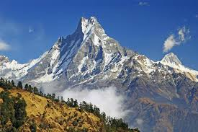
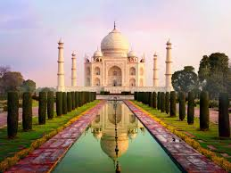
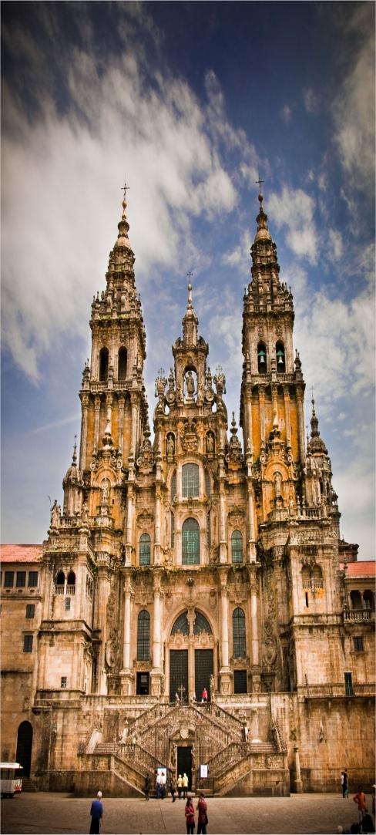
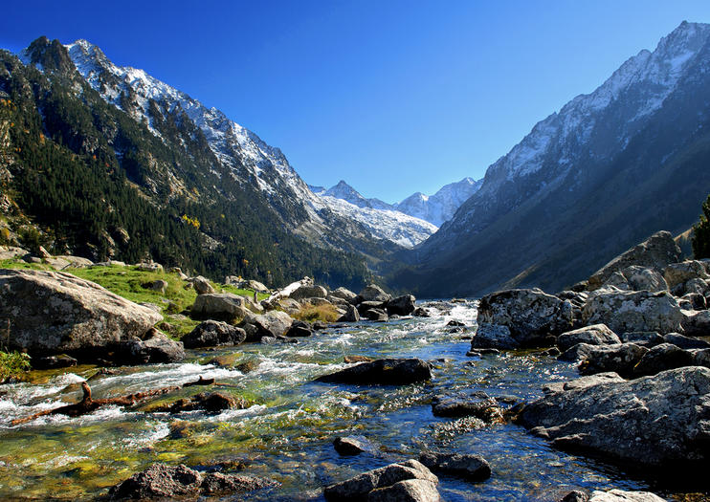
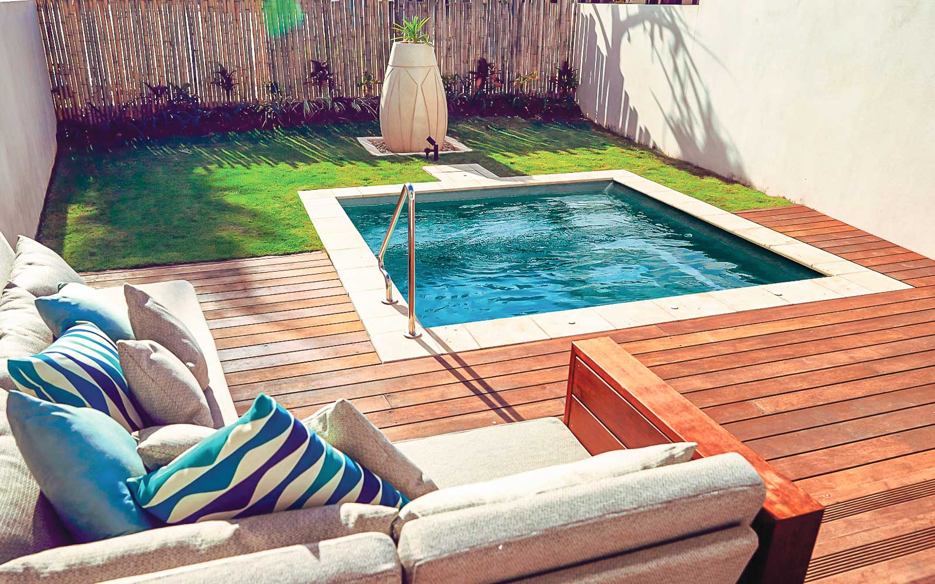
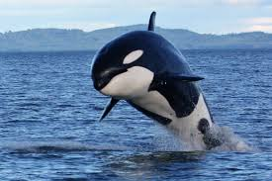
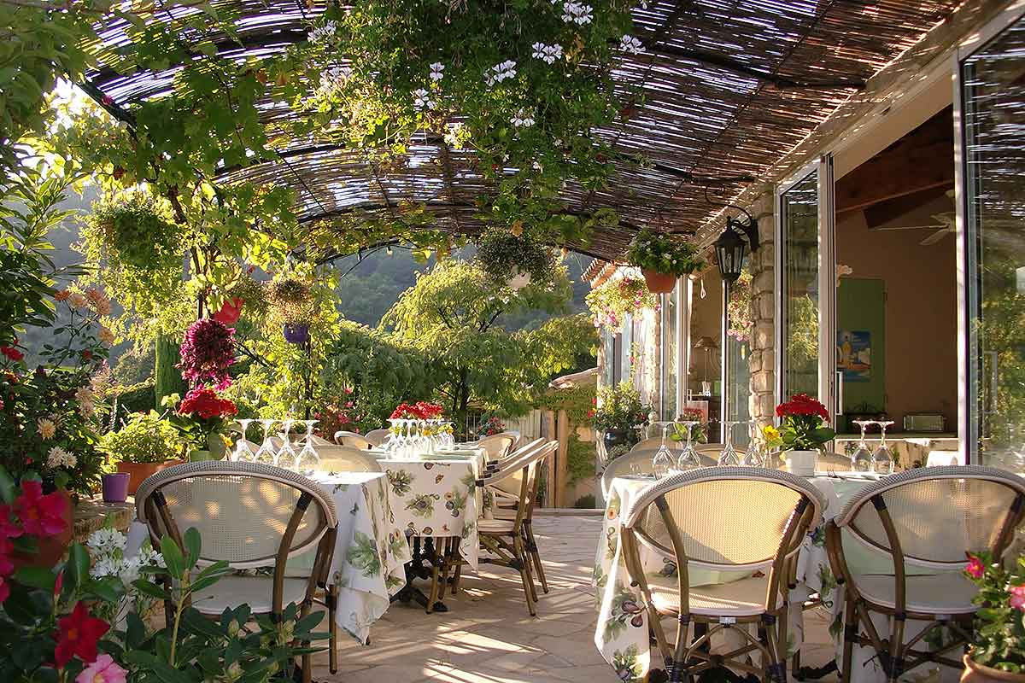
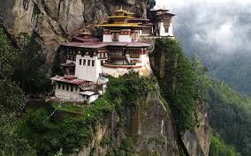
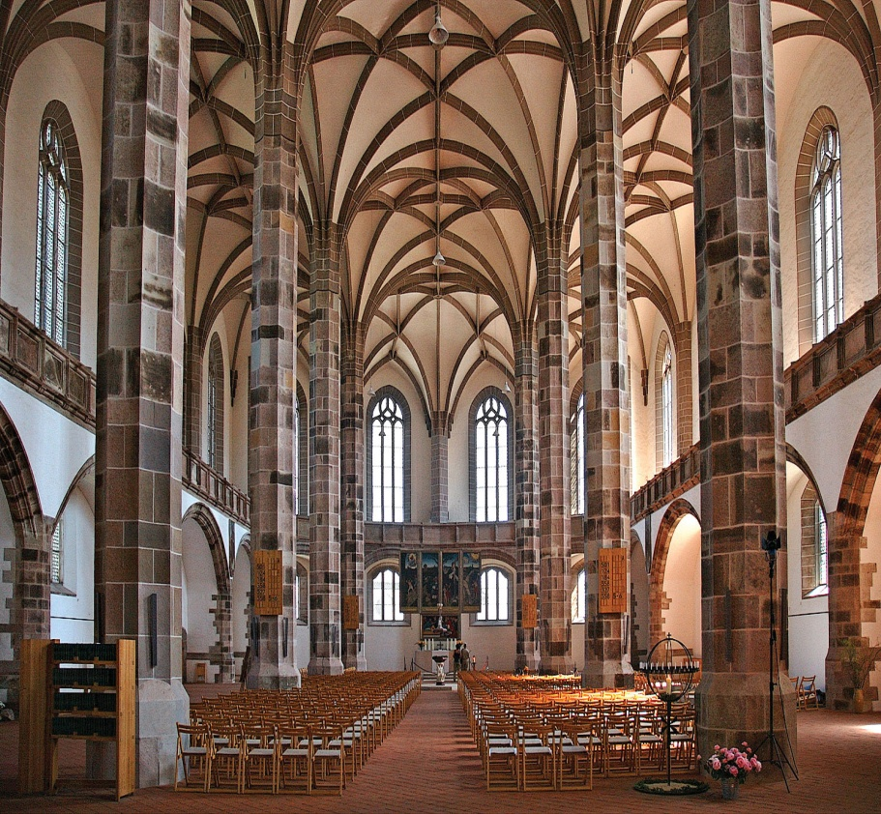
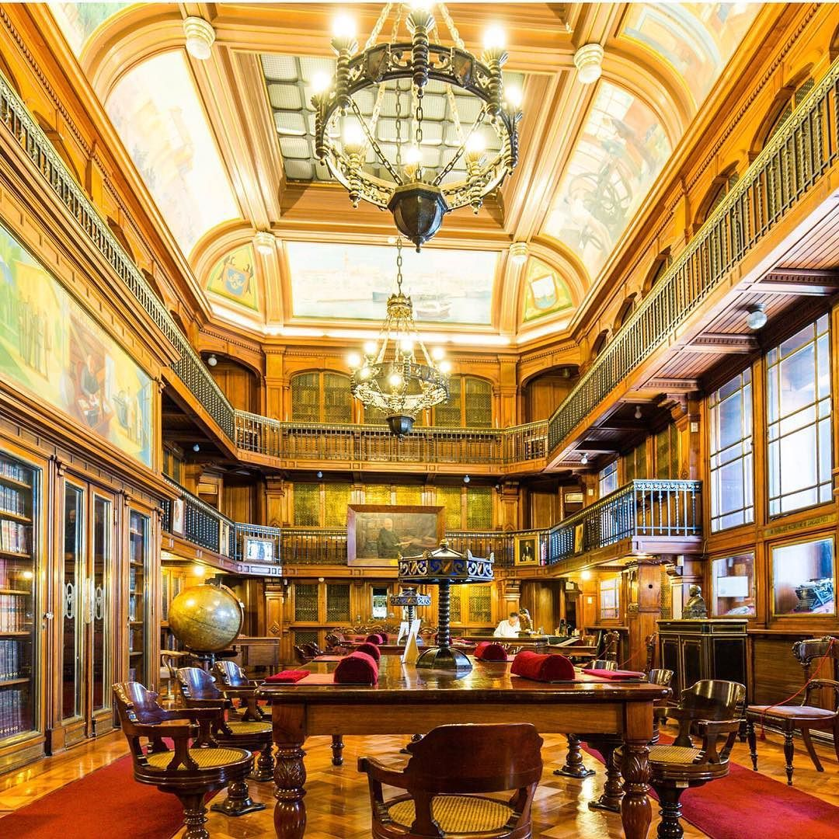
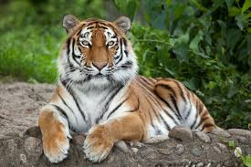
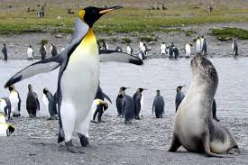
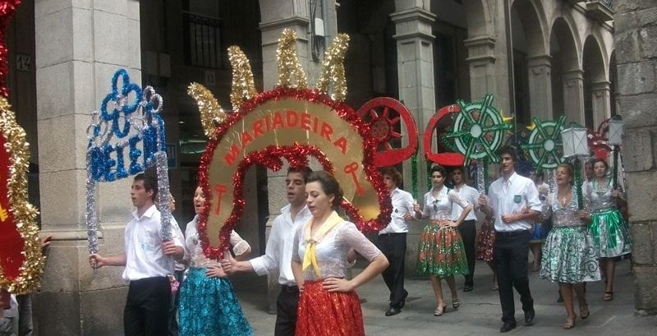

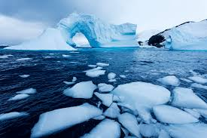
2. page 157, In which of the holidays are these places and things mentioned?
bed&breakfast
Buddhist monasteries
cathedral
fiesta
glaciers
Himalayas
library
orchids
penguins and seals
plunge pool and sauna
Pyreenes
church halls
Taj Mahal
tigers
whales

Slide 12
3. page 157, For each holiday, note down any information given about the following topics:
location, scenery, etc.
accommodation and facilities
length of holidays and itineraries on offer
what to do and see
meal arrangements

Slide 13
vocabulary
Part 1
(endless) succession = series, range, line
lack = shortage (nedostatak)
amenities = facilities
surroundings = setting, environment, ambience
make up for = compensate
to be after something = to pursue sthg. chase
I’m not after luxury = I’m not looking for luxury
wild buffalo – divlji bizon, bufalo
deer sg. pl. – jelen, jeleni
gibbon – a type of small ape (monkey), gibon
orchid /ˈɔːkɪd/orhideja
man-made places – antropogene turističke atrakcije (temples, mausoleums)
remote (places) = far-away, distant

Slide 14
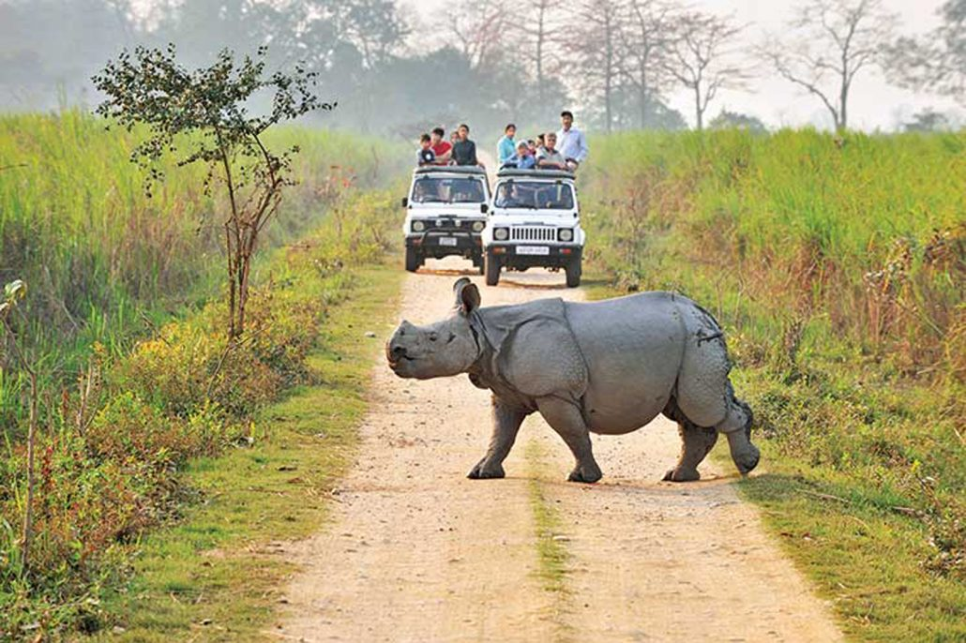
https://www.kaziranga-national-park.com/wild_grass_lodge.shtml

Slide 15
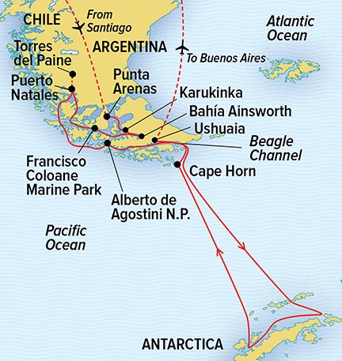
vocabulary
Part 2
ad = advertisement, reklama
where about (ask for the exact position of the locality)
set sail – start a voyage, otploviti
Antartic peninsula = poluostrvo
presumably = assuming, pretpostavljajući
coastal (areas) = near the coast
on-board = in the vessel, vehicle
expedition = travelling in order to make research and explore
fully-furnished (cabins) = well-equipped
glacier/ˈɡlasɪə/, = huge mass of ice. glečer
iceberg = santa leda
penguin /ˈpɛŋɡwɪn/= pingvin
seal /siːl/ colony = kolonija foka
catch a glimpse of = notice, observe
abandoned = napušteno

Slide 16
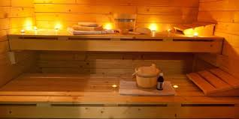
plunge /plʌndʒ/pool to plunge = to soak, to immerse in water, to dive sauna /ˈsɔːnə/ sauna

Slide 17
Vocabulary
Part 3
come along = arrive, accompany sb. on the trip
arduous /ˈɑː.dʒu.əs/ walk = difficult, exhausting
I’m a very keen walker = I’m very enthusiastic about walking, I’m a passionate walker
extended (trips) = lasting longer than excpected
to hold a meeting (a conference, event) = arrange and take part in, održati sastanak
preliminary = introductory, preliminarni
refugios = resting places, sanctuaries, sklonište
tend to be = (usually they are found in)
inn = guesthouse
to allow time for rest stops =stop en route for breaks

Slide 18
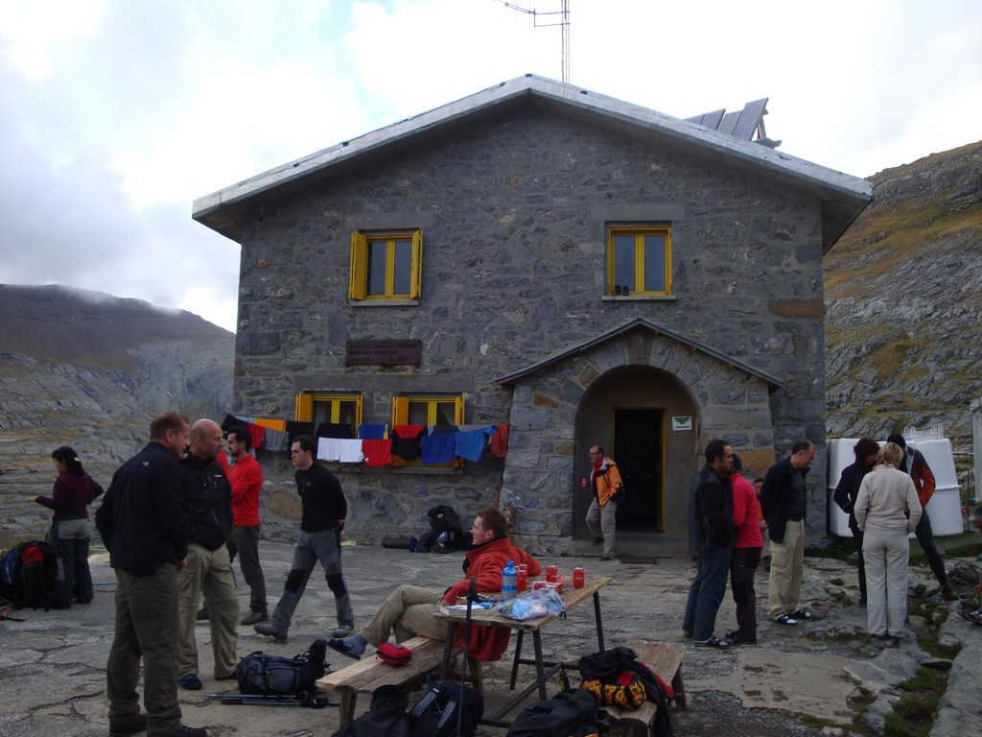
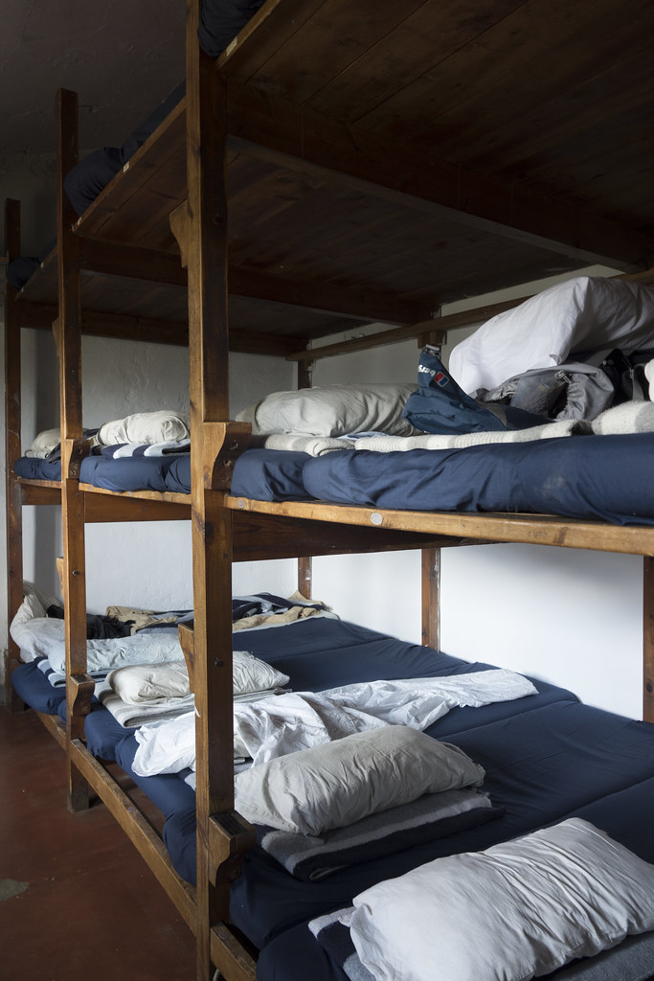
refugios, Spanish

Slide 19
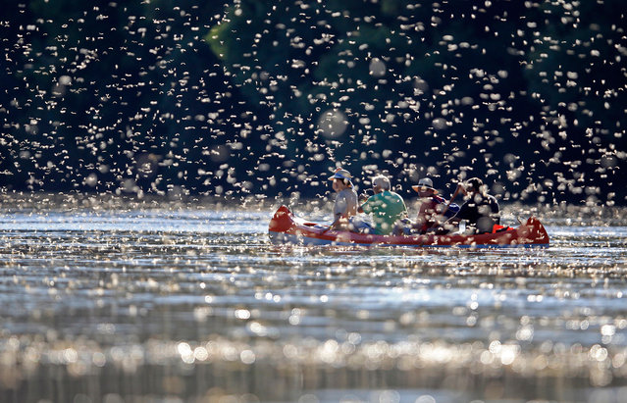
Thank you for your Attention!
The Blooming of Tisza

