Slide 1
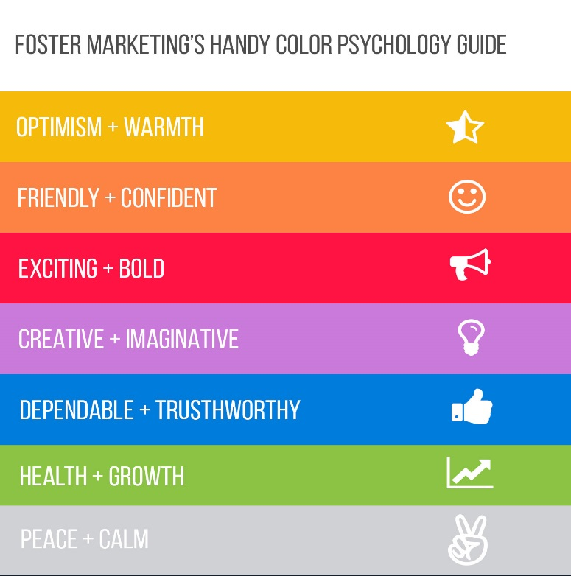
PRACTICE: Positive Connotation
Unit 11, pages 153-154

Slide 2
4. page 153, What would you say in these situations. Discuss in a group and role play the situation.
a. A customer is looking at a winter sports brochure.
b. A young couple is come in and start arguing about where to go.
c. A young family tell you how much they would like to spend on a two-week holiday. The kind of holiday they want is twice as expensive but they do not know this yet.
d. You are speaking on the phone to an important regular customer. Everyone else is busy. Suddenly someone comes in and starts complaining very loudly about the holiday they have just been on.
e. A customer asks you a detailed question about a particular resort which you are unable to answer.

Slide 3
Language FOCUS 1
Unit 11, page 153

Slide 4
Describing Features
1. page 153, In advertising and promotion it is important to use appropriate adjectives to describe features and facilities, so that they seem attractive. Here is a list of adjectives. Which nouns do they go with? Think of your own or choose from the list of nouns.
ADJECTIVES
lively
panoramic
peaceful
well-equipped
friendly
delicious
traditional
central
well-stocked
NOUNS
rooms
service
village
museum
disco
lunch
view
staff
facilities
unspoilt
pretty
interesting
secluded
hearty
relaxing
breathtaking
historic
location
mini-bar
holiday
cathedral
hotel
setting
restaurant
beach
scenery

Slide 5
Describing Features
2. page 153, Which of these phrases might appeal to the following people?
a honeymoon couple
a company looking for a location for a conference
a retired couple
you
your partner
your teacher

Slide 6
Connotation
In advertising and promotion it is also important to present everything in a positive way. However the same thing can be described in different ways – either with a positive or a negative connotation. For example, something which is described as “luxury” might be interpreted from a negative point of view as “expensive”.
In the language of marketing and promotion of tourism products, the statements often range from hyperbole (e.g. a breathtaking scenery) to understatement (e.g. good value for money accommodation)

Slide 7
Connotation
1. page 153, look at these adjectives, all of which have a positive connotation. Can you think of another way of describing things but from the negative point of view?
a luxury
b popular
c cosy
d simple
e relaxing
f unspoilt
g lively
h remote

Slide 8
Connotation
2. page 153, here are some words and phrases with possible negative connotation. Match them to the appropriate postive adjective from exercise 1.
i small
ii impossible to get to
iii expensive
iv noisy
v crowded
vi no facilities
vii nothing to do
viii boring

Slide 9
HW, page 154, Selling a Holiday
Fill in the chart about the place you know well. It is better not to be perfect. Include both the positive and negative points.
NAME OF PLACE
TYPE OF RESORT
TRAVEL TIME (FROM WHERE YOU ARE NOW)
CLIMATE
FAMOUS SIGHTS
PLACES TO VISIT
FOOD/WINE TO TRY
ACCOMMODATION
EXCURSIONS
ENTERTAINMENT AND NIGHT-LIFE
POSSIBLE INCONVENIENCES
LANGUAGES SPOKEN
NEED FOR A VISA
COST OF LIVING
CULTURAL AND RELIGOUS DIFFERENCES
OTHER DIFFICULTIES
DISADVANTAGES/REASONS NOT TO VISIT

Slide 10
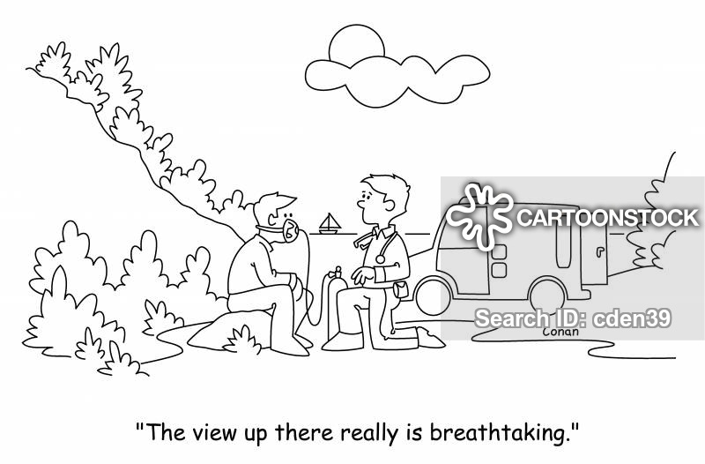
Thank you for your attention!

