Slide 1
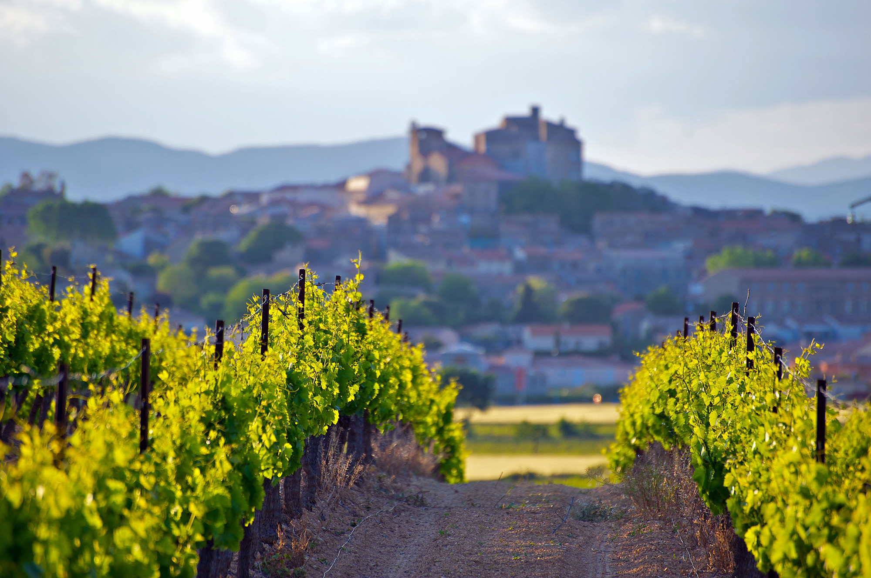
Niche Tourism
Special Interest Holidays

Slide 2
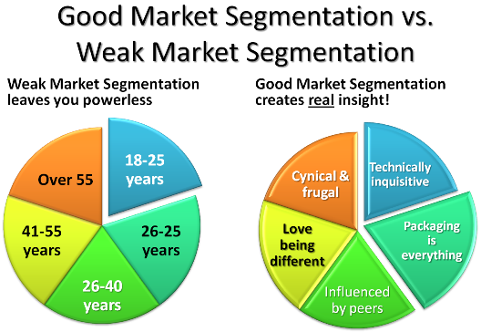
market segment = part of a market of individuals/families/companies/organizations sharing characteristic(s) that cause them to demand similar products or services.
-Market segments share same qualities: gender, age, interests, location, income

Slide 3
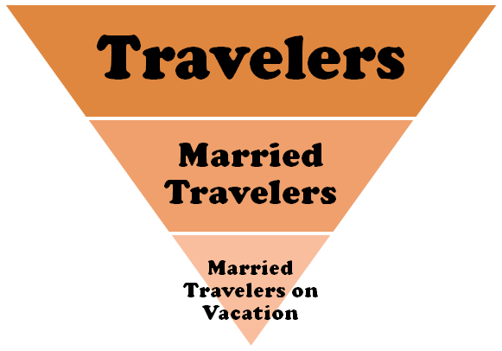
target group or focus group = a group of customers at which a company has decided to aim its products
Demographic – gender, age
Socioeconomic – income, profession, household size, education
Psychographic – interests, attitudes, values, lifestyles
Behavioral – occasion, degree of loyalty
Product- related – relationship to a product

Slide 4
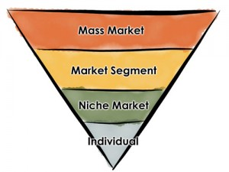
mass marketing = a firm decides to ignore market segment differences and go after the whole market with one offer
niche market = aimed at satisfying specific market needs (prestige, practicability, adventure, planet environment conscience)

Slide 5
Niche Tourism
Niche Tourism
Mass Tourism
cheap package tours
large tourist resorts
international hotel chains
man-made attractions such as Dysneyland
economy of scale (ekonomija obima)
potential high profit margins (high spenders)
‘small is beautiful’, small independent businesses, caters only for a group of people
small-scale operations

Slide 6
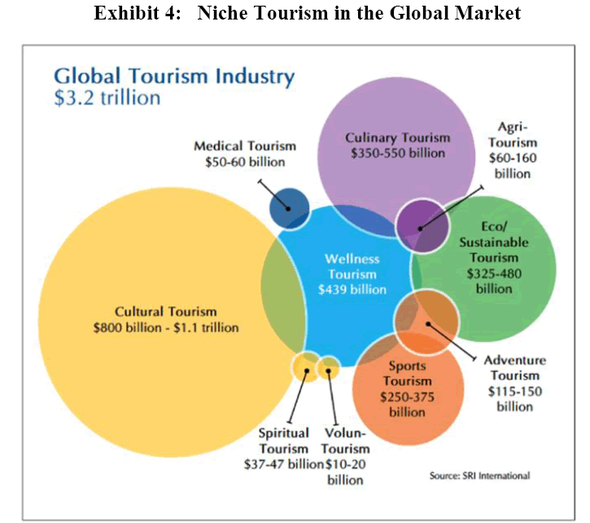

Slide 7

Holiday types (from the 1st year, Unit 3/Unit 7)
Safari
Cruise
Farmstay
Fly-drive
White-water rafting
Beach holiday
Self-catering
Adventure holiday
Trekking
Rambling holiday
Weekend break
Camping

Slide 8
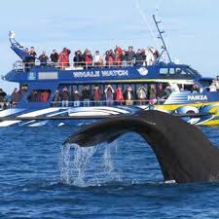
What could two holidaymakers do that is ‘different’?
WATCH!!! https://www.youtube.com/watch?v=WfwuyUTvzuw

Slide 9
Video: The niche – and sometimes fringe – travel industry that finds hidden treasures in unlikely places
What have been “new attractions-destinations” or hidden treasures for Canadian holidaymakers recently?
Who wants to go there and why?
What is tourism experience?
What has authenticity got to do with it?

Slide 10
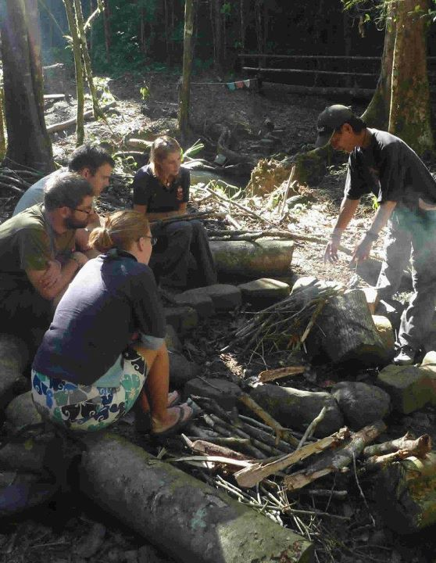
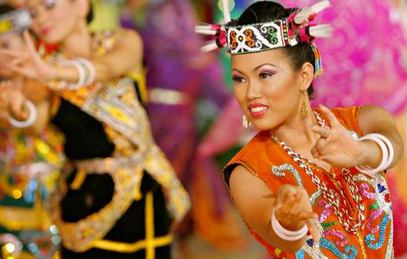
holiday with a difference to go off the beaten track

Slide 11

holiday with a difference
Medical and Wellness Tourism

Slide 12
Special Interest Tourism
Jafari, J. 2000,Encyclopaedia of Tourism
Special interest tourism is a controversial label which is often used mistakenly to describe a form which is in some way preferable to mass tourism.
However, it is not synonymous with terms such as alternative tourism, ethical travel, appropriate tourism or ecotourism, since the special interest type is not necessarily either responsible or sustainable; ecologically sustainable tourism).
Special interest tourists are motivated not so much by desire to be responsible tourists as by the desire to pursue a particular interest, hobby or activity, be it a sport such as scuba diving or golf, an outdoor activity such as mountain climbing or bird-watching, a cultural or heritage interest such as folk music or period architecture, or an educational pursuit such as European history or archaeology.

Slide 13
Special Interest Tourism
Jafari, J. 2000,Encyclopaedia of Tourism
They choose a destination that somehow offers a better or unique way of enjoying that special interest, and/or they choose a tourism experience that facilitates the enjoyment of something they are passionate about.
While independent travellers can be special interest tourists, organised special interest groups are both more visible and more relevant to the industry.
Indeed, there are travel agents and tour operators who cater exclusively for special interest groups, often designing and marketing their products in ways that appeal to a narrow segment or segments of the travelling public. Others respond to requests from organised groups on a one-off or recurring basis.

Slide 14
Special Interest Tourism
Jafari, J. 2000,Encyclopaedia of Tourism
The characteristics of special interest tour groups and their members have been casually observed but seldom investigated in any systematic way.
Despite the lack of research, the growth of special interest tourism is presumed to be more rapid than other forms, attributed mainly to the increased sophistication of the public and the resulting demand for more focused and high-quality tourism experiences. See also: adventure tourism; cultural tourism; ethnic tourism; historical tourism; nature tourism.

Slide 15
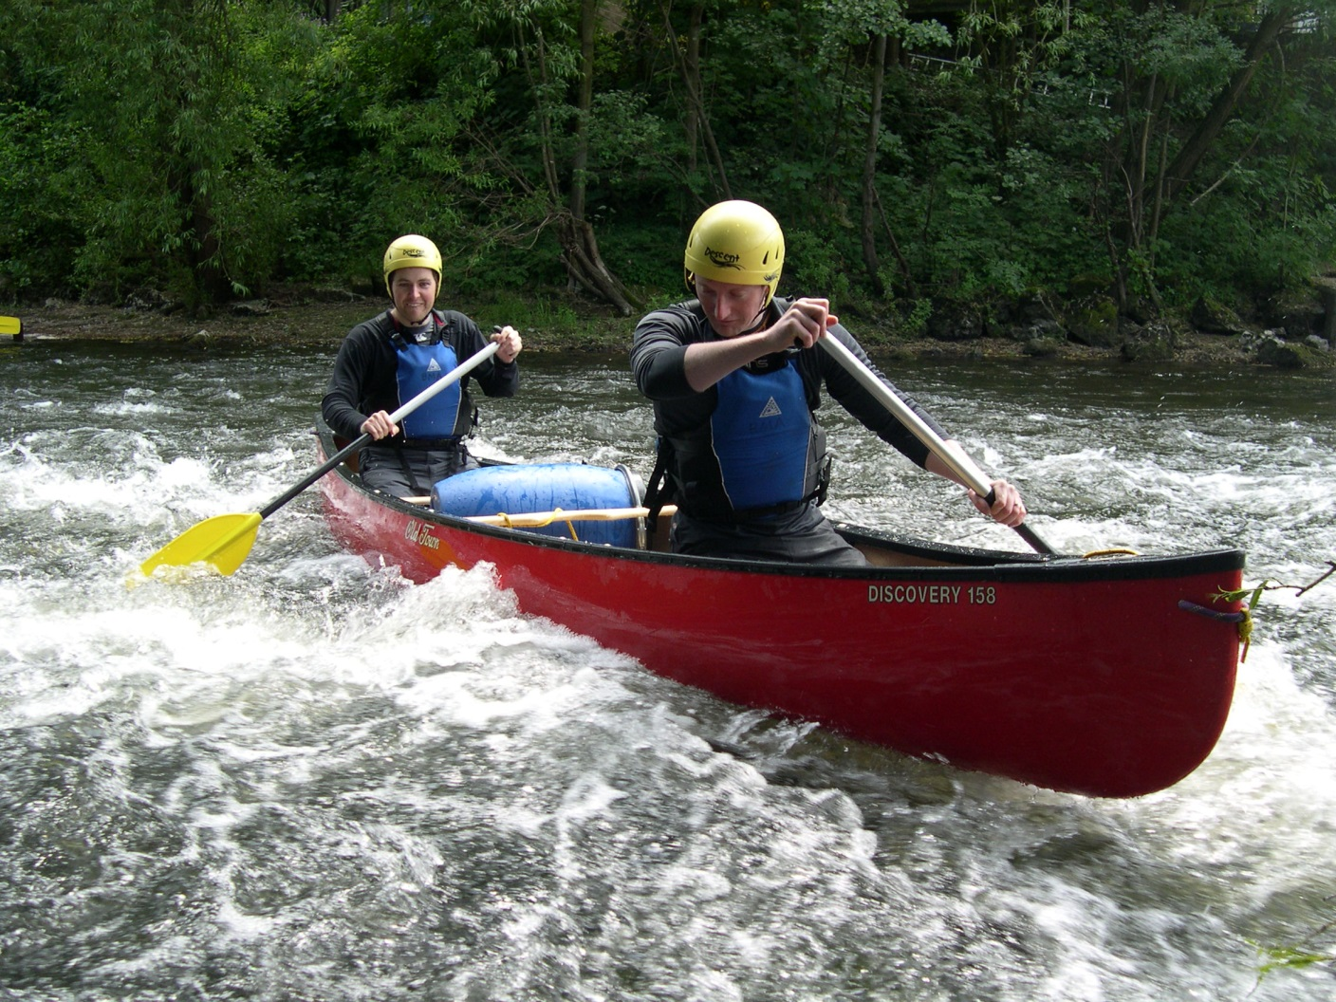
Holiday with a difference: adventure tourism, white-water rafting. Think about the potential target groups.

Slide 16
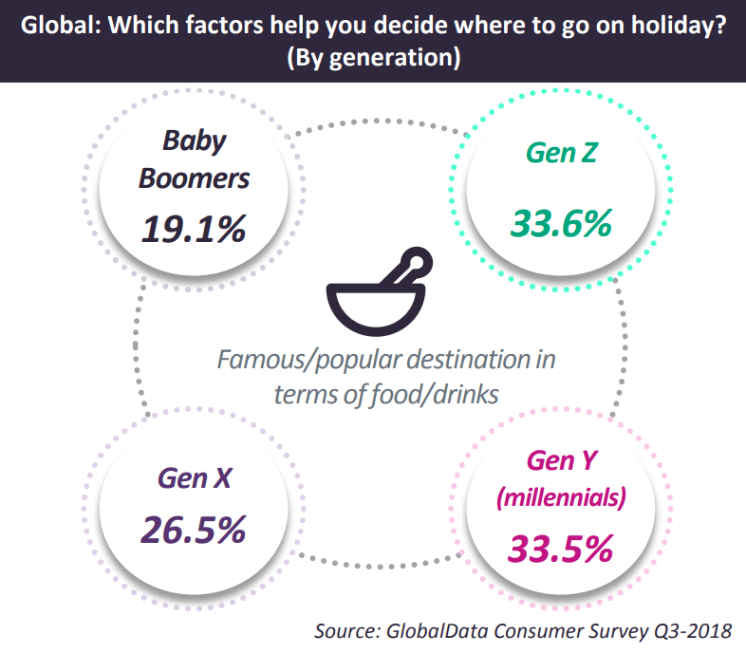

Slide 17
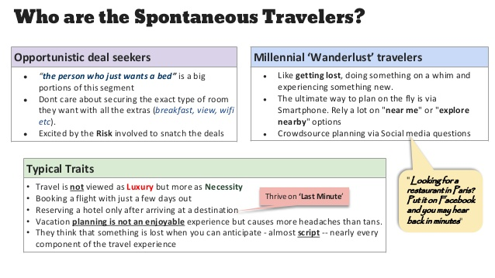

Slide 18
At the trade fair
Adventure and action
Ecotourism and nature
Escape and enlightenment
Culture and heritage

Slide 19
Escape and enlightenment
Adventure and action
Ecotourism and nature
Culture and heritage
a long weekend in London to visit museums and art galleries
learning survival skills in the jungles of Borneo
pilgrimage to Mecca
a weekend of beauty treatments and relaxation in a country hotel
off-piste mountain skiing
weekend-break at the Prague Music Festival
a research trip to collect data on ape behaviour in Malaysia

Slide 20
Escape and enlightenment
Adventure and action
Ecotourism and nature
Culture and heritage
a tour of Scotland visiting historic castles
mountain climbing
conservation work helping to repair coastal damage
windsurfing
cycling in the mountains and deserts of Mongolia
a four-week trip to Canada to learn English
a trip to Rio for 2016 Olympics
a whale-watching off the west coast of the USA
a week at the health farm to relax and ‘de-stress’

Slide 21
Five Types of Niche Tourism
1. _________ tourism such as pilgrimages and visits to ________ sites
2.Travel to __________________ festivals
3. Visits to ____________fields.
4. _____________ tourism, where people travel abroad for health reasons
5. Courses aimed at people who want to learn a ________

Slide 22
Five Types of Niche Tourism
1. Religious tourism such as pilgrimages and visits to sacred sites
2.Travel to music festivals
3. Visits to battle fields.
4. Medical tourism, where people travel abroad for health reasons
5. Courses aimed at people who want to learn a foreign language
https://www.youtube.com/watch?v=1AjHXM9JjdM

Slide 23
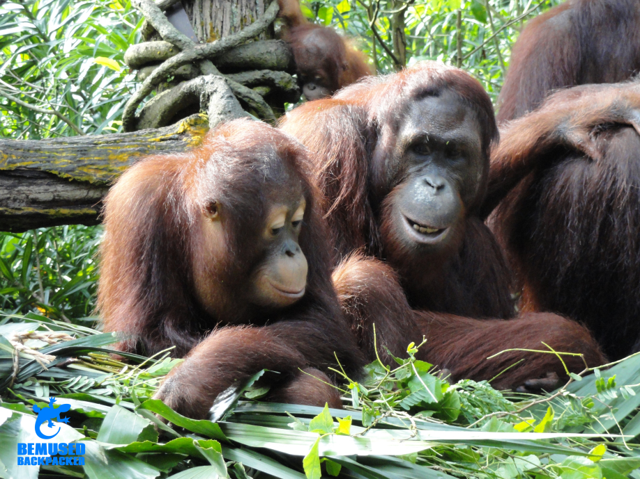
Safari&Wildlife
Climb into the canopy
Observe orangutans in their natural environment
Hiking in the forest
Travelling by a canoe from lodge to lodge.

Slide 24
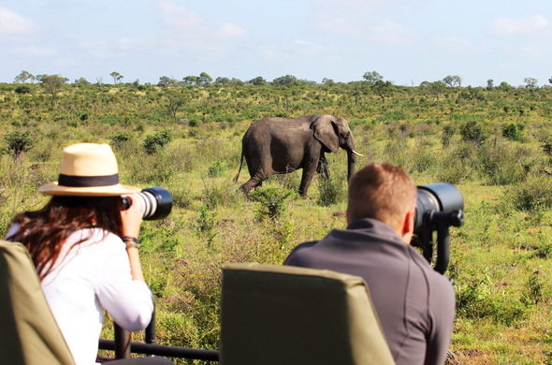
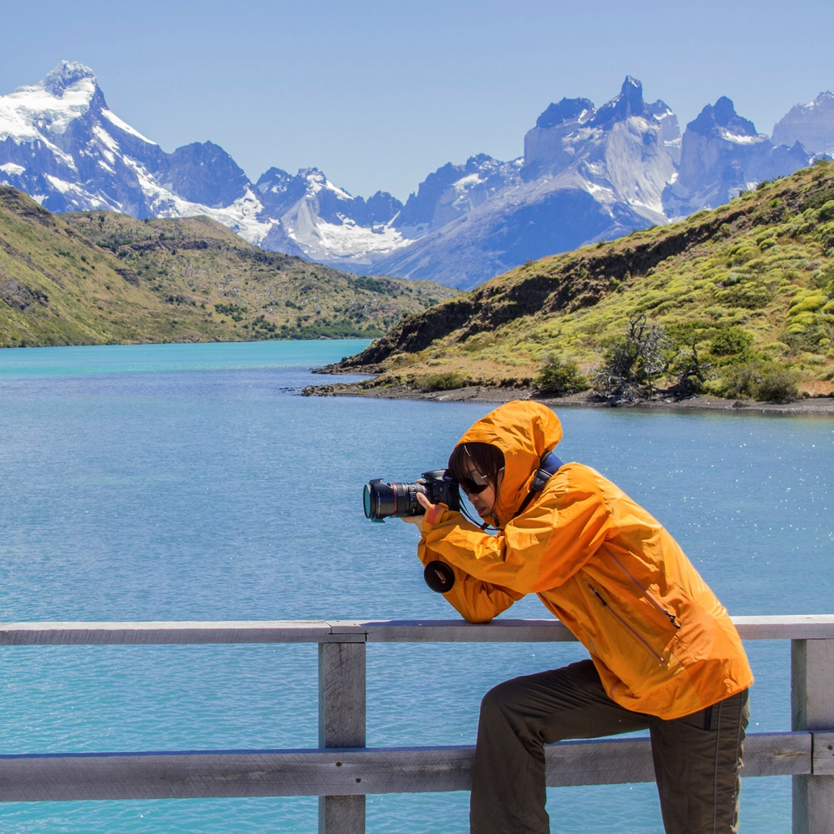
Photographic Tourism
https://www.nationalgeographicexpeditions.eu/

Slide 25
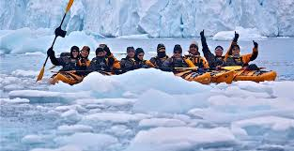
Extreme Tourism in Antartica
diving under ice

Slide 26
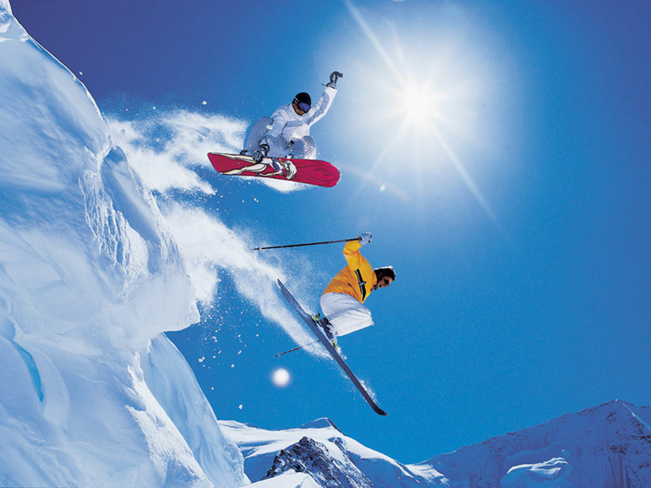
Snowboarding Holiday

Slide 27
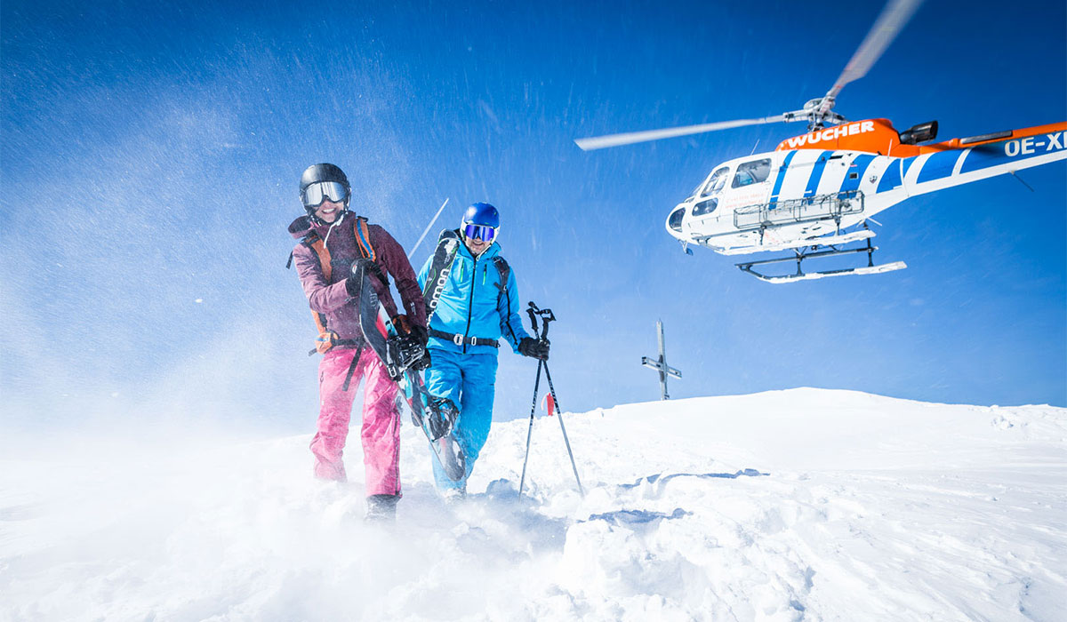
Heli Skiing

Slide 28
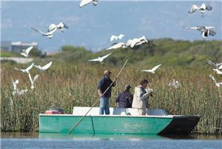
Avi-tourism
Bird-watching
Travel outside your natural environment to view birds in their natural habitat
Fast growing sector of nature tourism

Slide 29
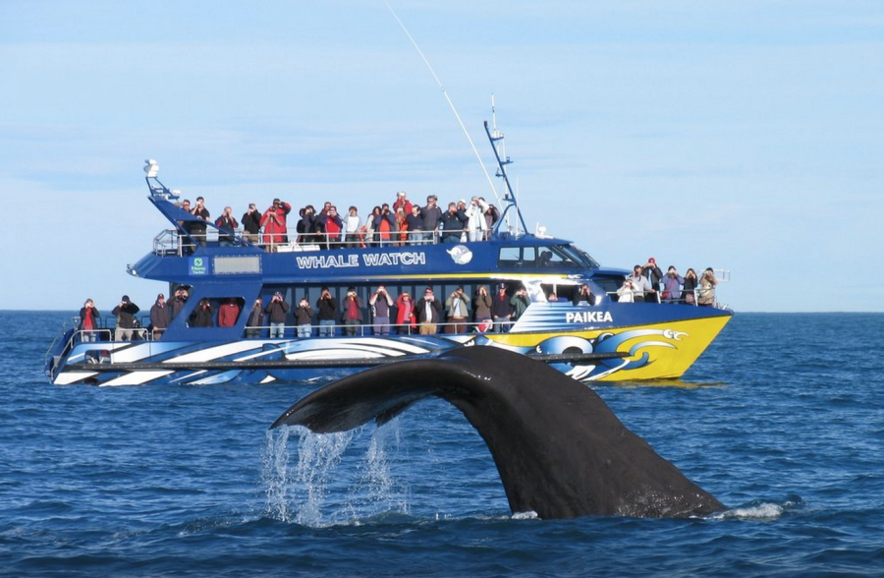
Whale-watching

Slide 30
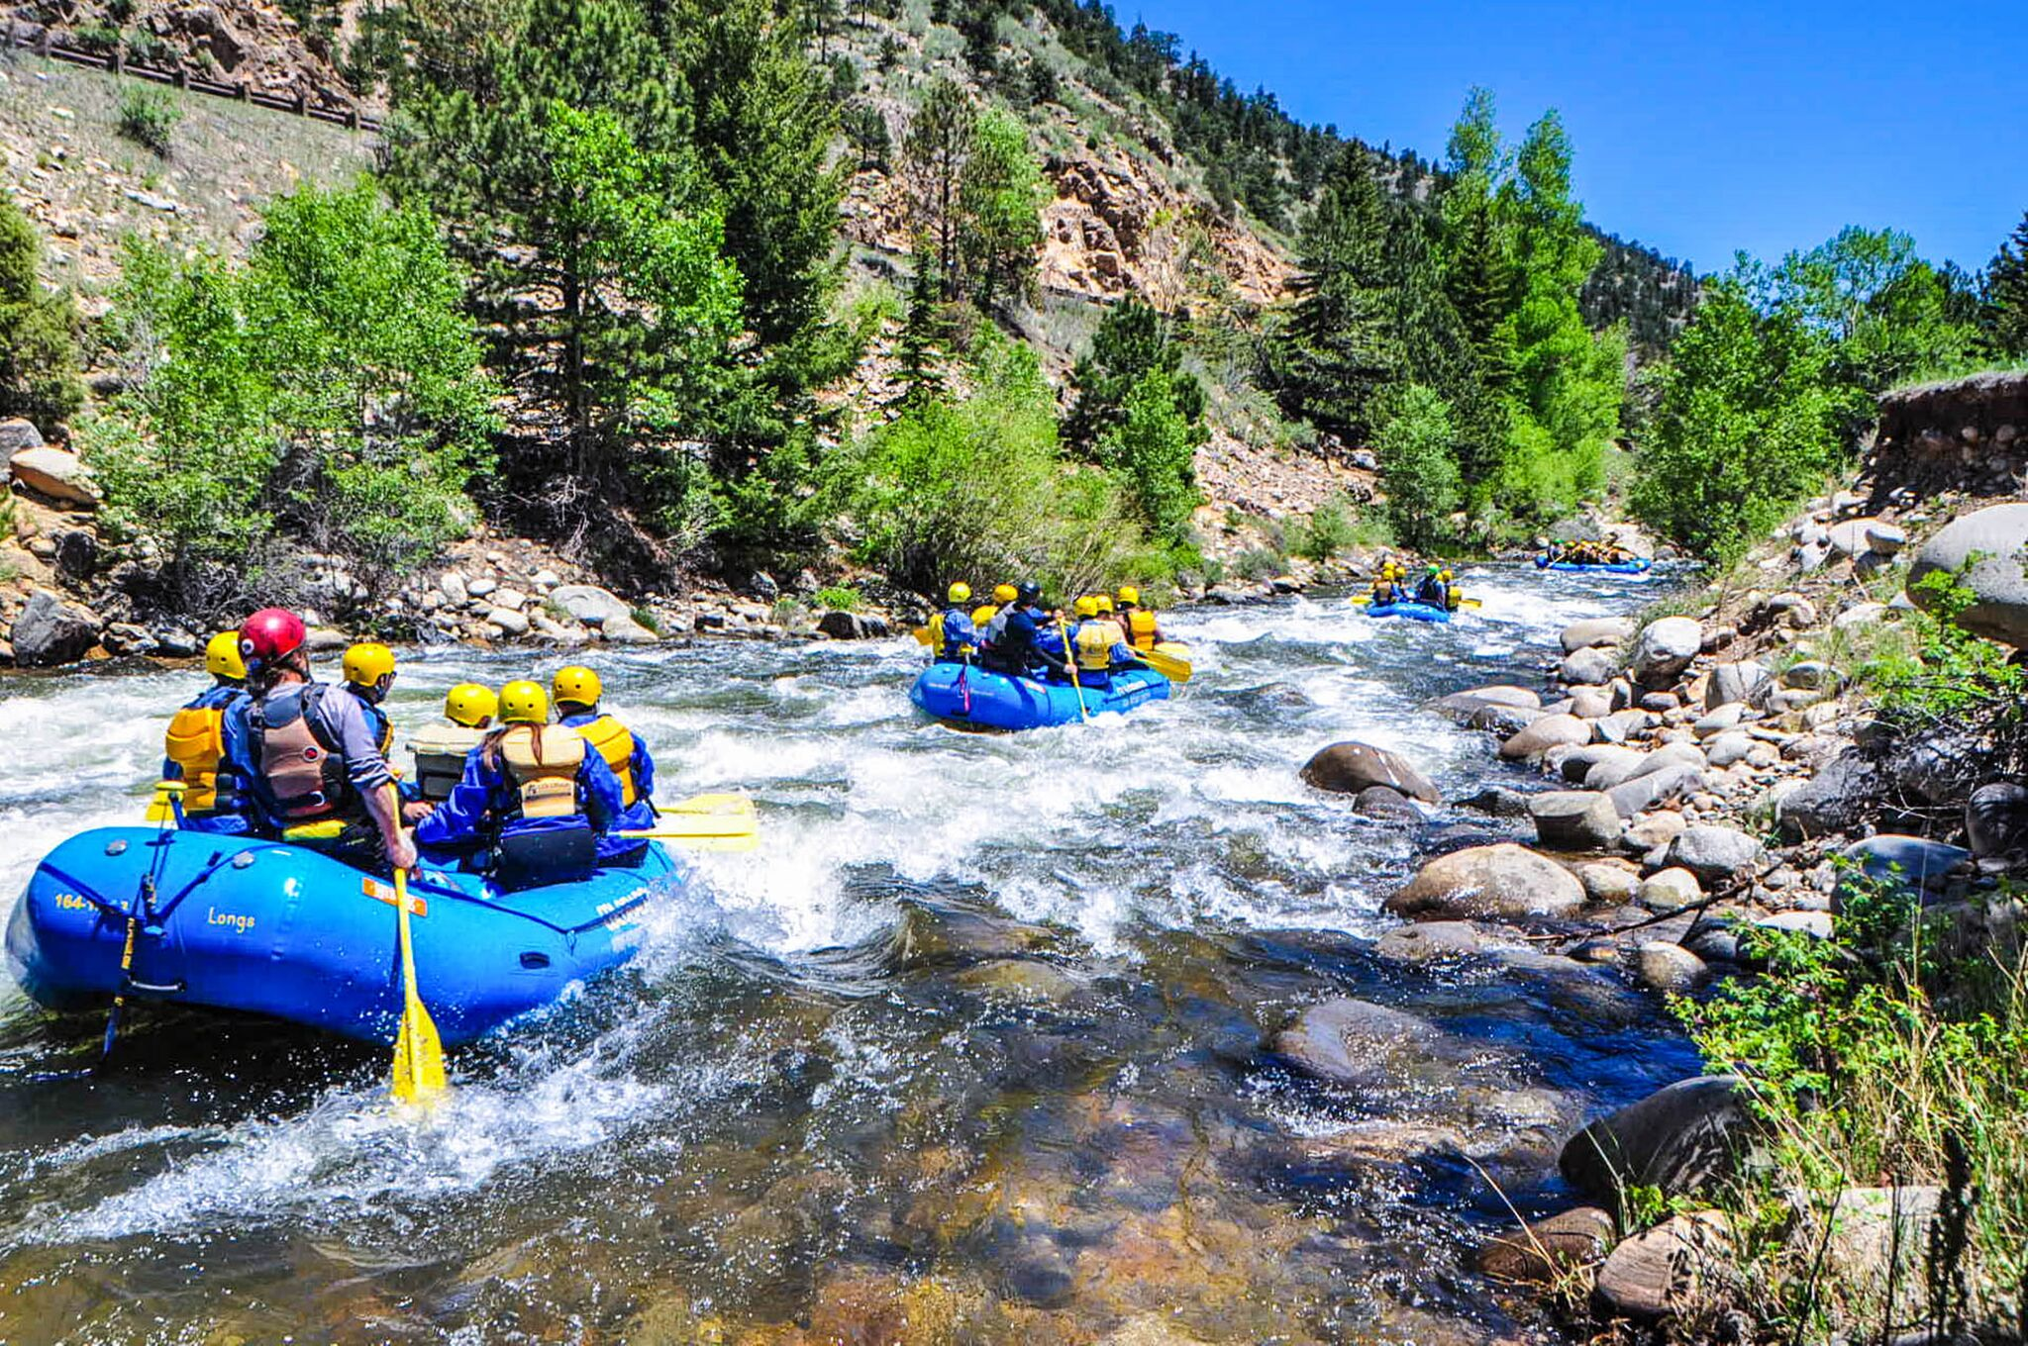
White-water Rafting

Slide 31
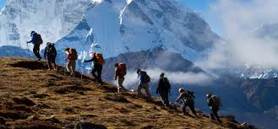
Trekking https://pinetrees.com.au

Slide 32
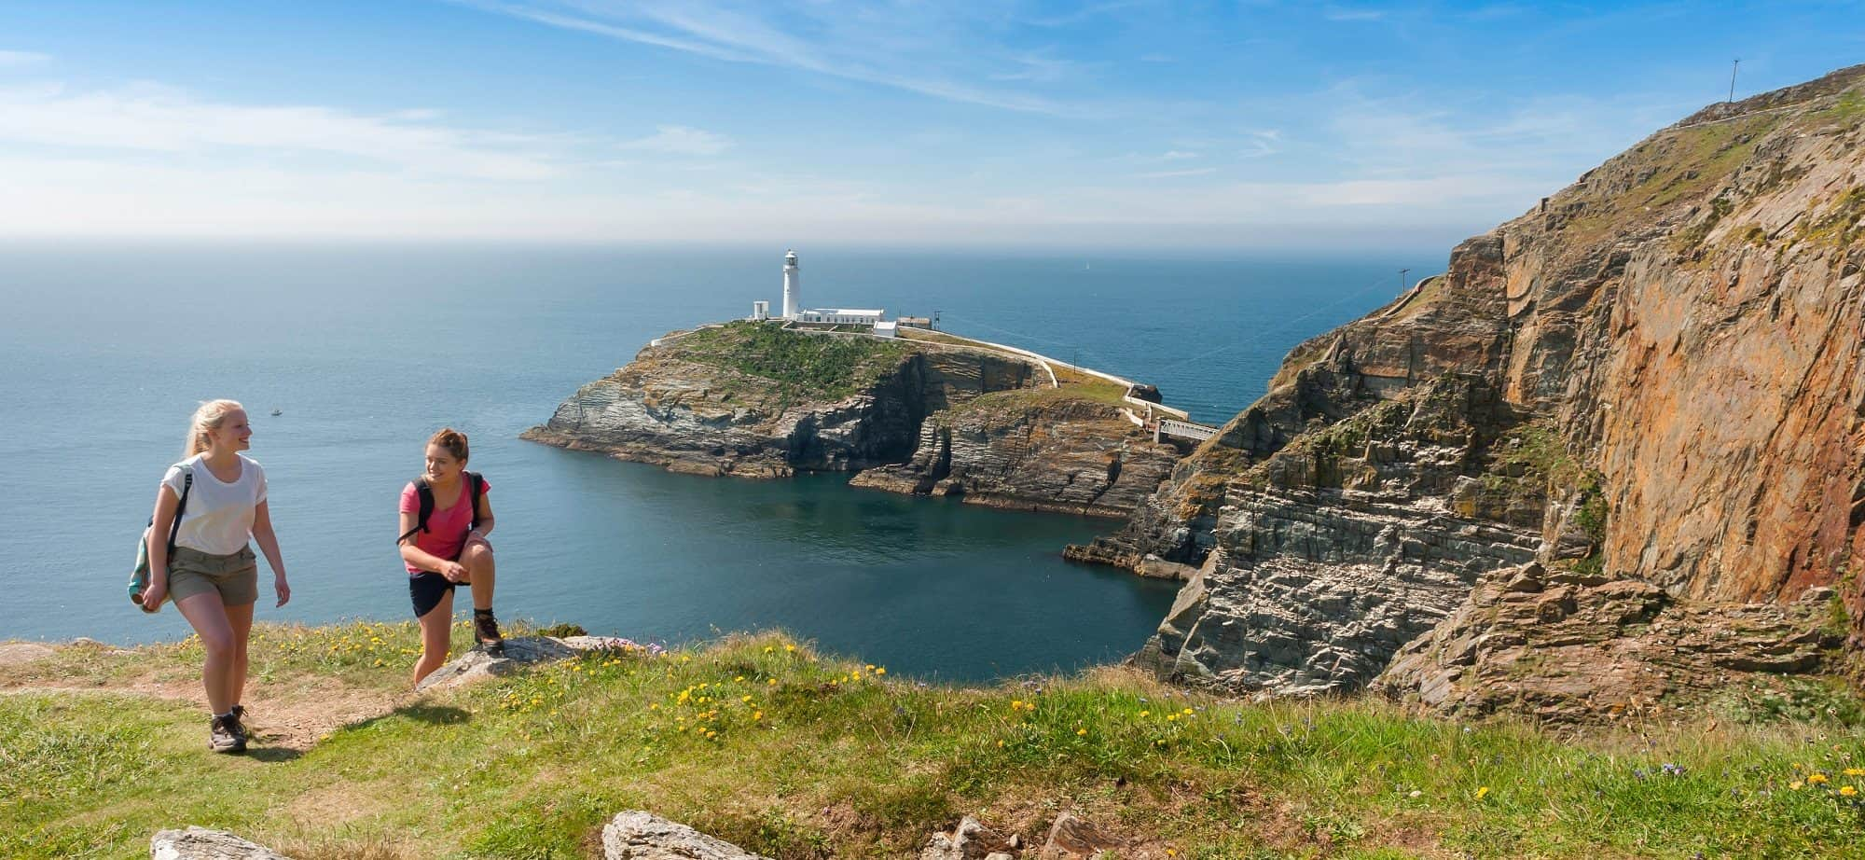
Rambling Holiday

Slide 33
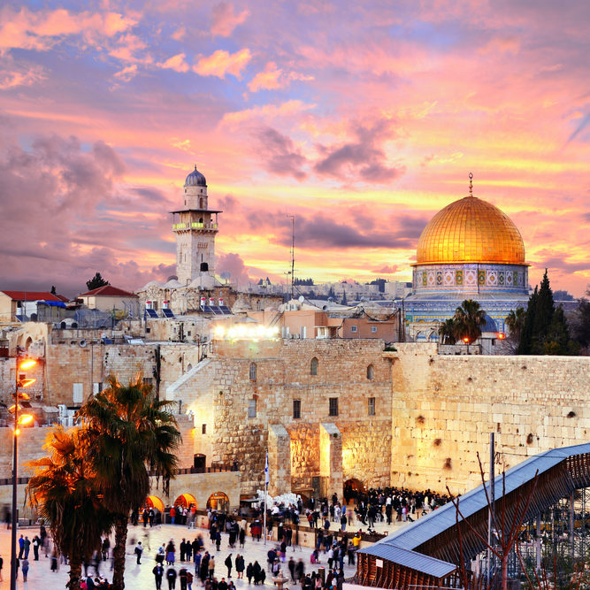
Pilgrimage and Religious Tours

Slide 34
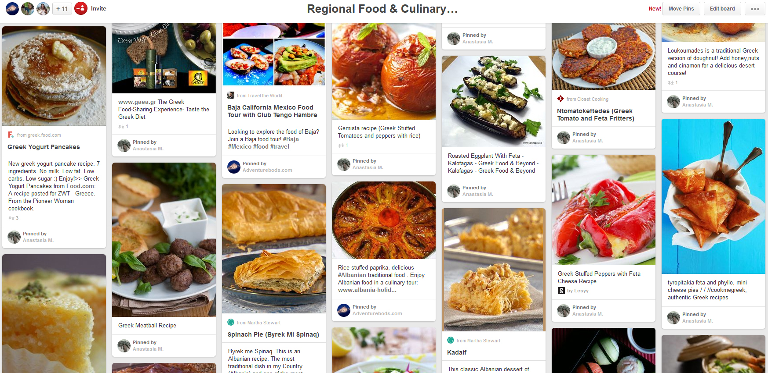
Culinary Tourism
Gastronomy Tours
Do you like experimenting with new recipes?
A chef will show you how to combine ingredients, prepare and cook them.
https://www.eatwith.com/
(vizeat)

Slide 35
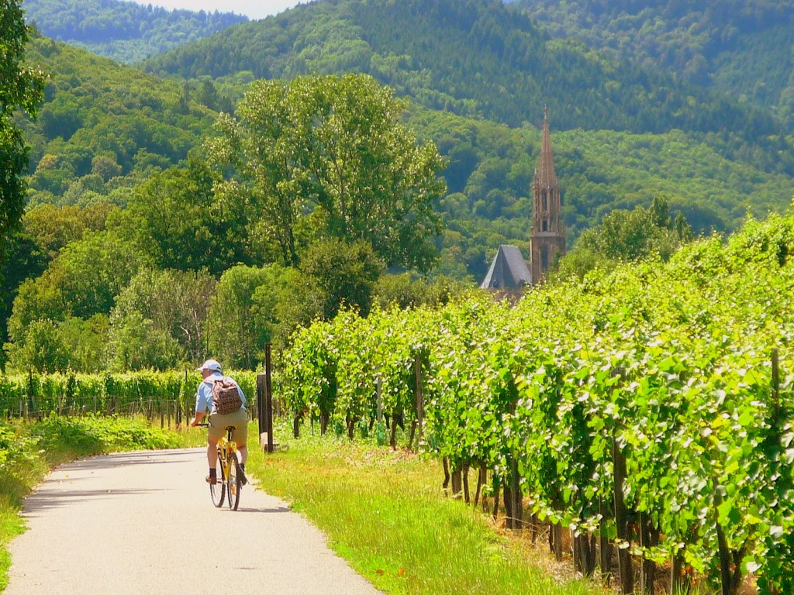
Wine or Winery Tours
Bordeaux
Burgundy
California
Chile
Tuscany
Mendoza, Argentina
Tikveška regija, MK
Sremski Karlovci – Fruška Gora
Negotin

Slide 36
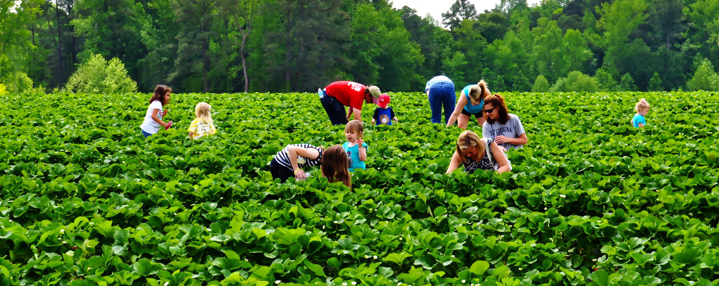
Agritourism
Rural Tourism
Farmstay

Slide 37
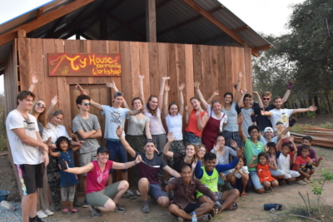
Educational Tours

Slide 38
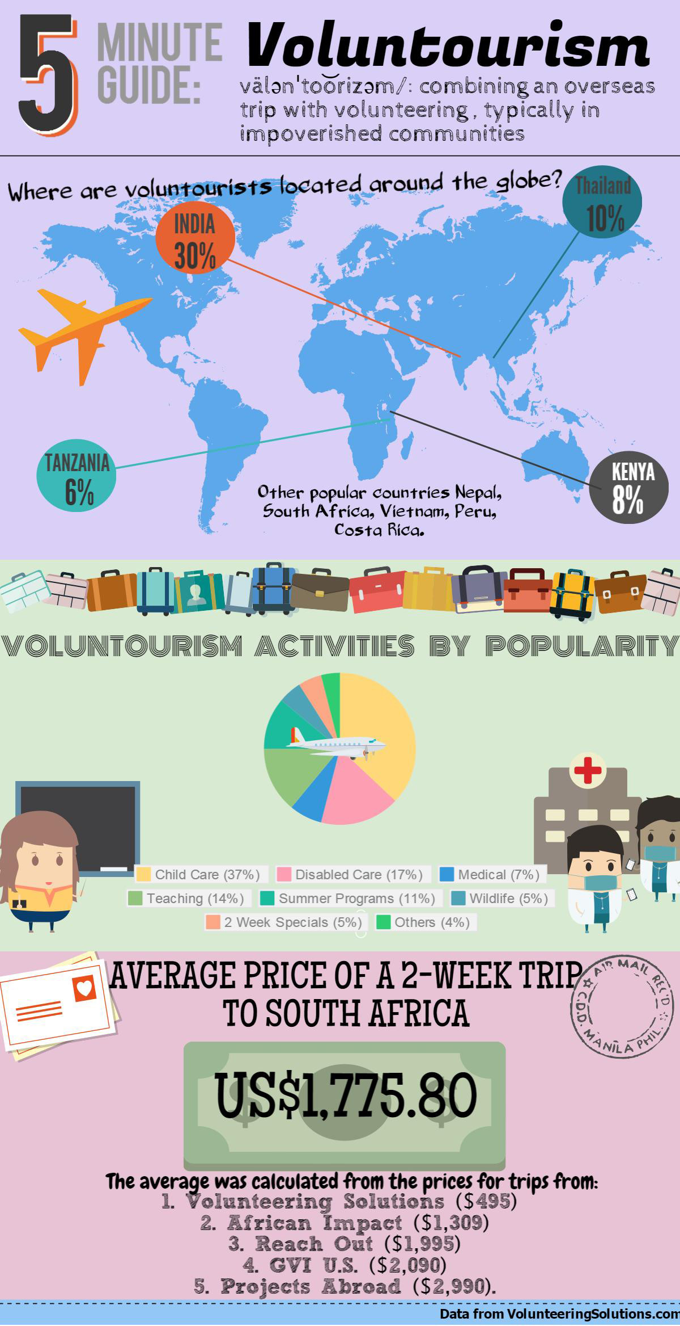

Slide 39
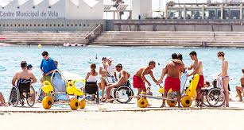
(Special Requirements Holidays/Accessible Tourism e.g. for disabled persons) https://www.traveleyes-international.com

Slide 40


Genealogy Tours
Travel to ancestral homelands

Slide 41
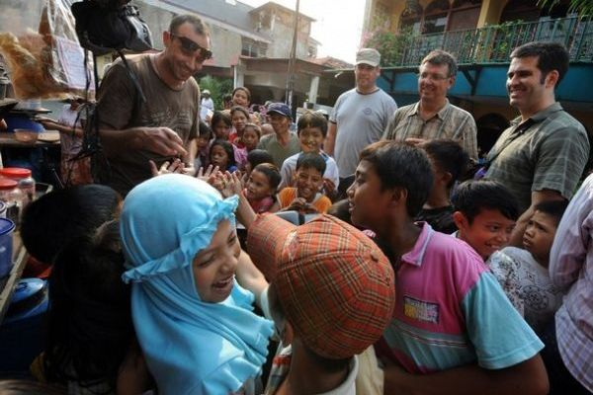
Slum Tourism
Real India
Recycling area
Contribute to local economy
Ethical issues

Slide 42

Thana or Dark Tourism thanatos

Slide 43

Fiction-induced Tourism

Slide 44
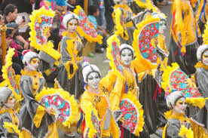
Cultural Tourism
purposeful tourist
sightseeing cultural tourist
chance discovery cultural tourist
casual cultural tourist
incidental cultural tourist
growth
better positioned those who combine
traditional sights with media, pop-culture
fashion, design, entertainment.

Slide 45
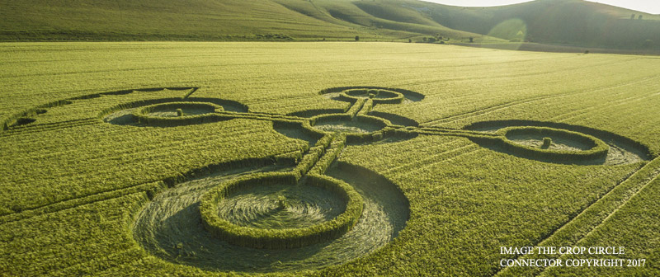
Fringe Phenomena

Slide 46
Niche Tourism Opportunities in Your Area
What potential is there for niche tourism in your local area? Make some suggestions for unexploited possibilities.
How would you attract different target groups for different types of niche tourism?
What could be your best marketing strategy?

Slide 47
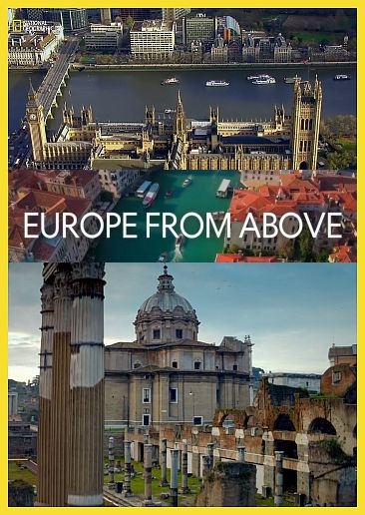
Thank you for your Attention https://www.natgeotv.com/za/shows/natgeo/europe-from-above

Slide 48
References
Jafari, J. 2000. Encyclopaedia of Tourism
Novelli, M. 2007. Niche Tourism.
https://www.youtube.com/watch?v=WfwuyUTvzuw
https://www.youtube.com/user/AuthenticAdventurer
https://www.youtube.com/watch?v=1AjHXM9JjdM
https://www.eatwith.com/

