Slide 1

SELLING A HOLIDAY
Promotion&Marketing in Tourism

Slide 2

Types of Advertising&Promotion
SECTION 1: Reading&Speaking

Slide 3

Intro
Are you familiar with any memorable and witty slogans used in tourism marketing campaigns/destination branding?

Slide 4
1. page 150, Look at these slogans and extracts from advertisements connected with tourism (1-11). Match them with the destination and services
7.For the time of your life
1. WHERE THE SUNSHINE NEVER GOES ON HOLIDAY
8. The sun is smiling on you down under
2. ANSWER THE CALL OF THE WILD
9. It couldn’t be easier. Step on in the heart of one capital city, three hours later step off in the heart of another.
3. The surroundings may be your greatest handicap
10. LEADING THE WAY TO LATIN AMERICA
4. Come fly the friendly skies
11. It’s your last run of the day Your legs are burning ... Your back is killing you... What’s the first you do when You reach the bottom? Head straight for the lift!
5. IT ONLY TAKES A TICK TO GET THERE
6.You drive – we’ll take the car!

Slide 5
1. page 150-151, Match slogans with the destination and services
1. Where the sunshine never goes on holiday.
2. Answer the call of the wild.
3. The surroundings may be your greatest handicap
4. Come fly the friendly skies.
5. It only takes a tick to get there.
6. You drive – we’ll take the car.
7. For the time of your life.
8. The sun is smiling on you down under.
9. It couldn’t be easier. Step on in the heart of one capital city, three hours later step off in the heart of another.
10. Leading the way to Latin America.
11. It’s your last run of the day..
a) Eurostar train London to Paris
b) holidays for people aged over 50
c) Portugal
d) brochure supply service for Australia and New Zealand
e) Iberia group airline
f) an American airline
g) skiing in the Canadian Rockies
h) Australia
i) golf holidays in the US mountains
j) African safaris
k) car ferry company

Slide 6
Match slogans with the destination and services
1. Where the sunshine never goes on holiday.
2. Answer the call of the wild.
3. The surroundings may be your greatest handicap
4. Come fly the friendly skies.
5. It only takes a tick to get there.
6. You drive – we’ll take the car.
7. For the time of your life.
8. The sun is smiling on you down under.
9. It couldn’t be easier. Step on in the heart of one capital city, three hours later step off in the heart of another.
10. Leading the way to Latin America.
11. It’s your last run of the day..
a) Eurostar train London to Paris
b) holidays for people aged over 50
c) Portugal
d) brochure supply service for Australia and New Zealand
e) Iberia group airline
f) an American airline
g) skiing in the Canadian Rockies
h) Australia
i) golf holidays in the US mountains
j) African safaris
k) car ferry company

Slide 7
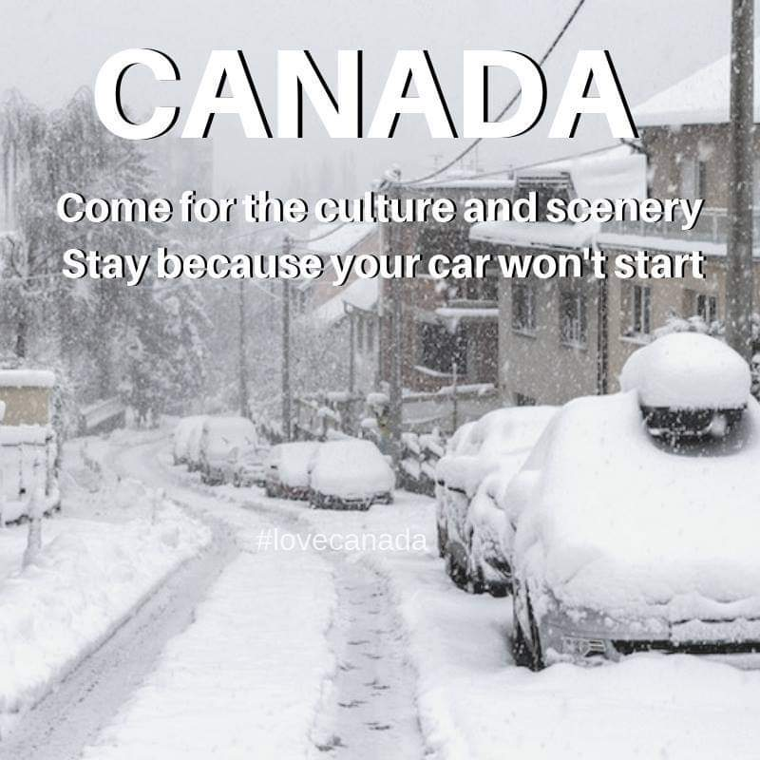

Slide 8
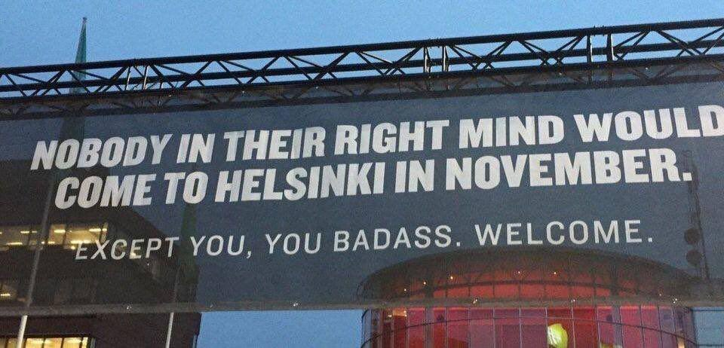

Slide 9
2. page 151, What other forms of advertising and promotional activity can you think of? Make a list
1. PR
2. online banner
3. SEO
4. promo video
5. social media campaign
6. blog or posted article

Slide 10
3. page 151, Here are some different ways of promoting a tourism product or service. What are advantages and disadvantages of each? Are any of them particularly suitable for certain products and services?
a) advertisement in magazine or newspaper.
b) leaflet given out in the street
c) leaflet available in travel shops
d) advertisement in theatre programme
e) neon sign in city centre
f) advertisement on bilbord by roadside
g) poster at railway station or airport
h) television advertisement
i) cinema advertisement
j) press release
k) sponsorship of a sporting event
l) sales promotion, e.g. early booking discount
m) personal selling, face-to-face or tele-sales
n) direct mailing/mailshot
o) web-site on the Internet
p) point-of-sale (leaflet, poster)
q) commission to selling agent

Slide 11
4. page 151, Which type of promotional activity do you think would be the best for the following?
- cheap last-minute flights
- new caravan and camping site
- inclusive packages to see the next Olympic Games
- travel insurance
- new cut-price transatlantic air service
- trekking holidays in Nepal
- new children’s theme park

Slide 12

Thank you for your Attention!

