Slide 1
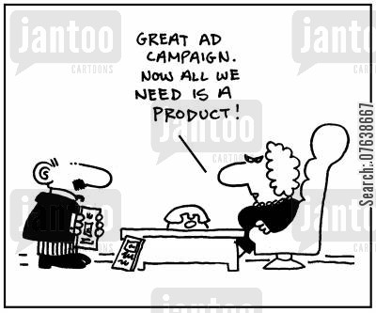
How to Sell a Product
Unit 11, page 152

Slide 2
Questions/Food for Thought
What is product placement/launch?
What are the ways to sell your product?
What is customer satisfaction and customer loyalty?
What are traditional and novel ways of selling the product?
What changes in travel business operations and marketing have been introduced in recent years?
Is travel agency business becoming more and more obsolete?
Do you think that the (post)-covid situation would bring about different ways of organizing tourist industry?

Slide 3
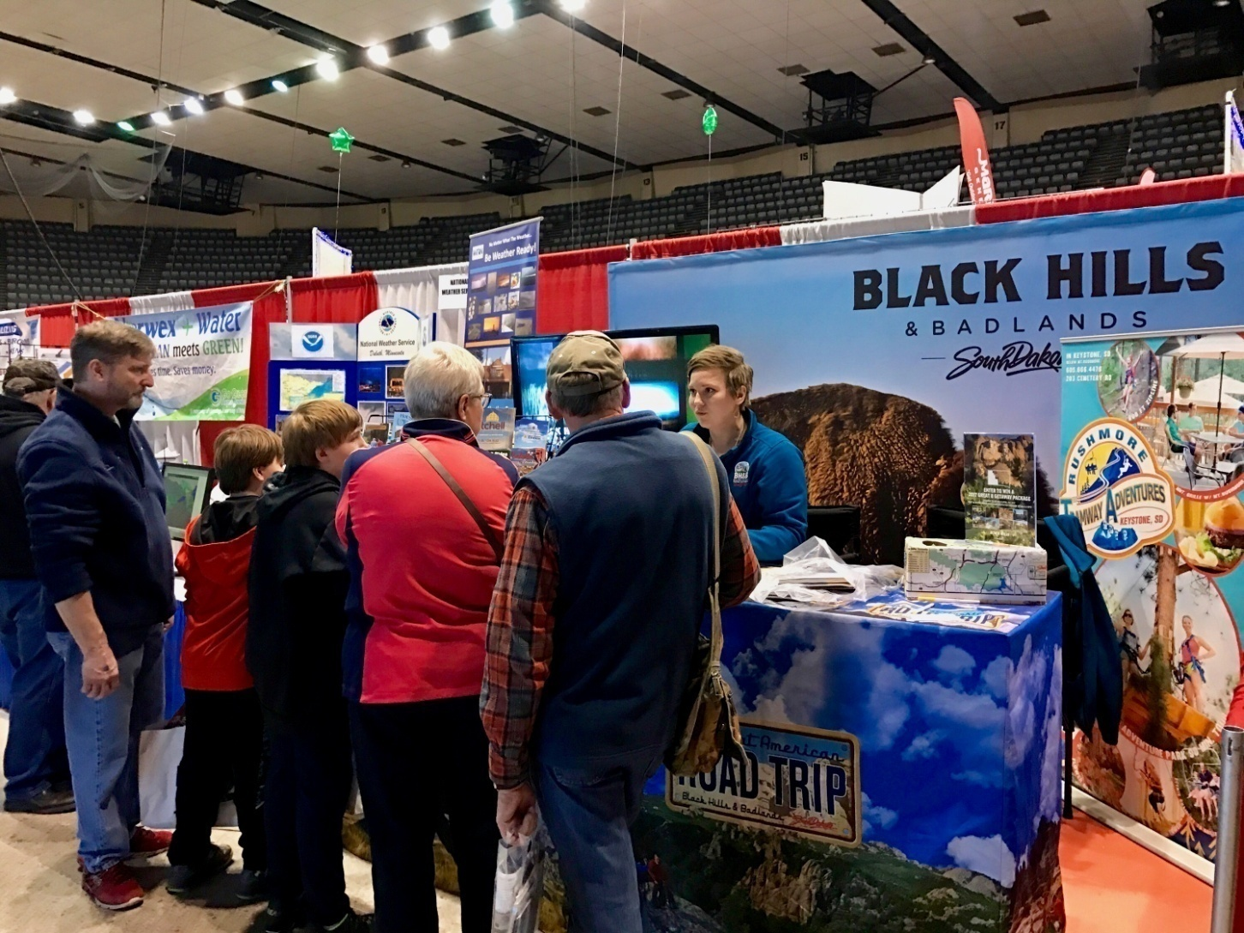
face-to-face promotion

Slide 4
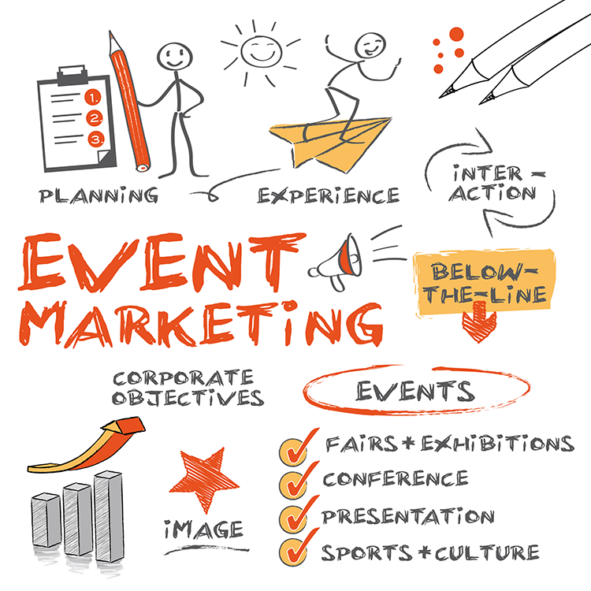

Slide 5
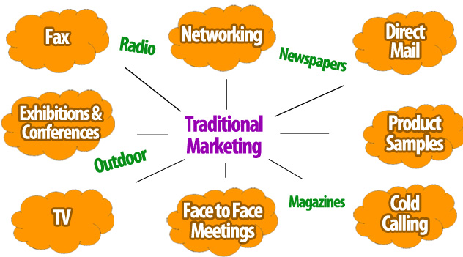

Slide 6
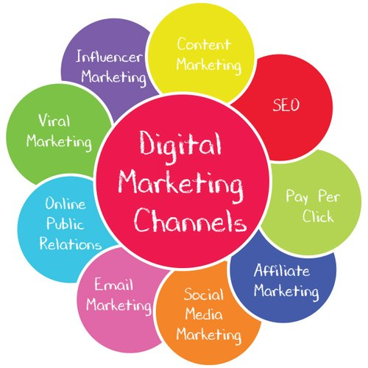

Slide 7
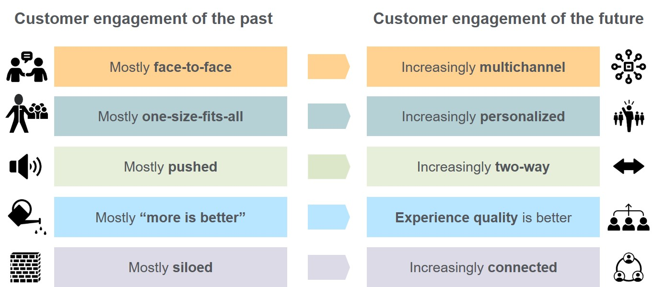

Slide 8
1. page 152, Before you read the text about how to sell your product, what order do you think these five stages of selling would be in?
a. find out what customer wants
b. post-sales contact
c. show product knowledge and expertise
d. help customer relax
e. close the sale

Slide 9
2. page 152, Read the article, find the correct order & provide five missing sub-headings
HOW TO SELL YOUR PRODUCT
Competition in travel agency business is tough. Businesses that want to survive must know how to gain customer confidence, present their products, and ultimately close the sale. Many books have been written on the art of successful selling, so here are some of the choicest tips in five simple stages.

Slide 10

tough competition
fierce competition
strong competition
to gain confidence
to develop confidence
to encourage confidence
ultimately – in the end, eventually, finally
business [C] = firm, company, enterprise
close, make the sale =
complete a sales transaction
close the deal
choice (adj.) = first-class, best
the choices tips = best advice

Slide 11
1. ____________________
First impressions count. As Oscar Wilde said “Only the superficial cannot judge by appearance”. Whether or not you agree with him, there is no denying the fact that most people hope a visit to a travel agent will be a prelude to, if not the memory of a lifetime, then at least the high point of the year. A warm smile, a pleasant appearance, and good eye contact will help the would-be traveller to relax, safe in the knowledge that he or she is in the hands of a professional.

Slide 12
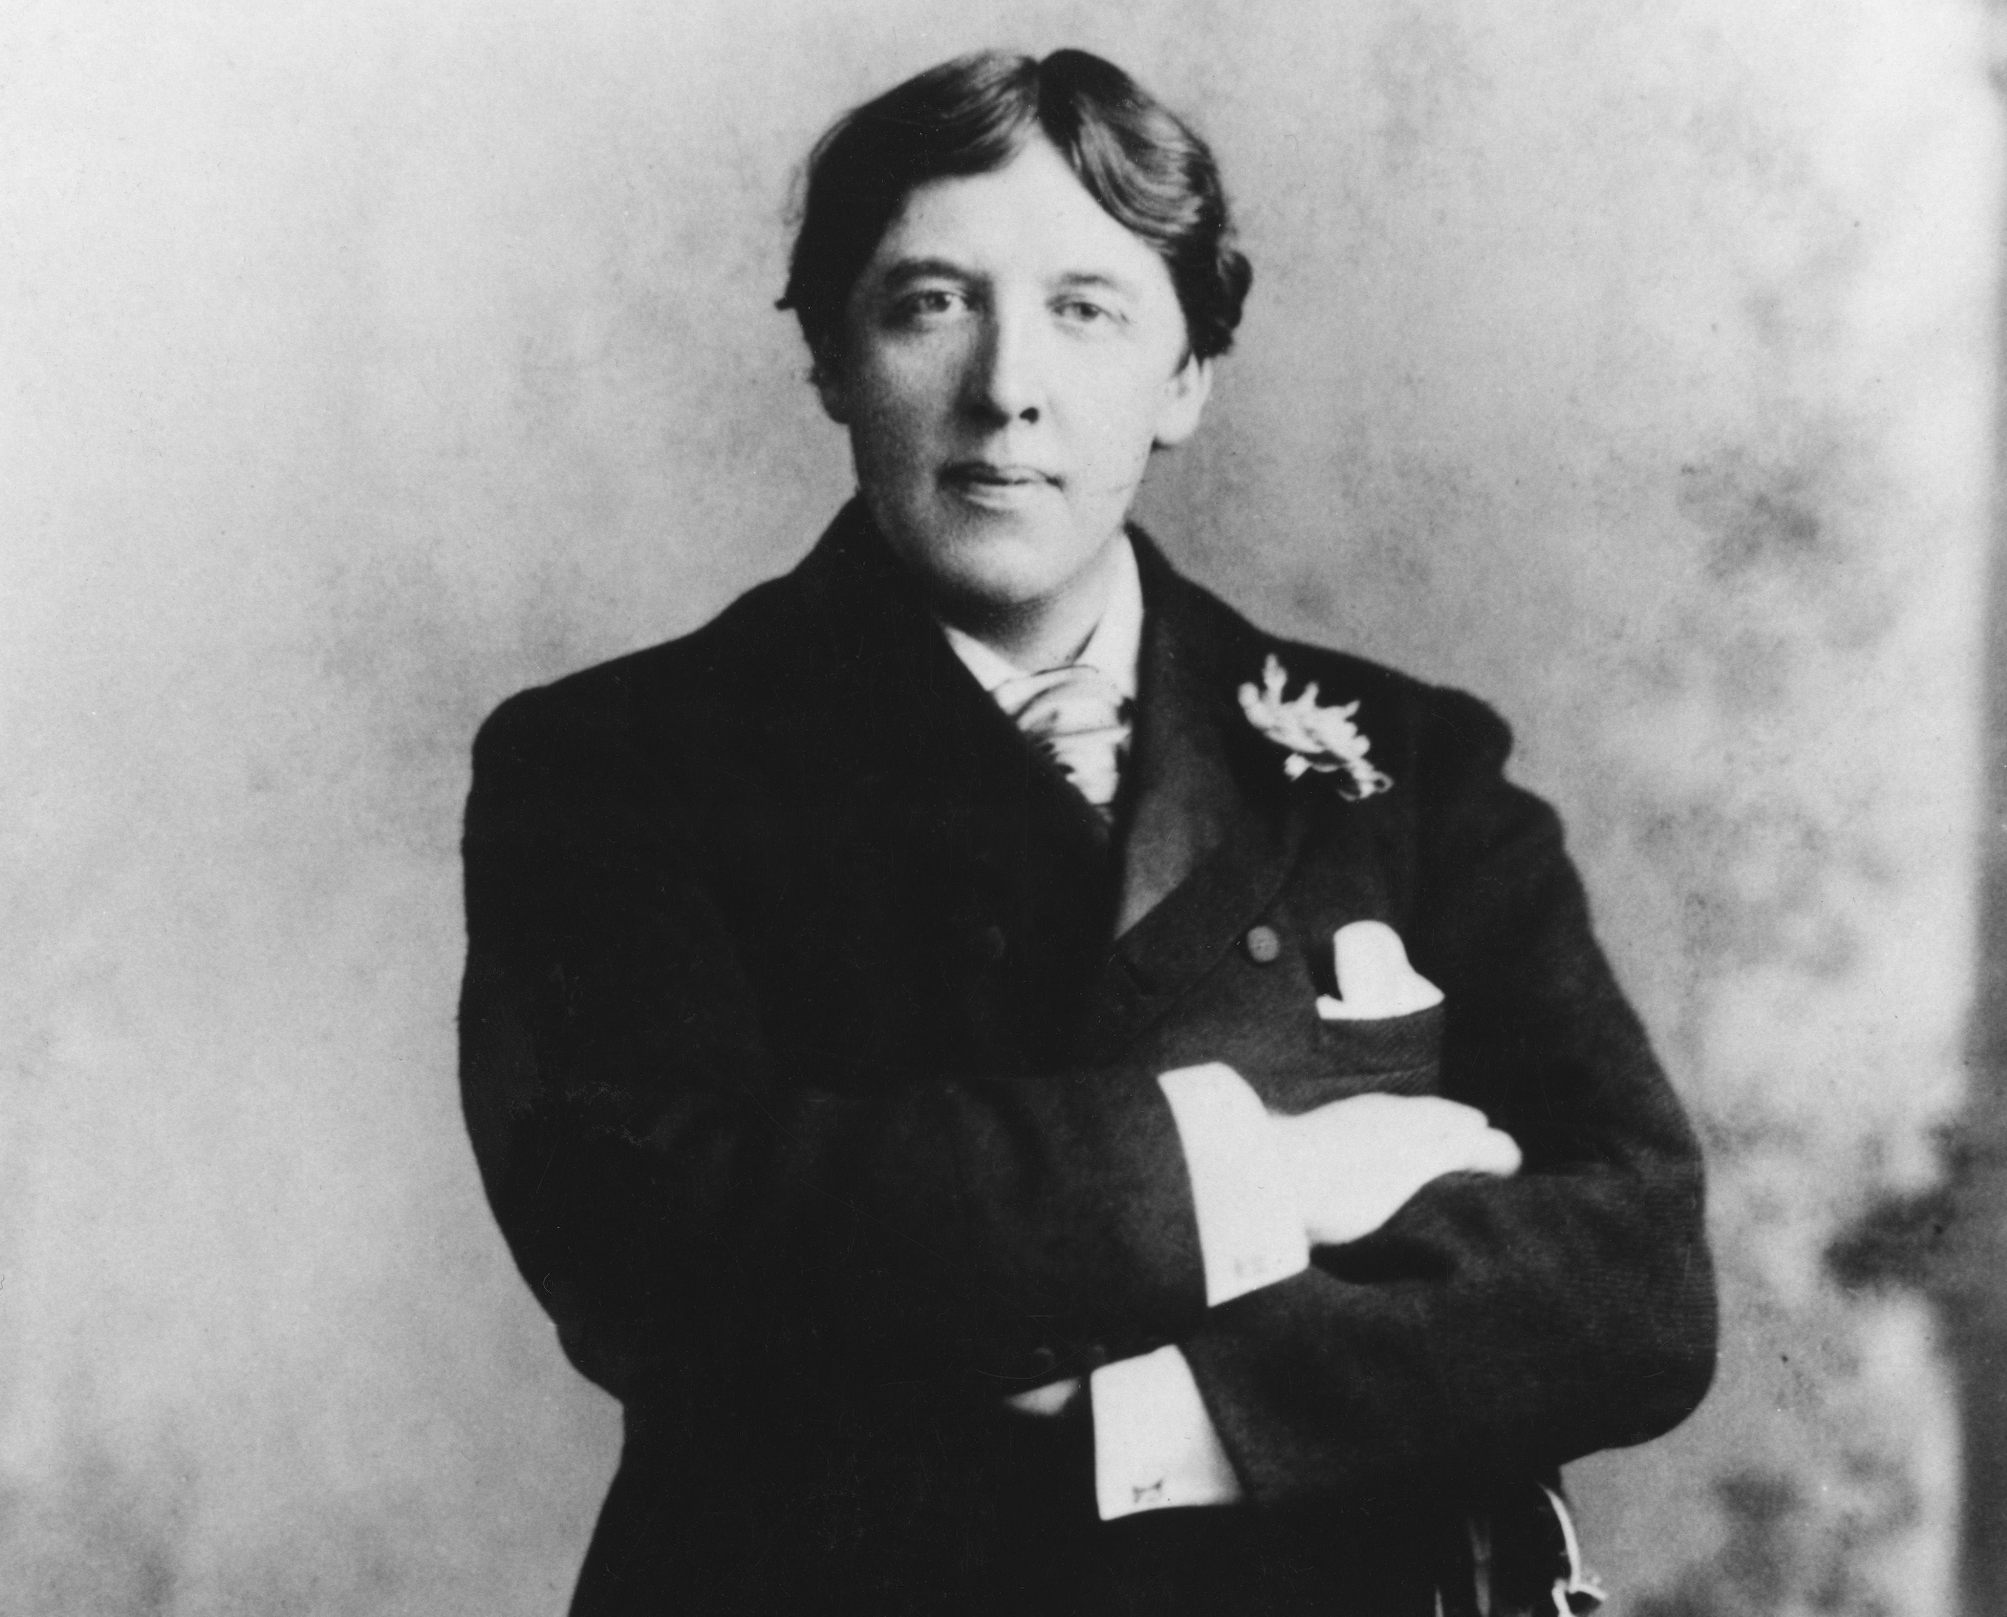
The Picture of Dorian Grey, Slika Dorijana Greja
The Importance of Being Earnest, Važno je zvati se Ernest
The Happy Prince and Other Tales
Poems

Slide 13
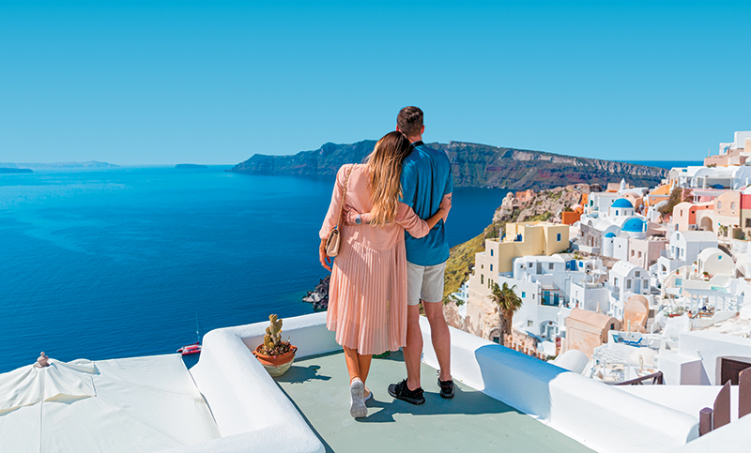
supercial = flippant, frivolous, shallow
don’t judge by appearances = judge the book by its covers (odelo ne čini čoveka)
prelude to = introduction, overture
once in a life time = second to none
would-be = potential, prospective

Slide 14
1. Help Customer Relax (d)
First impressions count. As Oscar Wilde said “Only the superficial cannot judge by appearance”. Whether or not you agree with him, there is no denying the fact that most people hope a visit to a travel agent will be a prelude to, if not the memory of a lifetime, then at least the high point of the year. A warm smile, a pleasant appearance, and good eye contact will help the would-be traveller to relax, safe in the knowledge that he or she is in the hands of a professional.

Slide 15
2. ___________________
The next stage is to identify the needs of the prospective client. This is done by asking questions about the composition of the group, the destination and duration of their trip, their preferred mode of travel, and their anticipated expenditure.
The problems encountered at this stage range from the client not having a very clear idea of what they want, to their being unrealistic about what is going to cost. As soon as the salesperson has established the customer’s requirements, he or she moves on to the next stage.

Slide 16
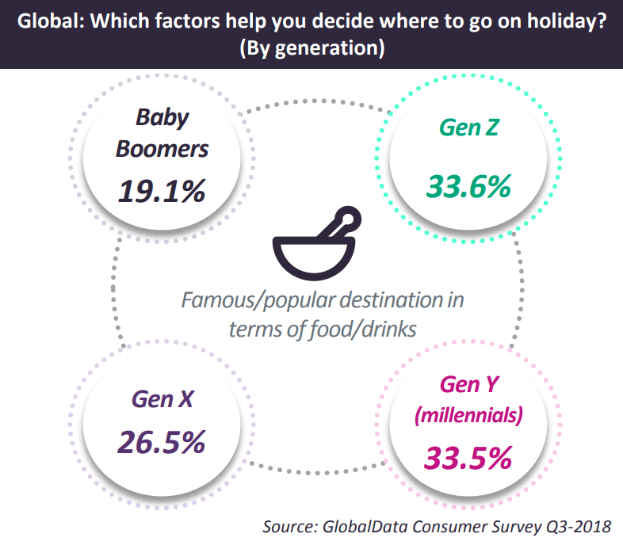
anticipated = expected, estimated
expenditure /ɪkˈspen.dɪ.tʃər/ = costs, expenses
to encounter = meet, face with, run into, come across
to range from = to very from ... to ... (u rasponu od ...do)
to establish = detect, discover

Slide 17
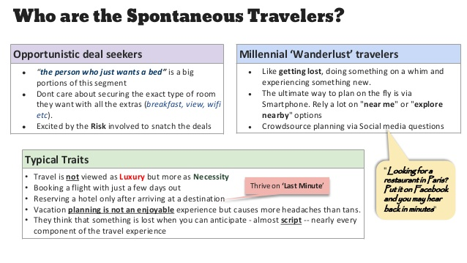

Slide 18
2. Find Out What Customer Wants (a)
The next stage is to identify the needs of the prospective client. This is done by asking questions about the composition of the group, the destination and duration of their trip, their preferred mode of travel, and their anticipated expenditure.
The problems encountered at this stage range from the client not having a very clear idea of what they want, to their being unrealistic about what is going to cost. As soon as the salesperson has established the customer’s requirements, he or she moves on to the next stage.

Slide 19
3. _______________________
Effective sales staff will demonstrate good product knowledge by pointing out not only the relevant features of a variety of travel packages, but also their advantages. Evidence show that the agent who demonstrates intimate knowledge of the product that they are recommending is more likely to achieve a successful sale. However, it is impossible to be familiar with all aspects of each company’s services. Therefore it is vitally important that the salesperson is able to access information quickly through the use of the computer or the brochures provided by tour operators.

Slide 20
3. ______________
Let’s assume that the first package you draw to your customer’s attention seems to meet with their approval. The sale does not stop here. It is now a good idea to show something else, if only to point out the comparative advantages of the first choice

Slide 21

demonstrate = show, present
good knowledge = sound, profound, intimate
point out = emphasize, underline, accentuate
variety = a wide range of
to be familiar with = to know, to recognize
aspect = angle, viewpoint, perspective
vitally = really, esentially, truly
to access = to obtain, retrieve, come to
draw sb.’s attention = capture, call, grab

Slide 22
3. Show Product Knowledge and Expertise (c)
Let’s assume that the first package you draw to your customer’s attention seems to meet with their approval. The sale does not stop here. It is now a good idea to show something else, if only to point out the comparative advantages of the first choice

Slide 23
4. _______________________
That way, with luck, the salesperson may proceed with the closing sale – in other words the client makes a commitment of some kind. The ideal outcome is that the client makes a firm booking by paying a deposit. Yet the salesperson must make sure clients do not feel pressurized into deciding one way or another. If need be, the salesperson should offer to call them later or invite them back in.

Slide 24
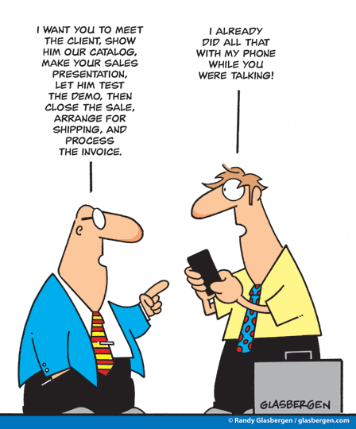
that way = thus, so,
to proceed with = to continue with, pursue
to make (show, give) a commitment
outcome = result, conclusions
to make a firm (early, late, priority) booking
deposit = initial payment, first instalment, stake
feel pressurized into doing sthg = to be forced to do sthg.
if need be = provided it is necessary

Slide 25
4. Close the Sale (e)
That way, with luck, the salesperson may proceed with the closing sale – in other words the client makes a commitment of some kind. The ideal outcome is that the client makes a firm booking by paying a deposit. Yet the salesperson must make sure clients do not feel pressurizedinto deciding one way or another. If need be, the salesperson must make sure clients do not feel pressurized into deciding one way or another. If need be, the salesperson should offer to call them later or invite them back in.

Slide 26
5. ___________________
A good sales technique does not stop with a successful sale. Interest and care must still be shown to ensure customer satisfaction. It has become common practice in many travel agencies to maintain some form of post-sales contact through the use of a ‘welcome home’ card, both to instil customer loyalty and to encourage a high level of repeat business. The skill of selling successfully to growing customer base requires human interest, dedication and above all, hard work.

Slide 27

to ensure = to secure,
common = usual
to maintain = keep
to instil – to encourage, boost, incite, spur
dedication = commitment, enthusiasm
customer loyalty
customer satisfaction
repeat business = customer returns to buy more products and services from the same company

Slide 28
5. Post-sales Contact (b)
A good sales technique does not stop with a successful sale. Interest and care must still be shown to ensure customer satisfaction. It has become common practice in many travel agencies to maintain some form of post-sales contact through the use of a ‘welcome home’ card, both to instil customer loyalty and to encourage a high level of repeat business. The skill of selling successfully to growing customer base requires human interest, dedication and above all, hard work.

Slide 29
5 stages
1. Help Customer Relax
2. Find Out What Customer Wants
3. Show Product Knowledge and Expertise
4. Close the Sale
5. Post-sales Contact

Slide 30
3. page 152-153, At which of the five stages might you hear the following:
a. I can really recommend the place – I was there myself last year.
b. Please take a seat.
c. Would you like me to make a definite reservation?
d. Can I help you?
e. We’ll be sending next year’s brochure to you in a few weeks.
f. Do you know where you’d like to go?

Slide 31
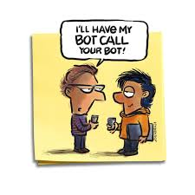
Thank you for your Attention!

