Slide 1
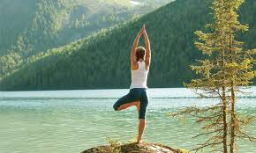
Medical&Wellness Tourism
definitions&types

Slide 2
medical treatments &services in tourism generally speaking
important aspect of emergency management and travel insurance
food-borne illnesses, contagious diseases and transportation accidents
sanitation and hygiene (hospitality industry) against contamination
elderly tourists at higher health risk

Slide 3
Medical tourism is a recent example of niche tourism mostly overlapping with
adventure and sports tourism
ecollogically sustainable tourism
rural tourism
heritage tourism
educational tourism
integrated tourism product

Slide 4
tourism& health
life-style related illness and tourism
health promotion: increase in recreation and leisure pursuits, and desire to reduce the stress of modern living
health and sustainable development (resource and energy use)
specialist and holistic integrated human health with environmental/ecosystem health, and socio-cultural impacts.
tourism specific concepts include guest versus host well-being, and links between wellness and quality of life of host community with tourist satisfaction as well as issues of safety and risks

Slide 5
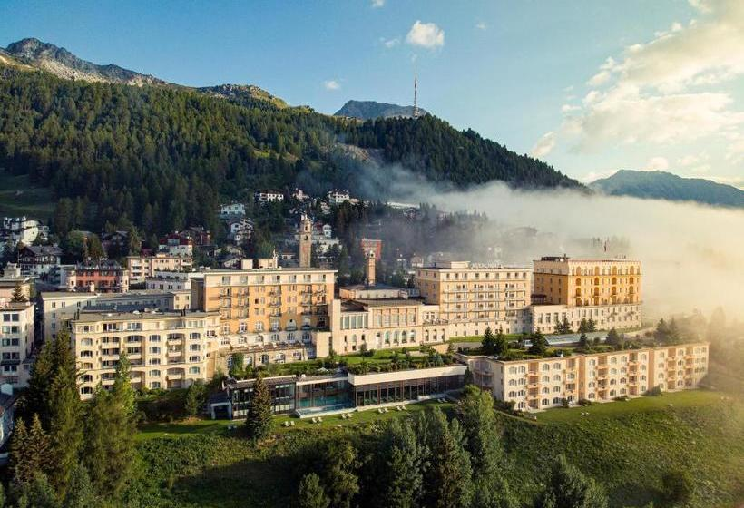
Switzerland, Kulm Hotel St. Moritz
Why not enjoy the mountains year-round? Winter is so pleasant that on fine days you can even walk without a jacket. health paradise marketed by Thomas Cook
Dr Bircher-Benner
muesli, Schweizer Snap
Apple Diet Meal to fight tuberculosis
Lebedinge Kraft
chalet-style health sanatorium
clinics
sun, good nutrition and vigorous climate with healing properties

Slide 6


Johanna Spyri/Thomas Man

Slide 7
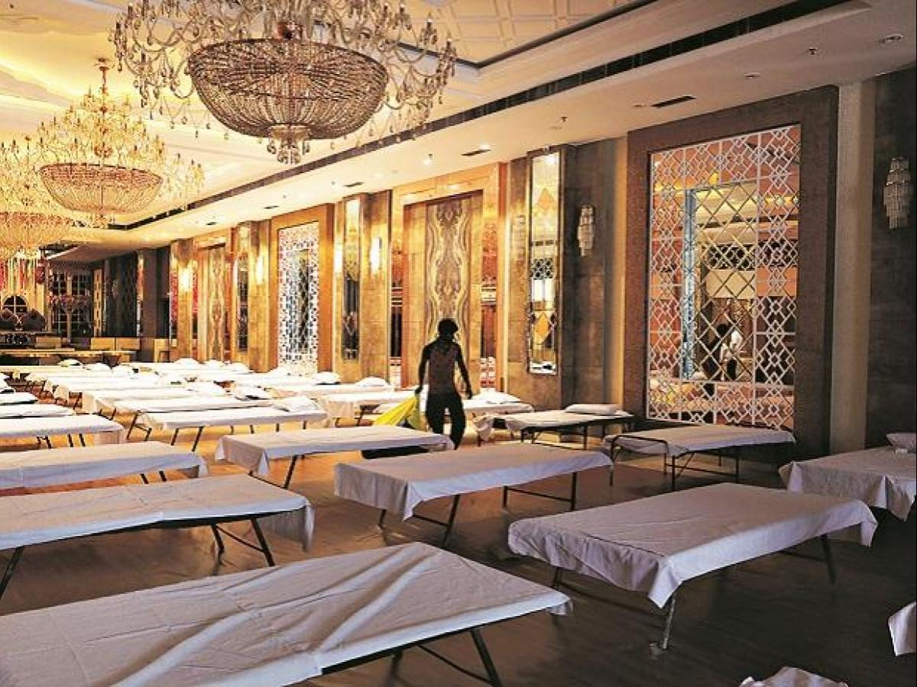
Trivia: “hospital” “hostel” and “hotel” origin of words from the same root,
French ostel, hostel, Latin “large house, shelter, inn” other similar words: host, hospitable

Slide 8
medical&wellness tourism
Medical, health, holistic, wellness
Medical – more for surgery, operations, invasive therapies, medical treatments, specialist checks, dental tourism, transplant tourism, pregnancy&abortion, stem cells etc.
Healthcare&Wellness – to improve physical fitness as well as for psychological and spiritual well-being, recuperation and rejuvenation

Slide 9
Essential vs. Voluntary
Essential – major surgery, organ transplants, cancer treatment
Voluntary – health care, preventive medicine, dental treatment, aesthetic improvements, plastic surgery, botox injections

Slide 10
Medical tourism: how it evolved
Tourists of developed countries are the main source, health care has become expensive
main destination Asia (dental treatment in Bangkok is 5 times cheaper than in Australia)
privatisation of health care?
20th and 21st century bodily obsession
cosmetic surgery has dominated medical tourism so far

Slide 11

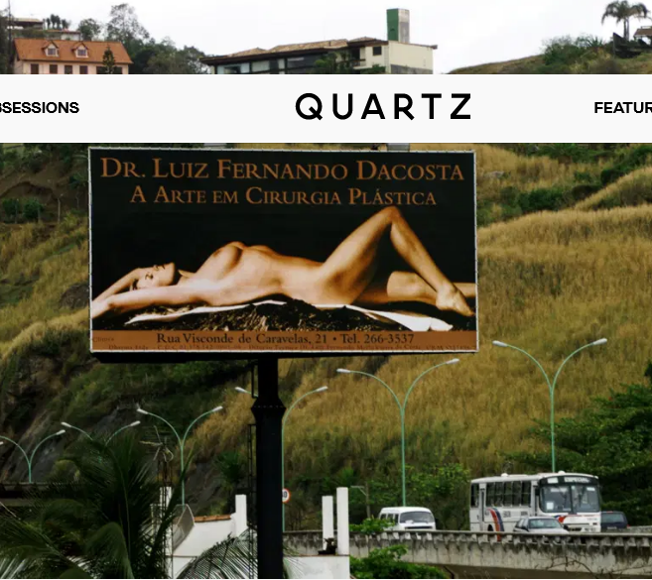
anti-ageing programs plastic surgery
Brazil
“the right to beauty”, offered it to the poor beauty becoming Brazilian cultural feature reconstructive and aesthetic procedures

Slide 12

pregnancy termination
UK 1967 women from Ireland travelled to England/Europe

Slide 13
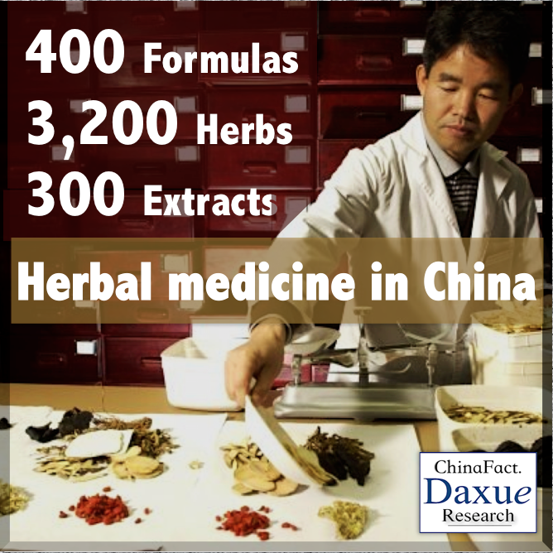
complementary and alternative

Slide 14
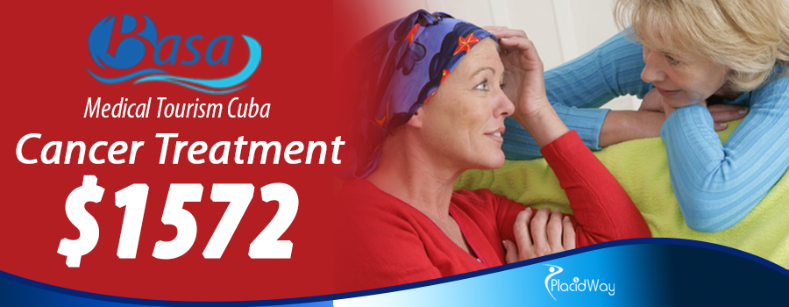
Cuba cancer&HIV treatments

Slide 15
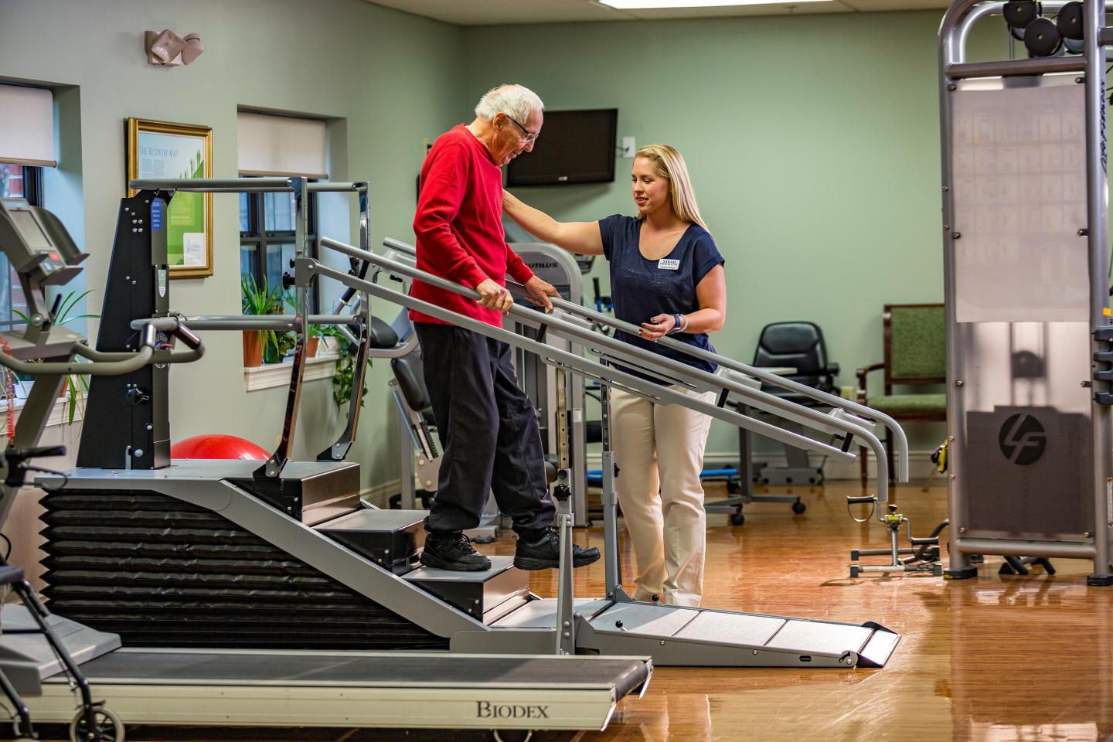
convalescent care
A gradual healing after illness or injury https://www.youtube.com/watch?v=ufdpP2l36SU
.

Slide 16
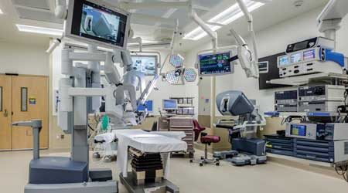
state-of-the art health care facilities for medical tourism https://www.youtube.com/watch?v=PIW7Sh0abd8
surgical and recuperation suites
feeding centres
labs
most advanced technology
conventional and alternative

Slide 17
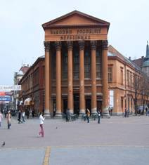
dentristry and orthodontics https://www.treatmentabroad.com/destinations/serbia/why-choose-serbia https://serbiandentaltourism.com/excursions/belgrade
medical tourism agent
Subotica
Užice
Novi Sad
Belgrade

Slide 18
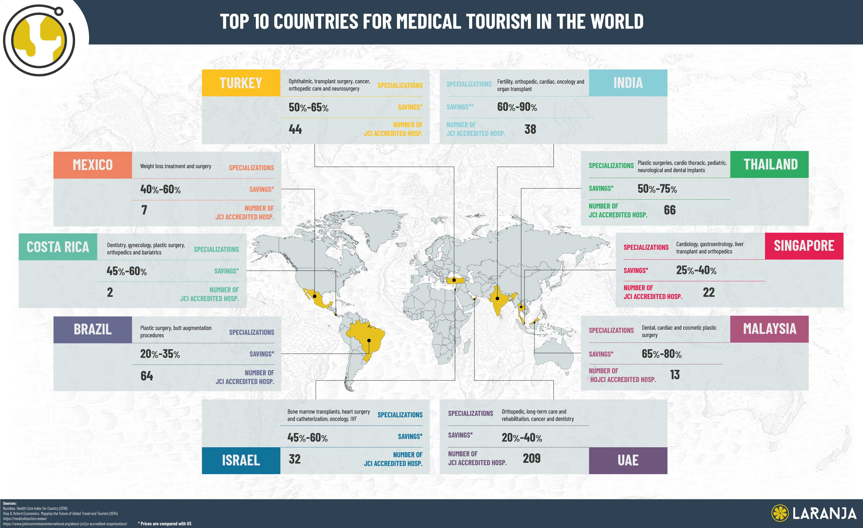
major destinations
Canada
Cuba
Turkey
Brazil
Costa Rica
Israel
Switzerland
South Africa
India
China
Russia

Slide 19
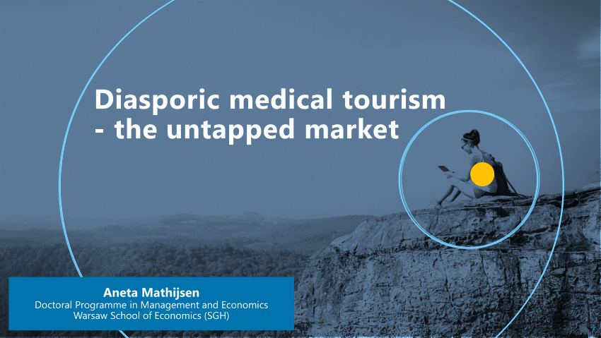
diasporic medical tourism bringing patiens to their homeland

Slide 20
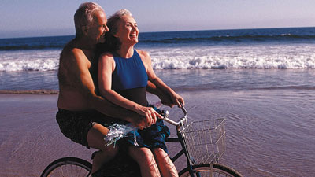
transnational retirement migration as global population age
Turkey
Tenerife (Spain)
Greece
In US (Florida)
Mexico

Slide 21
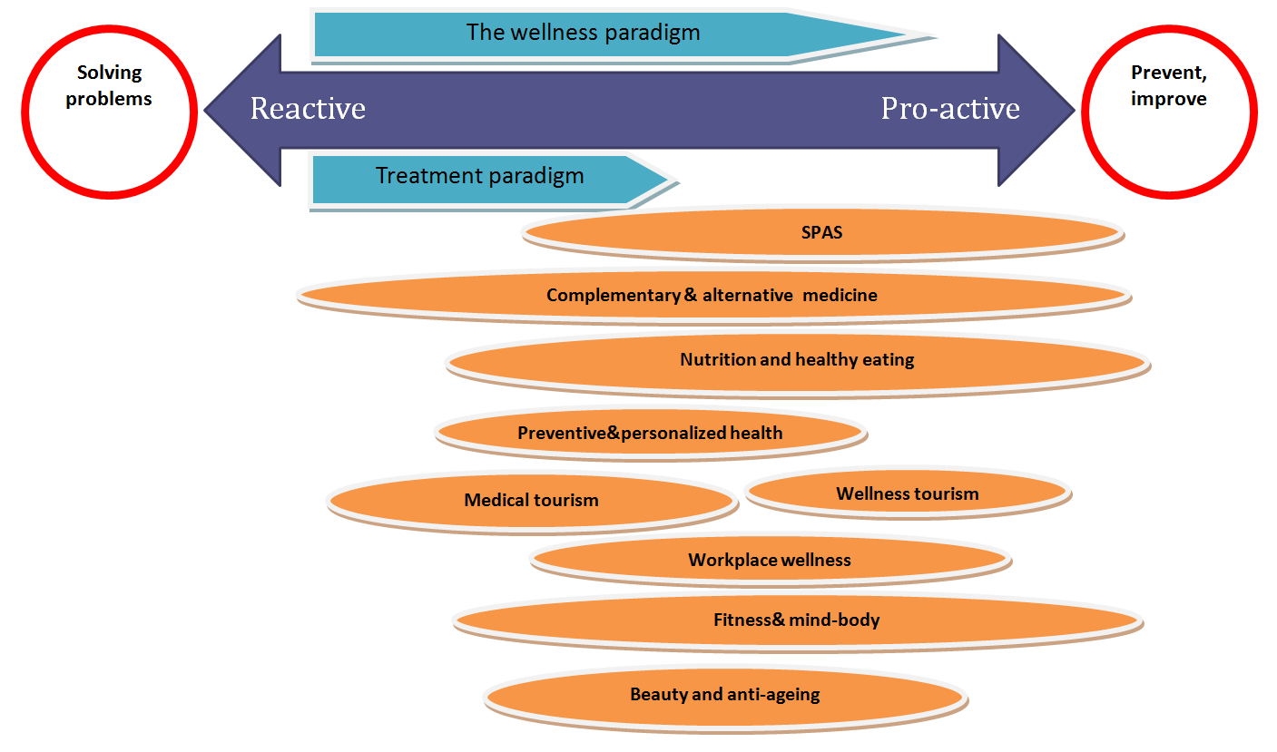

Slide 22
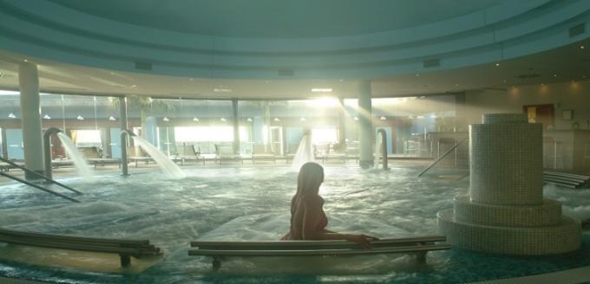
Spa
A spa is a resort which provides mineral or thermal water for drinking or bathing
natural springs with healing properties
de-stressing component

Slide 23
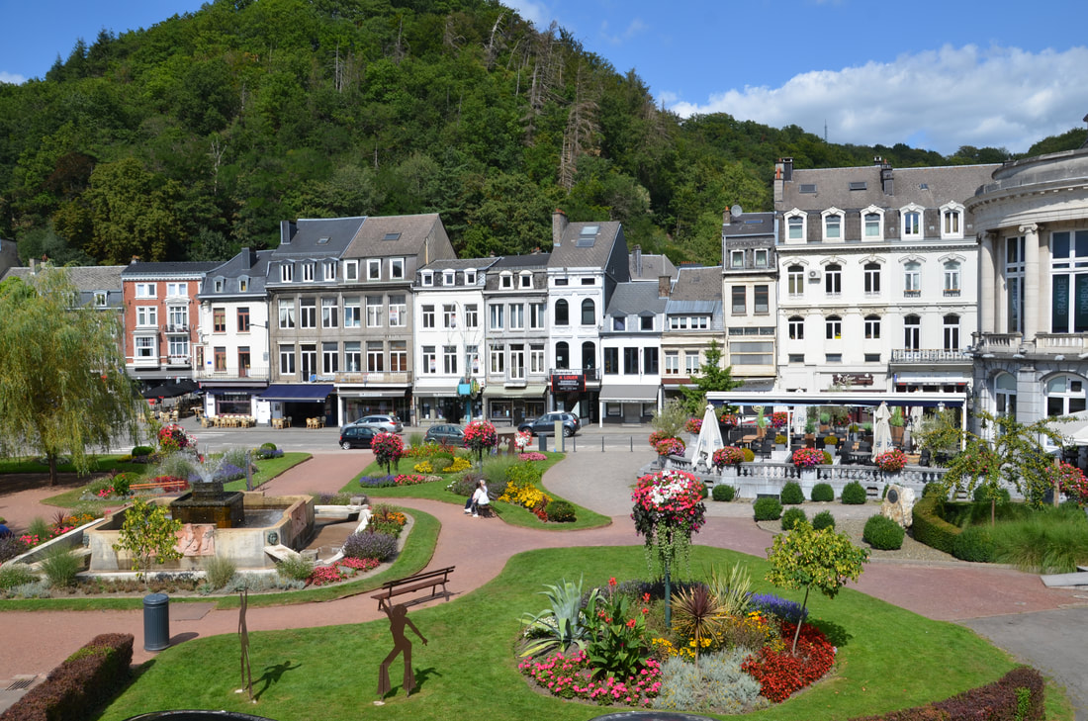
word origin, Sanus per Aquam
Spa is a town in Belgium which provided medical cures in pleasant surrounding
(espa = fountain)

Slide 24
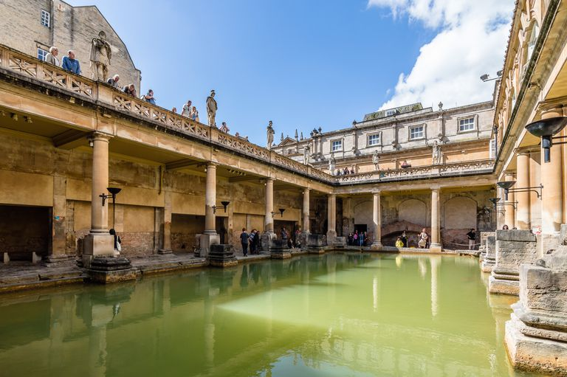
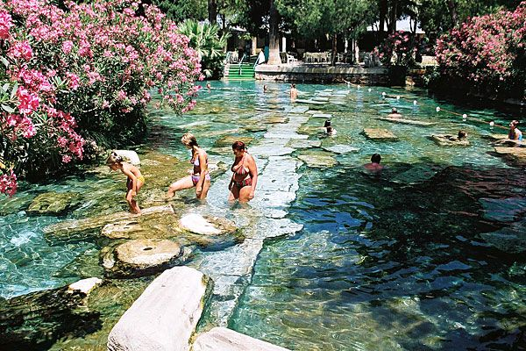
history, ancient Greece and Rome terme, latin
travelling for improved health is the most durable niche in the history of tourism

Slide 25
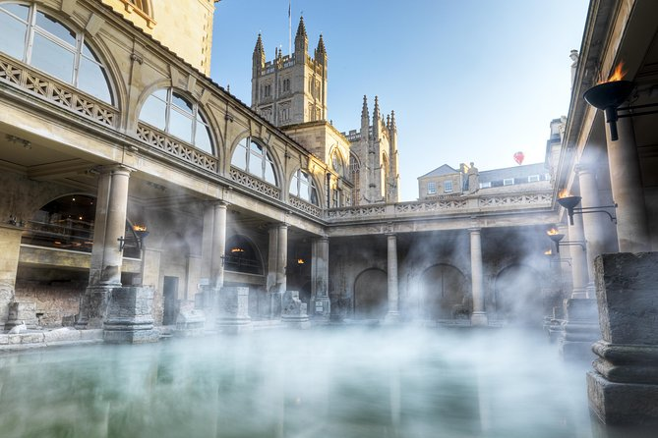
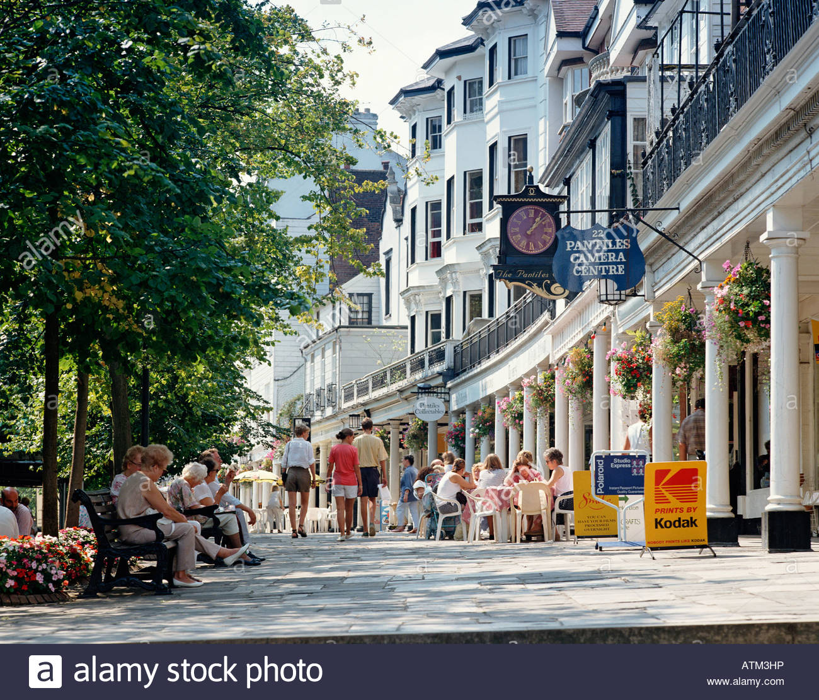
late 16th to early 19th century Europe
Bath and Tunbridge Wells

Slide 26
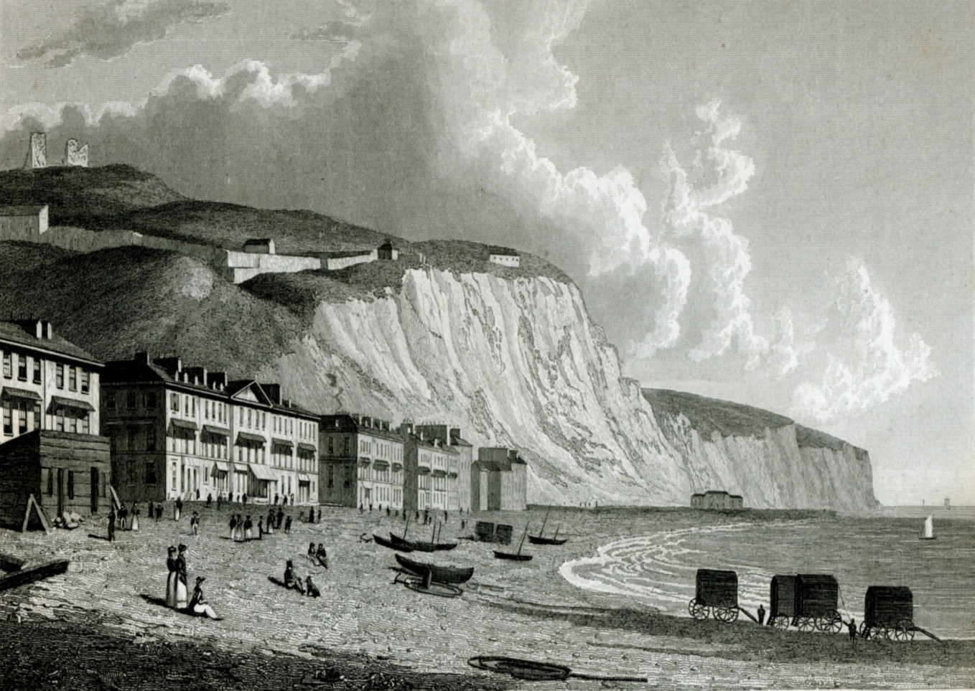
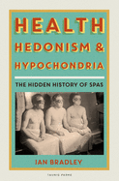
with Grand Tours for aristocracy coastal resorts
Enlightment (prosvetiteljstvo) extreme pollution in the cities

Slide 27
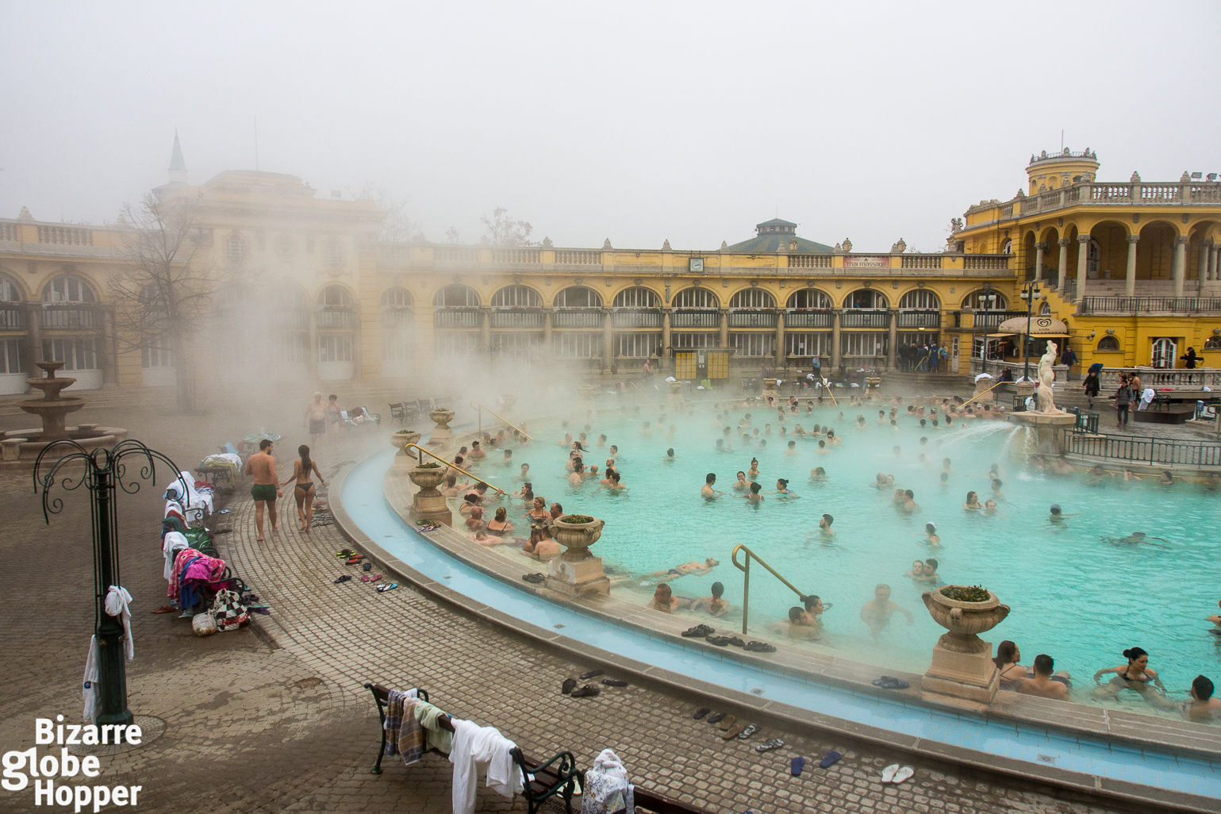
Spa destinations Europe https://www.youtube.com/watch?v=6zSB2coLxDM
Hungary
Belgium
Spain
Switzerland
Italy
Slovenia
Austria
Germany
Czech Republic
Uk
https://www.europeanspas.eu/en/members/serbia

Slide 28
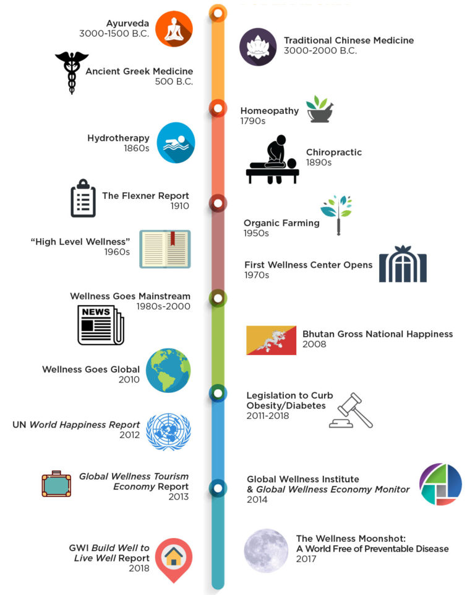

Slide 29
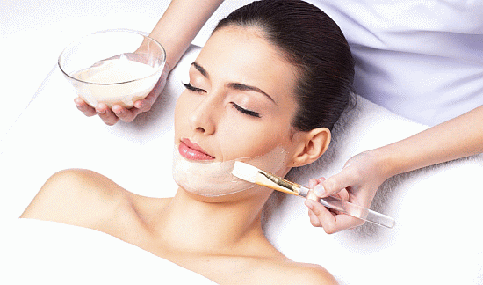
Wellness Tourism
1. BEAUTY TOURISM
Visits to a spa for water-based treatments such as saunas, hammam, steam baths accompanied by special massages and beauty treatments and skin care.
Thalassotherapy – seeweed, mud
Aromatherapy – essential oils
Vinotherapy grape-based products

Slide 30
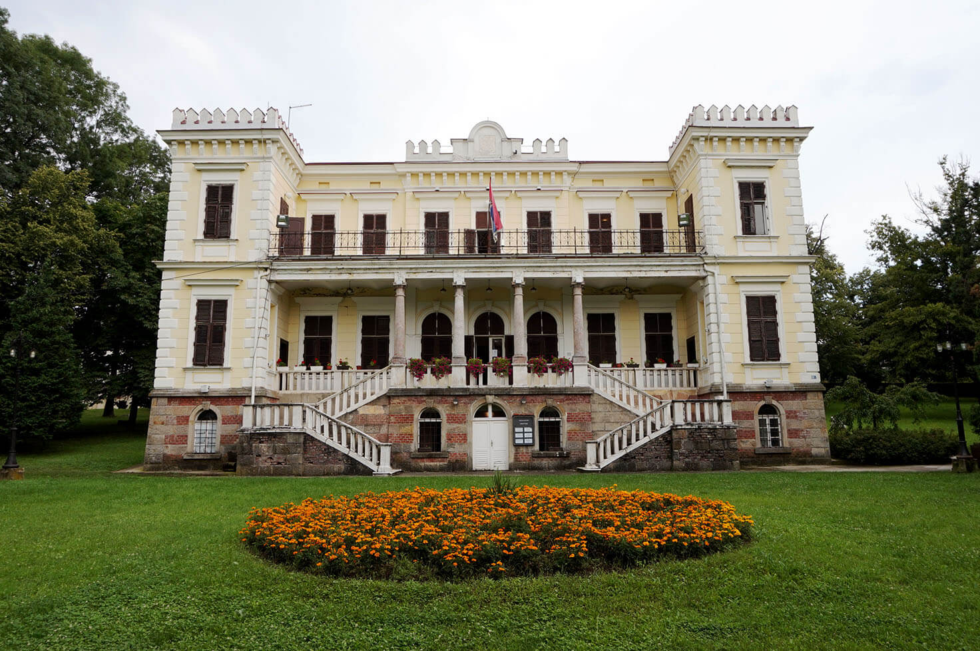
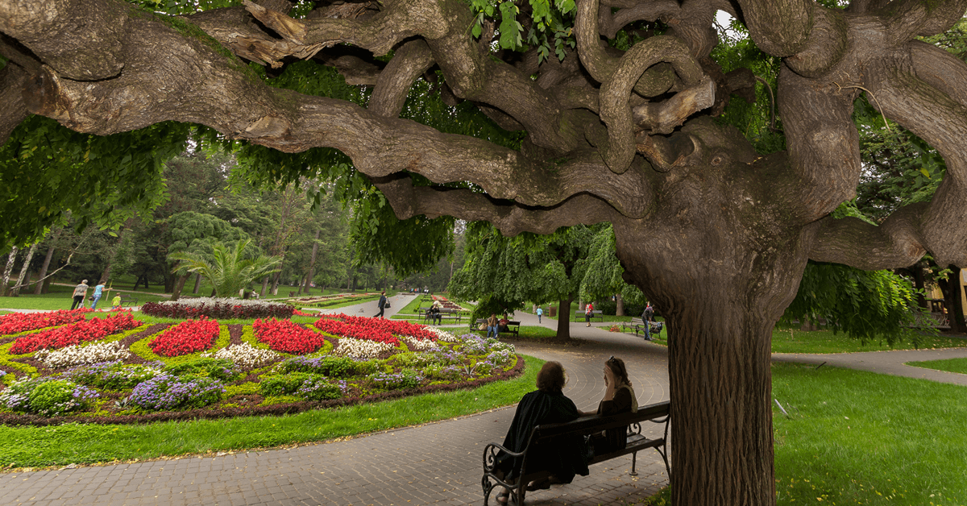
Serbia
Vrnjačka Banja
Austro-hungarian and Turkish influences
https://www.youtube.com/watch?v=nTeehxM56BA

Slide 31
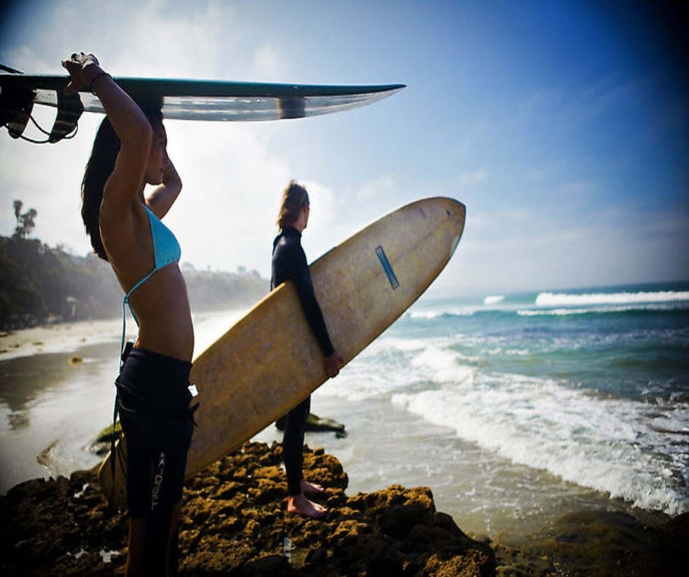
Wellness Tourism
activities and seminars related to fitness, exercise
healthy eating, weight loss and relaxation technique.
pills and potions (whey)
mens sana in corpore sano
a healthy mind in a healthy body

Slide 32
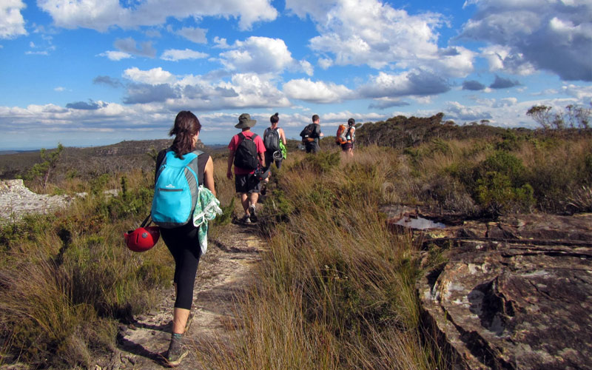
naturism and hiking/bushwalking

Slide 33
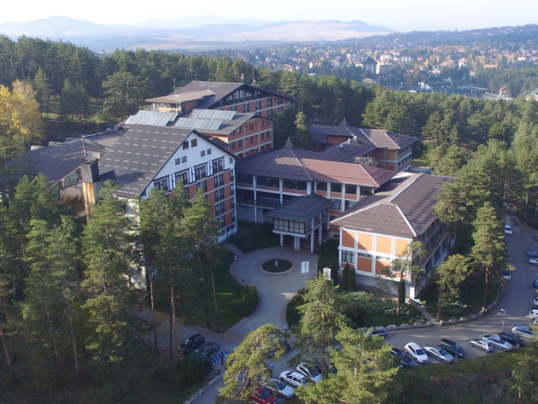
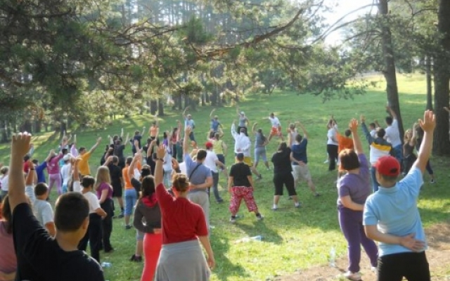
Čigota

Slide 34
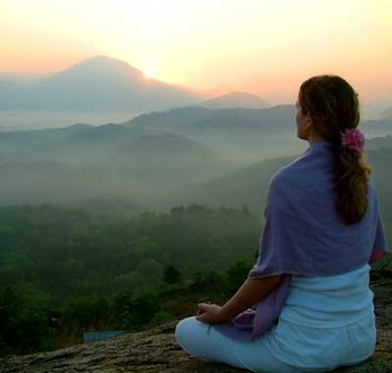
Wellness Tourism
3. Spiritual Retreat
Religious and non-religious
Meditation and detoxification
Yoga
T’ai Chi
Teachings and Philosophy

Slide 35
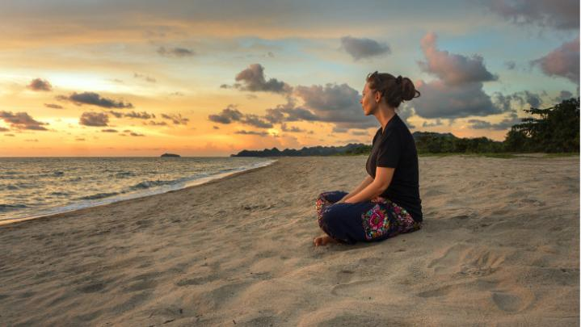
Soul healing (search) and holistic approach involve expert psychologists

Slide 36
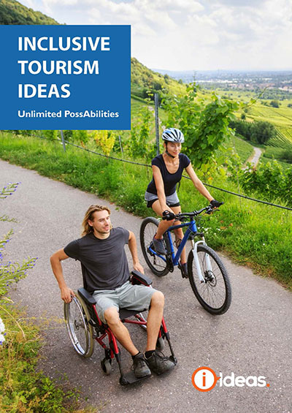
Inclusive Tourism

Slide 37
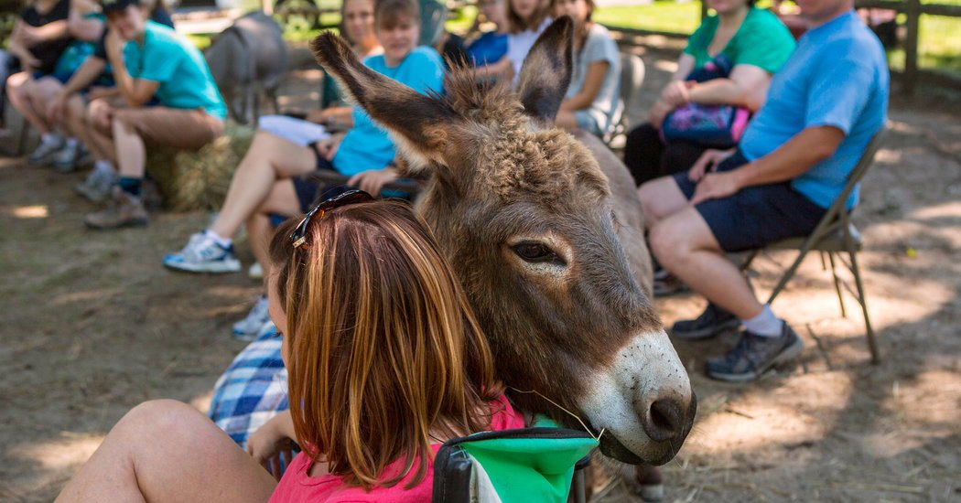
Therapeutic effects of animals (dogs, horses, donkeys farms) https://www.thedonkeysanctuary.org.uk/ https://www.youtube.com/watch?v=2pEzkMY09_E

Slide 38


Activities with therapeutic effects such as painting, sculpting, handiwork

Slide 39
issues and concerns
‘death tourism’ euthanasia raised ethical issues
risky affairs and fraud, medical malpractice, illegal purchase of organs and tissues (tkiva)
lawsuits
some procedures are illegal in home countries
deepening of inequalities (the rich and the poor)

Slide 40
task
What are potentials for further development and promotion of medical&health tourism in Serbia?
Which particular types of medical&health tourism can be promoted to apeal to different age/interest groups?

Slide 41
References:
https://globalwellnessinstitute.org/industry-research/history-of-wellness/
Switzerland as a health paradise:
http://www.bbc.com/travel/story/20170924-the-town-that-sold-mountains-to-the-world
http://www.bbc.com/travel/story/20170808-how-switzerland-transformed-breakfast
Budapest, Szechenyi Thermal Spa: https://www.youtube.com/watch?v=6zSB2coLxDM
Serbia spa places, NTO: https://www.youtube.com/watch?v=nTeehxM56BA
Donkey sanctuary: https://www.youtube.com/watch?v=2pEzkMY09_E

Slide 42
References:
https://www.treatmentabroad.com/destinations/serbia/why-choose-serbia
https://serbiandentaltourism.com/excursions/belgrade
Israel health tourim promo video
https://www.youtube.com/watch?v=PIW7Sh0abd8
Turkey recovery therapy
https://www.youtube.com/watch?v=ufdpP2l36SU
https://visitbath.co.uk/
Spa, Belgium
https://www.youtube.com/watch?v=3TqwsSkWlDg
https://www.europeanspas.eu/en/members/serbia
John Connell (2011) Medical Tourism
Routledge Handbook of Health Tourism (2017) eds. Smith, M.K.&Puczko, L.

Slide 43
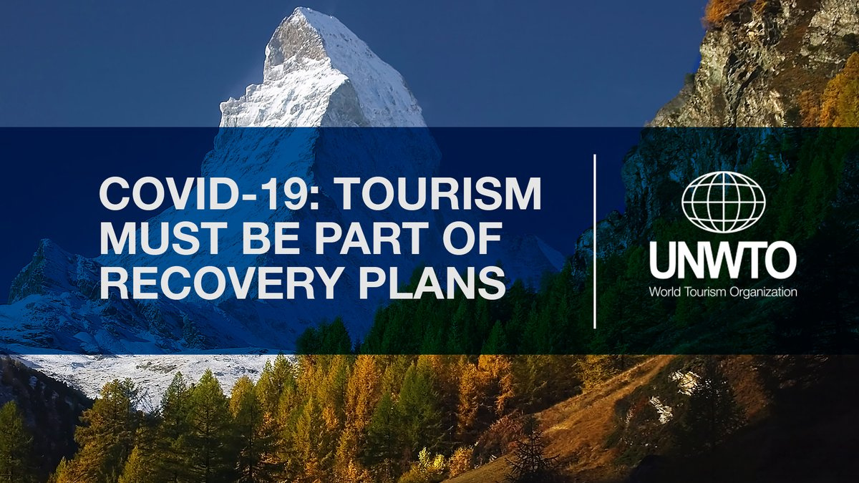
Thank you for your attention!

