Slide 1
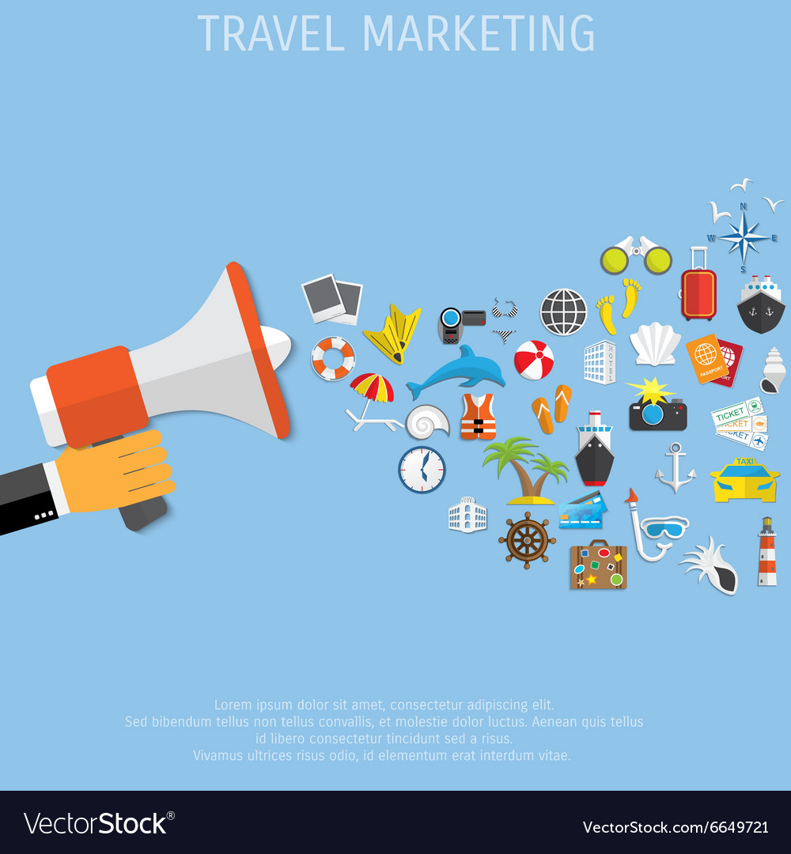
PROMOTION AND MARKETING IN TOURISM
How to Sell a Product

Slide 2

Types of Advertising and Promotion

Slide 3
Important Notions
Market (supply&demand, buy and sell)
System where parties engage in the exhange of
goods, services and information.
E.g. labour market, real estate market, emerging
market, EU market,

Slide 4
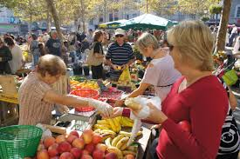
The Origin
Bartering (trampa)
Money – Currency
Retail/Wholesale
Intermediator
(broker)
Stock exchange

Slide 5

Stock Market
Wall Street
Rise/Fall - Plummet/Hike
Assets - Liability
Crash - 1920s – Great Depression
Boom / Boost - Recession
Shares/Securities
Commodities (oil, sugar, gold)
Financial Times
Monopoly
Free Trade
Speculations

Slide 6

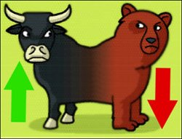
BULL MARKET VS BEAR MARKET
Increase Decrease
Rise Fall
Optimism Pessimism

Slide 7


Slide 8
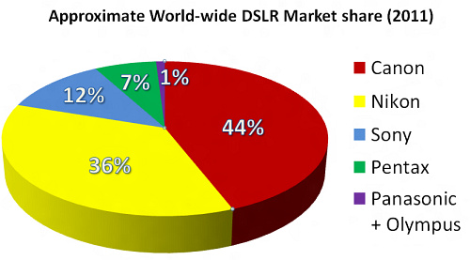
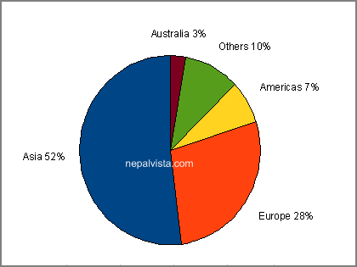
Market Share
Volume of sales achieved by a company in a specific area, compared to all sales of similar products/ companies. It is expressed as a percentage

Slide 9
to market, v. – to do things that cause people to know about and want to buy sthg.
A group of consumers sharing certain demographic/ geographic characteristics to whom products are offered or sold.
Travel agent : “My market is upscale retirees in the Houston metropolitan area.”
(a specified category of potential buyers)

Slide 10

marketing = identifying and reaching specific segments of population in order to sell a product or service

Slide 11
Important Notions
Marketing/advertising agency
Marketing guru&team (psychologists, economists, jurists, designers/artists, PR, IT)
Market research
Target group/focus group – market segmentation

Slide 12

market research = gathering information about markets or customers – anticipate what they need and would like to buy
- conducting a survey
- SWOT analysis
- social media platforms
- qualitative&quantitative research

Slide 13
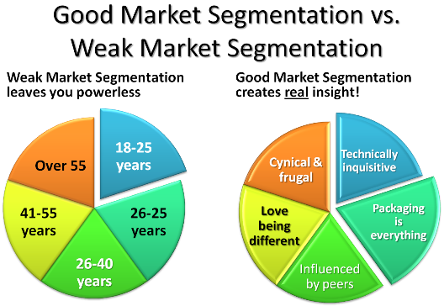
market segment = part of a market of individuals/families/companies/organizations sharing characteristic(s) that cause them to demand similar products or services.
-Market segments share same qualities: gender, age, interests, location, income
.

Slide 14
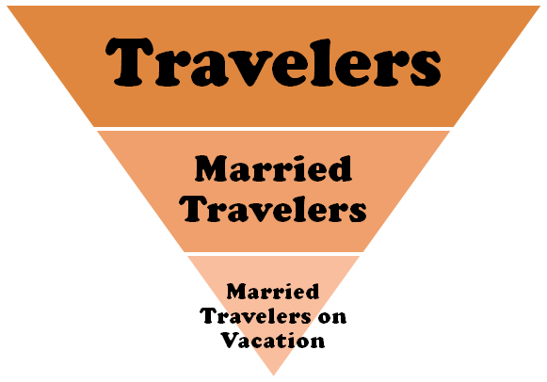
target group or focus group = a group of customers at which a company has decided to aim its products
Demographic – gender, age
Socioeconomic – income, profession,
household size, education
Psychographic – interests, attitudes, values,
lifestyles
Behavioral – occasion, degree of loyalty
Product- related – relationship to a product

Slide 15
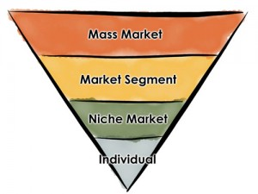
mass marketing = a firm decides to ignore market segment differences and go after the whole market with one offer
niche market = aimed at satisfying specific market needs (prestige, practicability, adventure, planet environment conscience)

Slide 16
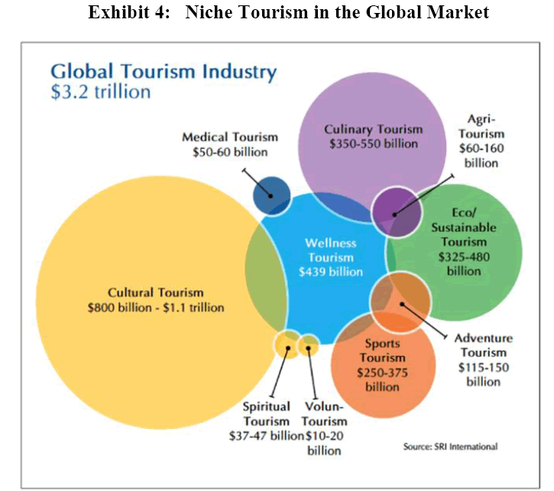

Slide 17
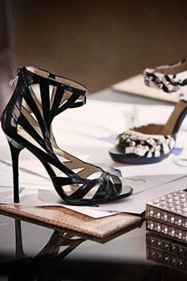
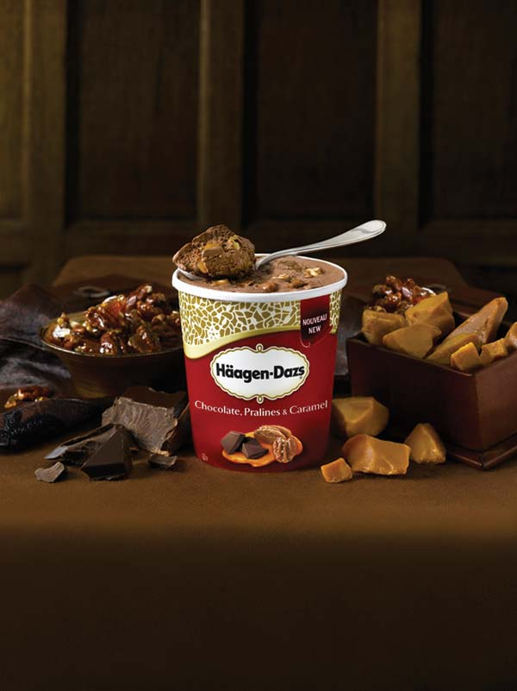
Image-Exclusivity-Economics
upmarket
intended for high-income
consumers
downmarket
mainly sold to
low-income people

Slide 18
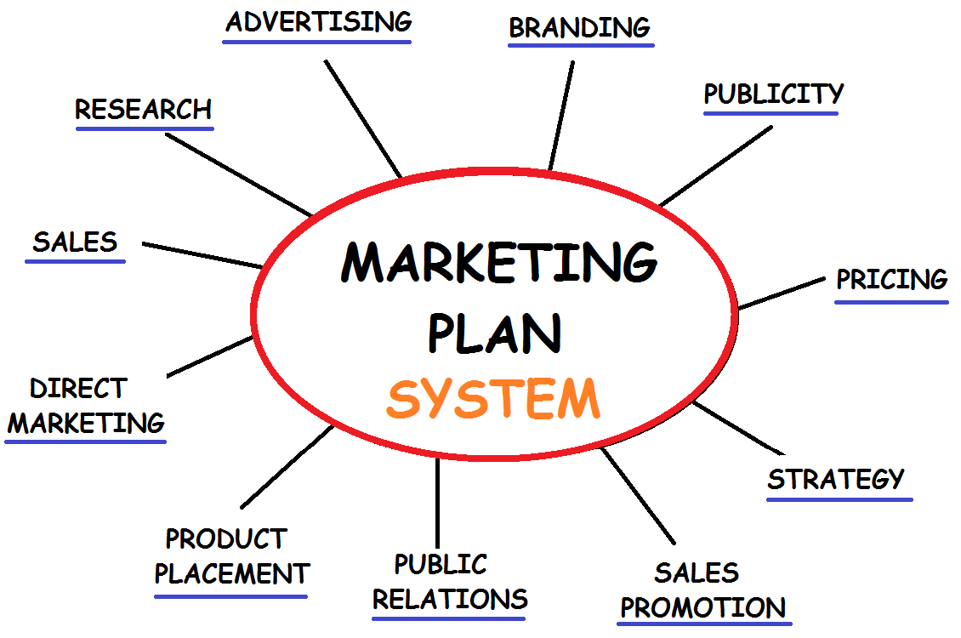
Strategy

Slide 19
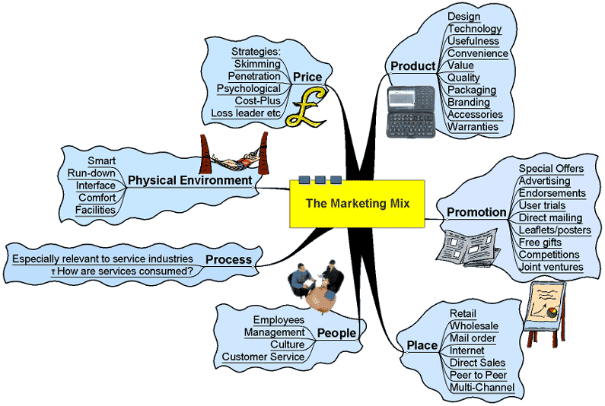
Marketing Mix
4 Ps
Product Price Promotion Place (distribution)
4 Cs
Commodity Cost Communication Channel

Slide 20
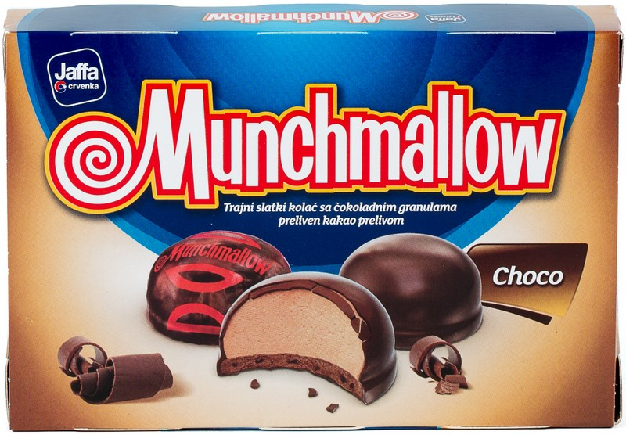
Market Stretching

Slide 21


to promote
help sell a product or service, make it more popular by advertising it or offering a special price

Slide 22
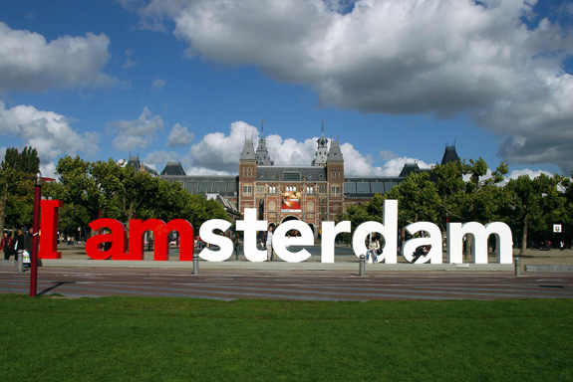
Slogans and Logos tactile, innuendo, disturbing, overexicting, puns
https://www.youtube.com/watch?v=hqEh0iFWlgs

Slide 23

Emotions
Blatant, Agressive Ways

Slide 24

Emotions
Subtle, Subliminal Ways
WATCH https://www.youtube.com/watch?v=CML7wk62rsA
https://www.youtube.com/watch?v=1NXWRMrnNxA

Slide 25
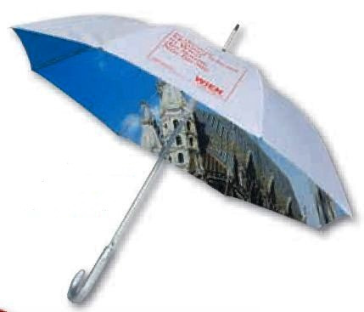

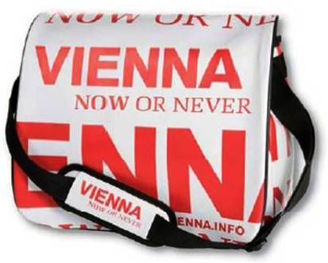
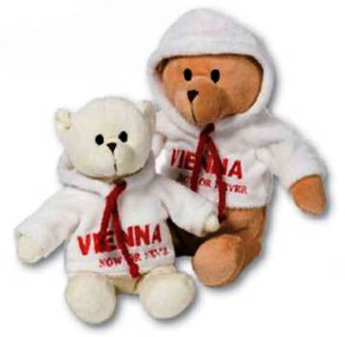

Country – City Branding and Country as a Brand

Slide 26


TV Commercial

Slide 27

Endorsed Ad
https://www.youtube.com/watch?v=Svlks_34XCc

Slide 28


Radio Ad

Slide 29

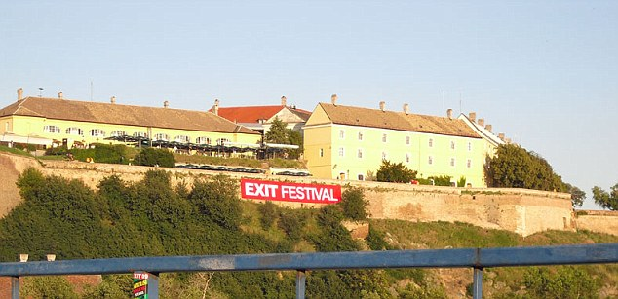

Cinema/Theatre/Festival Ad

Slide 30
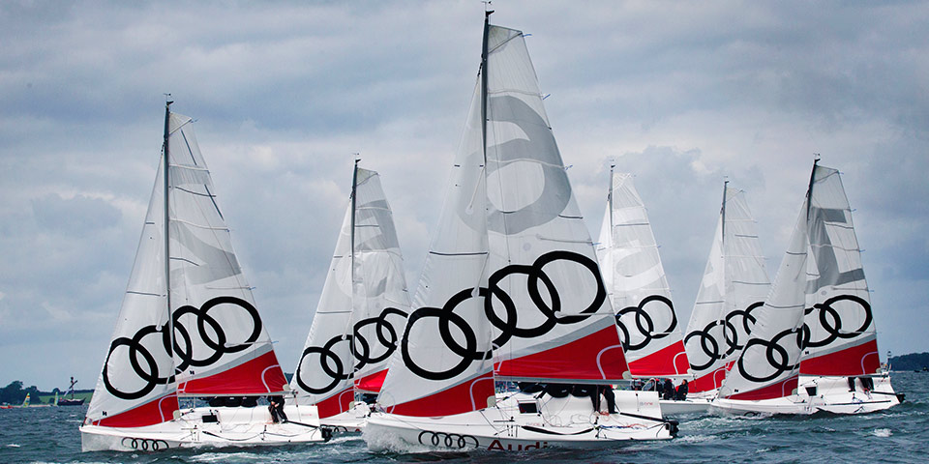
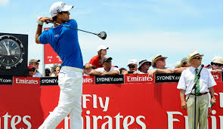
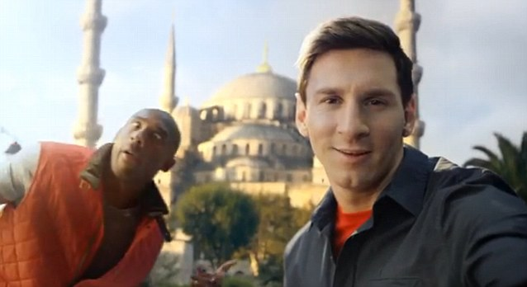
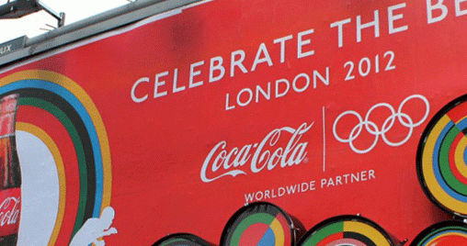
Sporting Event - Sponsorship

Slide 31
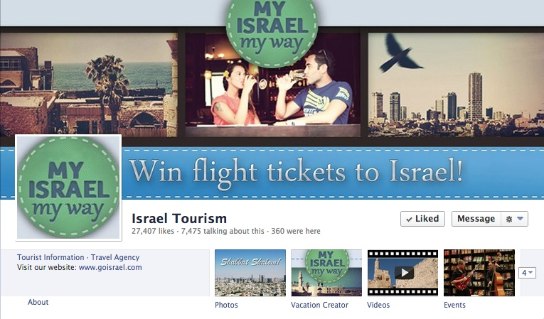



web site&social media

Slide 32
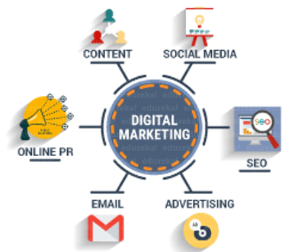

Slide 33
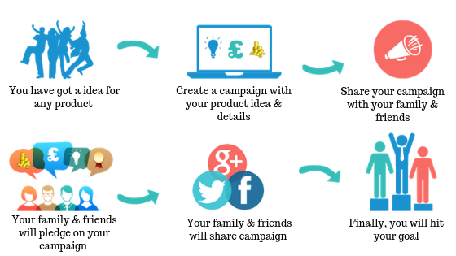
Crowdfunding

Slide 34
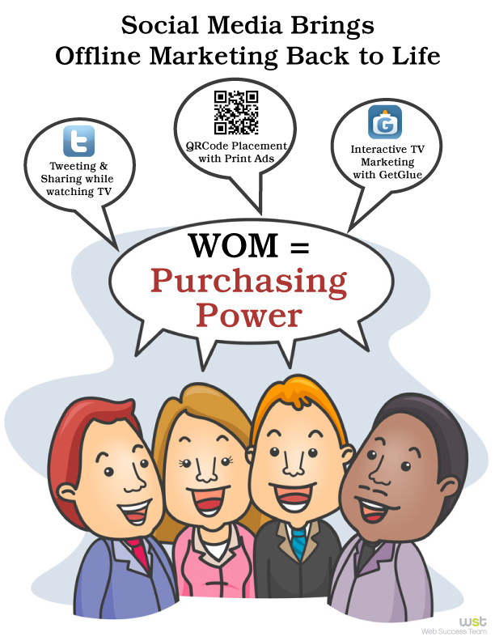

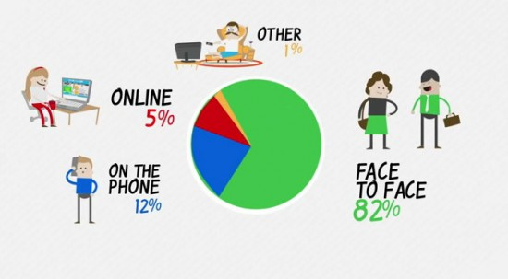
The Word of Mouth&Face-to-face, tele-sale

Slide 35
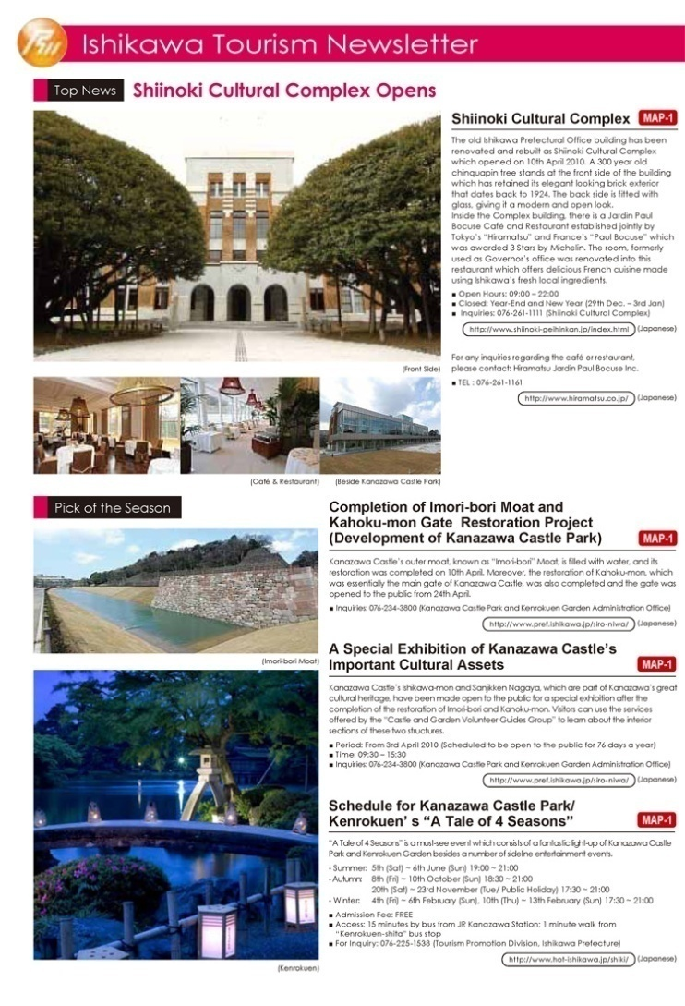
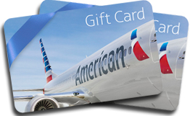

Mailing, Correspondence,
Loyalty Program, Newsletter, Feedback Questionnaire

Slide 36
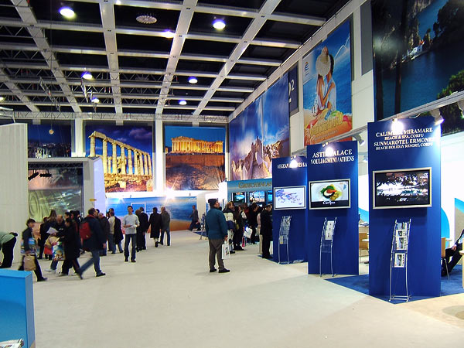
Tourism Fair&Sales Promotion
First and Last Minute

Slide 37

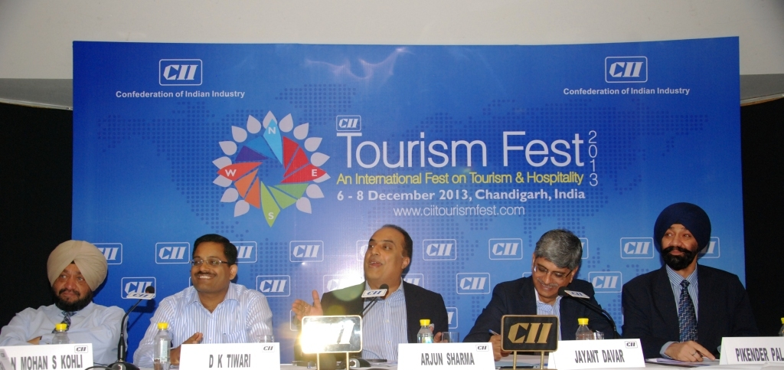

Press Release&News Conference, TV Shows - PR
News that is sent out or released by the company making the news. (company bias)

Slide 38
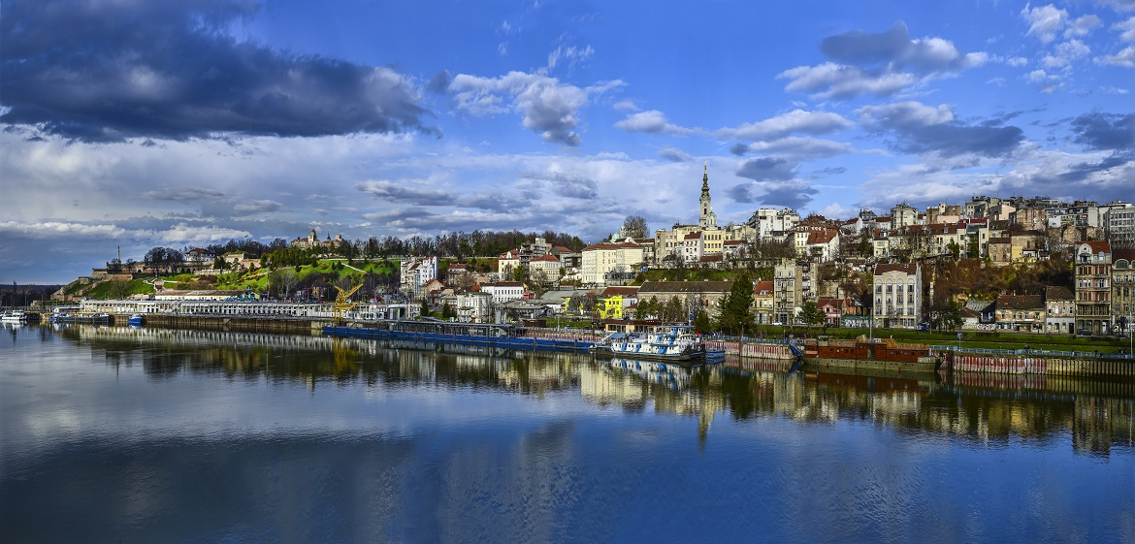
NTO paid article
https://www.theguardian.com/travel/2009/dec/13/belgrade-from-our-correspondent

Slide 39
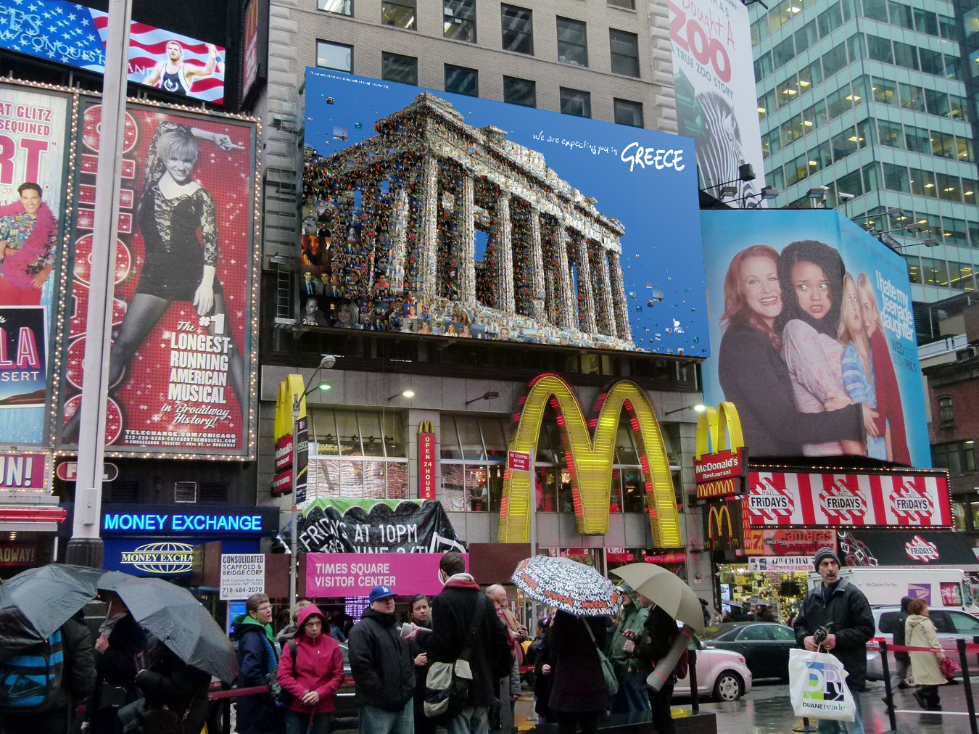
billboard = a large board at the side of the road advertising something

Slide 40
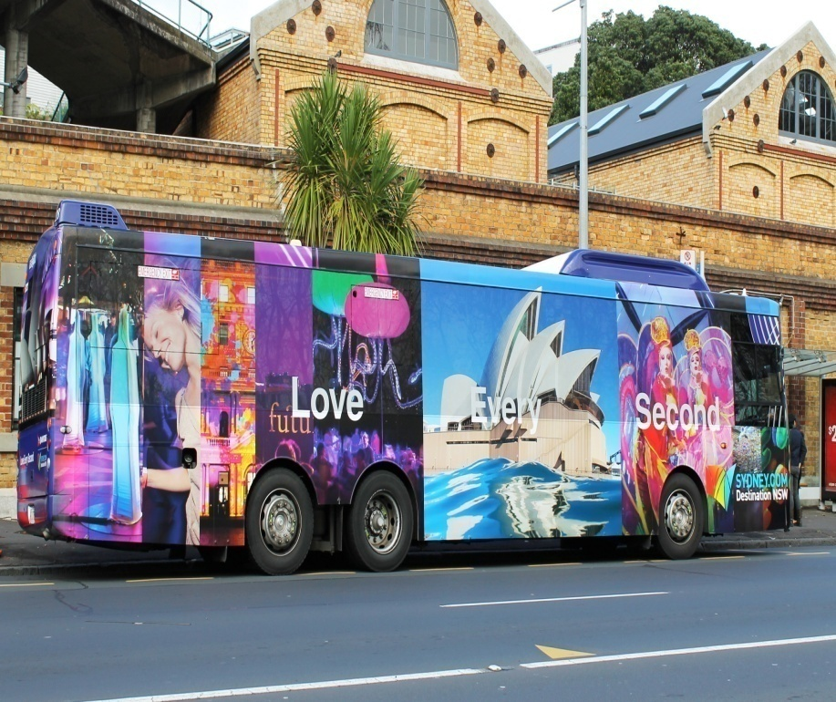
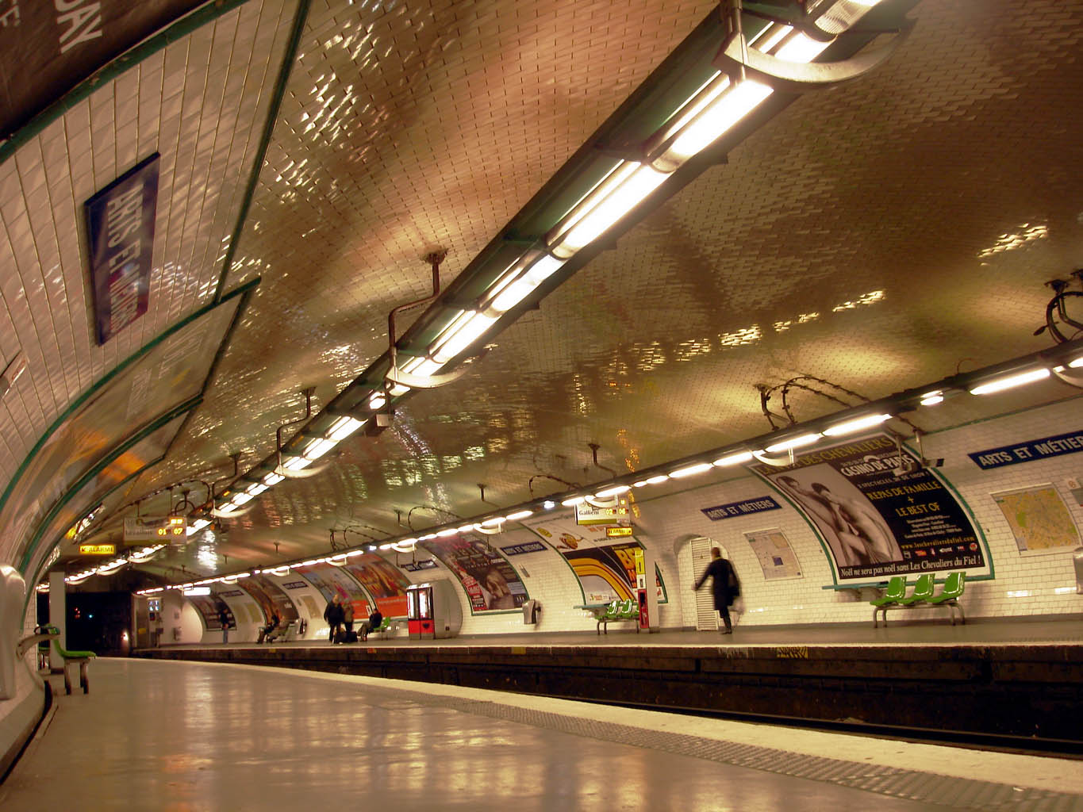

Bus&, Railway, Metro Stations, Airports
Neon Sign

Slide 41

poster = a large glossy printed paper put in a public area

Slide 42

catalogue – a rich publication that contains a list of things that you can buy, use with plenty of pictures

Slide 43
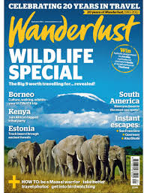

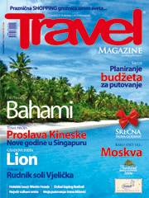
Magazine and Newspapers

Slide 44
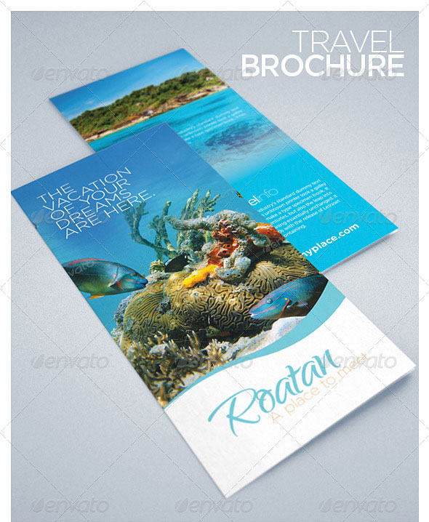
brochure = a booklet with pictures and information about a destination

Slide 45


leaflet = a printed and folded sheet of paper

Slide 46

Controversy: Like a Prayer with Pepsi!

