Slide 1
Sustainable Tourism
Tourism and Environment

Slide 2
How to Maintain Sustainability?
There’s always been a conflict between
ENVIRONMENT AND DEVELOPMENT
ECONOMY

Slide 3

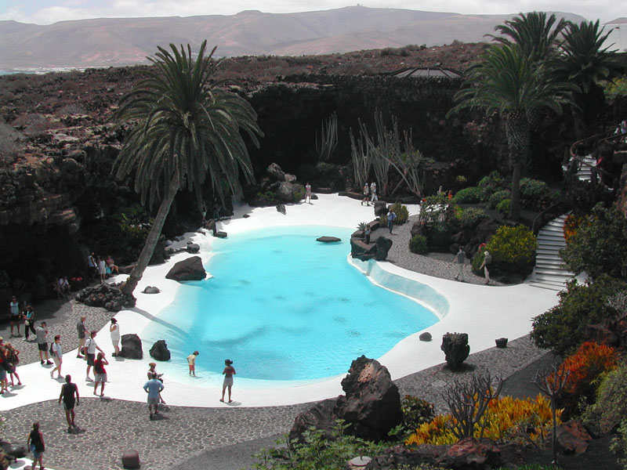
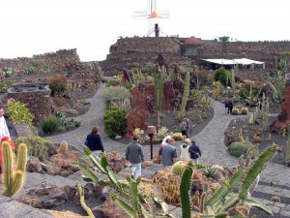
What have we learned so far?

Slide 4
Cesar Manrique’s Achivements
use of local materials (not imported or too artificial)
integration with nature
traditional style and chill-out atmosphere
promotion of Lanzarote, but ban on agressive advertising

Slide 5
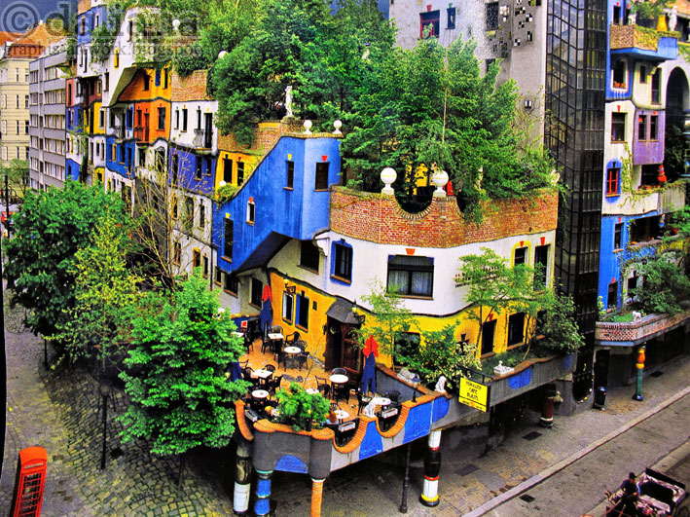
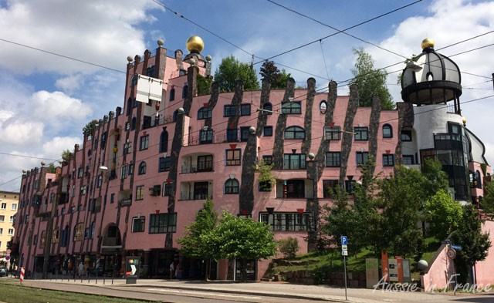
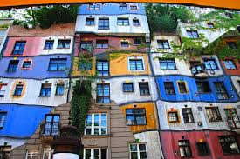
Hundertwasser

Slide 6
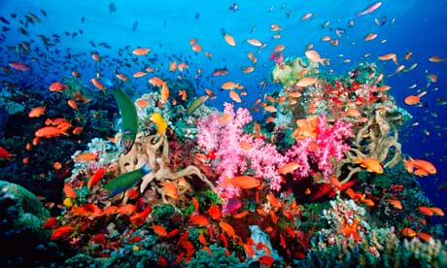
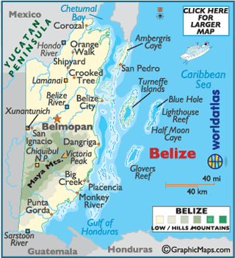
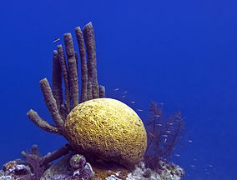
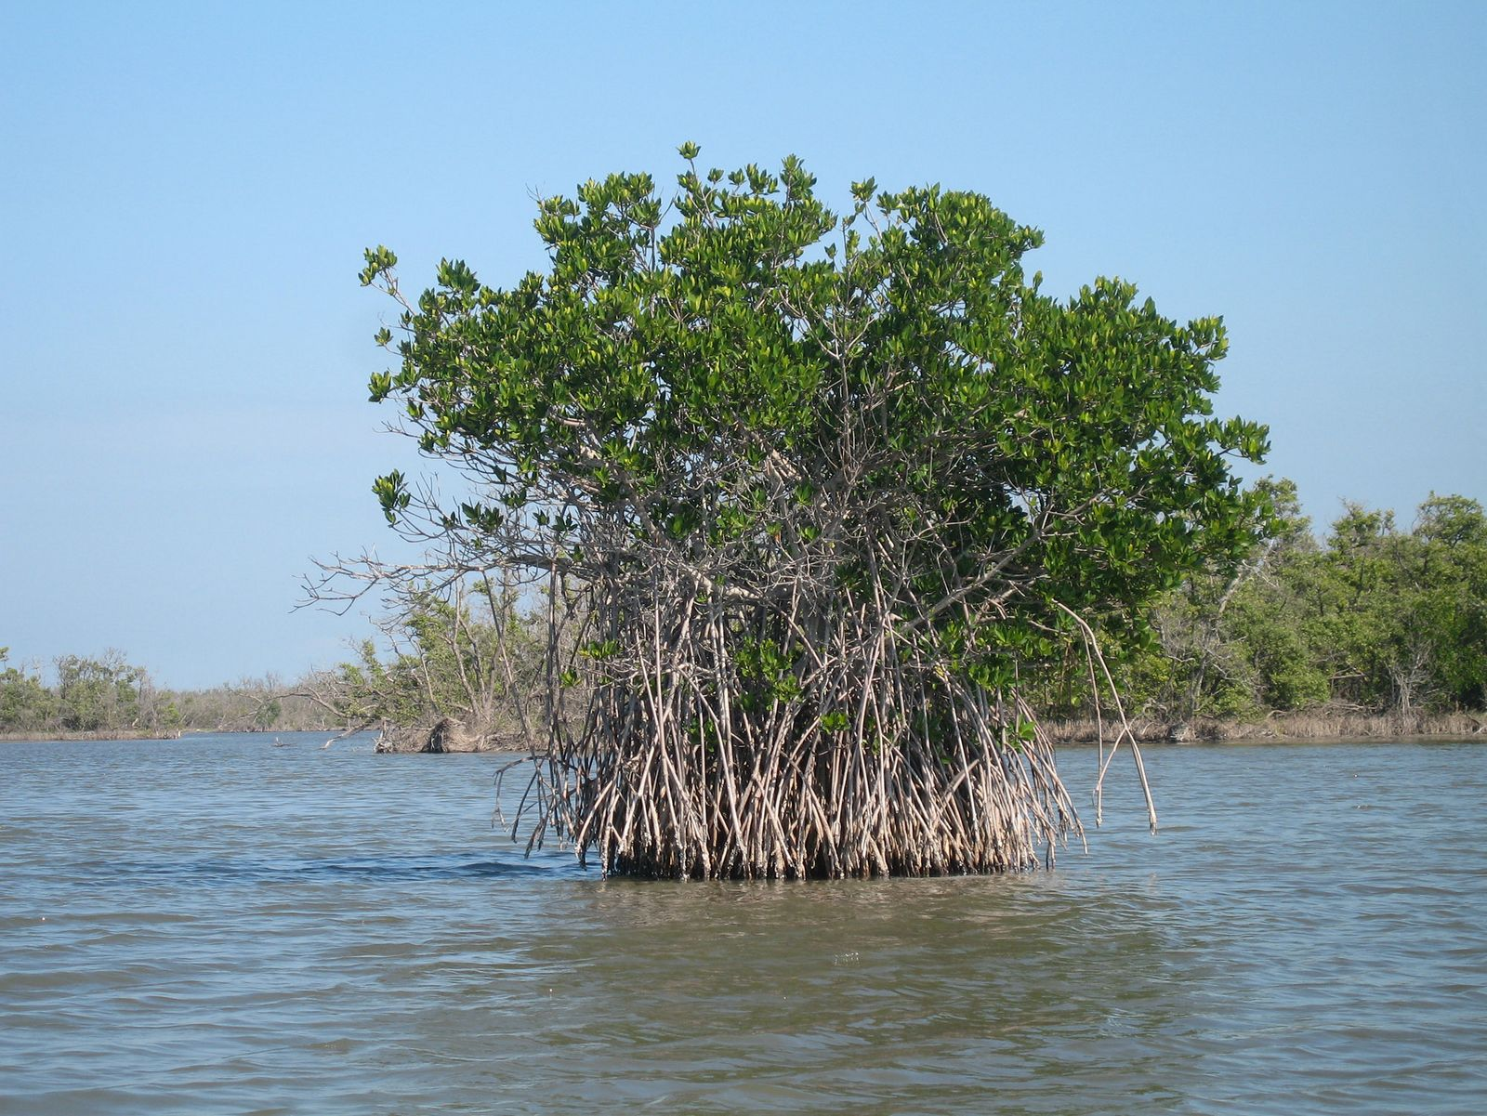

Slide 7
Development and Sustainability
developed countries (Sweden, Norway)
developing countries (transition, Serbia)
undeveloped or underdeveloped countries (Ethiopia)

Slide 8
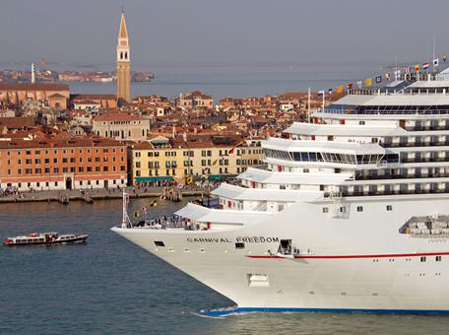
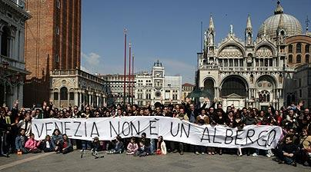
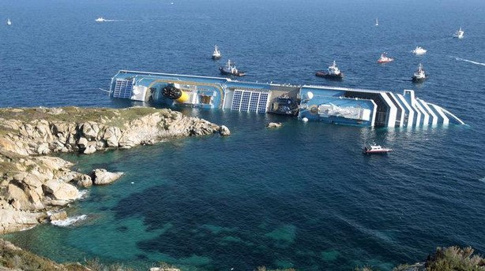
Cruisers

Slide 9
We live on...
air, water, earth, fire
natural resources (renewable and non-renewable)
ecosystems and natural habitat for species
Amazon rainforests
Barrier Reef and marine life
flora and fauna (biodiversity of plants&animals)
ozone layer

Slide 10
What do we do with our resources?
(negative) impact
We use them to develop and facilitate our daily lives, but we also exploit them to gain profit
-Clearing swamps
-Cutting trees/deforestation
-Waging wars (over land/wealth)
-Overfishing
-Overconsumption and waste disposal
High-rise construction and parking lots
Nuclear plants and industrial zones
Use of Leaded fuel in transportation

Slide 11
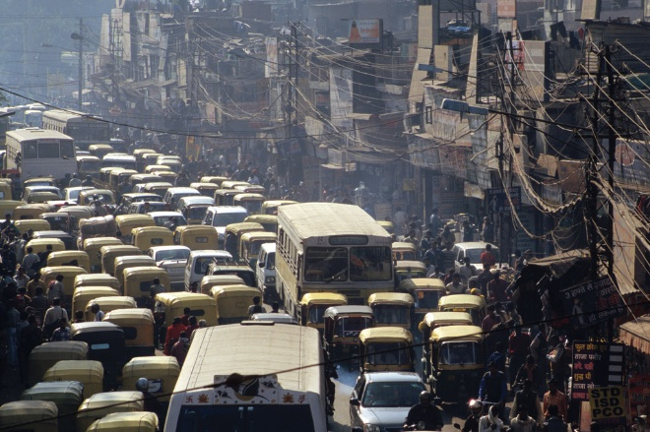

Slide 12
What are the effects?
Shore erosions and land slides
Floods and tsunamis
Climate change
Endangered and extinct species – change in food webs/cycle
Air/water pollution
Radiation
Greenhouse effect (global warming)
Acid rains
Ozone depletion
Ultimately, illnesses

Slide 13
What can we do about it?
Recycle
Solar panels
Wind turbines
Biomass
Support local economies
Construct eco-friendly houses/hotels
Good urban planning
Conservation projects
Solar cars
Raising Awareness

Slide 14
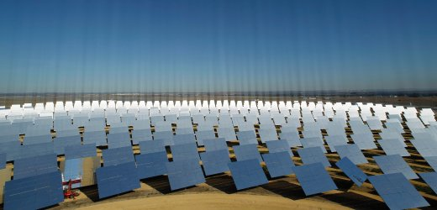
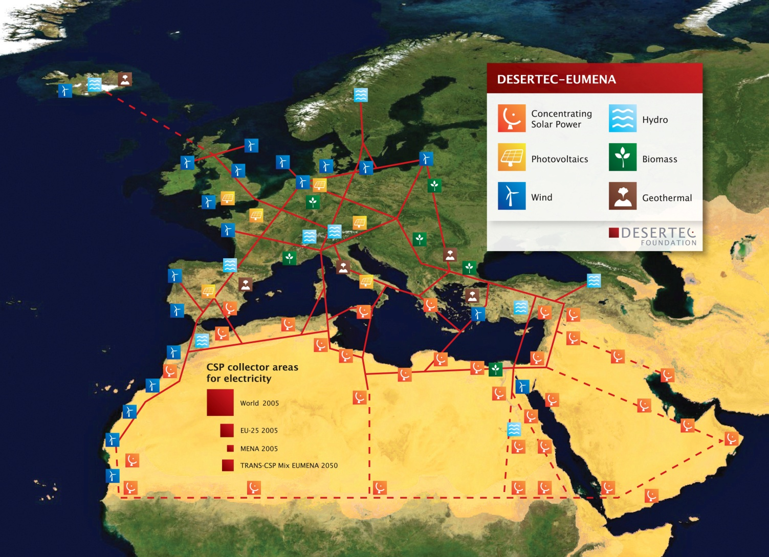

Slide 15

Slow Tourism https://www.youtube.com/watch?v=8HCOjH6egdk
Slow Trips and Hiking
Cycling
Equestrianism
Rowing
Water Sports
Caving
Birdwatching
Hot-air Balooning
Paragliding
Cross country skiing

Slide 16

Leaves of Grass

