Slide 1
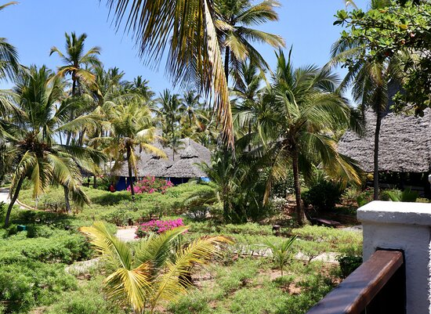
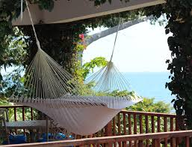
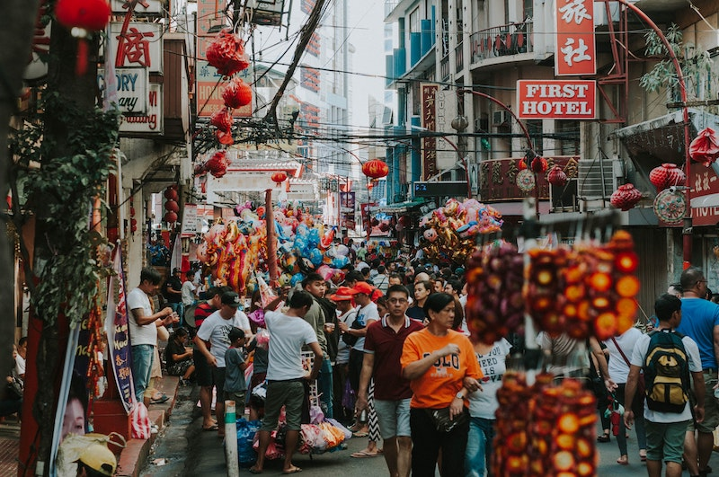
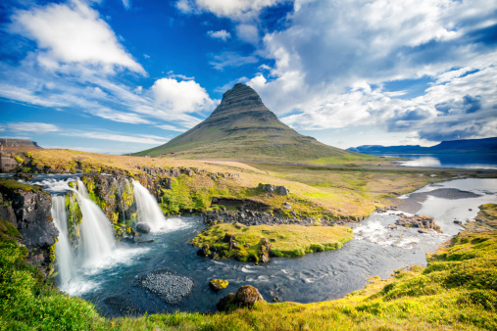
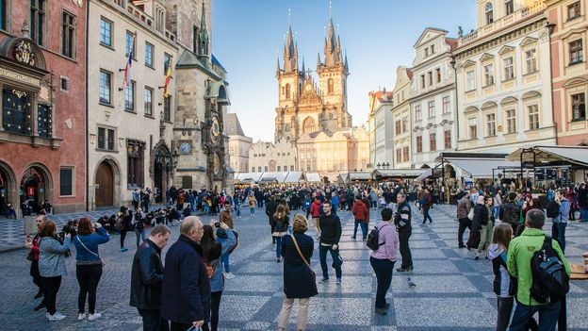
Promotion In Tourism
Part 2
Presented by Milina Kosanovic

Slide 2
Language of promotion
The promotional material can be web-based or published. In promotional texts or video narratives positive adjectives are used to attract potential visitors.
Look at the exercises on pages 38 and 39 in your practice book English Vocabulary In Tourism

Slide 3
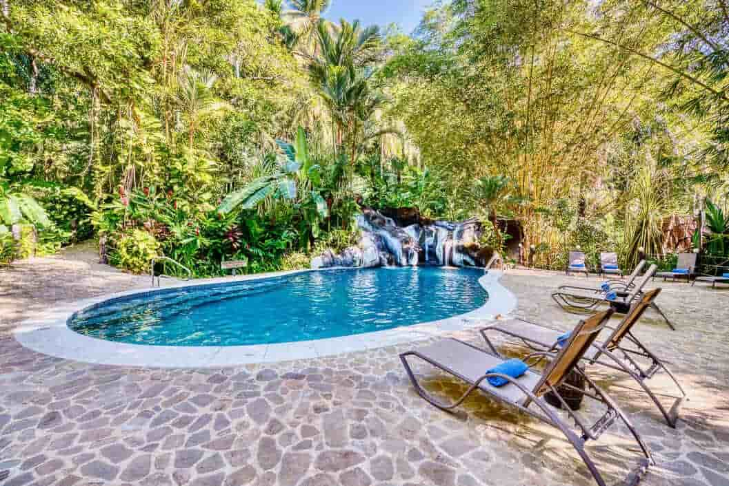
LUSH (bujan)- LUSH GARDEN, LUSH FOREST
= full of vegetation
Behind the hotel there is a lush garden with beach chairs and hammocks for guests to enjoy.

Slide 4
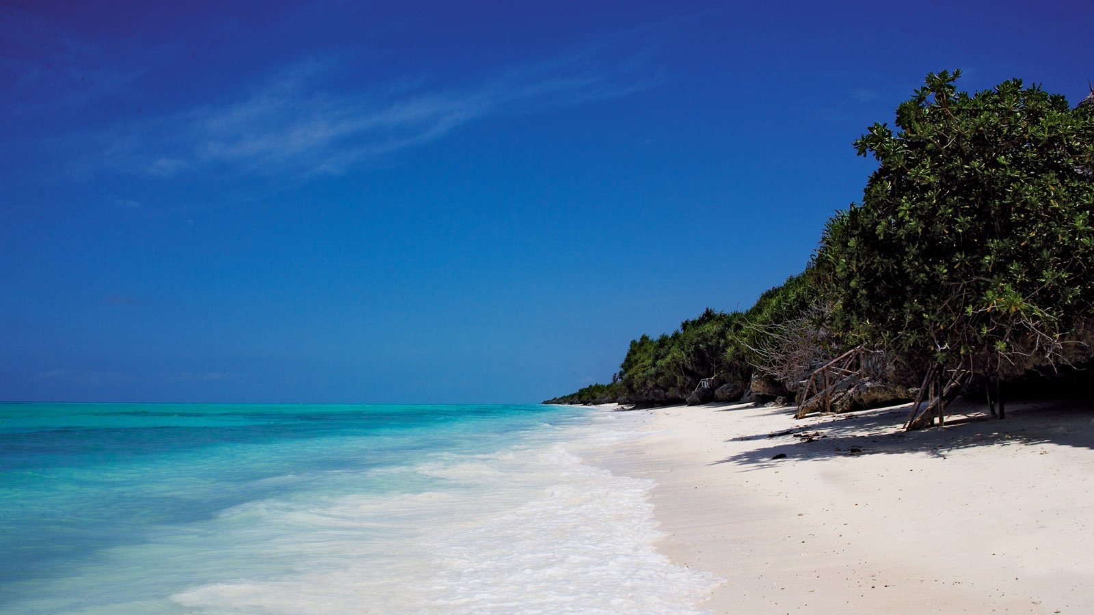
PRISTINE (čist, netaknut) - PRISTINE BEACH, PRISTINE NATURE
= clean, unspoilt
In Zanzibar there are lots of pristine beaches.

Slide 5
BUSTLING (živ)- BUSTLING CITY
= lively, full of people
Numerous bustling cities in South Asia await for you with their colourful markets and amazing culture.

Slide 6
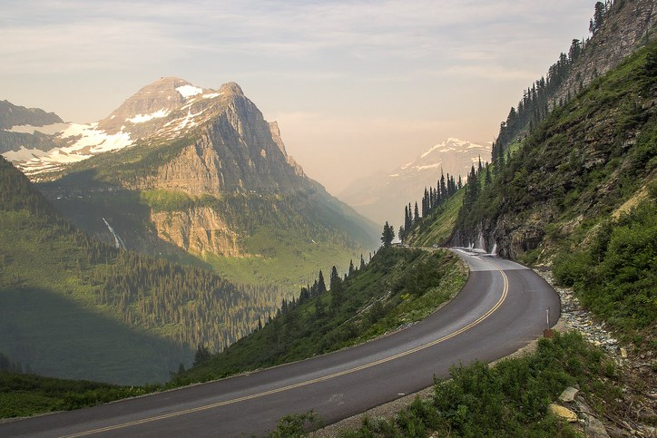
SCENIC (sa divnim pogledom)- SCENIC DRIVE
In the USA you can enjoy lots of scenic drives.

Slide 7
Positive adjectives
Amazing, fascinating, extraordinary, spectacular, splendid (sjajan), stunning (zadivljujuć), impressive, breath-taking, magnificent, fantastic, impressive...

Slide 8
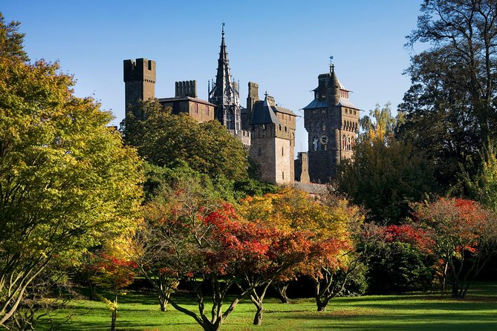
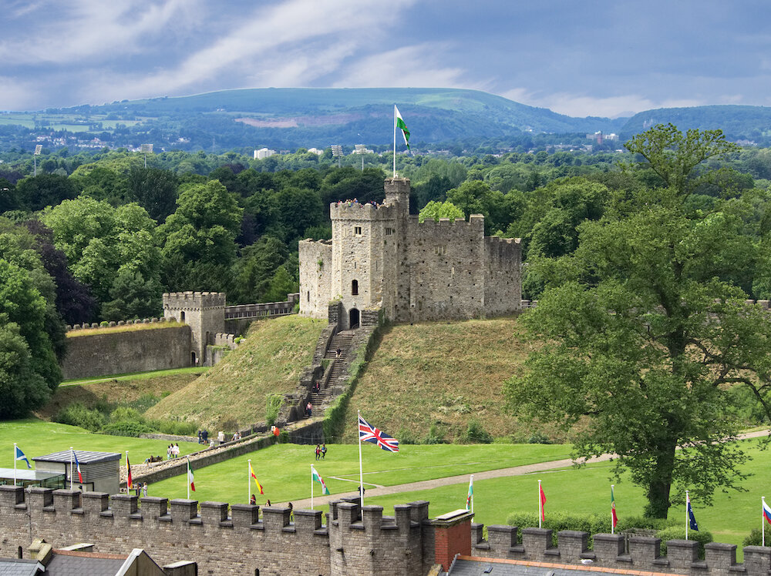
Cardiff Castle, Wales

Slide 9
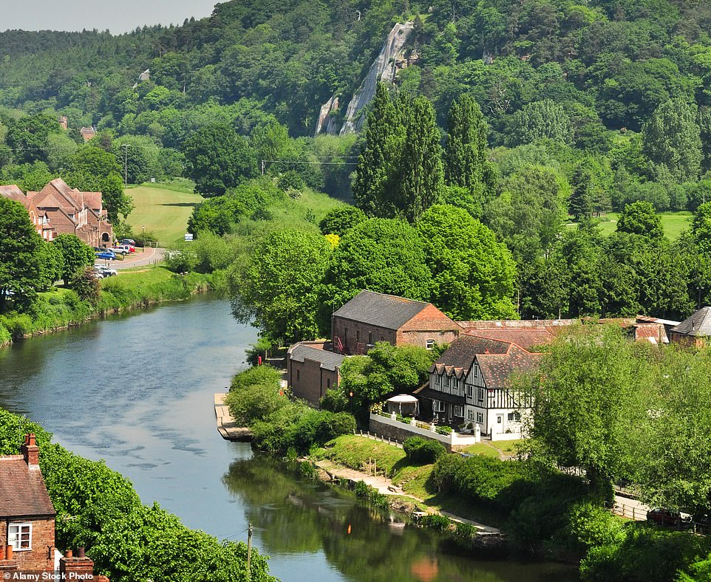
Shropshire Region

Slide 10
Marketing and promotion in tourism
Although the first goal of marketing is to attract new clients, its aim should also be to encourage brand loyalty and repeat purchases.
Read about competition and differentiation of products in tourism on pages 43 and 44 in your practice book English Vocabulary In Tourism.

Slide 11
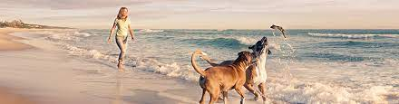
NICHE PRODUCT/SERVICE – products or services that are aimed at a small number of clients who specialise in one profession or have a very unique interest and knowledge about something.
NICHE MARKET- a target group of tourists interested in a specific service.
Tourists who want to stay in dog-friendly places are an example of a niche market.

