Slide 1
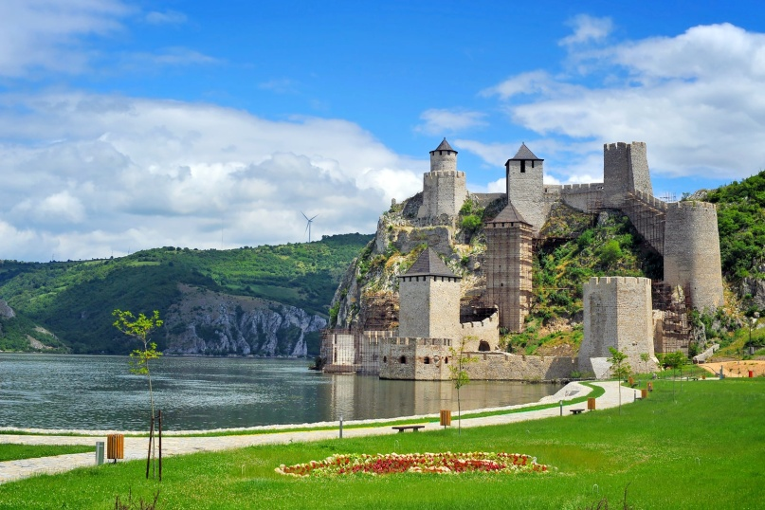


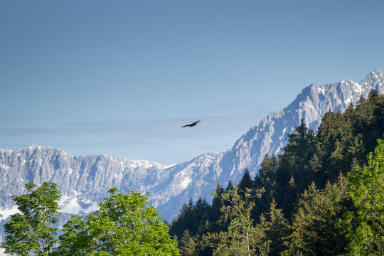
Language of promotion
Presented by Milina Kosanovic

Slide 2
Typical features of the language of promotion
Slogans and metaphors
Typical collocations of positive adjectives and nouns
Giving advice/making suggestions

Slide 3

Slogans and metaphors
Malaysia- truly Asia! (rhyme-based slogans)

Slide 4

Slogans and metaphors
Taiwan- the Heart of Asia (metaphor)
Metaphor is is a way of describing something using the similarity of a physical object and a more abstract idea. Heart is a part of a body, it is central and important, so Taiwan is described as a vital and central point in Asia associated with love.

Slide 5
Slogans and metaphors
New Zealand- 100% Pure
Live your myth in Greece!
Montenegro-Wild Beauty

Slide 6
Collocations
Collocations are typical combinations of words. In marketing typical positive adjectives are combined with nouns. Here are some examples:
Lush forest/garden (rich in vegetation)
Picturesque countryside/ village (lovely)
Pristine beach (clean, unspoilt)
Dramatic mountains/ cliffs (impressive)
Spectacular/breathtaking landscape

Slide 7
Collocations
Thriving community (lively and prospering, successful, flourishing)
Soaring mountains (very high)
Amazing adventures

Slide 8
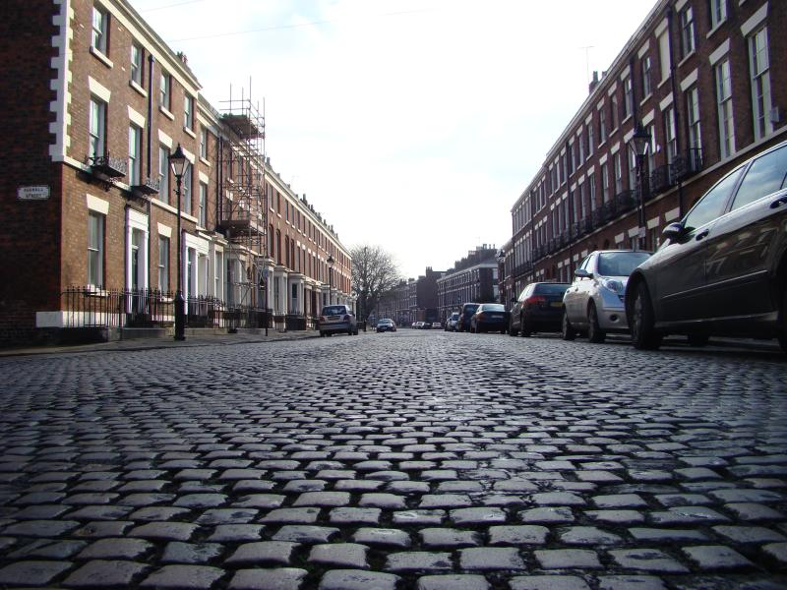
Tree-lined, traffic-free, cobbled
STREET
Cobbled- made of stones

Slide 9
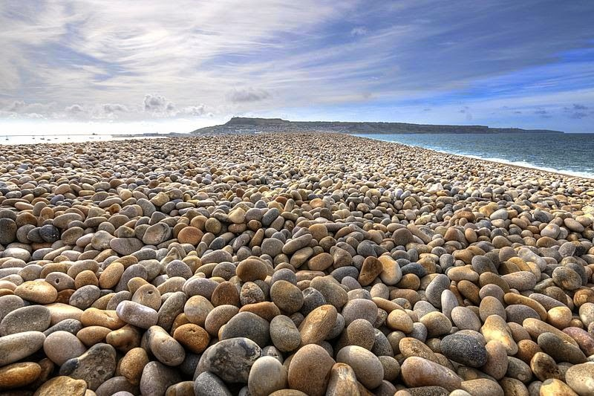
Pebble, sand, secluded
BEACH
Pebble- small round stone
Secluded- private, not crowded, sheltered

Slide 10
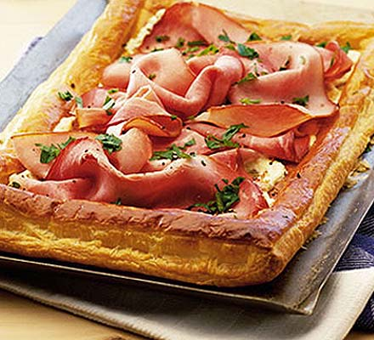
Savoury, delicious, mouth-watering
DISH, FOOD
Savoury- tasty

Slide 11
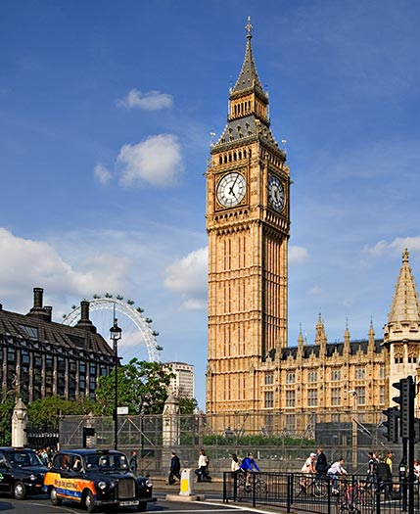
Major, chief, main
ATTRACTION
Chief- main

Slide 12
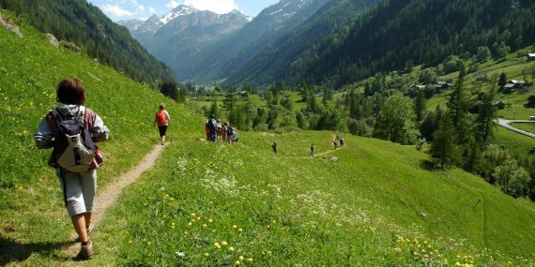
Refreshing, invigorating, clean
AIR
Invigorating- refreshing

Slide 13
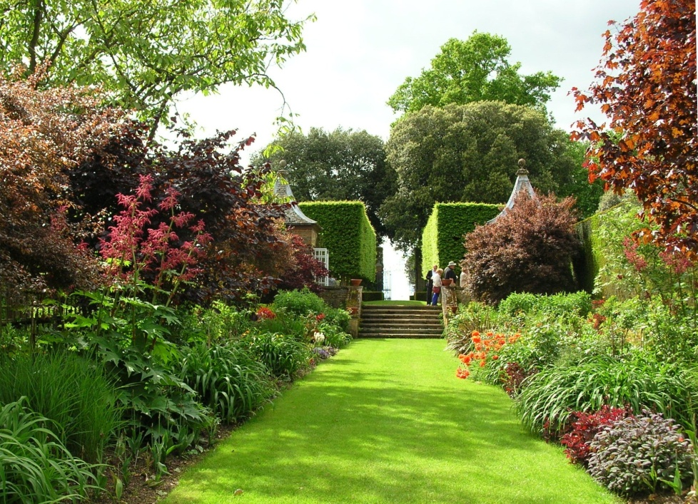
Mature, iconic, idyllic
GARDEN
Mature- grown up, not young
Iconic- typical

Slide 14
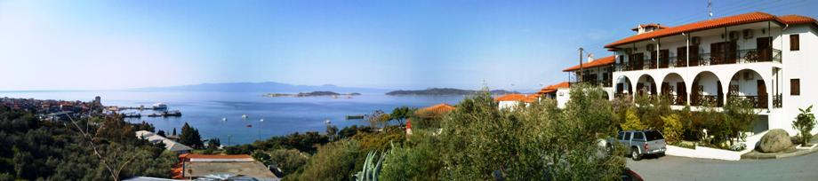
Perched on a hill, nestled in the valley, conveniently situated
HOTEL
Perched-situated on a high place
Nestled- situated in a sheltered position

Slide 15
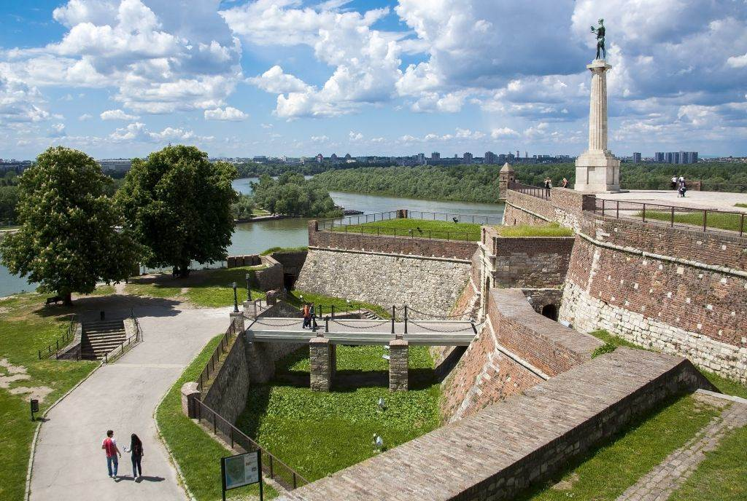
A text without adjectives
Attractions of Belgrade are Kalemegdan fort, Temple of St Sava and Knez Mihajlova Street. If you want to taste Serbian cuisine you can go to Skadarlija street where you can find many restaurants. You can also visit Ada Ciganlija where you can relax on the beach and have a drink in bars.

Slide 16
The same text with adjectives
The main attractions of Belgrade are the medieval Kalemegdan fort, the magnificent Temple of St Sava and traffic-free Knez Mihajlova Street. If you want to taste savoury Serbian cuisine you can go to picturesque cobbled Skadarlija street where you can find many superb traditional restaurants. You can also visit attractive Ada Ciganlija where you can relax on the long pebble beach and have a drink in many popular beach bars.

Slide 17
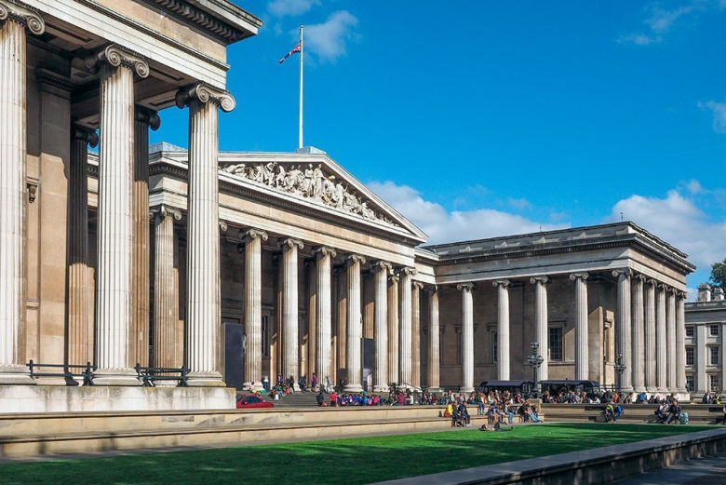
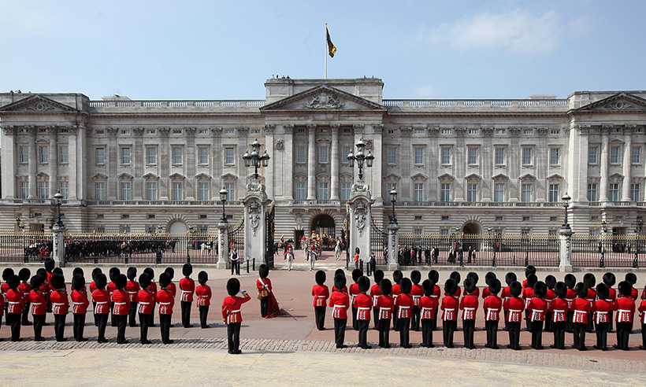
Giving advice
In promotional materials tourists are given advice what to see. For example:
Big Ben is a must.
The Buckingham Palace is well-worth visiting.
No trip to London is complete without a visit to the Zoo.
You can`t leave London without a visit to the British Museum.

Slide 18
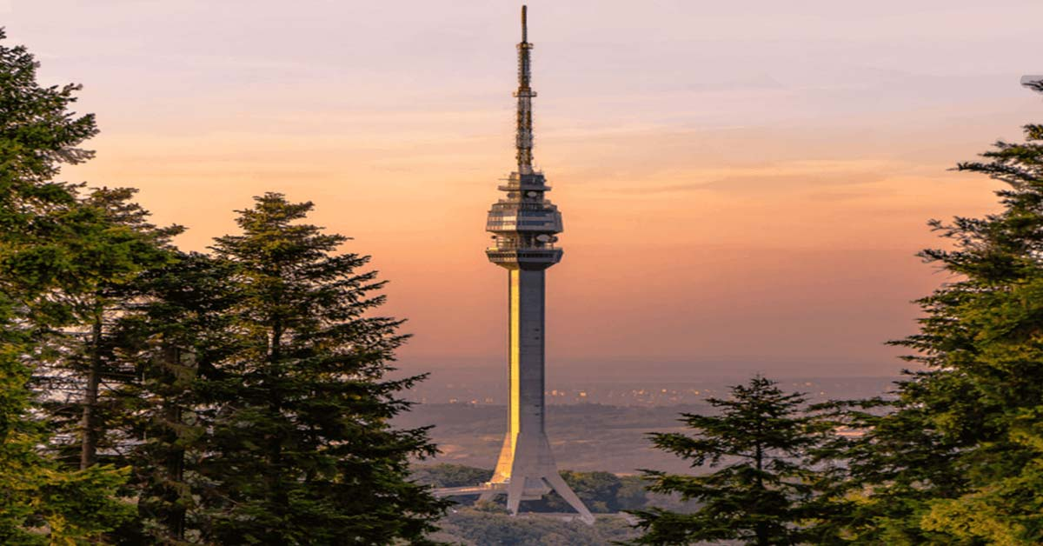
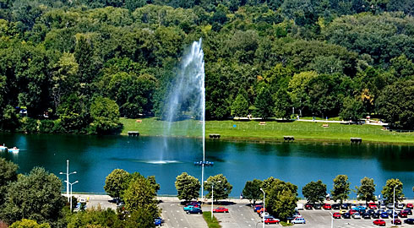
Making suggestions
Imperatives are often used to make suggestions:
Don`t miss Avala tower!
Uncover Belgrade`s past!
Step back into prehistory and visit Vinca!
Discover Ada Ciganlija!
Explore Kosutnjak!

Slide 19
Making suggestions
If you are souvenir- hunting, why not buy woolen socks from Sirogojno.
Art- lovers will enjoy a visit to the National Museum.
Those who love sports may try artificial rock climbing or cycling on Ada Ciganlija.

Slide 20
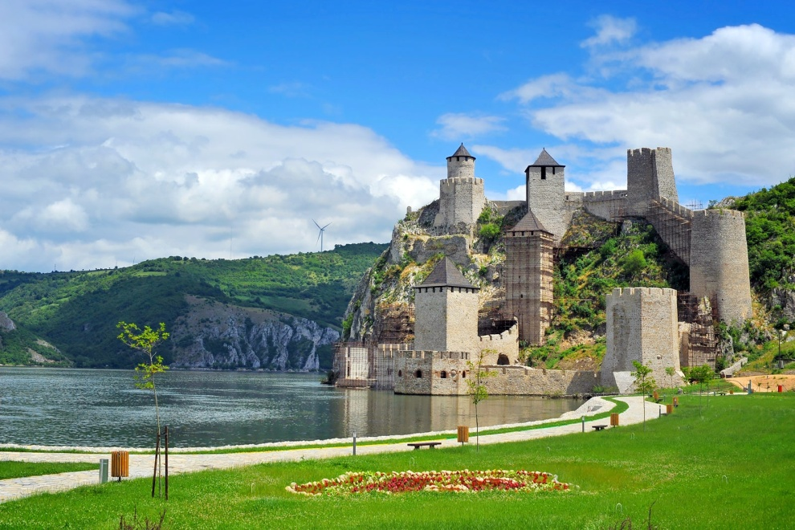
TASK
Write a short text about a destination in your home country or about a destination you have visited. Use all the tools used in the language of promotion.

