Slide 1
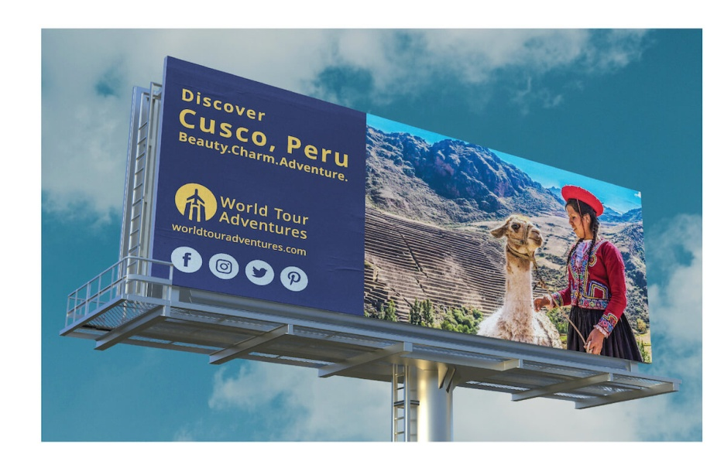
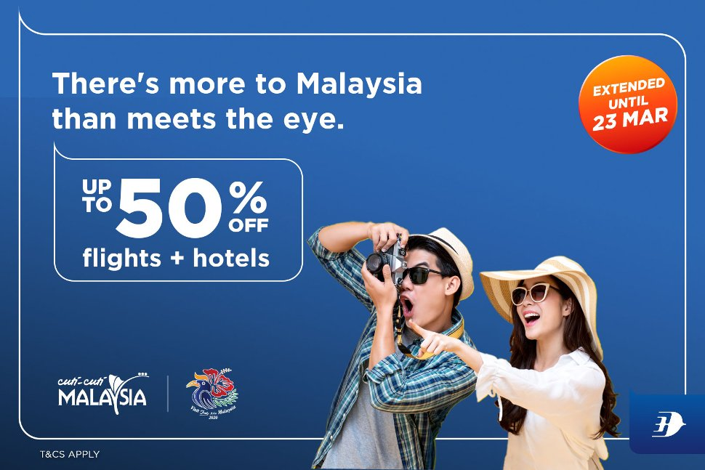
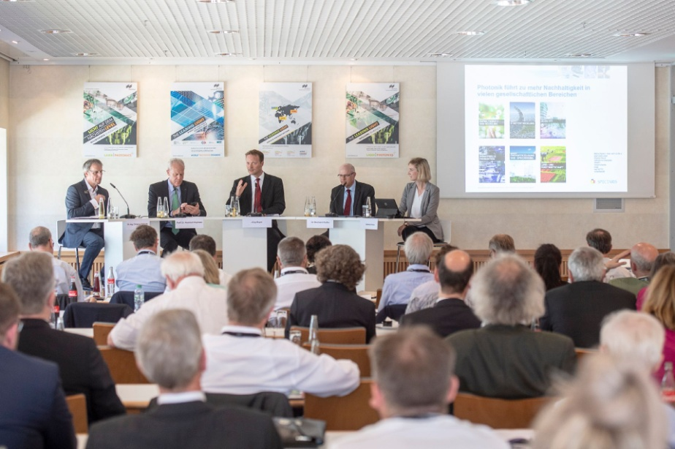

Promotional tools
Presented by Milina Kosanovic

Slide 2
Methods of promotion
Brochures
TV commercials
Sponsorship of events
Social media
Influencer marketing
Promotional videos
Documentaries
Indirect promotion through feature films

Slide 3
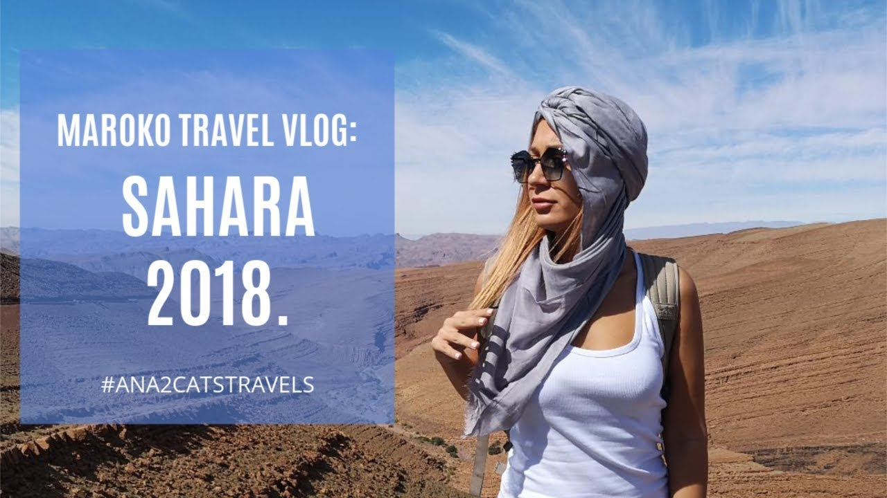
Methods of promotion
Blogs and vlogs (video blogs)
Logos
Slogans
Online booking or online sale

Slide 4
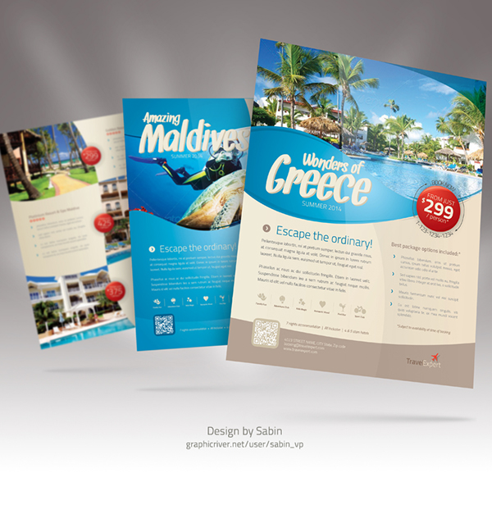
Flyer
Flyer is a small, single piece of paper with short information about a product or service.

Slide 5
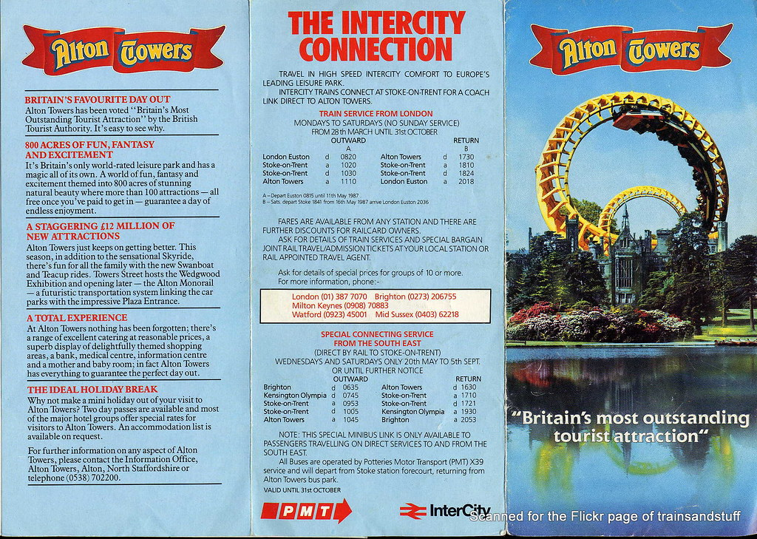
Leaflets
Leaflets are folded pieces of paper with information about a product and service.

Slide 6

Advertising hoardings/billboards
Advertising hoardings (Br E) or billboards (AmE) are huge posters at the roadside.

Slide 7
Trade shows/fairs
Trade shows or trade fairs are annual events where companies show their products to potential customers.

Slide 8
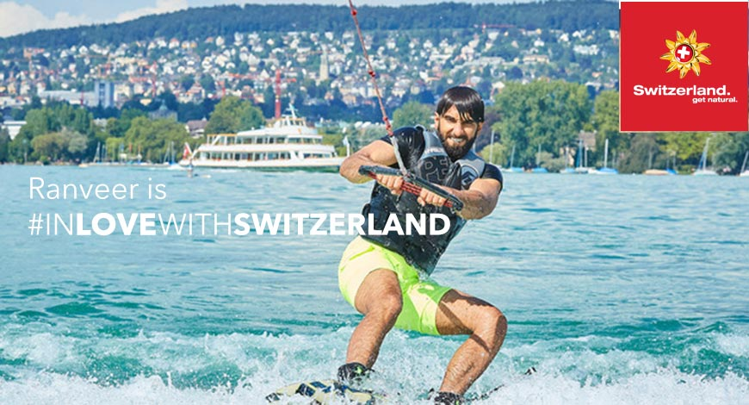
Endorsements
Endorsement is a form of promotion when a celebrity (an actor, singer, sportsman) says they love or use a service or product.

Slide 9
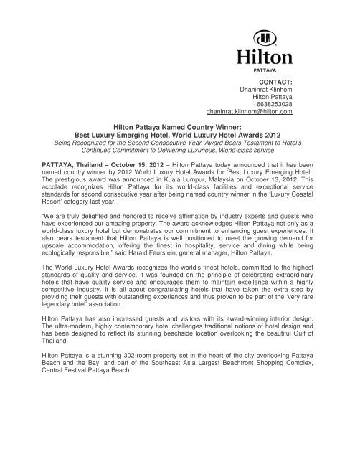
Press release
Press release a written document or an email sent to media representatives with information about a (new) product or service, or a received award.

Slide 10

Press conference
Press conference is a gathering of media representatives and representatives of a company or organization with the purpose of giving information about an event, service or product and answering questions.

Slide 11
Sales promotion
Sales promotion is a short-term activity aimed at increasing the popularity of a product or service by giving free samples or discounts.

Slide 12
Task
Read the lesson on pages 33 and 34.
After reading the lesson what sort of advice would you give to a small family-owned hotel that would like to promote itself? What advice would you give to tourism organization of an underdeveloped region in Serbia. What sorts of promotional activities would suit them?

