Slide 1
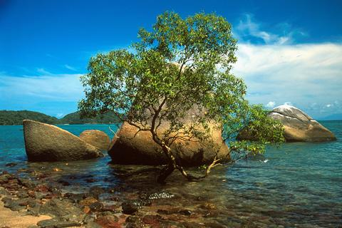
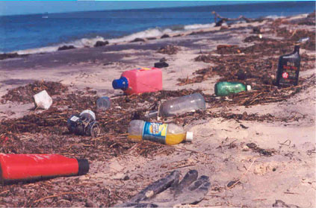
EFFECTS OF TOURISM presented by Milina Kosanovic

Slide 2
POSITIVE EFFECTS OF TOURISM
Tourism creates jobs for local people
Tourism brings foreign currency and income for a country
Tourists buy local products such as locally produced food, hand-made clothes etc.
Tourists want to see local wildlife so that creates pressure to conserve local species of animals and plants
Tourists want to experience local culture so that encourages preservation of local customs and crafts, local cuisine, local music and dance

Slide 3
NEGATIVE EFFECTS OF TOURISM
Tourism can cause environmental degradation: airplanes and cars pollute the air, tourist resorts use too much water, tourists throw away litter, forests are cleared in order to build hotels...
Jobs in tourism are mainly seasonal and low paid. Local people change their way of life and abandon their traditions and professions.

Slide 4
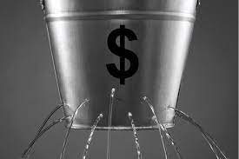
NEGATIVE EFFECTS OF TOURISM
Tourism creates economic leakage: if a hotel owner is from abroad the money earned through tourism flows to another country and not to the local community. Also, furniture, food, cosmetics and other goods that tourists use in a hotel are often imported, and not locally produced so there is no benefit for local people.
MONEY LEAKAGE
curenje/ odliv novca

Slide 5
NEGATIVE EFFECTS OF TOURISM.
Tourists can disrespect local culture by wearing inappropriate clothes or behaving in a rude way. Tourism can cause noise and disturbance
Tourism may bring a rise in living cost which can harm locals. Local goods can become expensive because tourists are willing to pay more. The cost of real estate (houses, flats, land) can rise because tourists start to buy holiday homes.

Slide 6
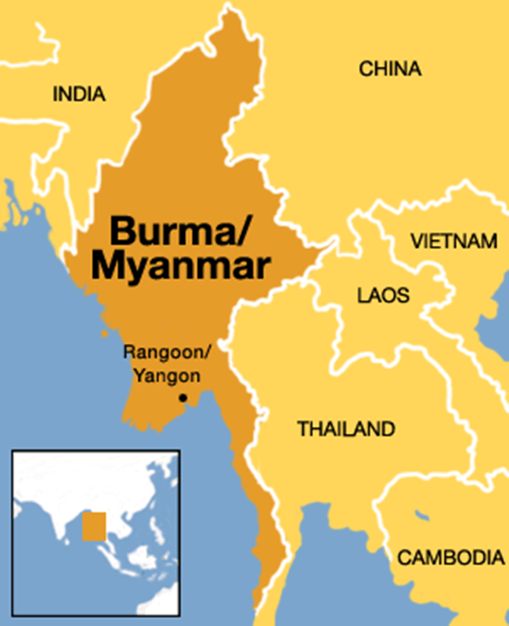
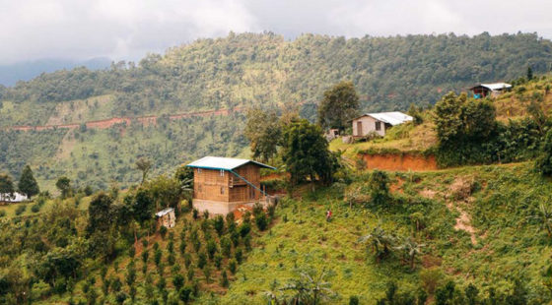
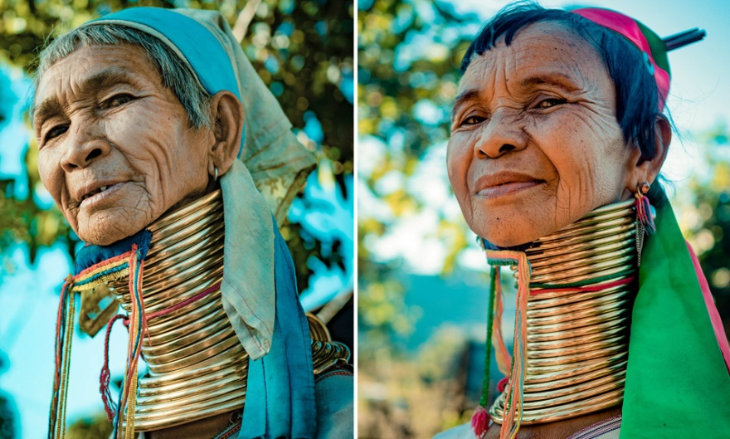
Negative Impacts of Tourism in Burma

Slide 7
Negative Impacts of Tourism in Burma
impact- influence, effect (uticaj)
inevitable- impossible to avoid (neizbežan)
precaution - an action which is done to prevent something dangerous happening (predostrožnost)
common-usual (uobičajen)
  Environmental degradation
precious- valuable (dragocen)
trail- a mark left by a person (trag)

Slide 8
Negative Impacts of Tourism in Burma
economic leakage- a situation when the profit does not stay in the place where it is earned but flows to another country or region (foreign ownership, imported goods)
to exhibit - to show (pokazivati)
interest payment- plaćanje kamate
loan- money borrowed from a bank (kredit)
franchise-a right to sell a company's products in a particular area using the company's name (franšiza)
tourist receipts- income from tourists (prihod od turista)

Slide 9
Negative Impacts of Tourism in Burma
Disrespecting local customs and culture
appropriate- suitable, decent (pristojan)
display- showing (iskazivanje)
affection- love (naklonost)
likely- probable (verobvatan)
to cause offence- to upset or hurt someone`s feelings (uvrediti)
observant- careful, ready to see (pažljiv)

Slide 10
Negative Impacts of Tourism in Burma
Support of cultural exploitation
display- show (predstava)
solely – only, exclusively (isključivo)
to devalue- lessen the value (devalvirati, uniziti, smanjiti)
revenue- income

Slide 11
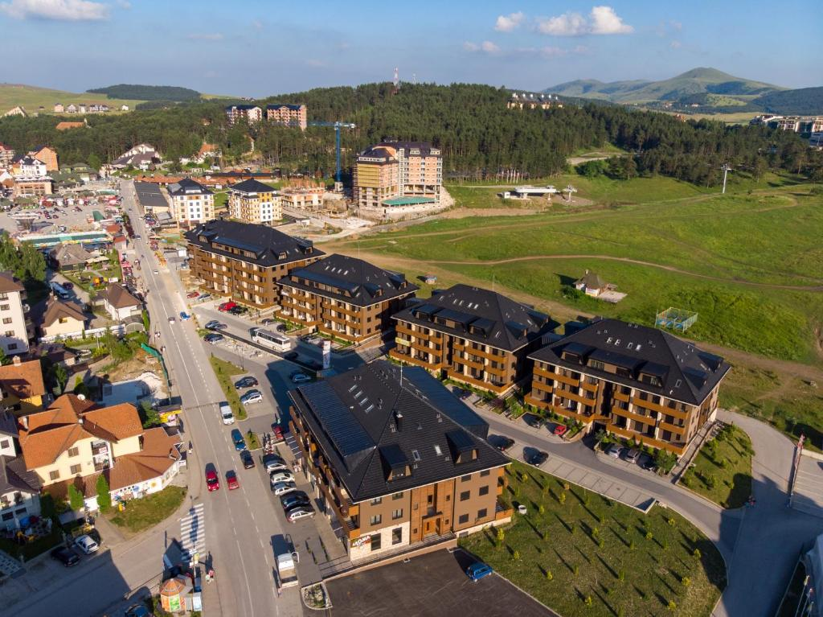
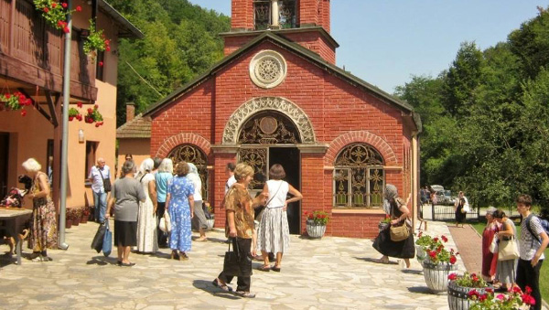
TASK
What are some examples of positive and negative effects tourism can have on mountain Zlatibor or on a Serbian monastery?

