Slide 1
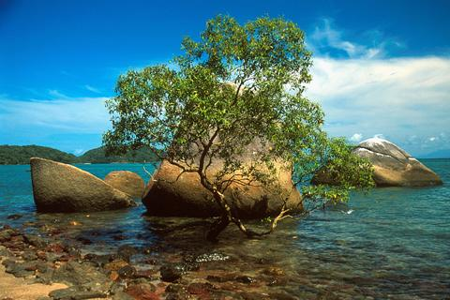
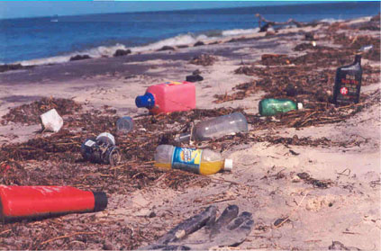
ADVANTAGES AND DISADVANTAGES BROUGHT BY TOURISM

Slide 2
Witness- see for yourself
Look-out point- a place that offers panoramic view
Upkeep- maintenance and preservation
Cliff- a high, steep rock
Arts and crafts- umetnost I zanati
Habitat- a place where a plant species or an animal species lives
Broaden- make wider
Greed- a strong desire to have more money than you really need

Slide 3
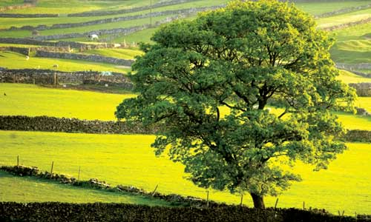
SUSTAINABLE TOURISM
Green Tourism
Responsible Tourism

Slide 4
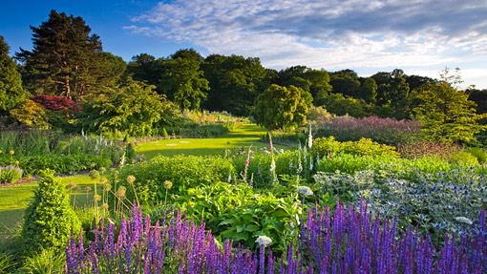
SUSTAINABLE TOURISM
Sustainable tourism is tourism which cares about nature, local people and local economy.

Slide 5
NATURE
Sustainability means caring about the environment.
It means that renewable sources of energy are used (solar power, wind power etc), and that the use of electricity is reduced in general.
Waste and rubbish are minimized and recycling is used wherever it is possible.

Slide 6

Environment- natural surroundings
Renewable sources of energy- sources of energy that cannot we cannot run out of. We can run out of coal or oil, but not of the sun, wind and sea/rivers. Energy created by the power of the sun, wind or water is called green energy.
Waste- unwanted material, usually created by industry, such as polluted water
Rubbish- trash, garbage, small unwanted pieces of material left on some place

Slide 7
PEOPLE AND CULTURE
Sustainable tourism means that the traditional way of life of local people is not changed completely because of tourism. Sustainability means that local community participates in decisions about building new accommodation capacities or tourism projects in general. Hotels cannot be built on holy places, at cemeteries or other places of cultural interest.

Slide 8
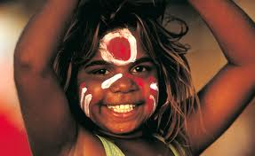
Local community- a group of people living together on one spot (village, small town etc)

Slide 9
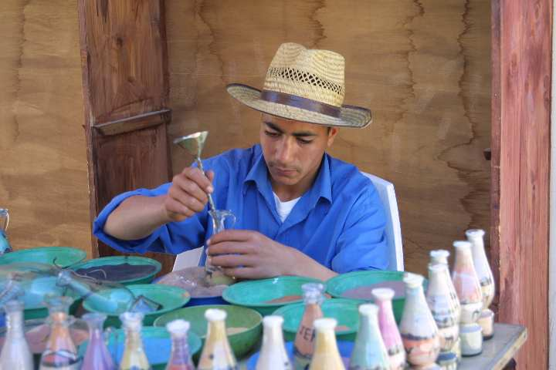
LOCAL ECONOMY
Sustainable tourism aims to involve local people in the business by employing them or by buying the food and other products they produce. It strives to provide economic benefit for local communities.

Slide 10
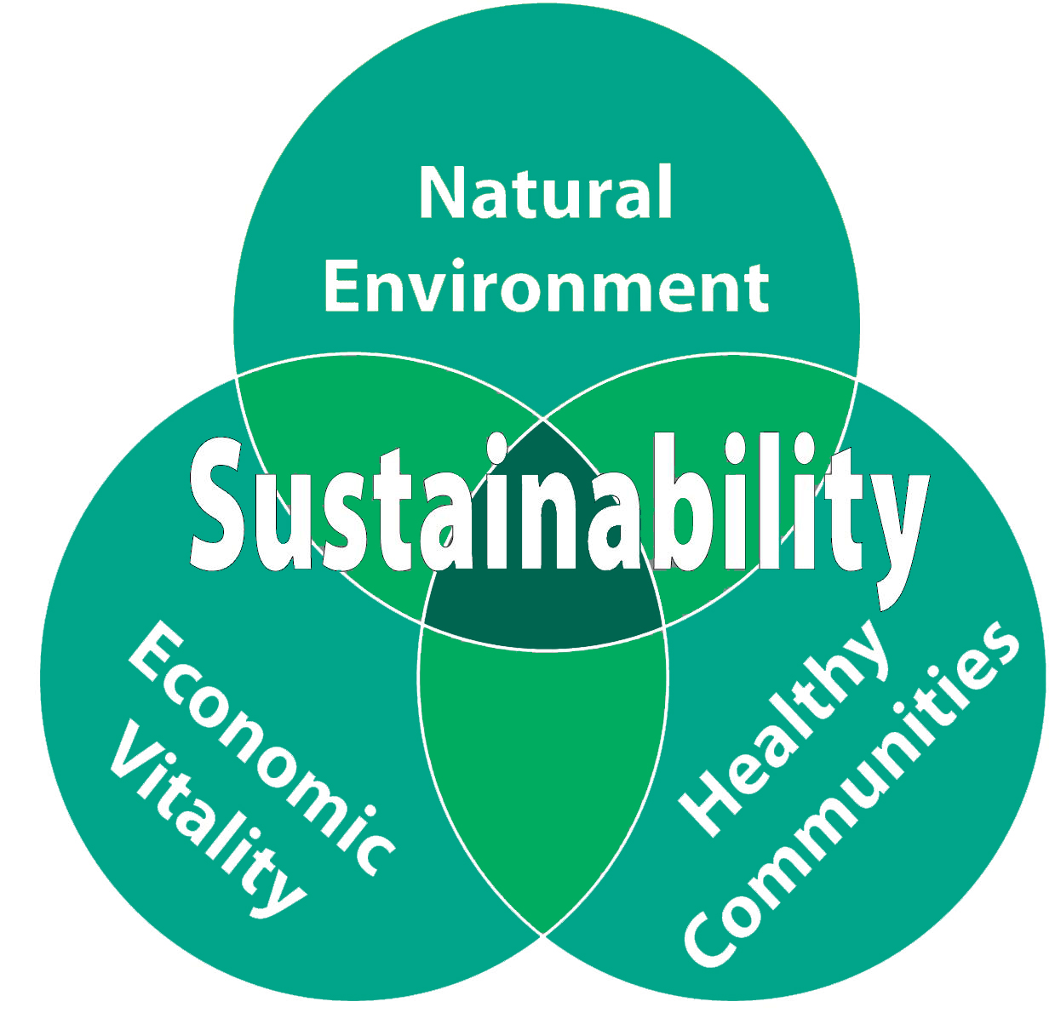

Slide 11
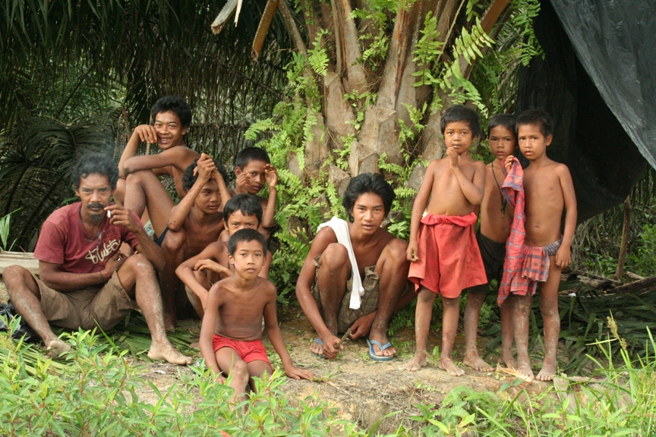
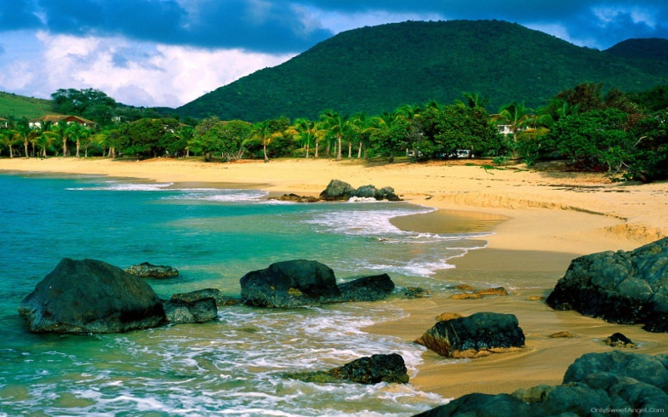
Sustainable tourism is an industry which attempts (tries) to make a low impact(influence) on the environment and local culture, while helping to generate income (create profit), employment, and the conservation of local ecosystems. It is responsible tourism that is both ecologically and culturally sensitive.

Slide 12
The Bedouin of Petra
Revenue- profits
To overshadow- to be stronger than
Herd- a group of animals, usually cattle
Flock- a group of animals, usually sheep
Pastoralism- looking after sheep, cows etc.
Hardship- difficult times
Abuse- bad use

Slide 13
When the tourists flew in
Boost- improve
Indigenes- local, native people
Texture- character
Dawn- sunrise
Sideshow- a small show offered in addition to the main one
Scarce- rare, not enough
Wage- money paid weekly to a worker

Slide 14
Defile- make dirty
Squalor- filthiness, dirt
Pageant- a pompous show
Eyesore- something unpleasant to the eye
Sidewalk ambassadors- native people who represent their country in the best light

