Slide 1

Mock Test 1
EJA2
Dr Emilija Lipovsek

Slide 2
add a missing word
In order to find out if a destination will be popular, we need to have m… r…
L… is a folded piece of paper with text and pictures
A… p… comes from factories and traffic.
F… b… starts with a slow walk in the woods.

Slide 3
add a missing word
In order to find out if a destination will be popular, we need to have market research
Leaflet is a folded piece of paper with text and pictures
Air pollution comes from factories and traffic.
Forest bathing starts with a slow walk in the woods.

Slide 4
adjectives – describe people/things
ancient, historic, modern, famous, vibrant, cosmopolitan, industrial, coastal, major, wonderful, university, bustling
high-rise, impressive, important, magnificent, brick, public, glass, restored, renaissance, ruined
young, elderly, middle-aged, famous, important, powerful, middle-class, local, strange
friendly, helpful, pleasant, hospitable, capable
tasty, delicious, fresh, home-cooked, healthy, frozen, take-away
wonderful, free, evening, popular, live

Slide 5
adjectives
ancient, historic, modern, famous, vibrant, cosmopolitan, industrial, coastal, major, wonderful, university, bustling city
high-rise, impressive, important, magnificent, brick, public, glass, restored, renaissance, ruined building
young, elderly, middle-aged, famous, important, powerful, middle-class, local, strange person
friendly, helpful, pleasant, hospitable, capable staff
tasty, delicious, fresh, home-cooked, healthy, frozen, take-away food
wonderful, free, evening, popular, live entertainment

Slide 6
il-/im-/in-/un-/ir-/dis-
comfortable, pleasant, acceptable
legal, legible, literate
courteous, honest, organized
practical, polite, patient
rational, regular, relevant,
accurate, competent, capable

Slide 7
un- comfortable, pleasant, acceptable
il- legal, legible, literate
dis- courteous, honest, organized
im- practical, polite, patient
ir- rational, regular, relevant,
in- accurate, competent, capable

Slide 8
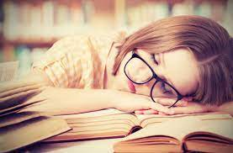
adjectives with –ing/-ed
This book is boring → I am bored.
Our holiday was amazing → We were amazed.

Slide 9
After a very … ride we all felt … (excite)
His hotel was … , nothing like the brochure and he sounded … in his email. (disappoint)
It was … to see them again! (surprise)
The whole group is … by their tour guide. (fascinate)

Slide 10
After a very exciting ride we all felt excited.
His hotel was disappointing, nothing like the brochure and he sounded so disappointed in his email.
It was surprising to see them again!
The whole group is fascinated by their tour guide.

Slide 11

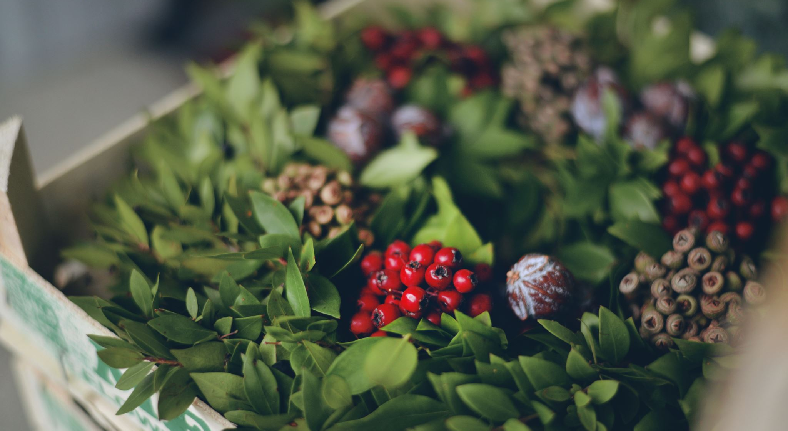




Merry Xmas and Happy New Year!

