Slide 1
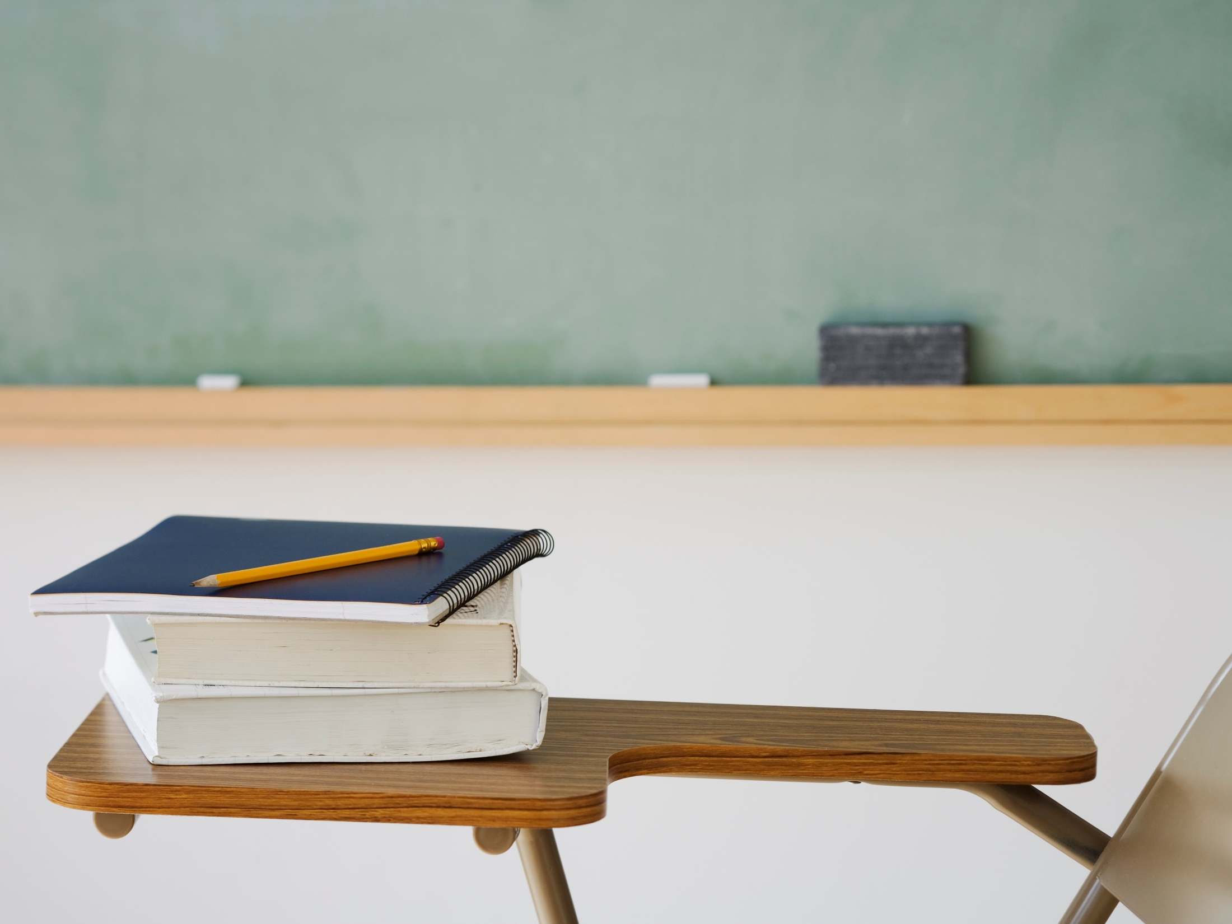
MOCK TEST
ENGLISH EJB3 unit 8

Slide 2
Complete with right words
Passengers go to b… r… to get their bags.
P… c… will check the visa if it is needed.
You need to show your b… p… before you get on the plane.

Slide 3
Passengers go to baggage reclaim to get their bags.
Passport control will check the visa if it is needed.
You need to show your boarding pass before you get on the plane.

Slide 4
Fill the gaps with modal verbs:
Passengers ……. use mobiles during the flight.
Passengers ……. read the safety card.
Passengers ….. fasten seat belts.

Slide 5
Passengers mustn’t (aren’t allowed to) use mobiles during the flight.
Passengers should read the safety card.
Passengers must (have to) fasten seat belts.

Slide 6
Write definitions
Boarding pass/card
Arrivals
Take off

Slide 7
Boarding pass/card – passengers need it to get on the plane
Arrivals – part of the airport where passengers come after their flight
Take off – plane starts flying

Slide 8
bonus
name three words for small bags passengers take with them during the flight
name three jobs in air travel

